Slide 1

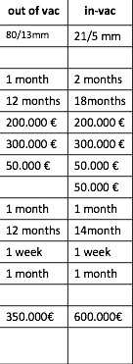
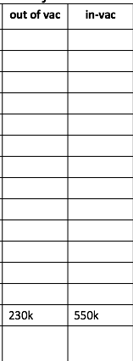
Undulators Cost Matrix
planar: hard x-ray
PSI
ALBA
Kyma
 |  | out of vac | in-vac | in-vac | SC NbTi | SC Nb₃Sn | HTS
Performance: K (λ/gap) | 15 / 4 mm |  | 4m | 2m
 | 10 / 3 mm
Design |  |  | 100 MM
Fabrication by Lab |  |  | 800 / 13units
Magnetarray |  |  | 300
Support |  |  | 380
Drive System / Controls |  |  | 50
Vacuum System |  |  | 70
Optimization |  |  | 4MM
Fabrication by Company |  |  |  | 1.1
Installation / Infrastructure |  |  | 400 + x floor
Commisssioning
Operation / Maintenance | 10 years
price / m [€] |  |  | 200 | 550
total price [M€] / saturation length [m] |  |  | 12

Slide 2




Undulators Cost Matrix
EPU: soft x-ray
Kyma
ALBA
PSI
ALBA
Kyma
 |  | APPLE II | DELTA | APPLE III | in vac | CPMU | SCAPE
Performance: K (λ/gap) | 40 / 7 mm |  |  | 2m
 | 20 / 5 mm
Design |  |  |  | 60MM
Fabrication by Lab |  |  |  | 600 / 16
Magnetarray |  |  |  | 130
Support |  |  |  | 420
Drive System / Controls |  |  |  | 20
Vacuum System |  |  |  | 30
Optimization
Fabrication by Company
Installation / Infrastructure |  |  |  | 70
Commisssioning
Operation / Maintenance | 10 years
price / m [€] |  |  |  | 300
total price [M€]/ saturation length [m] |  |  |  | 10

