Slide 1

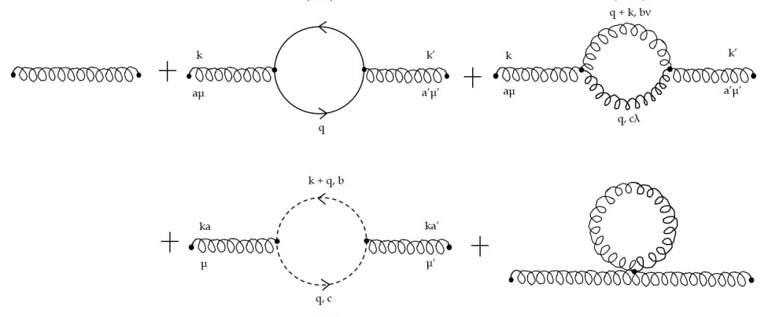
Series Expansion of the Quark Mass Renormalization Group Equation: An Application of Rubi
Alexes Mes¹, Jed Stephens¹
¹ University of Cape Town
A.Mes has received funding from the Harry Crossley Research Foundation and the Joseph Stone Fund
QCD Renormalization
High Energy Particle Physics Workshop - 2019

Slide 2
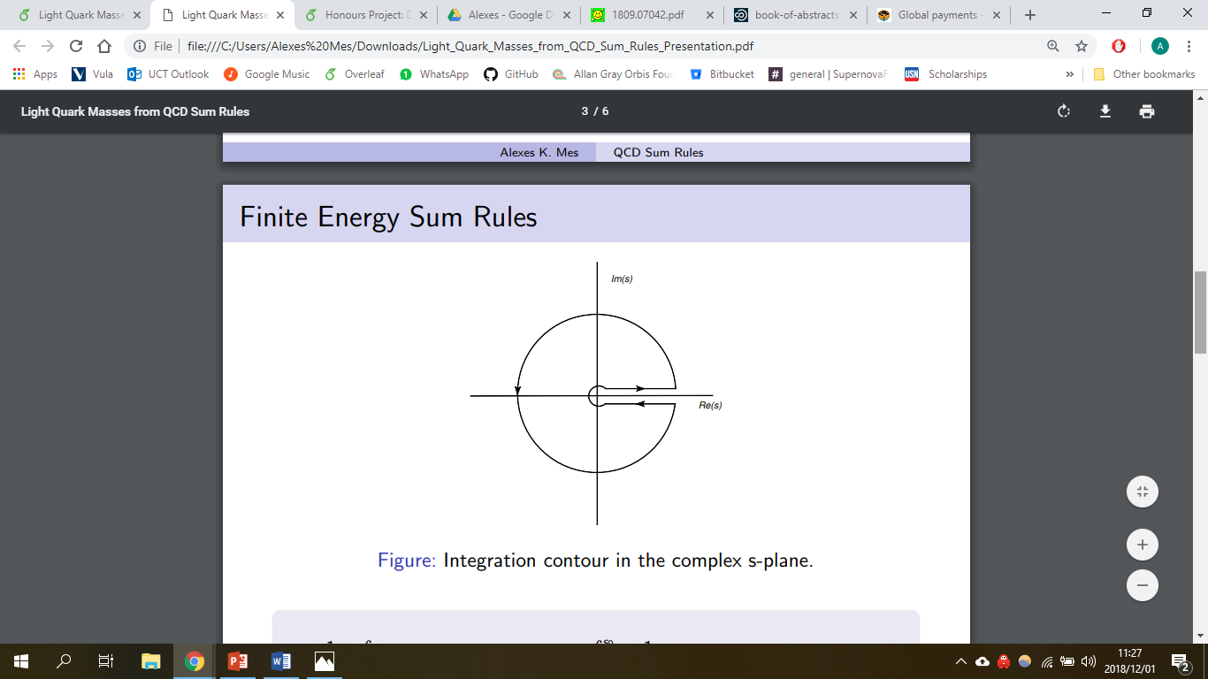
Regularization and Renormalization
Basic Structure
Ultraviolet (UV) singularities + Infrared (IR) singularities
Divergences in the high momentum limit
Divergences in the low momentum limit
Regularization and Renormalization obtains finite and meaningful results from expressions containing divergences
Regularization - Regulator parameter to deal with divergent integrals
- For UV divergences: Introduce ϵ, the minimal space distance
- Results will contain terms proportional 1/ ϵ which are not well defined in the limit ϵ 0
QCD Renormalization
High Energy Particle Physics Workshop - 2019

Slide 3
Regularization and Renormalization
Renormalization - There must exist observed values equal to some physical quantities that are expressed by seemingly divergent expressions
- Removes UV divergences by absorbing divergences into parameters of Lagrangian
- Calculating subtraction terms and defining Z coefficients
Regularization and renormalization enable us to calculate finite values for many quantities that appear divergent.
QCD Renormalization
High Energy Particle Physics Workshop - 2019

Slide 4
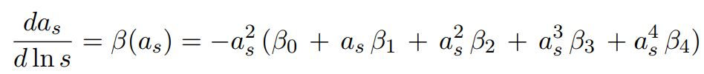
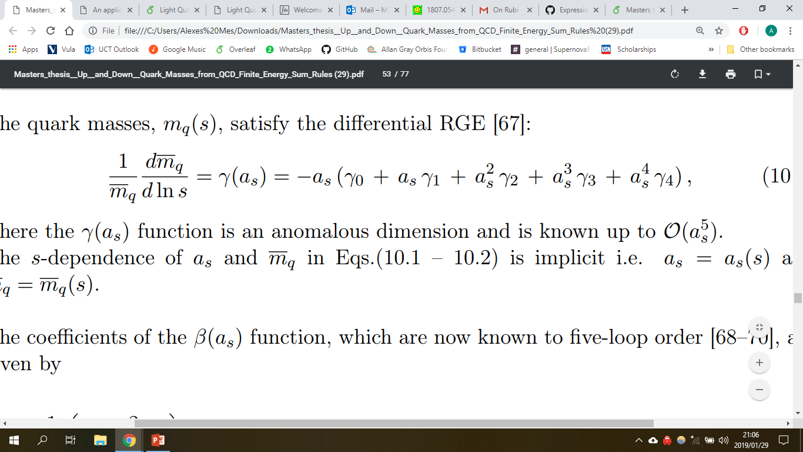
Renormalization Group Equations
Non-physical scale parameter μ introduced to represent the point where divergences are subtracted to render amplitudes finite
2 renormalized quantities: the quark mass m_{q}(μ²) and strong coupling α_{s}(μ²)
Scale dependence governed by corresponding RGE’s which rely on QCD’s anomalous dimensions as input
where the energy parameter is set such that s = μ²
QCD Renormalization
High Energy Particle Physics Workshop - 2019

Slide 5
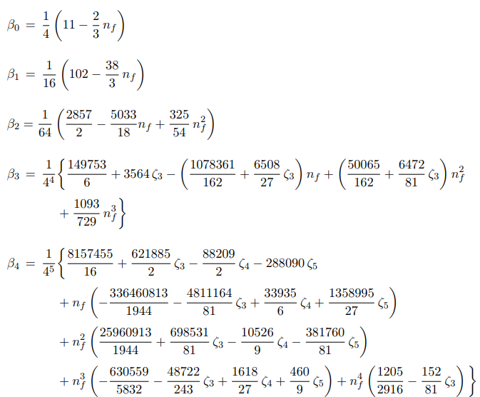
Renormalization Group Equations
QCD Renormalization
High Energy Particle Physics Workshop - 2019

Slide 6
Quark Mass RGE
Linearly separable differential equation
More lucid to solve in terms of a power expansion – provides insight into the renormalization scheme dependence of the running quark mass on the energy scale parameter at higher powers
This is important in accurately determining the light quark mass at a chosen scale.
QCD Renormalization
High Energy Particle Physics Workshop - 2019

Slide 7
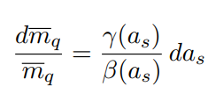
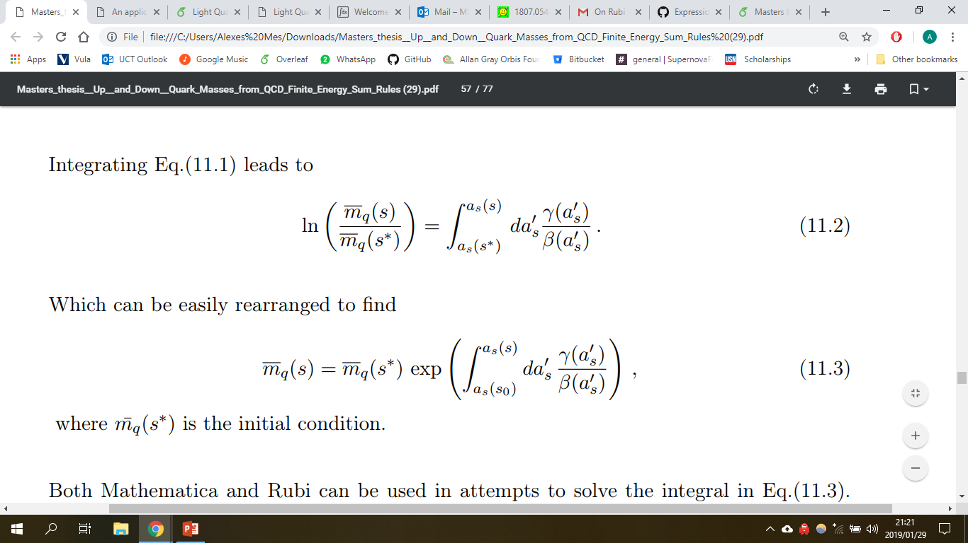
Quark Mass RGE
QCD Renormalization
High Energy Particle Physics Workshop - 2019

Slide 8
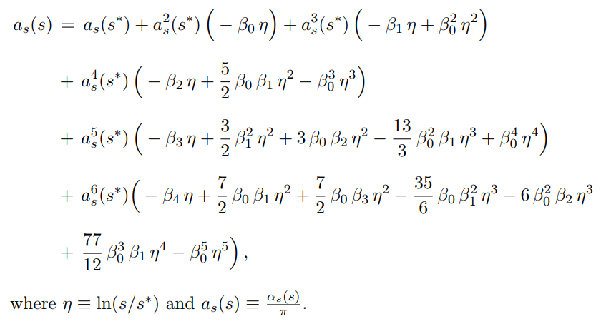
Quark Mass RGE
QCD Renormalization
High Energy Particle Physics Workshop - 2019

Slide 9
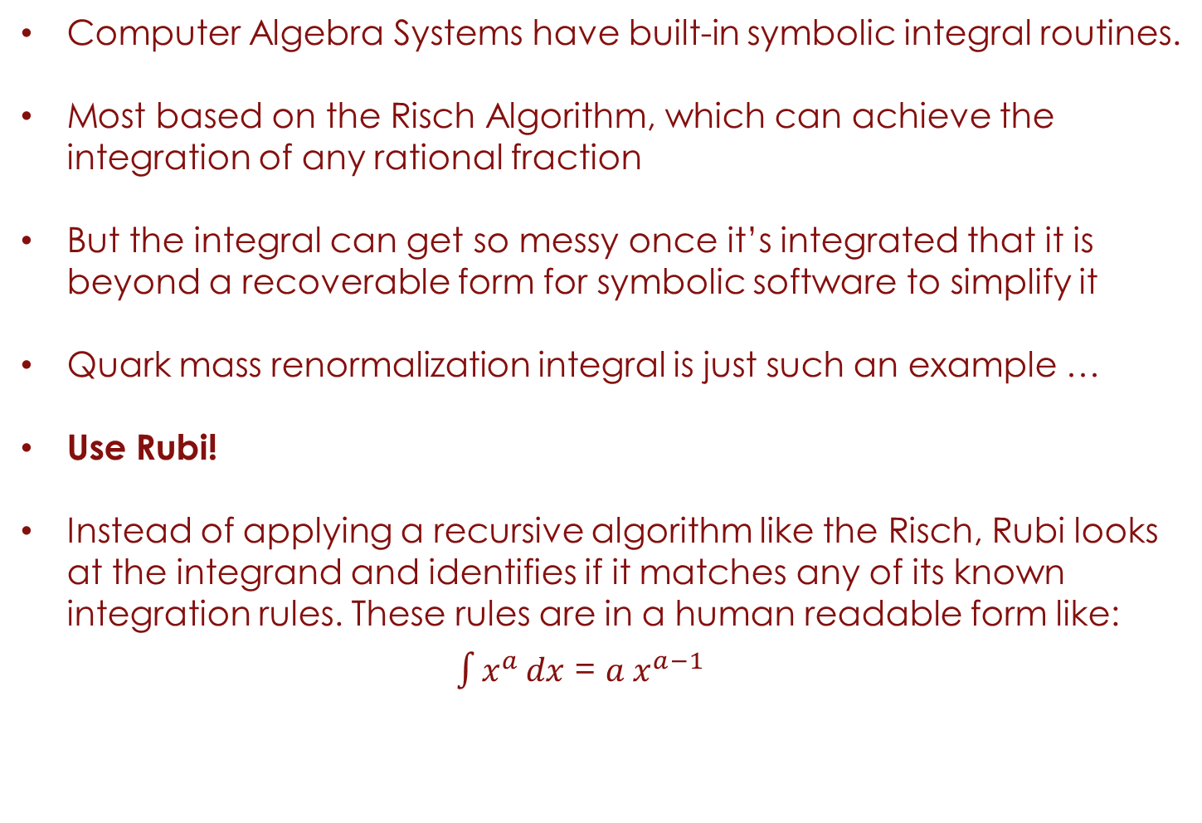
Computer Algebra Systems
Computer Algebra Systems have built-in symbolic integral routines.
Most based on the Risch Algorithm, which can achieve the integration of any rational fraction
But the integral can get so messy once it’s integrated that it is beyond a recoverable form for symbolic software to simplify it
Quark mass renormalization integral is just such an example …
Use Rubi!
Instead of applying a recursive algorithm like the Risch, Rubi looks at the integrand and identifies if it matches any of its known integration rules. These rules are in a human readable form like:
$\int{x^{a}}dx$ = ${a x}^{a−1}$
QCD Renormalization
High Energy Particle Physics Workshop - 2019

Slide 10
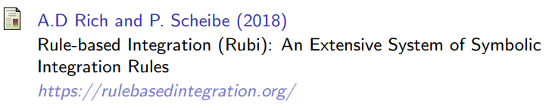
Rule Based Integration (RUBI)
Implemented as a Mathematica package that gives the user an option to inspect integration steps and application conditions
Applies extensive system of symbolic integration rules: Currently has +6600 rules implemented in Mathematica’s pattern matching language
Some of these rules are based on well integration formulas (Abramowitz, 2012; Burington, 1973; Gradshteyn, 2014; Zwillinger, 2011)
Other rules derived during Rubi’s development
QCD Renormalization
High Energy Particle Physics Workshop - 2019

Slide 11
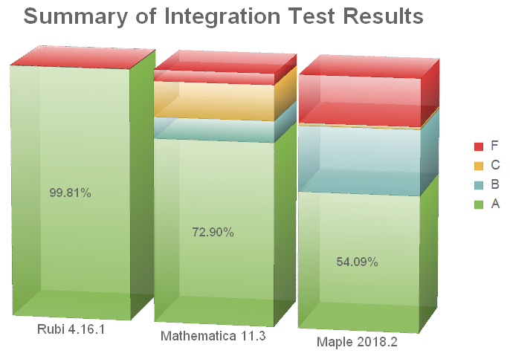
Integration tests for Computer Algebra Systems
QCD Renormalization
High Energy Particle Physics Workshop - 2019

Slide 12
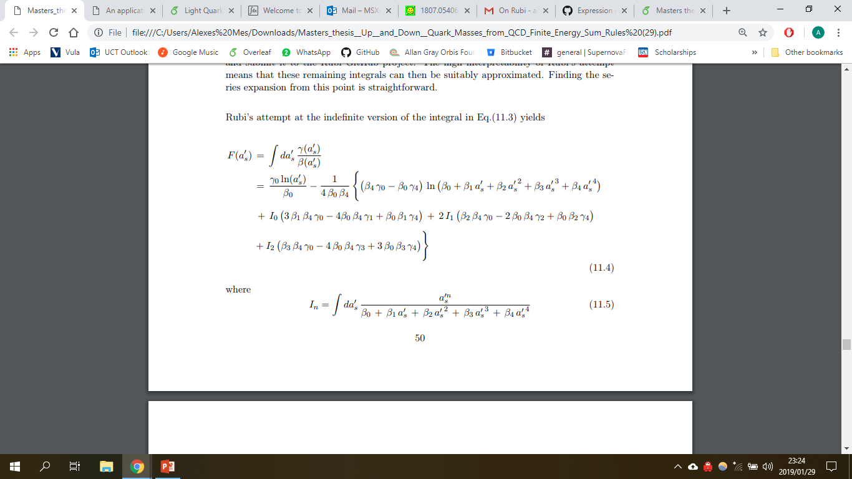
Rubi’s attempt to solve the Quark Mass RGE
At this stage, Mathematica is able to re-write these integrals in terms of RootSum objects (without logarithmic divergences)
QCD Renormalization
High Energy Particle Physics Workshop - 2019

Slide 13
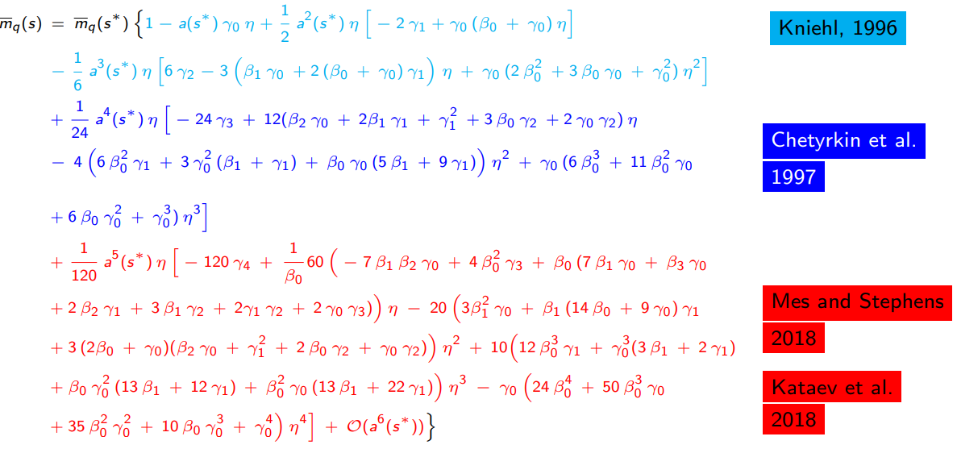
Results
QCD Renormalization
High Energy Particle Physics Workshop - 2019

Slide 14
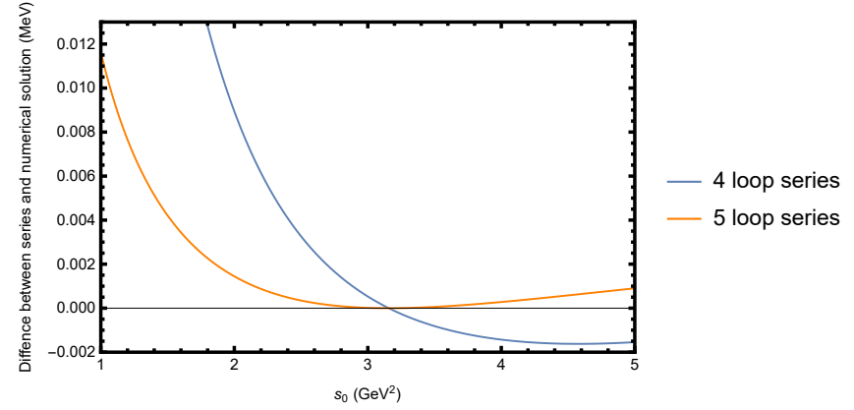
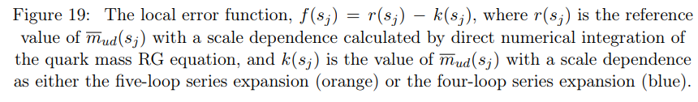
Results
QCD Renormalization
High Energy Particle Physics Workshop - 2019

Slide 15
Conclusion
Effect of fifth-loop correction term in the quark mass renormalization perturbative expansion is small, but does serve to increase it’s accuracy by about 0.5%
Result is not as important as the method to obtain the result
Can achieve same result using Mathematica only
But requires unintuitive method and only works if series expansion converges uniformly
The case for using Rubi as a tool in this situation, and in other Science, Technology, Engineering and Mathematics (STEM) research areas, is thus: it provides a lucid and intuitive approach to solving integrals, which other CAS systems are often unable to solve directly
QCD Renormalization
High Energy Particle Physics Workshop - 2019

Slide 16
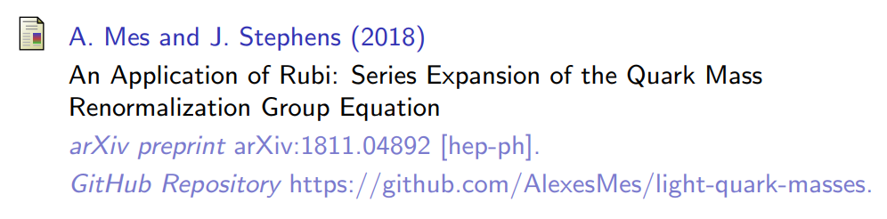
QUESTIONS ?
Alexes K. Mes
University of Cape Town
MSXALE002@myuct.ac.za
January, 2019
QCD Renormalization
High Energy Particle Physics Workshop - 2019

