Slide 1



What can the 3 leptons signatures at the LHC tell us about additional bosons?
Kehinde Tomiwa
University of the Witwatersrand,
Institute for Collider Particle Physics
HEPP 2019, Nelson Mandela University, 31/01/19

Slide 2
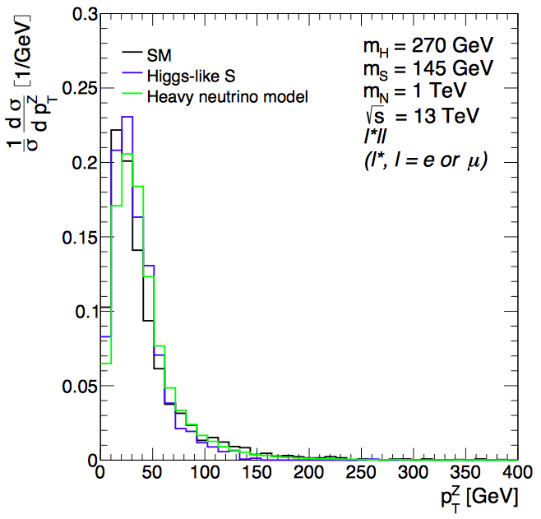
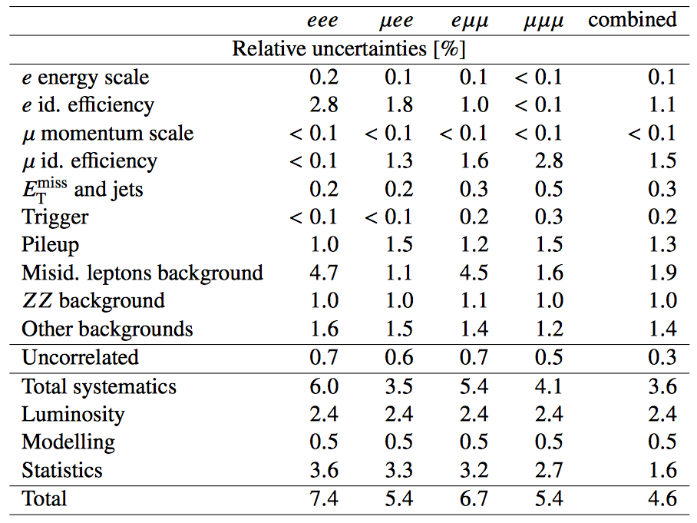
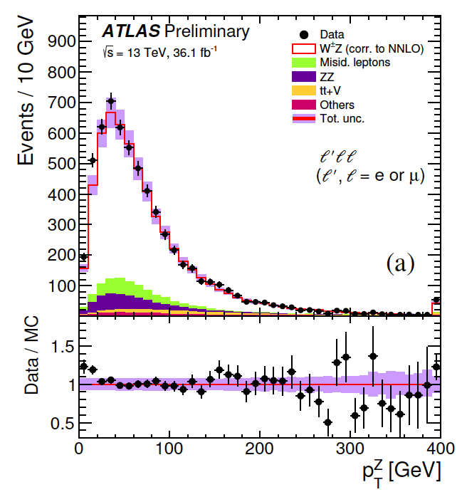
ATLAS-CONF-2018-034
3l with Z→ll (ZW cross-section)
ATLAS and CMS data at low Z p_{T} is deviates from SM MCs. Differences are outside systematics
Systematics that will directly affect the shape stand at few %
arXiv:1711.07874

Slide 3
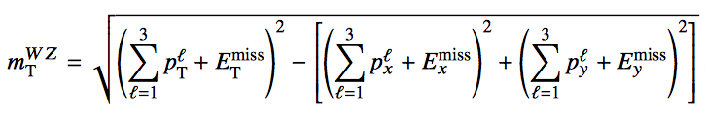
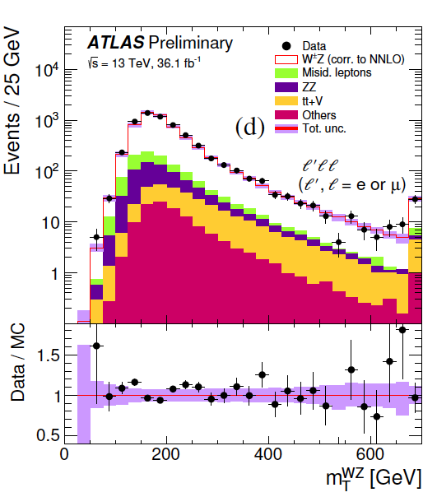
ATLAS-CONF-2018-034
Not only the p_{T} of the Z is not described, but the transverse mass (m_{T}) is not followed by the SM MC either. The error bar includes a normalization uncertainty that does not contribute to resolving the data/MC differences in the m_{T} . From the standpoint of the Madala hypothesis, the decay H-->Sh does not seem enough. Adding A→ZH→ZSh to the analysis of the spectrum, where H and A are members of a 2HDM

Slide 4
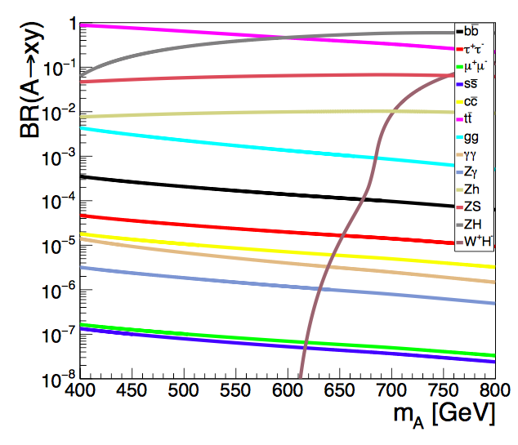
2HDM+S
arXiv:1809.06344

Slide 5
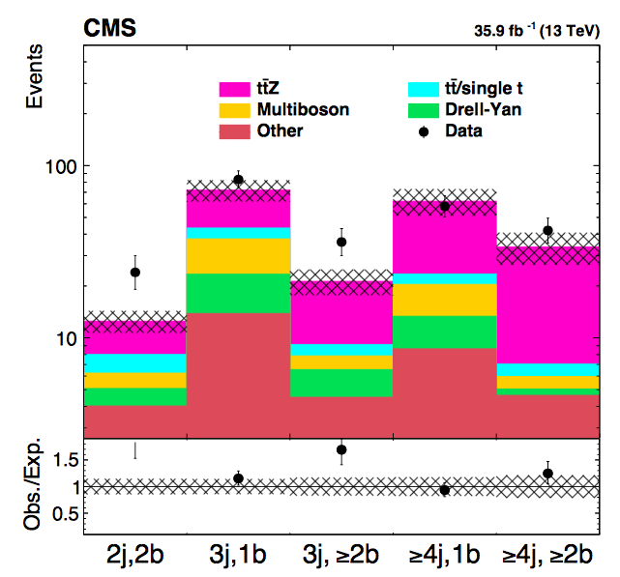
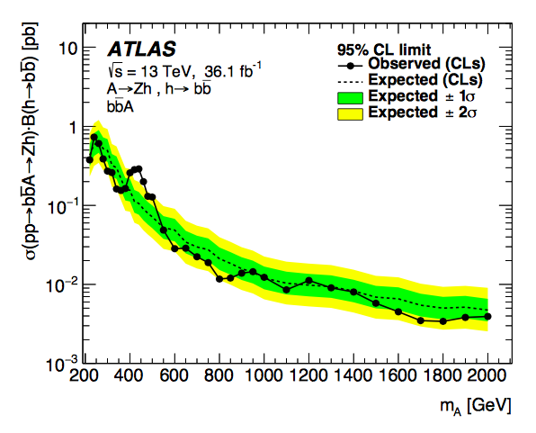
Excesses interpreted within 2HDM+S
arXiv:1809.06344
Try this decay chain with 3l final state

Slide 6
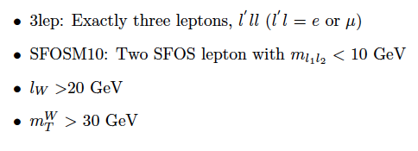

$W^{∓}Z$ Production Events selection

Slide 7
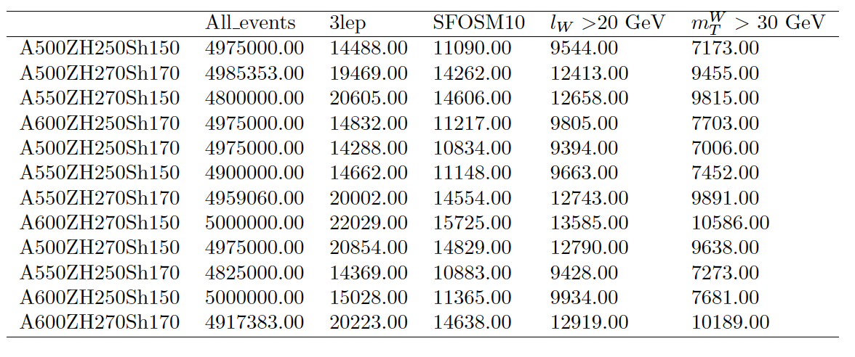
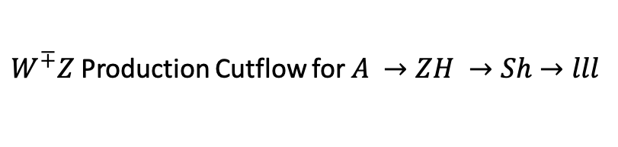
$W^{∓}Z$ Production Cutflow for $A →ZH →Sh→lll$

Slide 8
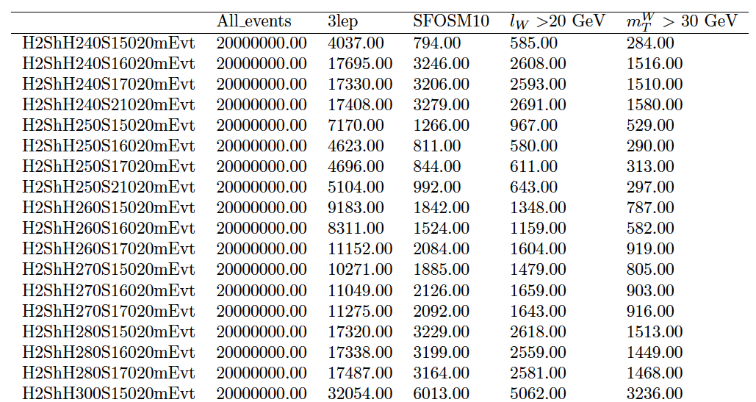
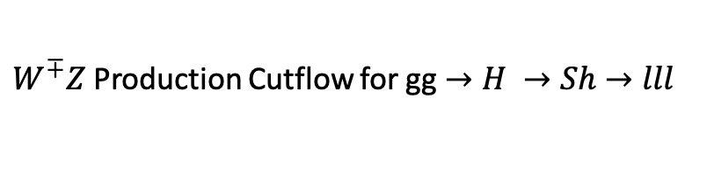
$W^{∓}Z$ Production Cutflow for gg$→H →Sh→lll$

Slide 9
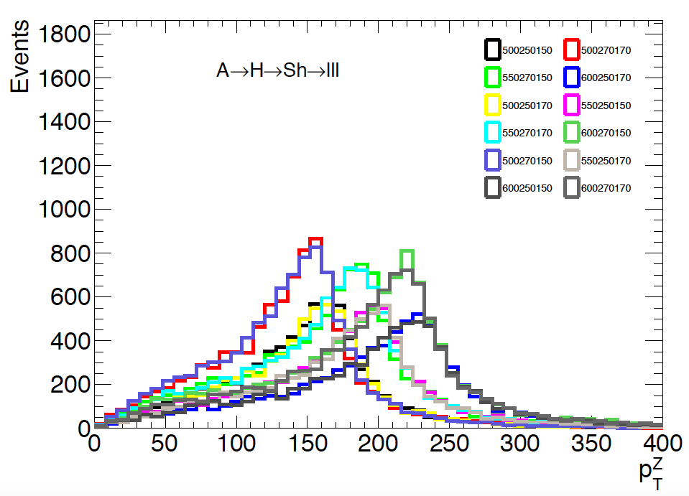
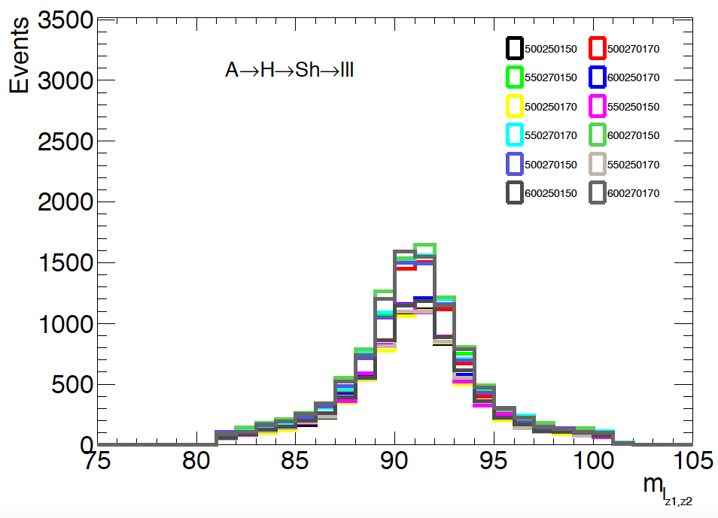
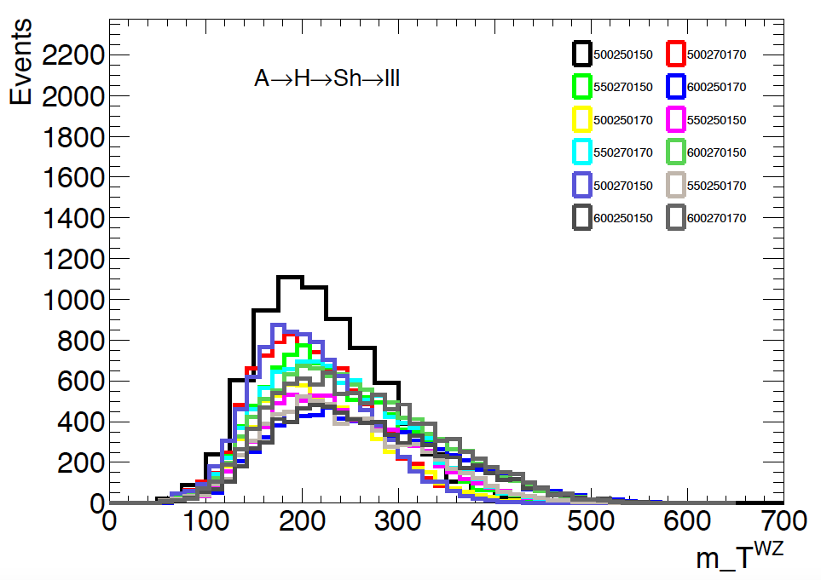
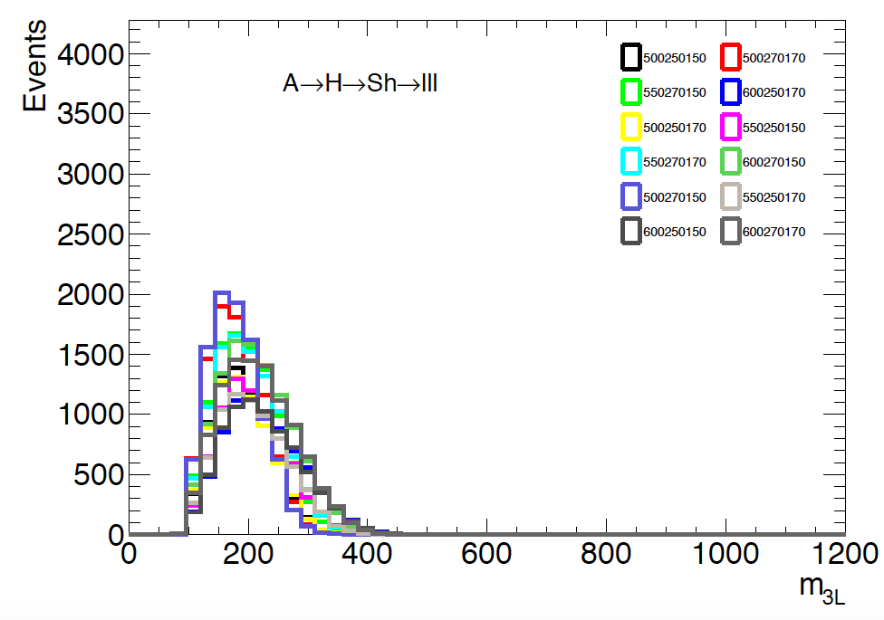

Slide 10
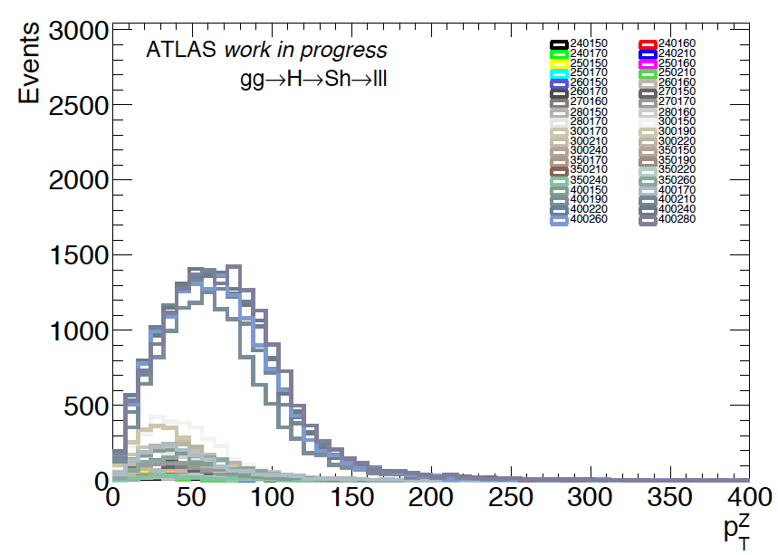
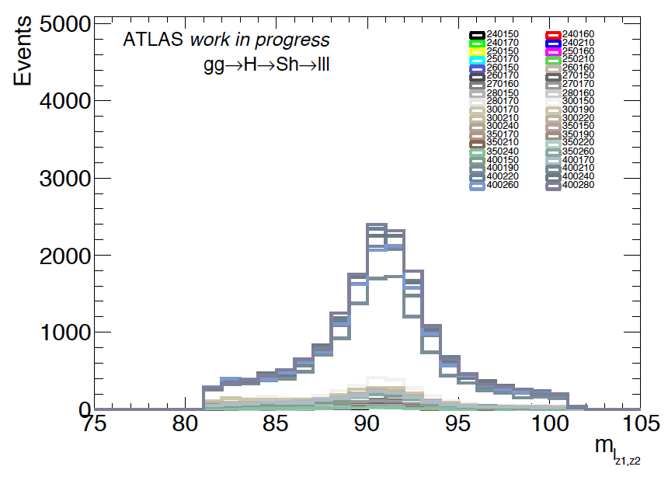
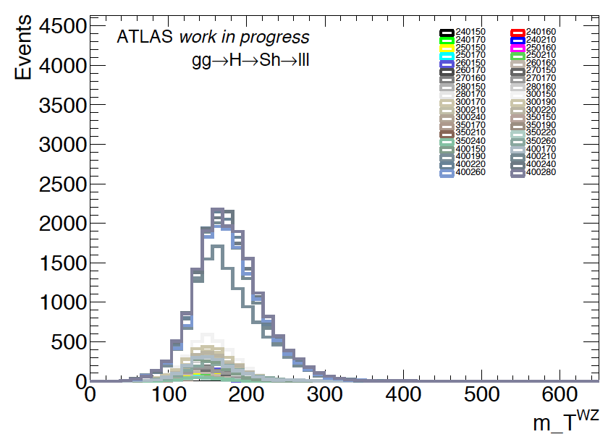
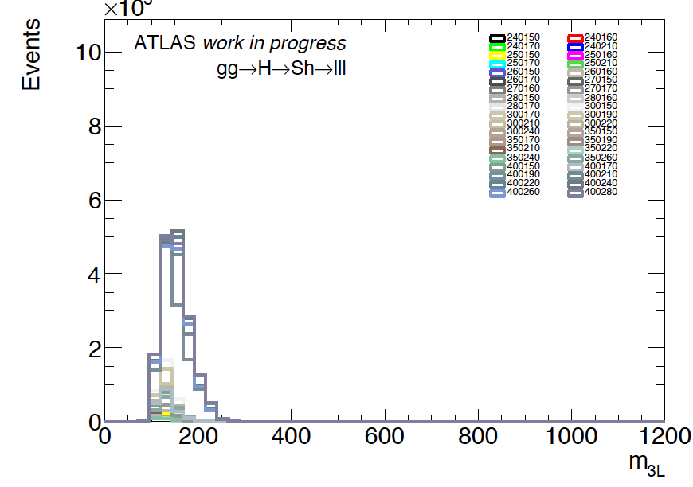

Slide 11
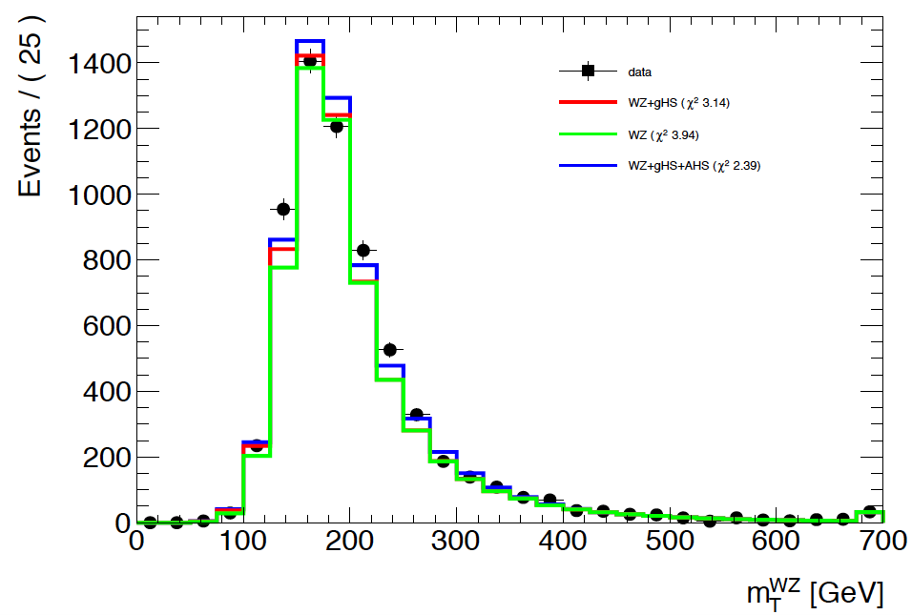
Strong improvement in Chi^2 by adding A→ZH. Next step is to vary the masses of H and S to understand if further improvement is possible.

