Slide 1



Funded by the European Union
Grant Agreement Nº 777431
XLS 1st Annual Project Meeting
Barcelona, December 10-12, 2018
https://indico.cells.es/indico/event/177

Slide 2
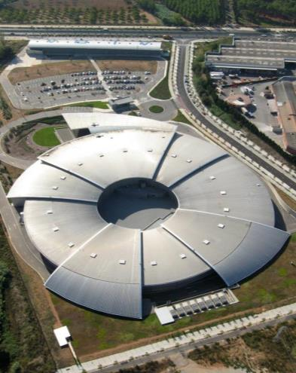
Welcome
Francis Perez

Slide 3
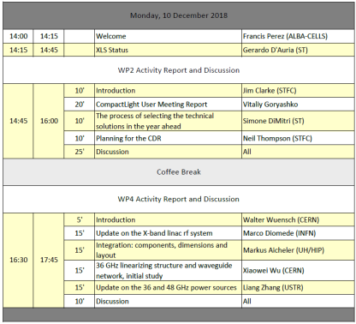
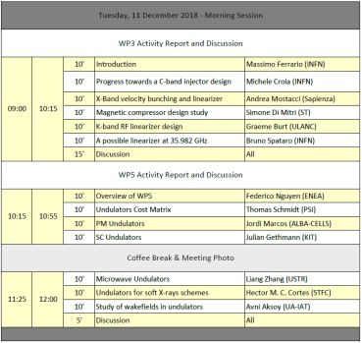
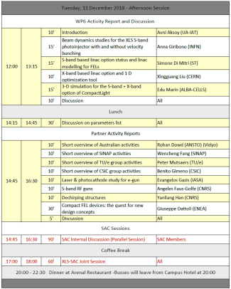
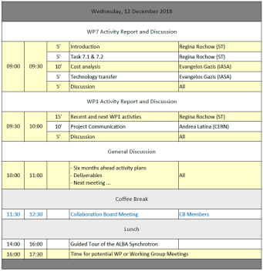
Program
https://indico.cells.es/indico/event/177/material/1/0.pdf
https://indico.cern.ch/event/779185/timetable/

Slide 4
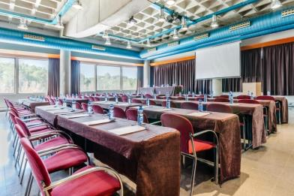

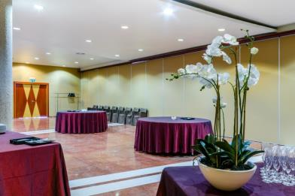

Coffee Breaks
Outside
“Lluis Vives” room
(workshop meeting room)
Lunches
“Martí Franques” room
(downstairs)

Slide 5
Group Photo
TUESDAY, 11th December
10:55
(just before the coffee)

Slide 6
WIFI
WIFI: Hotel Campus UAB
Password: Campus2016$UAB

Slide 7


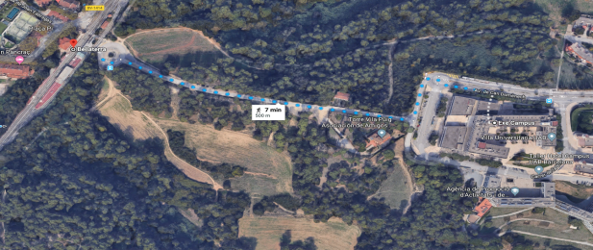
Today (Monday) evening
Free
(suggestion to go to BCN or Sant Cugat by train)
Bellaterra FGC railway station (S2 or S6 lines, trains every ~5-10min)
The journey to Barcelona Plaça Catalunya takes ~33 minutes
The journey to Sant Cugat takes ~7 minutes
The Exe Campus hotel is 500m away from the Bellaterra railway station

Slide 8

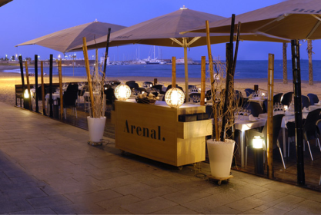
Tomorrow (Tuesday) evening
Dinner in Barcelona
Restaurant Arenal
http://gruparenal.com/en/restaurants/arenal/
20h00 (sharp!):
Bus from Hotel Exe Campus
20h30: Dinner
23h00: Bus from Restaurant to Hotel

Slide 9

ALBA Visit
Wednesday, 12th at 14:00
14h00: Bus from Hotel Exe Campus
14h15: Visit
16h00: Taxis to Airport or to Hotel
(contact Daimí)

Slide 10
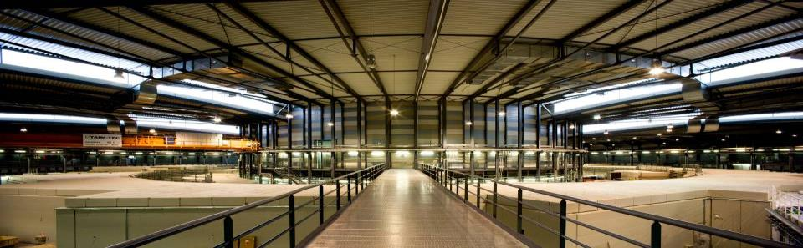
ALBA
3 GeV electron accelerator complex
8 beam lines in operation and 4 in construction
Funding is 50% Spanish – 50% Catalan Governments
Approved in 2003
In operation since 2012

Slide 11
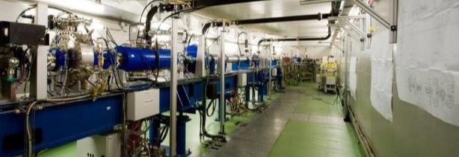
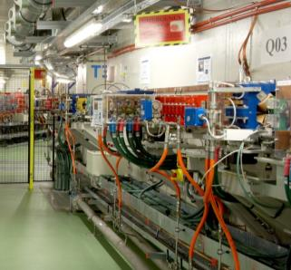
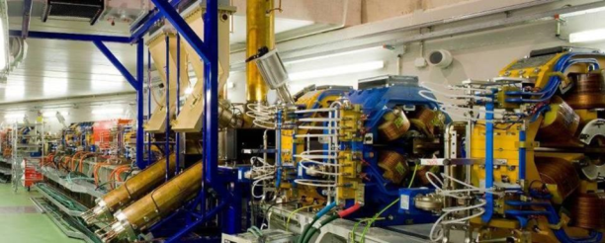
Linac
Accelerate electrons to 100 MeV
RF cavities 3 GHz
Repetition rate of 3 Hz
Booster
Accelerate e- from 100 MeV to 3 GeV
1 x RF cavity at 500 MHz
Repetition rate of 3 Hz
Storage Ring
Keep electrons at 3.0 GeV
Magnets and correctors to keep
the orbit (sub-um)
Vacuum Pumps (10⁻¹⁰ mbar)
6 x RF cavities at 500 MHz
Circulating current: 250 mA

Slide 12
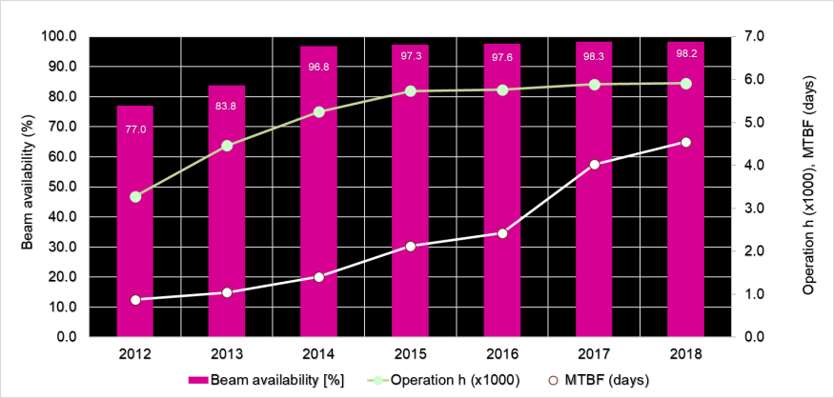
Accelerators Operation
Operating about 6000h/year
Beam availability > 98%
Mean Time Between Failures > 100h (> 4days)

Slide 13
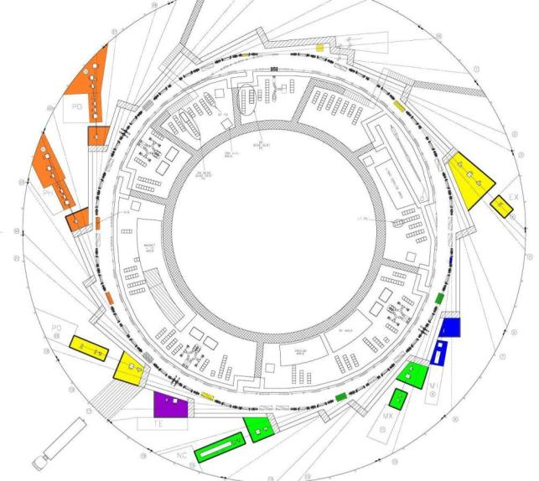
Beamlines
Bending: e⁻ Diagnostics
BL29: BOREAS
EU71– (0.08-3 keV)
Resonant Absorption
and Scattering
BL01: MIRAS
Bending – (0.4-100 µm)
IR Spectroscopy
BL24: CIRCE
EU62– (0.1-2 keV)
Photoemission
spectroscopies
BL04: MSPD
SCW31 – (8-50 keV)
HP/HR
Powder Diffraction
BLXX: FaxTor
ID: 3 pole wiggler
Hard x-ray tomography
In operation (8)
In construction (4)
BL06: XAIRA
IVUXX (~5-25 keV)
Macromolecular Cristallography
BL22: CLÆSS
MPW80– (2-63 keV)
Absorption &
Emission Spectroscopies
BL09: MISTRAL
Bending– (0.27-2.6 keV)
X ray Microscopy
BL20: LOREA
EU125 – (10-450 eV)
ARPES
BL11: NCD
IVU21– (6-13 keV)
Non Cristalline Diffraction
SAXS/WAXS
BL16: NOTOS
Bending
Metrology, XAS
BL13: XALOC
IVU21 – (5-22 keV)
Macromolecular Cristallography

Slide 14
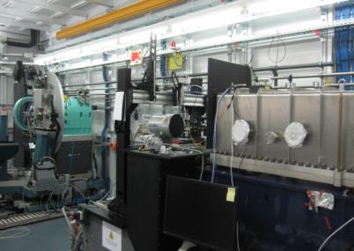
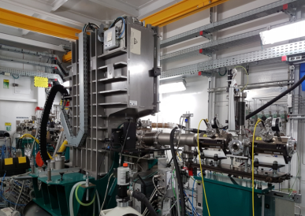
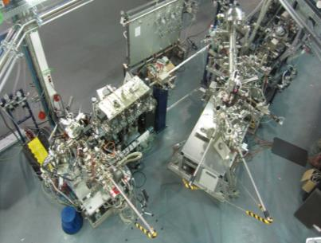
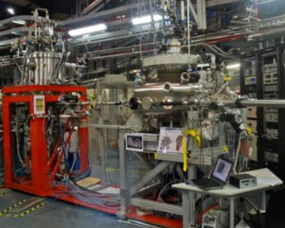
Condensed Matter, Chemistry
MSPD: Material Science Powder Diffraction
HP & HR stations
CLAESS:
Absorption & Emission Spectroscopies
  CIRCE: PhotoEmission Electron Microscopy & Near Ambient Pressure Photoemission
BOREAS Resonant Absorption and Scattering

Slide 15
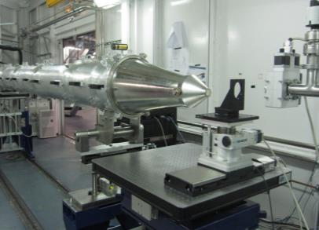
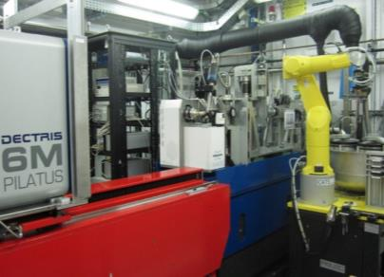
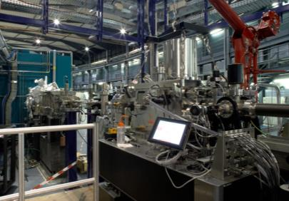
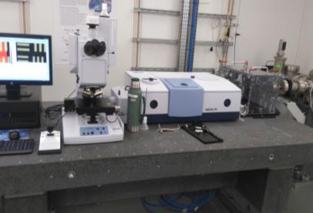
Life Sciences
NCD – SWEET, Non crystalline diffraction,
SAXS and WAXS
XALOC,
Macromolecular Crystallography
MISTRAL, Cryo nano-tomography
MIRAS, IR spectroscopy

Slide 16
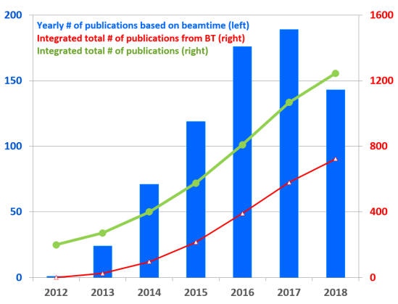
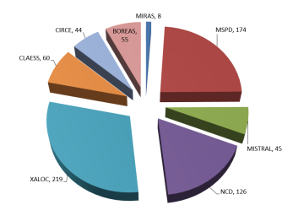
Scientific productivity
% of publications with IF > 7

Slide 17
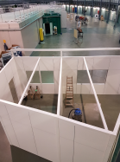

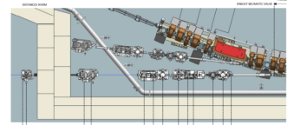


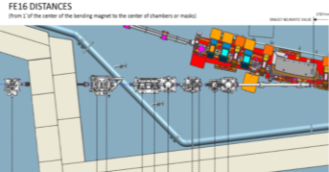

4 Beamlines under construction
LOREA, Angle resolved photoemission
XAIRA, Microfocus Macromolecular Crystallography
Electronic structures, Materials science, 0.01-1 keV
Biosciences, Proteins, drugs, 4 to 22 keV
Material science, catalyisis, instrumentation, metrology,, 4.8 to 30 keV
Fast X‐ray radioscopy, real time tomography hard X-ray range
NOTOS, HP, Absorption and Instrumentation Development
FAXTOR, Hard X-ray Tomography)

Slide 18
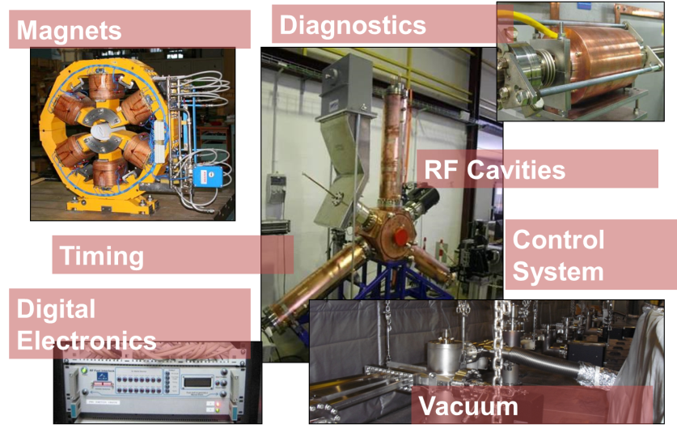
ALBA R&D in Accelerators

Slide 19
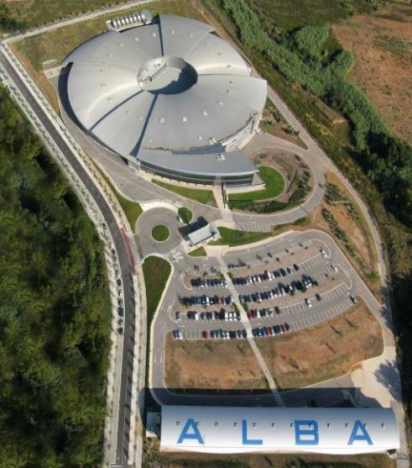
R&D labs
Magnetic lab
RF lab
Vacuum lab

Slide 20
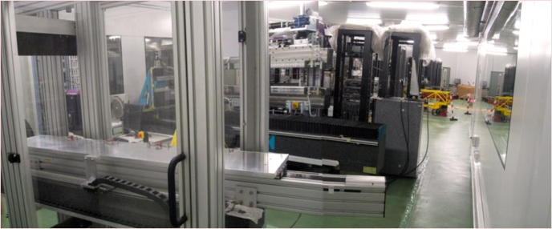
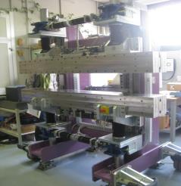
Magnetic Measurements Lab
Specialized in accurate measurements of big magnetic structures
Mission of the laboratory:
Measurement of Accelerators Magnets
Construction and measurement of IDs
  Rotating coil bench
  Fixed stretched wire bench
  Helmholtz coils
  Hall probe bench
  Flipping coil bench

Slide 21
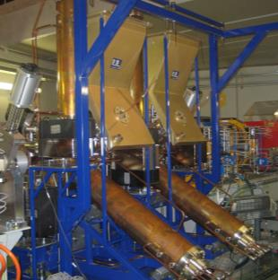
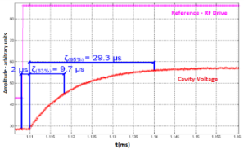
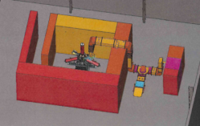

High Power RF Lab
Specialized in low and high RF power measurements and cavity conditioning
In order to build the accelerators, ALBA set up a complete high power RF laboratory for prototype testing and cavity conditioning:
LLRF tests
Controls tests
80 kW amplifier IOTs tests
High power RF conditioning of:
  Cavities
  Input power couplers

Slide 22
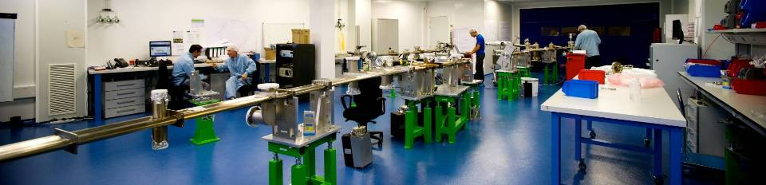
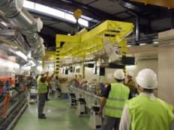
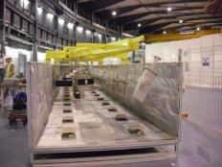
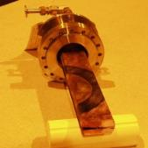
Ultra High Vacuum Lab
Specialized in Ultra High Vacuum: design, construction and tests
Clean room class 100000 (ISO 8)
1 T travelling crane
Bake-out oven, 14m long
ANSYS, NX, Molflow

Slide 23









International Collaborations
H2020 - XLS
FCC-CERN – HTS-BS-FCC
      Develop beam screens based on HTS
H2020 - Project EuroCirCol
      Design FCC VC chamber
Collaboration with CLIC-CERN
H2020 - ARIES – ADA
      Fast Feed Back Workshop hosted by ALBA, 12 -14 Nov 2018
ESRF - EBS – BPM tool
SIRIUS & DIAMOND - Digital LLRF
H2020 – BEATS (SESAME)
Build a beamline at SESAME, design and build ID&FE

Slide 24
ALBA in the future
2030
ALBA II
2020
11 Operating BLs
4 BLs in construction
2028
16-20 Operating BLs
Preparing ALBA II
2017-2020
Strategy Plan
In progress
Next decade fully exploiting the initial infrastructure by increasing number of BLs and add addional platforms (as Advanced Microscope Center)
Upgrade to more brilliant source

Slide 25
Funded by the European Union
Grant Agreement Nº 777431
XLS 1st Annual Project Meeting
Barcelona, December 10-12, 2018
Enjoy the meeting

