Slide 1

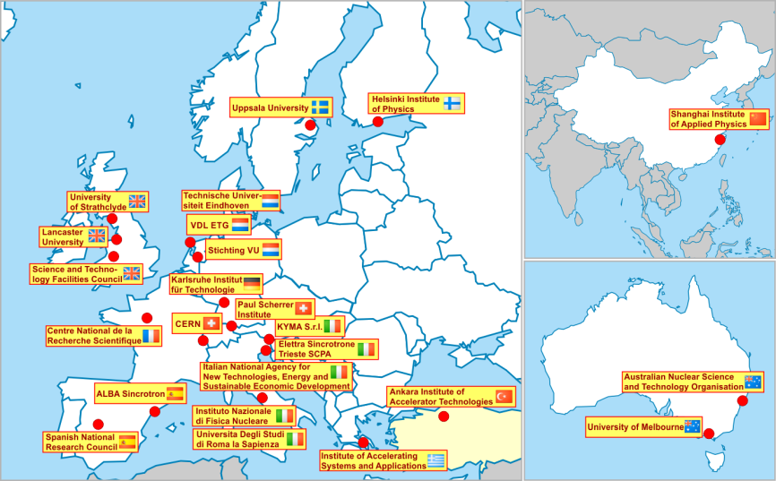
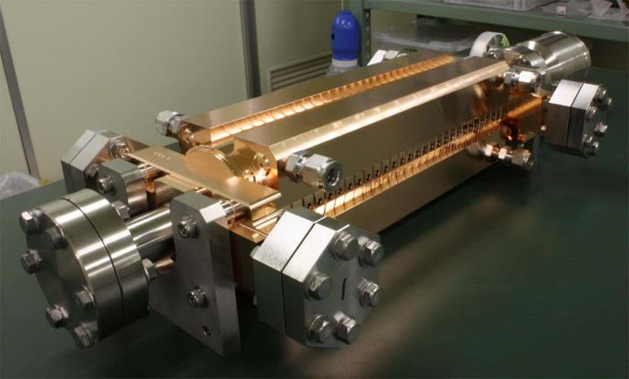
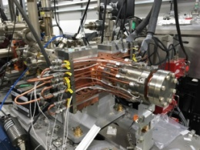
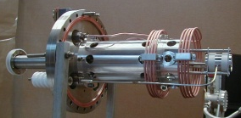
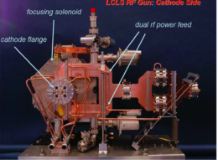
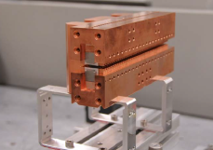
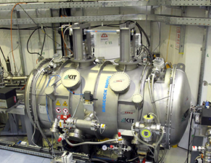
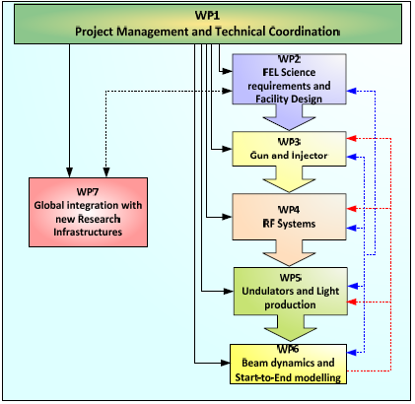
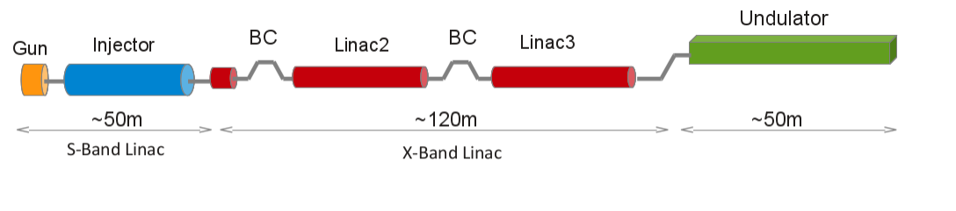
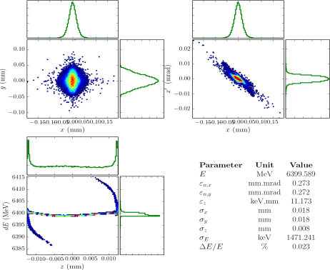
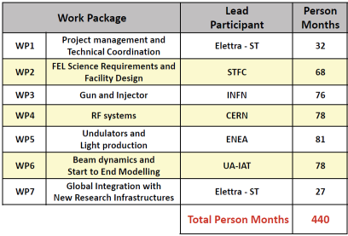
The CompactLight | XLS Project
H2020 INFRADEV - Design Study 2018 - 2020
Funded by the European Union
  http://compactlight.eu
Our aim is to facilitate the widespread development of X-ray FEL Facilities across Europe and beyond, by making their construction and operation more affordable through an optimum combination of emerging and innovative accelerator technologies
With CompactLight we plan to design
a Hard X-ray Facility
using the very latest concepts for:
High brightness electron photoinjectors
Very high gradient accelerating structures
Novel short period undulators.
The New Facility, compared with Current Facilities, will benefit from:
A lower electron beam energy, due to the enhanced undulator performance
Being significantly more compact due to lower energy and high gradient structures
Having a much lower electrical power demand than current facilities
Having much lower construction and running costs
Injector Gun
Review state of the art Gun/Injector (S, C, X band) and pick the best Develop a novel high rep. rate Gun/Injector with K-band linearizer
Undulators and Light Production
Comparative studies of “ambitious” undulators on the timescale of 4-5 years:
eg. cryo permanent-magnet, super-conductive undulators, …
Ultra-low emittance e⁻source TU/e
CERN CLIC Accel. Struct.
11.994 GHz_X-band
100 MV/m
ENEA-INFN
400Hz S-band Rf gun
CLARA
LCLS S-band rf gun
Cryo PM Undulator
HZB/UCLA
S. C. Undulator KIT
Start-to-end Electron Beam Simulation
CompactLight
WPs Structure
CompactLight is funded by the European Union’s Horizon2020 research and innovation programme under Grant Agreement No. 777431.
CompactLight@elettra.eu XLS www.CompactLight.eu

