Slide 1
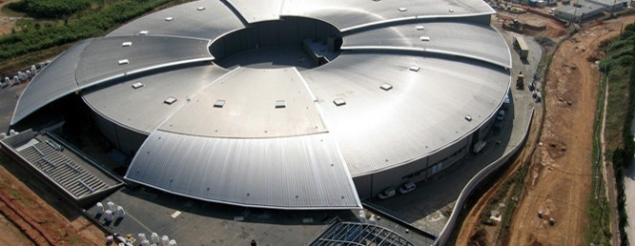
WP2 Introduction
11th December 2018, ALBA, Barcelona
CompactLight Annual Meeting, Barcelona
Jim Clarke, STFC Daresbury Laboratory

Slide 2
WP2 FEL Science Requirements and Facility Design
Task 2.1 - FEL user scientists and potential users will provide specification for the Hard X-ray FEL output parameters (in terms of wavelength range, pulse energy, polarisation, beam structure, pulse duration, synchronisation to external laser, etc.).
  Deliverable 2.1 - A report summarising the requests from the users and defining the performance specifications for the FEL, (31/12/18).
  Task Leader – Vitaliy Goryashko, Uppsala University
    Vitaliy will provide a report from the User Meeting that was held in November
  Agreeing the FEL specification this week is a key outcome from this meeting

Slide 3
WP2 FEL Science Requirements and Facility Design
Task 2.2 - The outcome of the previous task will be used by FEL experts (working closely with WP3, 4, & 5) to define the FEL system, with the accelerator and undulator requirements that are needed to achieve the specification (electron energy, bunch charge, peak current, emittance, energy spread, period, field strength, etc.). Then the task will identify and choose the most appropriate technical solutions considering cost, technical risk and performance. The other WPs make recommendations for all the technical solutions which are then agreed within this task.
  Deliverable 2.2 - A report summarising the FEL design, with the accelerator and undulator requirements to achieve the specification, i.e. electron energy, bunch charge, peak current, emittance, energy spread, undulator parameters, etc., (31/12/19).
  Task Leader – Simone DiMitri, Sincrotrone Trieste
    Simone will talk about the process of selecting the technical solutions in the year ahead

Slide 4
WP2 FEL Science Requirements and Facility Design
  Task 2.3 – Engineers, accelerator physicists, undulator and RF experts will receive machine specification from FEL experts and will then design a user facility capable of achieving these requirements. Regular contact and iterations between the FEL experts, engineers, accelerator and undulator designers will be essential to achieve an optimised design. The Hard X-ray FEL conceptual design report will also include options for Soft Xray FEL and Compton Source. WP2 has responsibility to ensure facility design is self consistent.
  Deliverable 2.3 - The conceptual design report for a Hard X-ray FEL facility, including cost estimates, with options for Soft X-ray FEL and Compton Source, (31/12/20).
  Task Leader – Neil Thompson, STFC Daresbury Laboratory
    Neil will talk about planning for the CDR

Slide 5
REMINDER: Compact Light FEL Preliminary Specification
Two informal meetings were held with leading proposers of UK XFEL
  All of them are experienced users of LCLS, and other FEL user facilities, including European XFEL now
  CompactLight proposal stated that “we will develop a hard X-ray FEL design tailored to the UK user specifications”
General comments from UK users
  If UK XFEL is not world leading then why would anyone want to use it?
  We will all just go to the best facility for our research whatever country it is in
  We can’t justify funding UK XFEL unless it has unique capabilities, enabling science that is not possible on other FELs
  A preliminary set of parameters were discussed in Trieste based on this input

Slide 6
REMINDER: CompactLight Preliminary Specification Notes
250 eV – to cover the carbon K edge
25 keV – requested by group studying extreme materials
Pulse duration – 100as isolated pulses have definite science need identified (atomic and molecular physics), case for shorter pulses than 100as to be determined
Pulse duration – 50 fs not a definite requirement, just a typical number
Pulse energy – 1mJ at 25keV highly desired by extreme materials, higher welcome but may not be realistic
Repetition rate – 100Hz at 25keV (high power lasers are combined in experiment and they only have low repetiton rate)
Repetition rate – 1000Hz or greater highly desirable for the soft X-ray, 250eV to 2keV
Two colour output is required – see slide
Two pulse output required with time separation of pulses set by the FEL between -20fs and +40fs. Larger time separations will be achieved within the beamline (split and delay)
Polarization – variable, selectable below 2 keV.
Polarization – above 2keV to be determined.
We are not expected to cover this photon range with one beamline
There is a natural beamline breakpoint at ~2keV where gratings are replaced by crystals

Slide 7
REMINDER: CompactLight Preliminary Specification
The table below separates the FEL output requirements into the two regimes of operation (soft/hard x-ray) to show which parameters are required in combination.
 | Soft x-ray | Hard x-ray
Photon energy [keV] (min-max) | 0.25 - 2 | 2 - 25
Wavelength [nm] (max-min) | 5 - 0.6 | 0.6 - 0.05
Repetition rate [Hz] | 1000 | 100
Maximum pulse energy [mJ] | Not specified | 1 (at 25 keV, less at other energies?)
Number of photons | Not specified | 2.5 x 10¹¹ at 25 keV
Pulse duration [fs] | 0.1 – 50
Polarisation | Variable, selectable | Not specified
Two-colour pulses: time separation [fs] | -20 -> +40
Two-colour pulses: photon energy variation (max. of E2/E1) | 2 (270-530eV), 1.2 for the rest of the range | 1.1

Slide 8
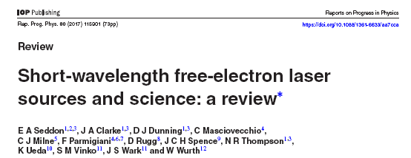
REMINDER: CompactLight Preliminary Specification Proposal

Slide 9
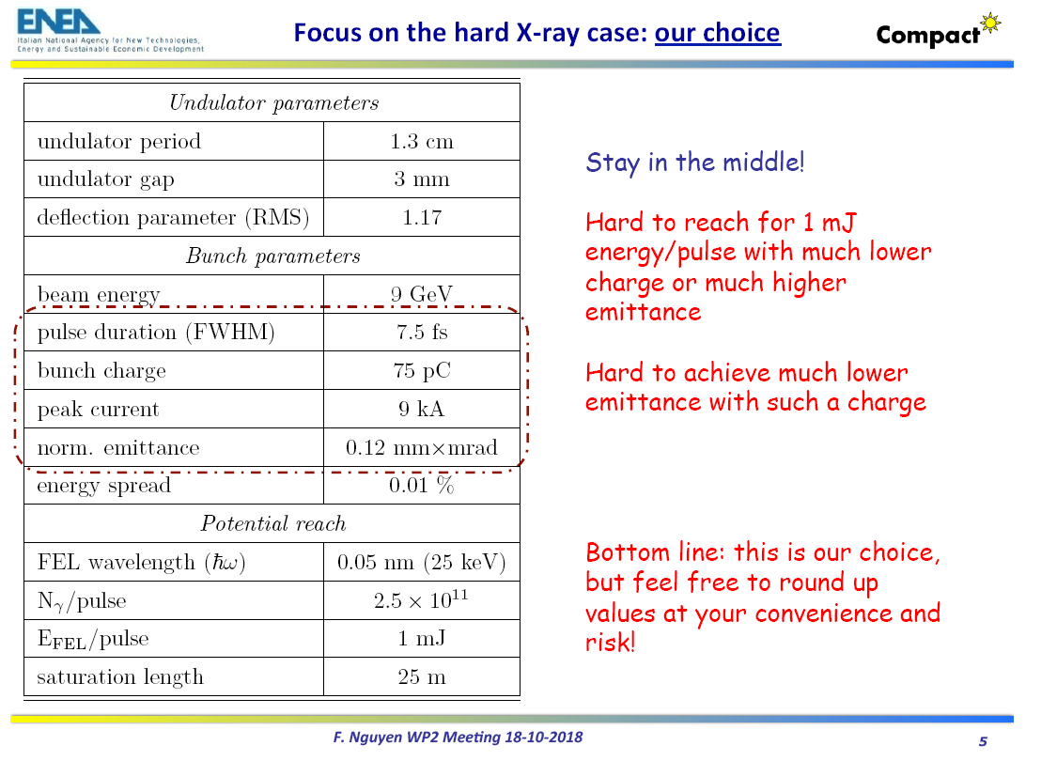

Slide 10
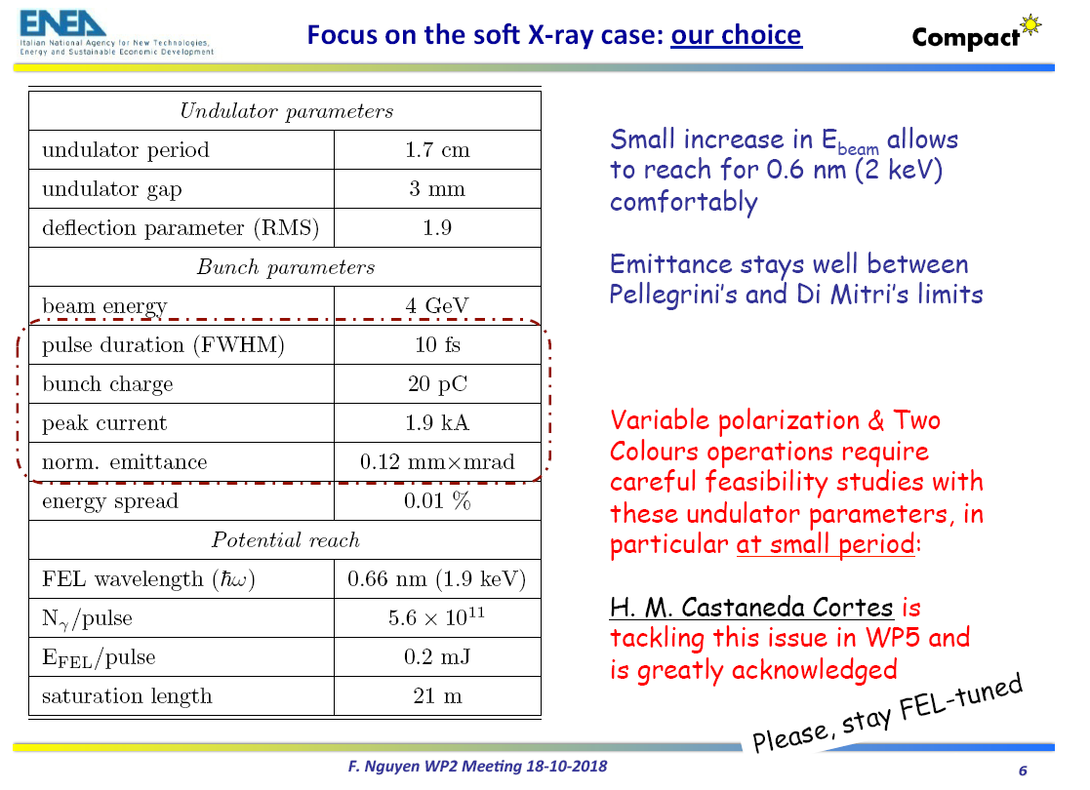

Slide 11
Other Interactions with Users
Representatives of CompactLight were at Science@FELs Conference in Stockholm and interacted with potential users
Representatives of CompactLight were at the Attosecond and FEL Science Conference in London and interacted with potential users
A dedicated CompactLight User Meeting was held at CERN in Nov 2018
A questionnaire has been developed and sent to ~50 users.

