Slide 1


User requirements
Vitaliy Goryashko, Alan Mak, Peter Salen, Jim Clarke, Regina Rochow, and Gerardo D’Auria
CompactLight Users Meeting, CERN, 2018

Slide 2
Communication activities
To communicate to and receive feedback from the FEL user community, we have undertaken the following steps:
Conference “Science@FELs,” Stockholm June, 2018
Workshop “FEL User-Developer Forum”, Stockholm, June, 2018
Conference “Attosecond and Free Electron Science”, London, July 2018
CompactLight User Workshop, CERN, November, 2018
Online user survey (Gerardo and Regina)
Workshop “Shaping the future of the European XFEL”, Hamburg, December, 2018

Slide 3
Warning: potential biases
Bias of representation. The sets of users and replies to the survey are not representative. Only 12 users attended the meeting and only 10 replies out of 50.
Bias of perspective. The survey and discussion with users mostly represented backward looking perspective. The users were mostly talking about their ongoing experiments.
Bias of communication. Some users communicated their messages across better than the other.

Slide 4
Results of the survey (only 10 replies ☹)

Slide 5
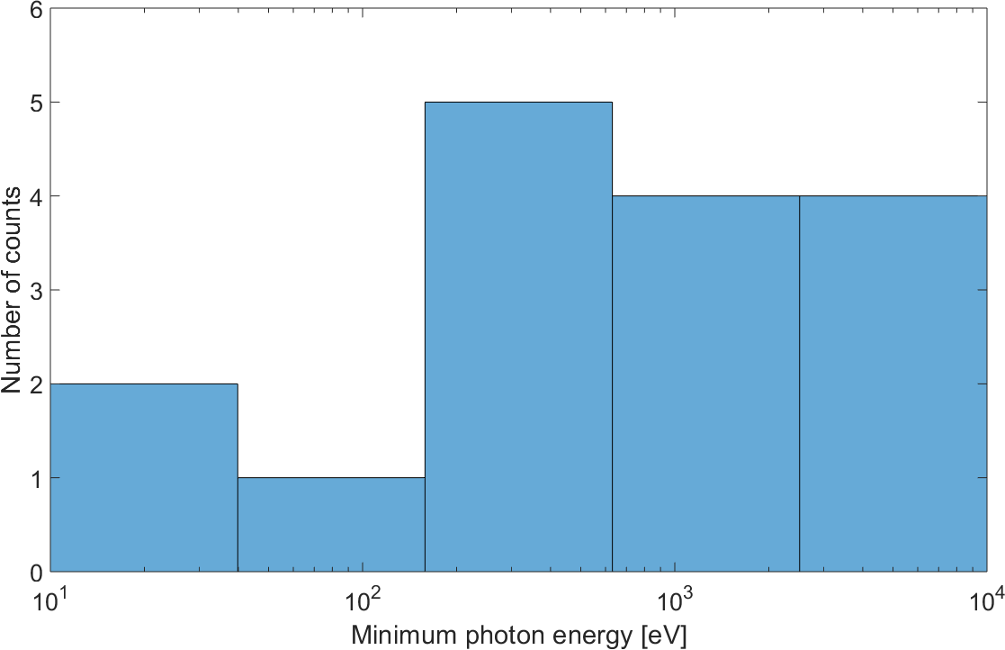
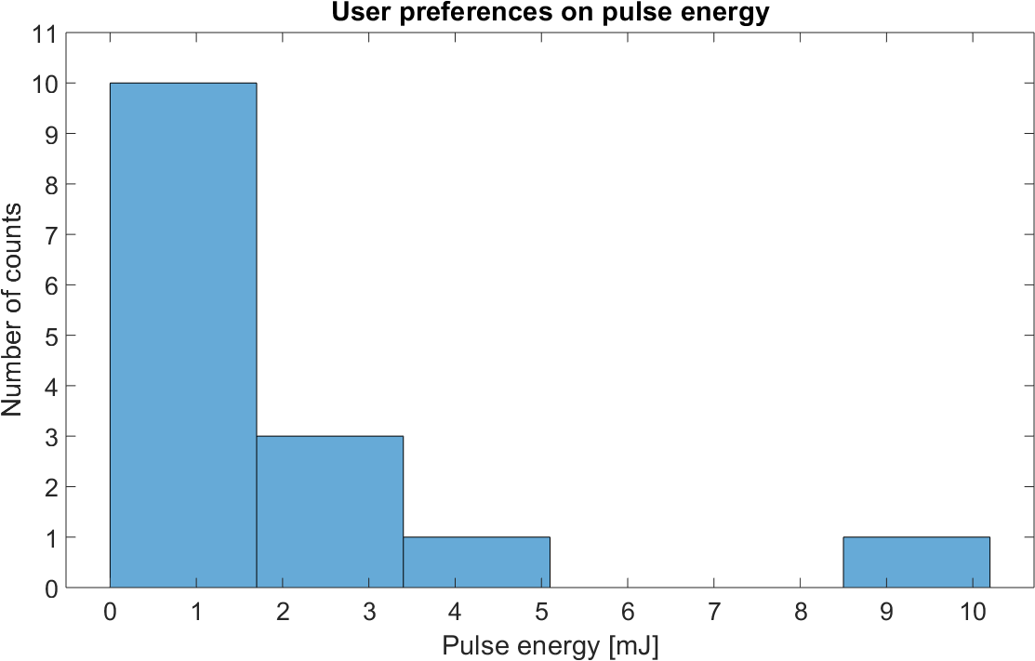
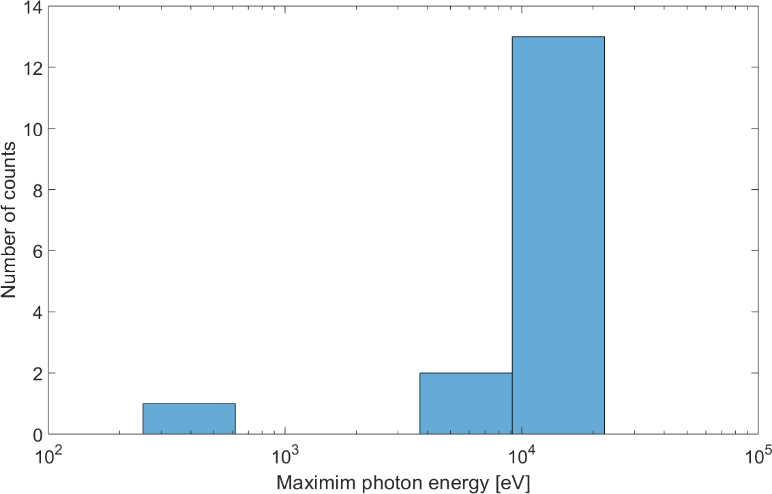
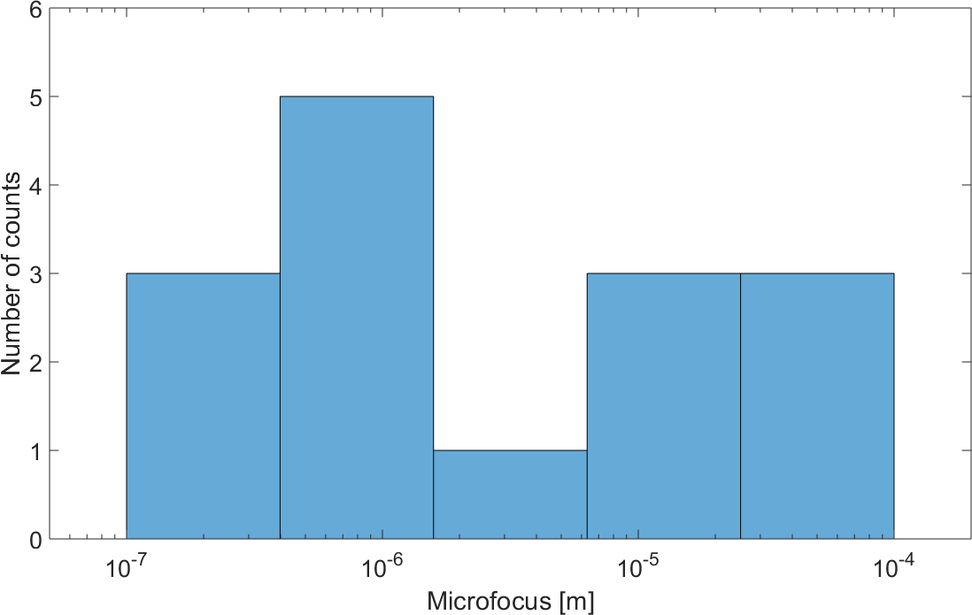
Photon Range, Energy & Focus
bottom limit 200 ev
pulse energy 1 mJ
upper limit 25 kev
focus 0.1-1 um

Slide 6
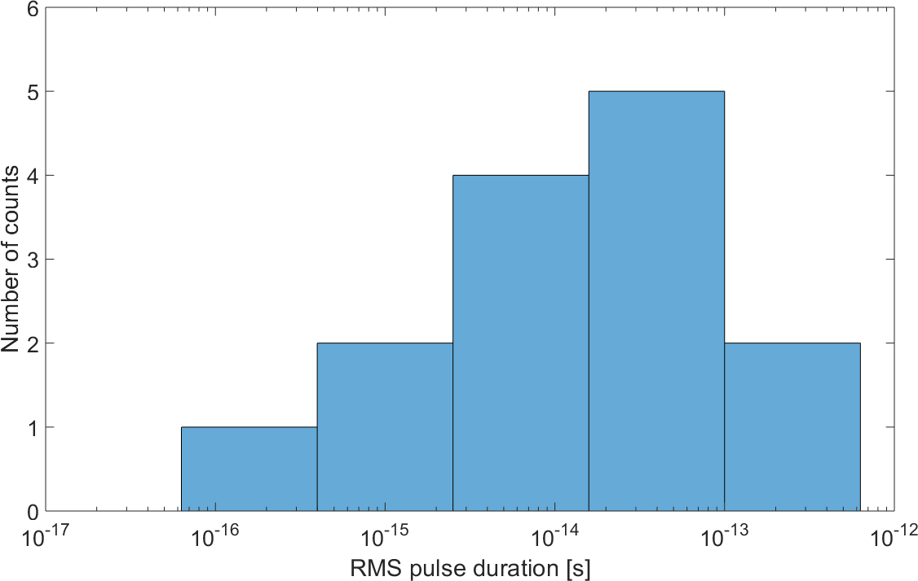
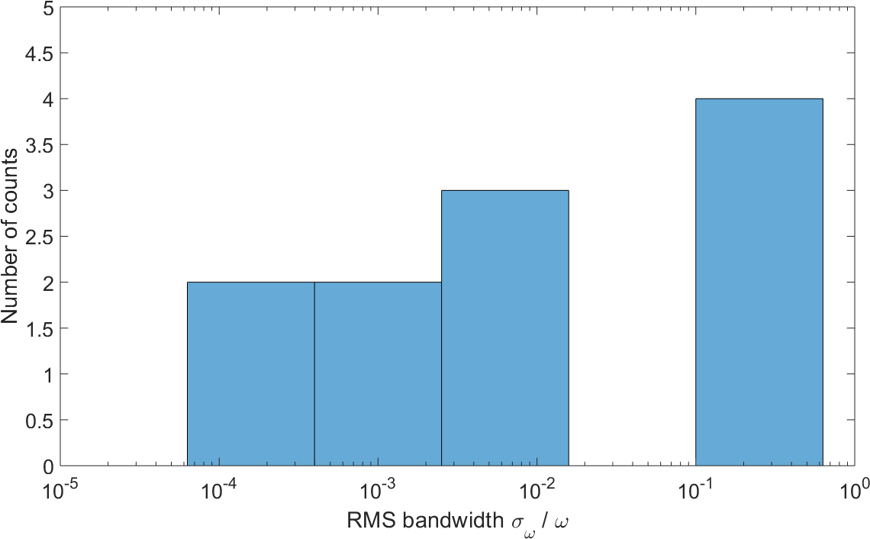
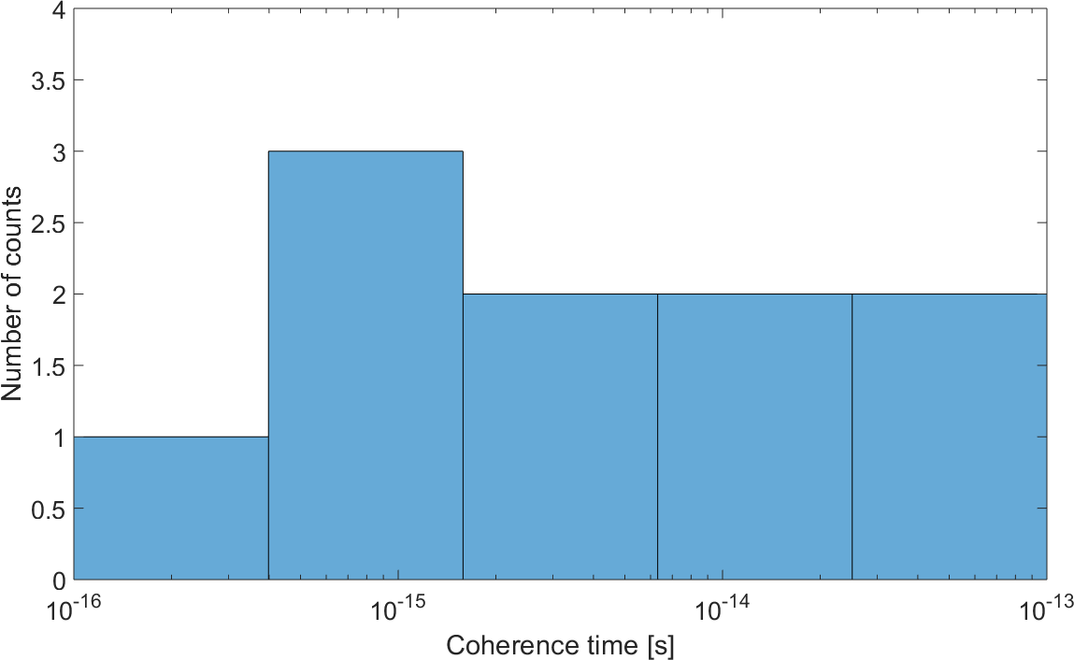
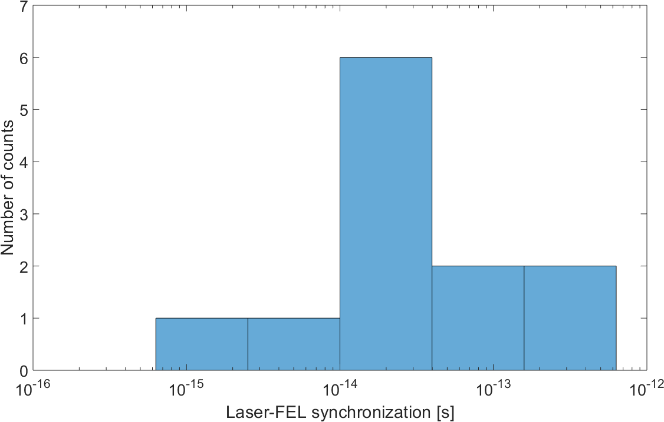
Temporal Characteristics
10-100 fs
0.1% bandwidth is OK
for many applications
10 fs
1-100 fs

Slide 7
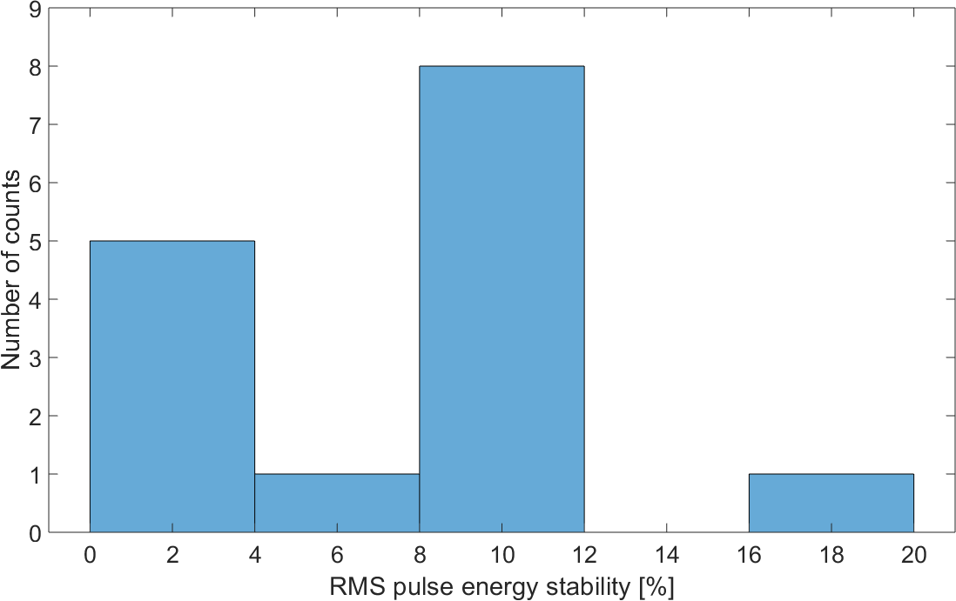
Stability
Energy stability is important.
1 mJ
10 fs
0.1-1%

Slide 8
General requirements
  The message that we have heard over and over at conferences and workshops: STABILITY is a key requirement
  Pointing stability of emerging FEL pulses
  Beam energy stability
  Beam arrival time stability
  Peak current stability
  Other key requirements:
  Polarization control
  Synchronization: 10 fs
  Repetition rate: > 100 Hz
  Full coherence
  Two pulses
  Short pulses
Bottom line:
for many currently ongoing studies at FELs, users want just a copy of SwissFEL but with much better stability.
Make an X-ray FEL really like a laser.

Slide 9
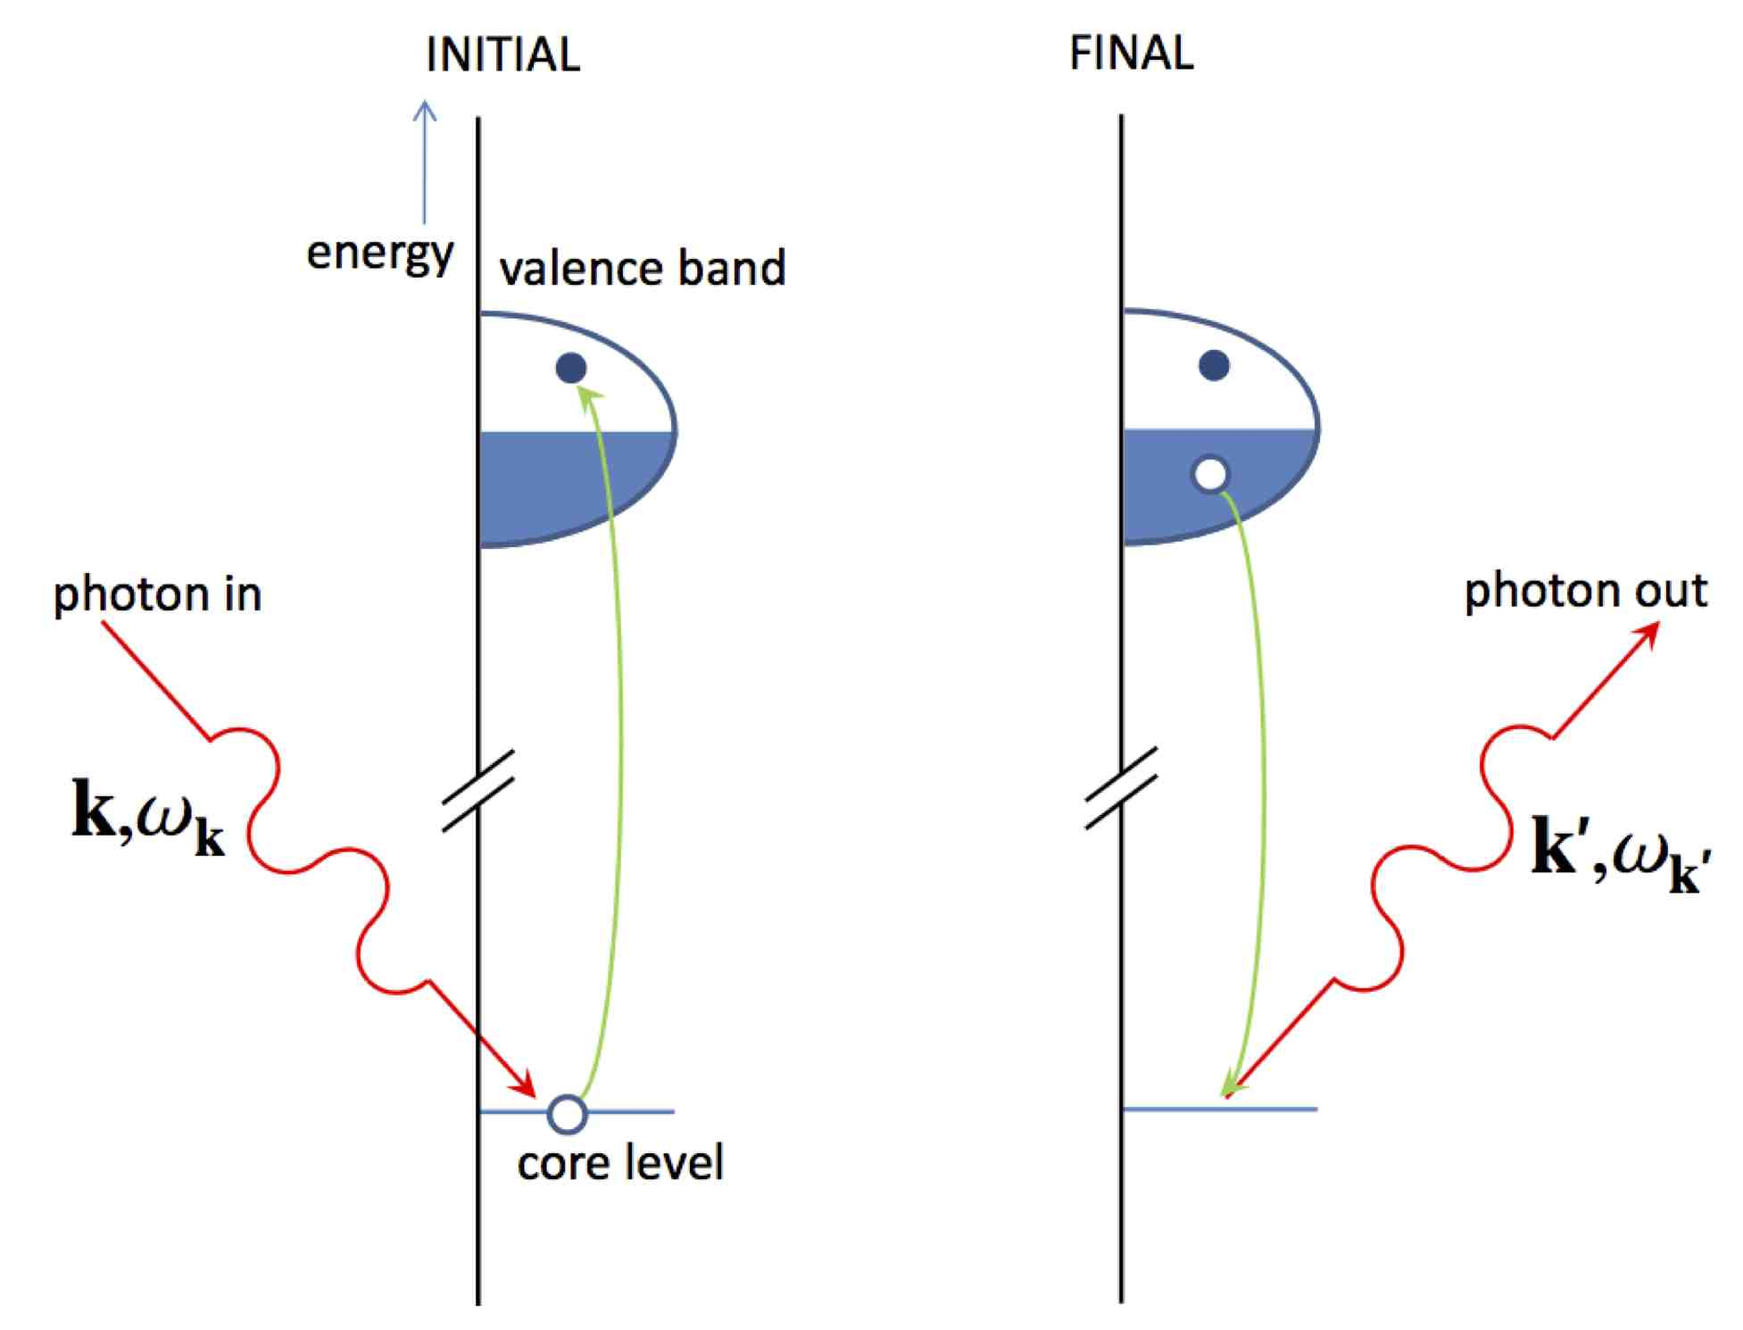
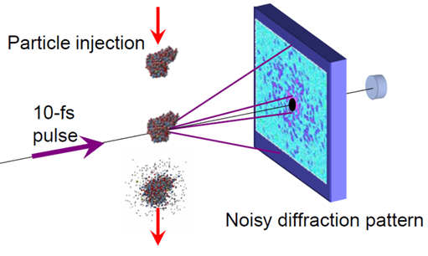
Key categories of experiments
Diffraction (scattering) technique:
measures the angles and intensities of diffracted photon beams
gives information about the electron density distribution in the sample
the more photons, the better
imaging of microcrystals ~ 1 um
requires an FEL beam spot of 1 um
with longitudinal coherence ~ 1 um.
Spectroscopy technique:
a photon-in/photon-out technique
measures the energy and momentum change of the scattered photon
element and orbital specific
inelastic scattering from materials or matter under extreme conditions
required coherence volume >1 um^3

Slide 10
Requirements on soft X-ray FEL
1.2 keV is often considered as a boundary between soft and hard X-ray.
1.2 keV corresponds to a transition from grating-based optical components to crystals for X-ray optics.
Other choices of the boundary are 2 or 3 keV.
Pink beamline
X-ray photon energy | keV | 0.2-1.2
Pulse duration | fs | 1-10
Pulse energy | mJ | 0.1
Focus | um | 1
Bandwidth | % | 1
Polarization control |  | yes
Coherence time | fs | 2
Two pulse delay | fs | ±100
Two color separation | ev | 10-100
Synchronization | fs | 10
Mono beamline
X-ray photon energy | keV | 0.2-1.2
Pulse duration | fs | 10+
Pulse energy | mJ | 0.1
Focus | um | 10
Bandwidth | % | 0.01
Polarization control |  | yes
Coherence time | fs | 2
Two pulse delay | fs | N/A
Two color separation | ev | N/A
Synchronization | fs | 10
These parameters are from Science Case (100+ users) for SXL (2018).

Slide 11
Requirements on hard X-ray FEL
Pink beamline
X-ray photon energy | keV | 1.2-16
Pulse duration | fs | 10
Pulse energy | mJ | 1
Focus | um | 0.1-1
Bandwidth | % | 0.1
Polarization control |  | yes
Coherence time | fs | 3
Two pulse delay | fs | ±100
Two color separation | ev | 600
Synchronization | fs | 10
Mono beamline
X-ray photon energy | keV | 1-10
Pulse duration | fs | 10
Pulse energy | mJ | 1
Focus | um | 10
Bandwidth | % | 0.01
Polarization control |  | yes
Coherence time | fs | 3
Two pulse delay | fs | ±100
Two color separation | ev | 100
Synchronization | fs | 10
The parameters are mostly based on the survey and not well consistent.

Slide 12
Requirements beyond basics
  FEL designers have proposed many ideas how to extend the capabilities of FELs
  only very few ideas are of interest to the user community:
  High pulse energy > 10 mJ
  Ultratight focusing ~ 0.1 um
  Independently tunable two-color pulses
  Attosecond and sub-fs pulses

Slide 13
Extreme pump-probe FEL
  X-ray pump
  Pink coherent pulses tunable from VUV to soft X-ray
  Pulse duration 50 fs
  Minimum pulse energy 1-10 mJ, desirable 10-100 mJ
  X-ray probe
  5-10 keV for spectroscopic studies
  10-50 keV for diffraction studies
  Monochromatic pulses with energies around 1 mJ
  Synchronization better than 50 fs
  Delay between the pulses from -1 ps to 10 ps
  Pulses should be incident at slightly different angles
  The same focal spot regardless of wavelength

Slide 14
Requirements on attosecond FEL
Courtesy of Jon Marangos, Imperial College London

Slide 15
Other comments from users
If the sources can be more monochromatic, ideally removing the need for the monochromator, that would be very beneficial. Many photons are lost in a monochromator.
If beam properties can be measured every shot then often the instability can be lived with.
Detectors are more limiting than FEL output performance currently.
Peak brilliance is the primary parameter that should be optimised for all classes of experiment.
FERMI is highly regarded because it is seeded and this gives greater stability.
All FELs are unstable but are improving with time as diagnostics improve.

Slide 16
Summary of XFEL workshop
  S. Molodtsov: science drivers for attosecond FEL
  E. Schneidmiller: very hard X-ray 25-100 keV
  M. Yurkov: soft X-ray, HLSS + tapering, 100+ mJ
  T. Tanikawa: seeded (eco + fresh bunch) 1-10 nm FEL
  G. Geloni: hard X-ray, double self-seeding + tapering, 10+ mJ
  E. Prat: sub-fs superradiant soft X-ray FEL
  V. Goryashko: 100 as soft X-ray FEL
  M. Krasilnikov: 5 nC ellipsoidal bunches with a very dedicated laser
  M. Krasilnikov: THz FEL for European XFEL
  E. Glushkin: SC undulators at 10 and 12 mm with K ~ 2
  T. Schmidt: CMPU at 12 mm, K ~2
  The main directions of R&D at European XFEL are on external and self-seeding, and short pulse capabilities. Both soft and hard X-ray modes.

Slide 17
Summary: general requirements
  The message that we have heard over and over at conferences and workshops: STABILITY is a key requirement
  Pointing stability of emerging FEL pulses
  Beam energy stability
  Beam arrival time stability
  Beam charge stability
  Other key requirements:
  Polarization control
  Synchronization: 10 fs
  Repetition rate: > 100 Hz
  Full coherence
  Two pulses
  Short pulses.
Bottom line:
for many currently ongoing studies at FELs, users want just a copy of SwissFEL but with much better stability.
Make an X-ray FEL really like a laser.

Slide 19
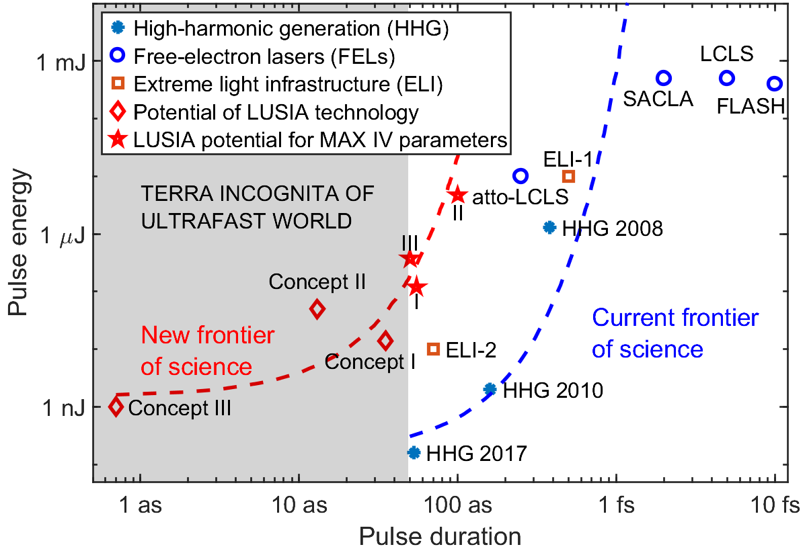
State-of-the-art
Attosecond SIngle-Cycle Undulator Light: LUSIA

Slide 20
Marketing of future FEL
  Target group: Universities
  Very high-risk experiments that are not granted beam time at mega scale FELs.
  Must be affordable by Universities: 25-30 MEuro (including civil construction).
  Target group: Infrastructure beyond the-state-of-the-art
  Groundbreaking research
  Mega scale FEL facility.
  Pulse energy: >10 mJ
  Pulse duration: 0.2-1 fs
  Focus: 0.1-1 um
  Photon energy up to 25 keV.
  User experiments in 10 years from now.

