Slide 1
WP4: RF systems
Update on the 36 GHz and 48 GHz power sources
Wenlong He, Laurence Nix, Liang Zhang, Li Wang & A.W. Cross
on behalf of research teams of
Department of Physics, SUPA, University of Strathclyde, Glasgow, G4 0NG, UK
Electronic Engineering Department, UESTC, Chengdu, China
XLS | CompactLight 1st Annual Meeting,
Barcelona, 10th-12th December 2018

Slide 2
Outline
Research groups (Strathclyde & UESTC)
Motivation
Principles of klystron and gyro-klystron
36GHz 2 MW gyroklystron simulation results
  MIG gun
  Cavity simulation
36 GHz 3 MW gyroklystron simulation results
48 GHz 1.5 MW studies

Slide 3
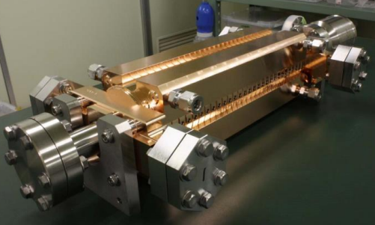
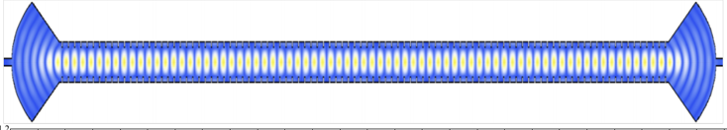
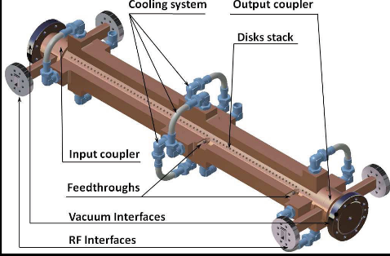
Motivation
Accelerator (High acceleration gradient, CERN)
  Higher operating frequency
  Breakdown limit
Microwave undulator (WP5)
  Smaller period requires higher frequency
  High power required
Lineariser (CompactLight, Cockcroft Institute)
  Correct the longitudinal phase space non-linearity from X-band linac
    compensate for the curvature imposed on the bunch by the fundamental by adding harmonic
  3rd (36GHz) or 4th (48GHz) harmonic of X-band (12GHz) LINAC frequency
    the higher the harmonic, the less amplitude (and thus RF power) required
    The higher the frequency and power the shorter the lineariser
Design targets
  Gyro-klystron (amplifier, narrow bandwidth)
  36 GHz, >2MW
    Design for 48 GHz, 1.5MW output power (Laurence Nix)
  Pulse duration 2 us, PRF 100 Hz.

Slide 4
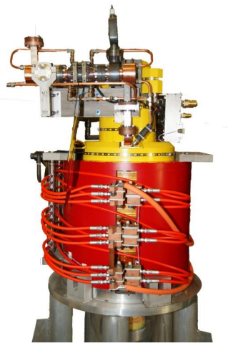
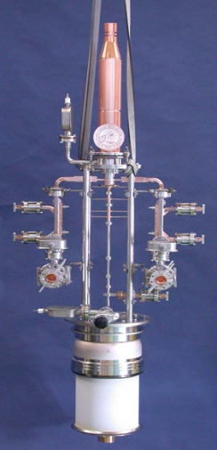
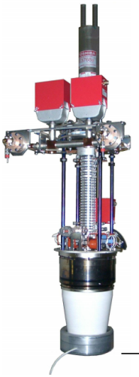
MW amplifiers
X-band (~12 GHz) klystrons
Average power (KW)
 | SLAC XL4,5 | CPI 8311A | Toshiba E3768B
Frequency (GHz) | 11.424 | 11.994 | 11.424
Beam Voltage (kV) | 440 | 410 | 500
Beam Current (A) | 350 | 310 | 270
Peak Power (MW) | 50 | 50 | 75
Gain (dB) | 50 | 48 | 60
Efficiency | 40% | 40% | 55%
10,000
Klystron
1,000
CFA
Gyro-devices
100.0
10.0
Triodes
Helix
TWT
CCTWT
1.00
0.10
Solid state
EIA, EIO
0.01
Magnetron
0
0
0.1
1.0
10
100
1000
Frequency (GHz)
    Klystrons: Operating frequency determined by the cavity size, difficult to achieve high power at high frequency

Slide 5
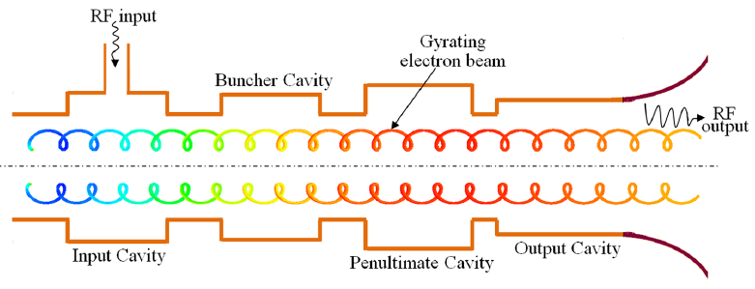
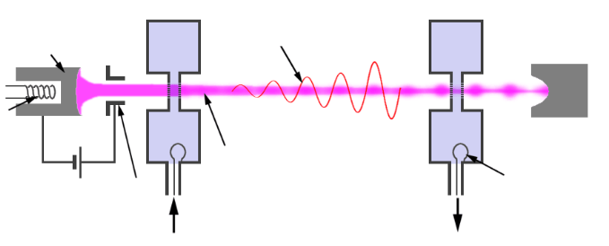
Klystrons & Gyroklystrons
Conventional klystron
  Bunching in axial direction, TM modes
  Operating frequency determined by the cavity size, difficult to achieve high power at high frequency
  High beam voltage, high frequency leads to small cavity gap
  To reduce the space charge effect and get higher power (still small dimensions)
  Multiple-beam klystron
  Sheet-beam klystron
Gyro-klystron
  Bunching in azimuthal direction. TE modes.
  Lower axial velocity due to the beam alpha results in larger cavity size.
  Operating frequency determined by the external magnetic field.
  Open output cavity, high power capability.
Gyro-klystron
Klystron

Slide 6
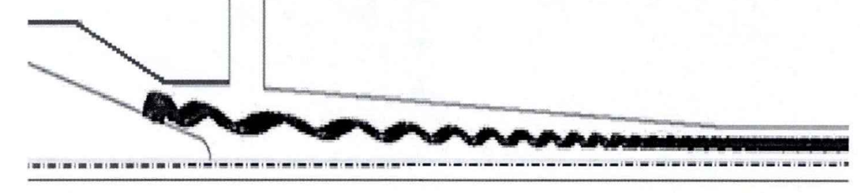

Ka-band gyro-klystron at UESTC
Medium-power demonstration version
Output power (kW) | 260
Beam voltage (kV) | 68
Beam current (A) | 11
Magnetic field (T) | 1.32
Output frequency (GHz) | 33.98
Drive power (W) | 40
Gain (dB) | 38.8
Efficiency | 40%
Bandwidth (MHz) | 280
Dual-anode MIG gun.
Beam alpha 1.2
Magnetic field compression ratio 7.8

Slide 7
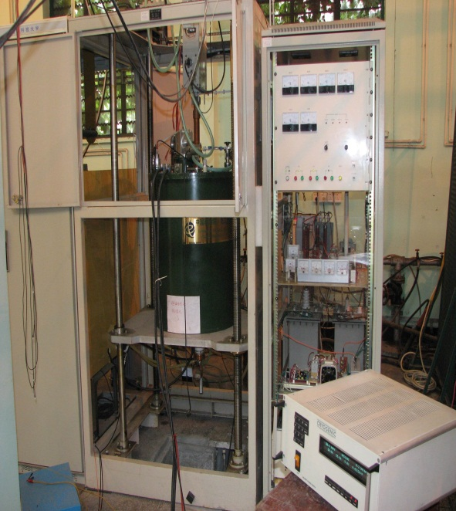
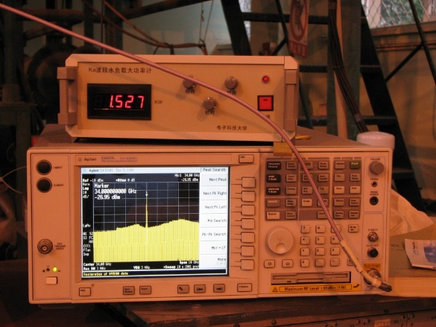
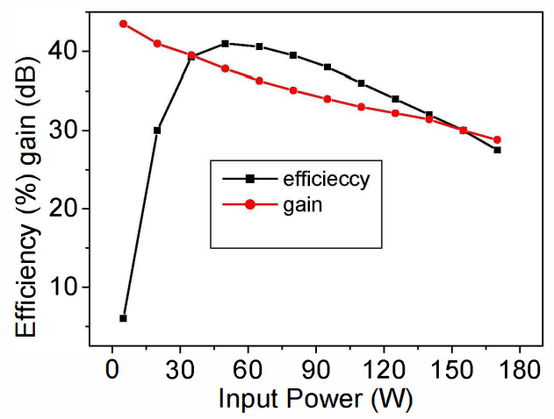
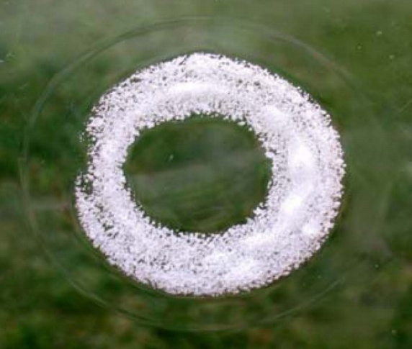
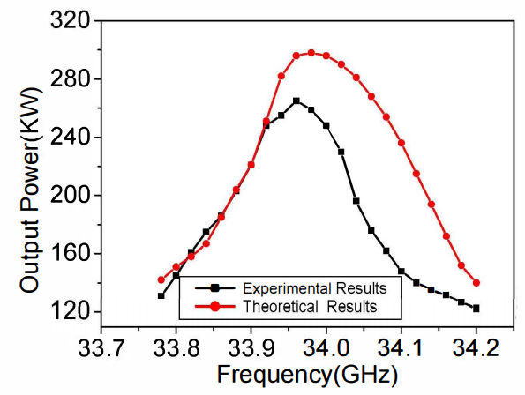
Ka-band gyroklystron at UESTC
Measurement setup
PRF 220 Hz
The TE01 output mode pattern captured on film
Successfully verified the design, further improvements on the electron gun and collector are required.

Slide 8
36 GHz, 2 MW gyro-klystron design
Voltage (kV) | 95 | Current (A) | 45
Velocity ratio | 1.3 | Drive power (W) | 200
Beam guide radius (mm) | 2.3 | Magnetic field (T) | 1.33
Result
Power (MW) | 1.9 | Bandwidth | 0.3%
Efficiency | 44% | Gain (dB) | 39 (max 42)
MIG-type electron gun
Three-cavity structure
TE01 mode for input and intermediate cavity
TE02 for output cavity

Slide 9
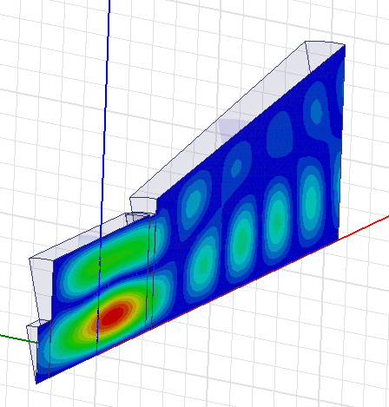
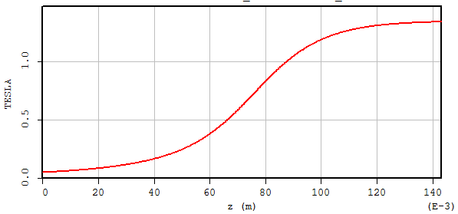

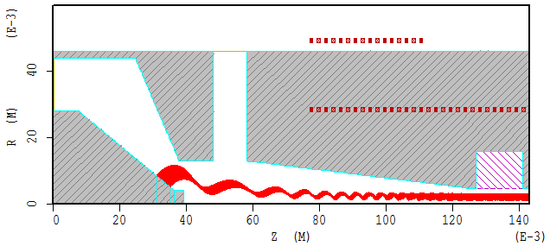
Electron gun and cavity
Three-cavity structure
The operating mode of input and buncher cavity are TE01. The mode of output cavity is TE02, to have larger power capability.
B₀ (T) = 1.34 T
① is the input cavity, ② is the 1st drift tunnel, ③ is the bunching cavity, ④ is the 2nd drift tunnel, ⑤ is the output cavity and ⑥ is the collector.
Structure | F | Q
Cavity 1 | 35.25 | 52.6
Cavity 2 | 34.58 | 23.5
Cavity 3 | 35.79 | 78.6

Slide 10
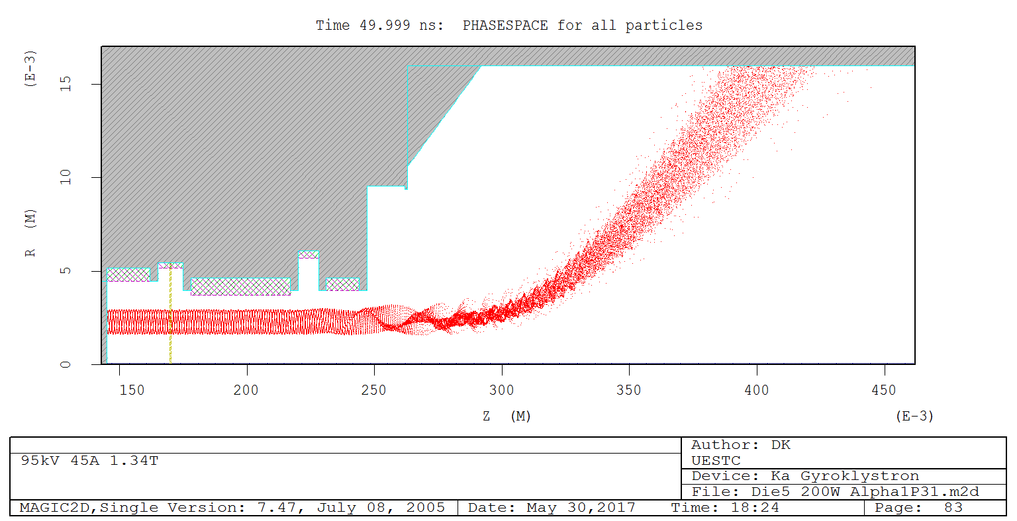
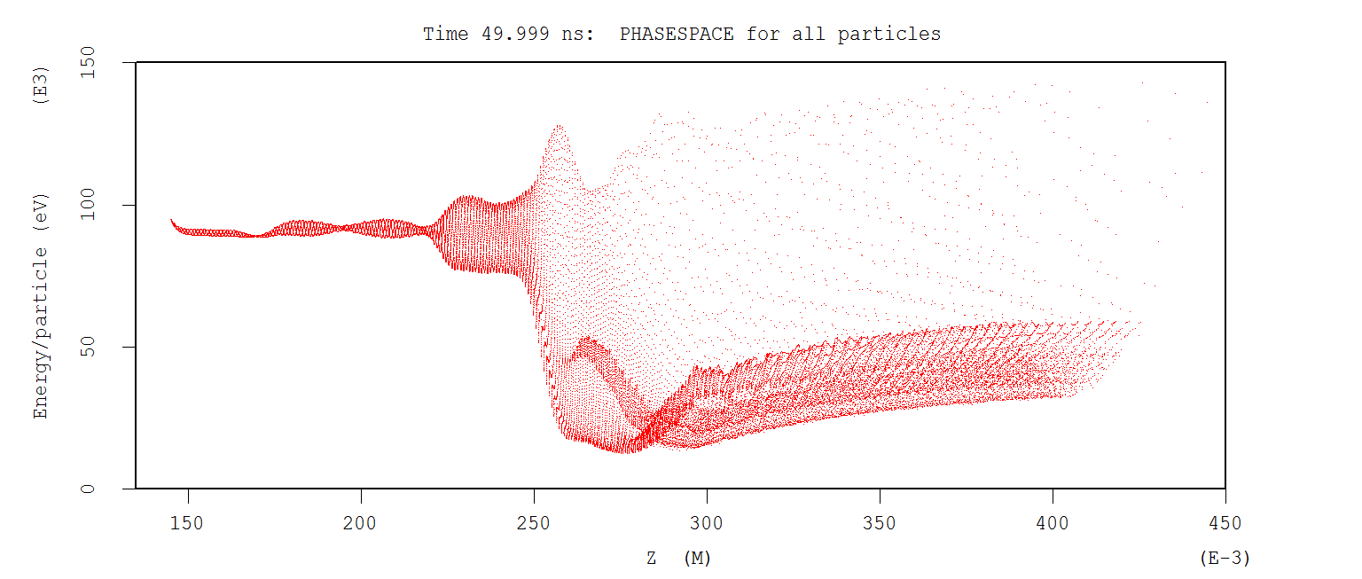
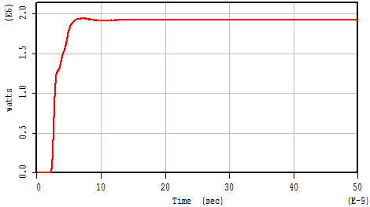
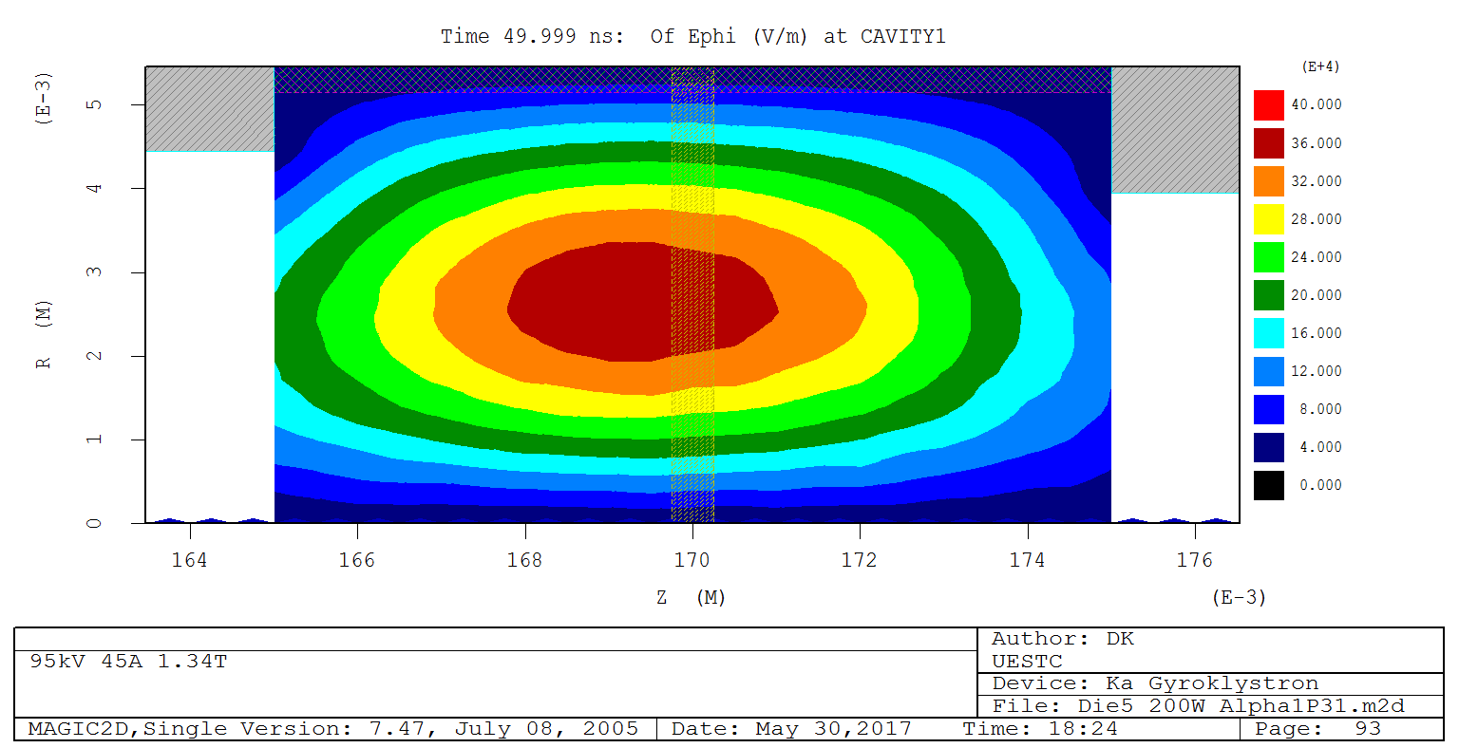
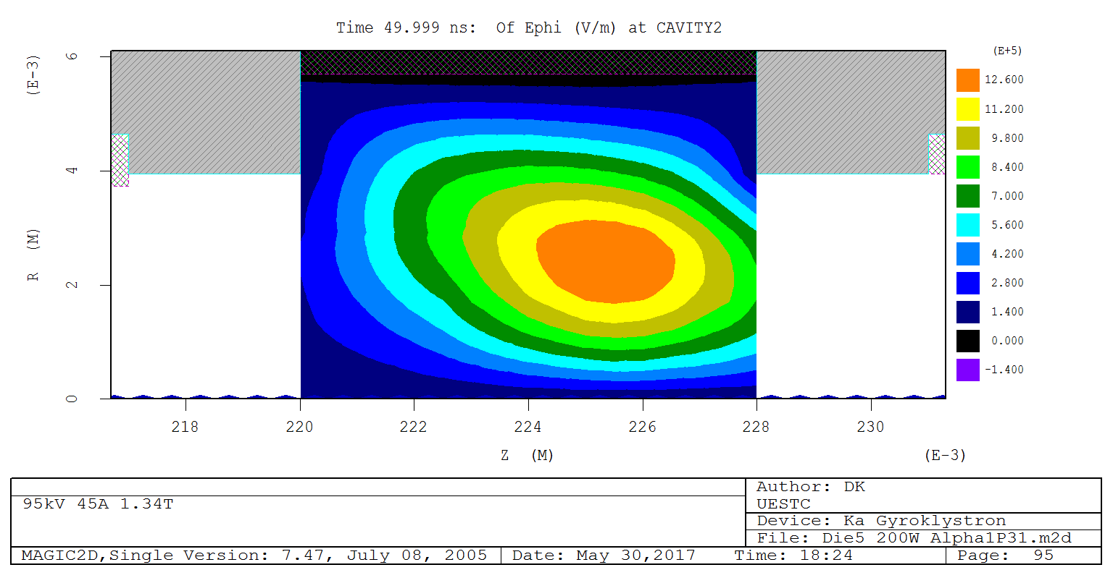
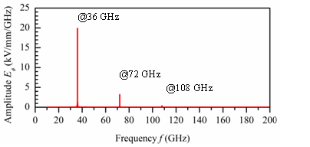
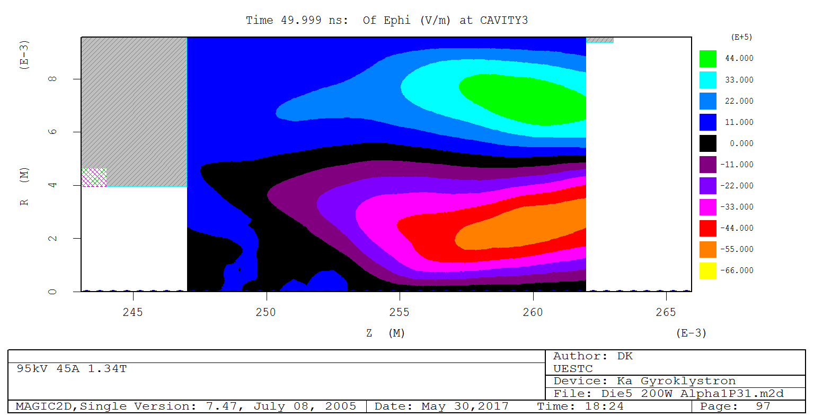
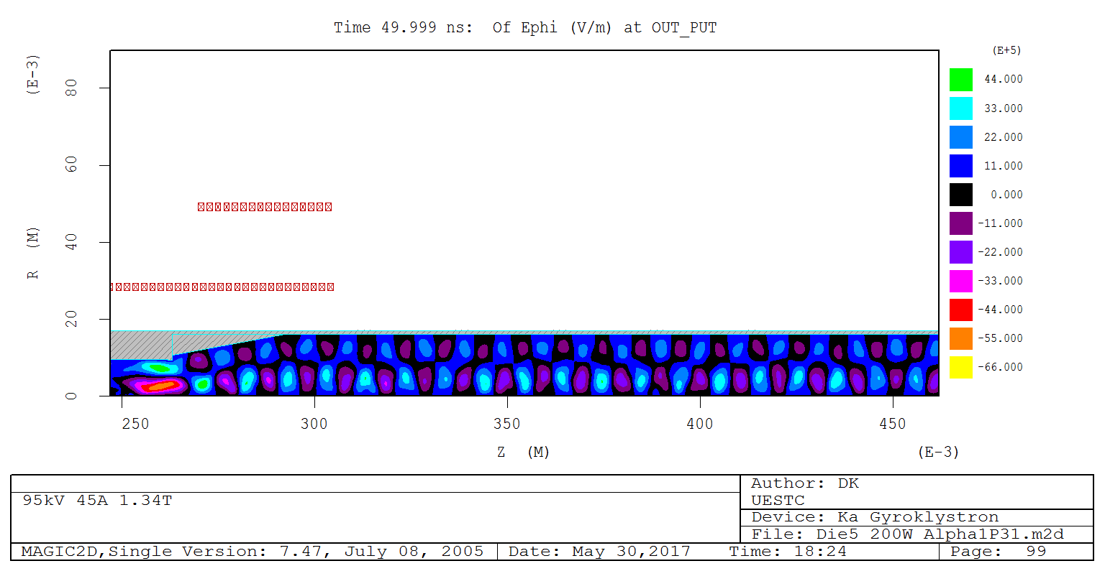
PIC simulations results
Output cavity

Slide 11
Gain curves in simulations
Output power and gain

Slide 12
36 GHz 3 MW gyroklystron design
Voltage (kV) | 150 | Current (A) | 45
Velocity ratio | 1.4 | Drive power (W) | 400
Beam guide radius (mm) | 2.3 | Magnetic field (T) | 1.46
result
Power (MW) | 3.0 | Bandwidth | 0.3%
Efficiency | 44% | Gain (dB) | 39 (max 42)
Similar configuration but with a higher operating voltage
  it is challenging to Increase the current using an MIG, it will reduce the beam quality, reducing the interaction efficiency

Slide 13
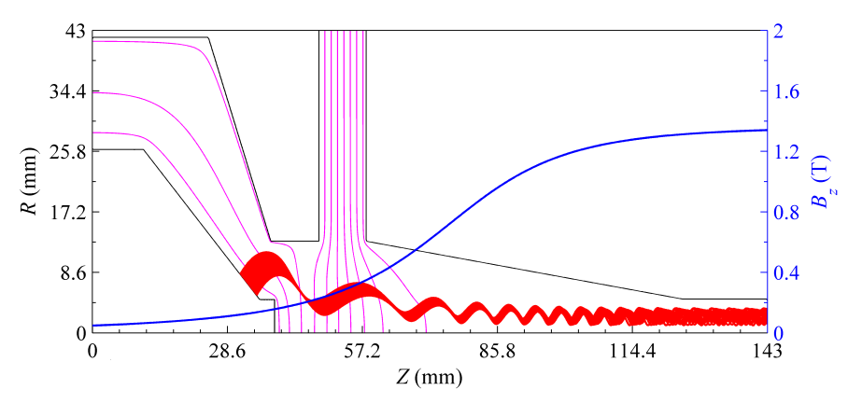
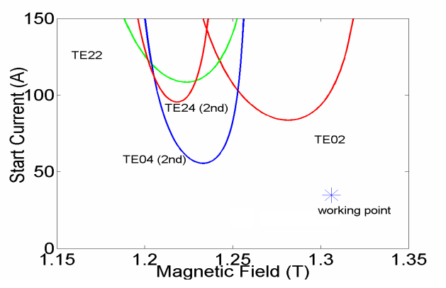
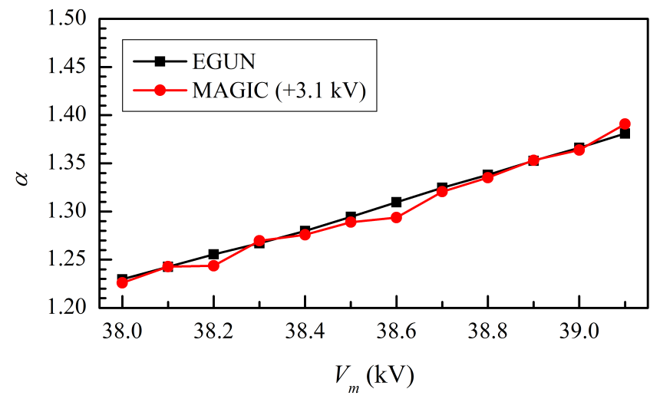
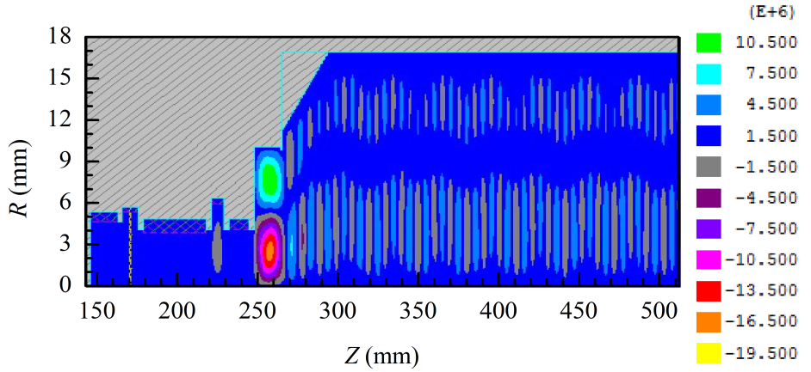
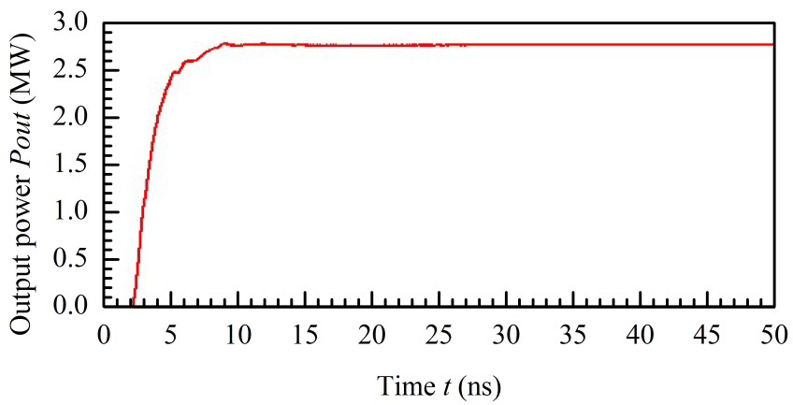
36GHz simulation results
Current I₀ (A) | 45
Anode voltage V₀ (kV) | 150
Modulating anode voltage V_{m} (kV) | 38.5
Magnetic field @ gun exit B₀ (T) | 1.34
Magnetic compression ratio f_{m} | 10.5
Velocity ratio α | 1.32
Axial velocity spread Δβ_{z} (%) | 2.25
Mean guiding center r_{g0} (mm) | 2.5

Slide 14
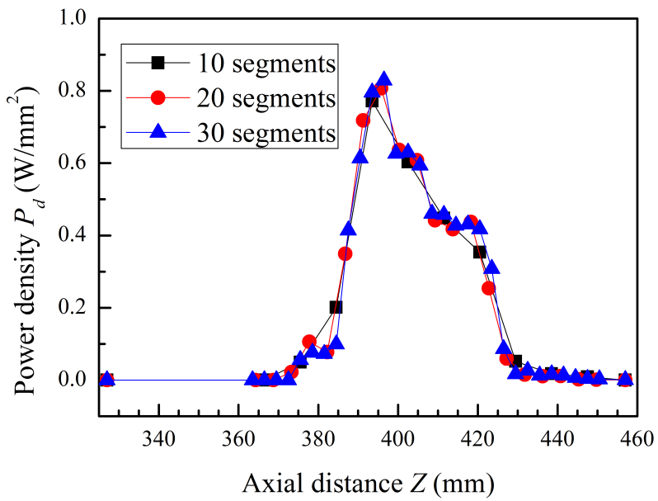
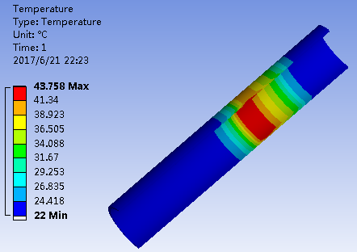
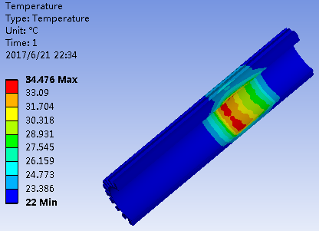
Collector design
Electron beam power 6.75 MW;
Output microwave power 2.77 MW;
Power loss 100 kW;
Power in the spent beam 3.88 MW;
The designed collector power density is 85W/cm².

Slide 15

48 GHz 1.5 MW Gyroklystron
PhD student: Laurence Nix
Higher frequency, smaller dimensions has limit in the beam current due to the space charge effect
Higher operating voltage up to 300 kV is being investigated
Higher operating mode than the TE₀₂ is being studied.
Improved inverse-MIG gun for the gyroklystron

Slide 16
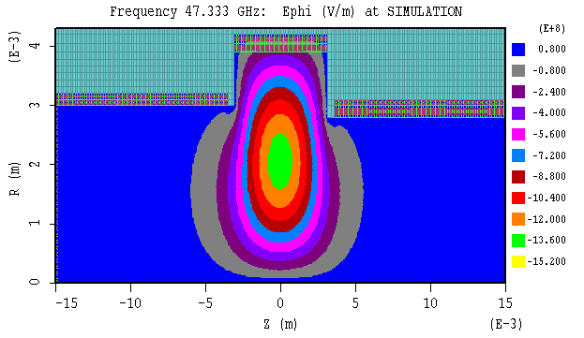
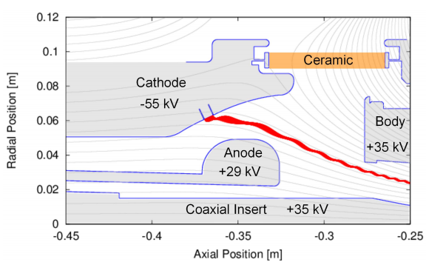
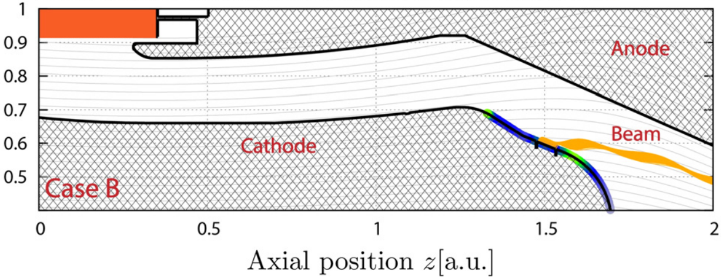
Preliminary results
TE01 mode in an example gyro-klystron cavity ready for further design work to determine optimal frequency and properties
Configuration of MIG and IMIG. An example from KIT for 2MW coaxial-cavity gyrotron. Inverted MIG allows a larger emitter ring to have larger beam current and is able to produce a high quality beam

Slide 17


Acknowledgement
This work is supported by the European Commission Horizon 2020 Project “CompactLight” (777431-XLS), and the State Scholarship Fund from the China Scholarship Council and the STFC, UK (Cockcroft Institute Core Grant)
Thank you for your attention!

