Slide 1


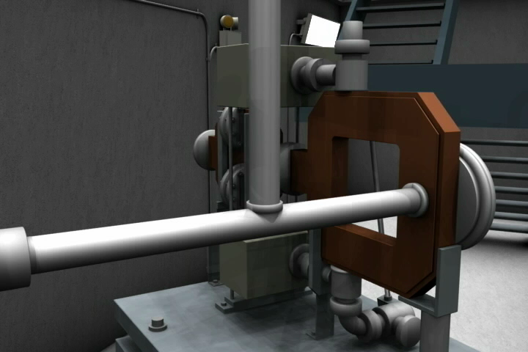
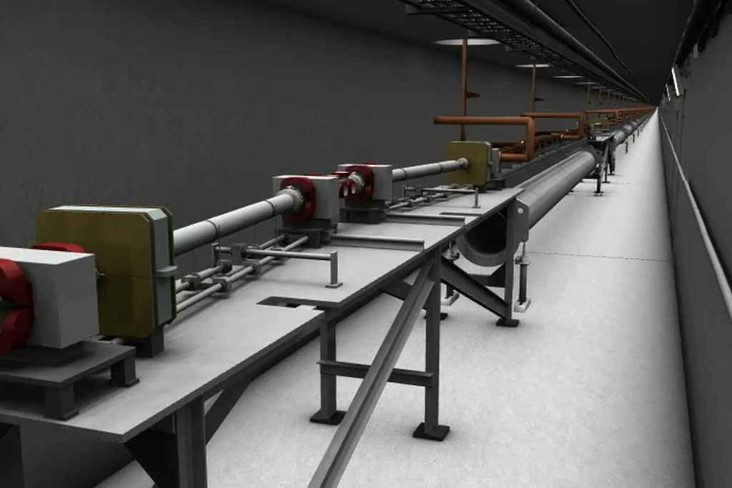
WP3 – Gun and Injector
Massimo.Ferrario@LNF.INFN.IT
Laser/Photocathode
RF/DC Gun
Solenoid
RF Velocity Bunching
RF Linearizer and L. Heater
Magnetic Chicane
Transv. RF Deflector
Beam Diagnostics
To design the Compact High Brightness Injector
To design the proper matching with the X-band Linac

Slide 2
Deliverables
D3.1 - Preliminary assessments and evaluations of the optimum e-gun and injector solution for the CompactLight design, (=>M18).
D3.2 – A review report on the bunch compression techniques and phase space linearization, (=>M18).
D3.3 – Design of the injector diagnostics/beam manipulations based on a X-band cavities, (=>M36).
D3.4 - Design of the CompactLight e-gun and injector, with phase space linearizer (=>M36).

Slide 3
Tasks and sub-Tasks
(task leaders institutes in bold)
Task 3.1 - Gun Design (RF, Solenoid, Cathode, Laser, Diagnostics) => D3.1 M18 => D3.3 M36
  S-Band Gun RF Design (CNRS + IASA+UAIAT-INFN+ALBA )
  C-Band Gun RF Design (INFN +IASA+Sapienza)
  X-Band Gun RF Design (CSIC-IFIC + UAIAT+ Sapienza)
  DC Gun Design (TU/e )
  Laser/Photocathode (IASA+CNRS+INFN )
Task 3.2 - Compressor Design (Velocity Bunching, Magnetic Chicane) ) => D3.2 M18 => D3.3 M36
  S-Band Velocity Bunching (TU/e + IASA+ALBA)
  C-Band Velocity Bunching (INFN +IASA+TU/e )
  X-Band Velocity Bunching ( Sapienza+CERN+IASA+INFN )
  Magnetic Compressor (ST + CERN+INFN+CNRS)
  Task 3.3 – X-Band Transverse RF Deflector (Sapienza+ IASA+ ) => D3.3 M36
Task 3.4 - : RF Linearizer Design => D3.2 M18 => D3.3 M36
  X-Band RF Linearizer Design (Sapienza )
  K-Band RF Linearizer Design (ULANC +Sapienza )
  Passive linearizer (CNRS )

Slide 4
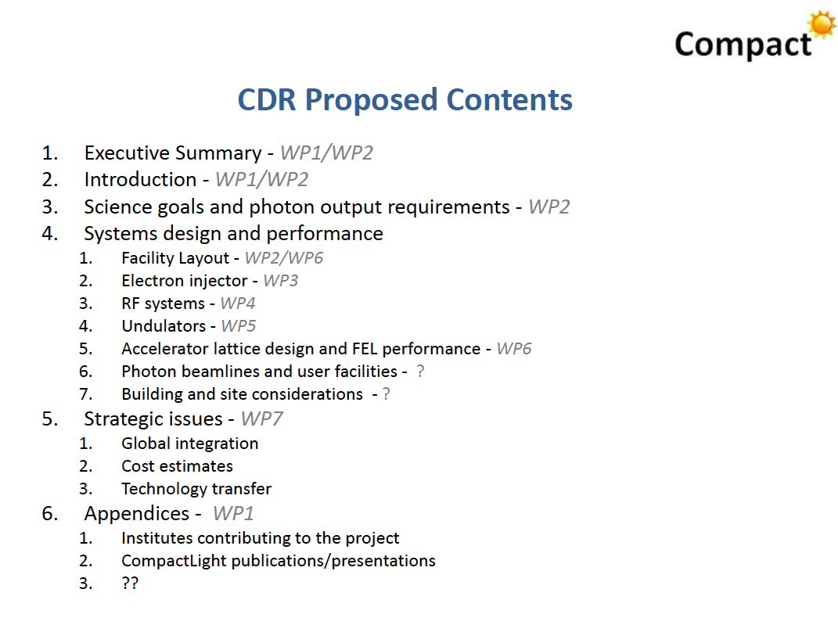

Slide 5
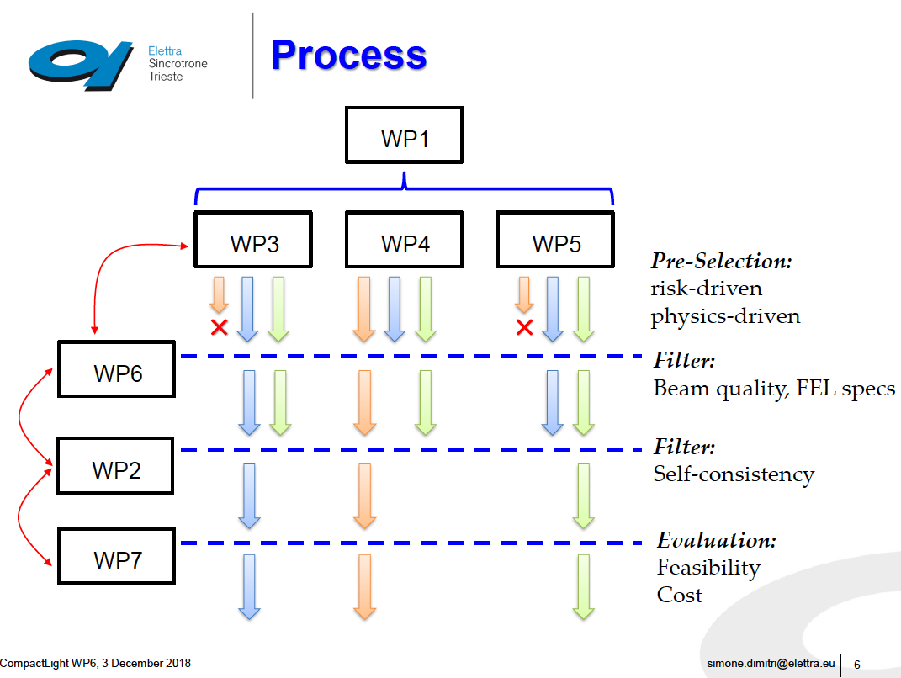

Slide 6
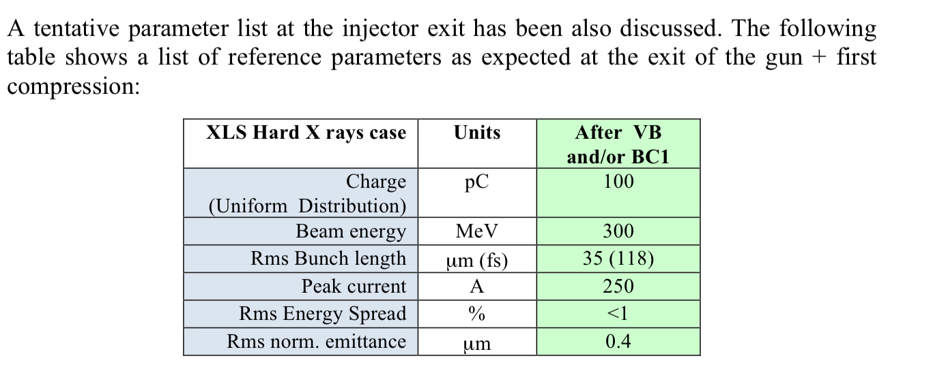
Reference
Parameters
FEL &
Users
S-C-X-DC Gun
Configurations
EM & BD
Codes
Magnetic or RF
Compressor
D3.1 & D3.2
1 or 2 Options
WP6
S2E integration
Optimized
Injector

Slide 7
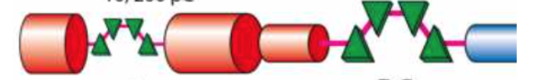
Reference Parameter List
FWHM
Rep rate 100 Hz

Slide 8
Configurations with Velocity Bunching
S-band , C-band , X-band , K-band
Linear.
TD
Gun
Vel. Bunching
Booster
X-Linac
K-Linear.

Slide 9
Configurations with Magnetic Compressor
S-band , C-band , X-band , K-band
Heater
Lin.
TD
X-Linac
Gun
Booster
Booster
Magn. Comp.

Slide 10
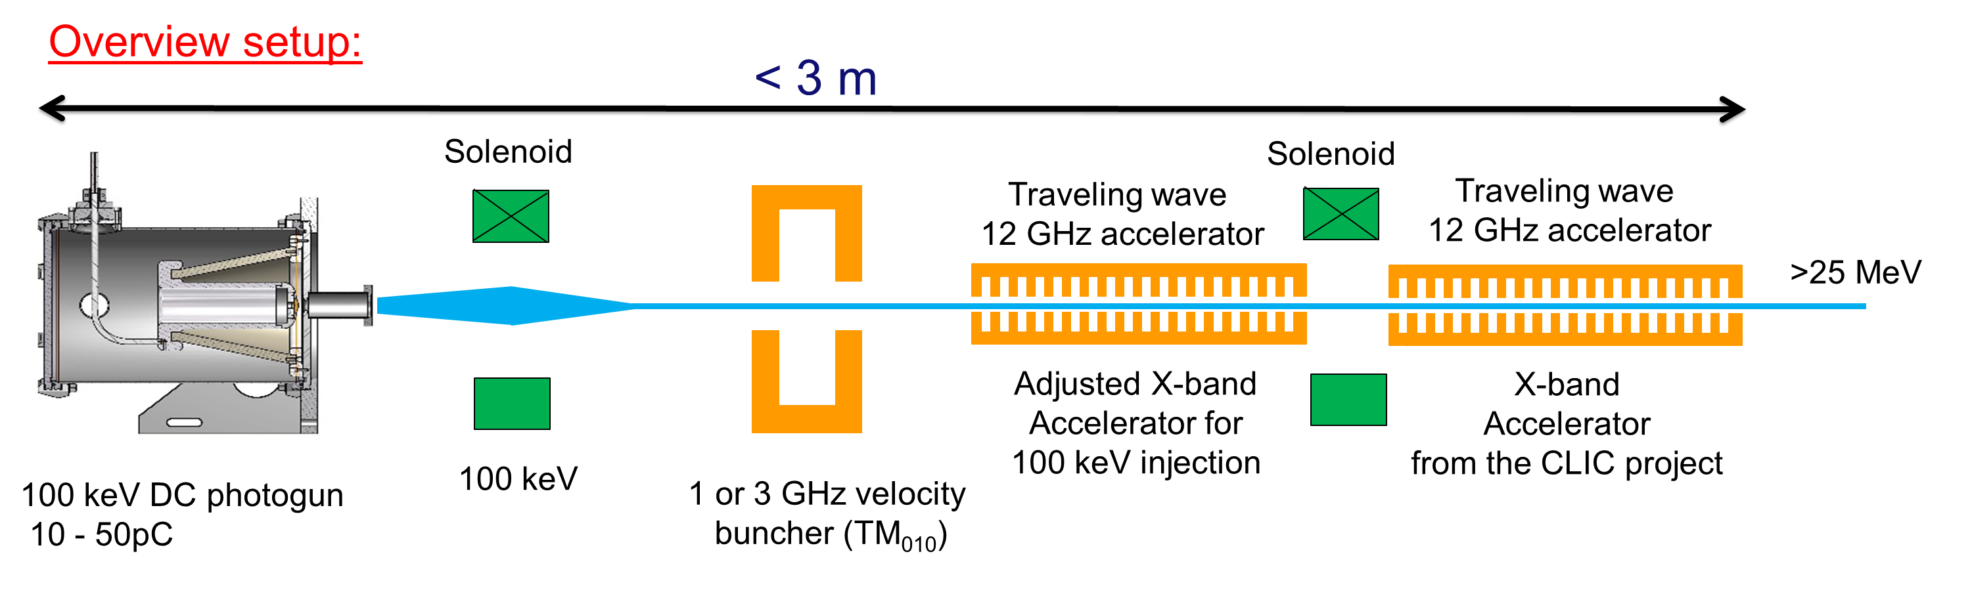
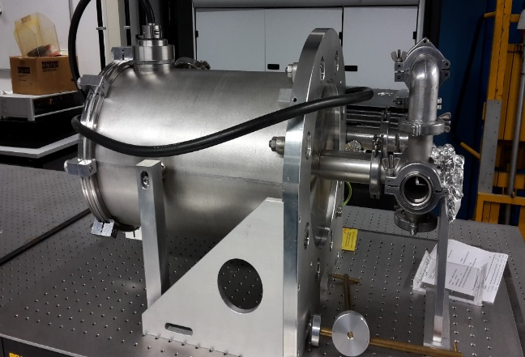
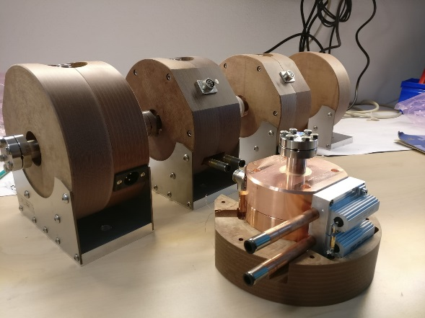
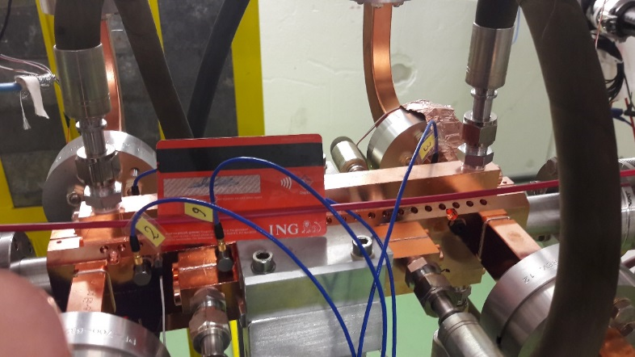

Already developed and available material
Made by ACCTEC
Made by ACCTEC
CLIC accelerator

Slide 11
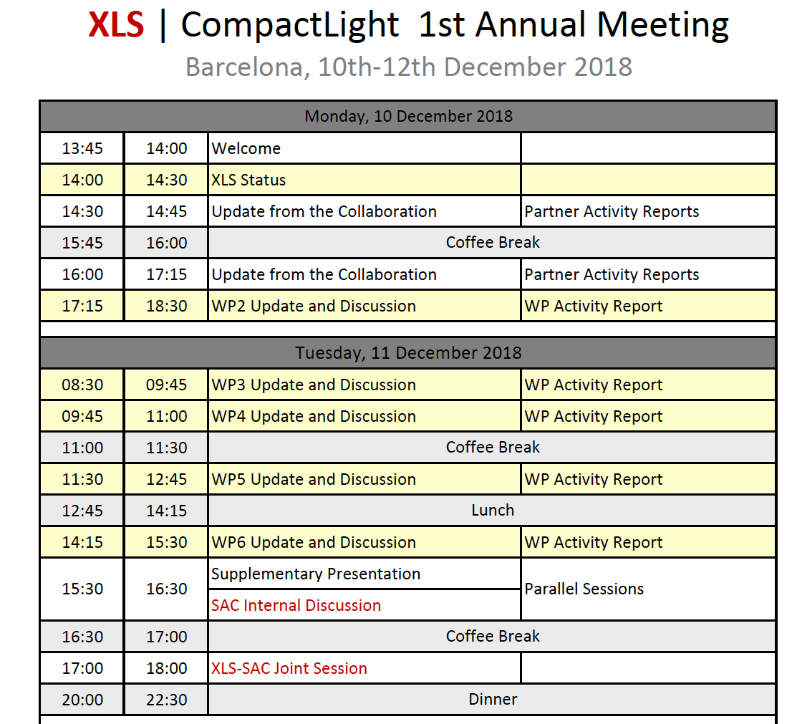

Slide 12
Agenda WP3
M. Croia (INFN), C-band injector design study (10’)
A. Mostacci (Sapienza), X-Band Velocity Bunching (10’)
S. Di Mitri (ST), Magnetic Compressor design study (10’)
G. Campbell Burt (ULANC), K-Band RF Linearizer Design (10’)
B. Spataro (INFN), A possible linearizer at 35.982 GHz (10’)
Discussion (all), 15’

Slide 13
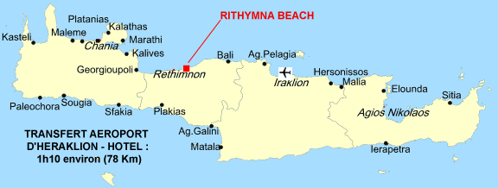
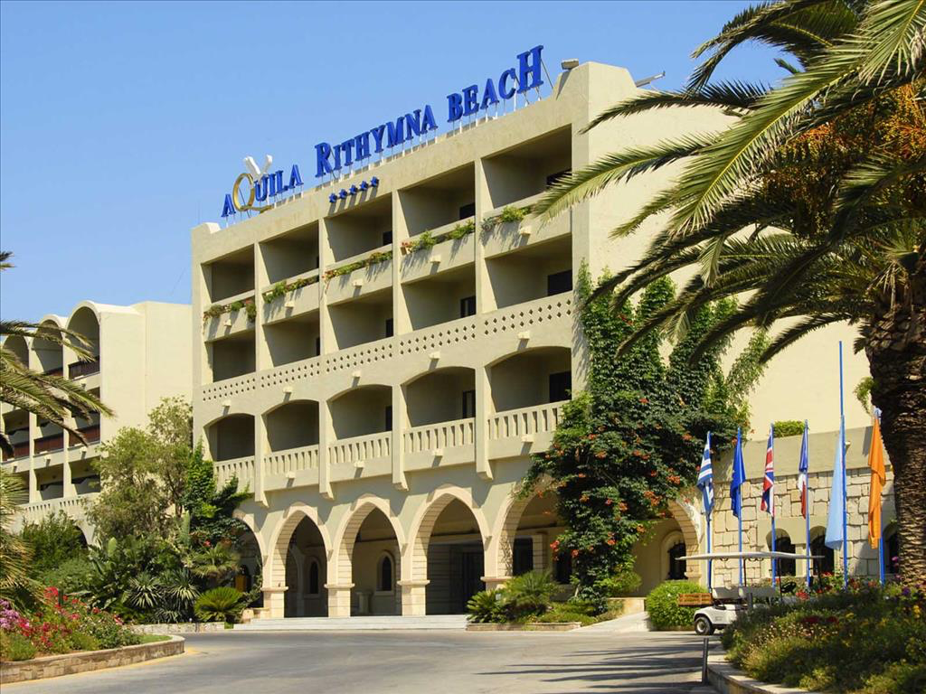
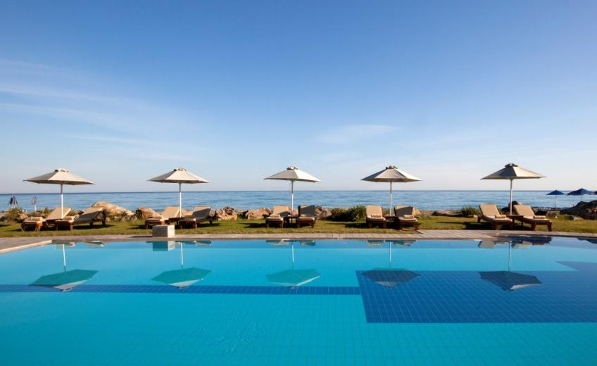
https://conferences.pa.ucla.edu/hbb-2019/index.html
“High Brightness Beam Physics”
7-11 April 2019
Crete – Greece

Slide 14
Thanks for your attention

