Slide 1
WP3
Magnetic Compressor Design Study
S. Di Mitri,
Elettra Sincrotrone Trieste
Contributors:
A. Giribono, C. Vaccarezza – INFN LNF
Latina, X. Liu – CERN
E. Marin, R. Munoz Horta – ALBA CELLS
A. Faus Golfe, Y. Han – LAL

Slide 2
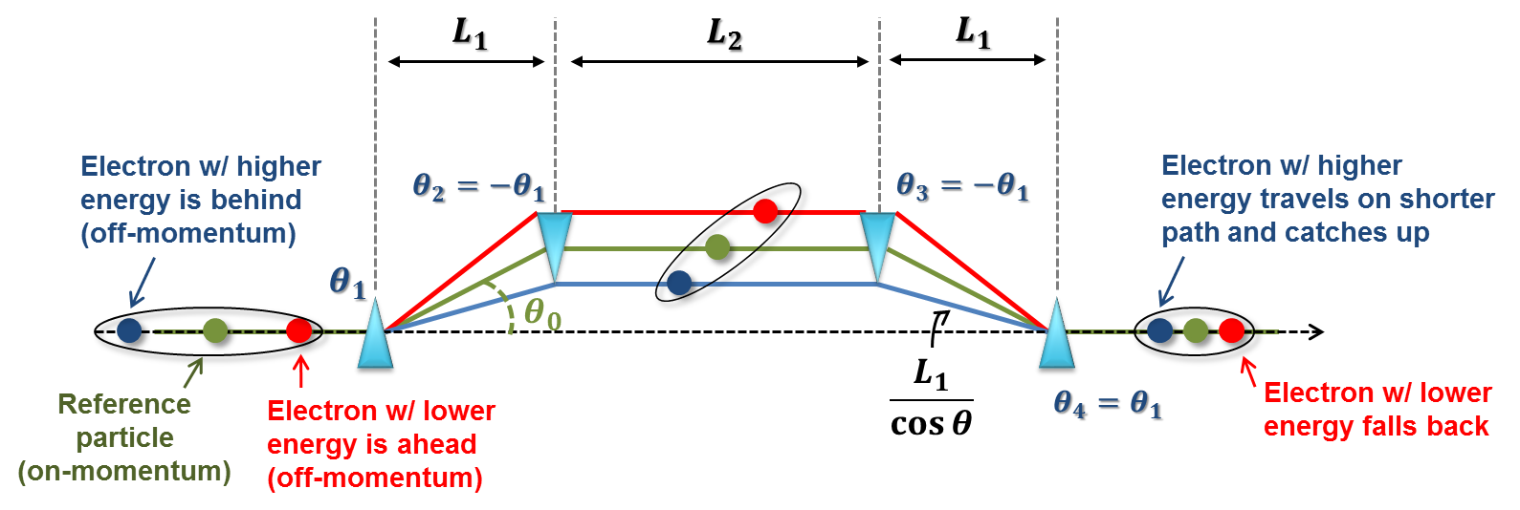
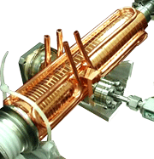
Analytical Estimates
C>>1, σ_{φ} = 0.1deg
σ_{C} < 5%
→ Δφ_{RF} < 25 deg
X-band cavity
S-band linac
Practical θ to limit CSR-induced ε_{x}-growth is < 0.1 rad
Total length < 15 m
→ R₅₆ < 50 mm
C>>1, E_{BC1} < 300 MeV
H = 4
→ ΔV_{Xb} < 25 MV

Slide 3






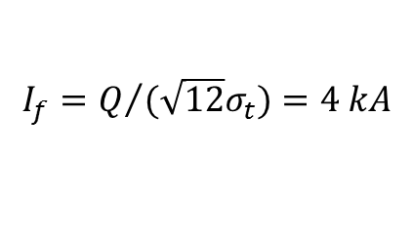
















Bunch Length, Slice Energy Spread
$$1+R_{56}h_{1}=0$$
$$Q=75 pC$$
$$E$$
$$σ_{t,i}=1 ps$$
+
=
$$I_{f}=Q/{(\sqrt{12}σ_{t})}=4 kA$$
$$σ_{t,f}=5 fs$$
$$I_{i}=15 A$$
$$CF=200$$
$$z$$
$$σ_{E,i}=2 keV$$
+
$$R_{56,tot}=100 mm$$
=
$$σ_{E,LH}=10 keV$$
$$σ_{t,min}=1 fs$$
$$E_{f}=4 GeV$$
SX FEL looks OK
+
=
$$CF=200$$
$$σ_{δ,f}=0.05\%$$
$$< ρ_{FEL}?$$
“Full-compression” (min. bunch length set by uncorrelated energy spread
$$σ_{t,min}=2 fs$$
+
=
HX FEL looks critical:
Nonlinear compression (single spike) ?
$$I_{f}=9 kA$$
$$Q=75 pC$$
$$CF=600$$
$$σ_{δ,f}=0.07\%$$
$$< ρ_{FEL}?$$

Slide 4
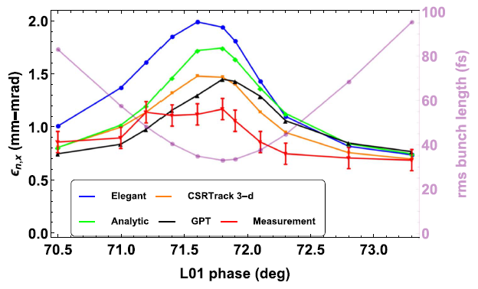
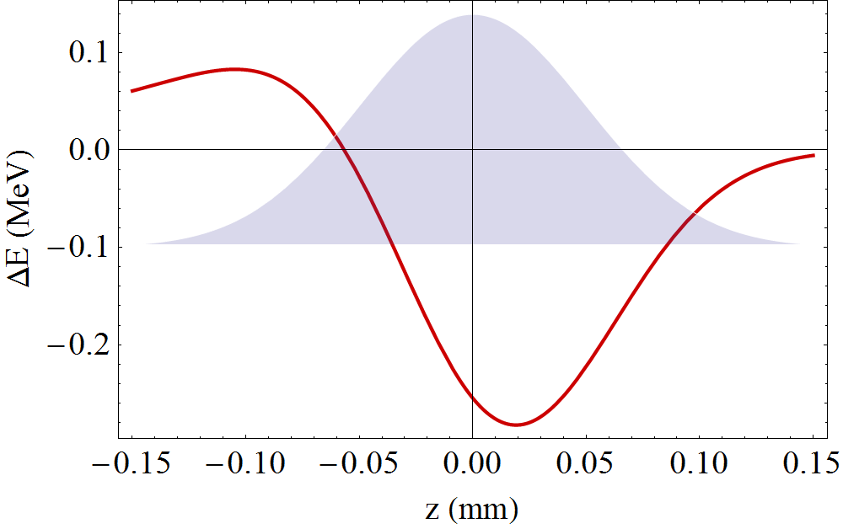
CSR – Projected Emittance Growth
In a 4-dipoles chicane, the CSR effect is stronger in the last dipole, where the bunch is shorter:
100pC
300 MeV
θ=0.105rad
R₅₆=-50 mm
Bunch head
gains energy
x, x’
Bunch tail
is not affected
head
tail
Bunch core
loses energy
A. Brynes et al., NJP (2018)

Slide 5
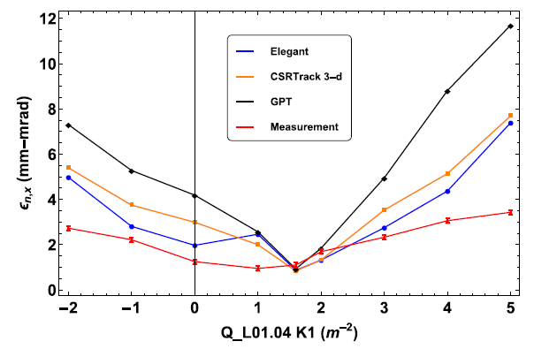
CSR – Linear Optics
In a 4-dipoles chicane, the CSR effect is stronger in the last dipole, where the bunch is shorter:
Horizontal waist between 3rd and 4th dipole; θ <<1
100pC
300 MeV
θ=0.105rad
R₅₆=-50 mm
Bunch head
gains energy
Bunch head
gains energy
x, x’
Bunch tail
is not affected
Bunch tail
is not affected
head
head
tail
tail
Bunch core
loses energy
Bunch core
loses energy
A. Brynes et al., NJP (2018)

Slide 6
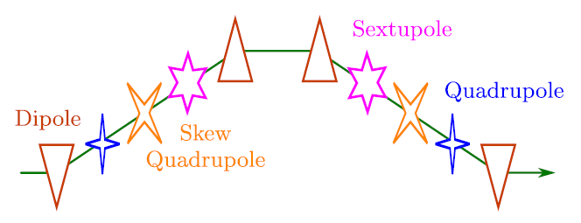
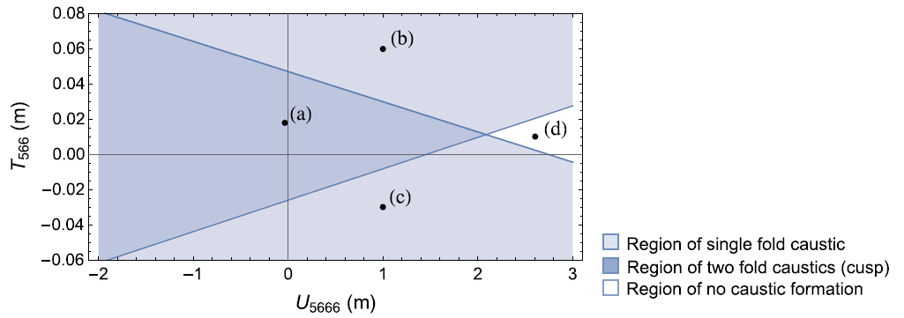
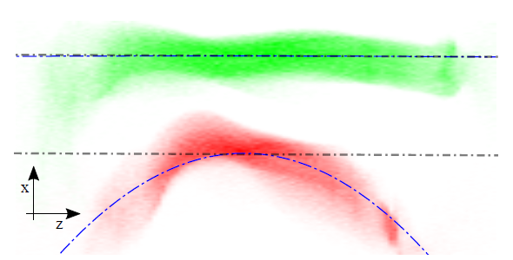
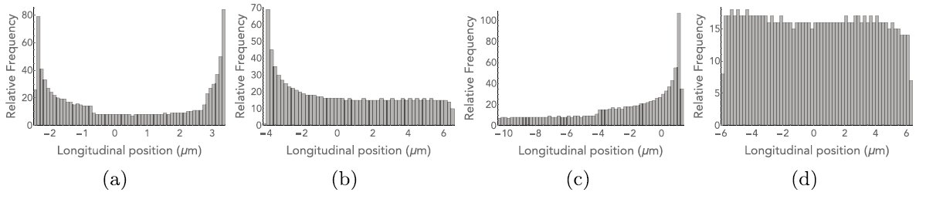
CSR – Nonlinear Optics
M. Guetg (2013)
T. Charles (2016)
Multiple optical knobs (quads, skew quads, sextupoles) to align slice centroids in (x,x’,y,y’).
Current profile almost unchanged.
Weak sextupoles for control up to 3rd order.
Current spikes are suppressed, compression “efficiency” increased.

Slide 7
CSR – Other Methods
Bunch current shaping (ramped, trapezoidal, etc.) from the injector to “linearize” the CSR wake.
  This implies most likely non-uniform slice optics and emittance. Emittance compensation can be limited.
Shielding of CSR wake with low gap chambers.
  Typically not practical (beam losses and resistive wall wakefields) as < 2 mm (or so) radius pipe is required.
Linear optics cancellation of CSR kicks by combination of multiple compressors.
  This requires very accurate optics tuning along a large portion of the accelerator. It strongly depends on specific beam parameters at the compressors.
“Adiabatic” compression – split compression in multiple (> 2) stages.
  This is adopted at PAL XFEL with good results. On paper, 3 chicanes give a lower emittance than 2. In reality, 3 chicanes are the nominal configuration.

Slide 8
Lessons Learned & Plan
Assumption: Q = 50 – 100 pC, I = 2 / 9 kA, CF > 150
Chicanes are most suitable devices for allowing E-chirp compensation at a later linac stage
2-stage compression (+ VB ?) are most likely mandatory for the HX FEL
Projected normalized emittance growth will be > 0.2 μm rad for C>100
Minimization of CSR effect mainly through linear and nonlinear optics tuning through each BC.
Semi-analytical setting of compression scheme (Elettra)
S2E run with Tstep + Elegant, including CSR and ways to overcome it (INFN)
S2E run finalized with GPT/Tstep + Placet (ALBA, CERN)
Comparison of performance vs. passive linearizer (LAL, CERN)

Slide 9
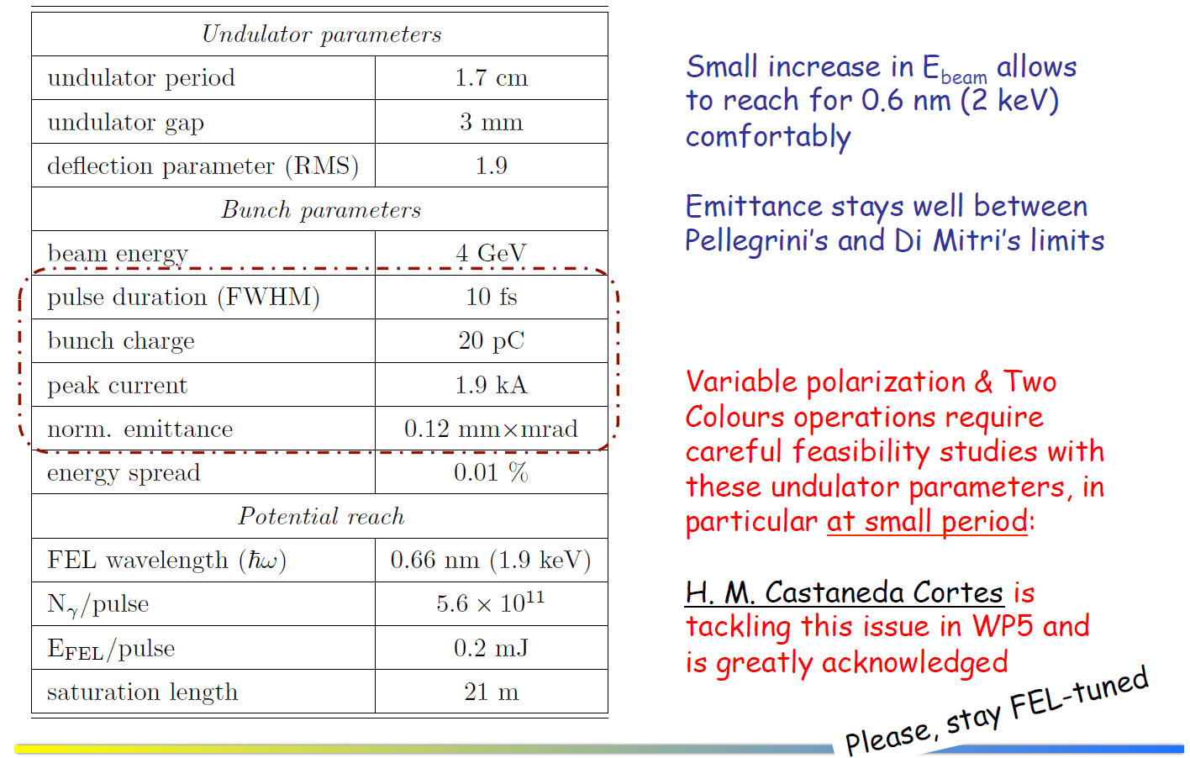
SX FEL – F. Nguyen 18 Oct.’18

Slide 10
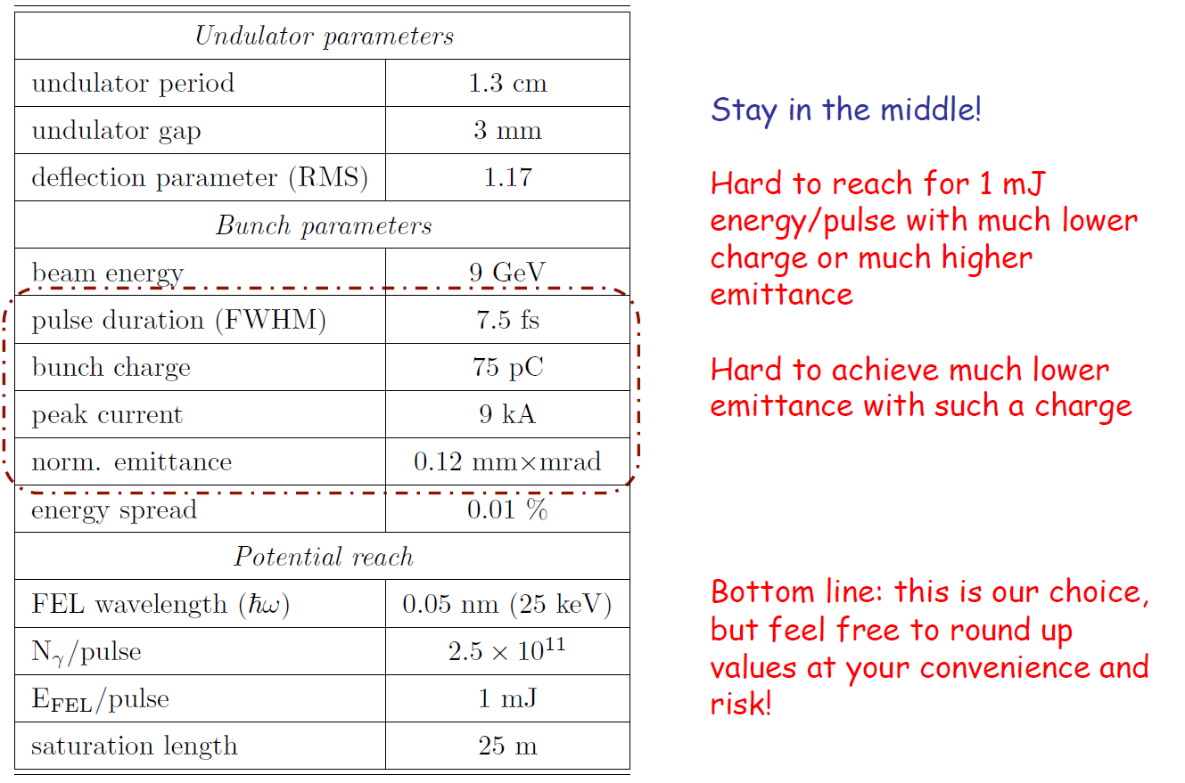
HX FEL – F. Nguyen 18 Oct.’18

