Slide 1

WP5: Undulators Cost Matrix
Barcelona, December 10-12, 2018
Thomas Schmidt, PSI
CompactLight@elettra.eu
XLS
www.CompactLight.eu

Slide 2
Undulators cost Matrix general aspects
cost for undulators depend on series or single devices
cost overview filled with data from labs and industry
industry (design, full systems, components, ...)
no new developments, but production of established system
requires Tech Transfer
price per m and for saturation (10x gain length)
price tags will give some orientation also for scaling
optimium especially for soft x-rays is not too long but more modules
even if the price for undulator is higher

Slide 3
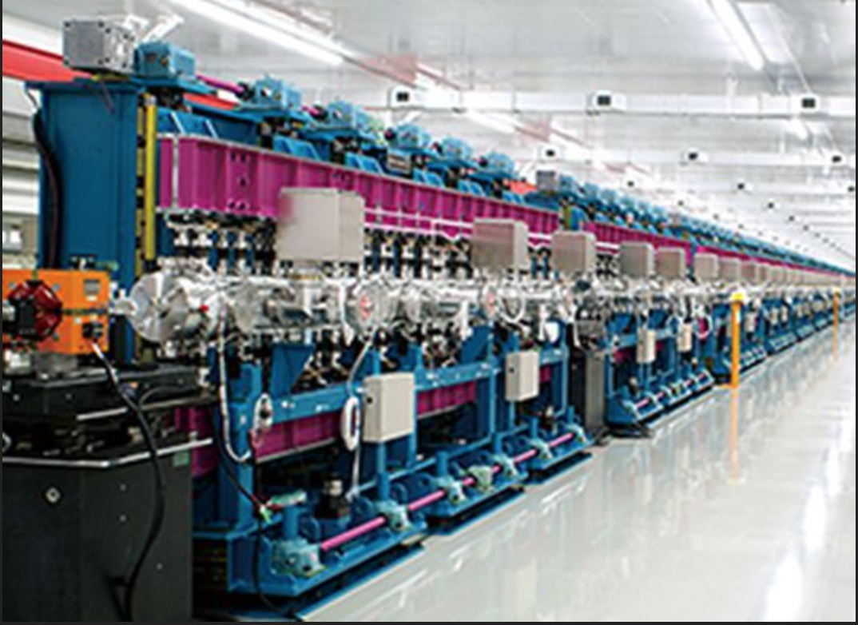
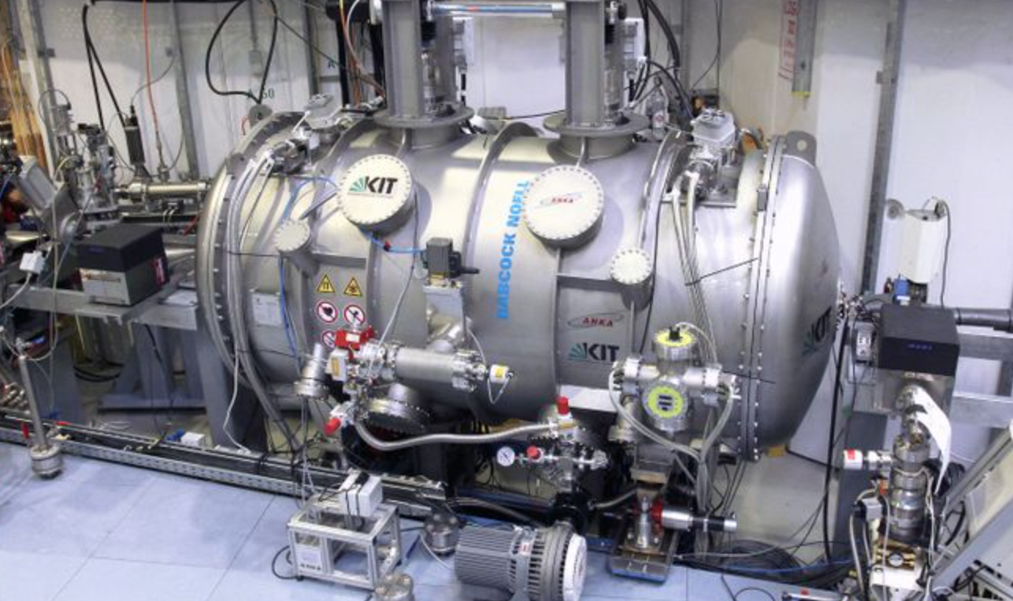
Undulators for Compact Light: Hard x-ray: planar
short period, small gap:
- in-vacuum
- cryogenic in-vacuum @ LN2
- classical sc
- High Temperature sc (HTS)

Slide 4
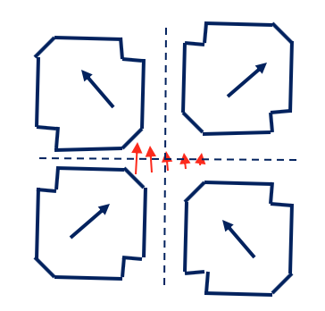
Undulators for Compact Light: Soft x-ray: variable polarization
short to medium period, small gap:
- planar out of vac FEL with polarized afterburner only
- APPLE II (also in-vac under construction at HZB)
- APPLE X with gradient control
- fixed gap DELTA
gradient control by individual
radial settings of magnet arrays:

Slide 5
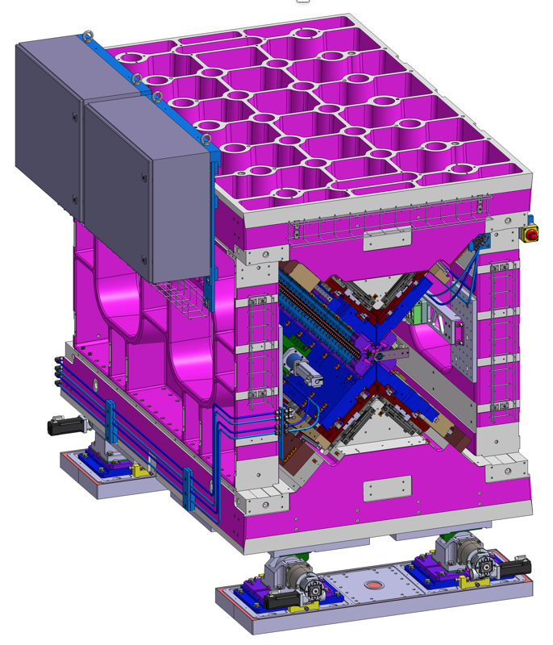
optimizing field strength: APPLE goes in-vac
J. Bahrdt et al., In-Vacuum APPLE II undulator,IPAC2018, Vancouver (2018)
Undulators for Compact Light: Soft x-ray: variable polarization
short to medium period, small gap:
- planar out of vac FEL with polarized afterburner only
- APPLE II (also in-vac under construction at HZB)
- APPLE X with gradient control
- fixed gap DELTA
in-vac APPLE II @ HZB for BESSY II
(Johannes Bahrdt, Atoosa Meseck)
APPLE X UE38 SwissFEL

Slide 6
hard x-ray
 | out of vac | in-vac | in-vac | CPMU | SC NbTi / SC Nb3SN | HTS
Performance: K (λ/gap/L) | 80/13/2 | 15/4/4 | 2m
Design | 1M | 100 MM | 2 M
Fabrication by Lab |  | 800 / 13units
Magnetarray | 200 | 300 | 200
Support | 300 | 380 | 300
Drive System / Controls | 50 | 50 | 50
Vacuum System |  | 70 | 50
Optimization |  | 4MM
Fabrication by Company | 460/1- 700/1 |  | 1100/1
Installation / Infrastructure |  | 400 + x floor
Fabrication Time by company / by Lab | 12/12 | 18/12 | 14/18
Operation / Maintenance
price / m [€] | 230 – 350 | 200 | 600 /550
total price [M€] / saturation length [m] | 0.46 - 0.7 | 12 | 1.2 / 1.1

Slide 7
EPU: soft x-ray
 | APPLE II | APPLE II | APPLE III | APPLE III | in vac | CPMU | SCAPE
Performance: K (λ/gap/L) | 70/14/2 | -/-/2 | -/-/2 | 38/6.5/2
Design | 1 M |  |  | 60MM
Fabrication by Lab |  |  |  | 600 / 16
Magnetarray | 200 |  |  | 130
Support | 300 |  |  | 420
Drive System / Controls | 50 |  |  | 20
Vacuum System |  |  |  | 30
Optimization | 1 M
Fabrication by Company | 800 | 560 | 760
Installation / Infrastructure | 2d |  |  | 70
Fabrication Time by company / by Lab | 12/18 |  |  | 24/24
Operation / Maintenance
price / m [€] | 400 | 280 | 380 | 300
total price [M€]/ saturation length [m] | 0.8 | 0.56 | 0.76 | 10
will be continued till June 2019

Slide 8
