Slide 1



Microwave Undulator
WP5: Undulators
Liang Zhang^{1,2}, Jim Clarke^{2,3}, David Zhu⁴ and Adrian W. Cross^{1,2}
¹Department of Physics, SUPA, University of Strathclyde, Glasgow, G4 0NG, UK
²The Cockcroft Institute, Daresbury Laboratory, Warrington. WA4 4AD, UK
³Science and Technology Facilities Council, Daresbury Laboratory, Warrington, WA4 4AD, U.K.
⁴ANSTO Melbourne, 800 Blackburn Road, Clayton, VIC 3168, Australia
XLS | CompactLight 1st Annual Meeting,
Barcelona, 10th-12th December 2018
ABP

Slide 2
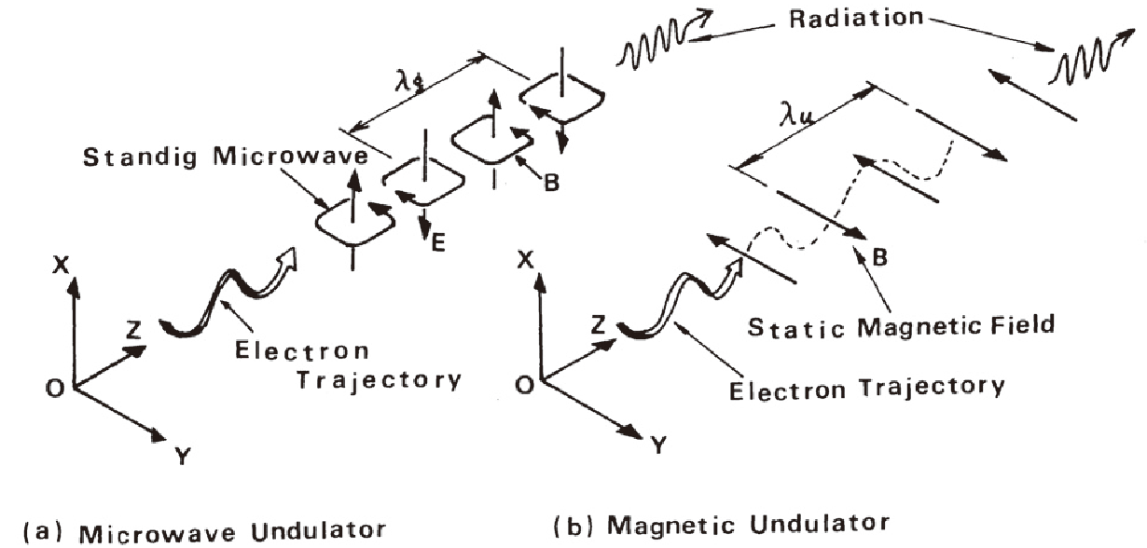

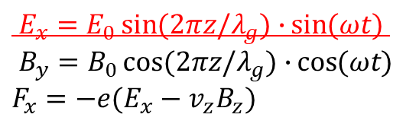
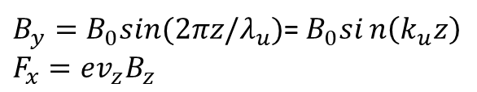
Microwave undulator
In microwave undulator, the electron bunch sees both the electric field and magnetic field.
$E_{x}=E_{0}\sin{(2πz/λ_{g})∙}\sin{(ωt)}$
$B_{y}=B_{0}\cos{(2πz/λ_{g})∙}\cos{(ωt)}$
$F_{x}=−e(E_{x}−v_{z}B_{z})$
$B_{y}=B_{0}sin⁡(2πz/λ_{u})$=$B_{0}sin\left(k_{u}z\right)$
$F_{x}=ev_{z}B_{z}$
Advantages: (1) Fast dynamic control of polarization; (2) Easy to control the field strength by adjusting the input power; (3) Short wavelength; (4) Large aperture (cm vs mm); (5) Less possibility of damage by radiation as compared with the use of permanent magnets
Figure source: T. Shintake, Development of Microwave Undulator, 1983

Slide 3
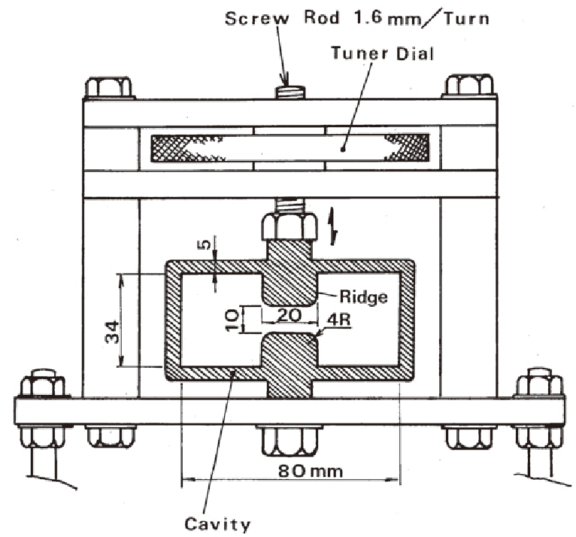
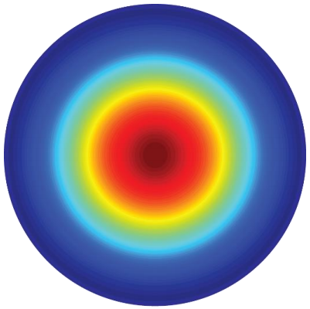
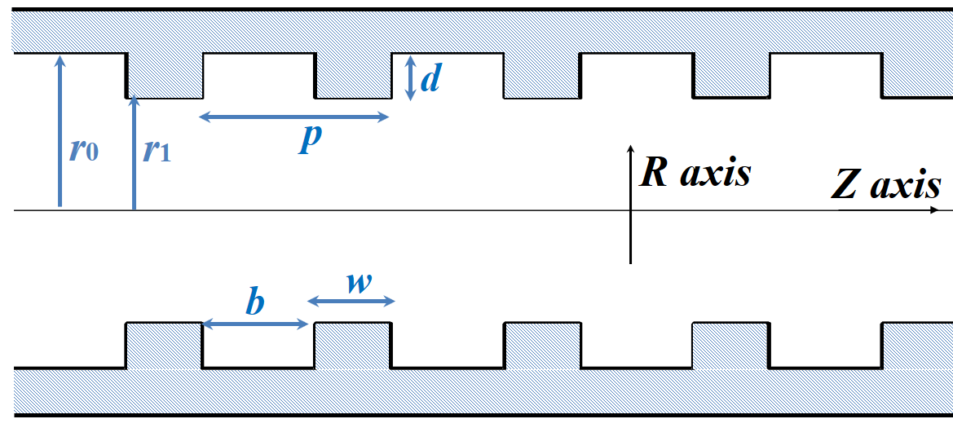
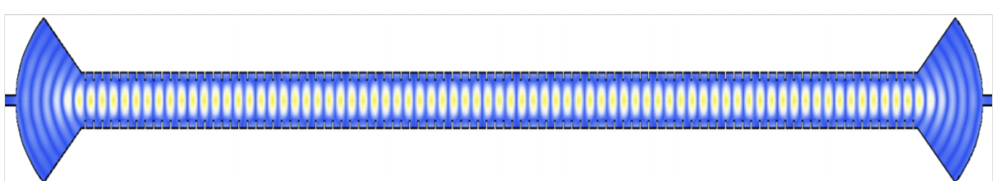
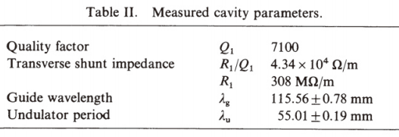
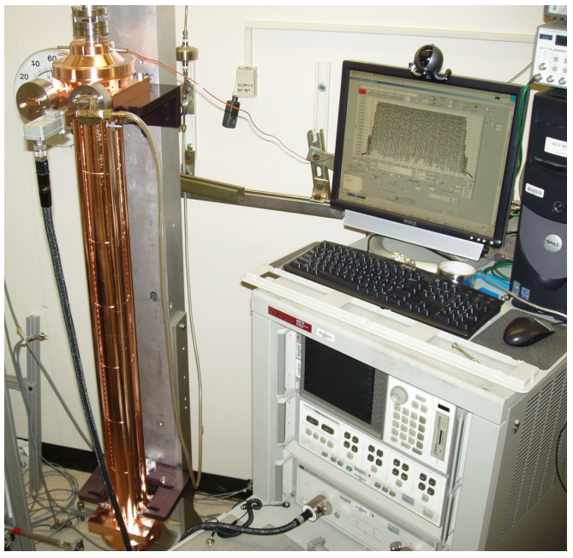
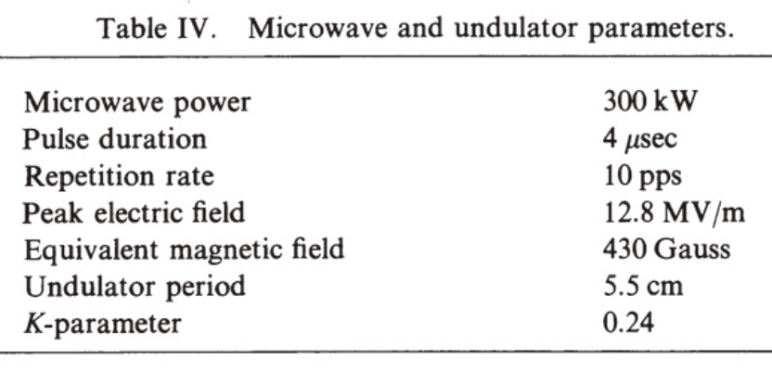

Previous experiments
HE11
Frequency 2.856 GHz (1983)
Freq. = 11.424 GHz
K = 1 for 50 MW
Bu = 0.77 T
λu = 1.39 cm
Q = 91000 (meas.)
Q = 94000 (simu.)
Length = 1 meter
(PRL, 2014)
Demonstration experiment at NLCTA, SLAC
Sami Tantawi, High-Field Short-Period Microwave Undulators

Slide 4

What we propose?
Possible improvements:
Evaluate the possibility to operate at Ka-band, to achieve short wavelength operation
Use a corrugated waveguide & further reduce the field at the wall (HE Hybrid mode)
 | State-of-the-art undulator | Record breaking undulator | Dream Undulator
Period (mm) | 13.9 | 13.9 | 4.4
Beam Aperture (mm) | 5.0 | 5.0 | 5.0
Peak B Field (T) | 0.92 | 1.62 | 2.0
K Parameter | 1.2 | 2.1 | 0.82
Length (m) | 4.0 | 1.0 - 4.0 | 1.0 – 4.0
Operating frequency (GHz) | 11.424 | 11.424 | 36
Required microwave power (MW) | 152 | 185 - 464 | 108 - 272
Required pulse length (us) | 5.8 | 1.4 - 5.7 | 0.8 - 3.2
$P∝L^{2/3}$ $T∝L$

Slide 5
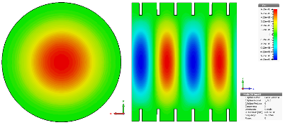
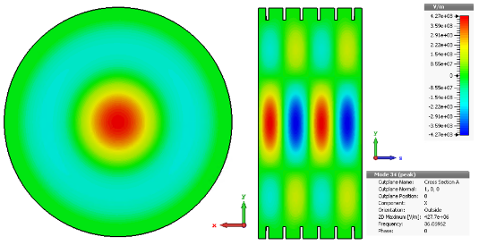
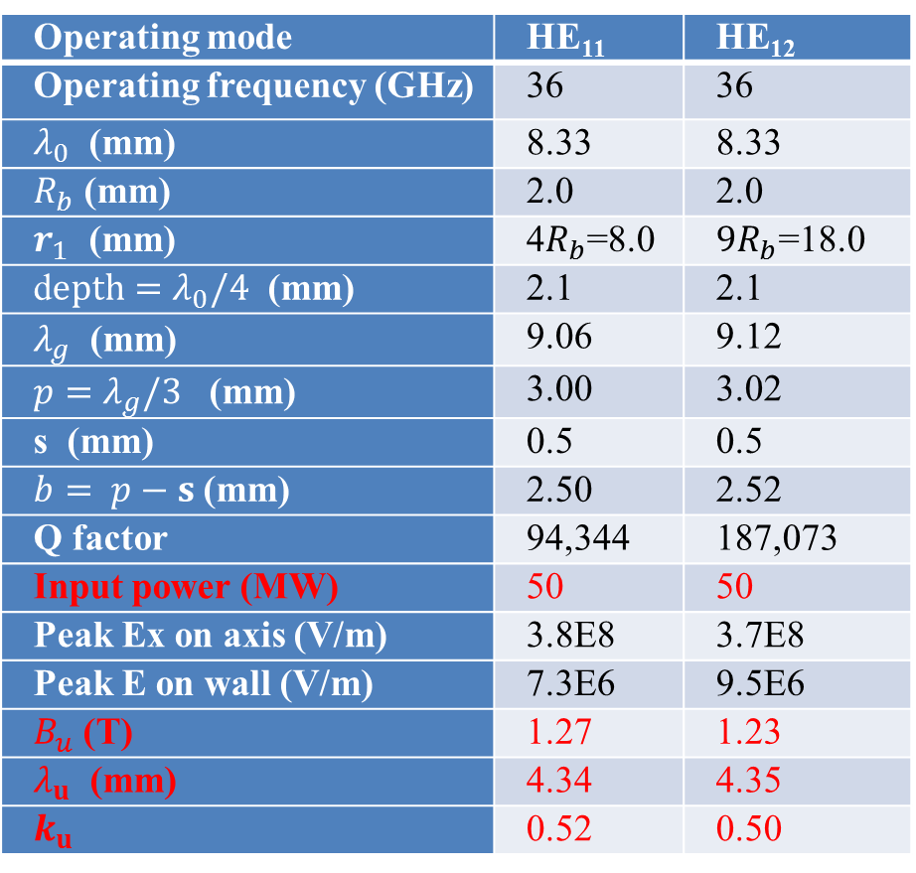
Corrugated waveguide design
Operating mode | HE₁₁ | HE₁₂
Operating frequency (GHz) | 36 | 36
$λ_{0}$ (mm) | 8.33 | 8.33
$R_{b}$ (mm) | 2.0 | 2.0
$r_{1}$ (mm) | 4$R_{b}$=8.0 | $9R_{b}$=18.0
d$epth=λ_{0}/4$ (mm) | 2.1 | 2.1
$λ_{g}$ (mm) | 9.06 | 9.12
${p=λ}_{g}/3$ (mm) | 3.00 | 3.02
s (mm) | 0.5 | 0.5
$b= p−s$ (mm) | 2.50 | 2.52
Q factor | 94,344 | 187,073
Input power (MW) | 50 | 50
Peak Ex on axis (V/m) | 3.8E8 | 3.7E8
Peak E on wall (V/m) | 7.3E6 | 9.5E6
$B_{u}$ (T) | 1.27 | 1.23
$λ_{u}$ (mm) | 4.34 | 4.35
$k_{u}$ | 0.52 | 0.50
HE11 mode
HE12 mode
Dimensions calculated
using theoretical equations
L. Zhang, W. He, J. Clarke, K. Ronald, A.D.R. Phelps and A.W. Cross, “Systematic study of the corrugated waveguide as a microwave undulator”, Journal of Synchrotron Radiation, vol. 26, 2019

Slide 6
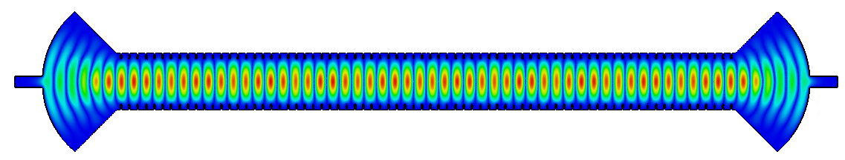
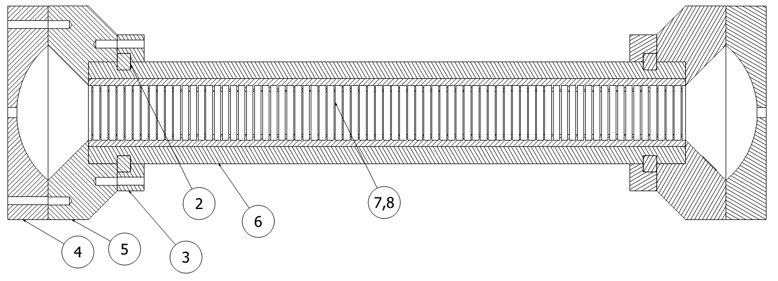
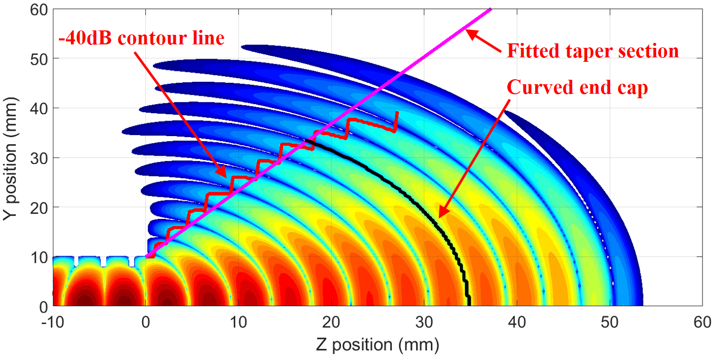
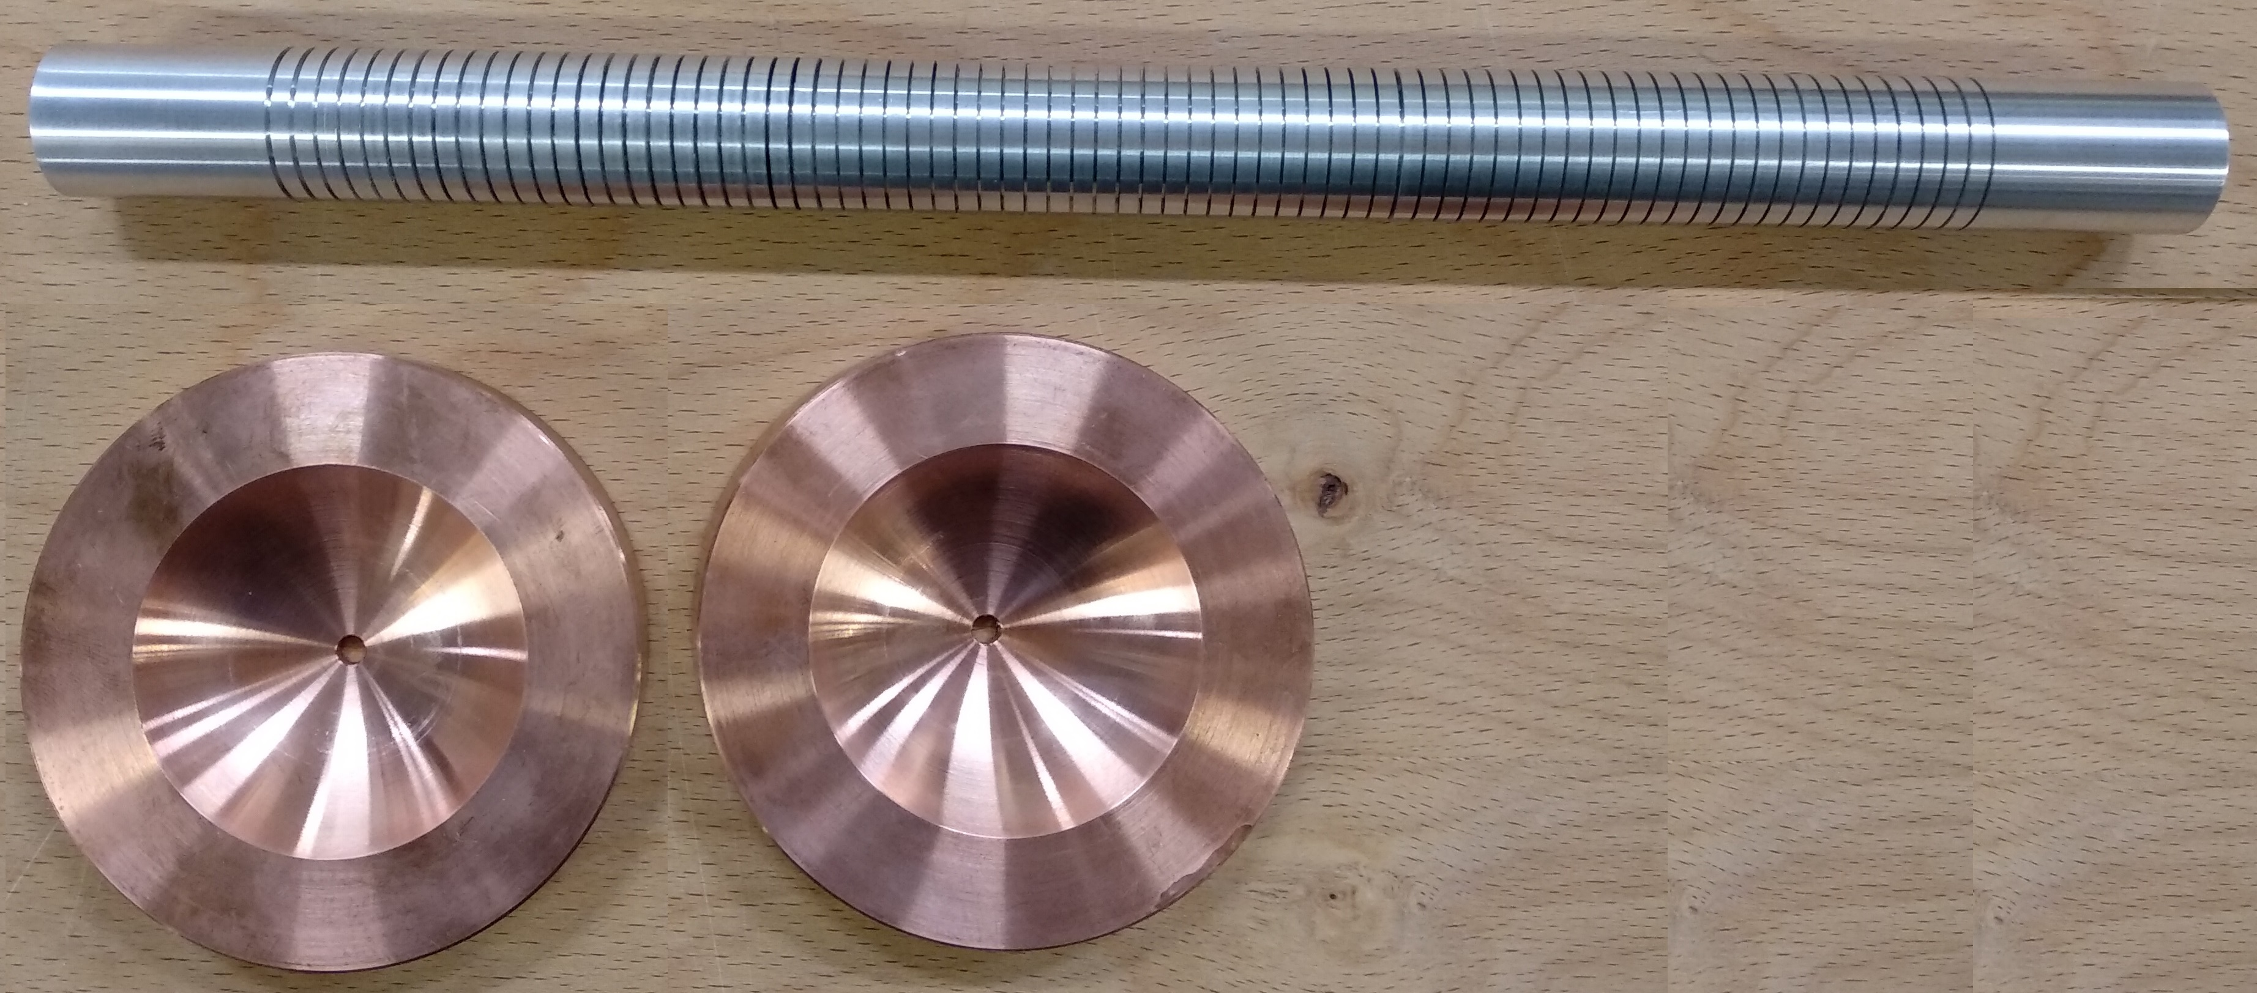
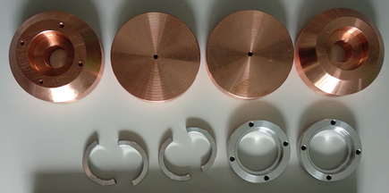


36 GHz corrugated cavity
Taper / Coupler design based on near field radiation pattern. (Improved Q = 89648)
An empirical formula was derived. (Allow scalable design)
A 30-cm cavity (74 periods) is currently been machined for cold test. (supported by CI)
Higher Q at more periods
On electroforming process
$L(N)=\frac{λ}{2}N[1+F\left(N\right)\frac{λ_{g}}{λ}]$
$$F\left(N\right)=0.123e^{−0.213N}+0.015$$

Slide 7
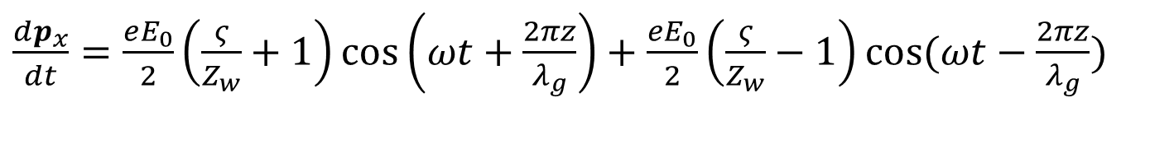
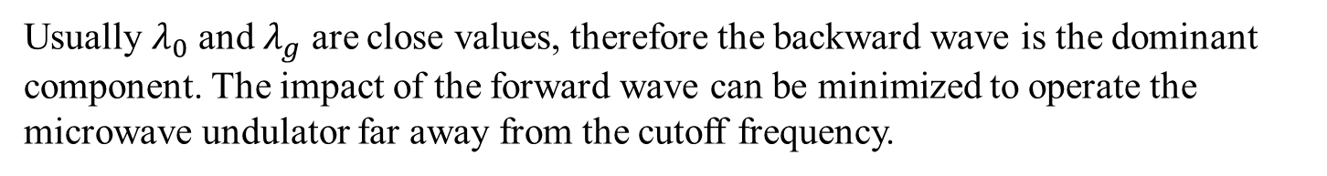
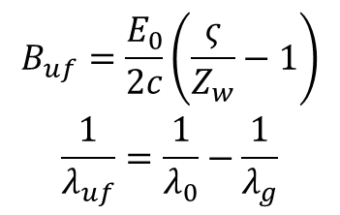
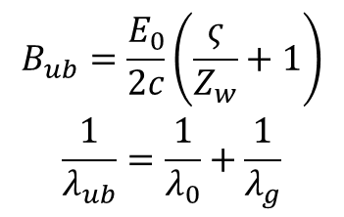
Principle of“Flying”undulator
Rewrite the motion of the electrons in a cavity-type microwave undulator as
$\frac{dp_{x}}{dt}=\frac{eE_{0}}{2}\left(\frac{ς}{Z_{w}}+1\right)\cos\left(ωt+\frac{2πz}{λ_{g}}\right)+\frac{eE_{0}}{2}\left(\frac{ς}{Z_{w}}−1\right)\cos{(ωt−\frac{2πz}{λ_{g}}})$
Backward wave
Forward wave
$$\begin{matrix}B_{ub}=\frac{E_{0}}{2c}\left(\frac{ς}{Z_{w}}+1\right) \\ \frac{1}{λ_{ub}}=\frac{1}{λ_{0}}+\frac{1}{λ_{g}}\end{matrix}$$
$$\begin{matrix}B_{uf}=\frac{E_{0}}{2c}\left(\frac{ς}{Z_{w}}−1\right) \\ \frac{1}{λ_{uf}}=\frac{1}{λ_{0}}−\frac{1}{λ_{g}}\end{matrix}$$
short wavelength.
long wavelength.
Usually $λ_{0}$ and $λ_{g}$ are close values, therefore the backward wave is the dominant component. The impact of the forward wave can be minimized to operate the microwave undulator far away from the cutoff frequency.

Slide 8
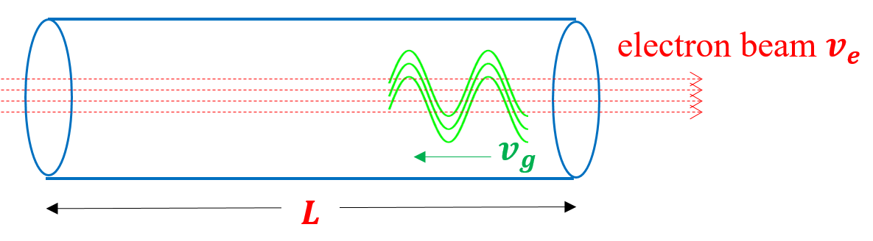
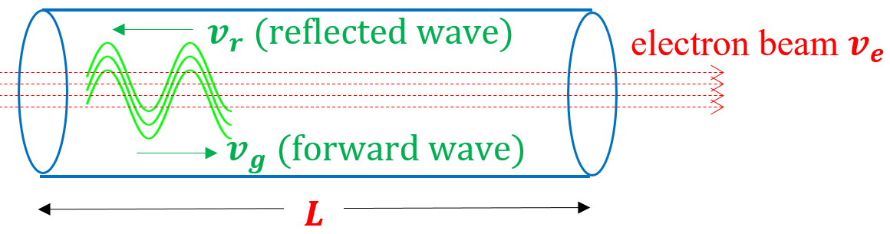
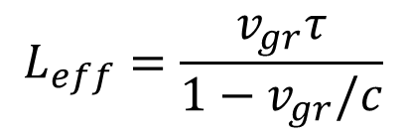
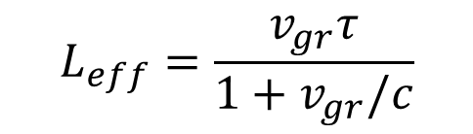
“Flying”undulator
A waveguide can be used as a undulator instead of a cavity structure. The wave can co-propagate or counter-propagate with the electron beam.
$$L_{eff}=\frac{v_{gr}τ}{1+v_{gr}/c}$$
$$L_{eff}=\frac{v_{gr}τ}{1−v_{gr}/c}$$
A co-propagating wave with backward group velocity has longer effective interaction length.
[1] S. V. Kuzikov, et al., "Flying radio frequency undulator," Appl. Phys. Lett., vol. 105, no. 3, p. 033504, 2014.
[2] S. V. Kuzikov, et al., "Configurations for short period rf undulators," Phys. Rev. S.T., vol. 16, no. 7, p. 070701, 2013.

Slide 9
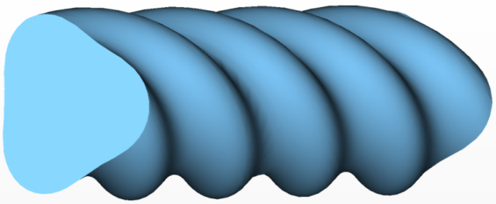
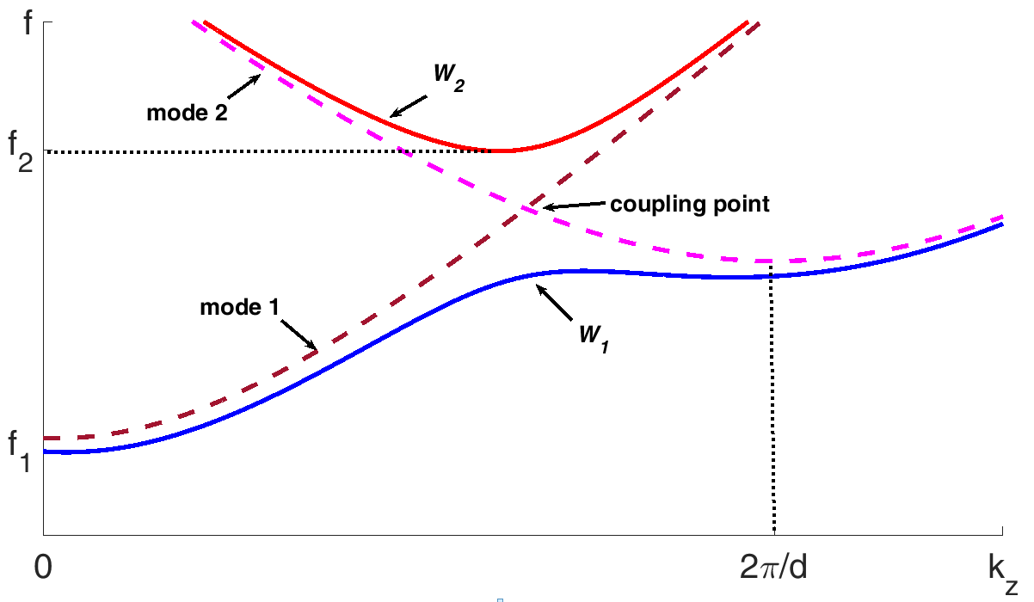
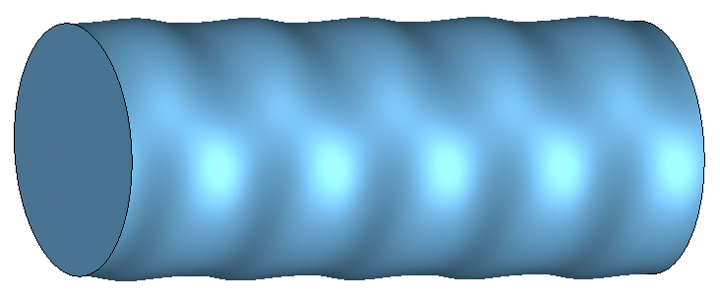


“Flying”undulator
“flying” undulator by helically corrugated waveguide
${r\left(θ,z\right)=R}_{0}+R_{1}cos(m_{B}θ+2πz/d)$
Circular polarization
The coupling modes 1 and 2 have opposite directions of group velocities.
Cavity-type | Flying-type
energy per pulse (~200J) | energy per pulse (~1J)
High power, long pulse microwave source (50 MW, 2 us), PRF (~50Hz) | Ultra high power Short pulse microwave source (1 GW, 1 ns), high PRF 1kHz
$r\left(θ,z\right)=R_{0}+R_{2}cos\left(m_{B}θ\right)cos\left(\frac{2πz}{d}\right)$
Linear polarization

Slide 10
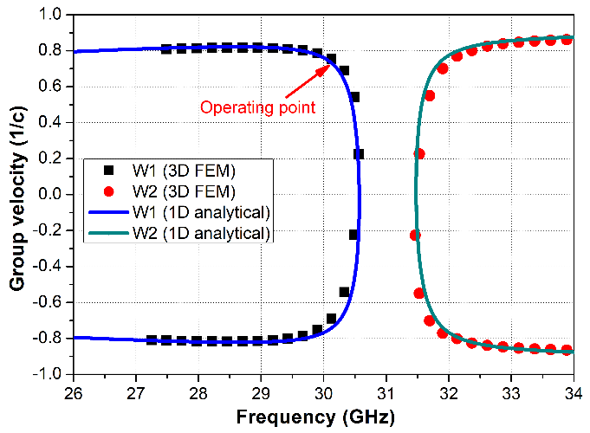
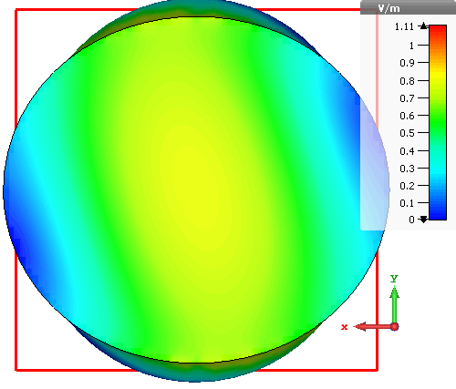
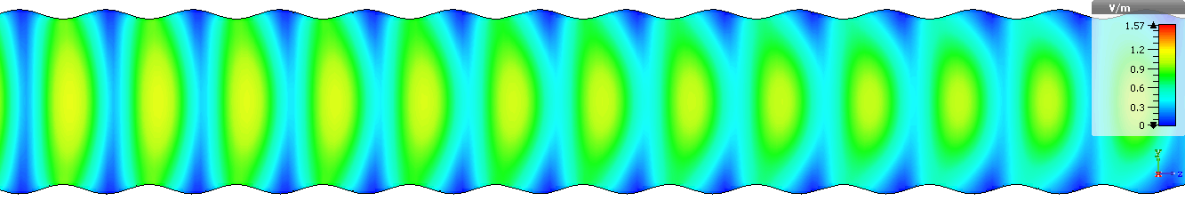
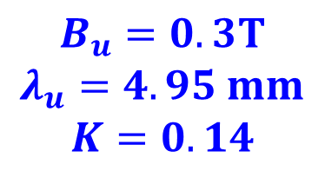

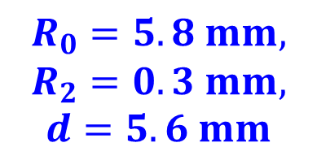
Design of“Flying”undulator
Operating mode: TE11 coupled with TE11 mode. Operating frequency: 30.3 GHz
The dimensions are chosen from the dispersion relation of the operating mode.
$$R_{0}=5.8 mm,$$
$$R_{2}=0.3 mm,$$
$$d=5.6 mm$$
$$v_{g}≈0.6c$$
1 GW input power:
$$B_{u}=0.3T$$
$$λ_{u}=4.95 mm$$
$$K=0.14$$
It is possible to be driven by SR BWO (0.6 GW, Ka band)
L. Zhang, W. He, J. Clarke, K. Ronald, A. D. R. Phelps, and A. W. Cross, “Microwave undulator using a helically corrugated waveguide” IEEE Trans. Electron Device, vol. 65, no. 12, 2018.

Slide 11
Conclusion & Future Work
Two types microwave undulators have been investigated and designed.
A cavity type microwave undulator is been machined and will be cold test in the future.
David Zhu in ANSTO is now simulating the electron beam dynamics.
The microwave undulators are on R&D stage, a proof-of-concept experiment will be proposed.
Acknowledgements
The STFC UK is gratefully acknowledged for supporting this work.
The University of Strathclyde is grateful to the Cockcroft Institute for supporting Dr. Liang Zhang.
The European Commission Horizon 2020 Project “CompactLight” (777431-XLS) is gratefully acknowledged for supporting this work.

