Slide 1
WP6
S-band based linac option status and linac modelling for FELs
S. Di Mitri,
Elettra Sincrotrone Trieste
Contributors:
A. Aksoy – Ankara Uni
A. Giribono, C. Vaccarezza – INFN LNF
Latina, X. Liu – CERN
E. Marin, R. Munoz Horta – ALBA CELLS
A. Faus Golfe, Y. Han – LAL

Slide 2
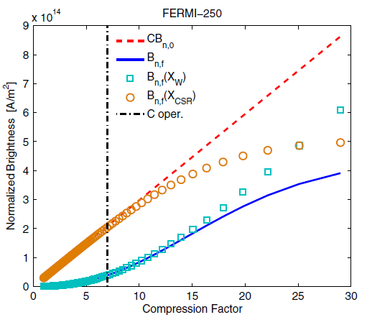
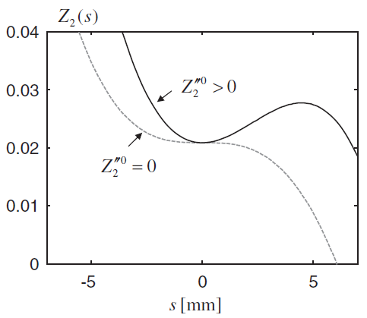
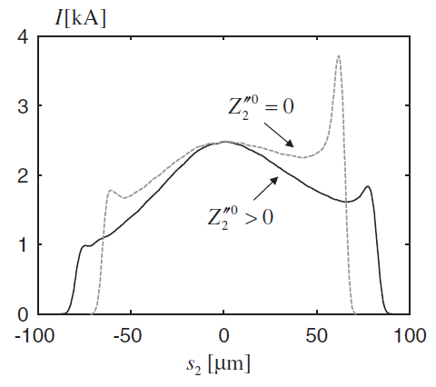
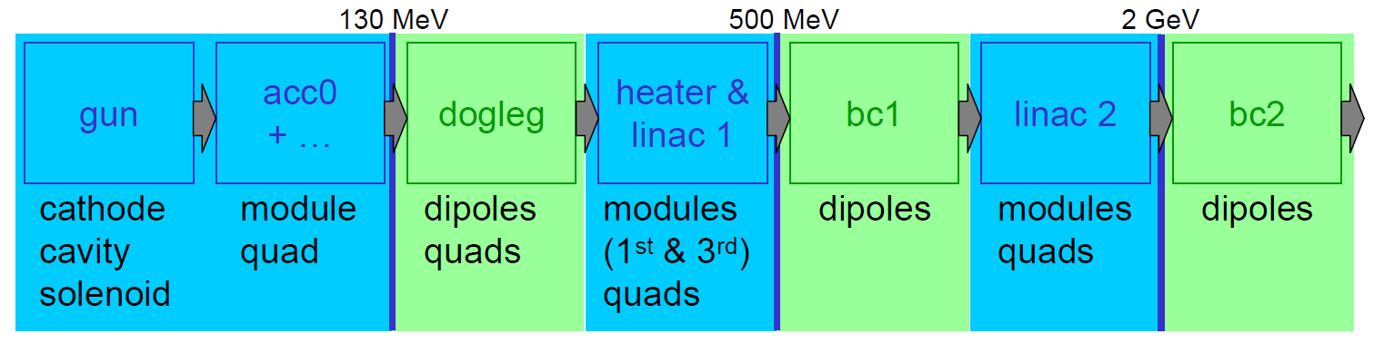
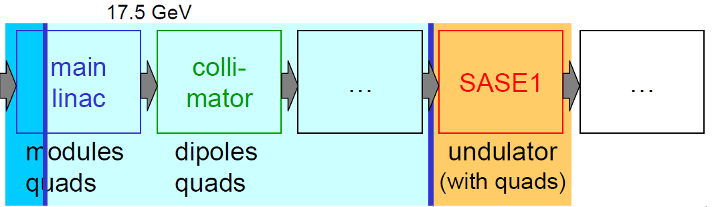
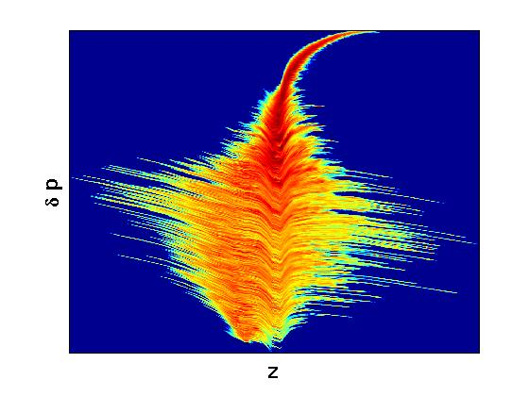
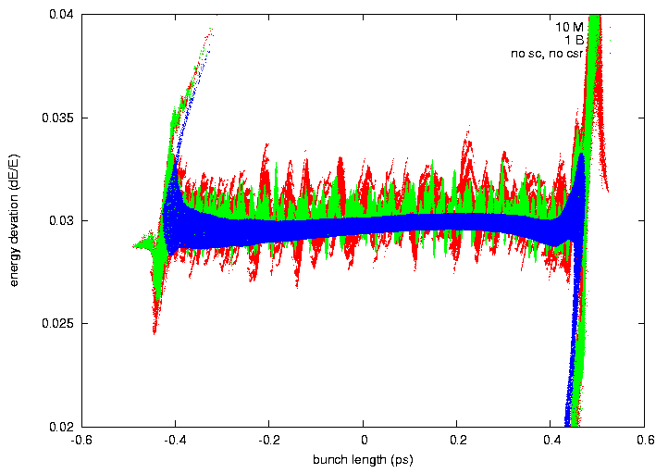
Codes
S. Di Mitri (2013)
Semi-analytical models of beam collective dynamics provide guidance to a first step-machine design.
I. Zagorodnov, M. Dohuls (2011)
M. Dohuls et al. (2008)
Chains of specialized codes allow to balance accuracy vs. CPU time in S2E simulations.
ASTRA
CSRTrack
ASTRA
CSRTrack
ASTRA
CSRTrack
Elegant
Genesis
GPT + Elegant
J. Qiang (2012)
PIC codes allow tracking with real number of electrons, e.g. from 0.4 to 5 billion or so.
IMPACT

Slide 3
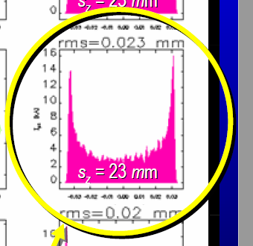
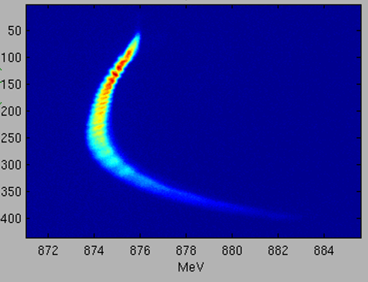
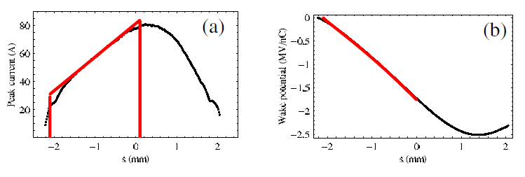
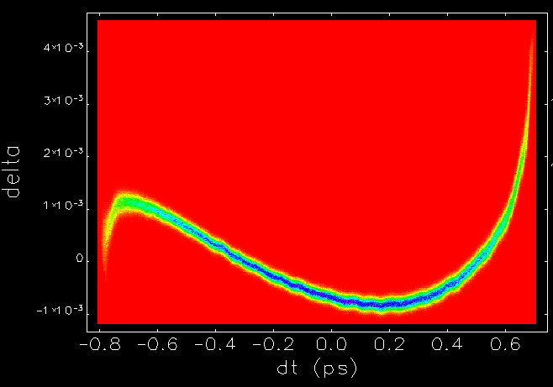
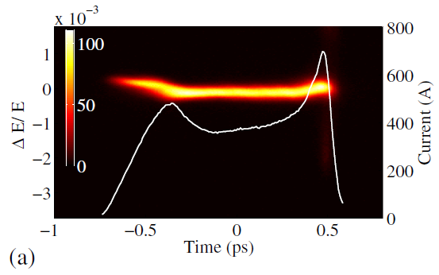
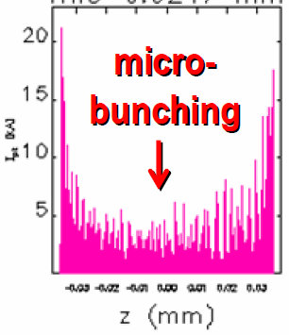
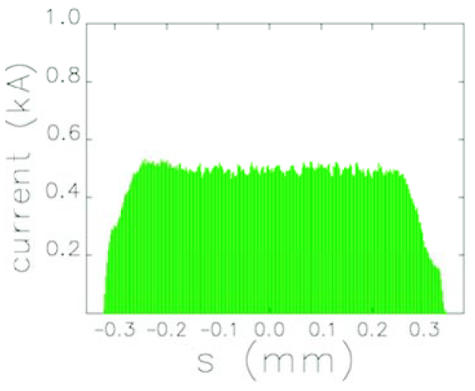
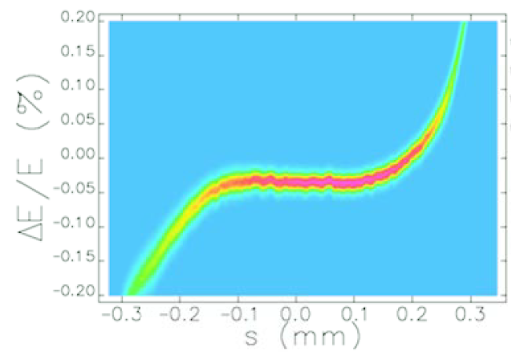
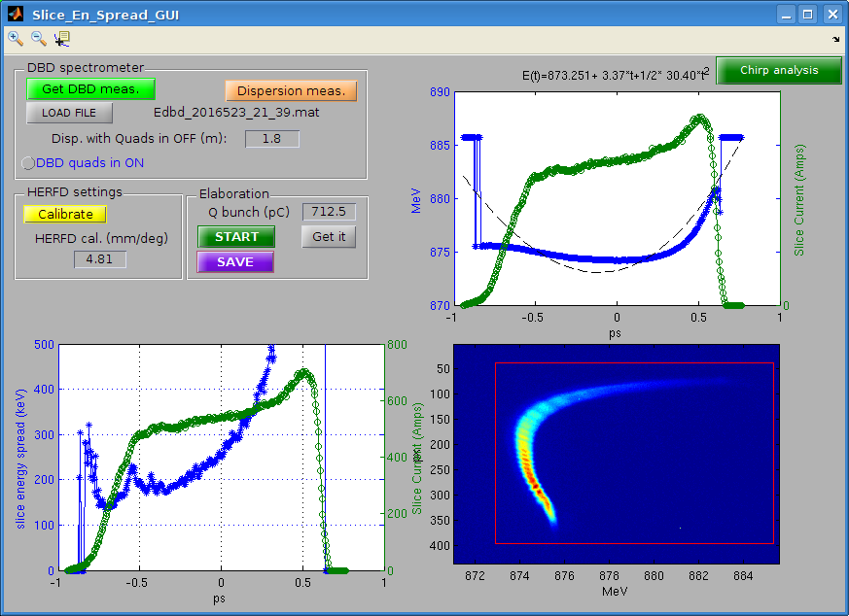
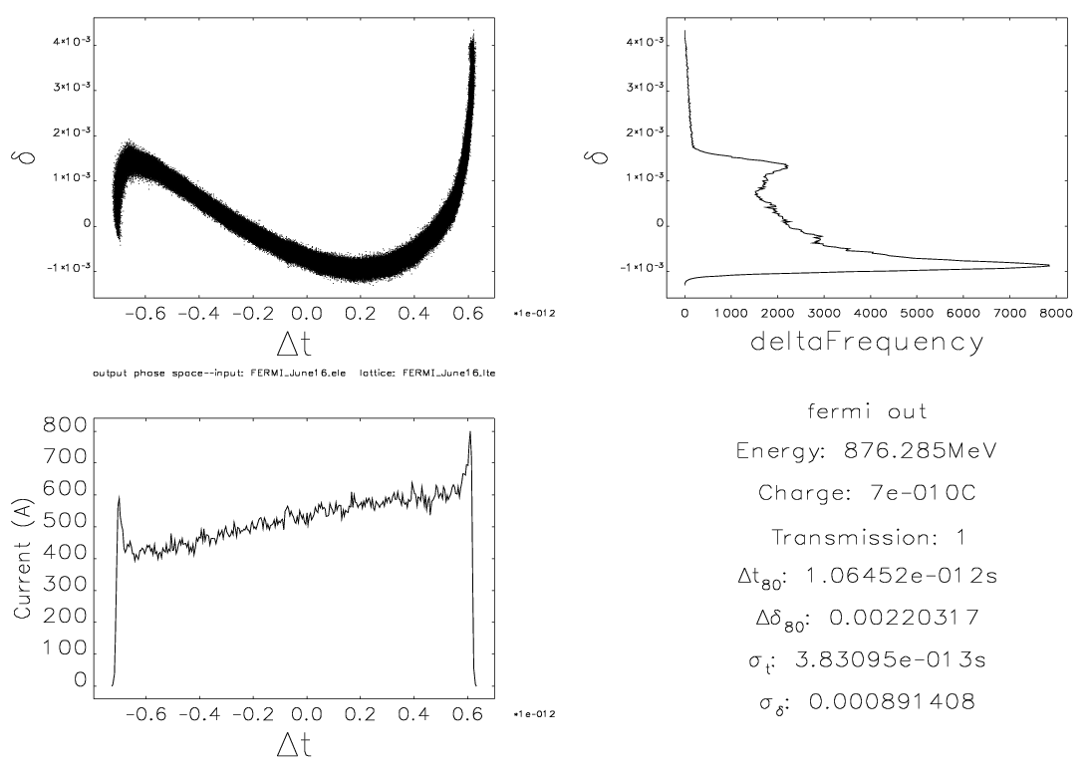
Geometric (RF) Wakefields
Geometric and RW wakefields can be computed accurately, and imported into tracking codes.
Strong wake potential + magnetic compression = multi-kA current spikes at bunch edges.
P. Emma for LCLS (2009)
  Spikes drive CSR & microbunching instability, and RW wake in low-gap pipe.
  Spikes magnitude depends on details of Injector Laser and Linac long. wakefield.
Wakefields data (to be made available):
S-band Injector
X-band Linac
Resistive Wall wake in Undulator ?
M. Cornacchia et al. (2006)
G. Penco et al. @ FERMI (2014)
Model vs. Measurement @ FERMI

Slide 4
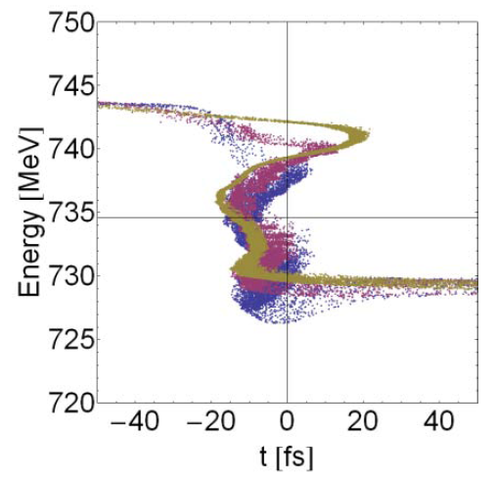
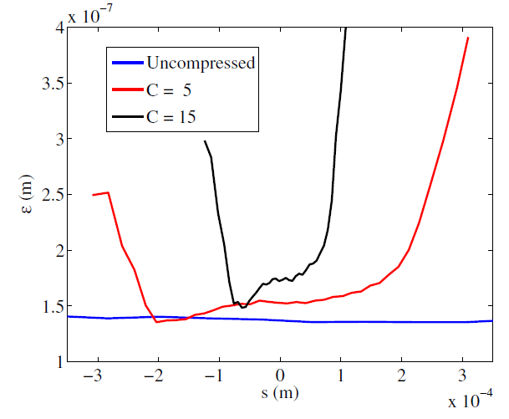
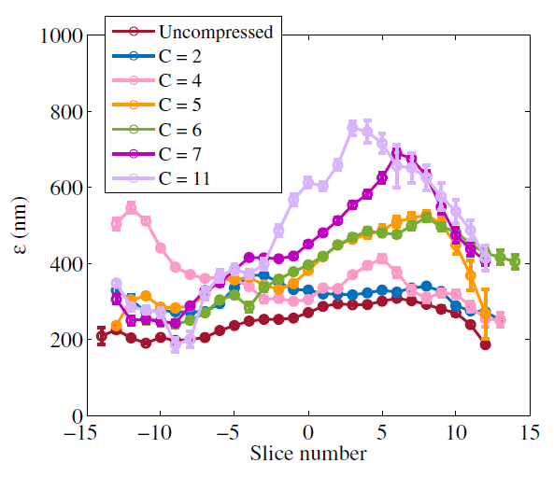
CSR – 1D vs. 3D
Projected emittance control is favoured by uniform slice Twiss parameters → injector optimization.
Slice norm. emittance is typically perturbed at < 0.05 μm level. Can be much worse at full compression.
3-D codes needed to predict slice emittance growth. 1-D runs typically over-estimate the final projected emittance.
Elegant Projected
P 2.84 µm
S 1.43 µm
200 pC
@ 735 MeV
CSRtrack 3D
CSRtrack Projected
Exp. vs. Codes
P 4.95 µm
S 1.85 µm
Codes
CSRtrack 3D
200 pC
@ 200 MeV
S. Bettoni et al., PRAB (2016)
H. Owen et al. for NLS (2008)

Slide 5
Work Plan, 2.A option
A. Giribono
C. Vaccarezza
E. Marin
R. Munoz Horta
A. Faus-Golfe
Y. Han
A. Latina
X. Liu
S. Di Mitri
A. Latina
X. Liu
S. Di Mitri
1-D tentative run with 2 compressors, to the linac end
PRESENT
Benchmarking injector beam dynamics
Specifications of the linearizer and compressor
NEXT STEP
S2E simulation
Optimized injector beam
S2E simulation

Slide 6
Codes – Our Choice
A. Giribono
C. Vaccarezza
E. Marin
R. Munoz Horta
A. Faus-Golfe
Y. Han
A. Latina
X. Liu
S. Di Mitri
A. Latina
X. Liu
S. Di Mitri
TStep
Placet
GPT
Astra
RFTrack
LiTrack
Elegant
GPT
// and ⊥ wakefields
CSR (3-D)
Microbunching instability
3-D Space-charge
// and ⊥ geometric wakefields

Slide 7
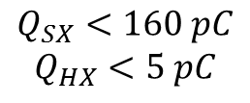
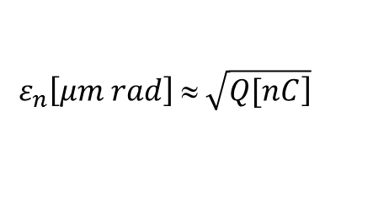
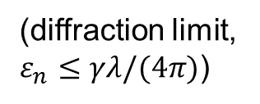
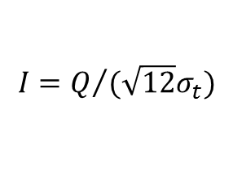
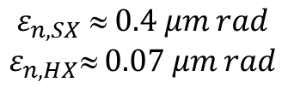
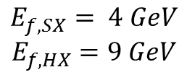
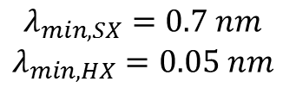
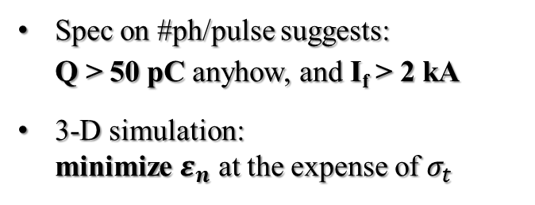
Charge
$$I=Q/{(\sqrt{12}σ_{t})}$$
for parabolic charge distribution
$$ε_{n}\left[μm rad\right] ≈ \sqrt{\left.Q[nC\right]}$$
for S-band NC Gun, w/o RF bunching, long bunches
$$λ_{min,SX}=0.7 nm$$
$$λ_{min,HX}=0.05 nm$$
+
$$E_{f,SX}= 4 GeV$$
$$E_{f,HX}=9 GeV$$
=
$$ε_{n,SX}  0.4 μm rad$$
$$ε_{n,HX} 0.07 μm rad$$
$$Q_{SX}<160 pC$$
$$Q_{HX}<5 pC$$
(FEL specs)
(assumption from preliminary FEL scaling laws)
(diffraction limit,
$ε_{n}≤γλ/(4π)$)
(FEL specs)
RF bunching × 5
Chicane 1 × 30
Spec on #ph/pulse suggests: Q > 50 pC anyhow, and I_{f} > 2 kA
3-D simulation: minimize $ε_{n}$ at the expense of $σ_{t}$
Q = 75 pC
σ_{t} ∼ 1 ps
ε_{n} ∼ 0.2 μm rad
I_{i} ∼ 15 A
&
CF ∼ 150
Chicane 1 × 15
Chicane 2 × 10

Slide 8
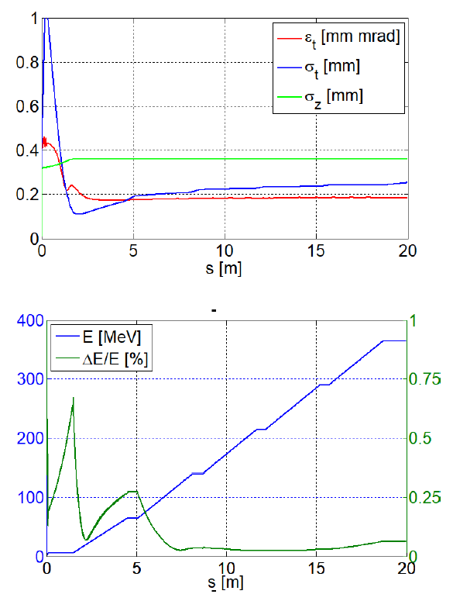
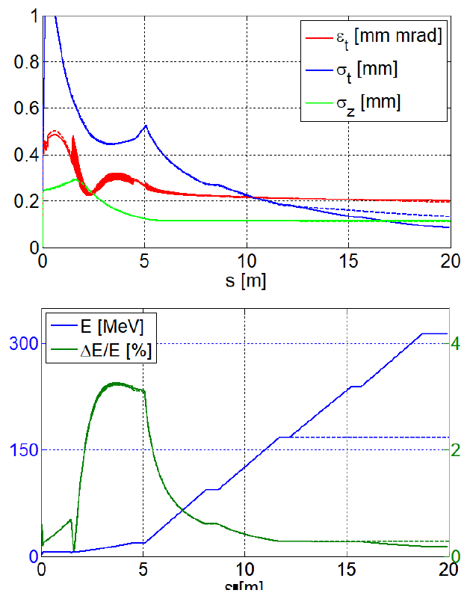
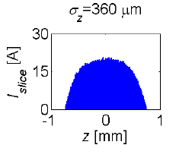
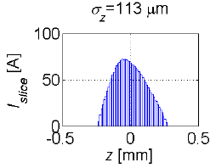
Injector (→ 100 MeV)
This slide by:
A. Giribono (INFN)
ONGOING
3-D codes (space charge) benchmarking: TStep vs. GPT vs. Astra
Nominal beam parameters: optimization w & w/o VB
75 pC, w/o VB
DONE
75 pC, w VB
0.2 μm
0.2 μm

Slide 9
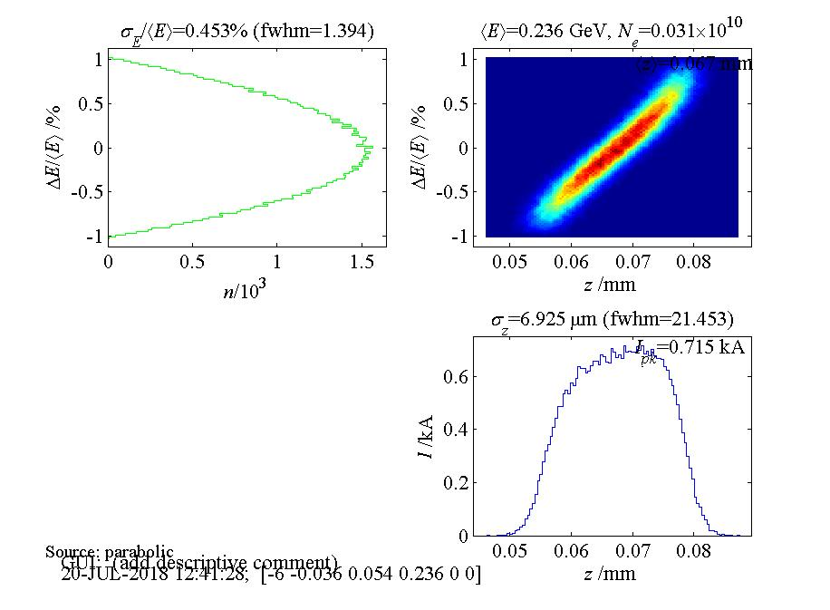
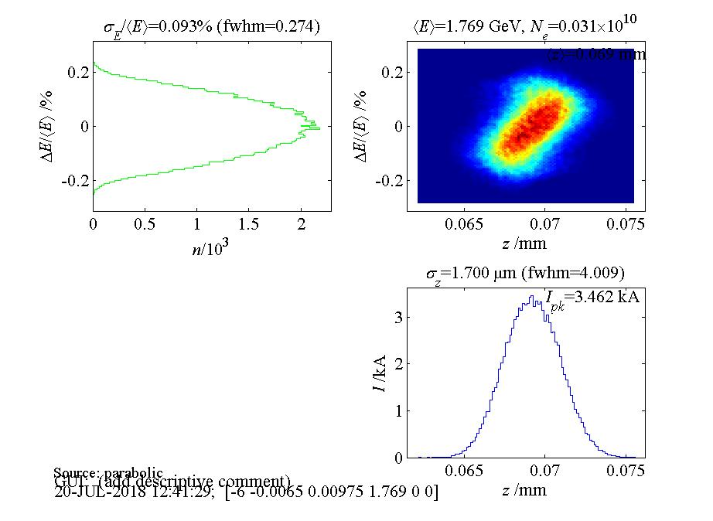
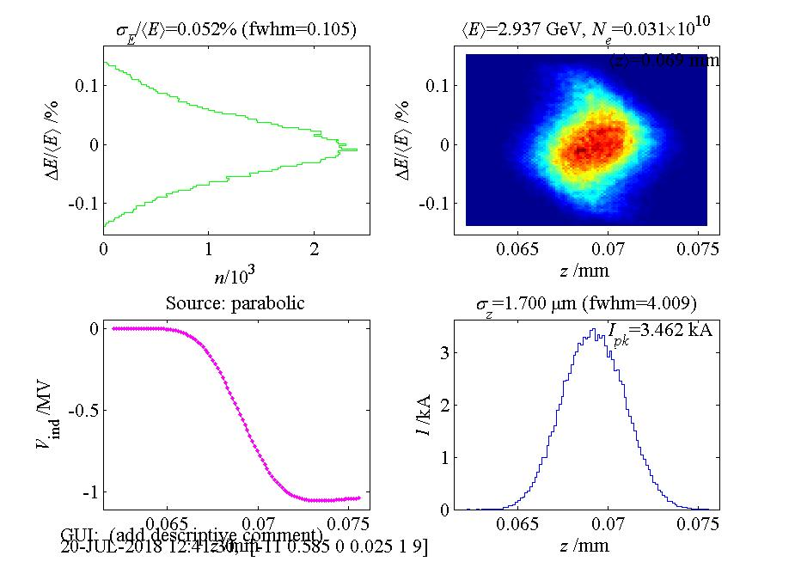
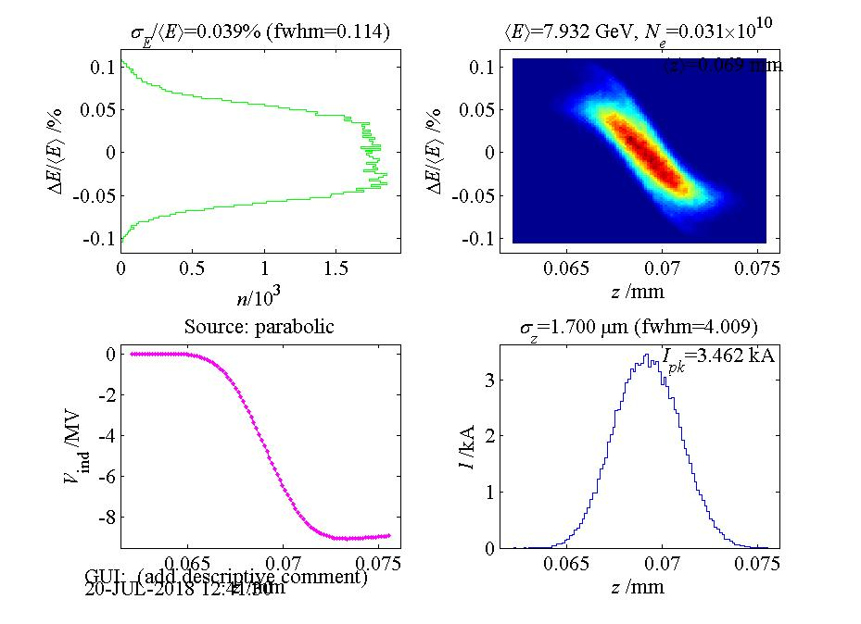
Main Linac (→ GeVs)
Q = 50 pC
I_{i} ∼ 30 A
CF = 20 × 5
EXERCISE
One injector beam for both SX and HX
One linac setting for both SX and HX
SX-beam extracted at intermediate energy

Slide 10
Lessons Learned & Status
Q = 75 pC is a starting point. S2E runs will tell us if ε_{x} ∼ 0.2 μm rad & I ∼ 3 kA are good enough for SX FEL.
HX FEL specs are critical (75 pC, 0.1 μm rad, 9 kA !!!).
X-band longitudinal wakefields impose off-crest acceleration for energy chirp compensation (manageable).
CF ∼ 150 most likely. CSR-induced projected emittance growth might become an issue (reduction of FEL gain) for CF > 100.
S-band injector file with optimized emittance/current @ 75 pC soon available (INFN)
GPT vs. Astra vs. TStep benchmarking soon finalized (ALBA, INFN)
S2E run with GPT ongoing (ALBA)
1-D run (Elettra) and S2E run (ALBA, CERN) follow

Slide 11
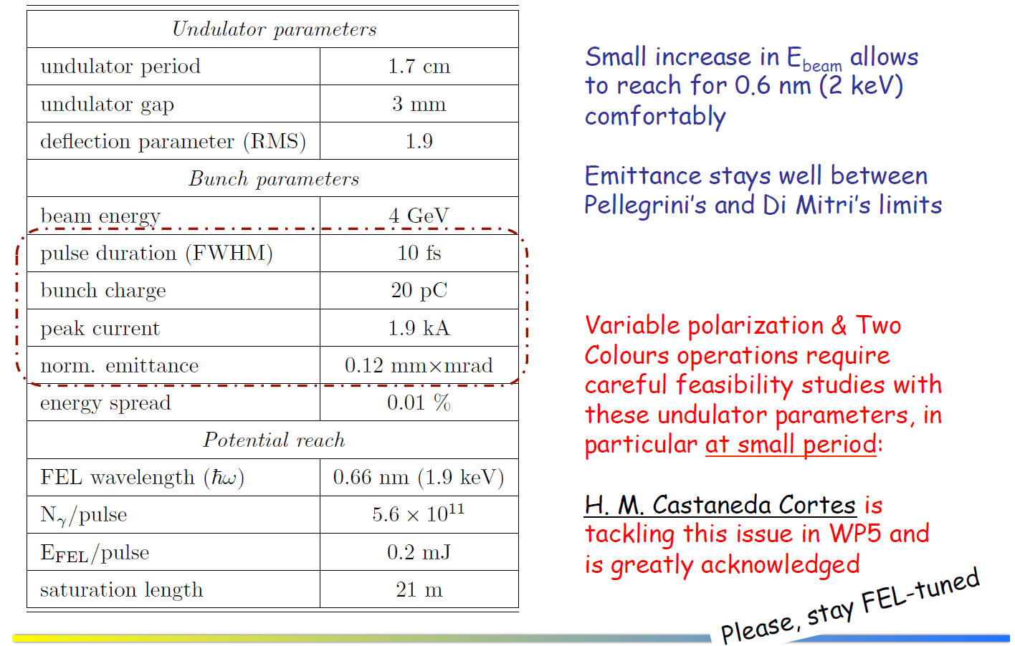
SX FEL – F. Nguyen 18 Oct.’18

Slide 12
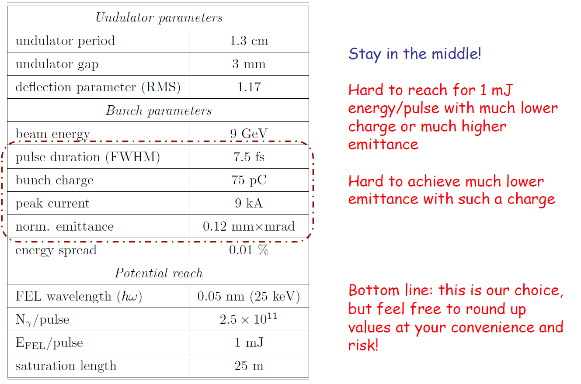
HX FEL – F. Nguyen 18 Oct.’18

