Slide 1
Longitudinal Design Considerations
6.2c: Xband – Kband lnrz - BC1 - Xband - BC2 - Xband
First XLS - CompactLight Annual Meeting
Xingguang Liu, Andrea Latina
CERN
Dec 10-12 2018, Barcelona, Spain

Slide 2
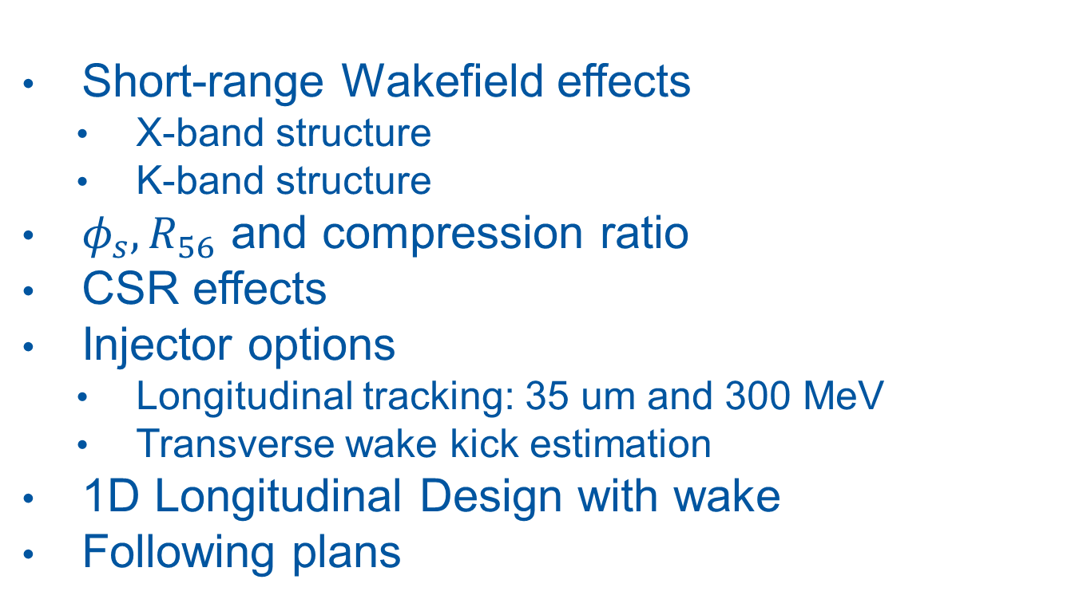
CONTENT
Short-range Wakefield effects
  X-band structure
  K-band structure
$φ_{s},R_{56}$ and compression ratio
CSR effects
Injector options
  Longitudinal tracking: 35 um and 300 MeV
  Transverse wake kick estimation
1D Longitudinal Design with wake
Following plans
Injector independent

Slide 3
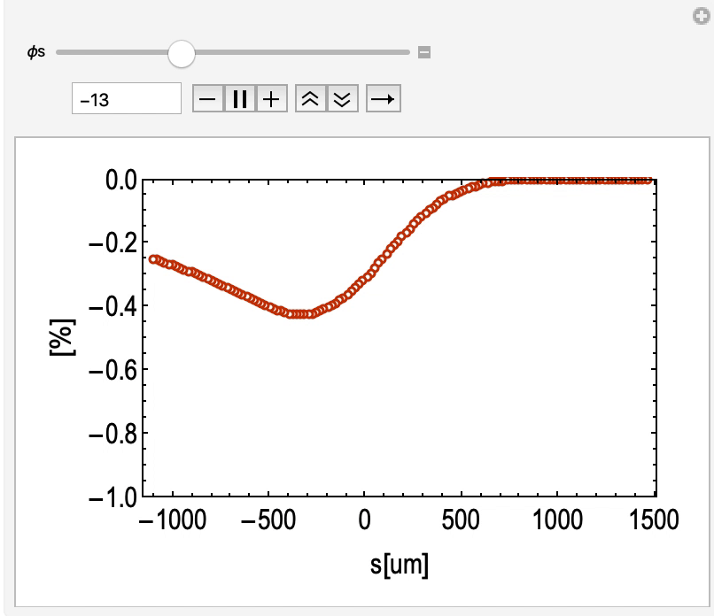
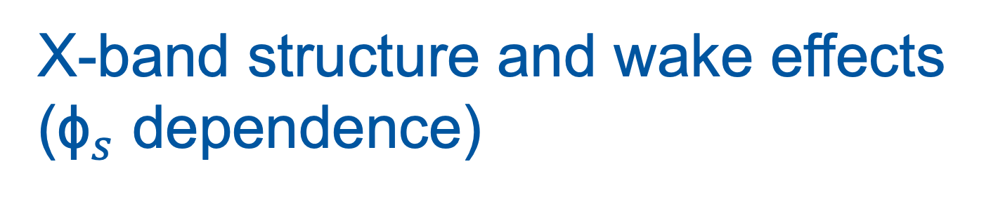
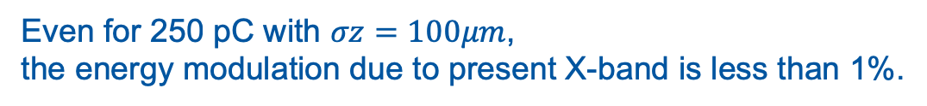
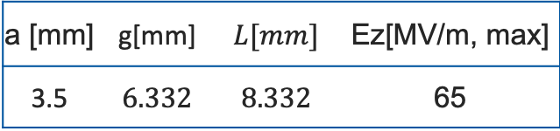
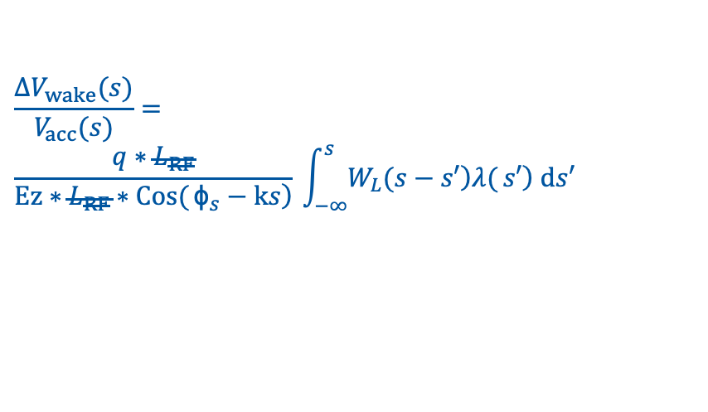
X-band structure and wake effects (${\text{ϕ}}_{s}$ dependence)
$$\frac{{ΔV}_{wake}(s)}{V_{acc}(s)}=$$
$$\frac{q∗L_{RF}}{Ez∗L_{RF}∗\left.\operatorname{Cos}{(}{\text{ϕ}}_{s}−ks\right)}⁢\int_{−∞}^{s}{\left.W_{L}(s−s′\right)⁢⁢\left.λ{(}s′\right)⁢ⅆs′}$$
independent of structure/linac length:
“longitudinal wake budget” once the RF design is chosen”
σz[um] | 300
Q[pC] | 250
N | 10000
σ(δ) | 0.03%
a [mm] | g[mm] | $$L[mm]$$ | Ez[MV/m, max]
3.5 | $$6.332$$ | $$8.332$$ | 65
A. Gallo, P9, WP4_present _ 20 _ 09 _ 19. pdf
Even for 250 pC with $σz=100μm$,
the energy modulation due to present X-band is less than 1%.

Slide 4
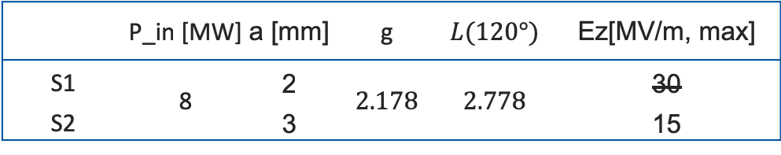
Preliminary K-band structure*
 |  | K-band structure gradient [MV/m] *
 |  | Structure Length [m]
 |  | 0.14 | 0.3 | 0.5 | 0.8 | 1.1
Aperture [mm] | 2 | 32.90 | 30.92 | 28.67 | 25.70 | 23.14
 | 3 | 15.33 | 14.97 | 14.54 | 13.92 | 13.33
 | 4 | 8.91 | 8.79 | 8.64 | 8.43 | 8.22
 | 5 | 5.77 | 5.71 | 5.65 | 5.56 | 5.46
 | 6 | 4.11 | 4.08 | 4.05 | 4.00 | 3.95
*scaled from 1MW results(old), curtesy by Graeme Burt (Cockcroft)
Cell parameters to use for evaluating wake effects
 | P_in [MW] | a [mm] | g | $$L(120°)$$ | Ez[MV/m, max]
S1 | 8 | 2 | $$2.178$$ | $$2.778$$ | 30
S2
 |  | 3 |  |  | 15
25 (updated)
*updated from Graeme Burt Team, Dec 3, 2018

Slide 5
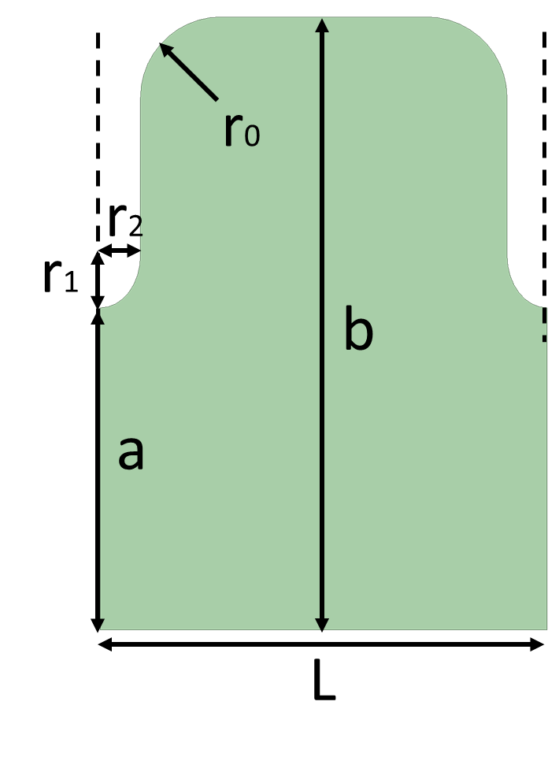
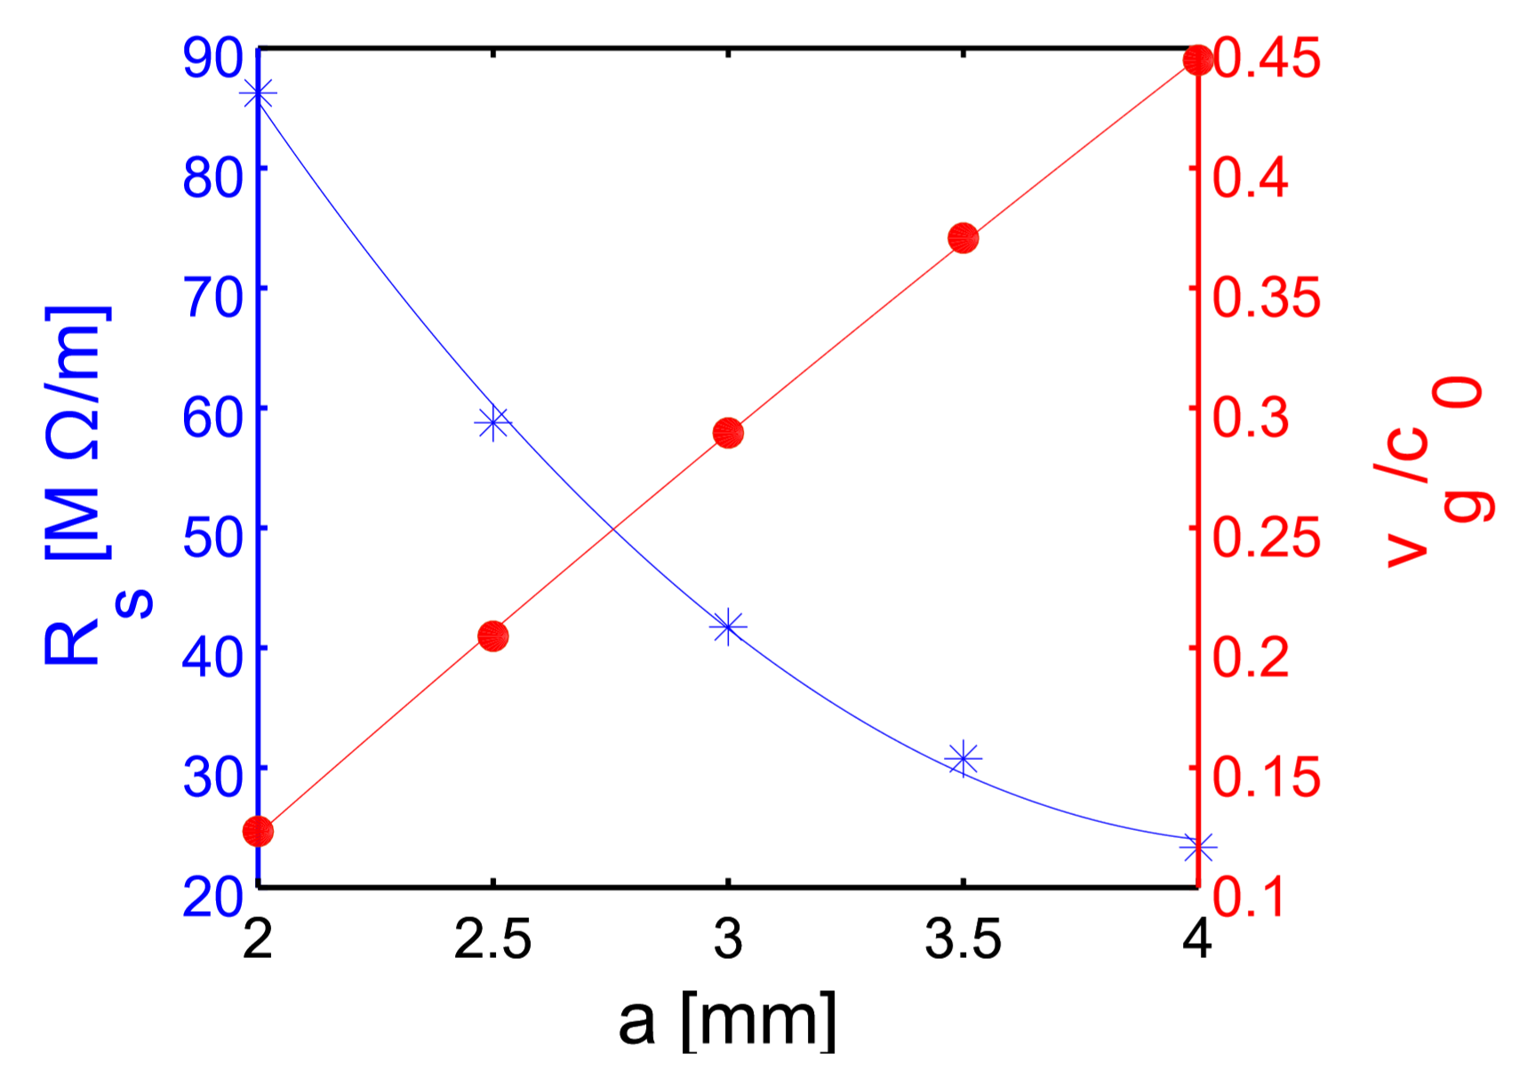
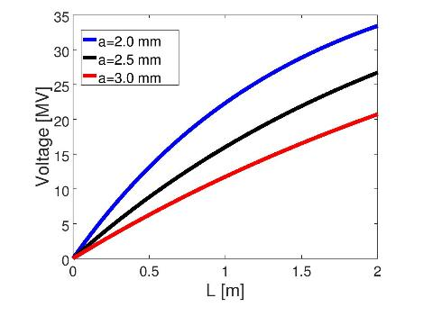
*K-band Structure Design (by X. Wu@CERN)
Structure analytical optimization
  Working at 36 GHz, 2π/3 mode
  Constant impedance structure
  22.4 MV at 8 MW input power for 1 meter Ka-band structure
  Consistent with Lancaster’s results

Slide 6
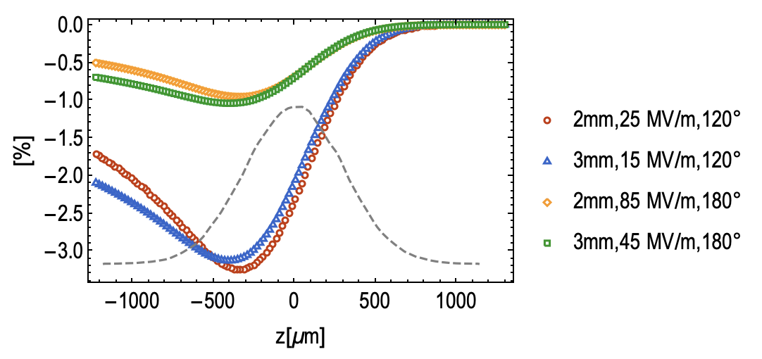

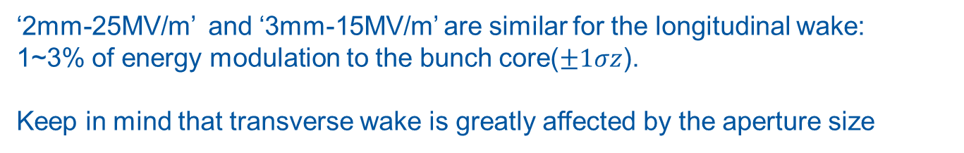
K-band longitudinal wake effects
σz[um] | 300
Q[pC] | 250
N | 100000
σ(δ) | 0.03%
$$φ_{s}=−180°$$
‘2mm-25MV/m’ and ‘3mm-15MV/m’ are similar for the longitudinal wake:
1~3% of energy modulation to the bunch core($±1σz$).
Keep in mind that transverse wake is greatly affected by the aperture size

Slide 7
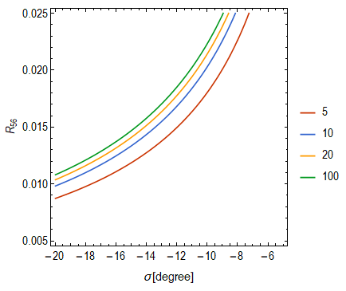


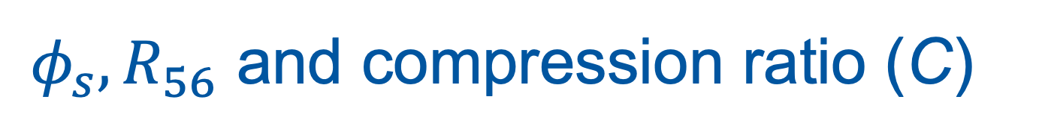
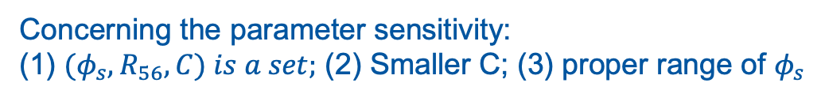

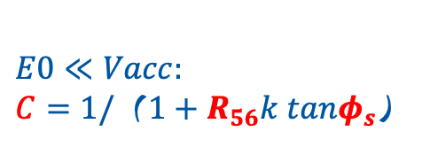


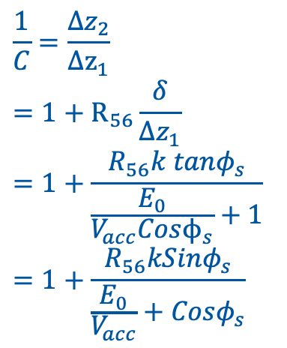

$φ_{s},R_{56}$ and compression ratio (C)
Compression ratio
$$Δz_{1},E_{0}$$
Acc
MC
$$Δz_{2},E_{2}$$
$$V_{acc}, φ_{s}$$
$$R_{56}$$
*note ${(φ}_{s}>0, R_{56}<0)$
$is similar$ by symmetry
$$\frac{1}{C}=\frac{Δz_{2}}{Δz_{1}}$$
$$=1+R_{56}\frac{δ}{Δz_{1}}$$
$$=1+\frac{R_{56}k tanφ_{s}}{\frac{E_{0}}{V_{acc}Cosϕ_{s}}+1}$$
$$=1+\frac{R_{56}kSinφ_{s}}{\frac{E_{0}}{V_{acc}}+Cosφ_{s}}$$
$$E0≪Vacc:$$
$C=1/（1+R_{56}k tanφ_{s}$）
$φ_{s}$[degree]
Concerning the parameter sensitivity:
(1) ${(φ}_{s}, R_{56}, C) is a set;$ (2) Smaller C; (3) proper range of $φ_{s}$
Notes:
Plot CSR vs phi_s for different C = 5, 10, 20, 100
Plot dz jitter as a function of phi_s
dC/C vs phi_s

Slide 8
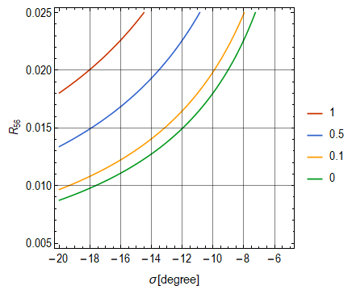

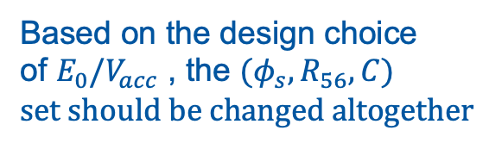
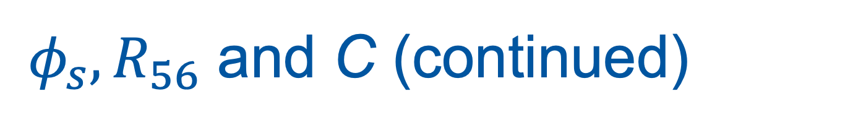


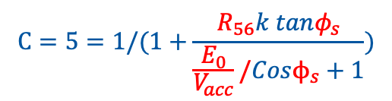
$φ_{s},R_{56}$ and C (continued)
$E_{0}/V_{acc}$ denpendence
Based on the design choice of $E_{0}/V_{acc}$ , the ${(φ}_{s}, R_{56}, C)$ $set should be changed altogether$
$$E_{0}/V_{acc}$$
e.g. in two MCs setup, design of MC2
$$C=5=1/(1+\frac{R_{56}k tanφ_{s}}{\frac{E_{0}}{V_{acc}}/Cosϕ_{s}+1})$$
$φ_{s}$[degree]

Slide 9

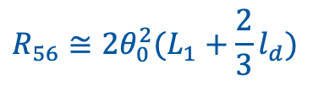
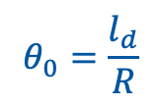
Coherent Synchrotron Radiation
σz[um] | 35
R56[mm] | 22
L1[m] | 6
Ld | 0.25
*B. Beutner. Phd Thesis, 2007, Hamburg
$$θ_{0}=\frac{l_{d}}{R}$$
$$R_{56}≅2θ_{0}^{2}(L_{1}+\frac{2}{3}l_{d})$$
$$σ_{0}≈R/γ^{3}$$
Expect strong CSR effects in the bunch compressor(s)!

Slide 10
Injector Options
 | BeamA | BeamB | BeamC
 | Avni*-250pc | Mohsen*-100pc-2 | Mohsen-50pc-1
Q[pC] | 250 | 100 | 50
E_inj[MeV] | 101 | 101.7 | 101.7
energy spread[%] | 0.5 | 0.33 | 0.33
I_peak[A] | 80 | 460 | 560
σt[fs] | 974 | 73.5 | 33
σz[um] | 292 | 22.05 | 9.9
σx,y[mm] | 0.12 | 0.2 | 0.2
εx,y[mm.mrad] | 0.4 | 0.62 | 0.68
Full x-band with two BCs
One BC?
No BC?
* A. Aksoy@AnkaraU
* M. D. Kelisani@IRFS

Slide 11
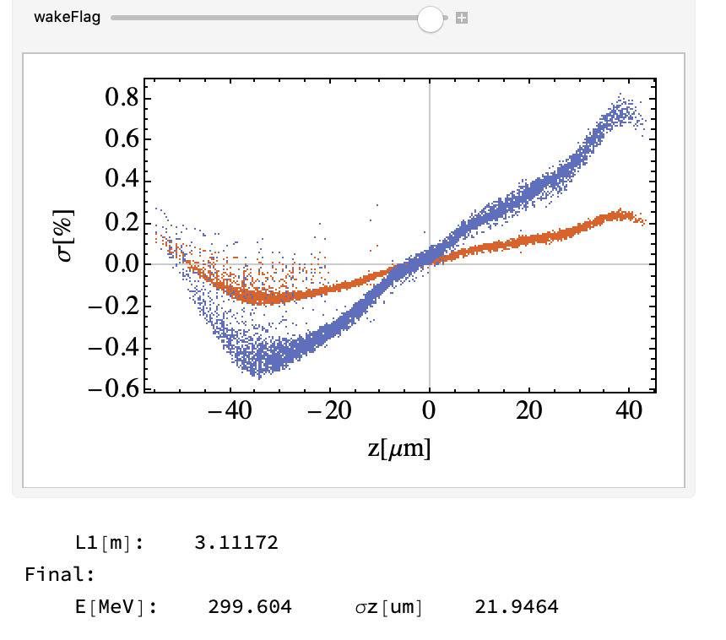
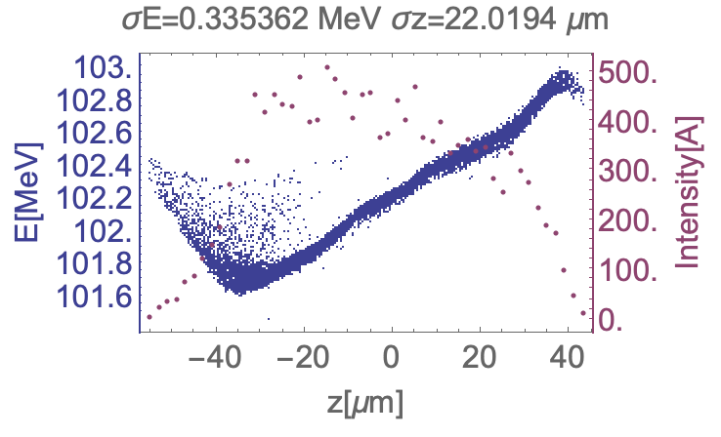
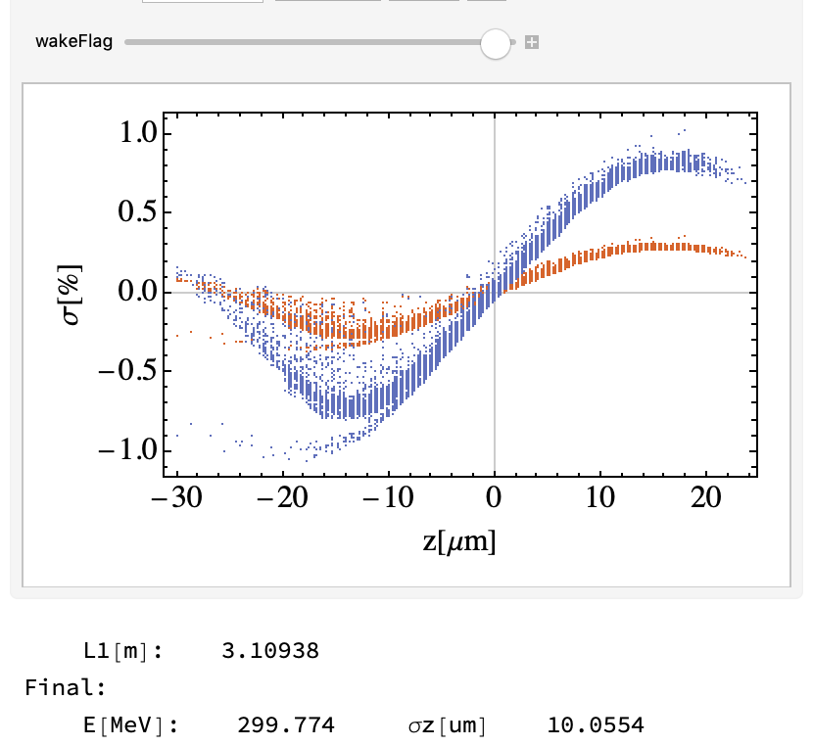
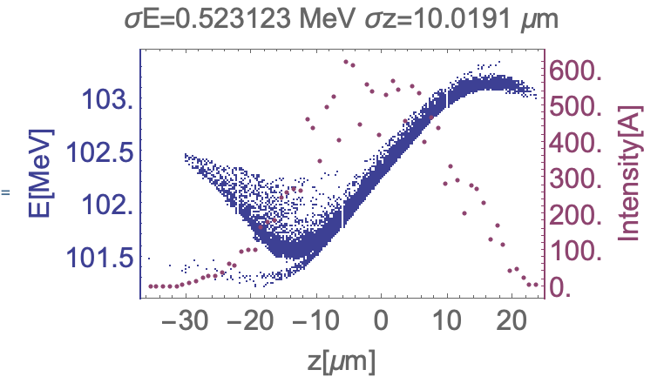
BeamB
X-band
Acc
BeamC
X-band
Acc

Slide 12
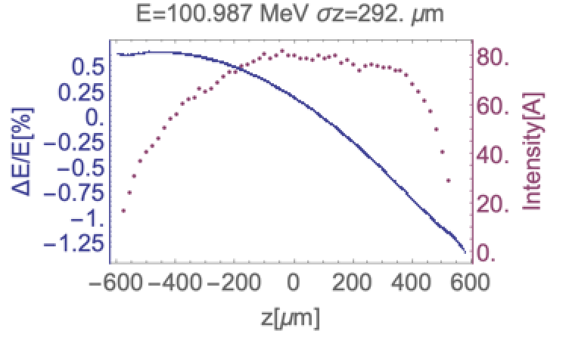
BeamA(x-band acc. & k-band)
Total Charge[pC] | 250
E0[MeV] | 100
Z0[um] | 292
L1[m] | 1.45
phi_1[deg] | -12 | 12
Vk | ?
phi_k | -180
E1[MeV] | 105~275 | 185~275
C1(R56) | R56>0 (Chicane) | R56<0(Arc)
Z2[um] | ~35
L2[m] | -
phi_2[deg] | -10 | 10
E2[MeV] | ~300
with K-band: S1(2mm) and S2(3mm)

Slide 13
S1: 2mm-25MV/m Vs. S2: 3mm-15MV/m
3mm
2mm

Slide 14
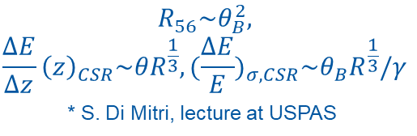
3mm
2mm
$$R_{56}\sim θ_{B}^{2},$$
$$\frac{ΔE}{Δz}{\left(z\right)}_{CSR}\sim {θR}^{\frac{1}{3}},{(\frac{ΔE}{E})}_{σ,CSR}\sim θ_{B}R^{\frac{1}{3}}/γ$$
* S. Di Mitri, lecture at USPAS
Where to put the k-band? | 200~250 MeV
K-band structure length? | S1 (2mm- 25MV/m) | 0.6~0.8m (15~20MV)
 | S1 (3mm- 15MV/m) | 1~1.4m (15~20MV)
R56? Chicane or Arc? | 0.022~0.025 | Chicane

Slide 15
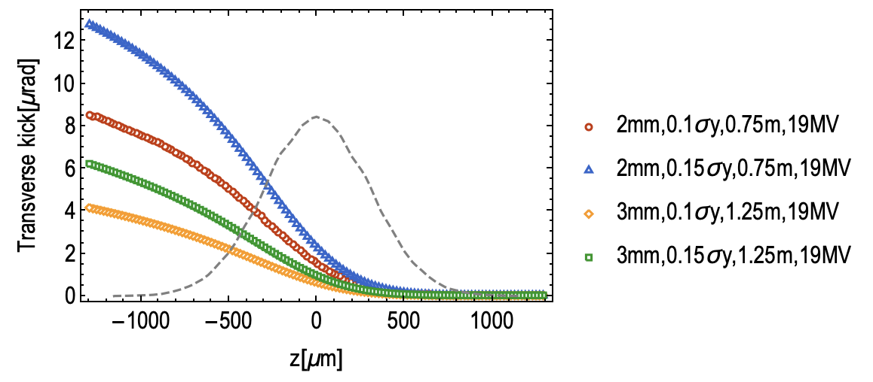


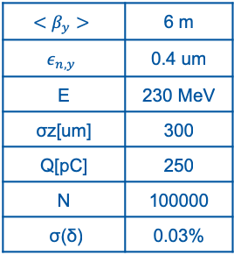
Transverse wake kick by K-band
$$<β_{y}>$$ | 6 m
$$ε_{n,y}$$ | 0.4 um
E | 230 MeV
σz[um] | 300
Q[pC] | 250
N | 100000
σ(δ) | 0.03%
$$Transverse jitter: Δy=10\sim 15\% σ_{y}$$
tail
head
$${σy}^{′}=\sqrt{ε/β_{y}}=12 μrad$$
The transverse kick due to short-range wake field kick seems acceptable in both cases given $10\sim 15\% σ_{y}$ jitter in present rough estimation.

Slide 16
1D Longitudinal Optimization with Wake
By Andrea Latina (CERN)

Slide 17
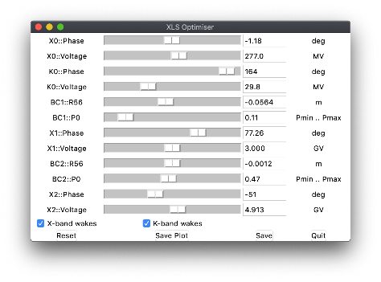
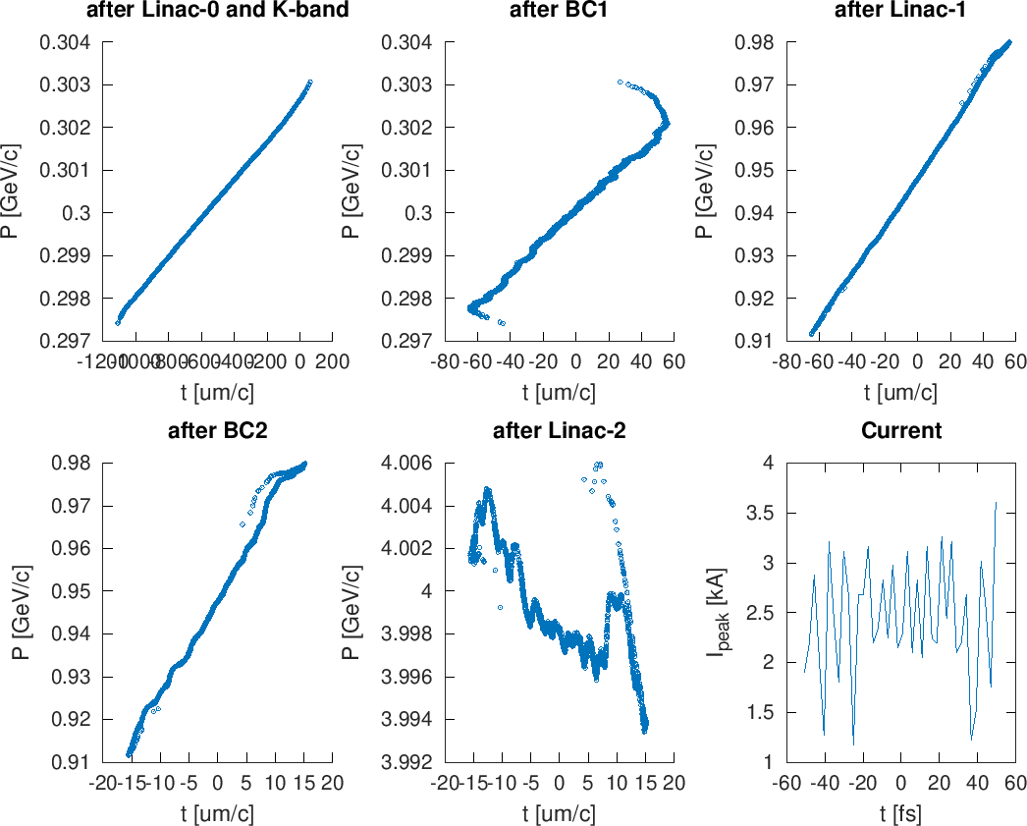
XFEL-Code 1D (A. Latina)
4 GeV beam –> uniform current
*X-band: Frascati’s XLS structure
*K-band:
a = 2 mm, L = 0.75 m, G_{max} = 25 MV/m
bc1_sigmaZ = 34.807 um
bc1_meanE = 0.30007 GeV
bc2_sigmaZ = 8.7351 um
linac2_meanE = 3.9991 GeV
sigmaE = 0.0025413 GeV
sigmaE_E_percent = 0.063547
sigmaE_slice = 0.00032475 GeV
sigmaE_E_slice_percent = 0.0081228

Slide 18
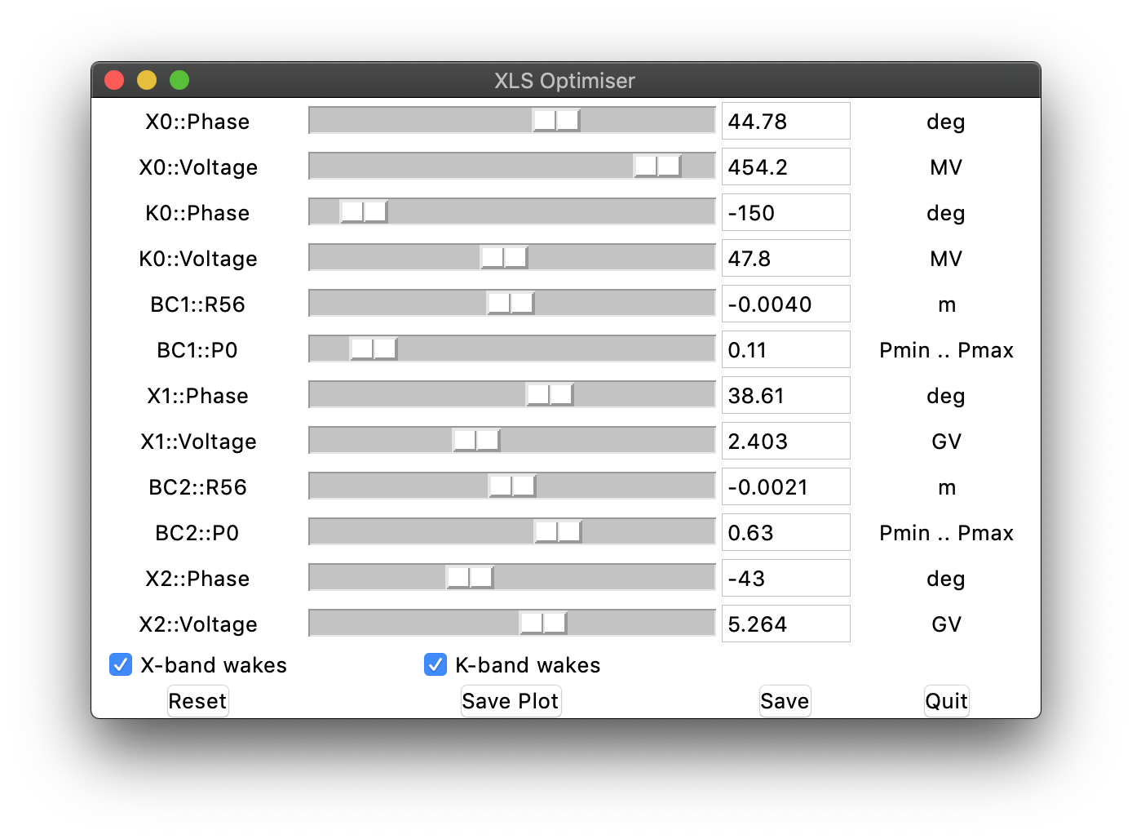
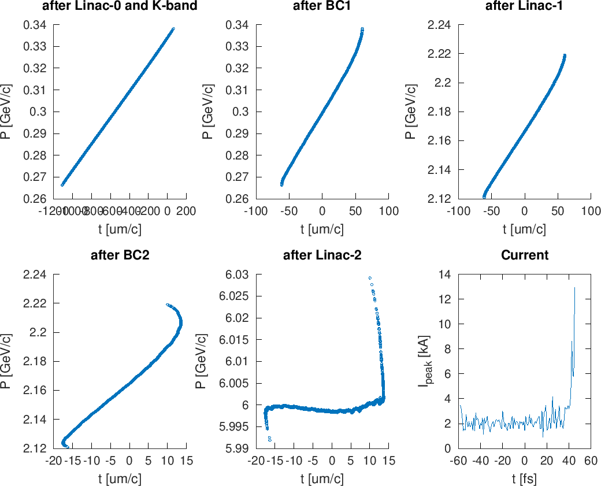
XFEL-Code 1D (A. Latina)
6 GeV beam –> uniform current
*X-band: Frascati’s XLS structure
*K-band:
a = 2 mm, L = 0.75 m, G_{max} = 25 MV/m
bc1_sigmaZ = 33.765 um
bc1_meanE = 0.30000 GeV
bc2_sigmaZ = 9.7789 um
linac2_meanE = 6.0000 GeV
sigmaE = 0.0032871 GeV
sigmaE_E_percent = 0.054785
sigmaE_slice = 0.000090374 GeV
sigmaE_E_slice_percent = 0.0015066

Slide 19
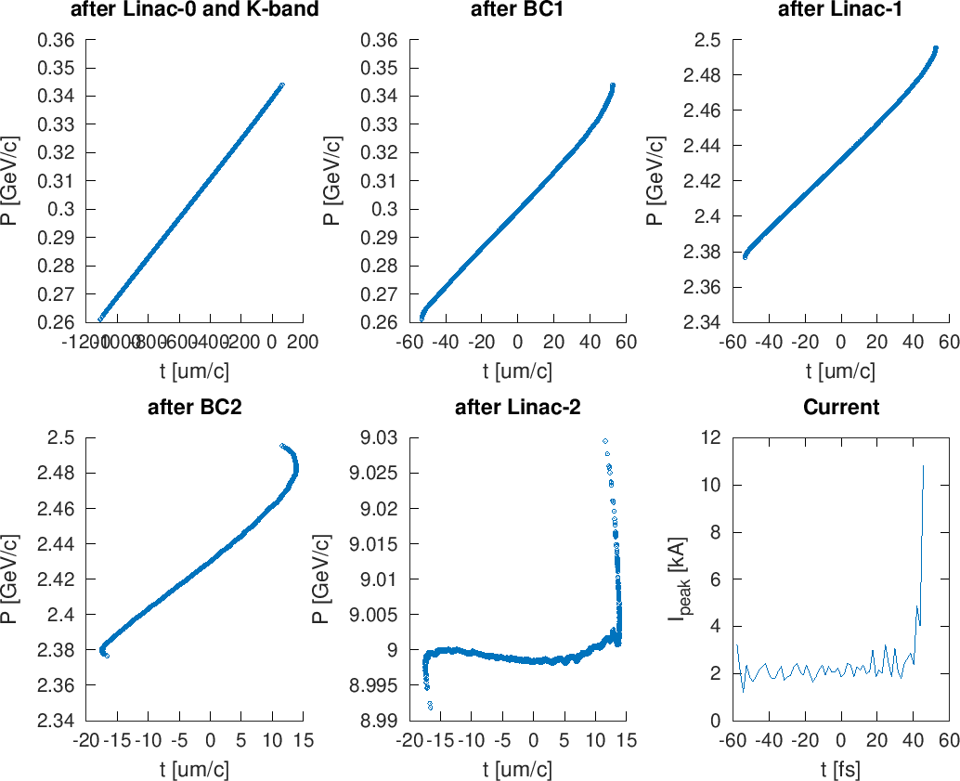
XFEL-Code 1D (A. Latina)
9 GeV beam –> uniform current
*X-band: Frascati’s XLS structure
*K-band:
a = 2 mm, L = 0.75 m, G_{max} = 25 MV/m
bc1_sigmaZ = 33.765 um
bc1_meanE = 0.30000 GeV
bc2_sigmaZ = 9.9865 um
linac2_meanE = 9.0000 GeV
sigmaE = 0.0029932 GeV
sigmaE_E_percent = 0.033257
sigmaE_slice = 0.00011149 GeV
sigmaE_E_slice_percent = 0.0012390

Slide 20
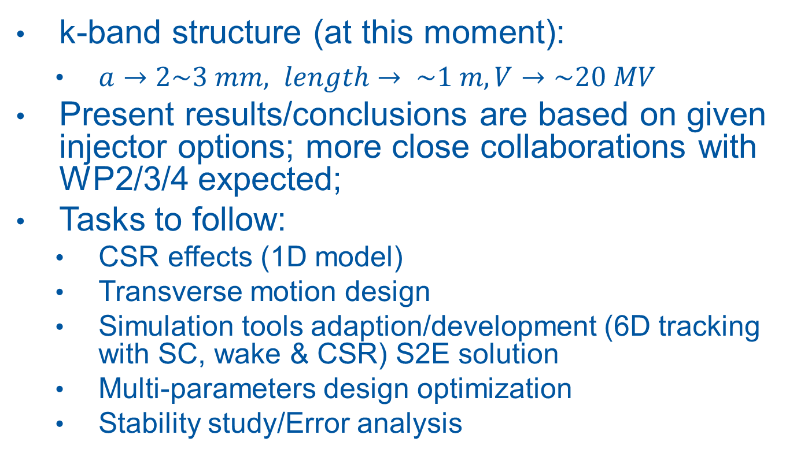
Summary and tasks to follow
k-band structure (at this moment):
  $a→2\sim 3 mm, length→ \sim 1 m, V→\sim 20 MV$
Present results/conclusions are based on given injector options; more close collaborations with WP2/3/4 expected;
Tasks to follow:
  CSR effects (1D model)
  Transverse motion design
  Simulation tools adaption/development (6D tracking with SC, wake & CSR) S2E solution
  Multi-parameters design optimization
  Stability study/Error analysis
Notes:
Tracking with K-band (w/ and w/o wakefiled) for Avni and Simone’s distributions
dC/C, arrival time stability
Demitt / emit (due to CSR, and wakefield)

Slide 21
THANKS

Slide 22
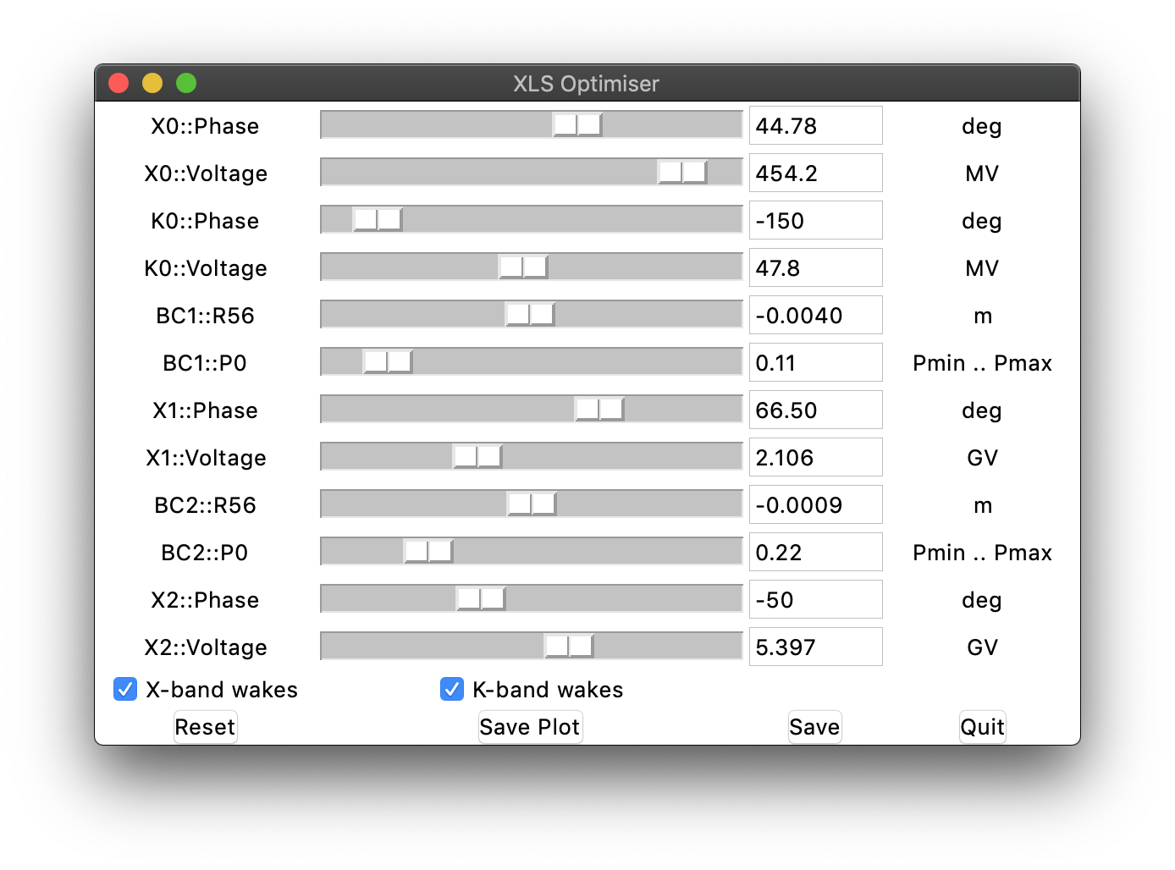
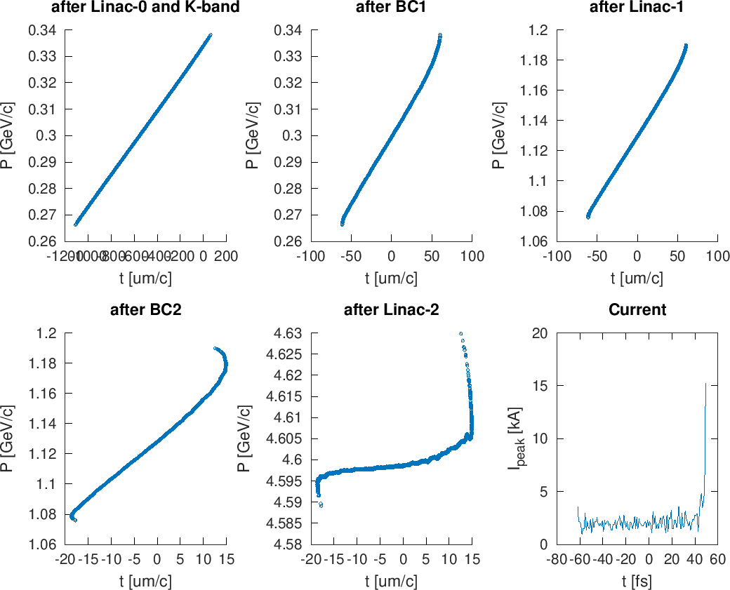
XFEL-Code 1D (A. Latina)
4.6 GeV beam –> uniform current
*X-band: Frascati’s XLS structure
*K-band:
a = 2 mm, L = 0.75 m, G_{max} = 25 MV/m
bc1_sigmaZ = 33.765 um
bc1_meanE = 0.30000 GeV
bc2_sigmaZ = 10.412 um
linac2_meanE = 4.6003 GeV
sigmaE = 0.0043391 GeV
sigmaE_E_percent = 0.094324
sigmaE_slice = 0.00013086 GeV
sigmaE_E_slice_percent = 0.0028455

Slide 23
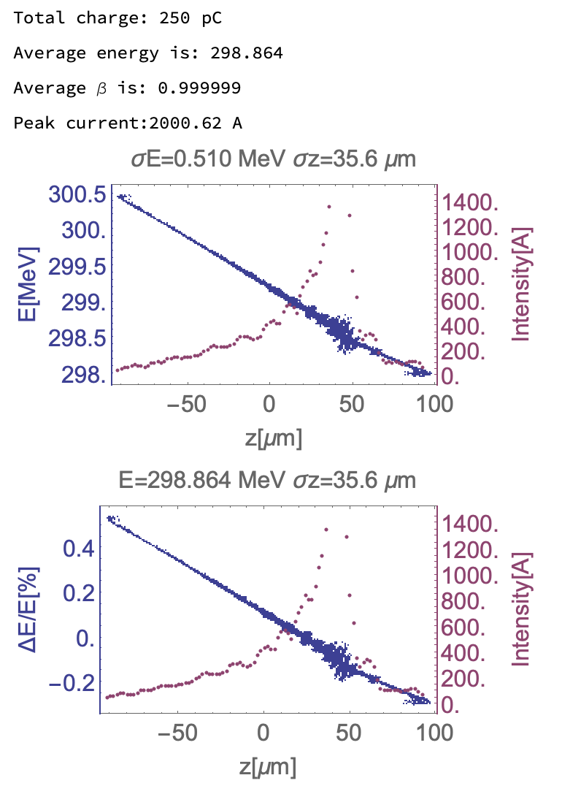
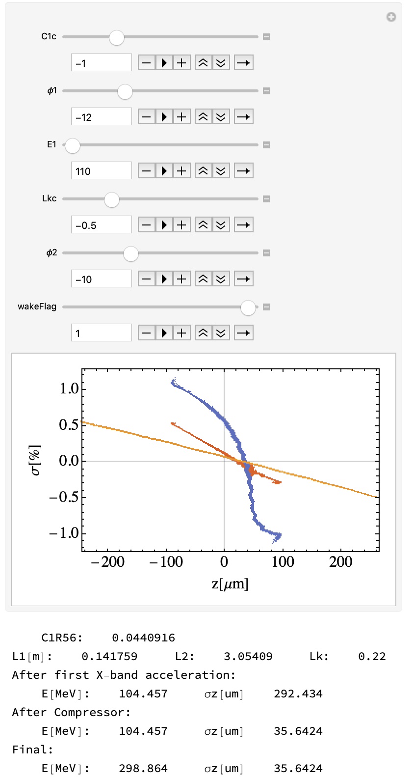
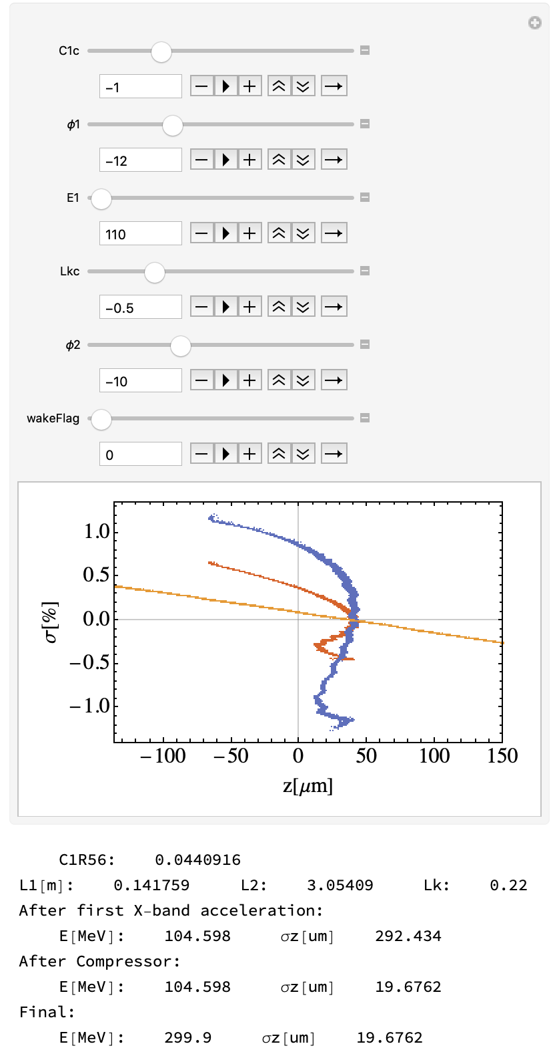
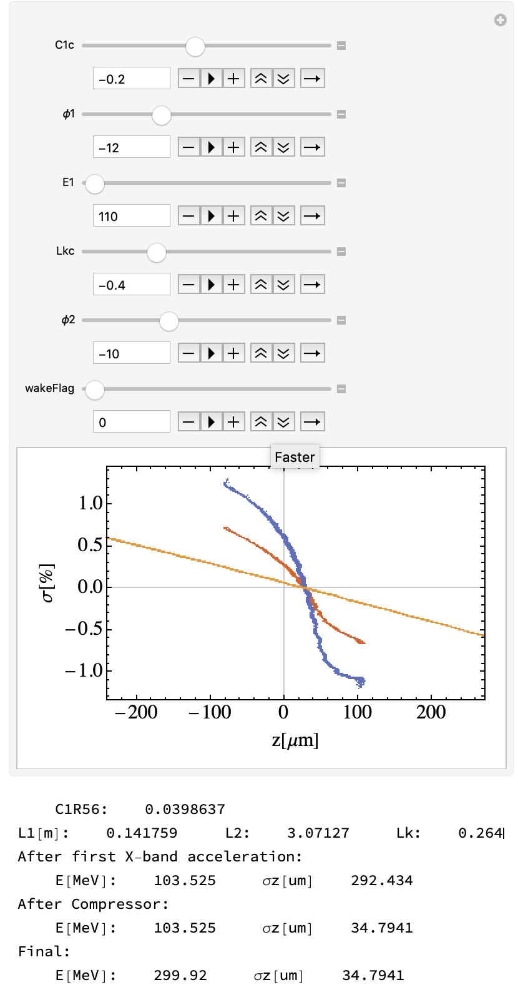
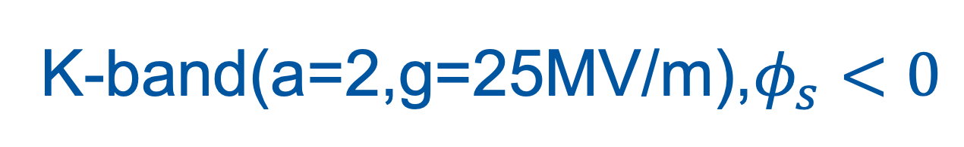
K-band(a=2,g=25MV/m),$φ_{s}<0$

Slide 24
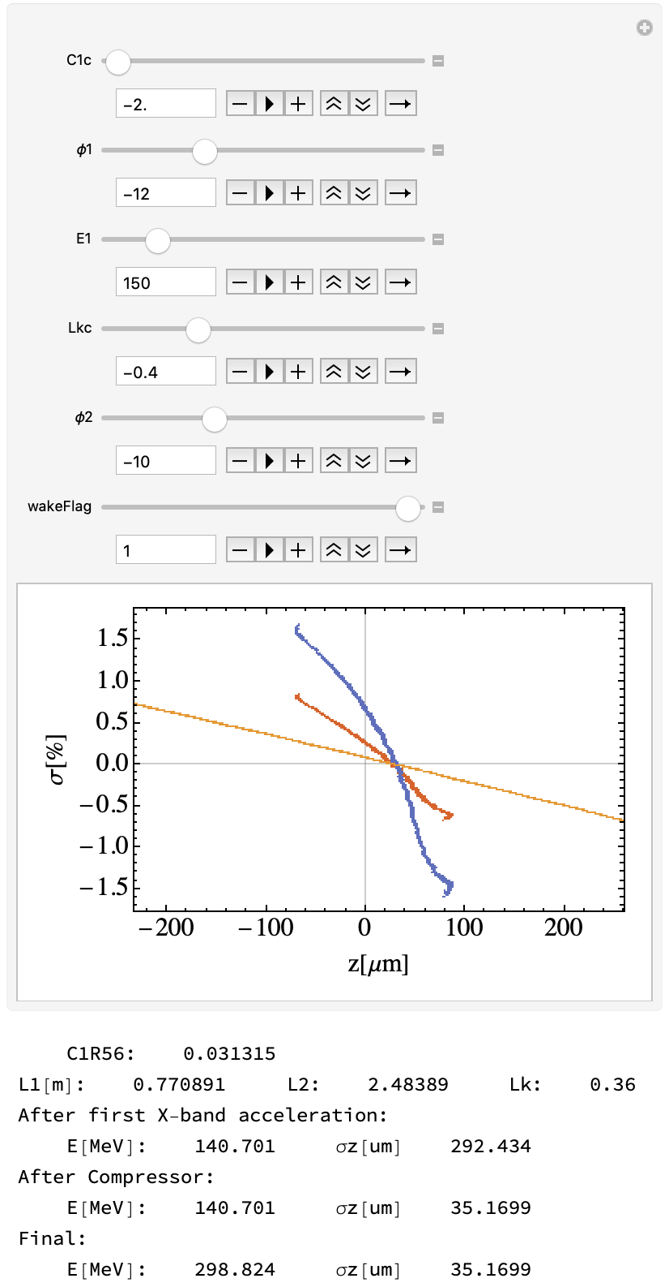
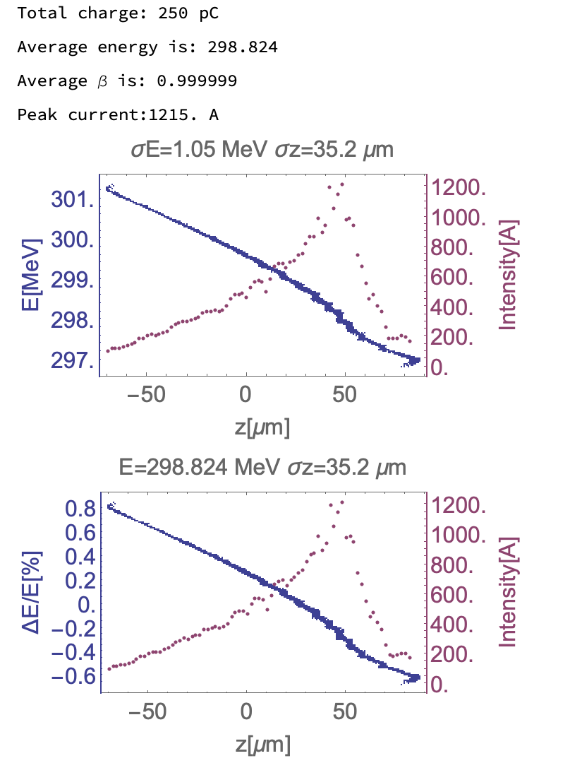
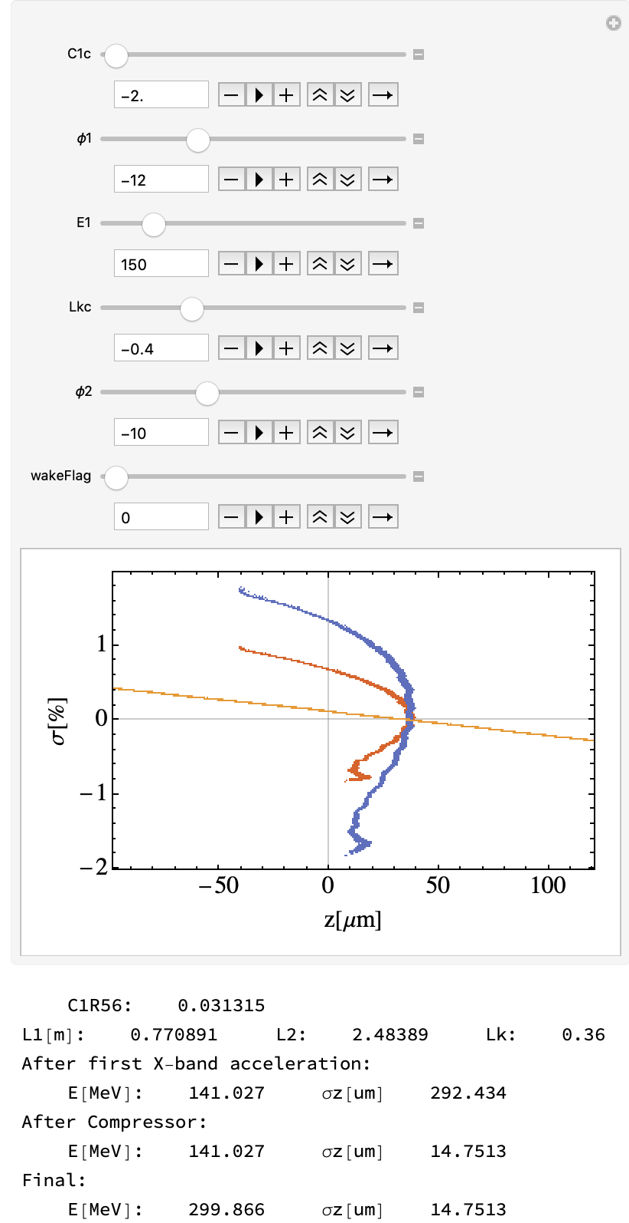
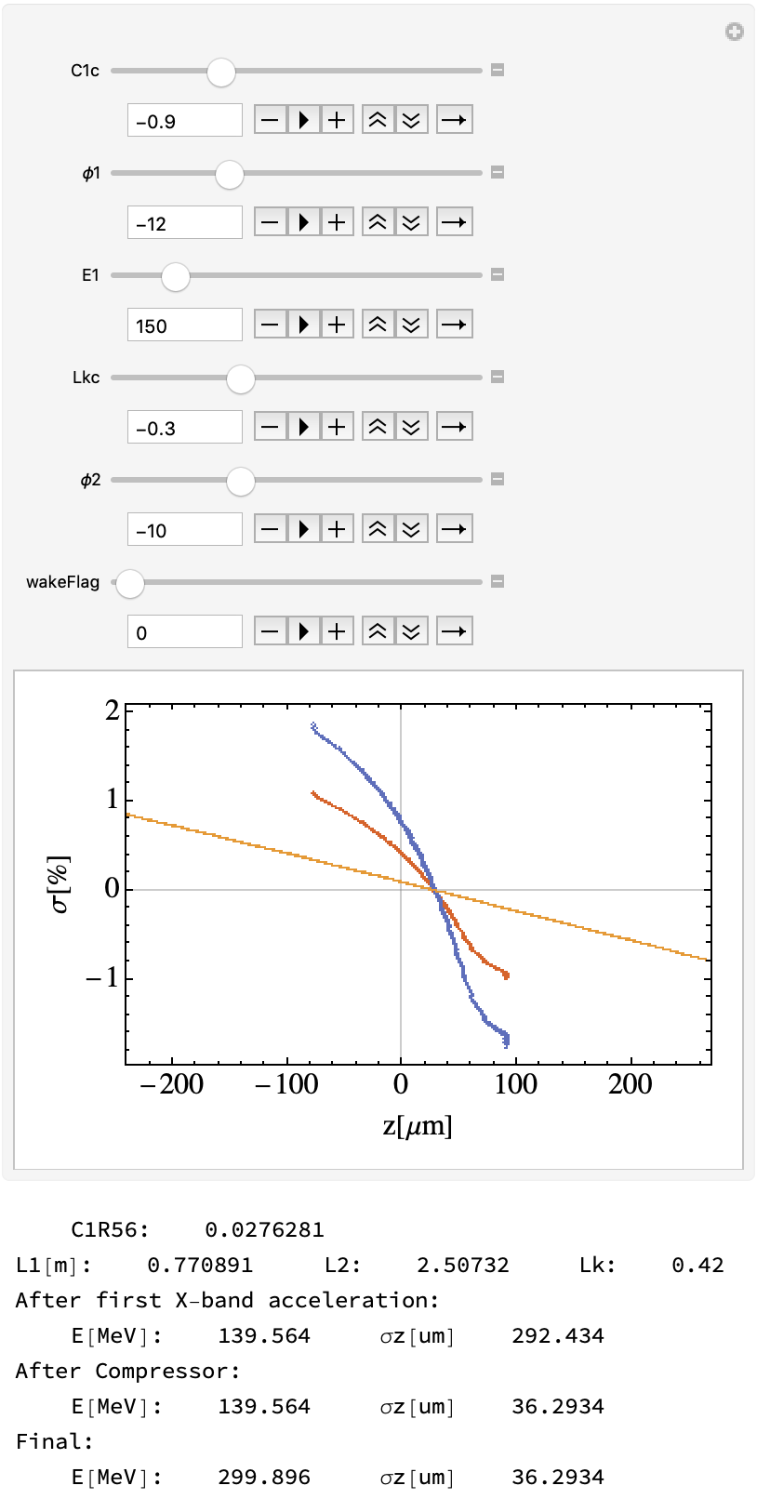

Slide 25
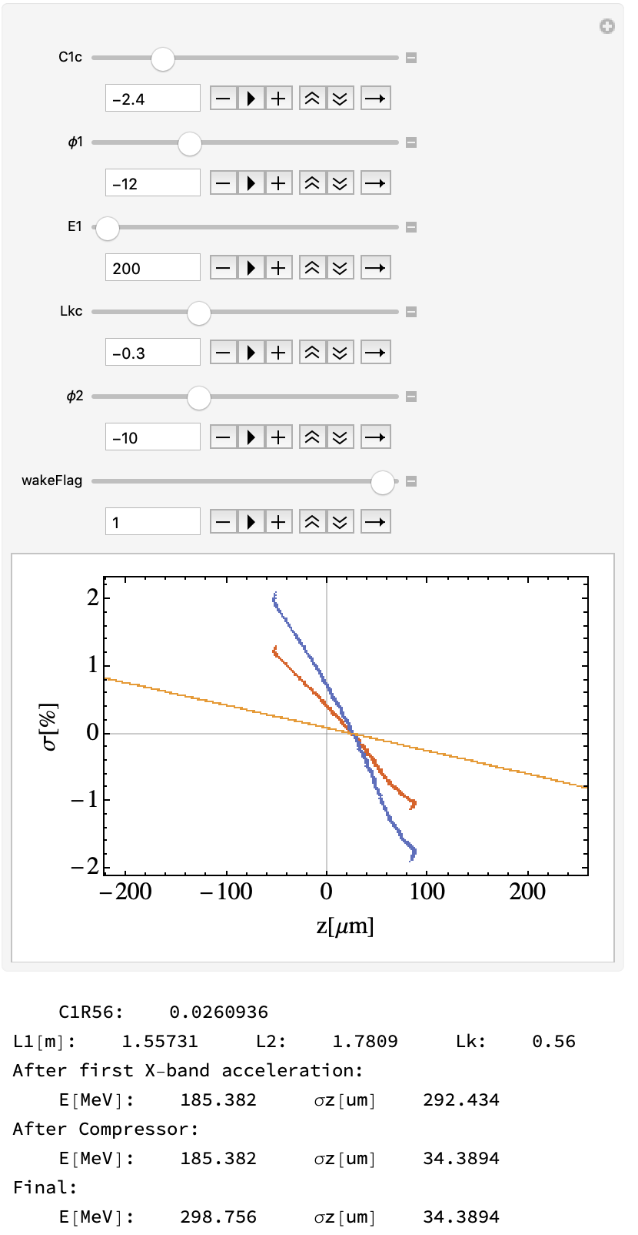
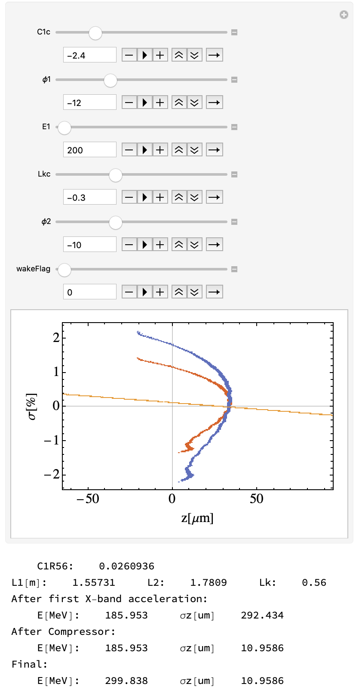



Slide 26





Slide 27





Slide 28





K-band(a=2,g=25MV/m),$φ_{s}>0$

Slide 29





Slide 30





Slide 31




K-band(a=3,g=15MV/m),$φ_{s}<0$

Slide 32




Slide 33




Slide 34




Slide 35




Slide 36




K-band(a=3,g=15MV/m),$φ_{s}>0$

Slide 37




Slide 38




