Slide 1

The Passive Dechirper
Funded by the European Union
Y. Han, A. Faus-Golfe, B. Bai
CNRS-LAL
11-Dec-2018
First XLS – Compact Light Annual Meeting

Slide 2
Outline
Why a passive dechirper
Principle of dechirper
Types of dechirper
The Wakefield of dechirper
Several examples
The XLS situation
Conclusion

Slide 3






Why do we need Dechirper ?
For FEL, bunch compression typically leaves an undesired time-energy correlation
  Broaden the FEL bandwidth and decrease FEL gain
RF (off crest) can remove it, but this can be costly & difficult for very high frequency (e.g. 36, 48 GHz)
Passive dechirper using self-induced wakefields to remove the chirp can be a better choice.
Linac
$$δ$$
tail
$$δ$$
$$δ$$
head
$$z$$
$$z$$
$$z$$

Slide 4
Outline
Why a passive dechirper
Principle of dechirper
Types of dechirper
The Wakefield of dechirper
Several examples
The XLS situation
Conclusion

Slide 5
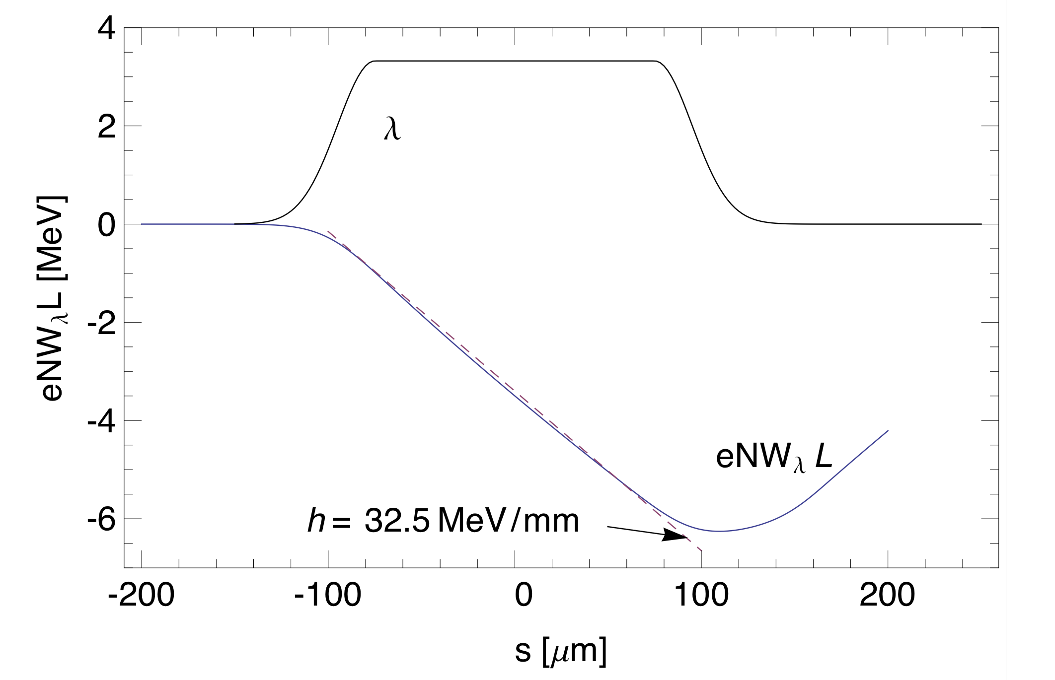



Principle of dechirper
When beam pass through a beam pipe, the induced short range wakefield can act on the beam itself
The bunch tail loss more energy than the head
$$δ$$
head
tail
$$δ$$
tail
$$z$$
$$z$$
head

Slide 6
Outline
Why a passive dechirper
Principle of dechirper
Types of dechirper
The Wakefield of dechirper
Several examples
The XLS situation
Conclusion

Slide 7
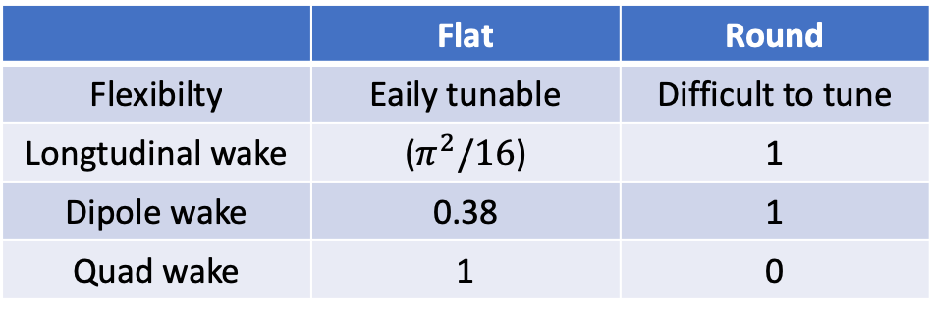






Types of Dechirper
Metal
$$a+δ$$
Three types of methods:
Metal waveguide with dielectric
Metallic structure with corrugated walls
RF cavity without input power
Different shapes:
Cylinder pipe
Rectangular pipe
Paralle plates
$$a$$
Dielectric
$$δ$$
$$g$$
$$2a$$
$$p$$
 | Flat | Round
Flexibilty | Eaily tunable | Difficult to tune
Longtudinal wake | ($π^{2}/16$) | 1
Dipole wake | 0.38 | 1
Quad wake | 1 | 0

Slide 8
Outline
Why a passive dechirper
Principle of dechirper
Types of dechirper
The Wakefield of dechirper
Several examples
The XLS situation
Conclusion

Slide 9
The Wakfield model – Cylinder corrugated
Cylinder corrugated pipe:
$$g$$
$$δ$$
$$2a$$
$$p$$
Wave number
Loss factor
Wake function
Wake potential
Bunch loss factor

Slide 10
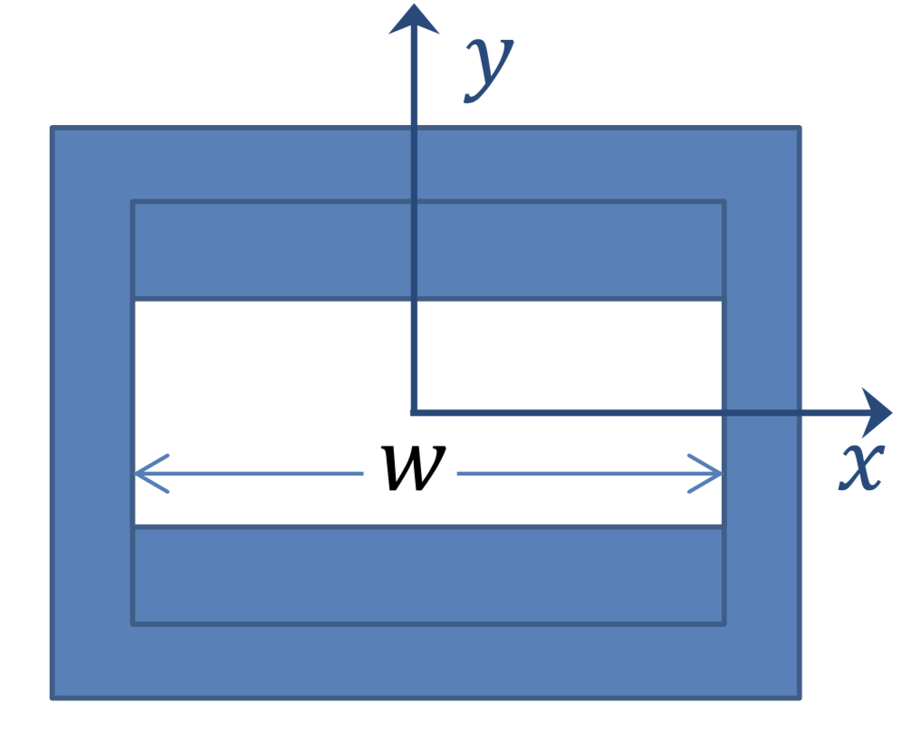
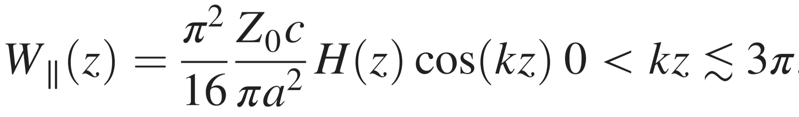
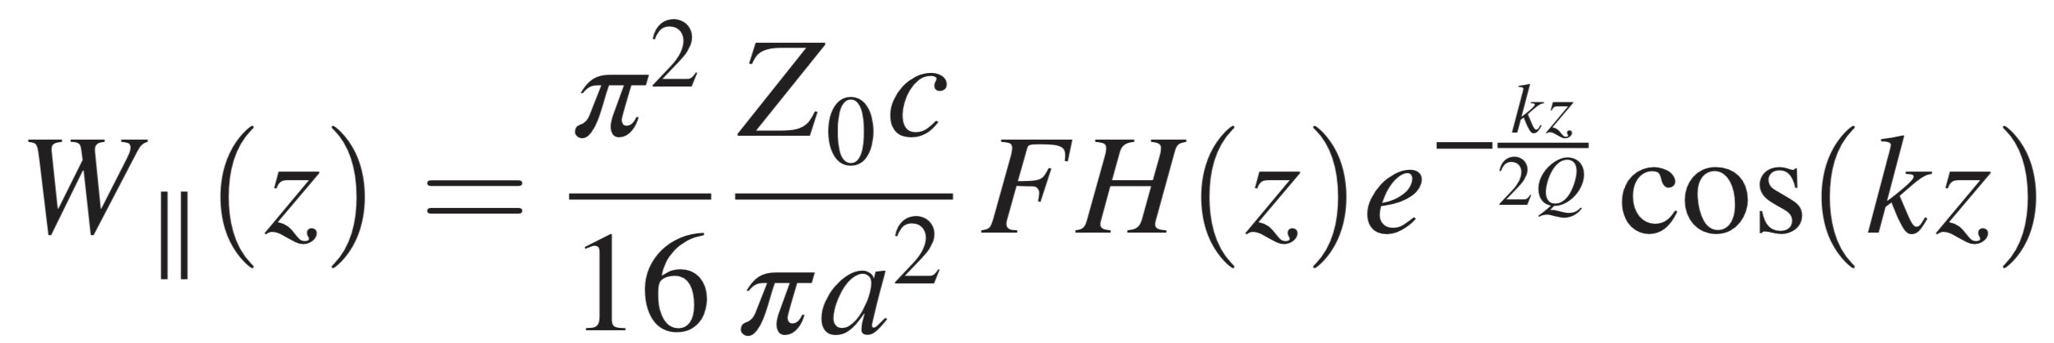
The Wakfield model – Rectangular Corrugated
y
Rectangular corrugated pipe:
$$g$$
$$δ$$
$$2a$$
$$p$$
Wave number
z
Loss factor
Wake function
If

Slide 11
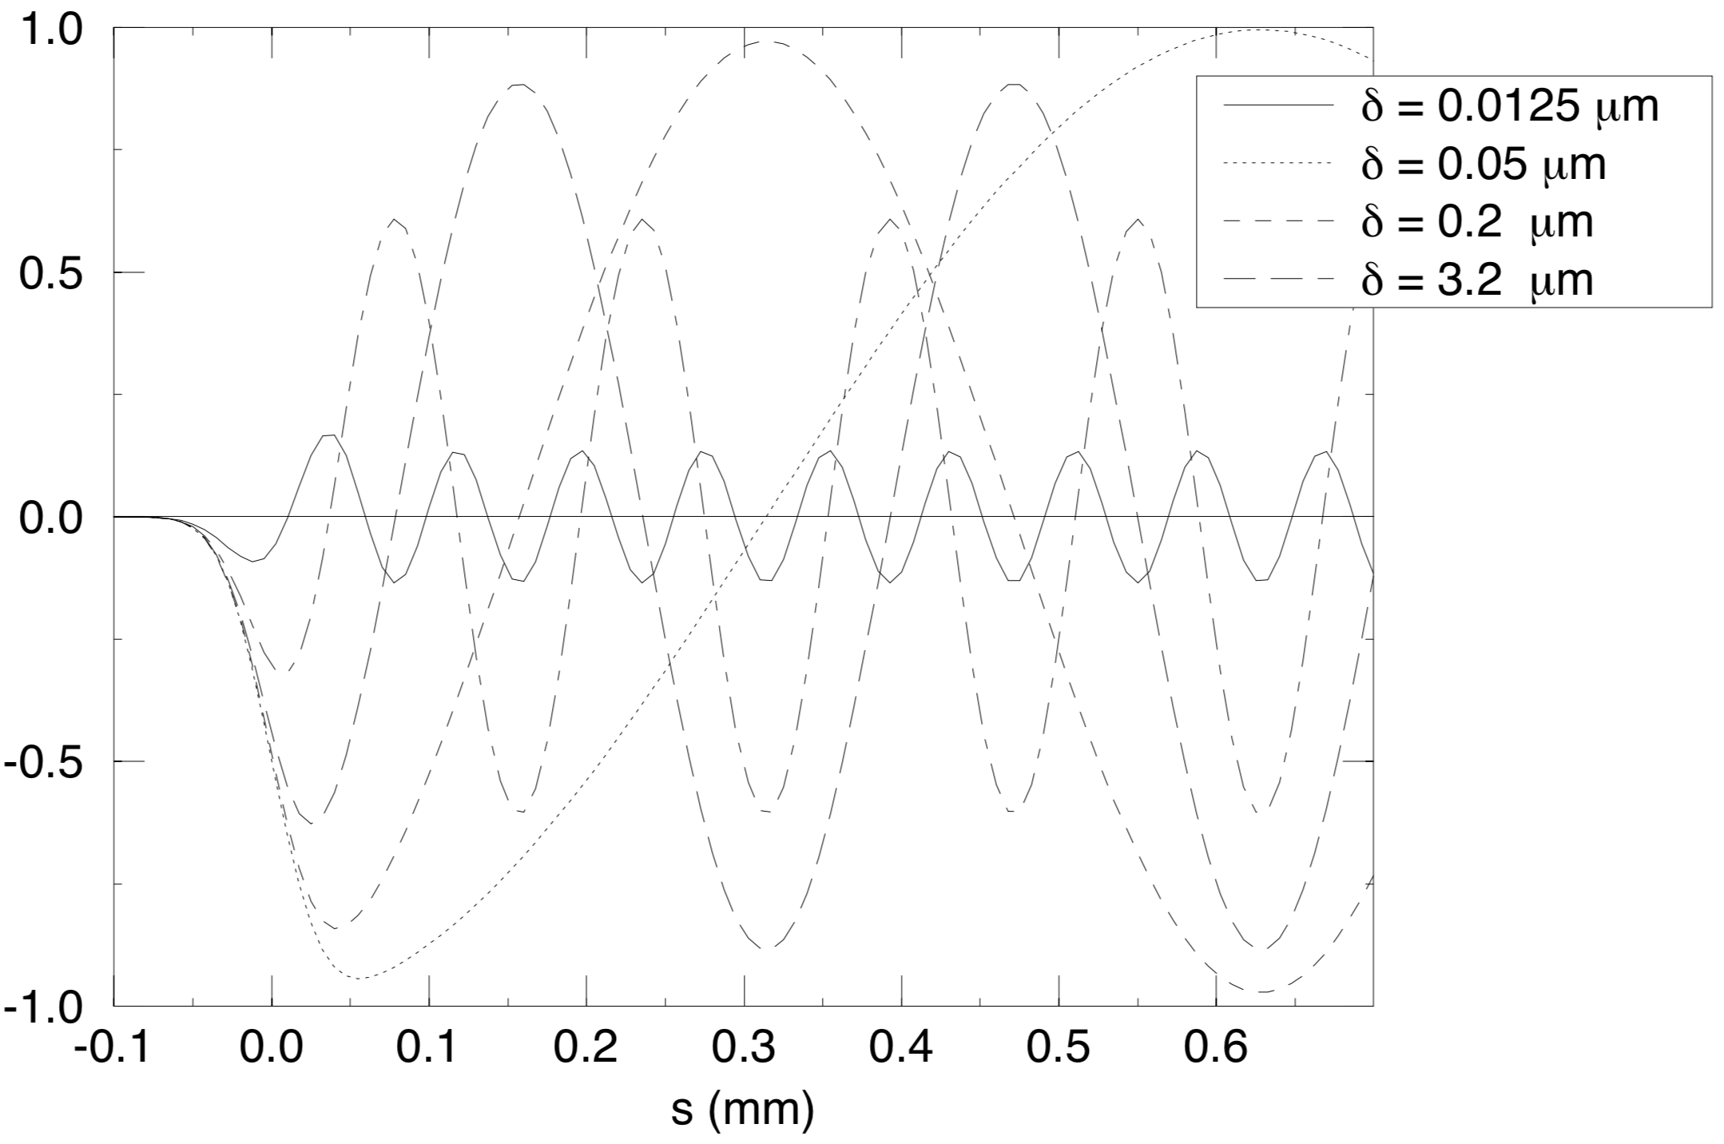
The Wakfield model -dielectric
Metal
$$a+δ$$
Cylinder dielectric pipe:
$$a$$
Dielectric
Wave number
Loss factor
Bunch loss factor

Slide 12
Outline
Why a passive dechirper
Principle of dechirper
Types of dechirper
The Wakefield of dechirper
Several examples
The XLS situation
Conclusion

Slide 13
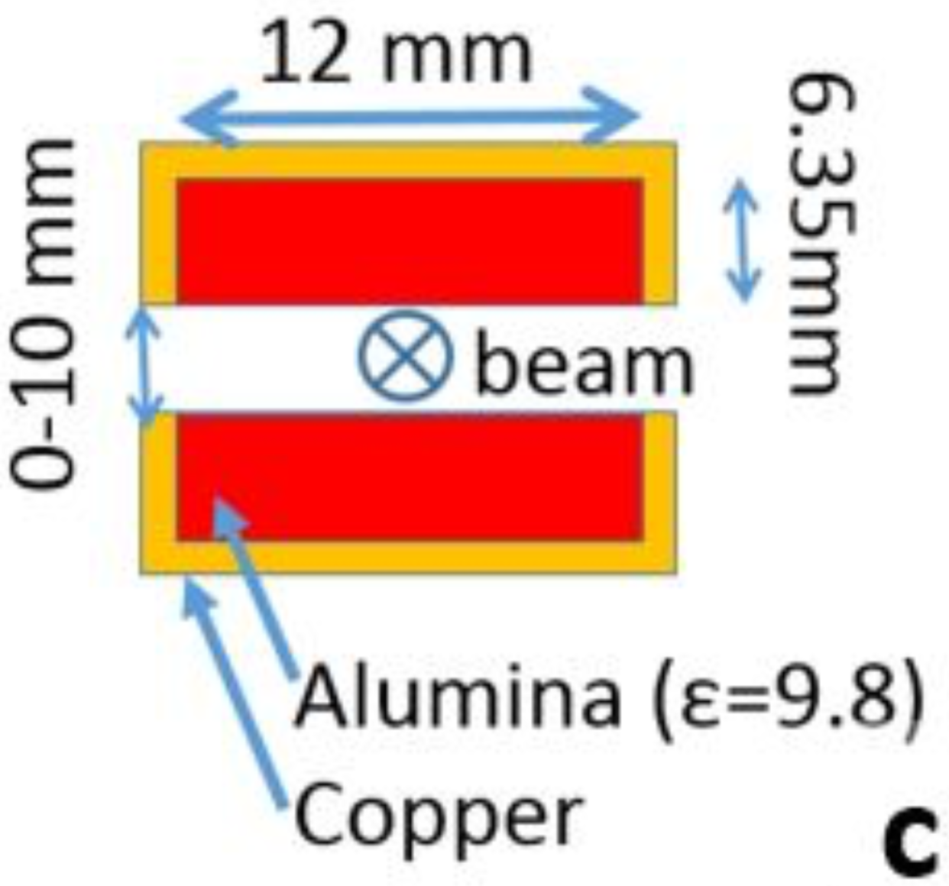
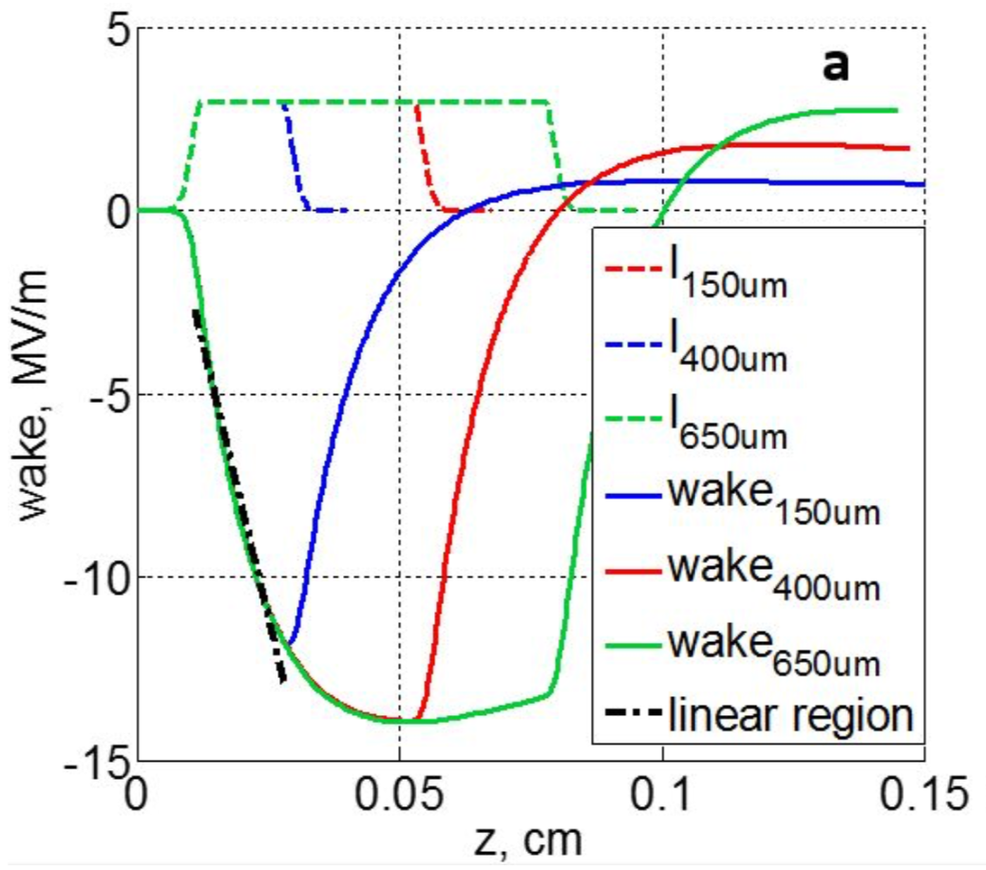
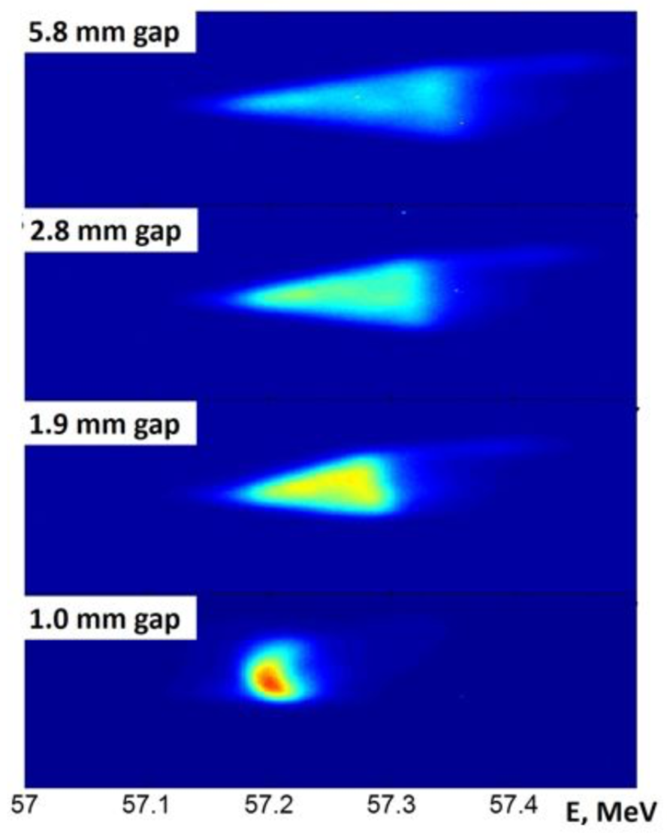
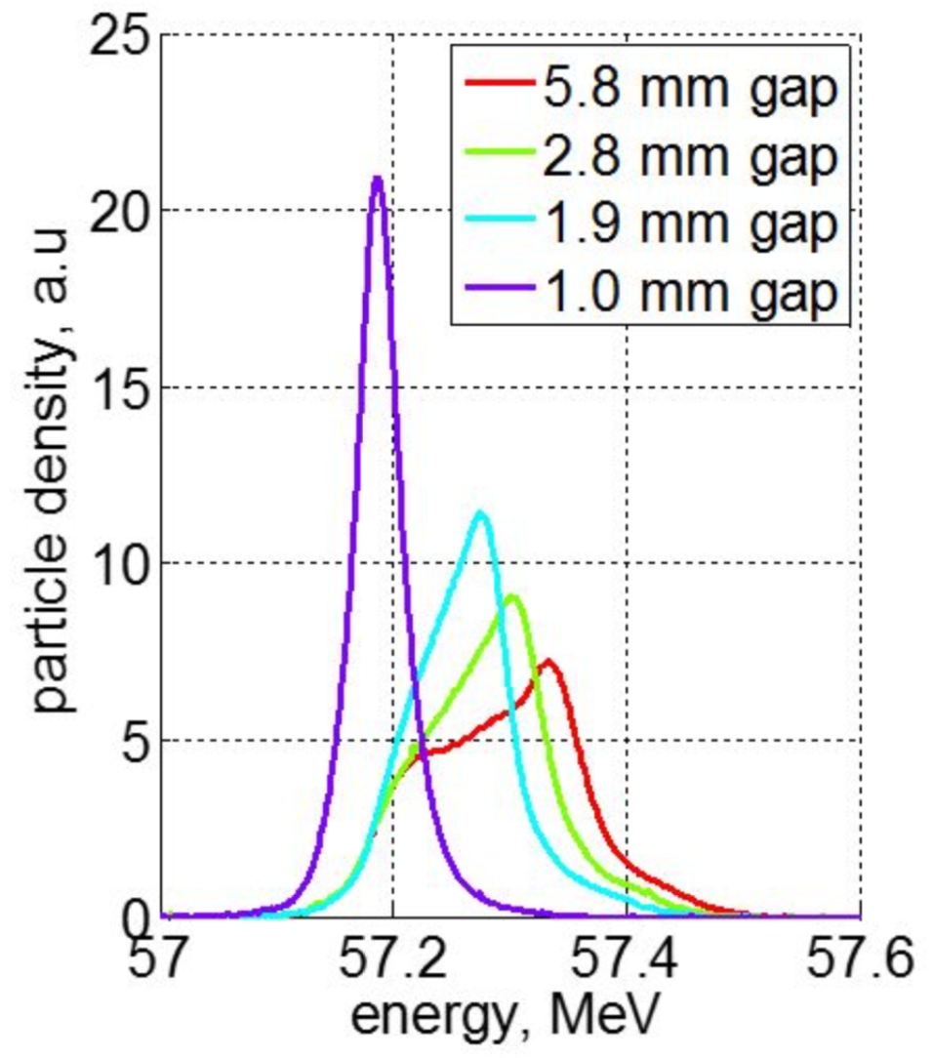
Examples- Brookhaven National Laboratory - ATF
60 MeV, 54 pC, 550 μm long
Energy chirp : 330 keV/mm
Planar tunable dechirper
  Two 10 cm long dielectric slabs
  The gap was changed from 5.8 mm to 1 mm

Slide 14
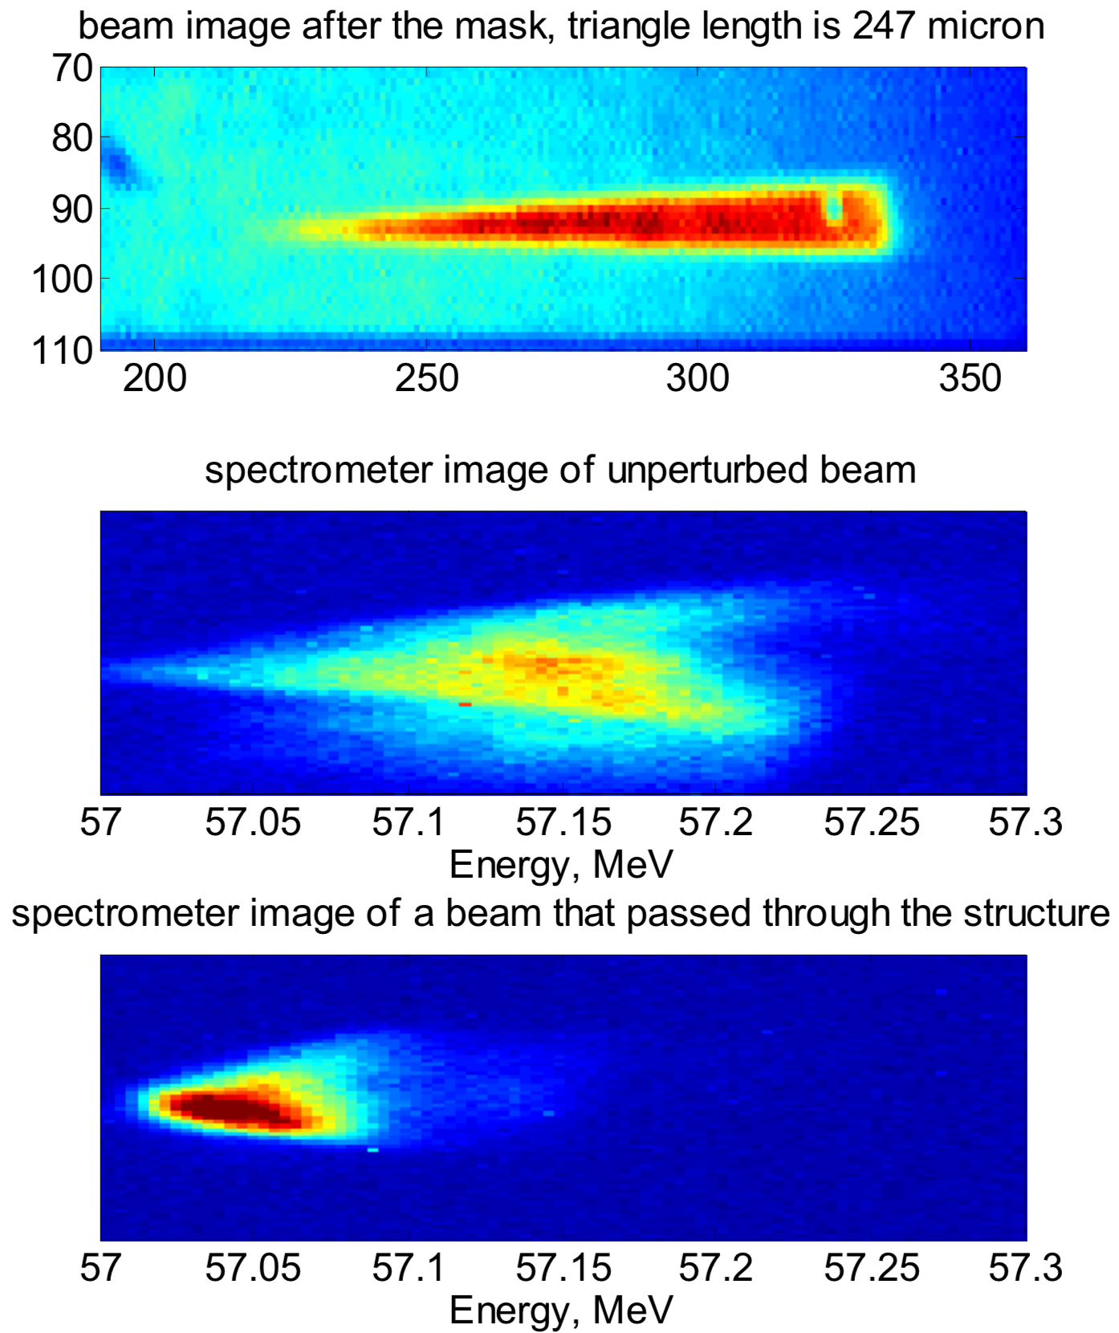
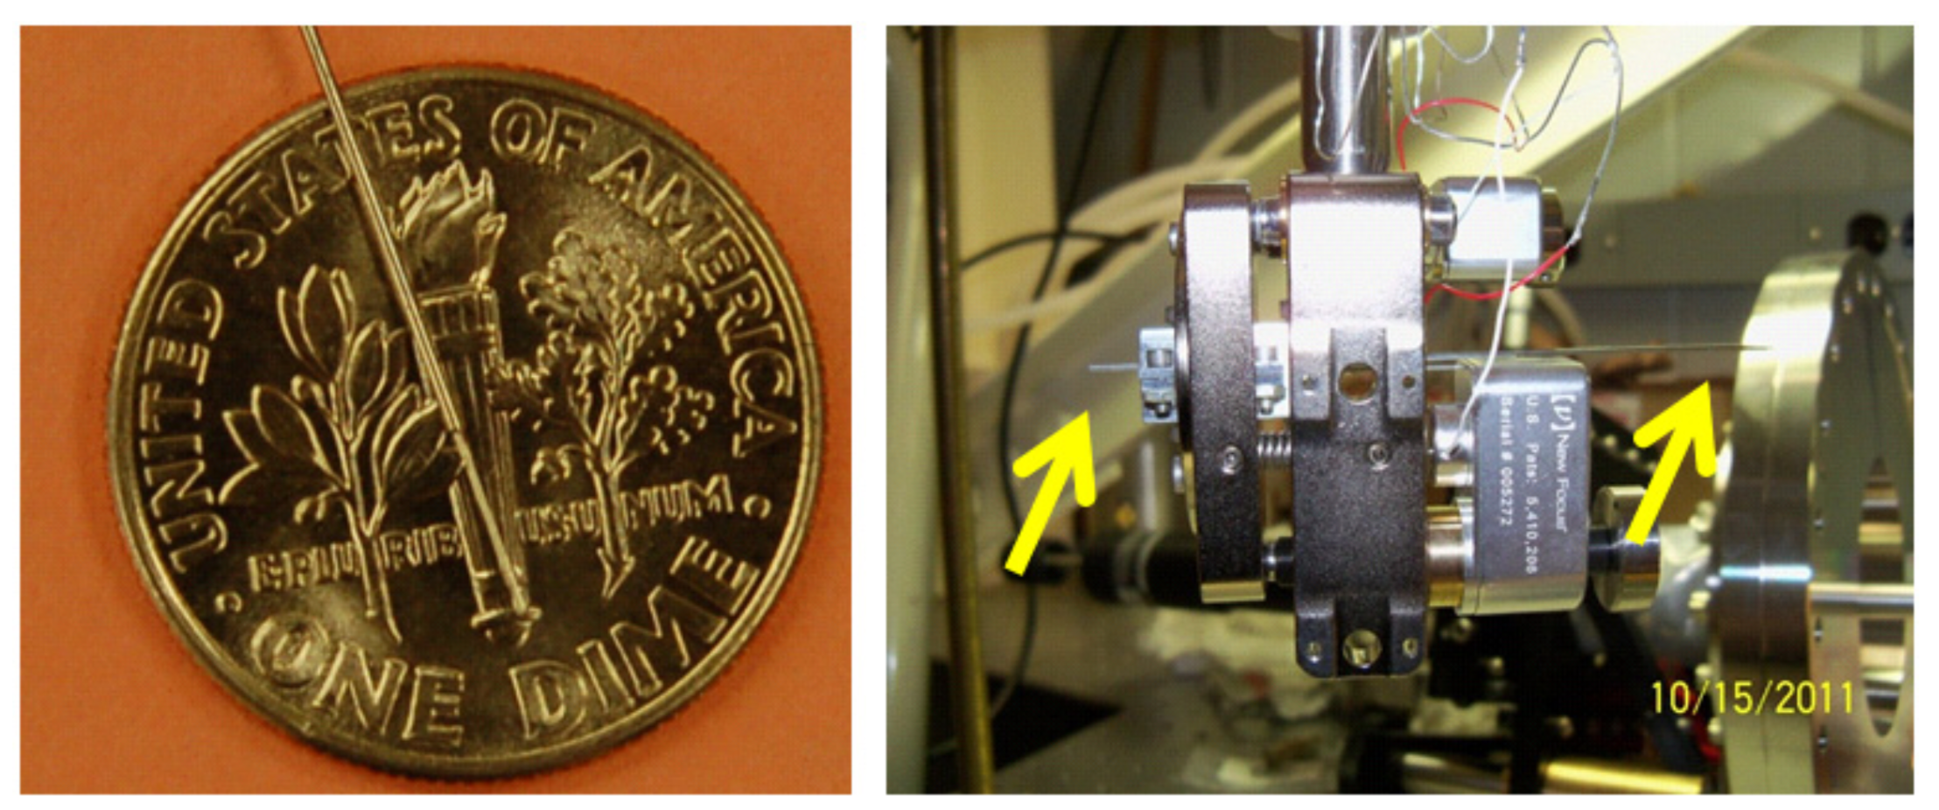
Examples- BNL ATF
57 MeV, 54 pC, 550 μm long
Energy spread: 200 -> 70 keV
Dielectric tube
  Inner radius: 330 mm
  Length: 5 cm

Slide 15
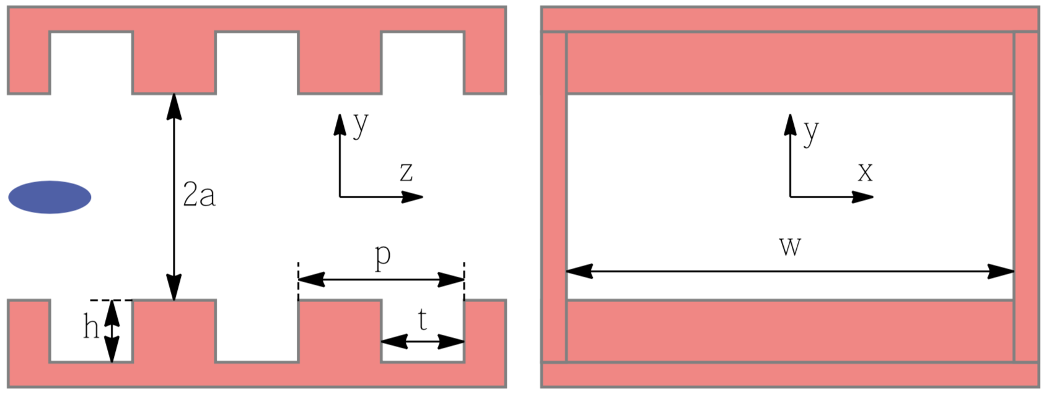
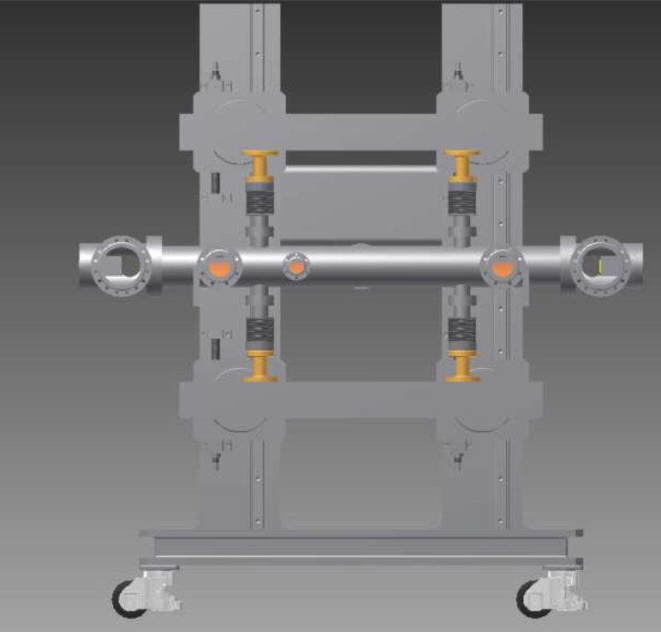
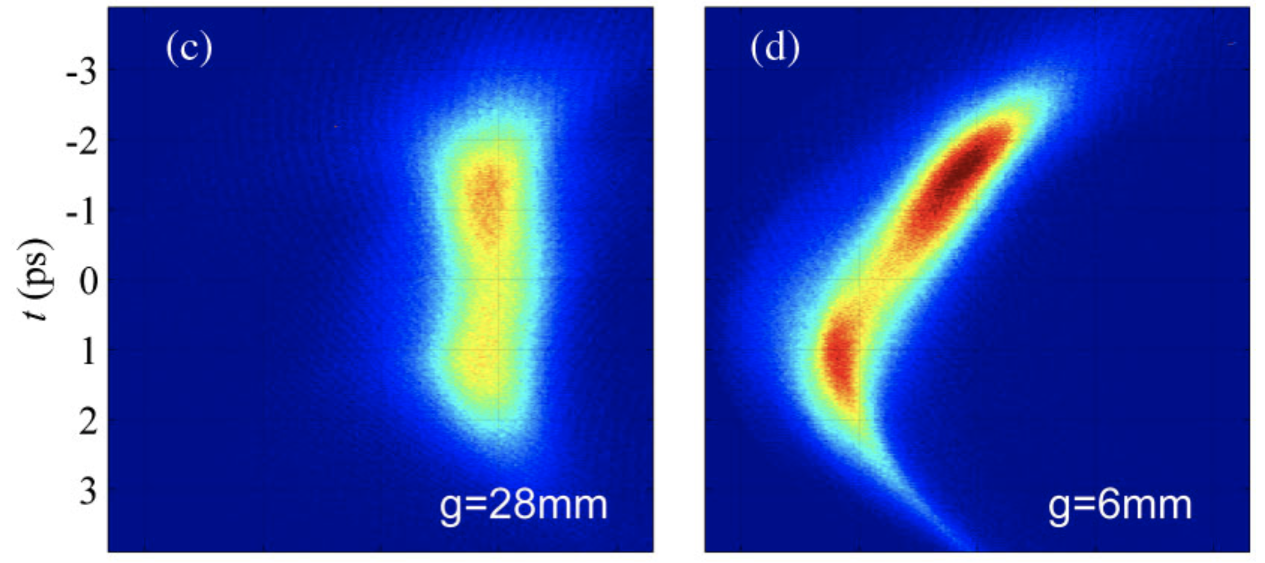
Examples- Pohang Accelerator Laboratory - ITF
70 MeV, 200 pC, 700 μm(σ_{z})
Corrugated rectangular pipe
  a = 28,6 mm, h = 0.6 mm, p = 0.5 mm, g = 0.3 mm
  Length: 1 m
g = 2a

Slide 16
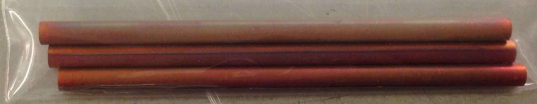
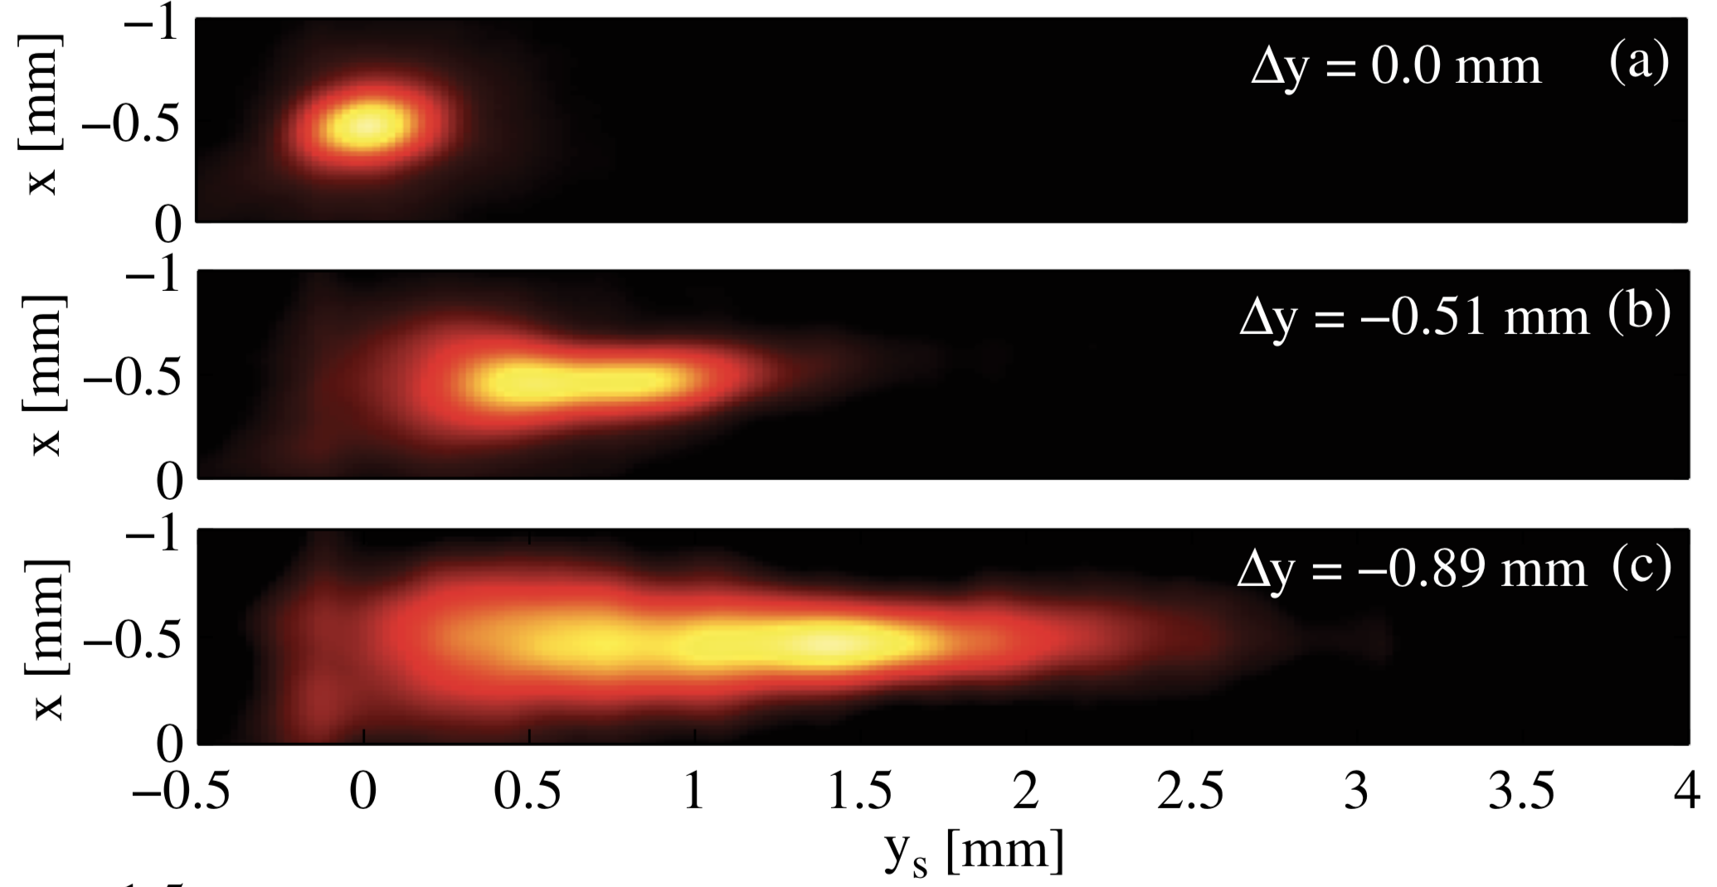
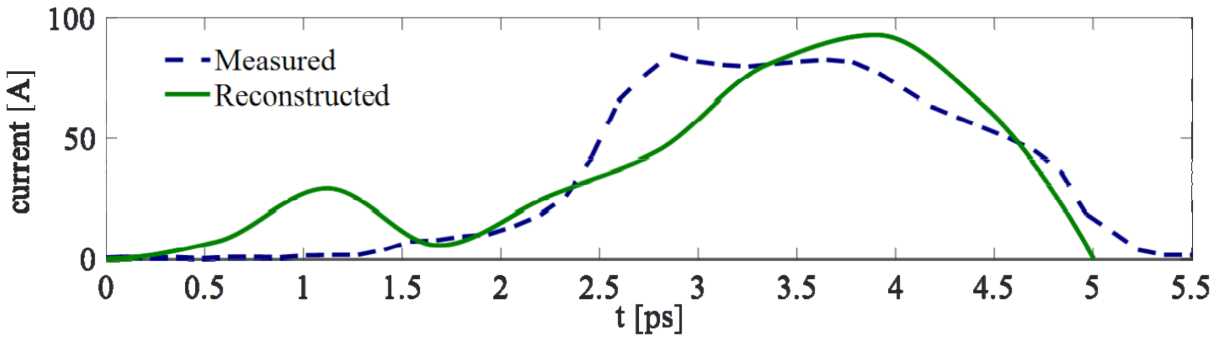
Examples- PSI - passive streaker
Temporal profile measurements
140 MeV, 200 pC, 1 ps (rms)
Dielectric cylinder pipe
  Alumina with Copper
  Inner radius: 1.65 mm
  Length: 9.5 cm

Slide 17
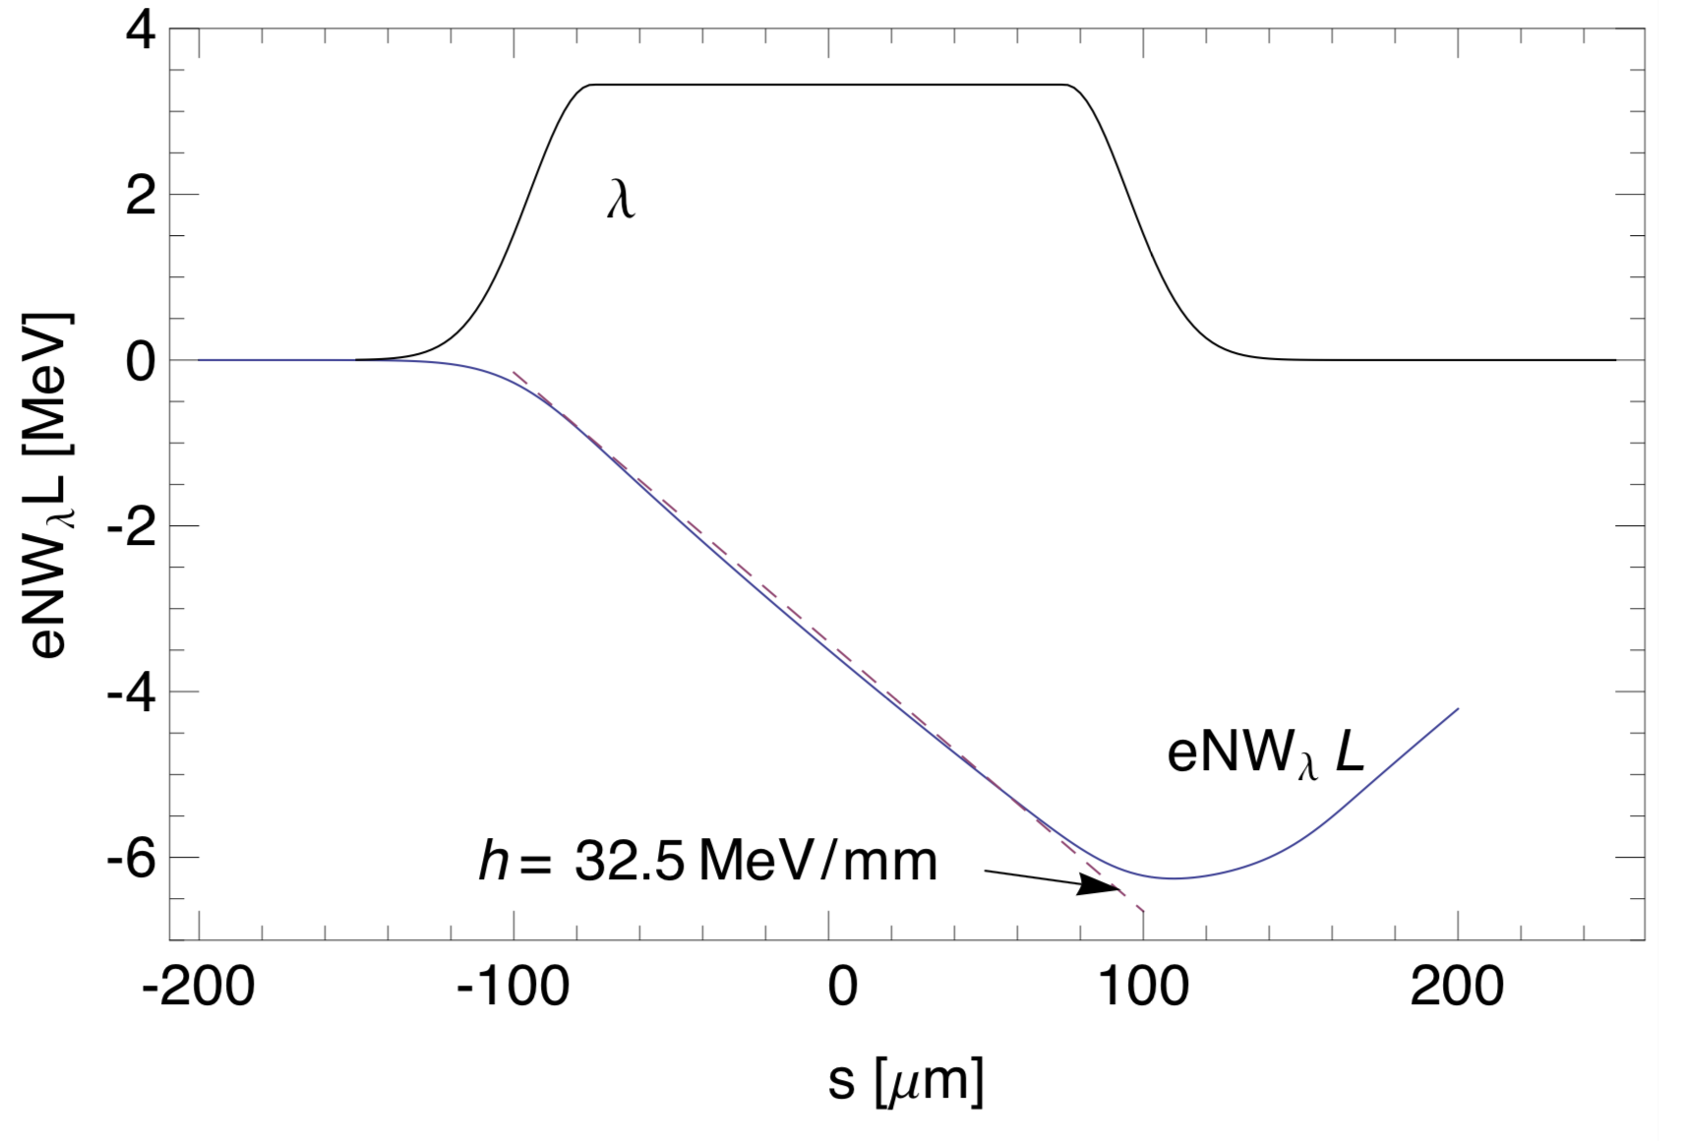
Examples- Berkeley National Laboratory - NGLS
$$δ$$
$$g$$
350 MeV, 300 pC, 150 μm long
Energy chirp : 40 MeV/mm
Corrugated cylinder pipe
  a = 3 mm, δ = 450 μm, p = 1000 μm, g = 750 μm
  Length: 6.65 m
$$2a$$
$$p$$
Due to the deviation between numerical and analytical results, the generated energy chirp is small than 40 MeV/mm. The 8.2 m structures is need.

Slide 18
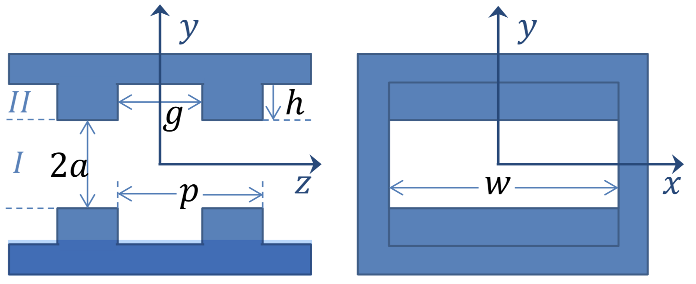
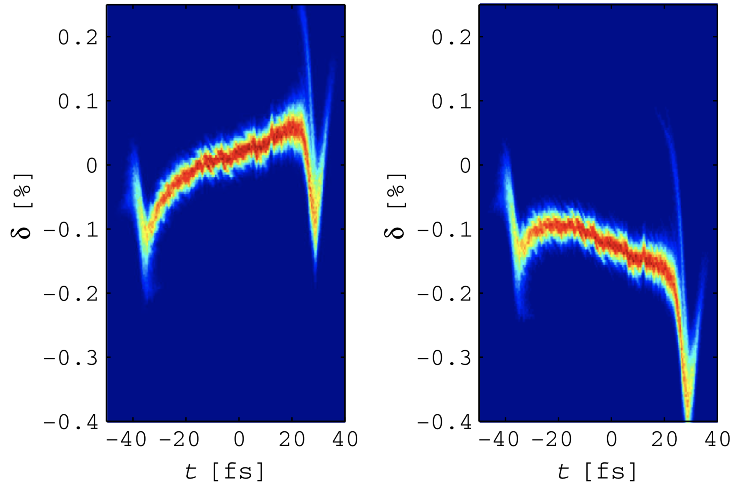
Examples- LCLS at SLAC
6.6 GeV, 150 pC, 15 μm long
Energy chirp : 1333 MeV/mm
Corrugated rectangular pipe
  a = 0.7 mm, h = 0.5 mm, p = 0.5 mm, g = 0.25 mm
  Length: 4 m
Before the dechirper
After the dechirper

Slide 19
Outline
Why a passive dechirper
Principle of dechirper
Types of dechirper
The Wakefield of dechirper
Several examples
The XLS situation
Conclusion

Slide 20
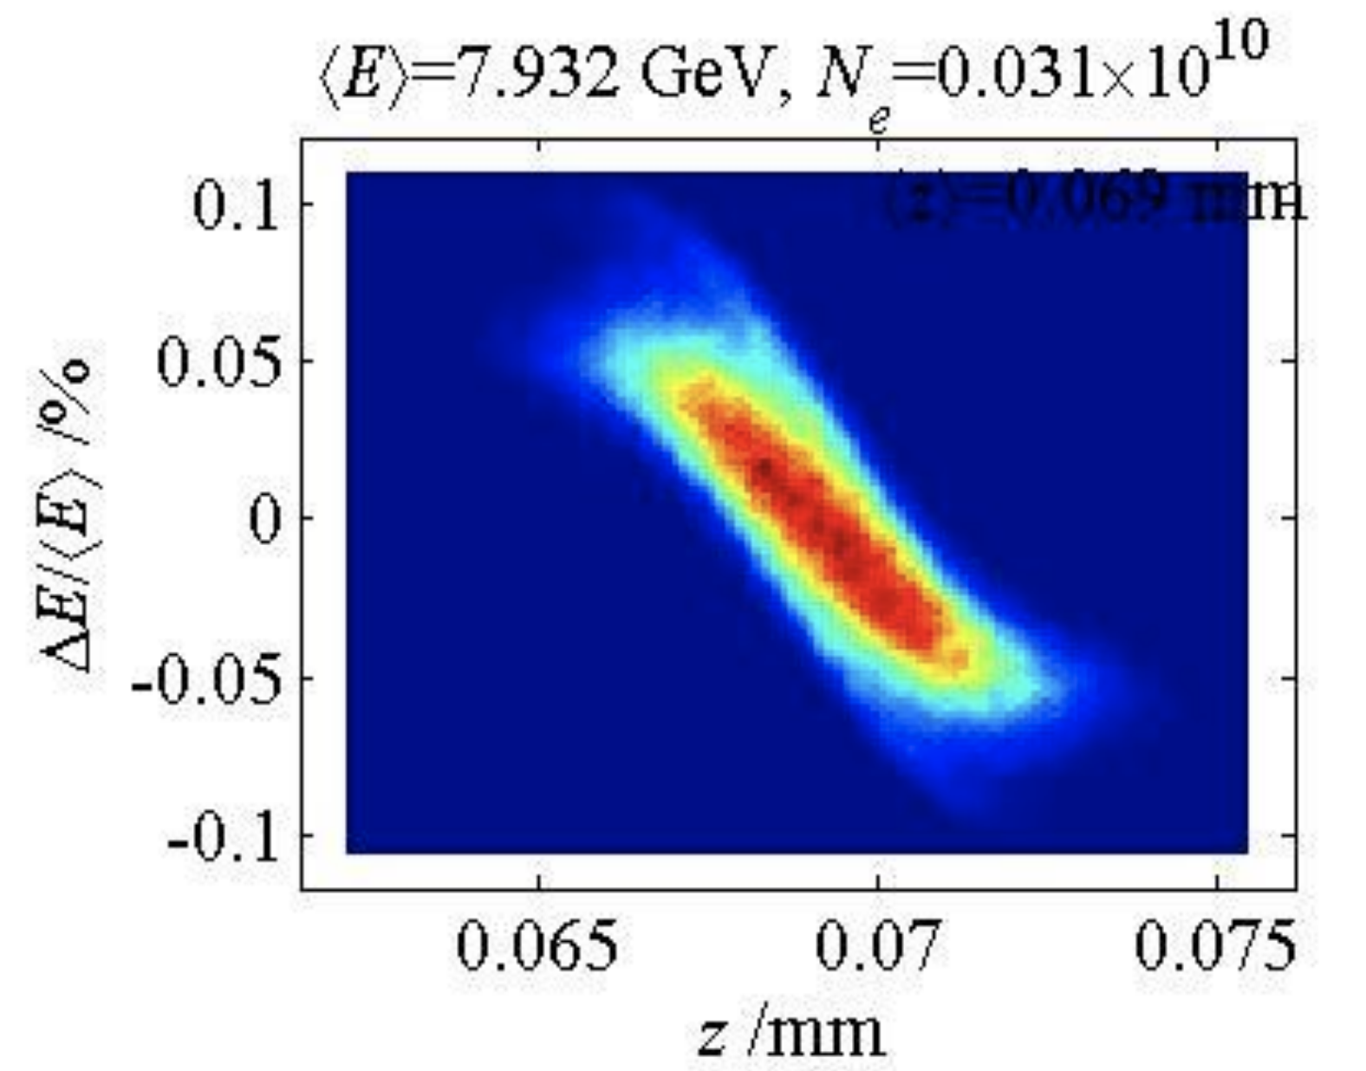
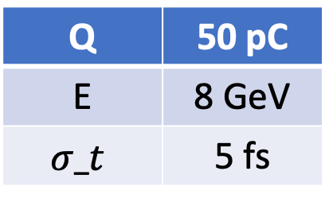
The XLS situation
Q | 50 pC
E | 8 GeV
$$σ_t$$ | 5 fs
Report by S. Di. Mitri at WP6 meeting
Required energy chirp: ~ 1800 MeV/mm
The dechirper at LCLS of SLAC can be a good start point.
Corrugated rectangular pipe
a = 0.7 mm, h = 0.5 mm, p = 0.5 mm, g = 0.25 mm
Length: 4 m
Energy chirp : 1333 MeV/mm for 6.6 GeV beam

Slide 21
Outline
Why a passive dechirper
Principle of dechirper
Types of dechirper
The Wakefield of dechirper
Several examples
The XLS situation
Conclusion

Slide 22
Conclusion
The different types of wakefield for the dechiper are reviewed
There are already serveral successful applications of the pasisve dechirper
It is very promising using the passive dechirper in the XLS project.

Slide 23
Reference
A. Novokhatski, IEEE-0-7803-4376-X/98
M. Harrison, IPAC 2013, MOPH025
K. Bane and G. Stupakov, NIM A 690, 106 (2012)
S. Antipov, et. al., Phys. Rev. Lett. 112, 114801 (2014)
P. Emma, et. al., Phys. Rev. Lett. 112, 034801 (2014).
S. Antipov, et. al., IPAC 2012, MOPPP013
Z. Zhang, et. al., Phys. Rev. Acc. & Beam, 18, 010702 (2015)
S. Bettoni, et. al., Phys. Rev. Acc. & Beam, 19, 021304 (2016)
F. Fu, et. al., Phys. Rev. Lett. 114, 114801 (2015)

Slide 24
Backup

Slide 25
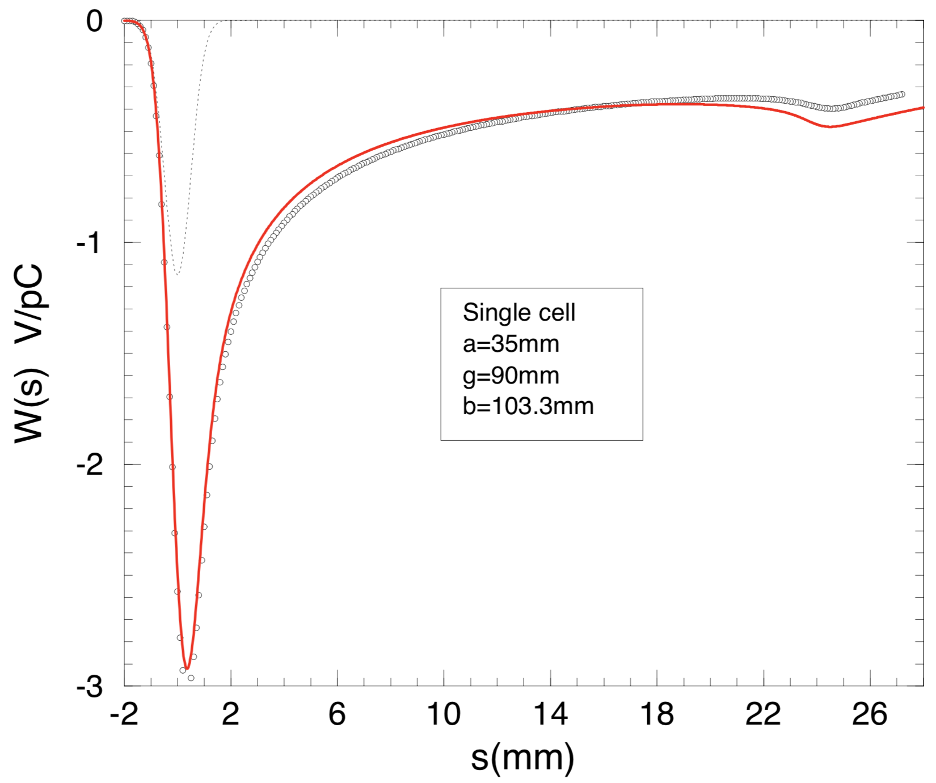
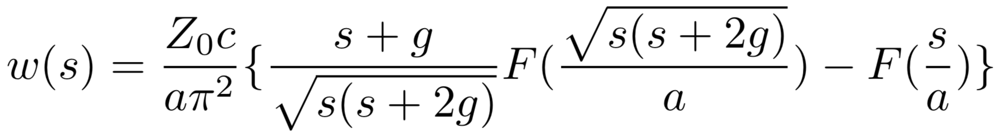
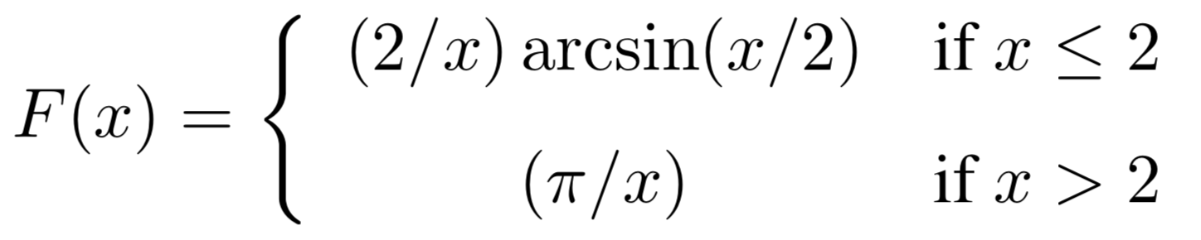
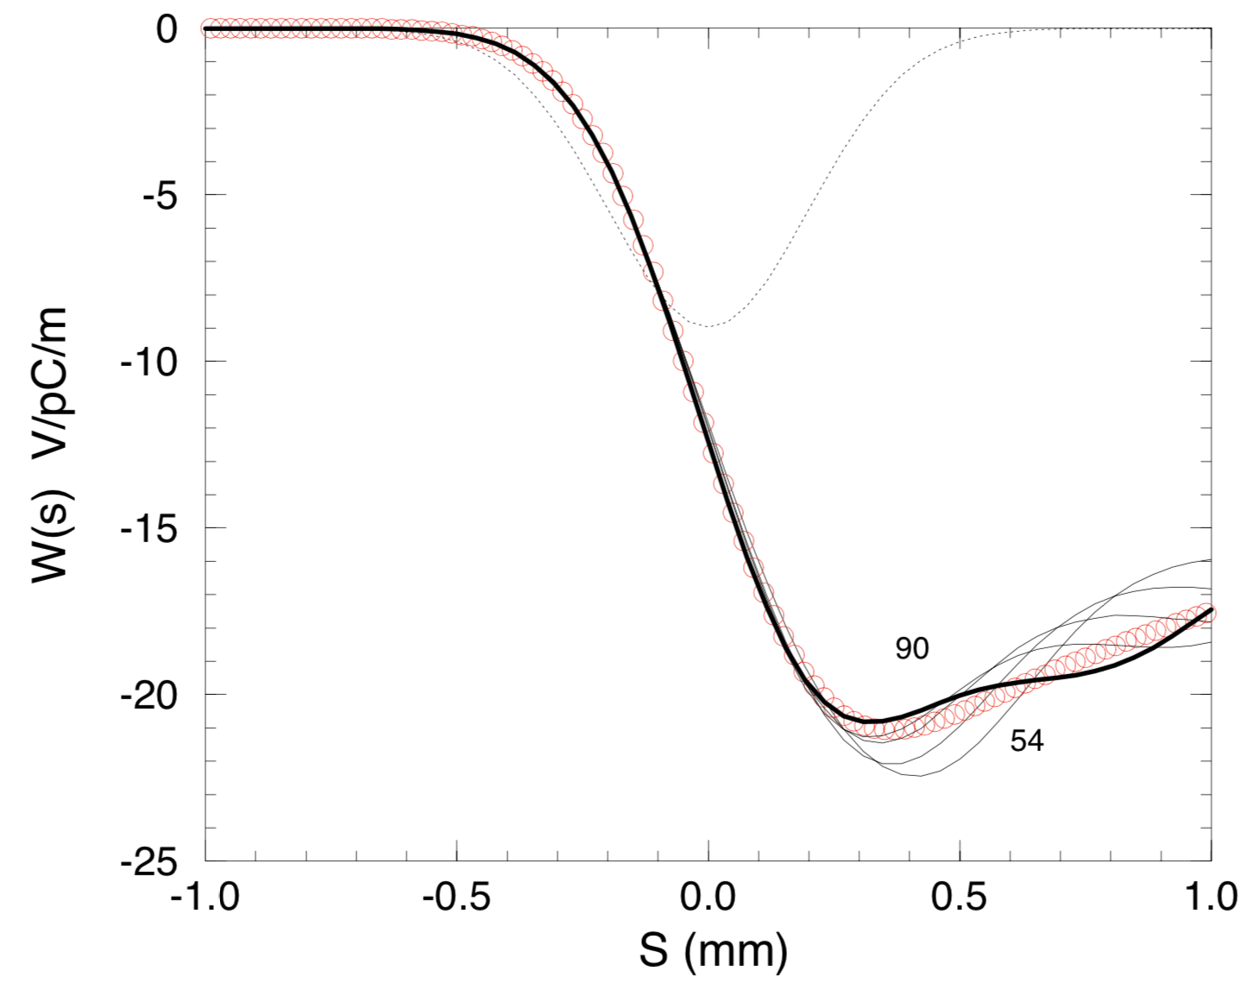
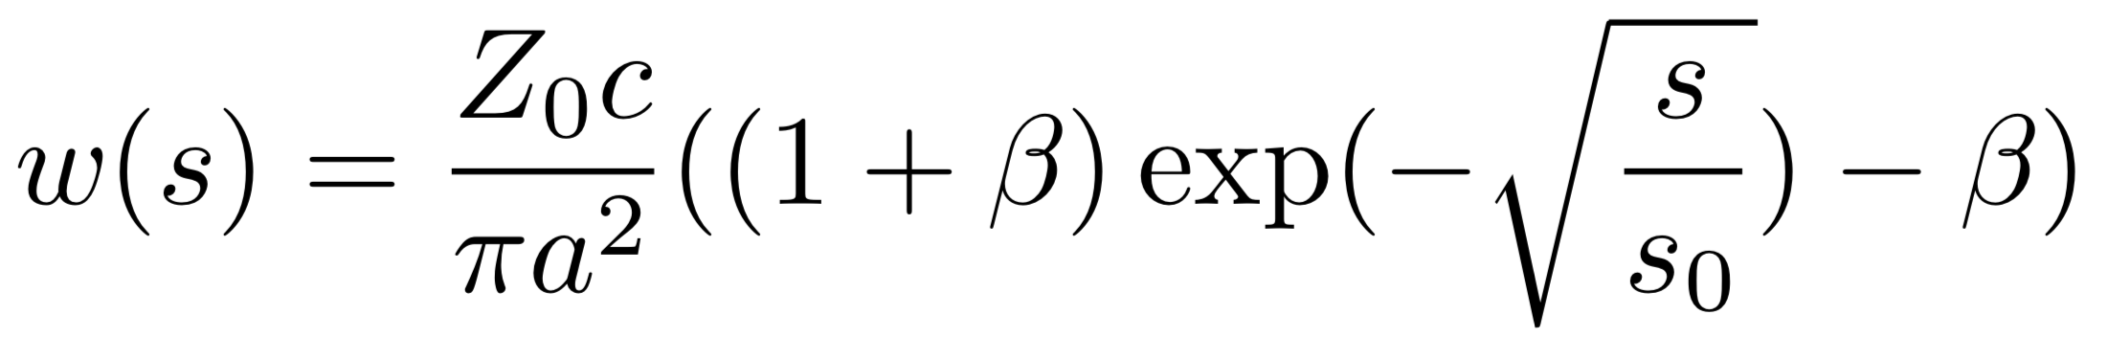
The Wakfield model – Cylinder cavity
Cylinder cavity pipe:
Single cells
Periodic cells
periodic

Slide 26
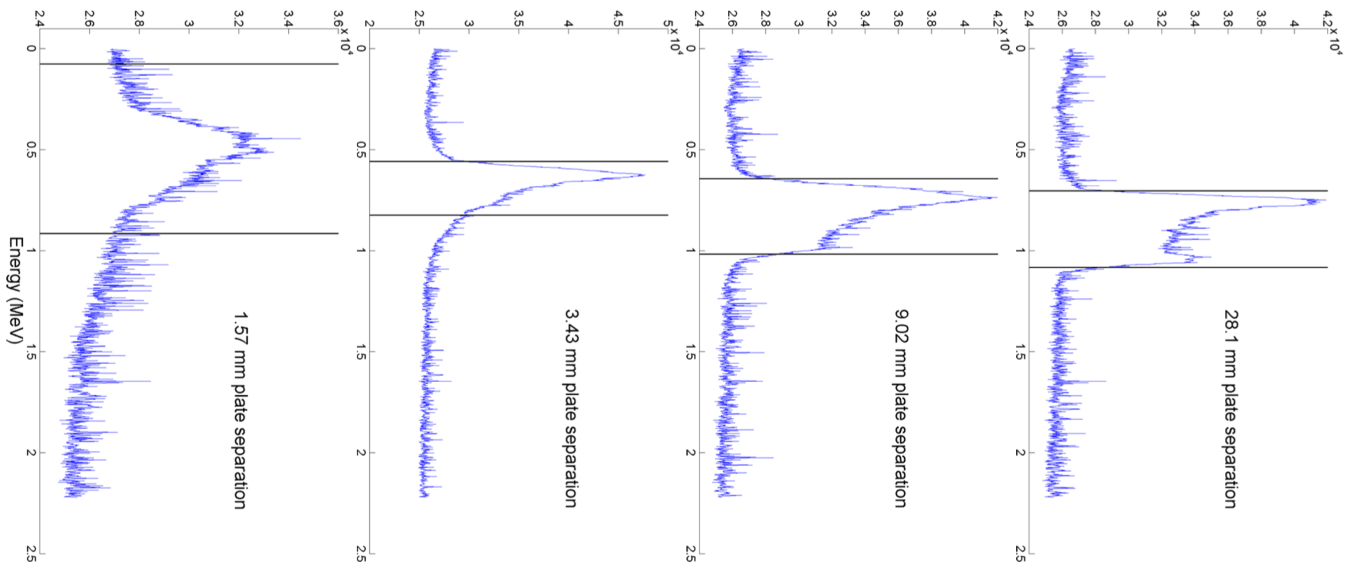
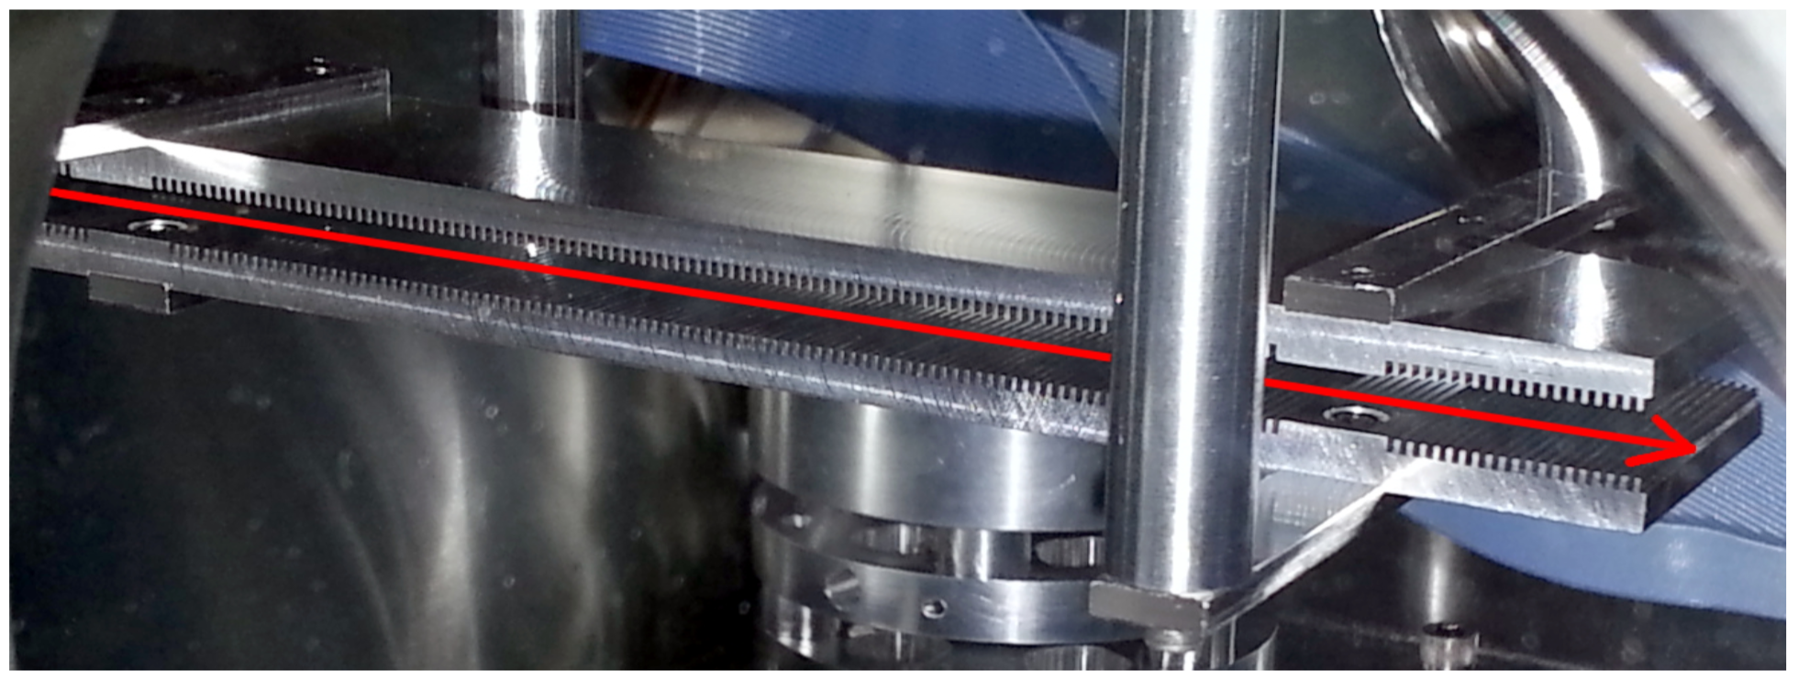
Examples – Radiabeam Technologies
Remove residual energy chirp: Manufacture & Experiment
BNF ATF beam
  57 MeV, 340 pC, 3.5 ps
  Intial chirp: 400 keV/mm
Rectangular dechirper
  Length: 18.1 mm, Width: 38.1 mm
  Gap: 1 -30 mm

Slide 27
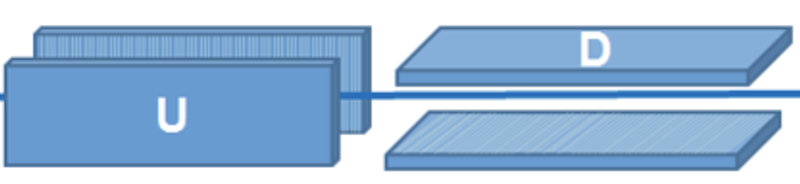
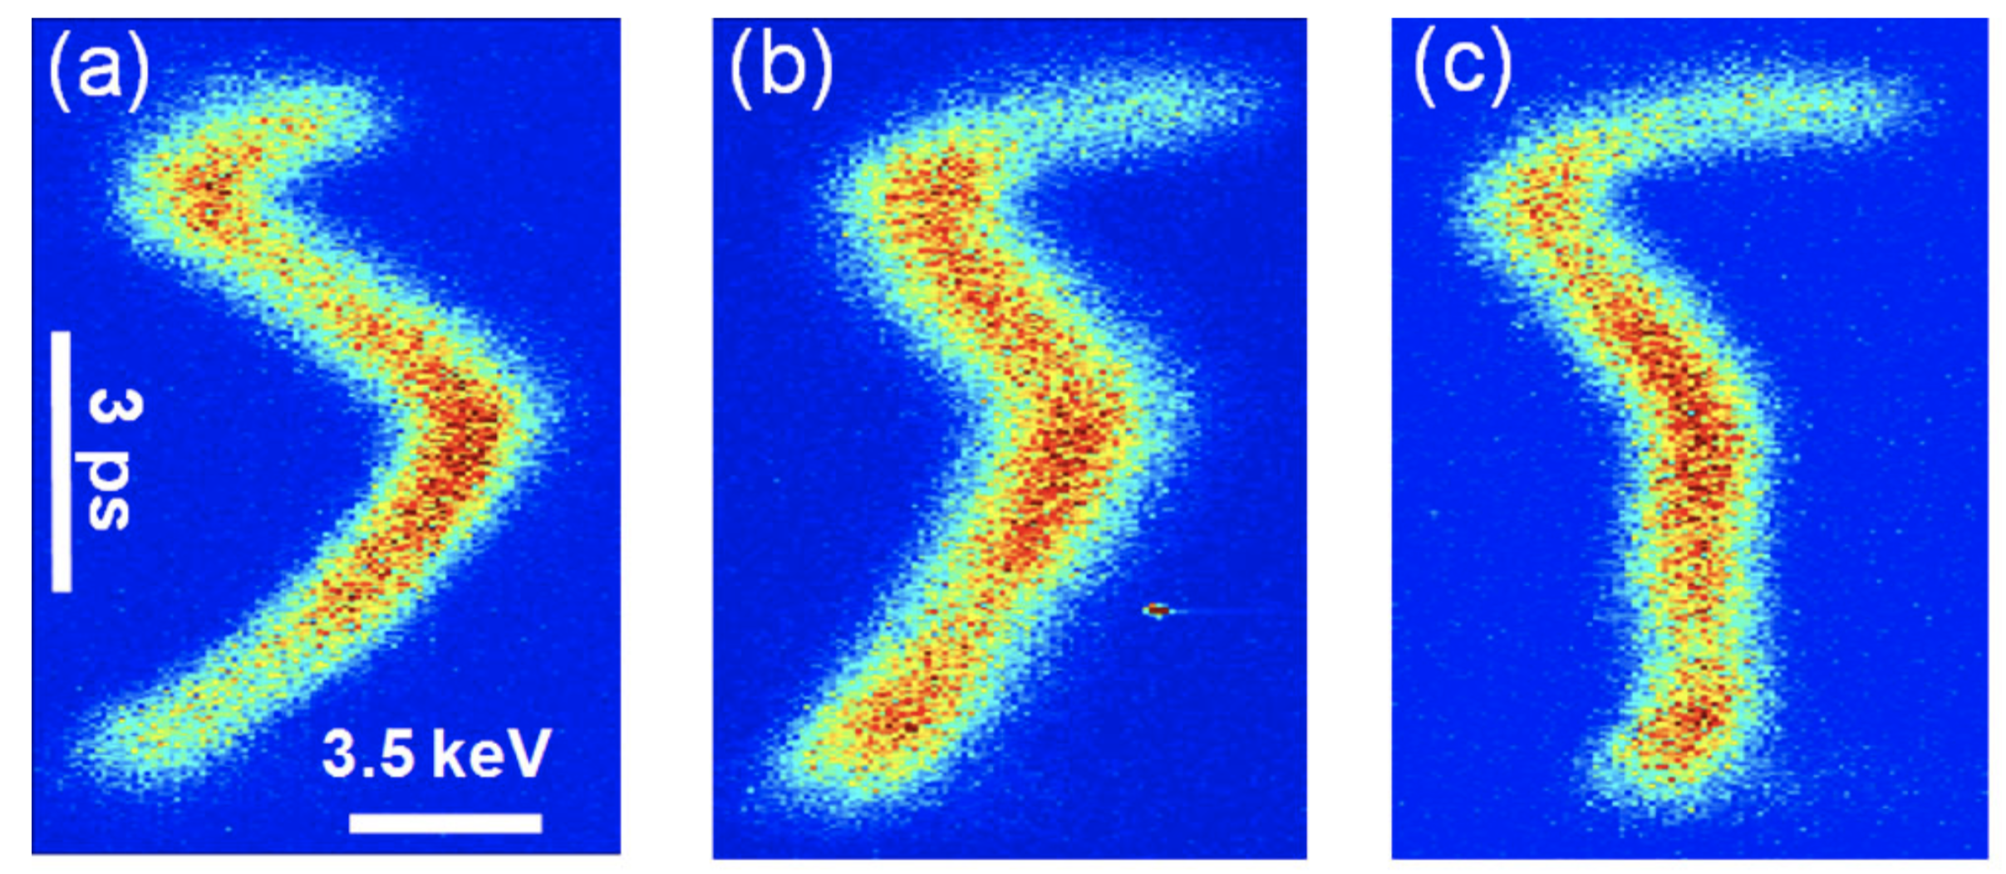
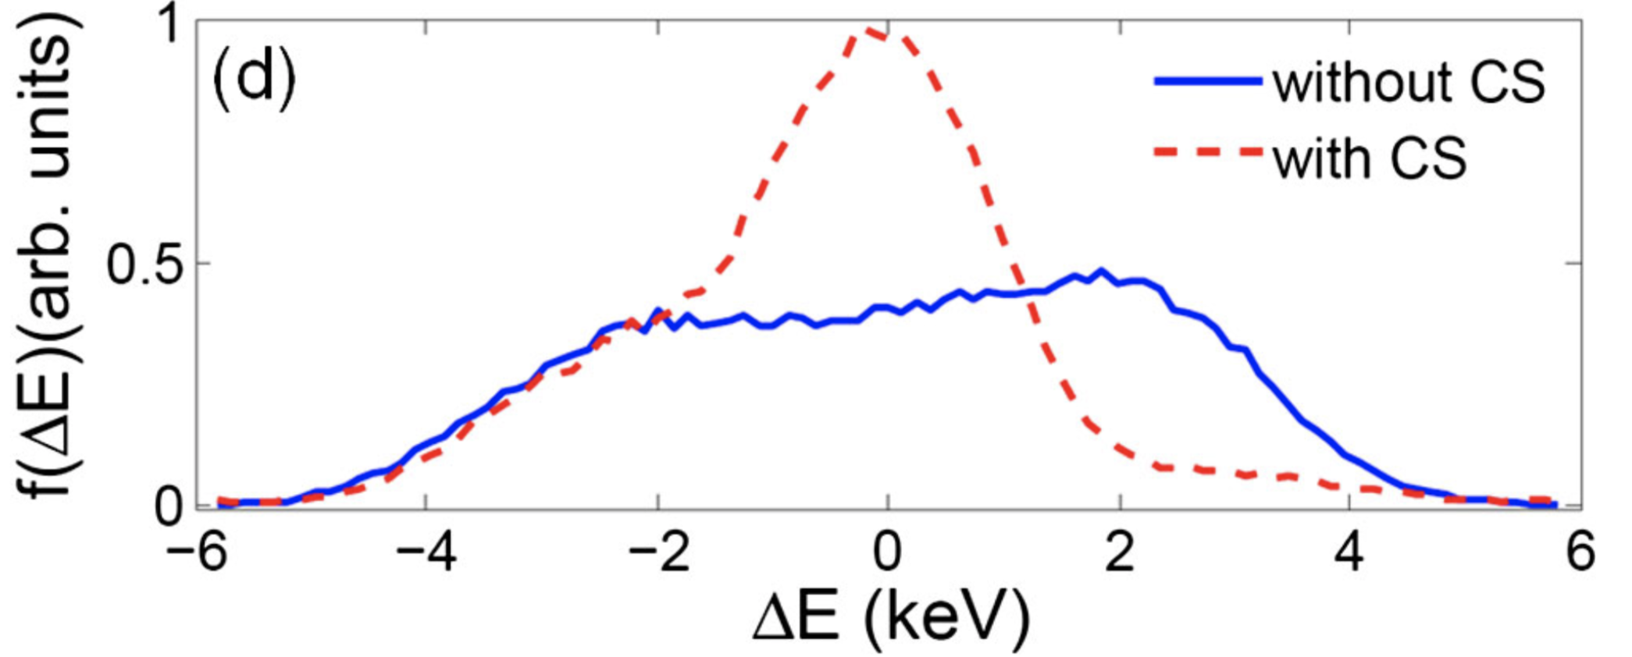
Examples- Shanghai Jiao Tong U.
Nonlinear-Energy chirp Compensation
3.3 MeV, 6 pC, 8 ps (FWHM)
Two Paralle Corrugated Plates
  Aluminum
  Length: 16 cm; Width: 3.2 cm
  Gap: 3 mm

