Slide 1
Compact FEL Devices: The Quest for new design solutions
G. Dattoli
ENEA FRASCATI FSN DIVISION
Alessandro Curcio and Federico Nguyen

Slide 2
Energy and frequency
Letardi -Chart

Slide 3
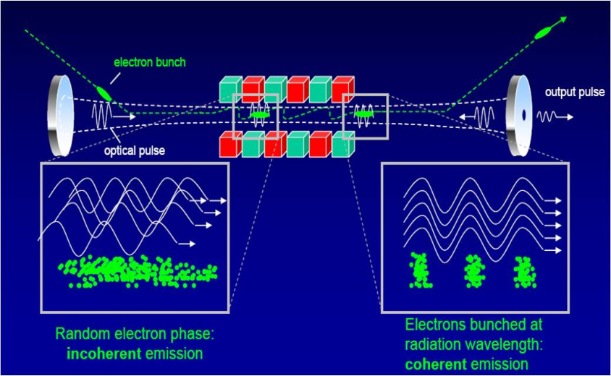
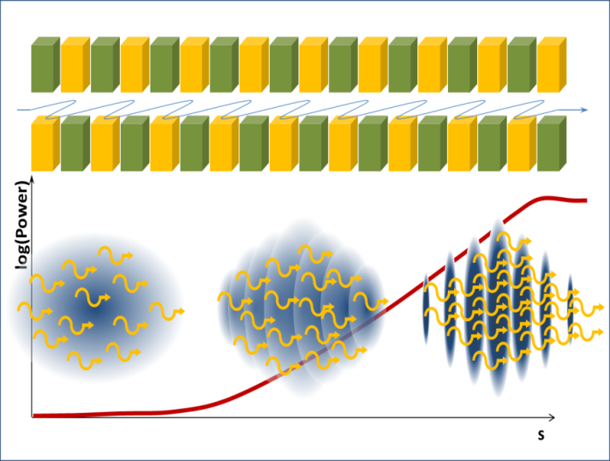
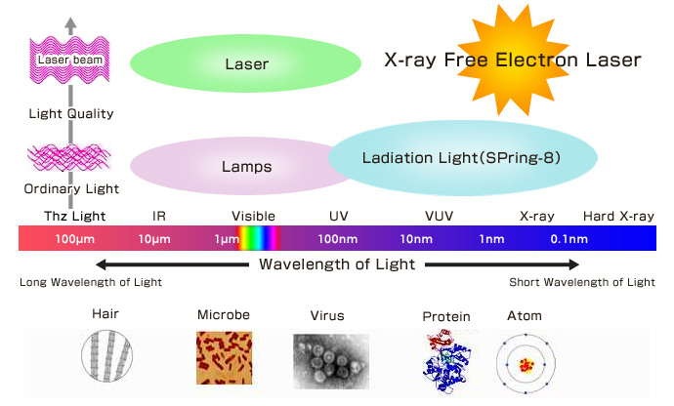
FEL Oscillator or SASE

Slide 4
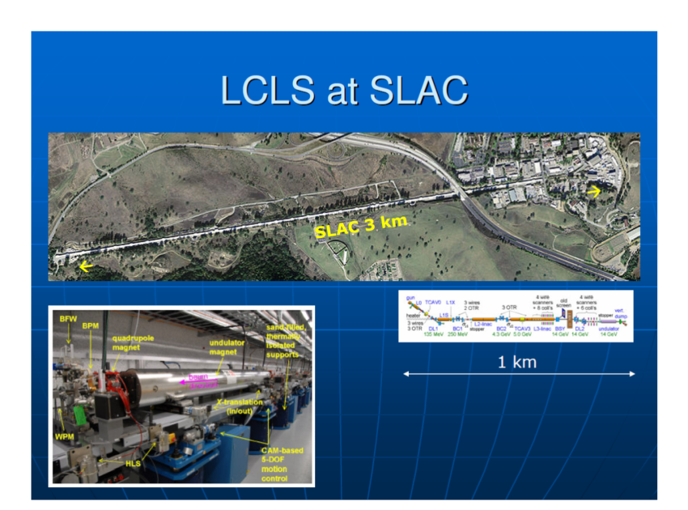
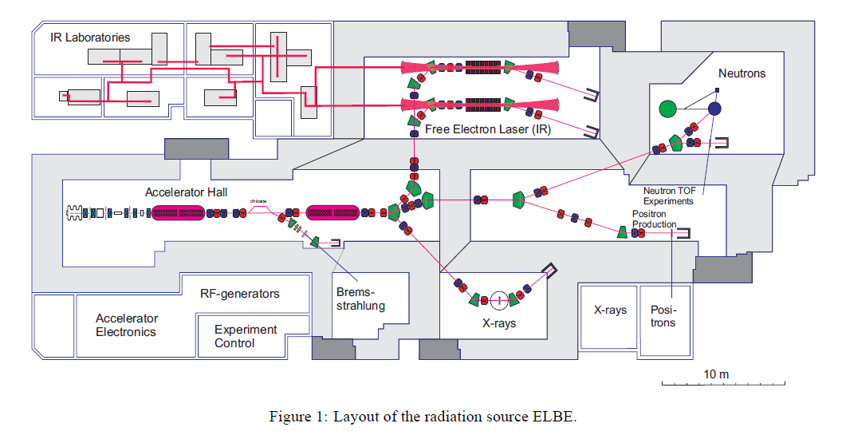
Two Paradigmatic Examples

Slide 5

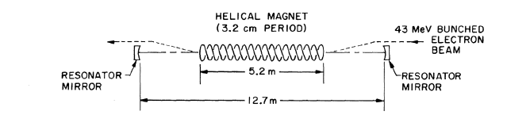
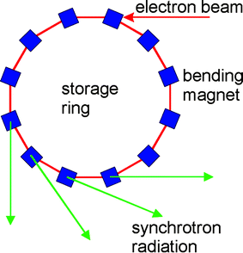
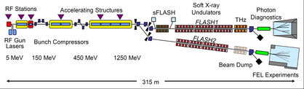
What’s the Price to be Payed?
Size and Costs….few experimental lines

Slide 6
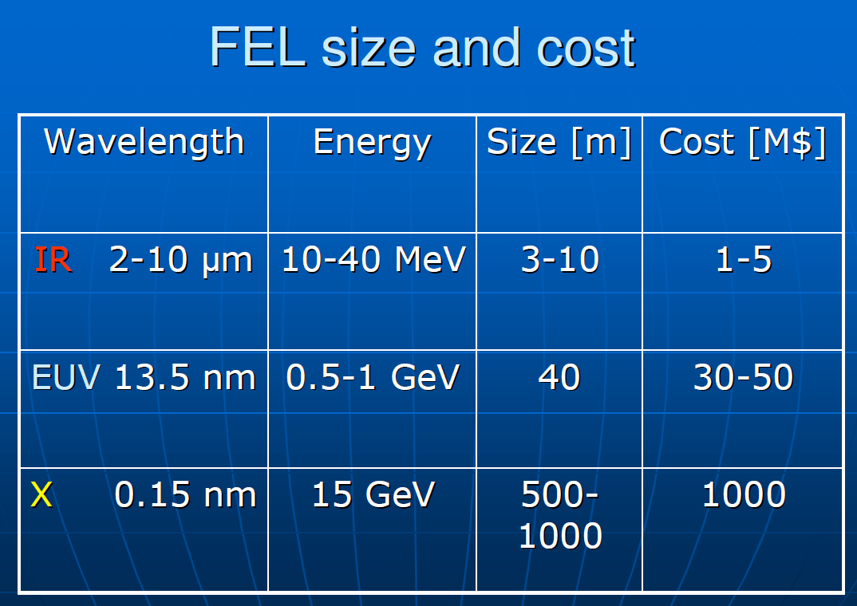
What about money?

Slide 7
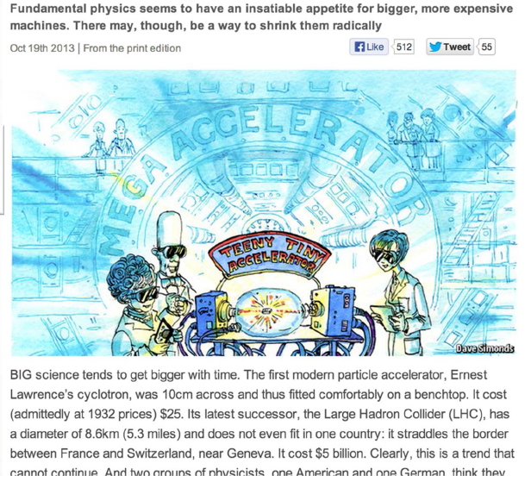
Reduce cost and size:The problem is of public domain…
Cannot continue for longer time

Slide 8
The Challenges
A) Reduce the costs
B) reduce the sizes
C) Improve the «light» coherence properties
D) Increase the number of experimental stations
……The Strategy
A) Reduce the undulator length using exotic devices
(Laser Wave undulators, R.F. Undulators,….)
B) Reduce the size of the accelerator using different acceleraing schemes
(High gradient, Plasma accelerators,…)

Slide 9
The solution stays in a nut shell
Remind that there are crucial parameters which allow a very quick understanding of the design parameters

Slide 10
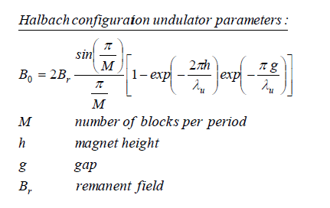
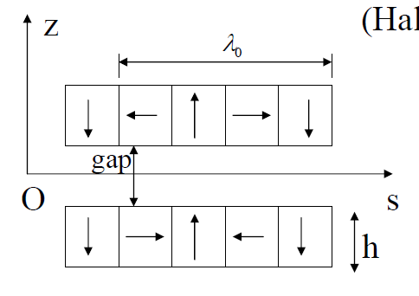
PM Undulators

Slide 11
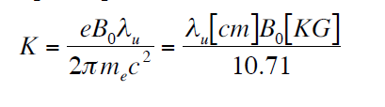
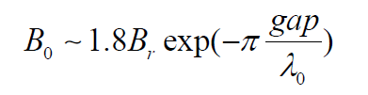
Are these reliable parameters???
g
u

Slide 12
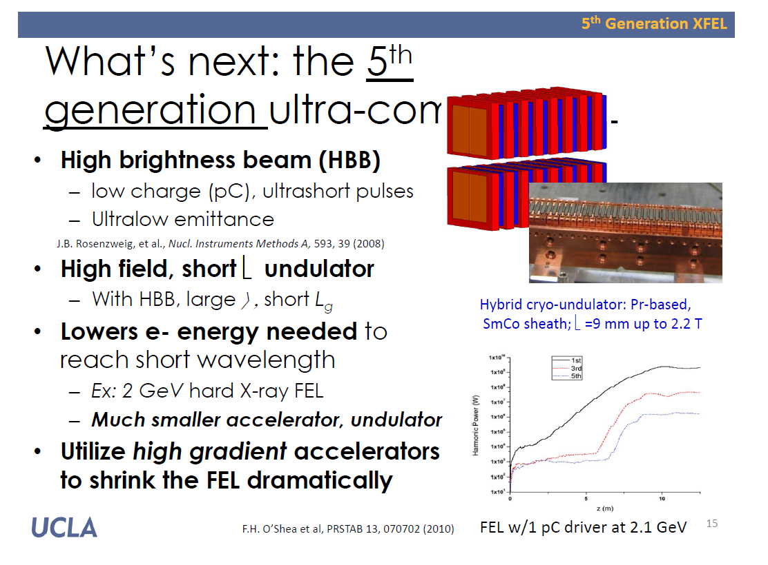
Courtesy of J. Rosenzweig

Slide 13
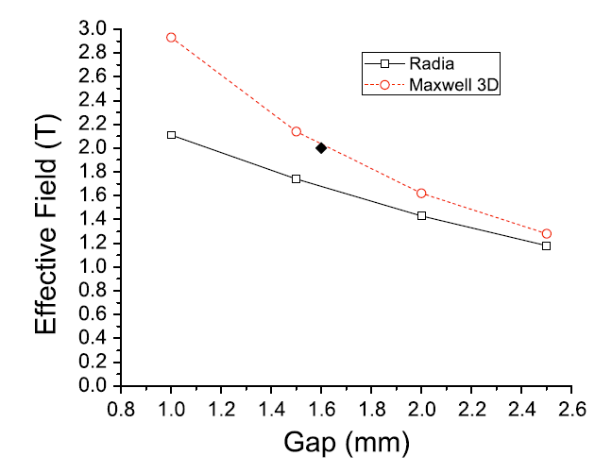
High field criogenic undulators
.

Slide 14
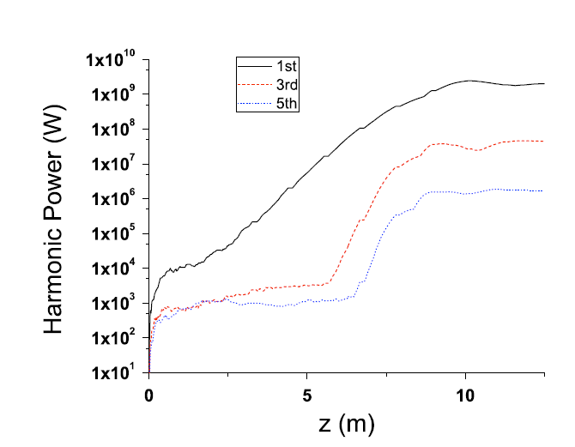
What does compact mean?
SPARX (O’Shea et al. PRSTAB (2010))

Slide 15
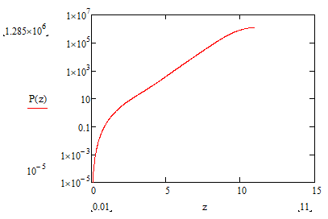
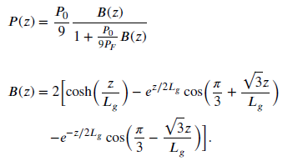
Saturation 10 m!!
Including Energy spread, diffraction,…

Slide 16
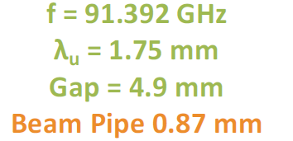
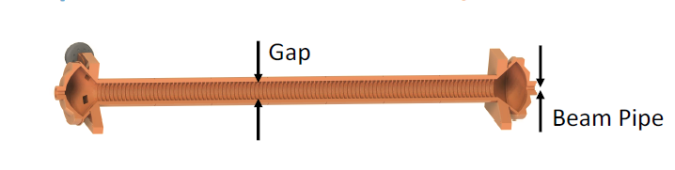
Alternative Solutions?
Wave Undulators
RF Undulators

Slide 17
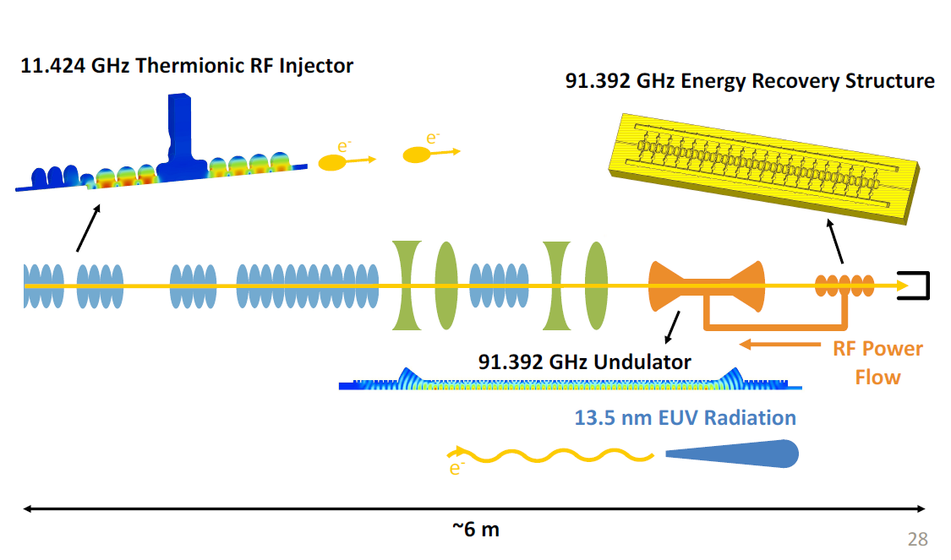
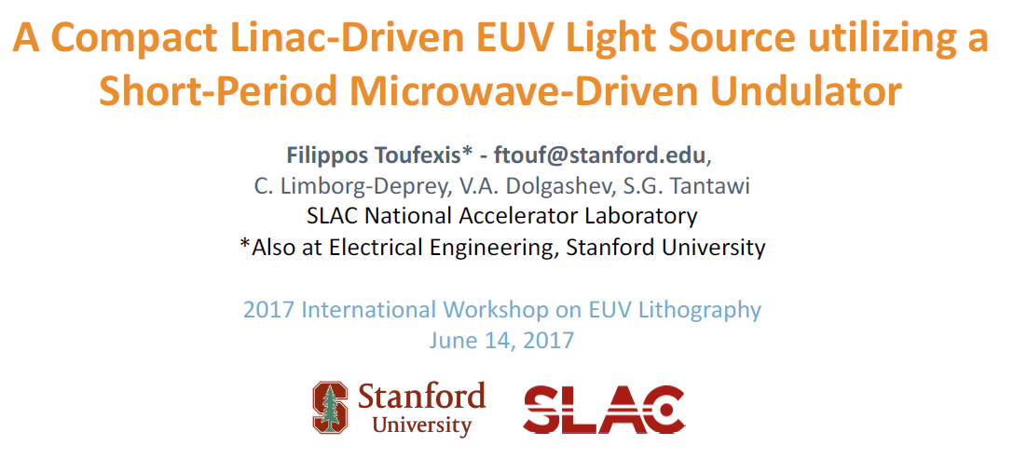
Towards A Compact Device
.

Slide 18
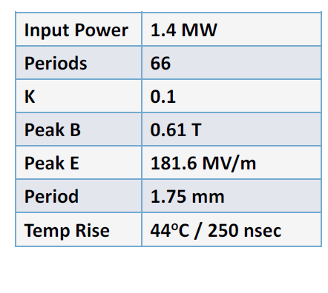
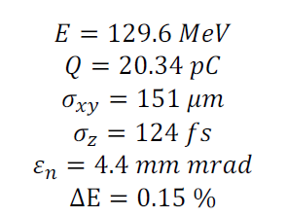
A few parameters
.

Slide 19
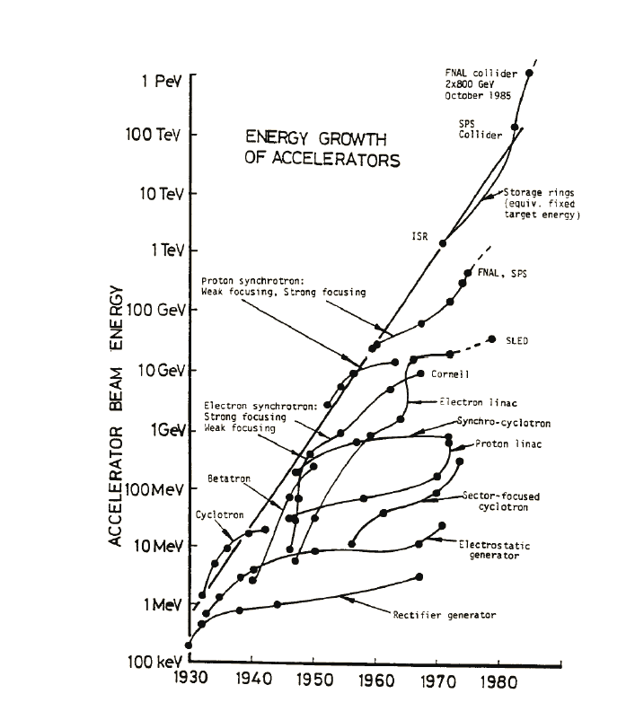
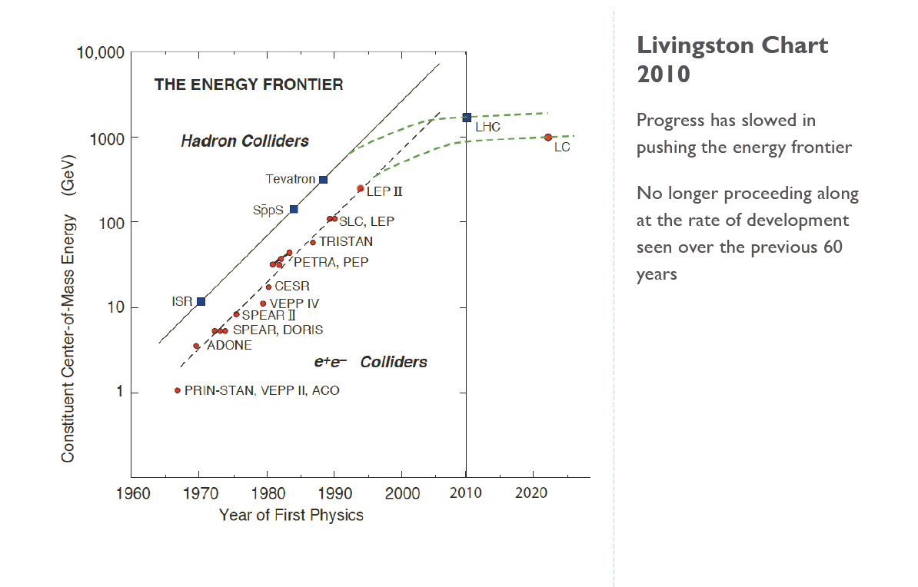
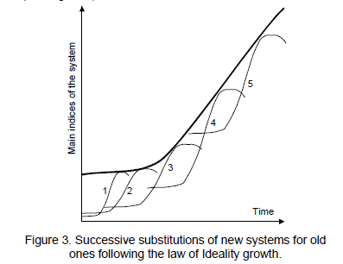
Livingston Plot and Saturation of technologies

Slide 20
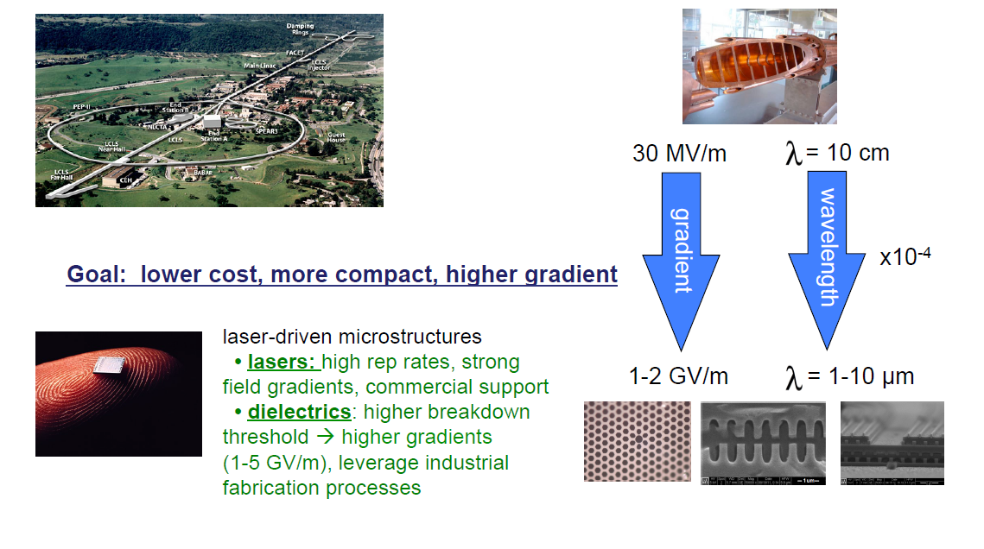
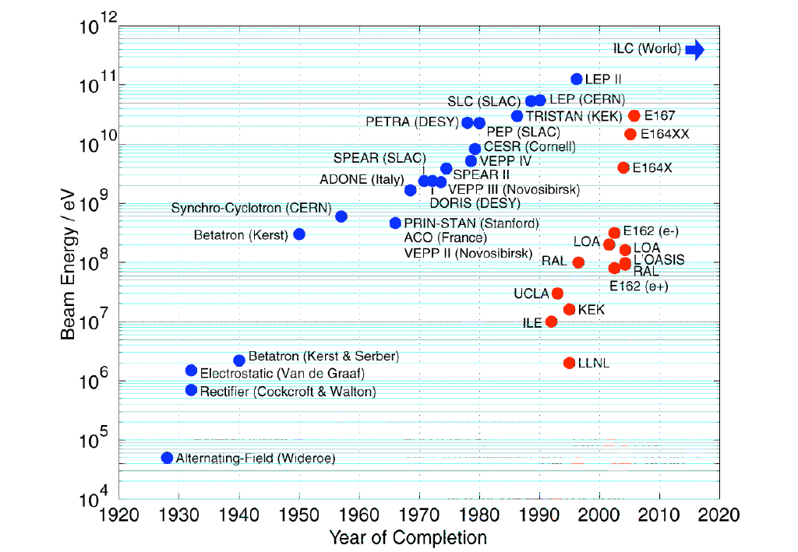
Is the future coming?
IF so where is it going?

Slide 21
LPA-Parameters
The effective accelerating length is

Slide 22
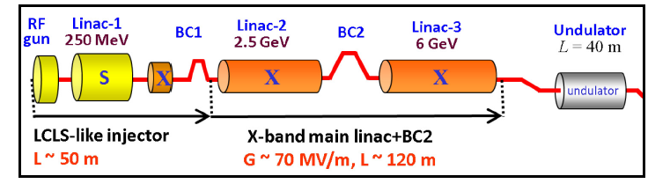
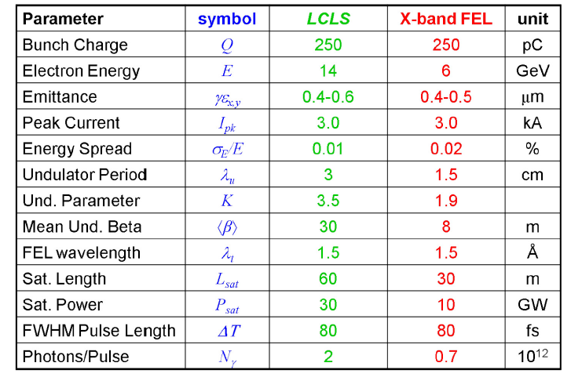

An exercise: X-Band LINAC
(70 MeV/m)

Slide 23

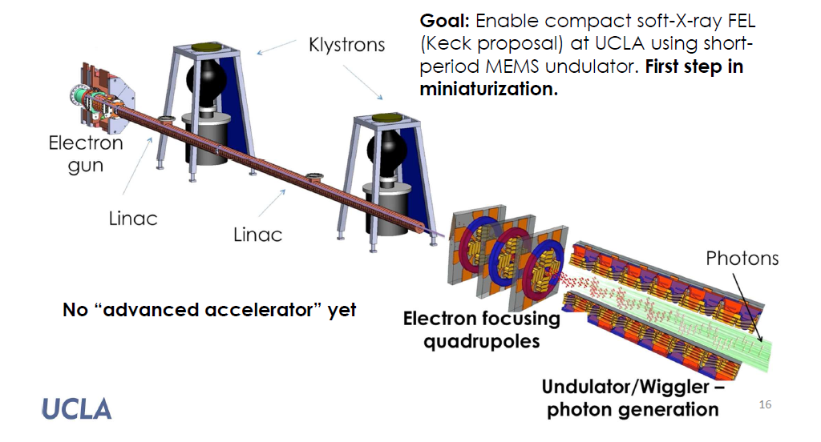
Towards «Bonsai» FEL

Slide 24
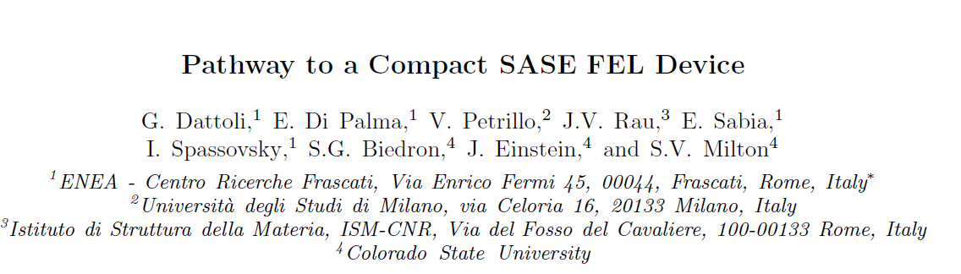
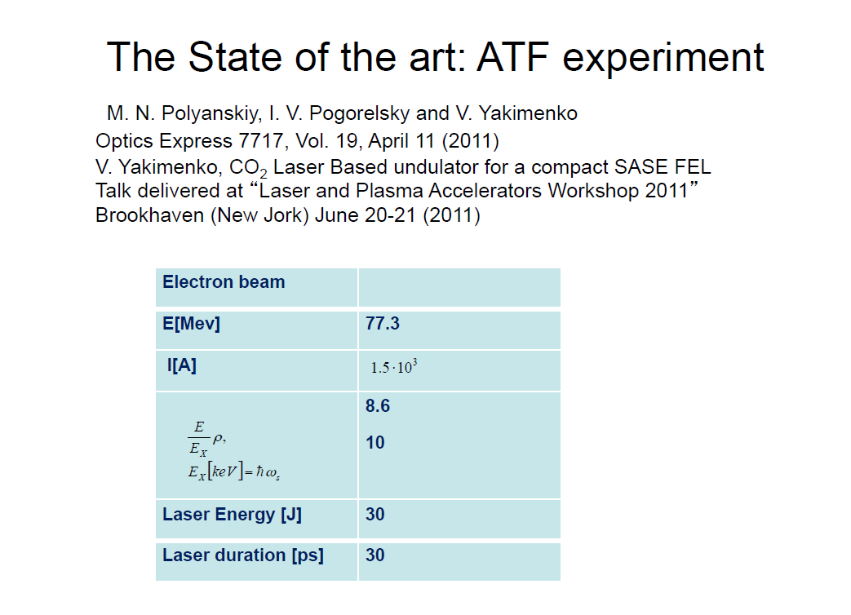
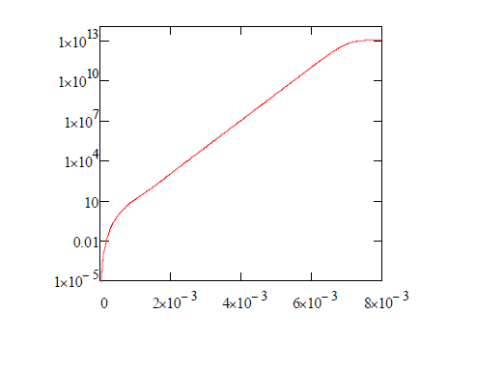
Wave undulators: Use a laser instead of a magnetic device

Slide 25
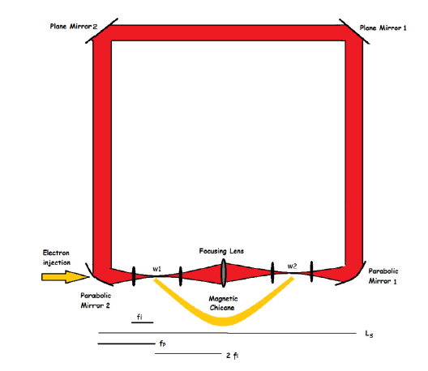
A Super Compact FEL device
A. Curcio et Al. Opt. Commun. (2017)
.

Slide 26



