Slide 1



XLS-WP3 Gun and Injector Meeting
X-band Gun RF design
Daniel González-Iglesias¹, Daniel Esperante¹, Marçá Boronat¹, César Blanch¹, Benito Gimeno¹, Juan Fuster¹, Avni Aksoy²
¹Group of accelerator physics, Instituto de Física Corpuscular (IFIC), Valencia, Spain
²Institute of Accelerator Technologies, University of Ankara, Ankara, Turkey
11rd December 2018

Slide 2
Summary
It is worth to mention, our group has no previous experience in the design of RF components. Due to this, the work carried out during the past months is focused on the understanding of the RF gun structures.
The tasks performed can be split in two categories:
  Bibliographic review of the technical literature. The objective is become familiar with the theoretical basis that supports photoinjector design and get an insight of how they operate.
  Learning to use the computational tools employed for the design of RF guns. Until now, we have focused on those related with the RF design, namely, SUPERFISH (2D) and HFSS (3D).
Some of the bibliography revisited:
T. P. Wangler, “RF Linear Accelerators”, ed. Wiley-VCH, 2nd edition, 2008.
T. Rao, D. H. Dowell, “An Engineering guide to photoinjectors”, 2013.
M. Reiser, “Theory and design of Charged Particle Beams”, ed. Wiley-VCH, 2nd edition, 2008.
L. Faillace, “Innovative Radio-Frequency Linear Accelerating Structures”, PhD Thesis, University La Sapienza, 2008.
F. B. Kiewiet, “Generation of ultra-short, high brightness relativistic electron bunches”, PhD Thesis, University of Eindhoven, 2003.
2

Slide 3
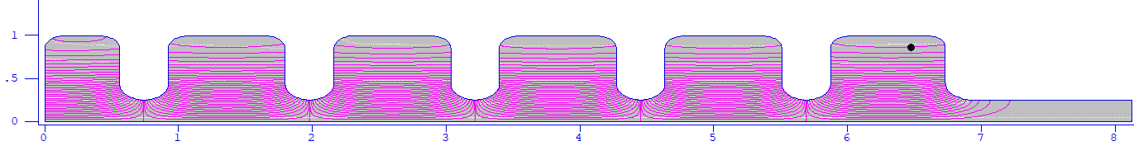
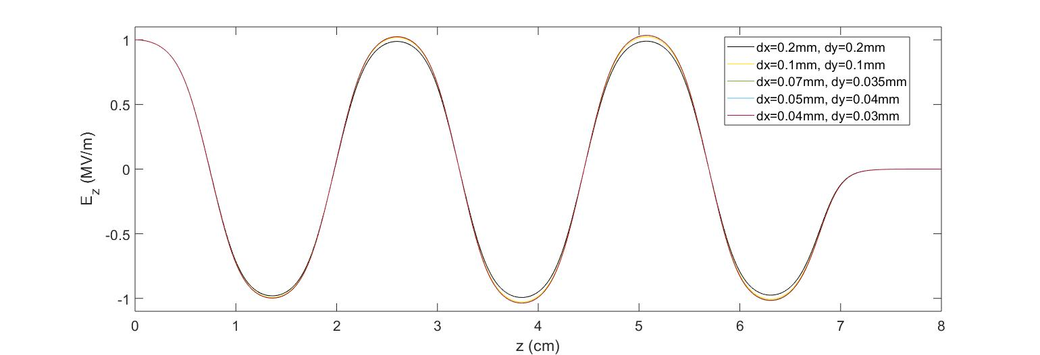
5.6 cell X-band RF gun
Firstly, we have been aimed on the analysis of a 5.6 cell X-band RF gun design provided to us by the Prof. Avni Aksoy from the University of Ankara
This design has been a very useful starting point and it has allowed us to learn about how to use the SUPERFISH software.
In fact, now we are able to build new geometries, obtain and plot the RF fields, estimate ohmic losses, change the mesh size, adjust precision parameters of the RF solver, etc.
Scheme of the 5.6 RF gun in SUPERFISH
Example: Convergence analysis performed for the Avni RF gun. It is plotted the RF electric field along the gun axis, for different values of the mesh spacing.
dx(mm) | 0.2 | 0.1 | 0.07 | 0.05 | 0.04
f_{π} (MHz) | 11991.47 | 11990.76 | 11990.080 | 11990.04 | 11989.96
dx, dy are the mesh increments along the z and r directions, respectively
3

Slide 4
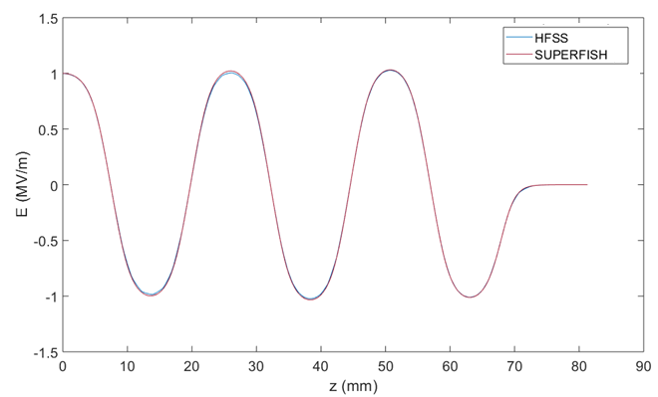
5.6 cell X-band RF gun
In addition, the same structure was analysed using the HFSS software.
At present, we are able to use efficiently HFSS:
build and analyse RF gun structures (obtain and
export RF fields, adjust precision of the solutions,
etc.)
3-D view in HFSS of the 5.6 cell X-band gun
In order to check that we are employing correctly both electromagnetic solvers, it was performed a comparison between the results provided with HFSS and SUPERFISH.
As it is observed in the left figure, there is a very good concordance between them, thus it is demonstrated the accuracy of our analysis.
Comparison between the results provided by SUPERFISH and HFSS for the 5.6 cell X-band gun
4

Slide 5



RF coupler
Once understood the basic structure of a RF gun, the next step we performed is to acquire some knowledge about the RF coupler that feeds the gun.
To reach this aim, the following structure extracted from the literature⁽¹⁾ has been considered for the analysis of a coaxial coupler scheme.
The main concern is the calculus of the coupling factor, β
Scheme of the 2.6 cell RF gun photoinjector
$$P_{ext}≡Power consumed by the external circuit$$
$$P_{c}≡Power disipated in the cavity (RF gun)$$
$$P_{ext}$$
C$oupling factor β=\frac{P_{ext}}{P_{c}}$
$$P_{c}$$
At resonant frequency, it can be shown that$β=\frac{1+\left|S_{11}\right|}{1−\left|S_{11}\right|}$
⁽¹⁾ F. B. Kiewiet, “Generation of ultra-short, high brightness relativistic electron bunches”, PhD Thesis, University of Eindhoven, 2003.
5

Slide 6
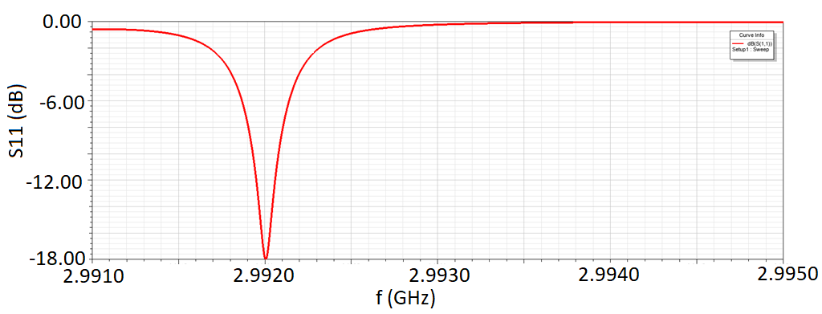
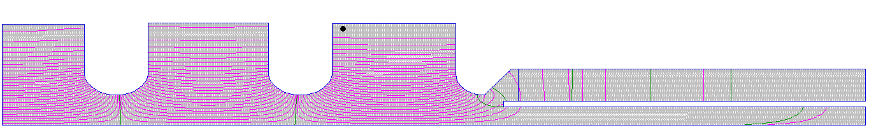
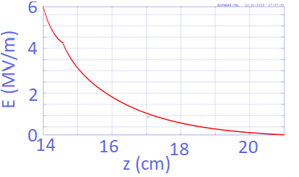











RF coupler
Firstly, the analysis is performed using HFSS. Obtaining β is straightforward:
Secondly, the analysis is carried out with SUPERFISH. For obtaining β, it must be defined a fictitious dielectric lossy material with properties:
$$\left|S_{11}\right|=−17.984 dB$$
$$β=\frac{1+\left|S_{11}\right|}{1−\left|S_{11}\right|}$$
$$β_{hfss}=1.29$$
$$ε_{r}=0.6+0.8j$$
$$μ_{r}=0.6+0.8j$$
Dielectric
Scheme of the 2.6 cell RF gun with coupler in SUPERFISH
Dielectric interface
If the dielectric length is enough to ensure all the RF power is absorbed, then the coupling factor can be calculated in the following way:
$$P_{diel}=P_{ext}$$
$$β=\frac{P_{ext}}{P_{c}}$$
$$P_{diel}=19.346 MW$$
$$β_{superfish}=1.28$$
$$P_{c}=15.09 MW$$
$P_{diel}$ is the power absorbed by the dielectric
RF electric field along the coupler
6

Slide 7
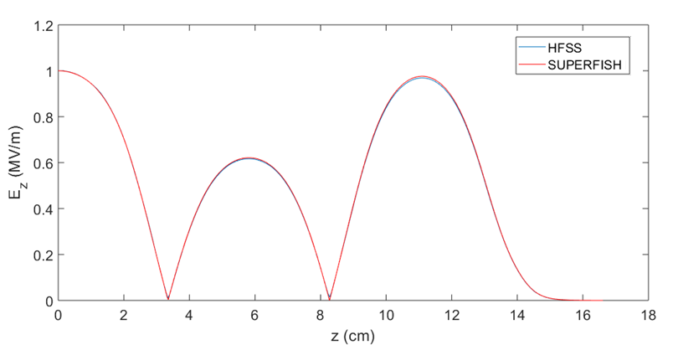


RF coupler
Finally, we compare the axial electric field and the resonant RF frequency for the sake of completeness:
Again, good concordance is obtained between HFSS and SUPERFISH
$$f_{superfish}=2992.6 MHz$$
$$f_{hfss}=2992.0 MHz$$
7

Slide 8
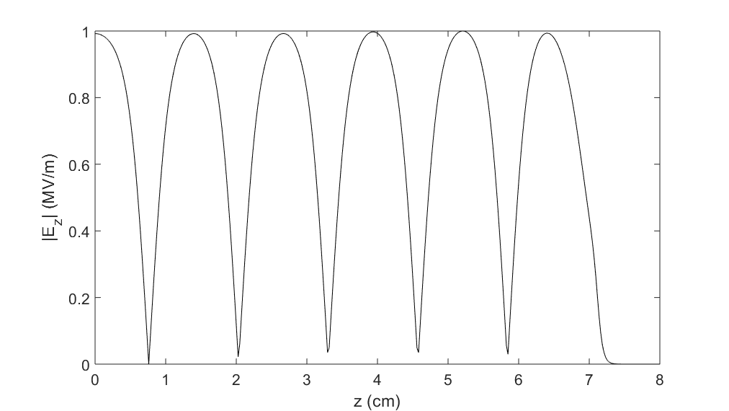

Design of a RF gun with coupler
In order to learn a bit more about photoinjectors and couplers, we tried to design a 5.6 cell RF gun with a coaxial coupler using the Avni gun as the reference model.
To do this, SUPERFISH software (which is much faster than HFSS) was employed
The final objective was to design a gun with the following optimized magnitudes:
After some attempts we reached a prototype that presents the following characteristics:
$f_{π}=11.8 GHz, same peak value of the Ez in all cavities, β=1$
Scheme of the 5.6 cell RF gun with coaxial coupler
$$f=11.799912 GHz$$
$$β=1.015$$
RF electric field maximum flatness is better than 99%
8

Slide 9
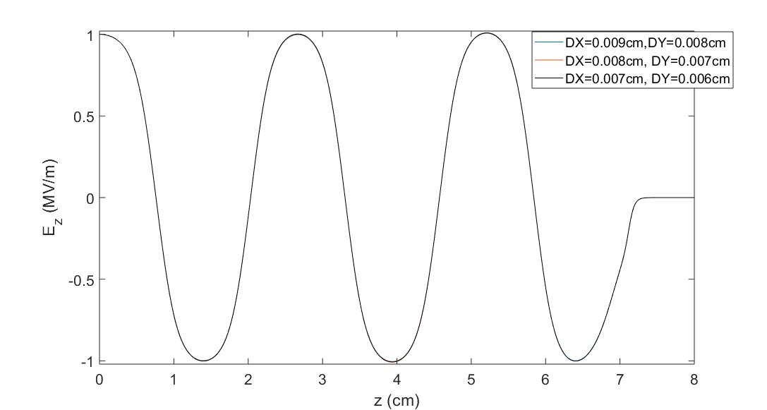
Design of a RF gun with coupler
  Finally, it is checked the convergence of the solution by essaying different mesh size increments
DX(cm), DY(cm) | f (MHz) | β
0.009, 0.008 | 11800.05 | 1.014
0.008, 0.007 | 11799.91 | 1.015
0.007, 0.006 | 11799.80 | 1.013
These are the mesh values employed in the design process
DX, DY are the mesh increments along the z and r directions, respectively
9

Slide 10
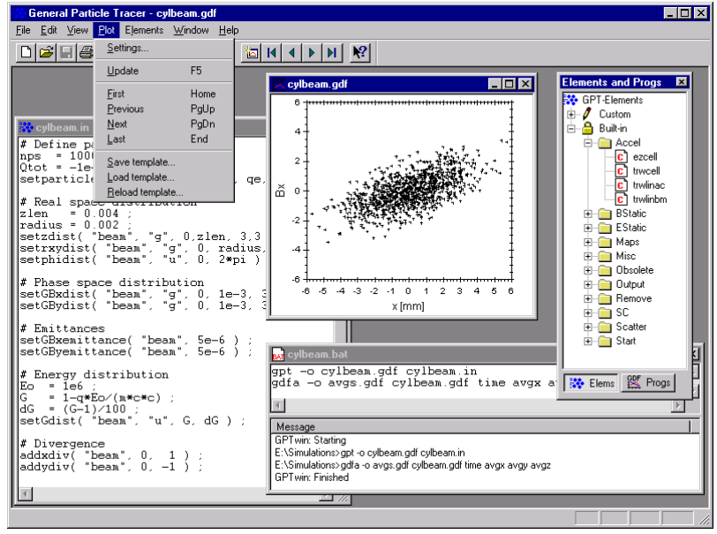
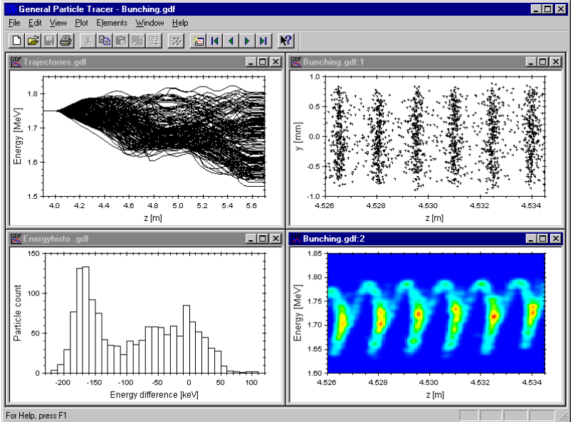
Future work
For the previous designed 5.6 cell RF gun with coupler, it is expected to optimize other parameters such as the mode separation and the RF electric field intensity at cavity surfaces
We plan to learn the General Particle Tracer¹ (GPT) software, which is a commercial code able to simulate the electron beam dynamics along the RF photoinjector. To reach this aim, the following steps will be given*:
    Read carefully the GPT manual (currently in progress)
    Run the examples included with the GPT manual
    Try to build some basic scenarios which might be checked with analytical expressions (e.g., one single electron in a pillbox)
    Simulations of an electron beam through a realistic RF gun, exploring all the GPT capabilities
*A physics degree student will be helping us with GPT simulations
¹ http://www.pulsar.nl/gpt/
Some GPT screenshots
10

