Slide 1
Experience with NXCALS
(…and comparison with CALS)
R. De Maria,
Thanks to NXCALS team for the support!!!

Slide 2
Caveats
The slides are based on my personal experience and my understanding of the project.
The content might not be then accurate…

Slide 3
NXCALS introduction
CERN accelerators’ data is stored in a centralized database which is queried by control room applications and users.
CALS (CERN Accelerator Logging Service):
uses a ORACLE database and exposes a Java API (supported by CO).
CALS has a GUI application TIMBER (supported by CO).
CALS Java API as a Python wrapper (pytimber) supported by users (ABP, BI, OP).
NXCALS (Next CALS):
New system to replace CALS during LS2
NXCALS exposes a new Java and Python (and Scala) API via Spark.
NXCLAS will expose a compatible CALS Java API.
More info at https://wikis.cern.ch/display/NXCALS

Slide 4
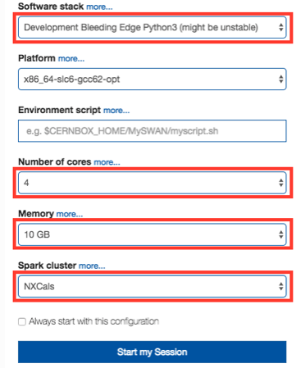

NXCALS: how to use with Spark in SWAN
It is indeed unstable.
INC1853240: cannot connect to Spark NXCLUSTER cluster from swan:
Solved using now LCG 94 Python3
SWAN 3rd Line Support: “ ok, also in the near future we will have a separate view for NXCals (something like LCG 94 Python3 NXCals) which should be more stable…”
Then click “star” button to connect to the cluster and get spark object
Need to type user password and wait a little while…
Users needs to self-subcribe to it-hadoop-nxcals-pro-analytics e-group.
References: http://nxcals-docs.web.cern.ch, http://swan.cern.ch

Slide 5
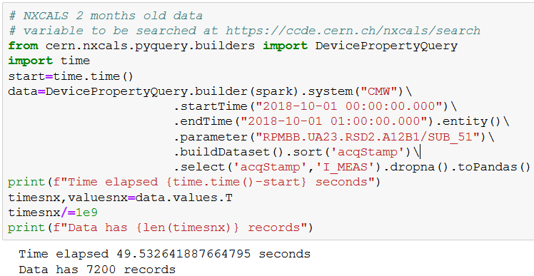
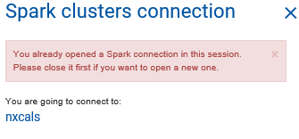
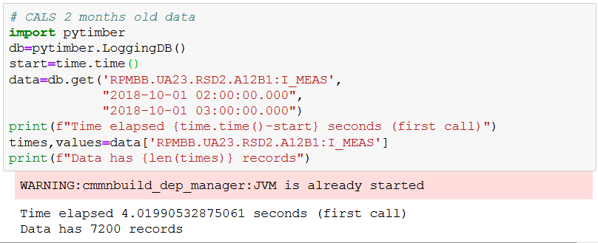
NXCALS: Demo on swan
Only one notebook possible at the same time!
Some missing data in BBQ.

Slide 6
NXCALS: install+run pyspark on local machine
Ref: https://wikis.cern.ch/display/NXCALS/NXCALS+-+Data+Access+User+Guide
Do once:
Create keytab: (it worked from lxplus, a local machine I could create a keytab created but authentication failed)
ktutil # open new shell
add_entry -password -p rdemaria@CERN.CH -k 1 -e arcfour-hmac-md5
wkt rdemaria.keytab
exit
Copy rdemaria.keytab to local machine
Download bundle and unzip: wget http://photons-resources.cern.ch/downloads/nxcals_pro/spark/spark-nxcals.zip
Setup virtual environment: source ./prepare-nxcals-python-virtual-env.sh (or perhaps install the .whl?)
Every time:
Initialize token: kinit -f -r 5d -kt rdemaria.keytab rdemaria
cd ~/spark-2.2.1-bin-hadoop2.7 (it seems one has to start from this specific directory)
To use ipython instead of the standard python interpreter: export PYSPARK_DRIVER_PYTHON=ipython3
./bin/pyspark --master yarn --num-executors 5 --executor-cores 2 --executor-memory 3G --conf spark.driver.memory=10G
Only one connection per machine seems possible as well (apparently because pyspark opens a certain number of TCP ports at fixed (but configurable) numbers.

Slide 7
CALS: install Python API in local machine
Install locally (once): pip install pytimber
Use pre-configured python installation (setup):
source /cvmfs/sft.cern.ch/lcg/views/LCG_94python3/x86_64-slc6-gcc62-opt/setup.sh
source /acc/local/share/python/setup.sh
To run use simply python or ipython. Object creations are not blocking each other.

Slide 8
NXCALS: pyspark and spark-submit
One can connect to “yarn” cluster? (lower start-up): ./bin/pyspark --master yarn …
Or local instance (faster start-up): ./bin/pyspark --master local …
Script can be submitted with (a not limited by 1 job however)
./bin/spark-submit some_script.py
from pyspark import SparkContext
from pyspark.sql import SparkSession
from pyspark.conf import SparkConf
spark = SparkSession.builder\
.master("local")\
.appName('intensity_example')\
.getOrCreate()
#… queries …#
Method | Total time | Retrieval time
Spark Yarn | 51 sec | 22 sec
Spark Local | 12 sec | 8 sec
CALS | 2.5 sec (1.6 sec) | 1.5 sec (0.6 sec)

Slide 9
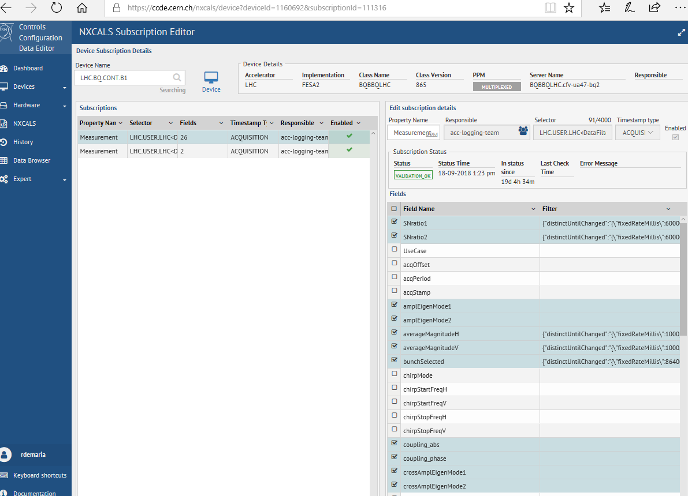
NXCALS and variables
NXCALS: Does not use variables (at least now) but device/property/field that matches FESA classes.
Website available https://ccde.cern.ch/nxcals/search
No way to go from CALS variables to NXCALS device/property/field.
Some CALS variables are stored in NXCALS.
CALS: Simple API provided for free search and Hierarchy. E.g.:
import pytimber
db=pytimber.LoggingDB()
db.search(“%LUMI%”)
db.tree.<tab>

Slide 10
Problems with Variables
Example: Wanted data stored in CALS in
LHC.BQBBQ.CONTINUOUS.B1:ACQ_DATA_H.
Tried (some guess work) with (“LHC.BQ.CONT.B1/Measurement").buildDataset().select("acqStamp","lastRawDataH”)
However [https://issues.cern.ch/browse/NXCALS-2196] I should have used:
(“LHC.BQ.GATED.B1/Measurement").buildDataset().select("acqStamp","lastRawDataH”)
Are Gated /Continuous devices intermixed on purpose?

Slide 11
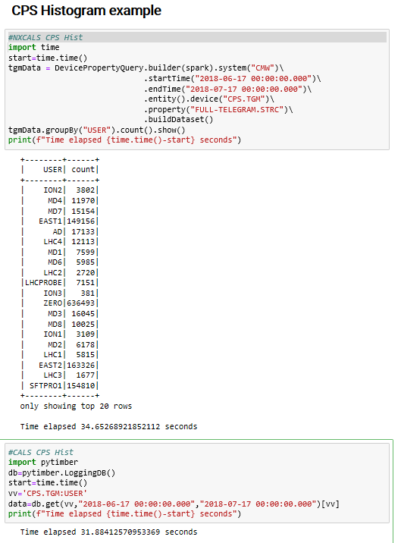
Spark computations
NXCALS – Data Access User Guide: We recommend reading Spark documentation and going via the book "Spark: The Definitive Guide, 1st Edition" by Bill Chambers and Matei Zaharia. ‘ 603 pages!
NXCALS support: “In the distributed computing environment operations should be performed on the servers and not locally….”
NXCALS support: “Unfortunately, spark does not support fft natively…”
NXCALS support: “It is possible, naturally, to run any function against the cluster, but in the current version of hadoop we have experienced some issues with it. So unless it's an absolute must, let's avoid it till we upgrade.”””
Simple statistics like histograms scales well (tried one year statistics of CPS users).
Not clear if arbitrary computations are possible in the server and can scale well.

Slide 12
Comments
NXCals based on open source stack: it is extremely valuable and appreciated!
Data retention is already larger than CALS (some high frequency data is in NXCALS and not in CALS).
Simple aggregate queries on scalar quantities seems to scale well.
One single interactive sessions is very unpractical.
Raw data extraction seems much slower than CALS and can have impact on existing applications.
Some missing data in BBQ raw data field.
Time scales are a bit unclear for CALS to NXCALS migration.
No CALS compatible API yet is concerning for existing users.

Slide 13
Wishes
An Python API (or Java to wrapped in Python) to get data:
  with no expiring authentication
  response time at least comparable with CALS for raw data extraction
  supporting multiple interactive Python process
An API to search for available variables or device/property/fields.
Keep Java API compatible with legacy applications if possible.

