Slide 1
Summary of 10 MHz cavity impedance measurements
G. Favia, A. Lasheen
Acknowledgments: H. Damerau, V. Desquiens
LIU-PS Beam Dynamics Working Group MEETING
12/12/2018

Slide 2

Overview
Single-bunch beam measurements
Multi-bunch beam measurements
PSC10 impedance with closed gaps
PSC10 impedance contribution at higher frequencies
Conclusions

Slide 3
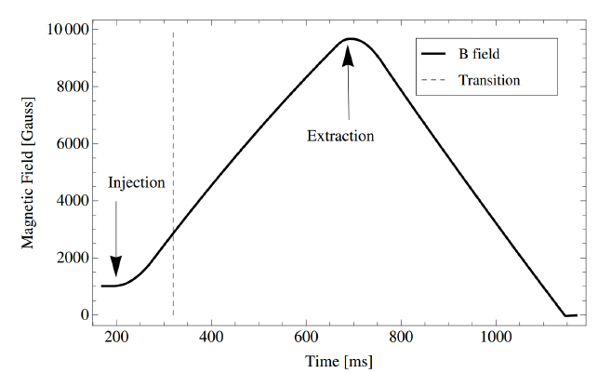
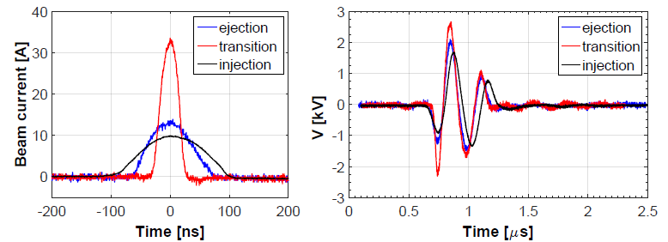
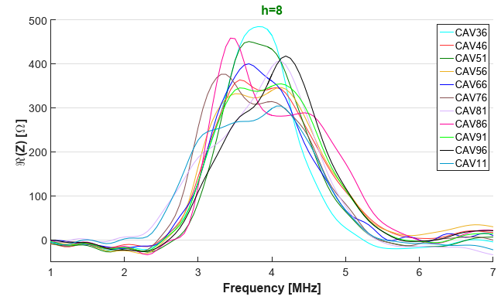
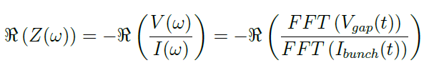
Single bunch beam
TOF Single bunch beam to neglect the multi bunch effect
Measurements of the beam induced voltage (no RF on the gap )
The impedance is computed from the beam induced voltage:

Slide 4
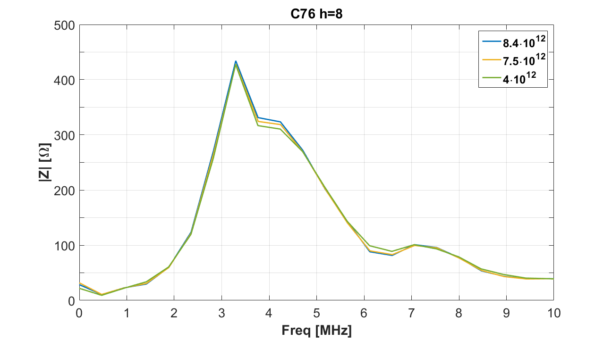
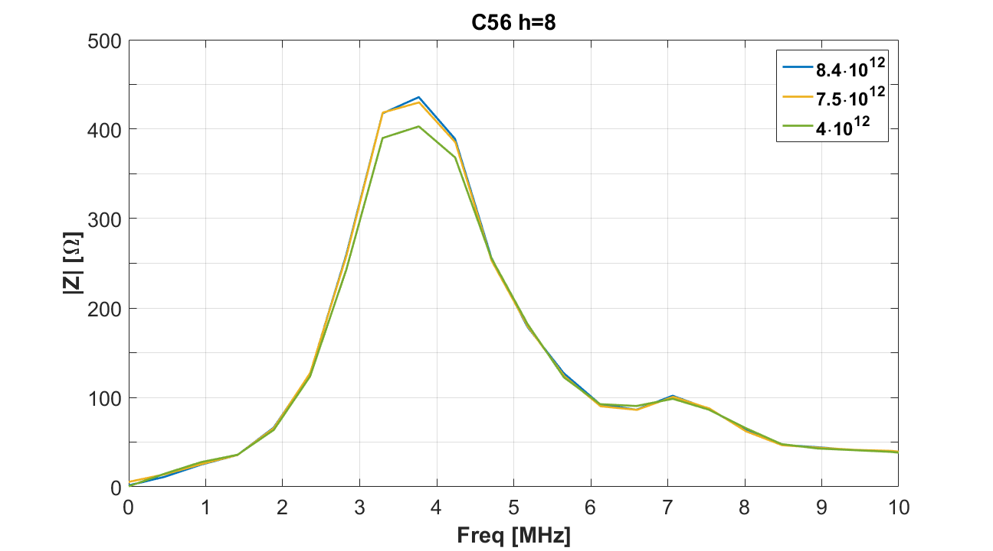
Recent observations
Beam intensity variations cause marginal impedance variations

Slide 5
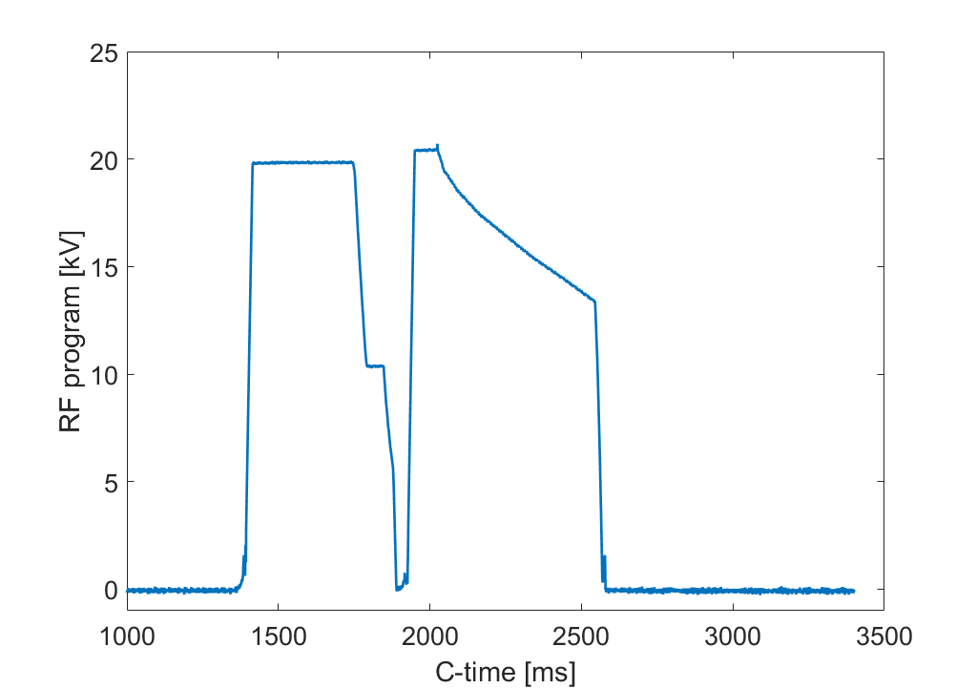

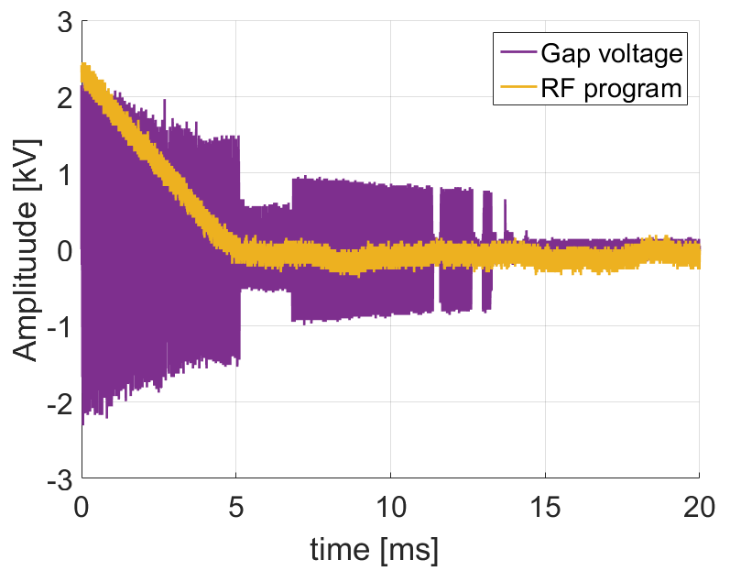
Multi bunch beam
Measurements done using LHC type beam
Closure of gap relay
Closed gaps
Beam induced voltage measured just before the gap closure
Beam induced voltage

Slide 6
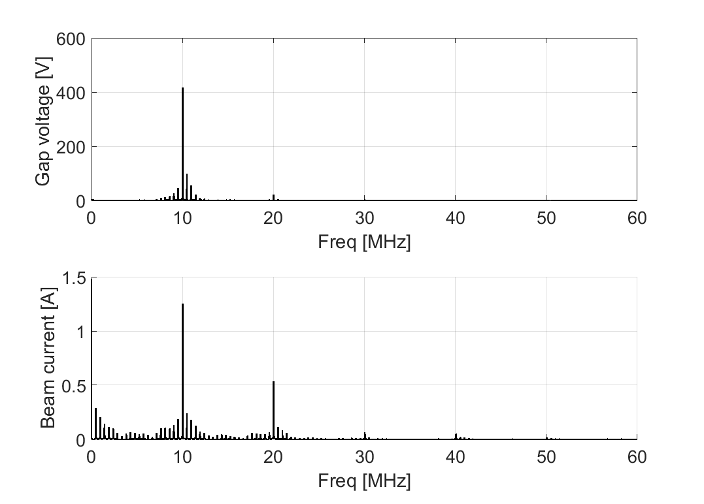
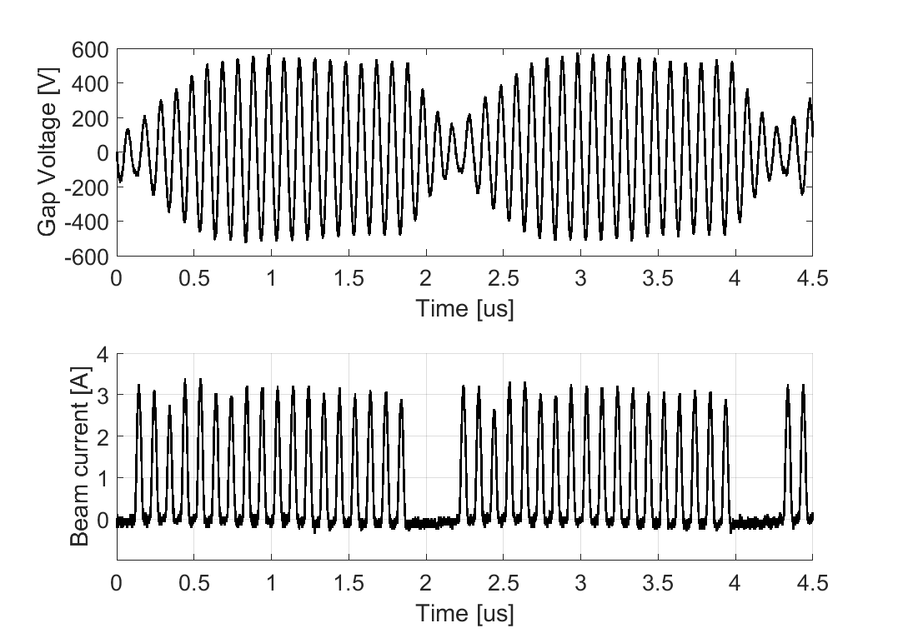
Measurement results
Impedance calculated by dividing the induced voltage in frequency domain by the beam spectrum
The deconvolution is applied only on the revolution frequency peaks
The voltage does not decay to zero as in the single bunch case
FFT computed over a 100 us period

Slide 7
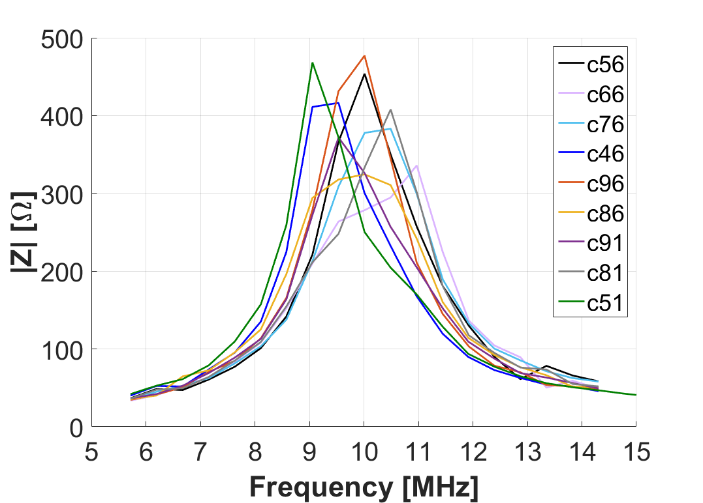
Measurement results
Average value comparable with 2016 results
C36 and C11 missing due to gap relay and amplifier issues

Slide 8
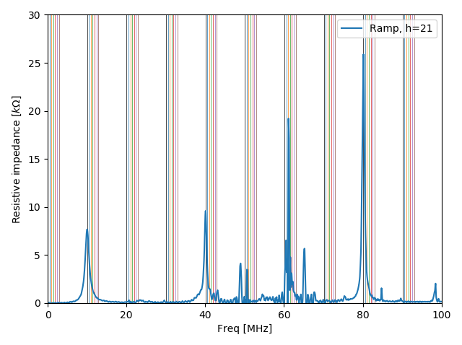
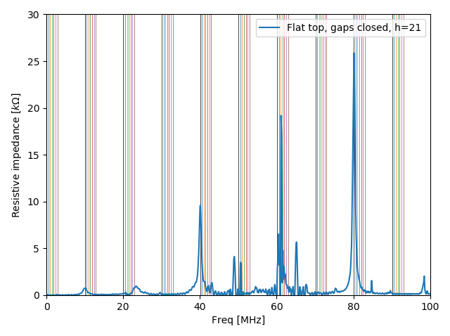
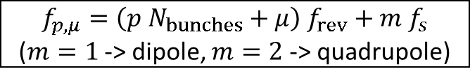
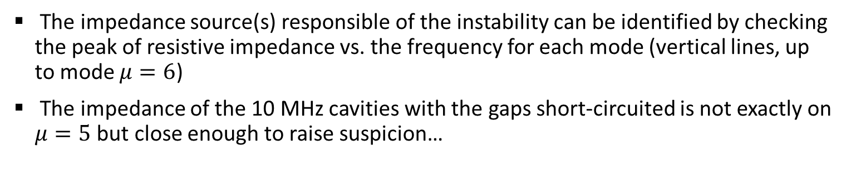
Impedance and coupled-bunch modes *
Kicker resonance to be checked…
Impedance gap relay closed *
$f_{p,μ}=\left(p N_{bunches}+μ\right) f_{rev}+m f_{s}$
($m=1$ -> dipole, $m=2$ -> quadrupole)
* G. Favia, based on C10-11 measurements, https://cds.cern.ch/record/2286835/
The impedance source(s) responsible of the instability can be identified by checking the peak of resistive impedance vs. the frequency for each mode (vertical lines, up to mode $μ=6$)
The impedance of the 10 MHz cavities with the gaps short-circuited is not exactly on $μ=5$ but close enough to raise suspicion…
* A. Lasheen, LIU-PS Beam Dynamics Working Group
23/11/2018

Slide 9
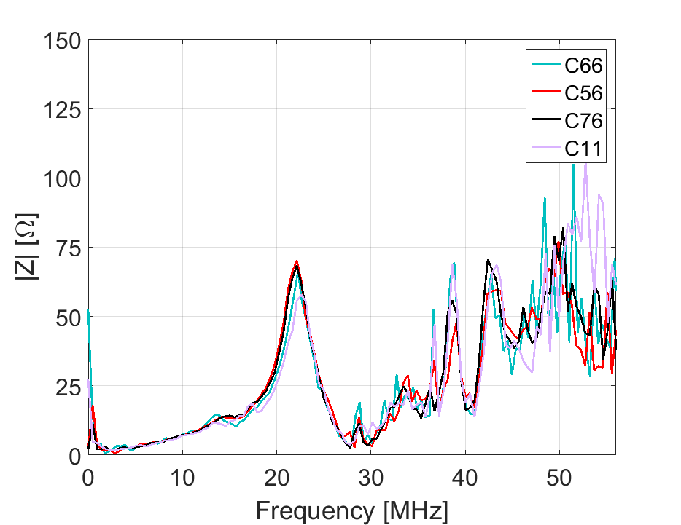
Closed gaps
Single bunch measurements
h=8
The impedance of the 10 MHz cavities with the gaps short-circuited is not negligible

Slide 10
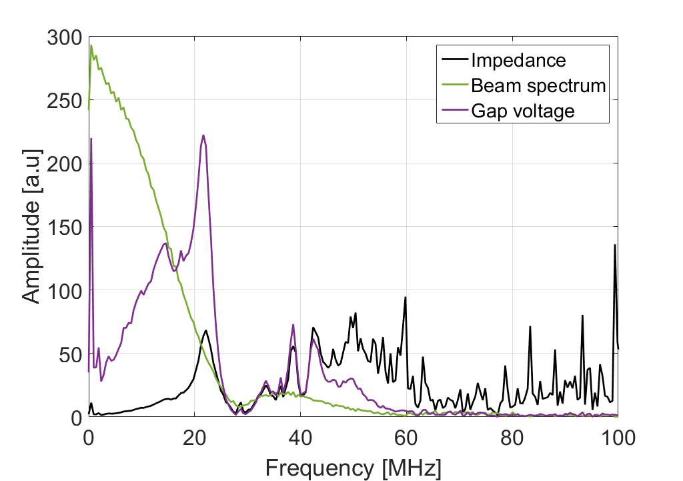
Closed gaps
Single bunch measurements
h=8
The impedance of the 10 MHz cavities with the gaps short-circuited is not negligible
Above 30 MHz impedance results may be affected by :
Noise level comparable with signal one
Limited oscilloscope dynamics
Unknown gap probe attenuation

Slide 11
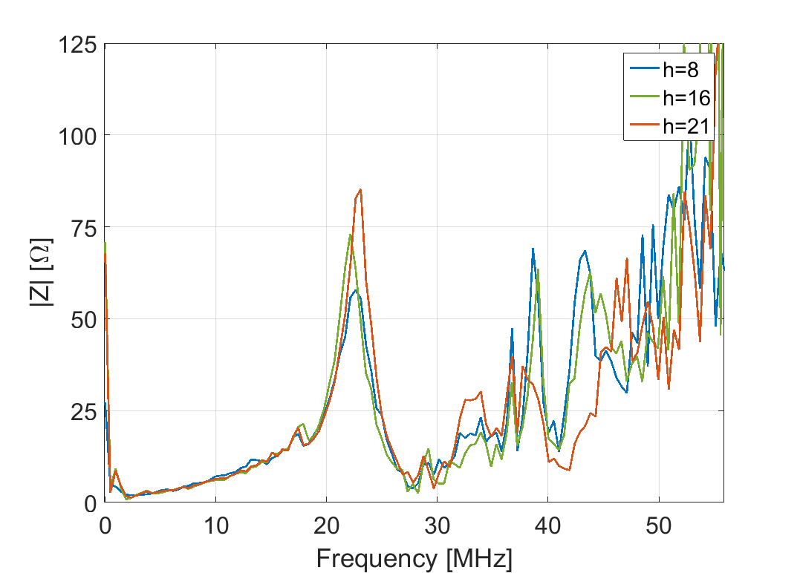
Closed gaps
C11, closed gaps
Single bunch measurements
The peak of impedance moves by few kHz with frequency tuning
Measurements at different harmonics available just for cavity 11

Slide 12
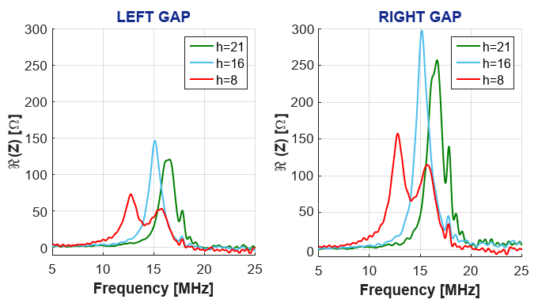
Closed gaps
C11, left gap closed
Single bunch measurements
The peak of impedance moves by few MHz with frequency tuning
The impedance is large, but in a frequency region far from the one expected for quadrupolar instability (~20 MHz)

Slide 13
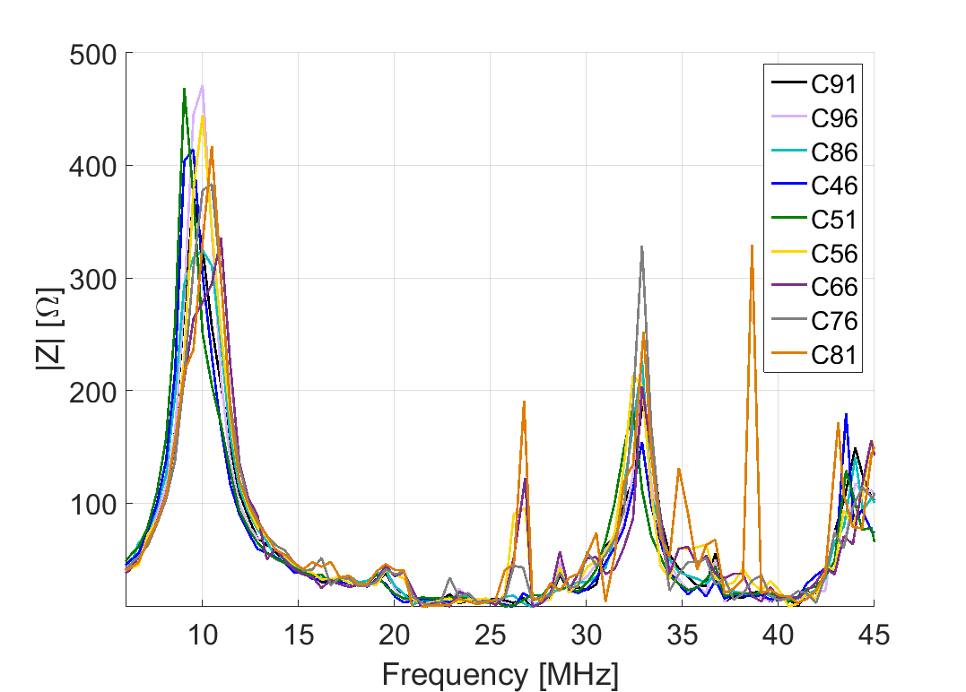
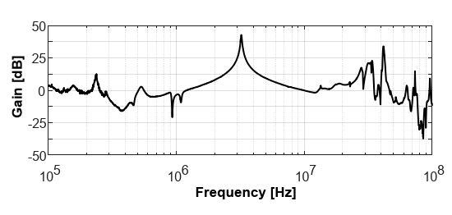
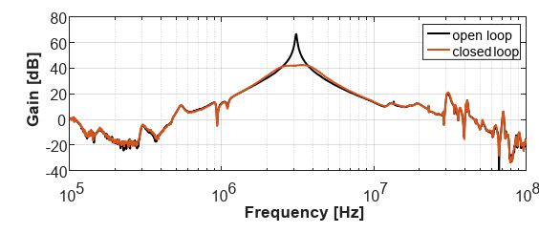
C10 impedance at higher frequencies
The cavity coupling line has a very dangerous parallel resonance with the anode capacity of the final tube at about 32MHz
Multi-bunch measurements h=21
Final stage transfer function
Amplifier transfer function

Slide 14
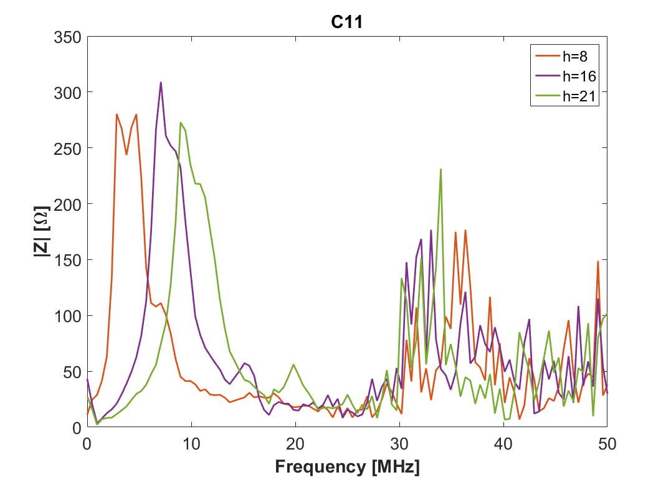
C10 impedance at higher frequencies
Single bunch measurements
The peak of impedance at ~32 MHz seems moving with frequency tuning

Slide 15
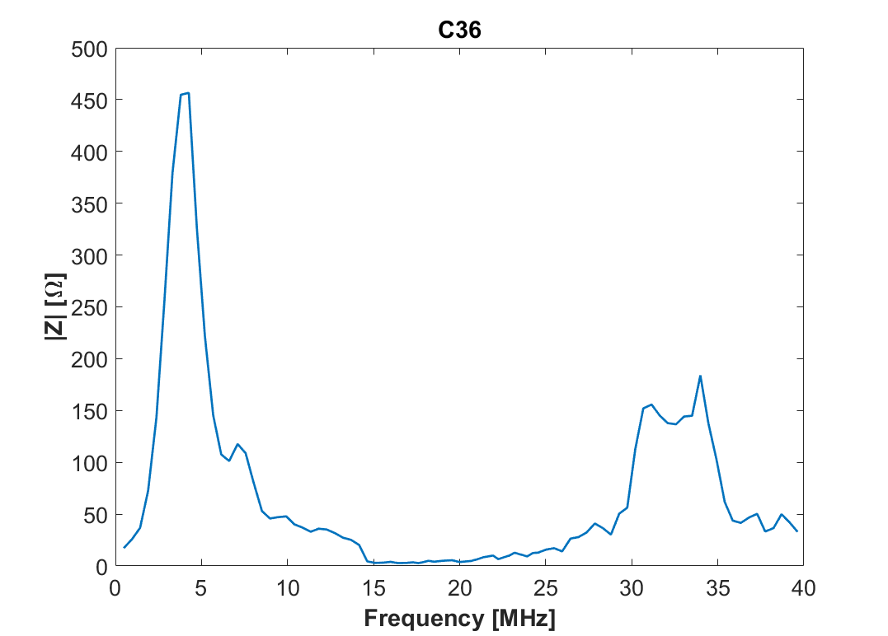
C10 impedance at higher frequencies
Single bunch measurements
Above 30 MHz impedance results may be affected by :
Noise level comparable with signal one
Limited oscilloscope dynamics
Unknown gap probe attenuation
Impedance measured using spectrum analyzer

Slide 16
Conclusions
Measurements of PSC10 impedance at h=21 using multi-bunch beam were performed
The PSC10 impedance when gap relays are closed is not negligible and may be responsible of quadrupolar oscillations
The PSC10 system may contribute to the total PS impedance above operational frequency, due to a parallel resonance at 32 MHz
The validity of impedance results at frequencies above operational one has to be further investigated
Worth investigating deeper the problem for eventual improvements?

Slide 17
Thank you
for you attention

Slide 18
