Slide 2
Studies in 2018 and outlook to 2019
LIU-PS Beam Dynamics Working Group
12 December 2018
H. Damerau, M. Fraser, V. Forte, A. Huschauer, A. Lasheen

Slide 3
Introduction
The LIU-PS beam dynamics working group in numbers
17 meetings in 2018
> 40 presentations
Even more exciting results!
Big ‘Thank You’ to Alexandre and Vincenzo for the minutes!

Slide 4
2018 priorities for LIU-PS BD
LIU-PS BD
08/02/2018
Transfer and injection
  Investigate/determine additional contributions to the observed emittance growth at PSB-PS transfer, in particular with large ε_{l}
    Sensitivity studies, understanding of emittance measurements: SEM grids, deconvolution
    Exploit fast beam instrumentation as it becomes available for matching studies
    Proof-of-principle study with matched transfer line optics
Transverse
  Complete injection bump studies (single particle and space charge simulations)
    Effects of eddy current induced sextupolar component
  Optimization of working point during the cycle, chromaticity correction with new sextupoles
  Establish horizontal BGI as tool to investigate transverse emittance blow-up

Slide 5
2018 priorities for LIU-PS BD
LIU-PS BD
08/02/2018
Longitudinal
  Full exploitation of new high-frequency power converters for MD studies
    Complete studies for Landau RF system to define parameters for technical design
    Conclude on shaving and post-acceleration → higher intensity with more bunches
  Intensity reach and longitudinal impedance model
    Impedance of 10 MHz prototype and stability 40 and 80 MHz with multi-harmonic feedback
    Summarize model from simulations, integrate feedback studies for RF systems
Studies in view of LS2
  Reference measurements
    Longitudinal and transverse impedance measurement
    Coupled-bunch instabilities during acceleration cycle

Slide 6
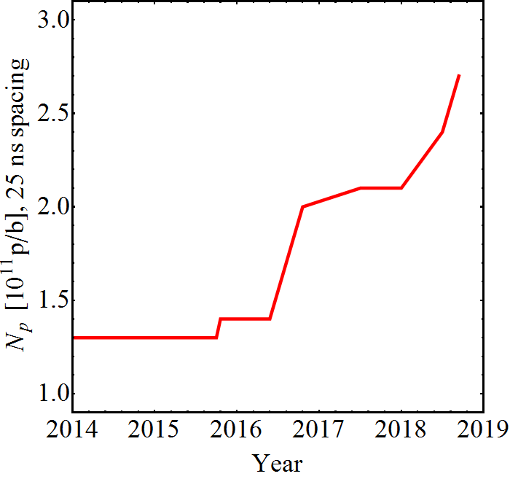
Highlights 2018 (1)
Reaching the LIU intensity within longitudinal specification
  Full exploitation of potential with new anode power converters on 40 MHz and 80 MHz cavities → Game changer for high-intensity studies
  Multi-harmonic feedbacks for all 40 and 80 MHz cavities, use as Landau system
  Wealth of beam measurements at N_{b} = 2.6 ∙ 10¹¹ p/b
Intensity per bunch at extraction
Multi-harmonic feedbacks
C40-78 as Landau RF system
LIU baseline
Suspected feedback saturation
Optimization 2017
Early 2018
Finemet dipole-mode
coupled-bunch feedback
Reach with C10-86/96 coupled-bunch feedback (2005)*
Bunch profile/length
*Intensities >1.3 ∙ 10¹¹ ppb were delivered <2016, but not with sufficient quality for LHC

Slide 7
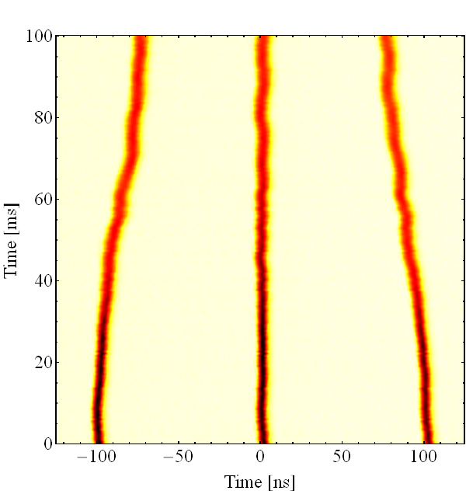
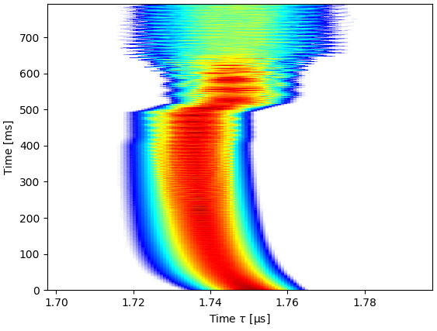
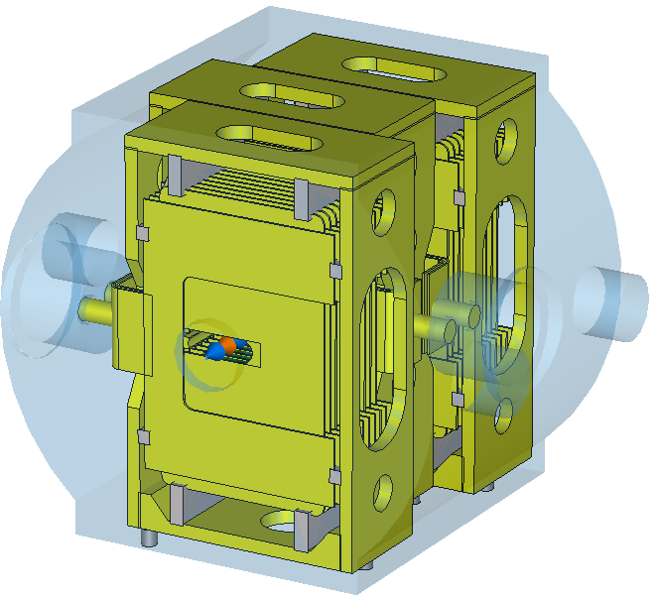
Highlights 2018 (2)
Impedance modelling and simulations
  Solid understanding of impedances: RF cavities (10 MHz, 40 MHz and 80 MHz), kickers (KFAs, BFAs, vacuum equipment, dumps, space charge, resistive wall, ...
  BLonD simulations reproducing the observed instabilities
Ion beam with 75 ns bunch spacing (Xe → Pb)
  Prepared in LEIR and PS in May
  Major contribution of injectors to luminosity record in LHC
Tracking simulation with BLonD
Part of ej. kicker (KFA79)
100 ns → 75 ns compression

Slide 8
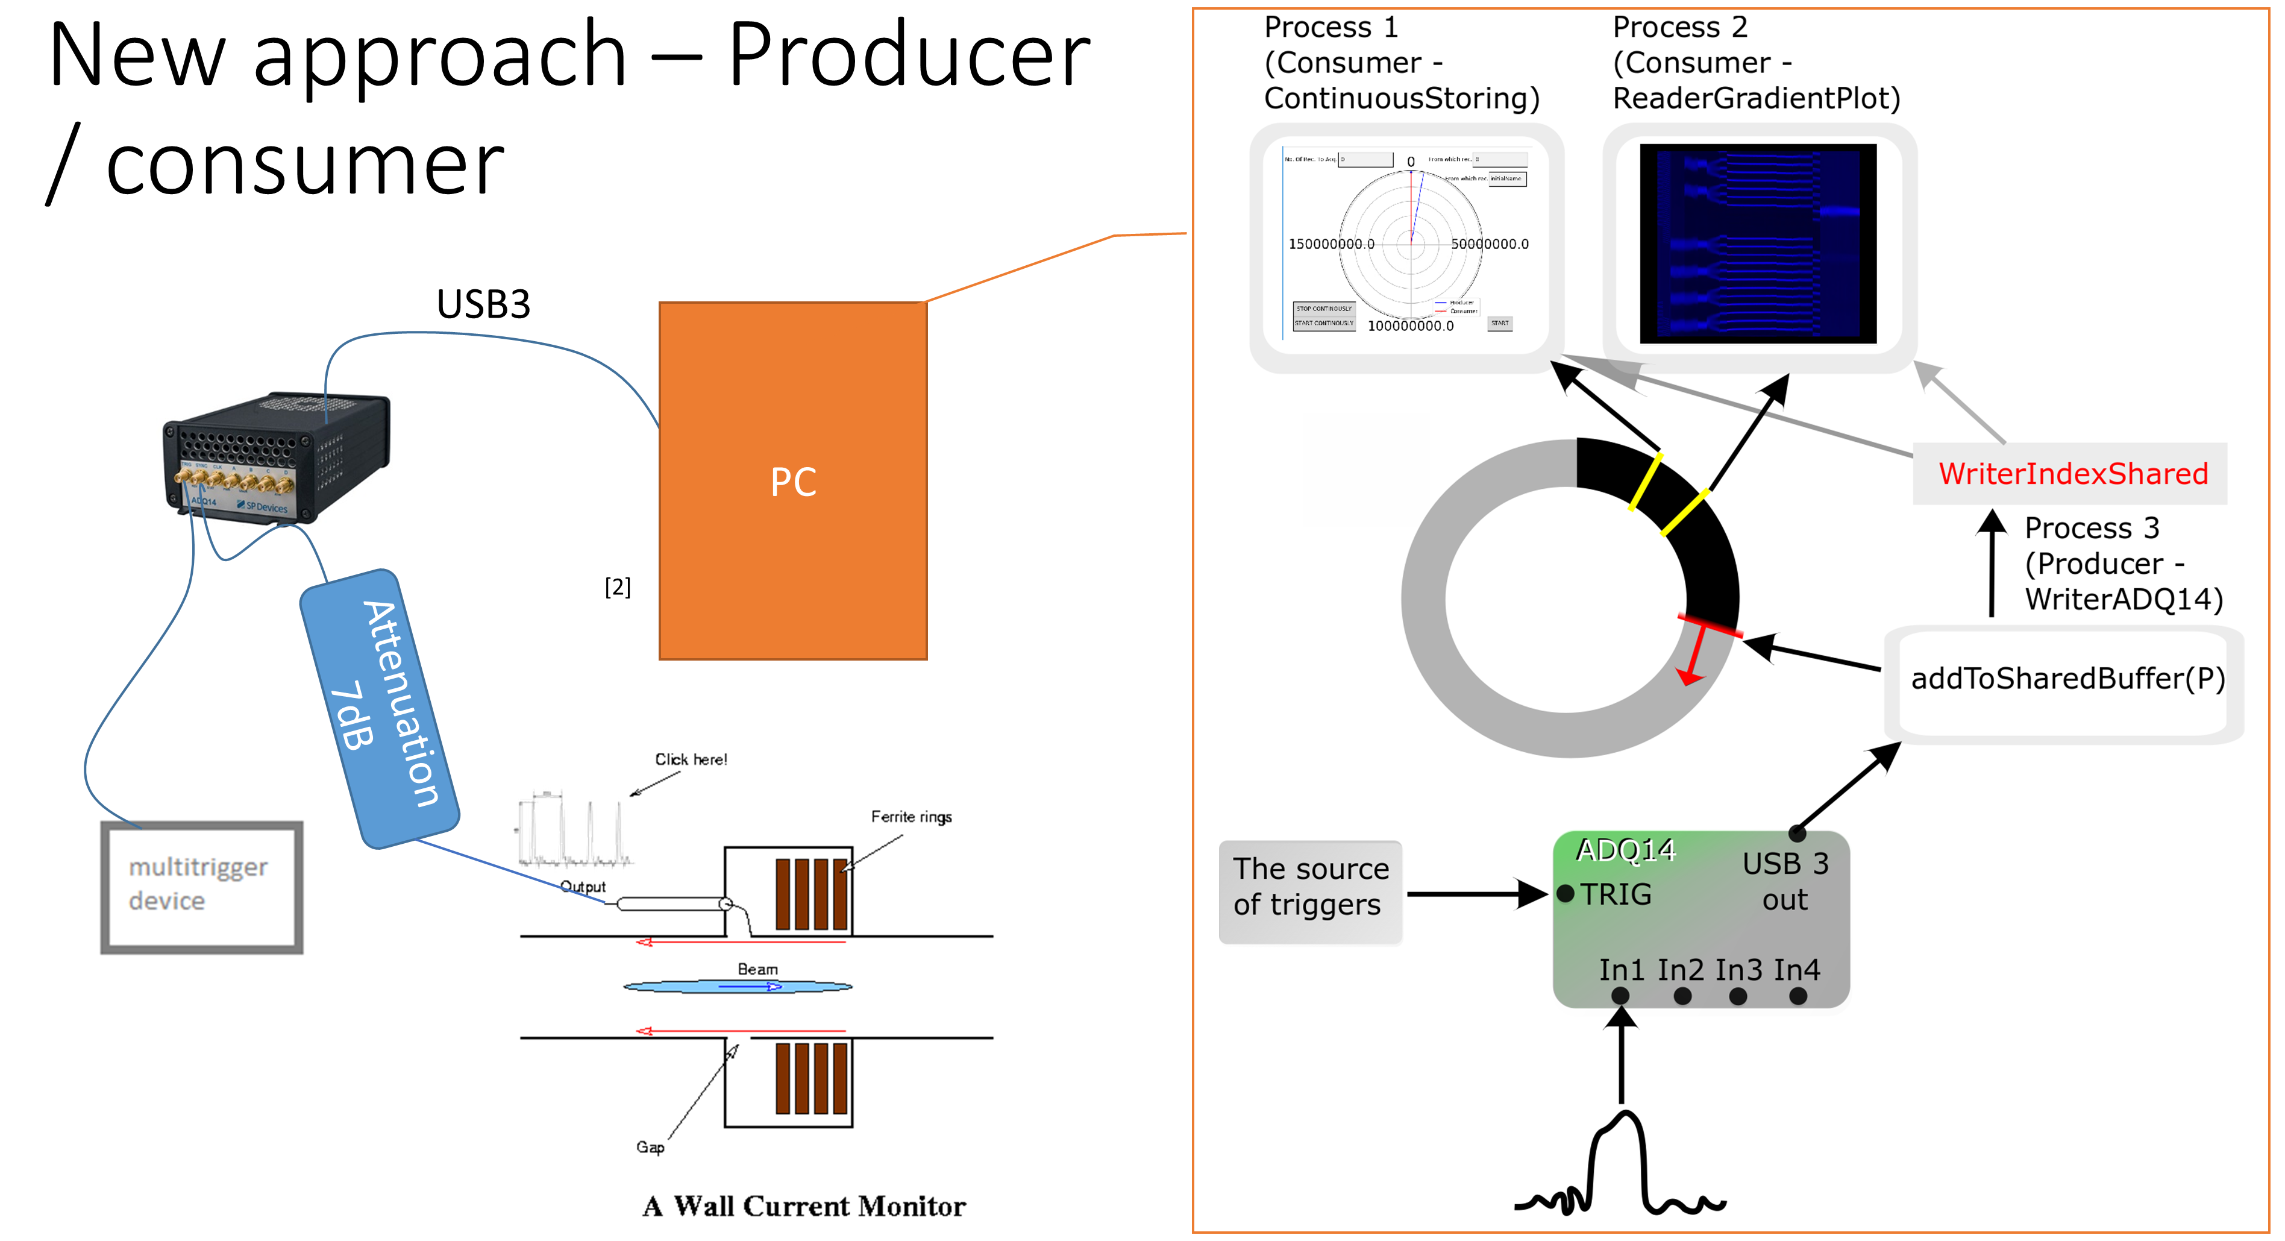
Highlights 2018 (3)
Real time data recording demonstrator
Longitudinal obser-
vation system
  Massive amount of data
  from longitudinal beam
  signals recorded before
  end of proton run
  Food for thought
  during LS2
Technical validations in view of LS2 beam control upgrades
  Digital radial loop processing, 40/80 MHz cavity controller, new master clock
  Confirms choices for beam control upgrade during LS2
Barrier buckets in the (non-LIU study)
  Exercised bunch length manipulations with moving barriers
  Demonstrated loss reduction with MTE beam up to highest intensities
  Ion batch compression?

Slide 9
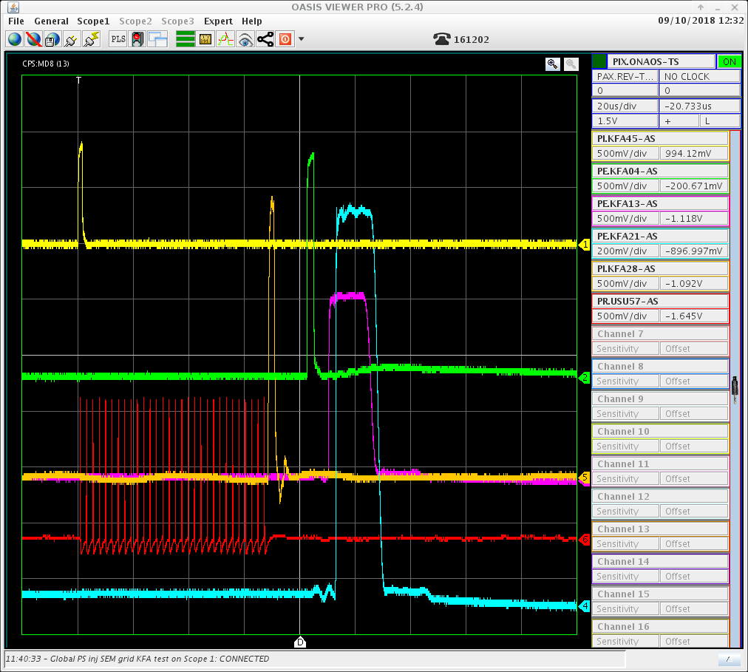
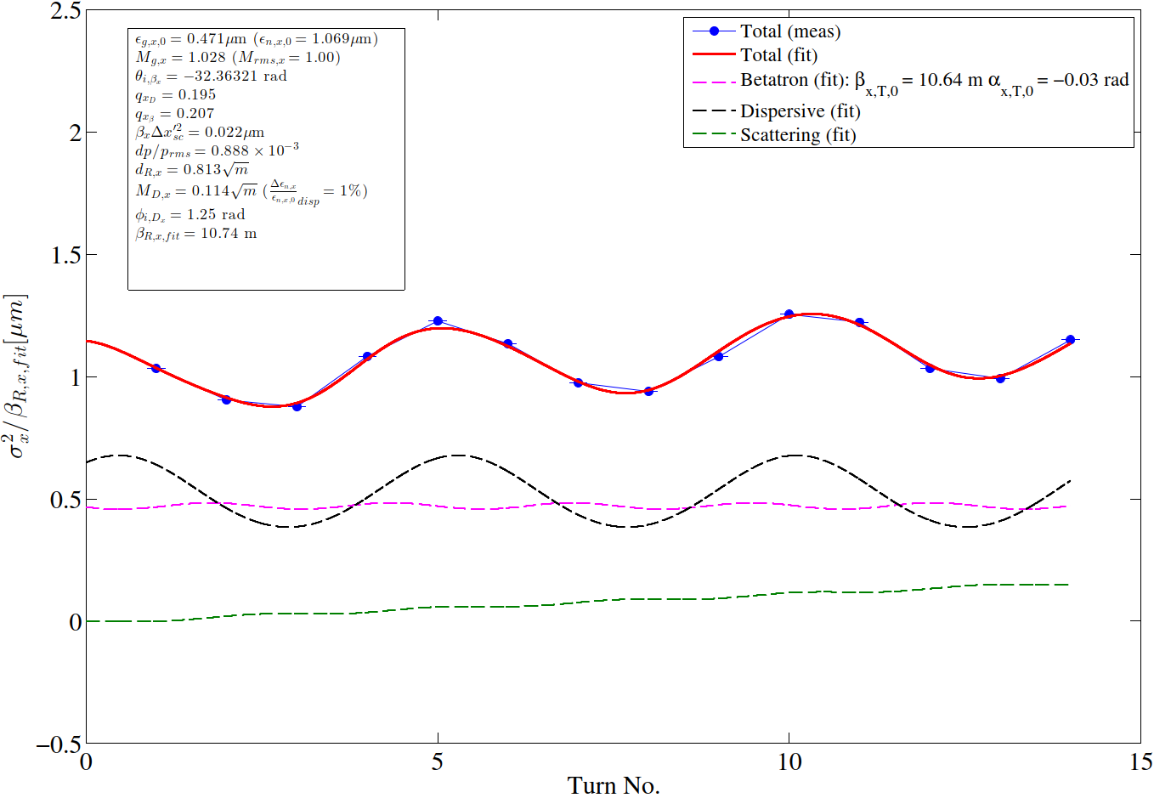
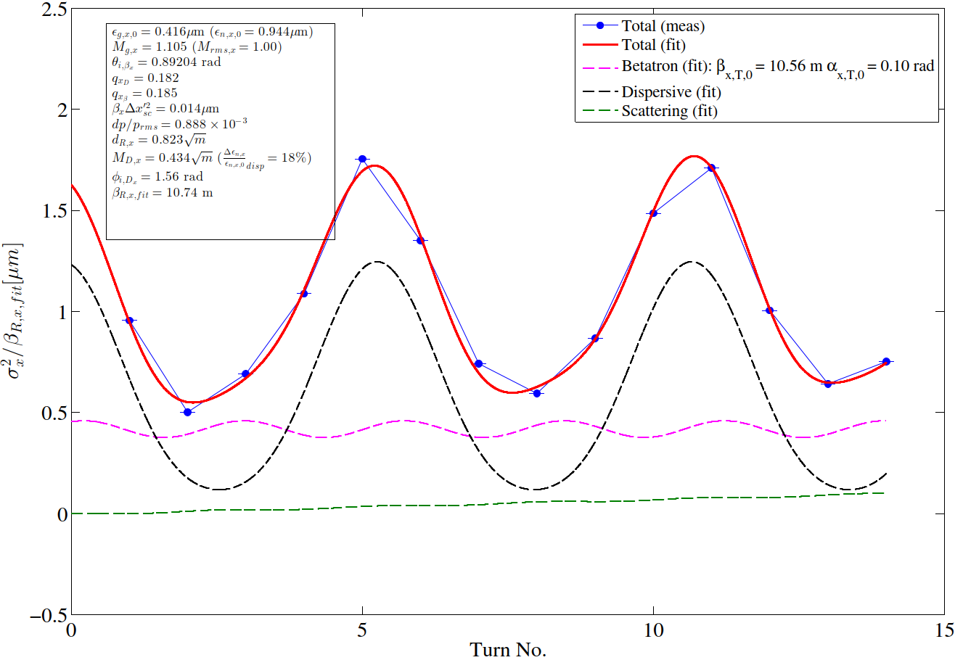
Highlights 2018 (4)
Ring-by-ring stitched YASP model for correction of PS injection oscillations
Turn-by-turn injection SEM grid electronics installed and commissioned pre-LS2 thanks to BE-BI
Implementation of PPM-rematched transfer line optics (R3) with T-by-T SEM grid
Standardised MD procedure for quantification of blow-up from mismatch (source confirmed to be dispersion dominated):
Blow-up expected ~ few %
Blow-up expected ~ 16%
Envelope: re-matched transfer line optics
Envelope: OP transfer line optics

Slide 10
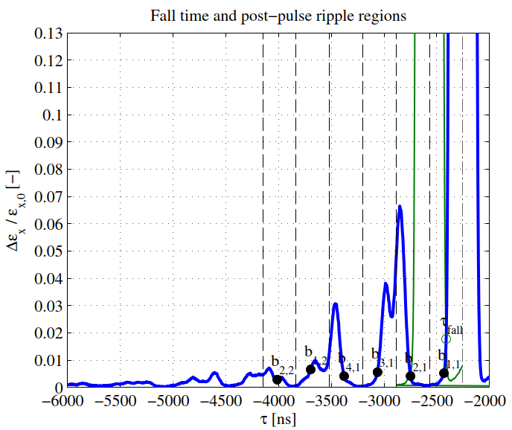
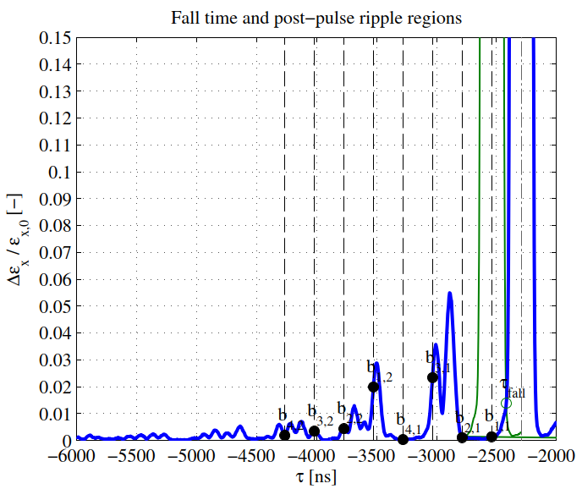
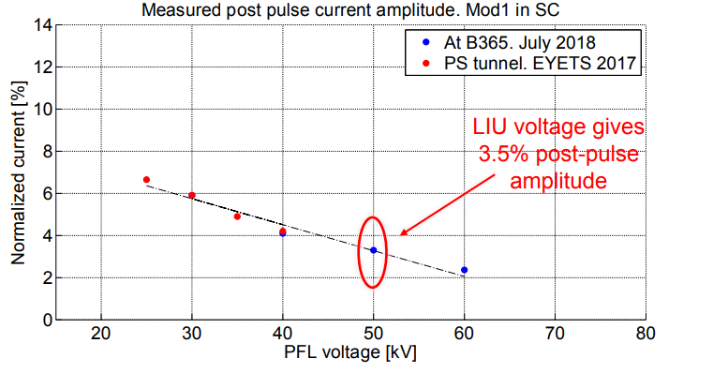
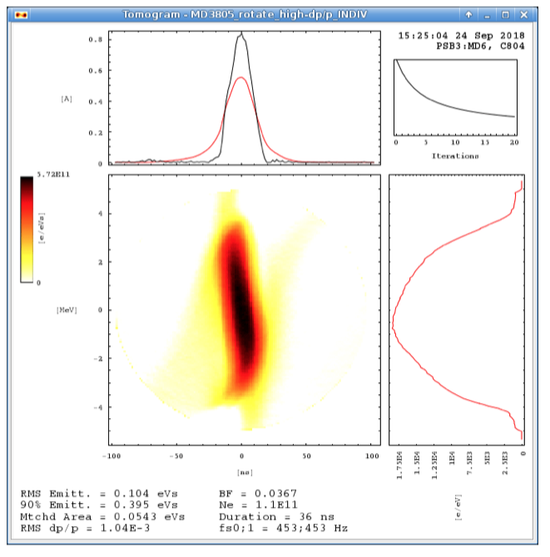
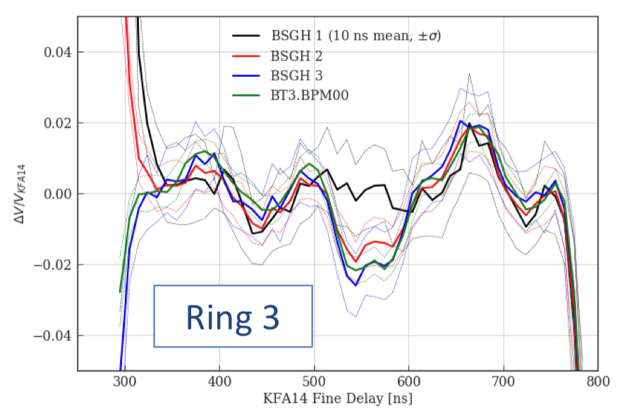
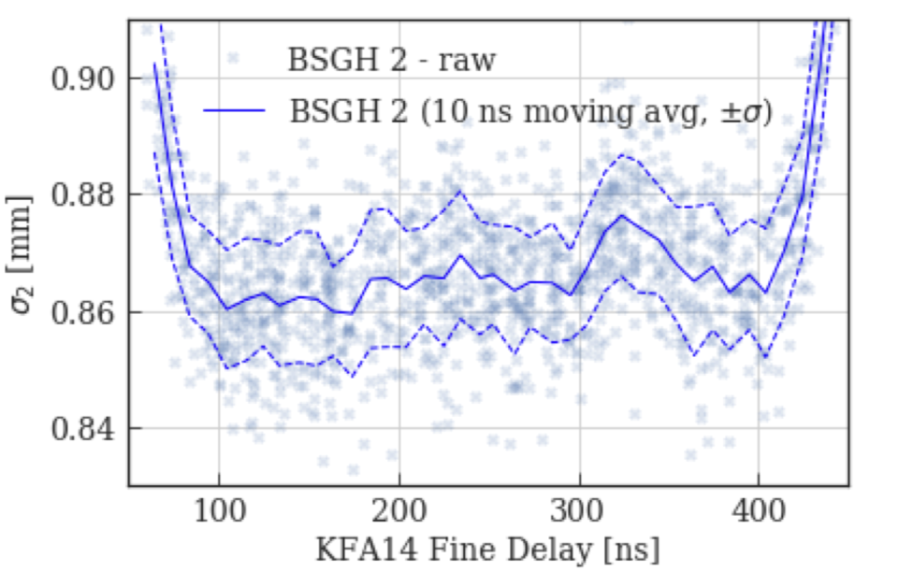
Highlights 2018 (5)
KFA45 waveform measurements and post-pulse investigations:
  Post-pulse is constant with voltage, impact on emittance minimal:
KFA14 waveform measured and impact on emittance (negligible) assessed:
h = 7
h = 9
BCMS 1.5 eVs

Slide 11
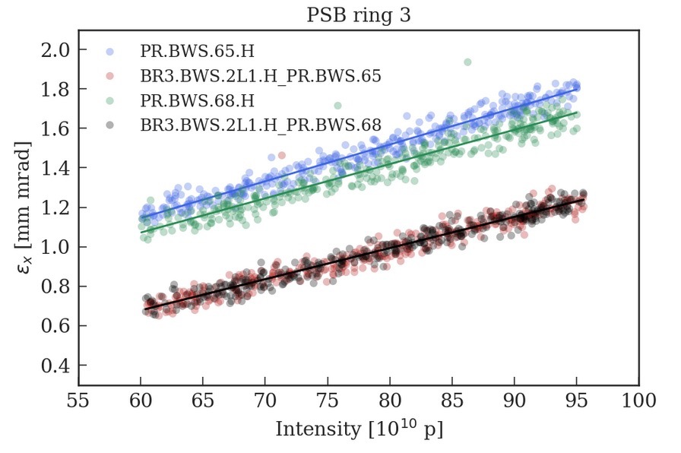
Highlights 2018 (6)
Estimated blow-up from turn-by-turn SEM grid measurements is smaller than implied by emittance measurements in PSB and PS
  Likely dominated by dispersion and challenges in deconvolution
  Implying systematic errors on the emittance measurements in the different machines
Follow up systematic error contributions emittance measurements:
  Understanding of RF voltage calibration in PSB and PS
  Impact of Tomoscope WCM baseline droop with intensity on the reconstruction
  Error on the dispersion measurement due to BPM calibration
  PS ring optics without and with space-charge expected to be small
  Optics measurements (quad gradient scan, turn-by-turn BPM analysis)
  Frailties of deconvolution algorithm exposed
PSB/PS brightness curve measurements
  Significant amount of data recorded in both machines
    operational BCMS, BCMS 1.5 eVs, operational and rematched optics, prototype WSs, SEM grids
  Ideal studies to evaluate importance of systematics
  Analysis ongoing

Slide 12
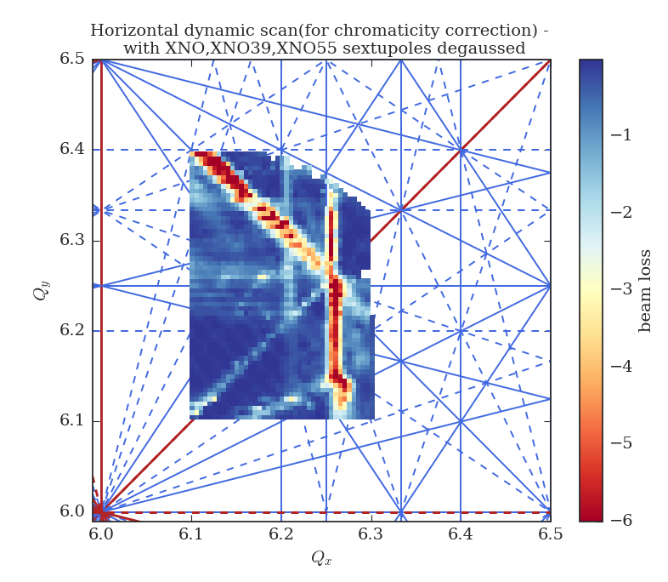
Highlights 2018 (7)
BCMS operation at low-chromaticity along the flat bottom
  Configuration proved to be extremely reliable in operation
  Chromaticity correction performed with PFW in 3 current mode
  Dedicated chromaticity sextupoles cause too strong resonance excitation
Transverse optimization of HI LHC-type beams
  Working point optimization, TFB at flat bottom to reduce beam loss and stabilize head-tail instabilities
  Vertical chromaticity adjustment during the ramp
  Enabled systematic studies of the longitudinal parameter reach
M. Kaitatzi

Slide 13
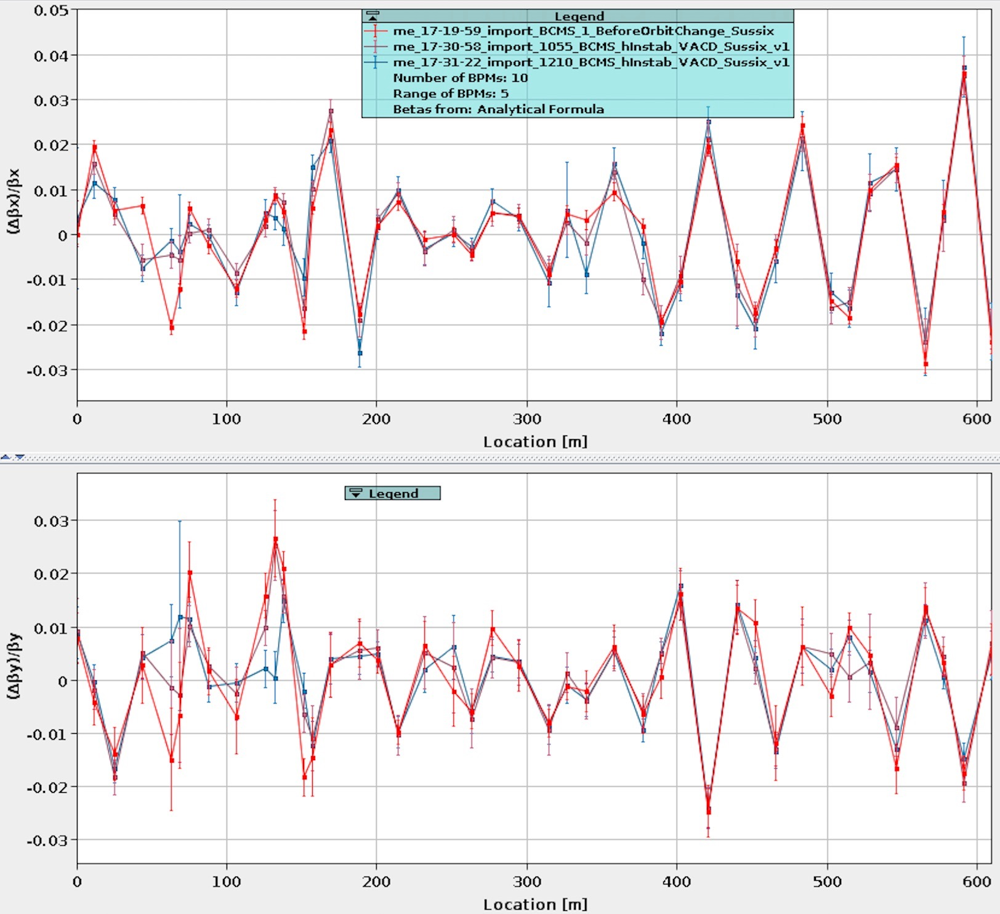
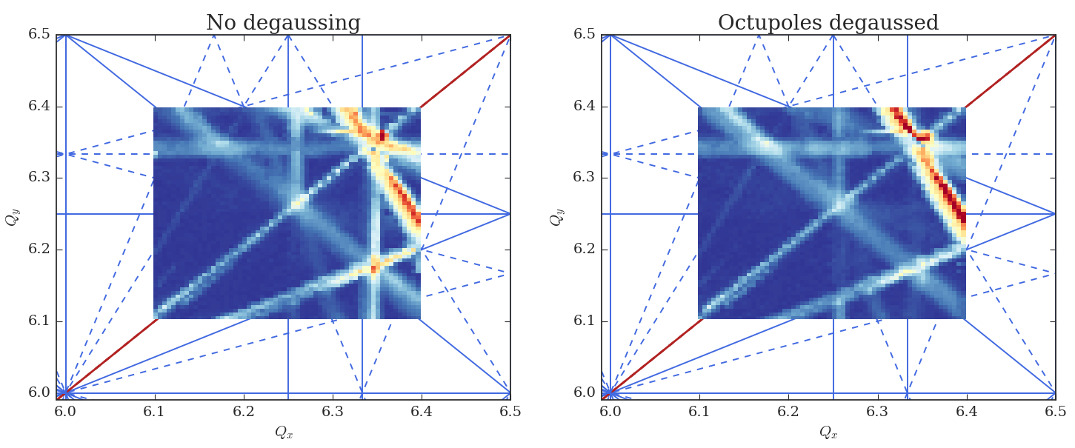
Highlights 2018 (8)
P. Skowronski
Optics measurements
  Applied LHC methodology and adapted software tools
  Linear optics measurements, RDTs, amplitude detuning, coupling correction
  Implementation of AC dipole excitation using the TFB
  Important input for emittance measurements and PS modelling
Presence of remnant magnetic fields in MTE circuits and potentially the main magnets
  Tune diagram measurements clearly showed different situation with respect to 2012
  Resonance excitation could be reduced applying dedicated degaussing cycles
M. Kaitatzi

Slide 14
Highlights 2018 (9)
Significant progress in the understanding of the interplay between structural lattice resonances and space charge forces
  Large amount of experimental data recorded for simulation benchmark
Transverse impedance studies
  Performed measurements at different energies, chromaticities
  Very good agreement with theoretical expectations
Working point control improvement
  Measurements taken during acceleration to reconstruct PFW matrix elements
  Potential to further improve tune/chromaticity control at high energy (and LHC flat bottom) and to reconstruct the basic functions
Implementation of physics concepts into LSA
  Several knobs defined, which have become standard operational practice
  Lots of additional implementations and clean-up during LS2

Slide 15
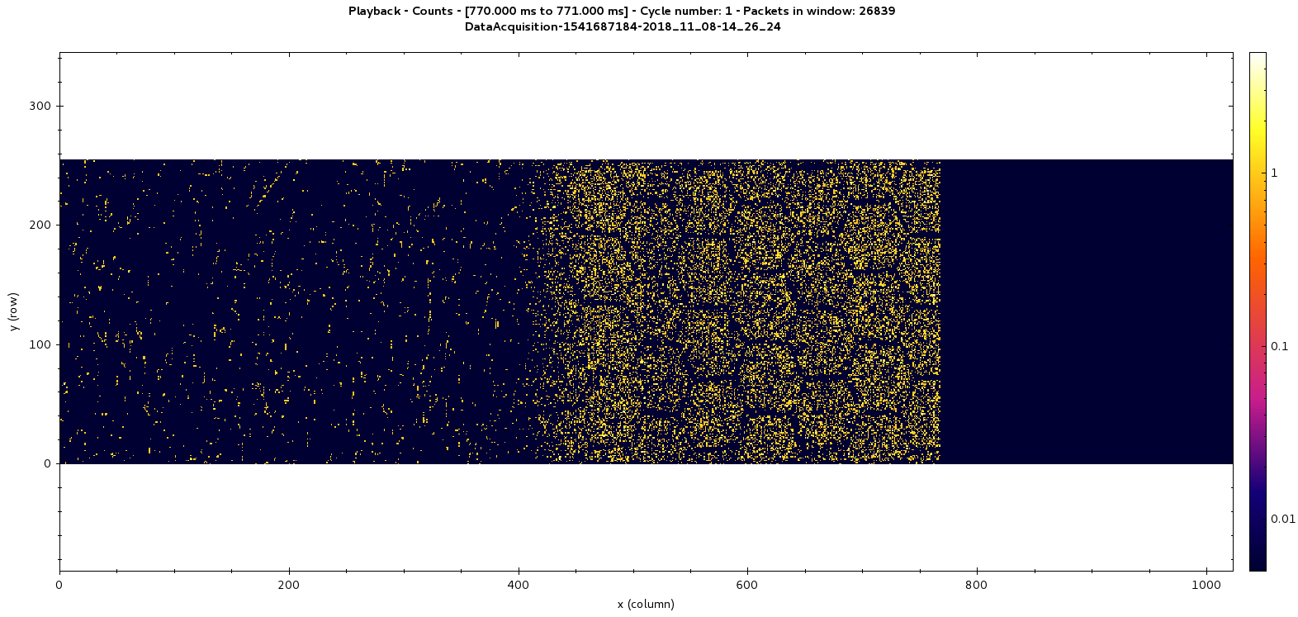
Highlights 2018 (10)
Close collaboration with BI to advance new instrumentation
  Horizontal BGI
    Demonstrated large potential (but also great complexity) of the device
    Important progress on various fronts (read out electronics, data analysis and interpretation, …)
  Prototype wire scanner
    Also used for brightness curve measurements
    Large amount of data for operational references and comparison with OP scanners
  TbT SEM grids
MTE splitting as seen by the BGI
S. Levasseur, H. Sandberg, J. Storey

Slide 16


Outlook 2019
No fresh data with beam in PS before end 2020
  Make the maximum of understanding out of 2018 data with beam
Transverse
  Understand role of systematics in measured blow-up
  Review and improve PS working point control
  Continue with benchmarking simulations
Longitudinal
  Understand impedances exciting coupled-bunch instabilities
  Performance predictions for RF upgrades during LS2
  Review and upgrade longitudinal Tomography

Slide 17
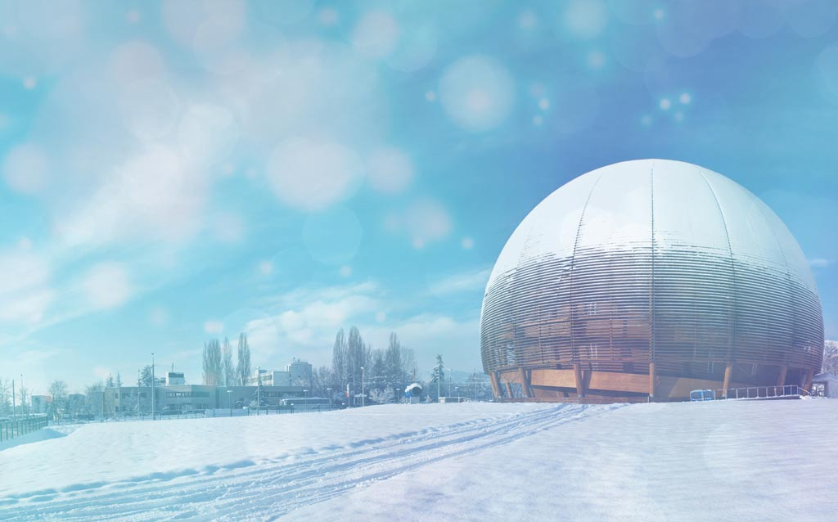

Seasons Greetings
Many thanks to everybody for your collaboration and dedication.
See you soon in 2019!

Slide 18
THANK YOU FOR YOUR ATTENTION!

