Slide 1

Central Heating at P1:
HL-LHC project impact vs consolidation
Laurent Tavian, ATS-DO
CERN, 06 December 2018

Slide 2
Introduction: Cooling needs
New total requirement:
2343 kW including 475 kW for HL-LHC (~20 % of the total need)

Slide 3
Introduction: Present performance

Slide 4
Central heating of P1 (including HL-LHC needs)
Assumptions:
Constant hydraulic impedance of the circuit (conservative assumption as the HL loop will be partially in parallel), i.e. DP_{loop} proportional to m².
Specific heat of water: 4.19 kJ/kg.K
Operating DT: 20 K
15 % of margin is:
- what is applied by CV for equipment design.
- what was recommended by the International Value Engineering Review of CV design.
→ Should also be valid for central heating

Slide 5
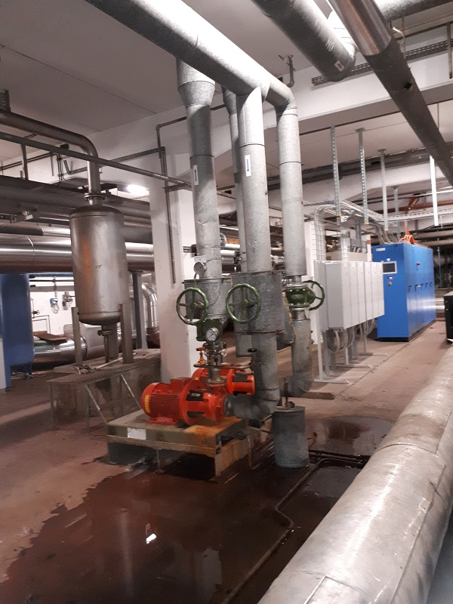
Central heating of P1: Conclusion
Two pumps in operation are needed to guarantee the total heating power with 15 % of margin.
By applying the redundancy strategy (N+1), a 3rd pump must be added:
  Hot spare ready to start in case of failure of one of the 2 pumps in operation.
This 3rd pump has to be:
  Integrated close to the existing pumps
  connected to the existing distribution piping network (including inlet/oulet valves)
  connected to proper electrical cabinet or to an existing one (if spare space is available)
  Connected to the central heating control system

Slide 6
Central heating of P1: Conclusion
The HL-LHC project is ready to contribute to:
  The supply and the integration study of this 3rd pump.
  The connection works of this pump to the existing piping, electrical and controls networks.
If the central heating system requires additional consolidations (renovation of existing pipework, existing electrical cabinets, existing heat exchangers, existing…) consolidation and/or DG reserve budgets should be requested.

Slide 7
Thanks

