Slide 1
PS Beam Commissioning Schedule
Frank Tecker, BE-OP
Many thanks to
D.Cotte, H. Damerau, M.Delrieux, O.Hans, A.Huschauer

Slide 2
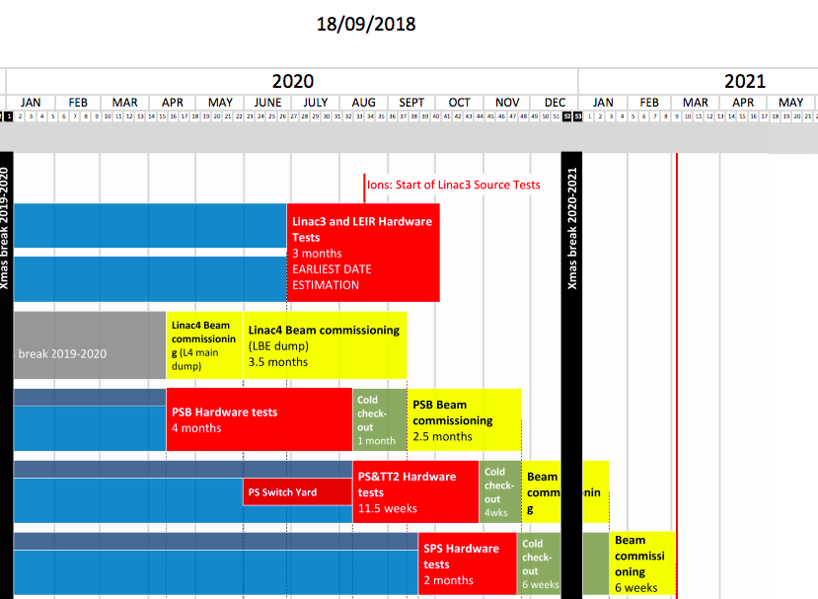
LS2 Master Schedule
6 weeks foreseen for PS beam commissioning
Interrupted by 2 weeks Christmas shutdown !!!
  Keep service running (CO, water, etc.)
  No lock-out
  Access system by TI
  Holidays
=> effective 4.5-5 weeks
Fast restart examples
  2010 AMS run
  2013 Jan restart

Slide 3
Beams required
SPS (from week 3/2021) (from K.Li’s presentation)
  LHCIndiv
  MTE low intensity (core only, 5e11, 2µs) after 1 week
  MTE low int (islands only, 5e12, 8µs) after 2 weeks
  (can we use full MTE?, island only not ‘clean’ in the PS, loose core)
  LHCProbe after 3 weeks
  Multi-bunch beams (12b, 24, 36, 48, 72) after 3 weeks
    Standard or BCMS? (not big difference for the PS RF)
  MTE full beam after 4 weeks
NTOF from week 3/2021 (new target, assume intensity ramp-up later)
AD from week 12/2021 (RF side should follow other beams)
EAST from week 18/2021

Slide 4
Assumptions / Prerequisites
Hardware tests/Cold checkout finished, all possible tests without beam done
  New injection equipment (polarity,…)
  BPM alignment offsets after main unit renovation
  new RF beam control validated without beam, existing one prepared for beam, 10 MHz cavity phasing
  Interlocks (new internal dump, interlock when in chamber to PSB extraction BIC + SIS interlock, interlock from BCT (TOF parasitic beam on EAST not extracted), BLM,…)
  External conditions (will have been renovated), some will have to be done when EIS are working
  Optics definitions, YASP configuration
  Magnetic checks of PFW circuits foreseen
Injection line PSB->PS commissioned up to BT dump
  known Twiss parameters
  BTP line magnets polarity checks, HW tests done
2 GeV injection cycles prepared (had a first check for RF already)
  Shorter ramp time needed (~30 ms less)
  POPS regulation should allow first ramp up modification
Plan in DSO tests for SPS, TOF, (AD, EAST later), …

Slide 5
Injection (~2 weeks)
First beam: TOF-like low intensity, LHCIndiv
Coarse B-field setting
BTP line commissioning (30m, 6 quadrupoles)
  BPM setup (should be like BT)
  Kick response
BPM commissioning, first turn, orbit
Injection bump setup
  First delay and amplitude optimization, bump closure (YASP, MatLab tool)
  To be redone after main magnet alignment with synchronization measurements
kick response matrix measurements
  corrector polarity, low energy quads
Multi-turn SEM grid measurement (dedicated time, circulating beam <~30 turns)
  Essential for injection matching
  (kick strength to kill the beam to be verified)
  Interleave with other commissioning (time for analysis needed, maybe several iterations)
Commissioning low-beta injection quadrupoles (large emittance beams) later

Slide 6
Initial RF setup (~1-2 weeks) – Orbit alignment
New RF beam control from the start
Old system kept as much as possible as back-up, can be switched PPM
RF capture, acceleration
Transition crossing
single bunch acceleration to 14/26 GeV
Orbit check at 14 GeV for main unit alignment (40 MU refurbished)
  Measure orbit, calculate magnet movements
  Align the magnets
  Remeasure orbit
k-modulation for low-energy quads

Slide 7
Transverse Feedback
Upgrade during LS2
  Digital control (similar to PSB)
  Power amplifier
Standard HW-check verification of knob, functions (gain, tune offset), BPM attenuation and gain procedure, kicker response
Essential for MTE and LHC beams
Commissioning with expert
Measure/optimize damping time of injection oscillations
1-3 days for a beam - in parallel with other activities

Slide 8
Extraction / TT2
Most critical for MTE beam
Depends very critically on orbit at dummy septum 15/septum 16!
Very limited orbit correction at high energy (3 correctors)
We will consider it when aligning the main magnets
  Could require another iteration of main unit movements (+2/3 days)
Optimize the shadowing TPS15/SMH16 with diamond BLMs
Final setup for all other beams after MTE
TT2 setup, kick response, Twiss parameters (SEM)
TOF beam to D3 dump

Slide 9
Further RF setup
1 week 200 MHz set-up – blowups for high intensity beams
  New system - Old system as backup
  at least 2 days for cavity setup
2-3 days 40/80 MHz cavity with new controller (LHC beams)
2 days 10 MHz 1-turn delay FB (for multi-bunch)

Slide 10
New Instrumentation post-LS2
Wire Scanners (all new, old ones removed, 54H,64V,65H,68H,85V )
  Extensive cross-check campaign done for 54H
  Commissioning needed with BI experts present
(Turn-by-turn) SEM grids
  1st prototype successfully tested
  2 more to be installed and commissioned
  kick strength to kill beam to be verified
  New ’Ralentisseur’ final verification with beam
BLMs
  Work well in the PS ring, higher bandwidth, higher sensitivity, no saturation
  TT2/TT10, FTN, (EAST) need to be commissioned
BGI (not critical for commissioning)
  Horizontal gave very promising results
  FESA class to be finalised, application being written
  Vertical (SS84) to be commissioned

Slide 11
Global planning (some items interleaved)
Week 1-2 (TOF-like low intensity, LHCIndiv)
  DSO test, Interlocks, Ext. conditions, BTP, Injection, bumper, LE orbit, kick response, dedicated injection matching
  BPMs, SEM grids, wire scanners, TFB
  Phase loop lock before injection, RF capture, radial loop, acceleration
Week 2-3
  RF transition crossing, single bunch to 14/26 GeV, 14 GeV orbit alignment, extraction, TT2
Week 4 (MTE core/islands)
  200 MHz setup (blowup for high-intensity beams)
  Stop beam for Christmas shutdown (Wed/Thu?)
Christmas shutdown
Week 5
  Restart and recover previous commissioning state
  Finalize LHCIndiv/LHCprobe and TOF setup, continue MTE
Week 6 (start multi-bunch LHC setup)
  40/80 MHz cavity with new controller
  10 MHz 1-turn delay FB (for multi-bunch)
Later AD, EAST

Slide 12
Remarks
Equipment groups work mainly during daytime, it would be essential to have the beam commissioning coordinators also on normal working hours (at least during the first 6 weeks of the start-up).
This would improve communication and would help everybody to keep up with planning changes according to the technical progress
More time needed between TOF/EAST beam permits and physics start!
  Had delays on the experimental zone readiness this year -> delayed beam permit
Reference magnet
  measurement system dis-/reassembled
  Setup with eddy current compensation card in reference magnet (was not present this year)

Slide 13
Conclusion
Hardware commissioning progress very important
Christmas shutdown needs to be incorporated as well as possible
  Reduces effective time
A lot of new essential equipment and instrumentation needs to be commissioned
  RF beam control
  Transverse feedback
  Wire scanners
  Multi-turn SEM grids
Should be able to get the required beams ready in time for the SPS
if there are no major hiccups

