Slide 1



LIU-PS
High-frequency cavity controller
With contributions of
H. Damerau, A. Jibar, D. Perrelet, Y. Brischetto, J. Molendijk

Slide 2
Overview
Contents
Introduction
  Multi-harmonic feedback
  Automated voltage control
  High-frequency cavity controller
Multi-harmonic feedback section
  Block diagram, signal scaling and cabling
  Transfer function
  Beam induced voltage reduction
  Effect on longitudinal beam quality
Automated voltage control section
  Block diagram, signal scaling and cabling
  Calibration without beam
  Tests with Ions beam
High-frequency cavity controller
  Multi-harmonic feedback rework
  Multi-harmonic complex source
Status and conclusions
Outlook

Slide 3
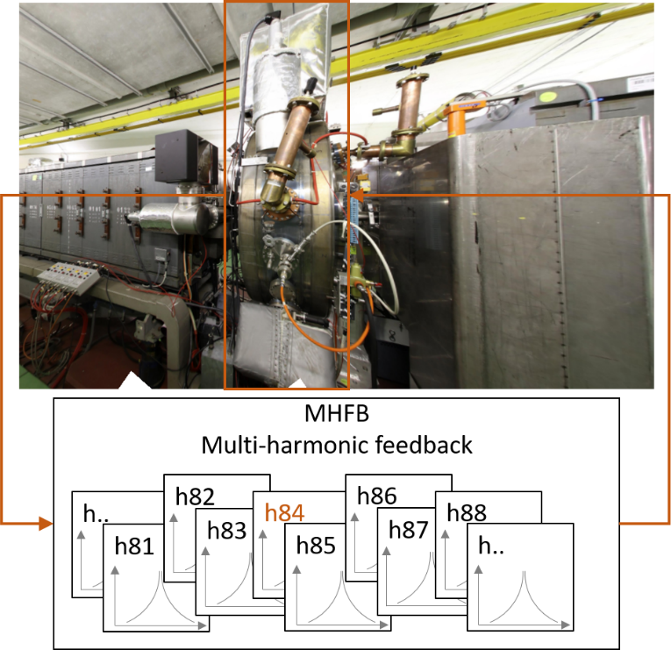
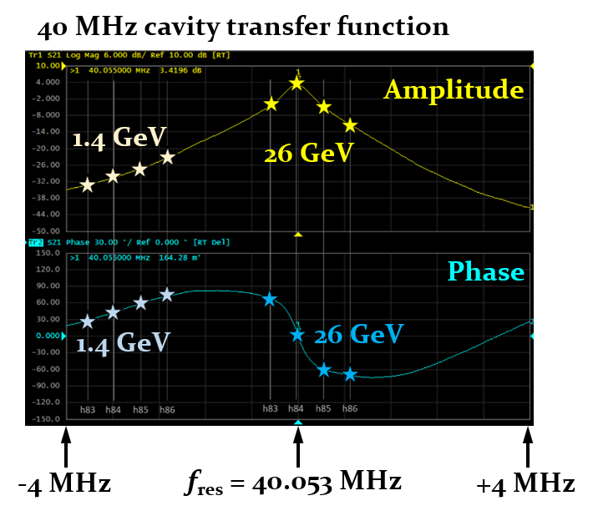
Introduction
Multi-harmonic feedback (MHFB)
Reduce induced beam induced voltage, as to reduce uncontrolled blow-up at flat top
Based on narrow-band filters, treats each revolution frequency harmonic separately
After calibration, feedback phase dynamically adapts to the phase, in counter phase, of the transfer function of the cavity during revolution frequency sweep

Slide 4
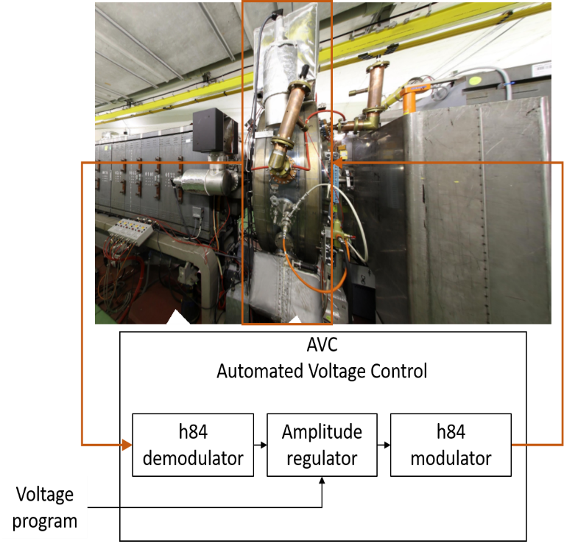
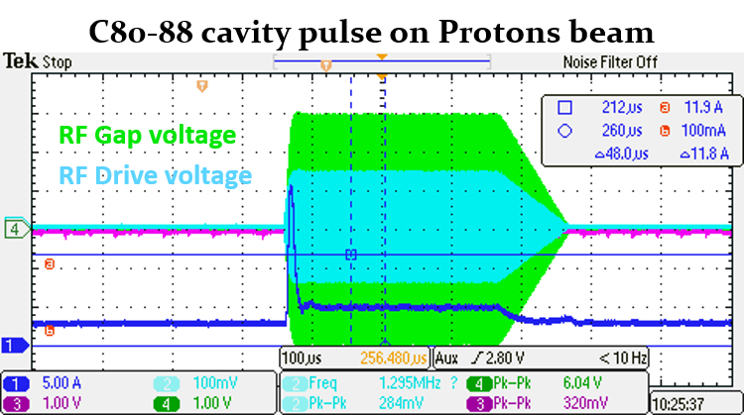
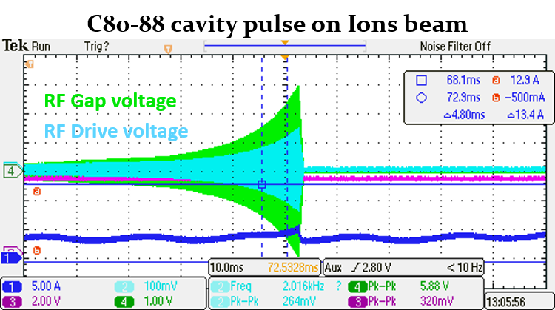
Introduction
Automated voltage control (AVC)
Cavity pulse voltage regulation with phase control
Based on central harmonic demodulated amplitude detection, with setpoint regulation loop
After return gain calibration, cavity gap voltage follows voltage program at cavity pulse frequency

Slide 5
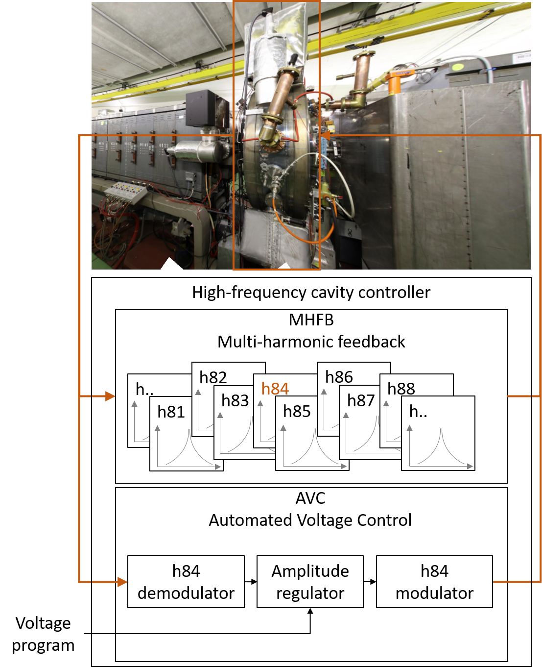
Introduction
High-frequency cavity controller
Integrates both the feedback and the voltage control in a single FPGA firmware
Compatible for PS 20 MHz, 40 MHz and 80 MHz systems

Slide 6
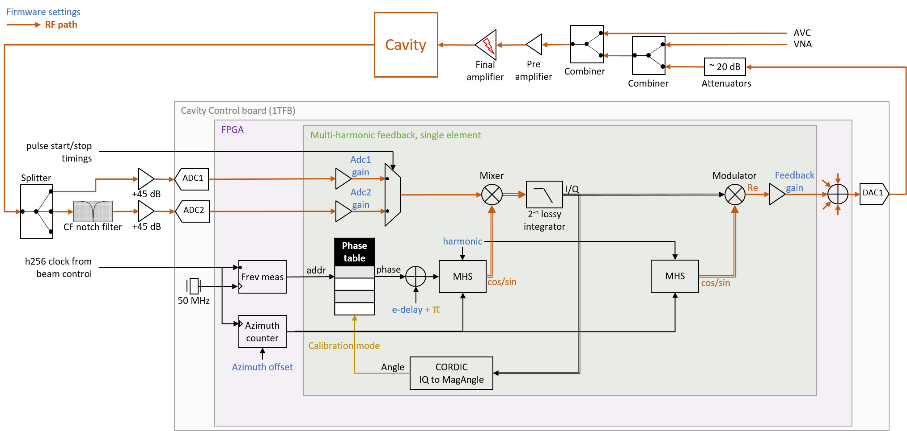
Multi-harmonic feedback

Slide 7
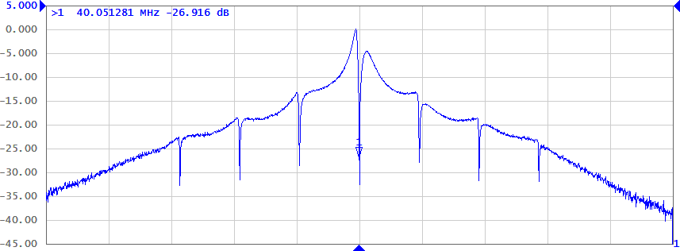
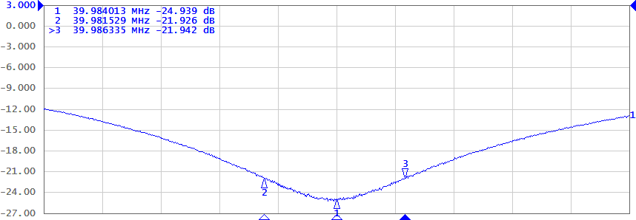
Transfer function
Measured transfer function – 7-harmonic feedback
5 dB/div
>20 dB impedance reduction at harmonics close to f_{res}
Notches 3dB bandwidth > 4 kHz to include multiple synchrotron frequency sidebands (f_{s} ≃ 350 Hz)
  Adjusted with IQ demodulation 2^{-n} lossy integrator gain
  Trade-off between notches bandwidth and feedback gain
5 MHz
Measured transfer function – notch zoom
3 dB/div
20 kHz
Expected to reduce uncontrolled blow-up at flat top

Slide 8
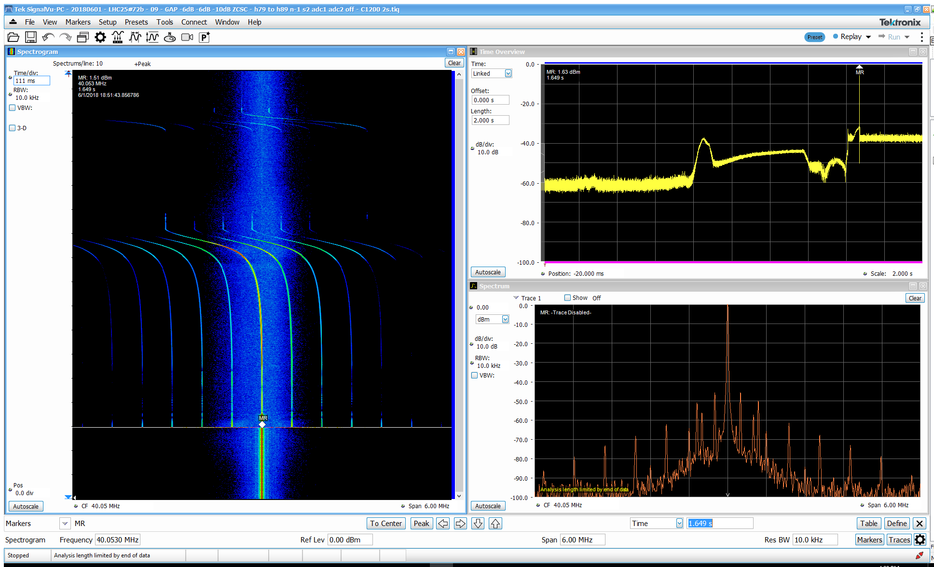
Beam induced voltage reduction
Firmware validated on both 40 MHz and 80 MHz RF systems, 11 harmonics configured
Beam induced voltage evolution through cycle – feedback OFF
Frequency
Amplitude
Amplitude scale
Overall beam induced voltage level
1.4 GeV
high
2.5 GeV
Intermediate
plateau
2.5 GeV
Cycle time
Cycle time
Cycle time
Acceleration h₂₁
to flat top
Amplitude
low
Spectrum @ marker
26 GeV
Frequency

Slide 9
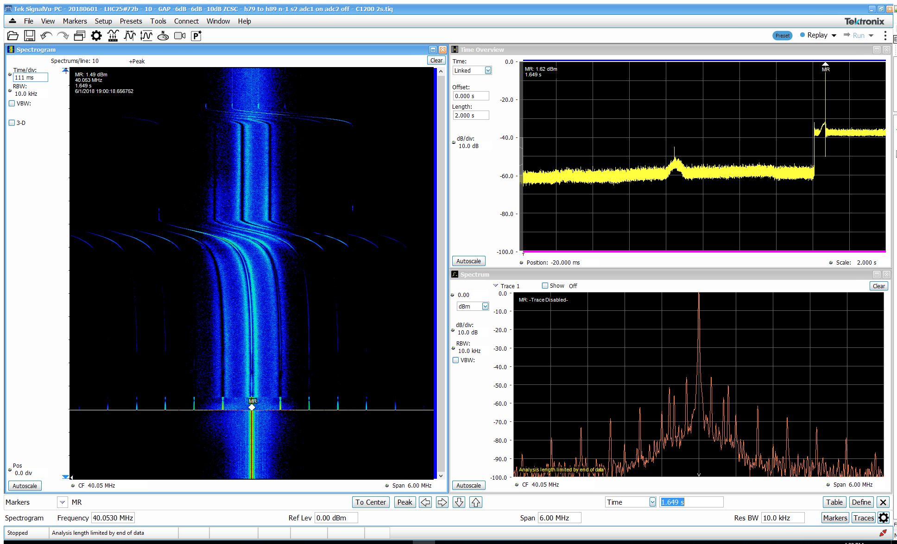
Beam induced voltage reduction
Firmware validated on both 40 MHz and 80 MHz RF systems, 11 harmonics configured
Beam induced voltage evolution through cycle – feedback ON before pulse
Frequency
Amplitude
Amplitude scale
Overall beam induced voltage level
high
Cycle time
Cycle time
Amplitude
low
2017 limitation
Feedback turned OFF when Vprog starts
Frequency
~20 dB beam induced voltage reduction
  During acceleration before start of voltage program

Slide 10
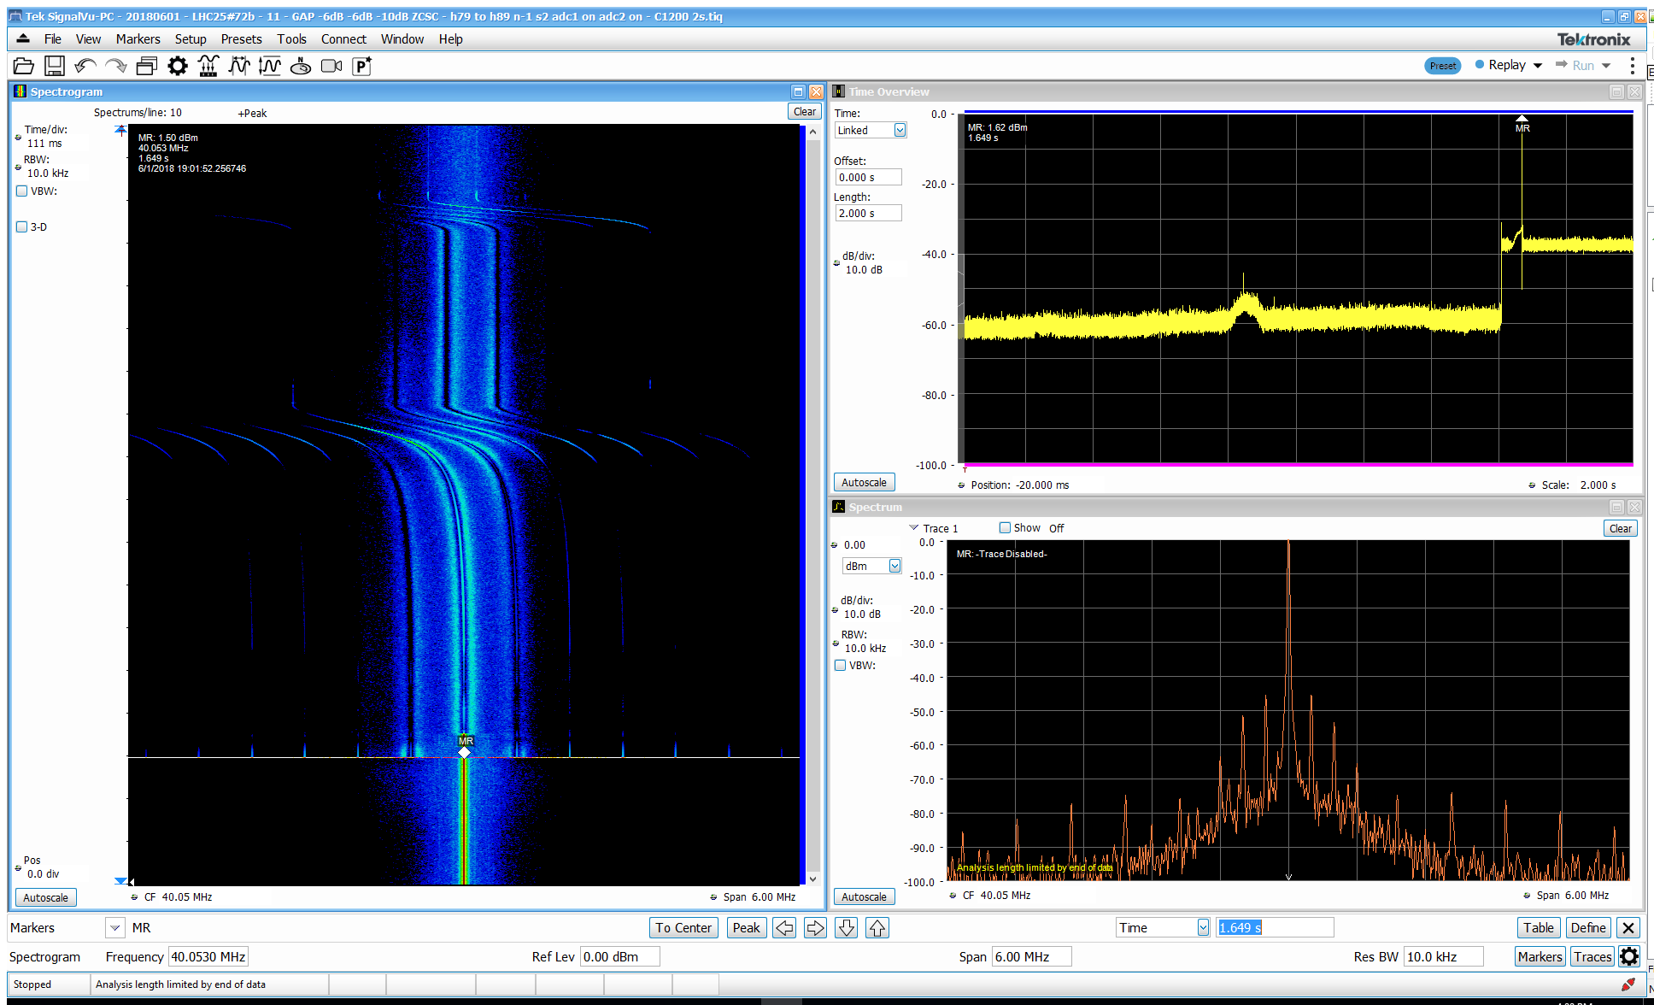
Beam induced voltage reduction
Firmware validated on both 40 MHz and 80 MHz RF systems, 11 harmonics configured
Beam induced voltage evolution through cycle – feedback ON during pulse
Frequency
Amplitude
Amplitude scale
Overall beam induced voltage level
high
Cycle time
Cycle time
Amplitude
low
With RF pulse filter
Signal processing path switched
Frequency
~20 dB beam induced voltage reduction
  During acceleration before start of voltage program
  And during RF pulse thanks to specific analog notch filters for 40 MHz and 80 MHz systems

Slide 11
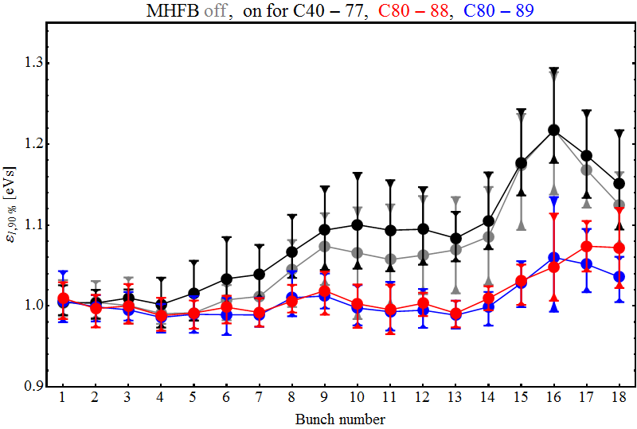
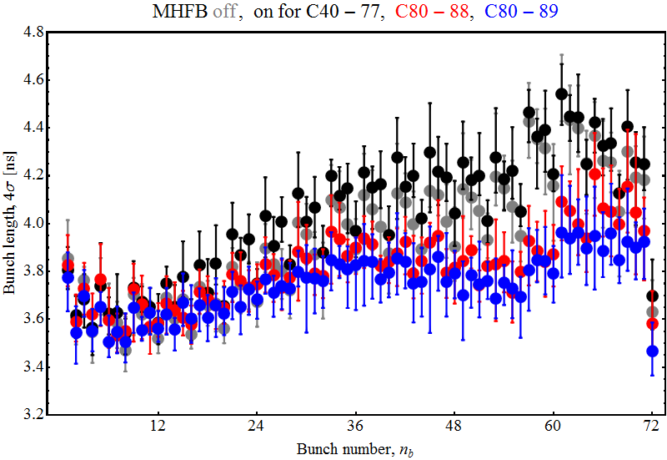
Effect on longitudinal beam quality
Test in July-2018: Proton cycle 72 bunches 2.3 ∙ 10¹¹ ppb – Effect on single cavity
  2x 40 MHz and 2x 80 MHz cavities
    MHFB configured on a single 40 MHz cavity and both 80 MHz cavities
  3rd 80 MHz (ion) cavity gap closed
Long. emittance (RMS) at start of flat-top with MHFB off, on for C40-77, C80-88, C80-89
Bunch length at extraction
with MHFB off, on for C40-77, C80-88, C80-89
MHFB on a single 80 MHz cavity improves longitudinal emittance along the batch
Effect is small with a single 40 MHz cavity

Slide 12
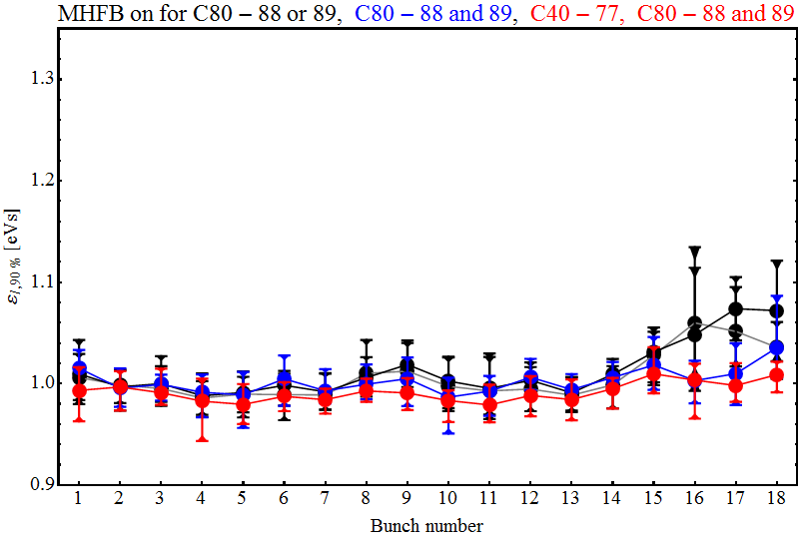
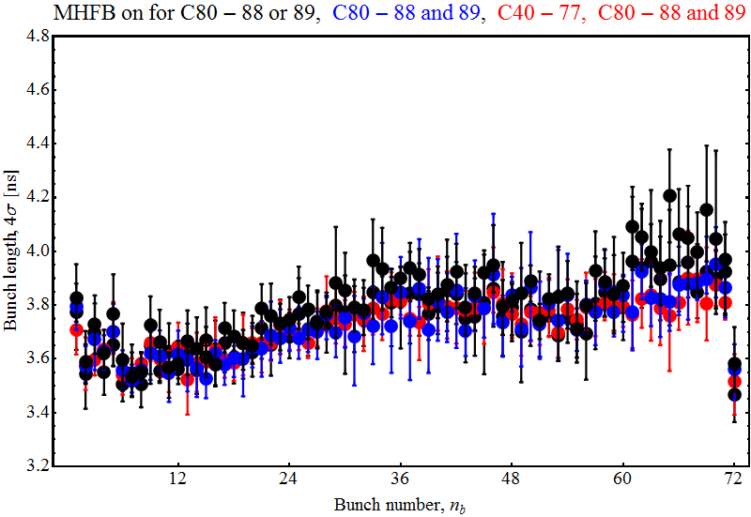
Effect on longitudinal beam quality
Test in July-2018: Proton cycle 72 bunches 2.3 10¹¹ ppb – Effect on multiple cavities
  2x 40 MHz and 2x 80 MHz cavities
    MHFB configured on a single 40 MHz cavity and both 80 MHz cavities
  3rd 80 MHz (ion) cavity gap closed
Long. emittance (RMS) at start of flat-top
with MHFB on for C80-88 or 89, C80-88 and 89, C40-77 C80-88 and 89
Bunch length at extraction
with MHFB on for C80-88 or 89, C80-88 and 89, C40-77 C80-88 and 89
MHFB on a single 80 MHz cavity improves longitudinal emittance along the batch
Effect is small with a single 40 MHz cavity
MHFB on both 80 MHz cavity provides even better beam quality

Slide 13
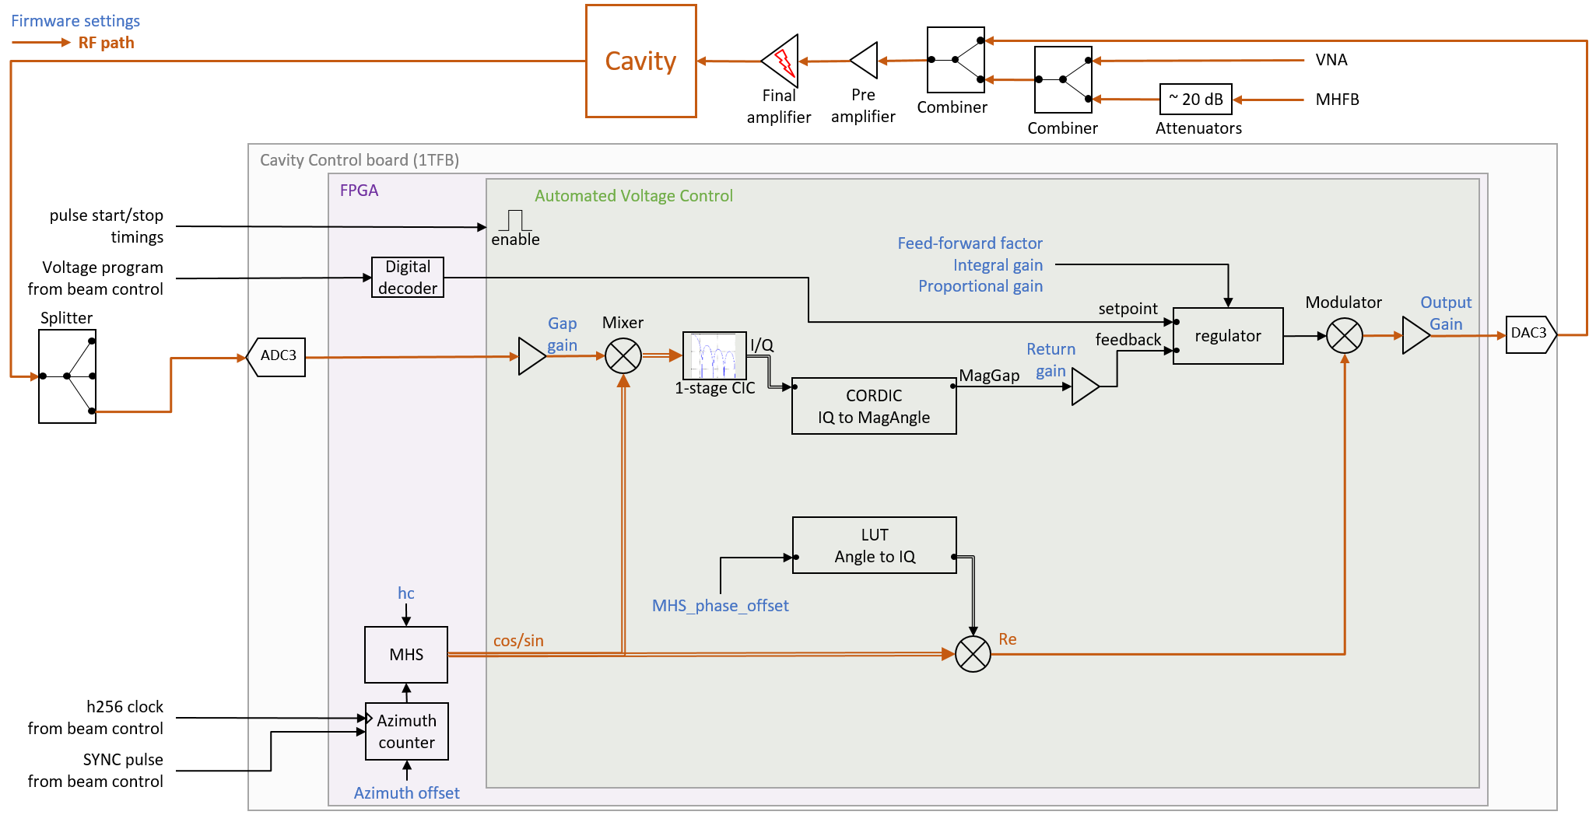
Automated Voltage Control

Slide 14
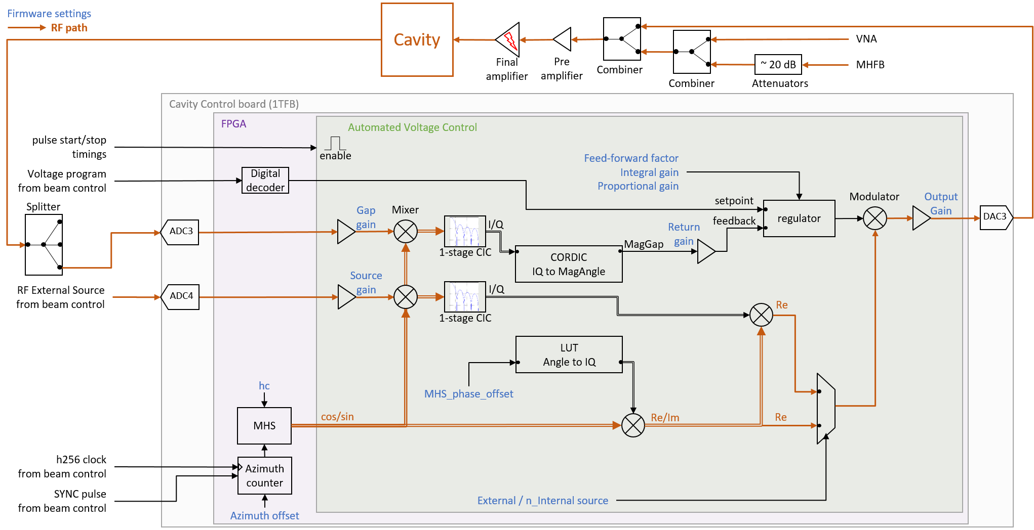
Automated Voltage Control

Slide 15
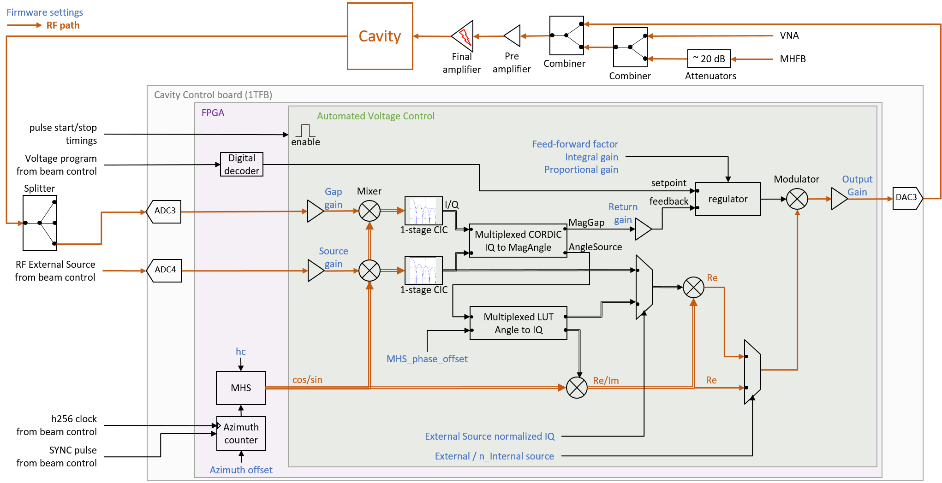
Automated Voltage Control

Slide 16
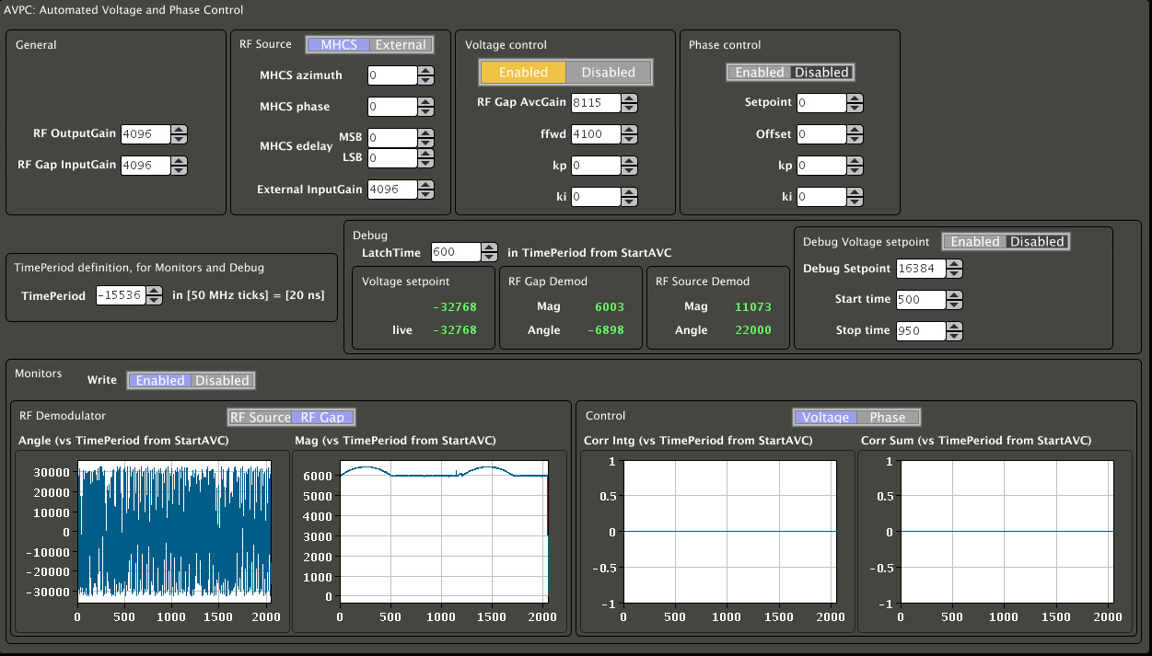
Calibration without beam
Set voltage program function to generate a nominal pulse
  300 kVp for 300 µs, 100 µs shut down ramp to minimize final amplifier demand
80 MHz cavity C80-88 tuned for Ions
  Revolution frequency 473.143 kHz, harmonic h169
Use internal source, set all RF digital gain to 1
No proportional gain since loop delay ~ 2 µs is too large
Inspector panel to control firmware

Slide 17
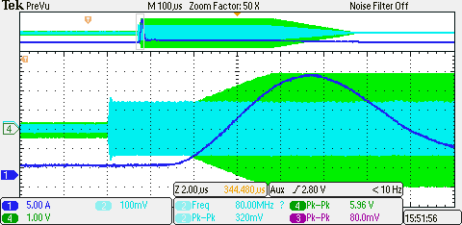
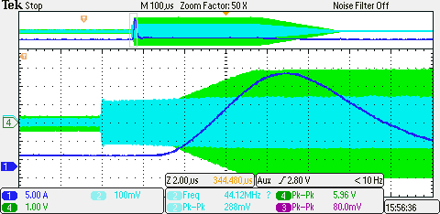
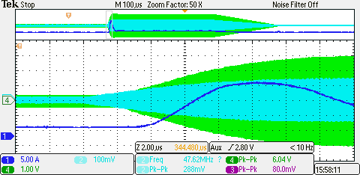
Calibration without beam
Open-loop for return gain adjustment
Return gain adjustment: No regulation at first, open-loop only
  no integral gain (Ki = 0), no proportional gain (Kp = 0), adjust feed-forward factor (FFWD) until scope measurement shows 300 kVp equivalent
  300 kVp = 6 Vpp on scope, reached for FFWD = 4100
  Firmware RF Gap amplitude measured = 8270
  300 kVp setpoint = 16384, so return gain = 16384/8415 = 1.981 *2¹² = 8115 in fixed-point format
Test1: 80% feed-forward + integral setting
  80% feed-forward means FFWD = 4100 * 0.8 = 3280
  For integral gain Ki= 1100, control loop results in minimized overshoot and fast cavity voltage stabilization (~8 µs)
Test2: All-integral setting
  0% feed-forward means FFWD = 0
  For integral gain Ki= 4200, control loop results in good compromise between overshoot and cavity voltage stabilization time (~14 µs)
High-voltage final amplifier current
RF Drive
RF Gap
Test1: 80% feed-forward + integral
Test2: All-integral

Slide 18
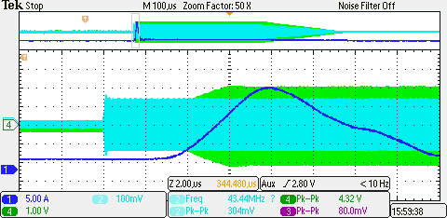

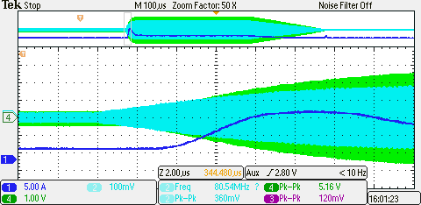
Calibration without beam
Open-loop with initial feed-forward factor
Simulate power amplifier performance decrease, 3 dB attenuation at input of cavity drive amplification chain
Open-loop mode with calibration feed-forward factor
  Response shape unchanged, missing 3 dB
Test1: 80% feed-forward + integral setting
  Response in 2 stages
  1st stage response fast, this is the feed-forward action
  2nd stage compensates for 3 dB attenuation, this is the integral action
  Because of low integral gain, stabilization time much longer, ~ 80 µs compared to ~ 8 µs
Test2: All-integral setting
  Response shape unchanged but longer, ~ 22 µs compared to ~ 14 µs
  Option chosen for tests with beam
High-voltage final amplifier current
RF Drive
RF Gap
Test1: 80% feed-forward + integral
Test2: All-integral

Slide 19
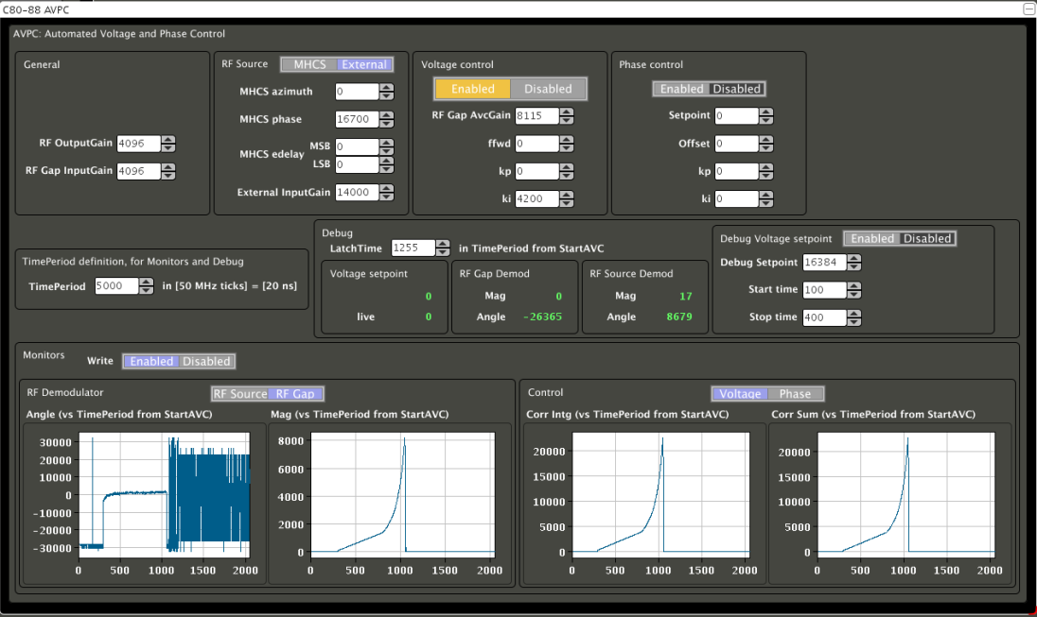
Tests with Ions beam
Synchronization on SYNC pulse from beam control allows to have a reproducible phase relationship between beam and signal processing
All modes tested for drive signal modulation
  Internal RF source
  External RF source in direct IQ mode
  External RF source in normalized IQ mode
Inspector panel – Ions beam, External Source mode, phase adjustment
All modes demonstrated amplitude and phase control reproducibility with Ions beam

Slide 20
High-Frequency cavity controller
Multi-harmonic feedback rework - motivation
Multi-harmonic feedback firmware with 11 harmonics on 1TFB board FPGA takes already 80% of resources
High-Frequency cavity controller must integrate Automated voltage control in addition
Each feedback element includes 2 MHS instances and CORDIC components, heavy in resources
Multi-harmonic feedback rework – optimization
Use a single harmonic source
  remove phase shifted harmonic source for demodulation
  perform phase shift operation in baseband on IQ signal with simple complex multiplication
Multiplex resources usage across MHFB elements for
  phase shift
  IQ to MagAngle CORDIC conversion
Common harmonic source to feed MHFB elements: Multi-harmonic complex source (MHCS)
  Feeds AVC as well

Slide 21
Multi-harmonic feedback - old

Slide 22
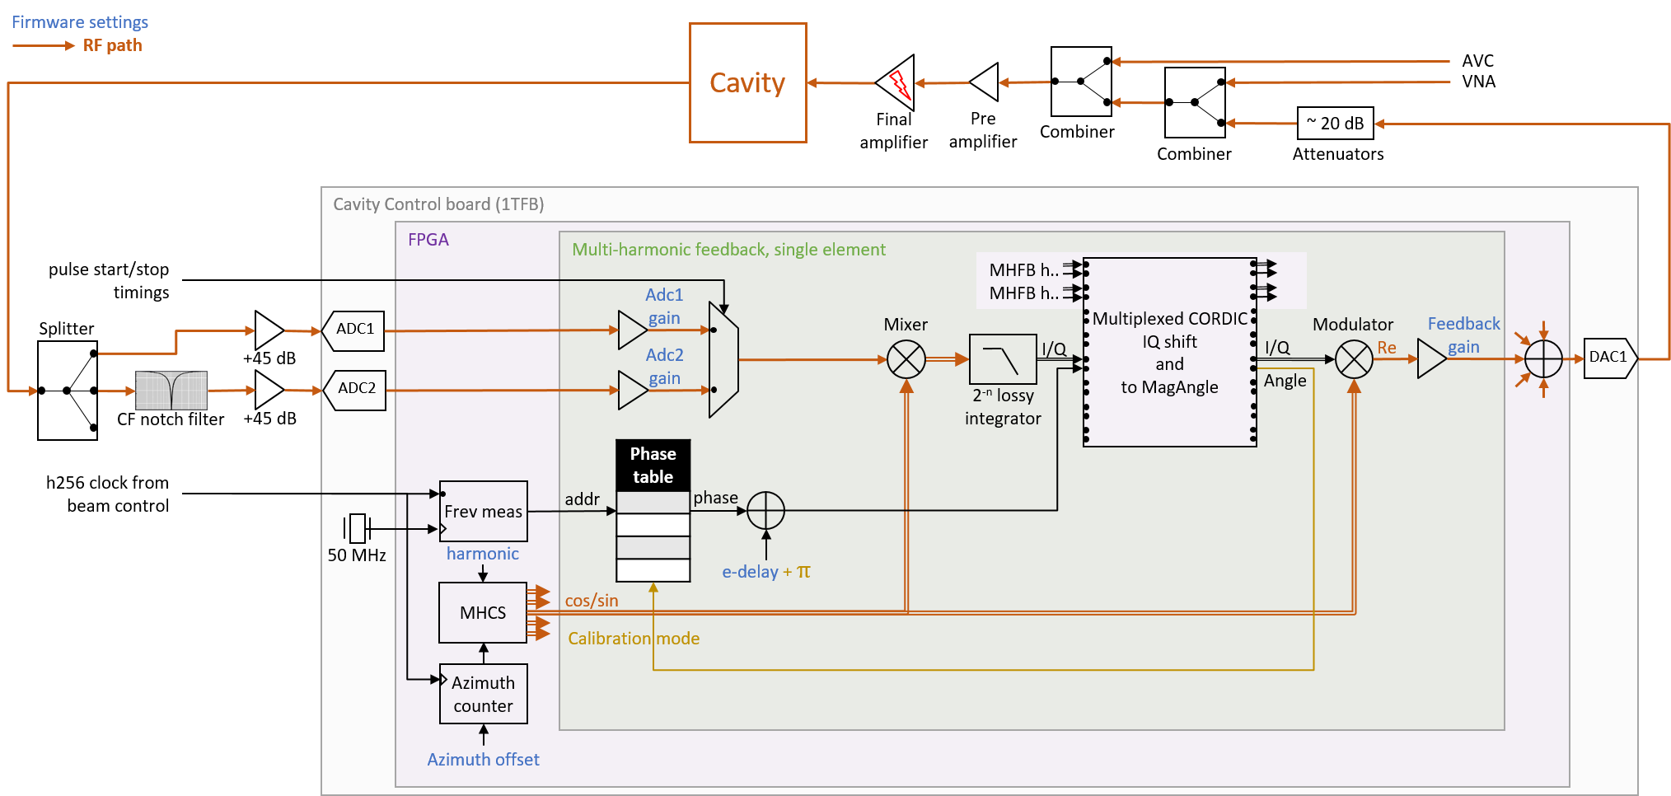
Multi-harmonic feedback - new

Slide 23
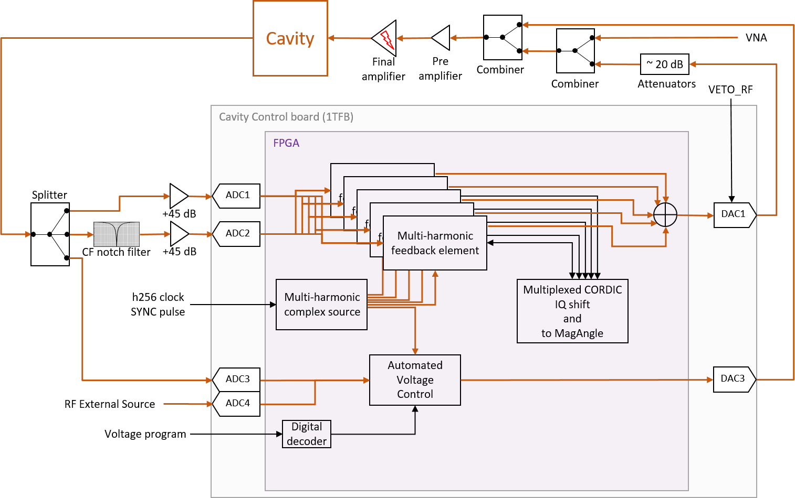
High-Frequency cavity controller

Slide 24
High-Frequency cavity controller
Multi-harmonic feedback rework - motivation
Multi-harmonic feedback firmware with 11 harmonics on 1TFB board FPGA takes already 80% of resources
High-Frequency cavity controller must integrate Automated voltage control in addition
Each feedback element includes 2 MHS instances and CORDIC components, heavy in resources
Multi-harmonic feedback rework – optimization
Common harmonic source to feed MHFB elements and AVC: Multi-harmonic complex source (MHCS)
Multiplex resources usage for
  demodulator harmonic source phase shift
  IQ to MagAngle CORDIC conversion

Slide 25
Status and conclusions
Multi-harmonic Feedback operational on 40 and 80 MHz systems
Beneficial effect on beam validated, significant reduction of emittance blow-up along the batch
  Feedback activated on a single 80 MHz cavity
  Feedback activated on multiple High-Frequency cavities, especially 80 MHz cavities
Automated voltage control demonstrated amplitude and phase control reproducibility on Ions beam

Slide 26
Outlook
During LS2
  Perform Multi-harmonic feedback transfer function in lab with new architecture
  Update Fesa class
Longer term
  Consider replacing 10 MHz systems One-turn feedback by Multi-harmonic feedback

Slide 27
Thanks
Heiko Damerau
Azeddine Jibar
Ylenia Brischetto
John Molendijk
Damien Perrelet

