Slide 1
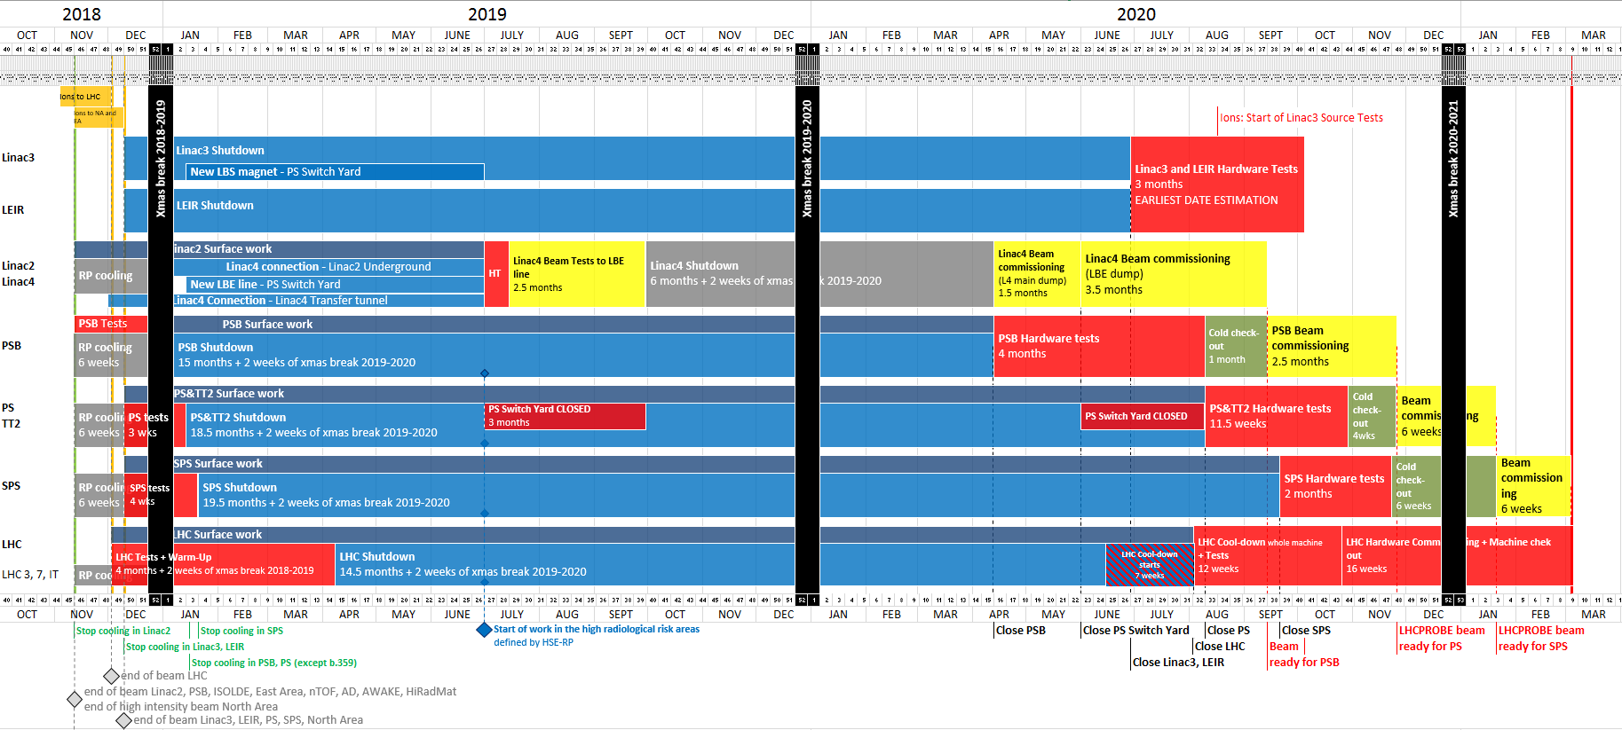
Master Schedule of the Long Shutdown 2 (2019-2020)
Week 46
12/11/2018
LHCPROBE beam
available for LHC
Week 9
04/03/2021
Week 31
31/07/2020
Week 15
10/04/2020
Week 26
26/06/2020
Week 38
18/09/2020
Week 22
29/05/2020
Week 32
07/08/2020

Slide 2
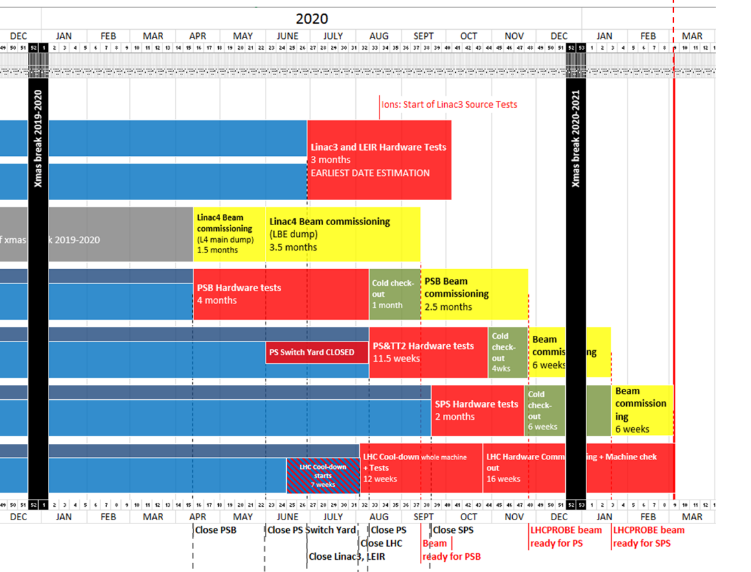
Restart schedule for the PS in 2020
LHCPROBE beam
available for LHC
Week 9
04/03/2021
Linac3
LEIR
Linac4
PSB
PS
SPS
LHC

Slide 3
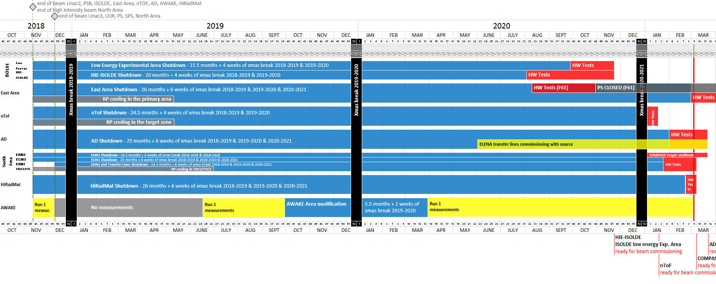
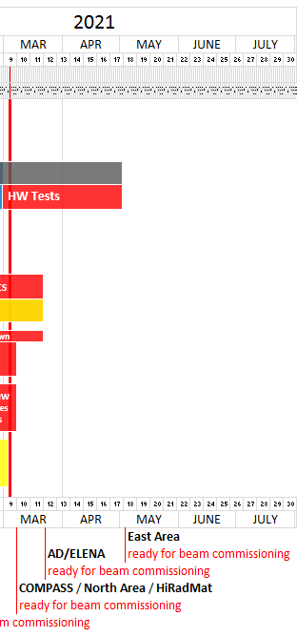
Master Schedule of the Long Shutdown 2 (2019-2020)
Week 46
12/11/2018
LHCPROBE beam
available for LHC
Week 9
04/03/2021
First physics user of PS: nTOF
Week 50
10/12/2018
Week 25
17/06/2019
Week 40
30/09/2019
Week 14
30/03/2020
Week 31
31/07/2020
Week 39
25/09/2020
Week 32
07/08/2020

Slide 4
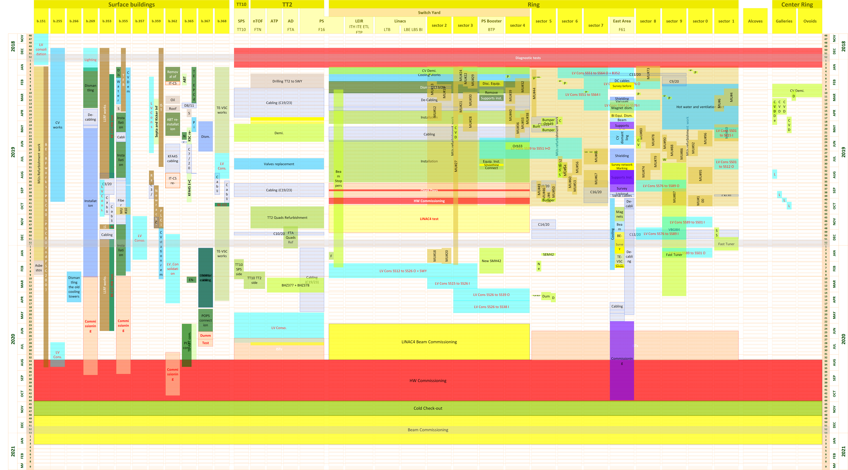
Co-activities in PS central building
F. Pedrosa, PS LS2 Planning overview, LS2 Committee Meeting, 30/11/2018 (link)

Slide 5
Co-activities in PS central building
Building 353 will remain accessible most of the time, but
No water for air conditioning from 10/12/2018 to ?/2020
Renovation of electrical power distribution to racks
  Scheduled for September/October 2019; James Devine, EN-EL
Installation of optical fibres (on top of racks, after the power distribution renovation)
  Jean-Marc Lassauce, EN-EL
Signal cabling activities
  Scheduled for October to December 2019; Patrick Lelong, EN-EL
Ethernet socket installations
  Leszek Borakiewicz, IT-CS
Replacement of pulse repeater units
  Benjamin Ninet, BE-CO
OASIS installation
  Emmanuel Said, BE-CO

