Slide 1

DISMAC, cleaning and installation procedures Florian Meuter
07.12.2018

Slide 2
Outline
Introduction to the DISMAC project
Sequence of production and QA procedures
Procedures, insulation components and tooling
LHC-DQDB-IP-0003 (Cleaning)
LHC-DQDB-IP-0002 (Installation of the insulation plates)
LHC-DQDB-IP-0001 (Installation of the insulation insert)
Experience gained during insulation consolidation of LHC spare dipoles
Insulation material qualification

Slide 3
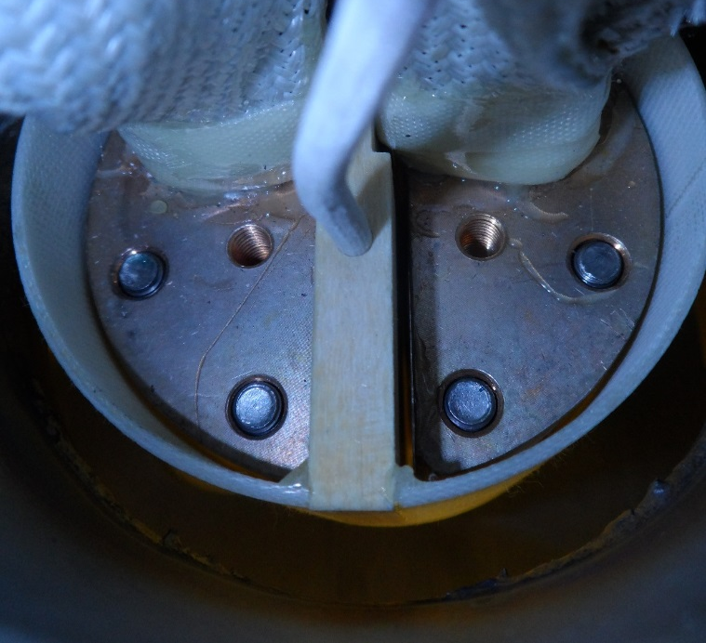
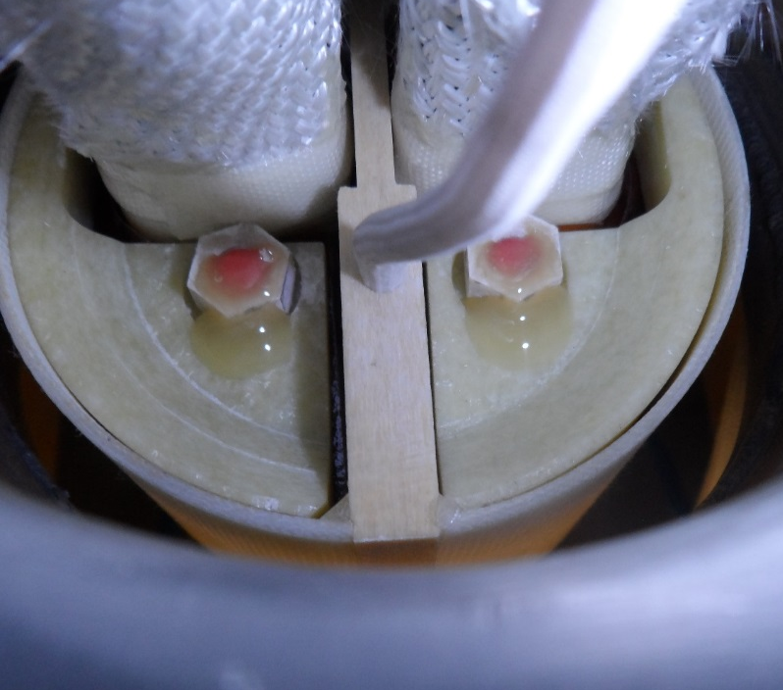
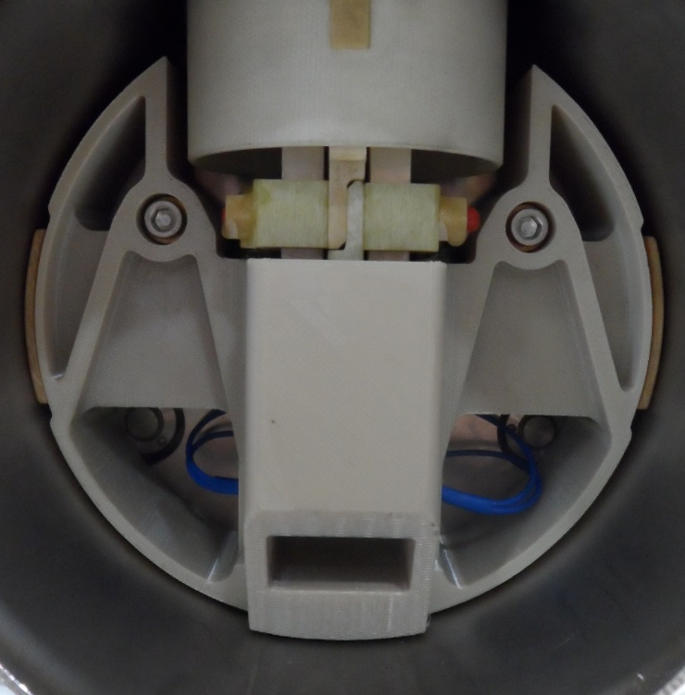
Introduction to the DISMAC project
(a)
(b)
In the past short circuits to ground have been found between the blank half-moon splice and the diode container T-tube.
Short circuits have been caused by metal debris, remaining from production, that is flushed into the diode container.
Due to interference with half-moon splice connecting screws, causing high contact resistance, the insulation plates have not been installed in all magnets during magnet manufacturing.
Multiple quenches are needed to raise the energy of the LHC, with each quench raising the risk to flush debris into the diode container.
Goal of the DISMAC project is the consolidation of the half moon splice insulation system, and to minimise the risk of short circuits in the diode container.
(a) Blank and (b) consolidated half-moon splice (MB2111).
Insulation insert to protect diode busbars.

Slide 4
Sequence of QC and production procedures
Visual Inspection after Opening (EDMS 1866312)
LLHC-DQDB-IP-0003 (EDMS 1892814) “Cleaning of LHC Dipole Diode Container, T-Piece and Cold Mass Extremity before Consolidation of the Diode Busbar Insulation System”
Inspection after Cleaning and Preparation (EDMS 1866313)
LHC-DQDB-IP-0002 (EDMS 1855547) “Installation of the Insulation Plates for the Consolidation of the LHC Dipole Diode Busbar Half-moon Splices Insulation System”
Inspection after Installation of the Insulating Plates (EDMS 1935507)
LHC-DQDB-IP-0001 (EDMS 186311) “Installation of the Insulation Insert for the consolidation of the LHC Dipole Diode Busbar Insulation System”
Inspection after Consolidation (EDMS 1935514)

Slide 5
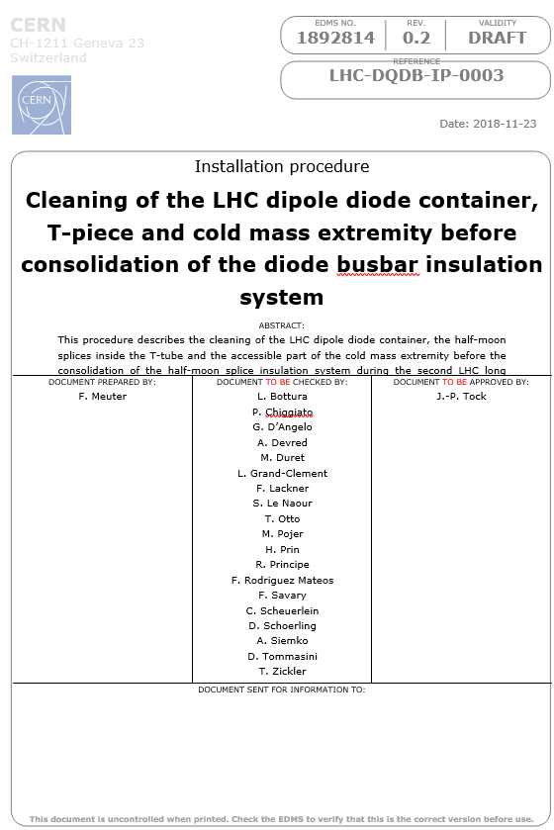
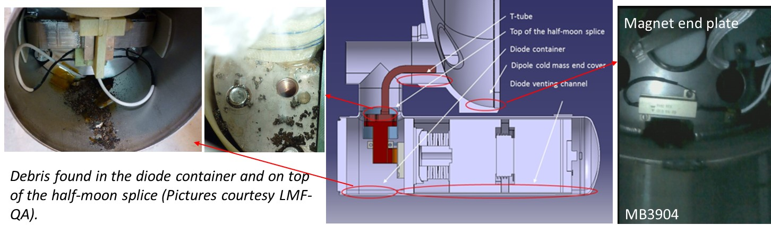
Cleaning procedure
Areas where debris is typically accumulated.
Goal of this procedure is the removal of debris in the diode container and magnet end cover before consolidation of the insulation.
On all 20 spare magnets, all visible debris inside the diode container and T-piece could be completely removed.
In the cold mass extremities debris is removed as complete as possible.

Slide 6
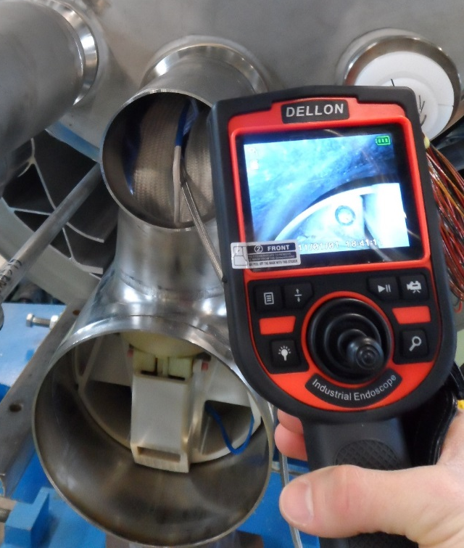
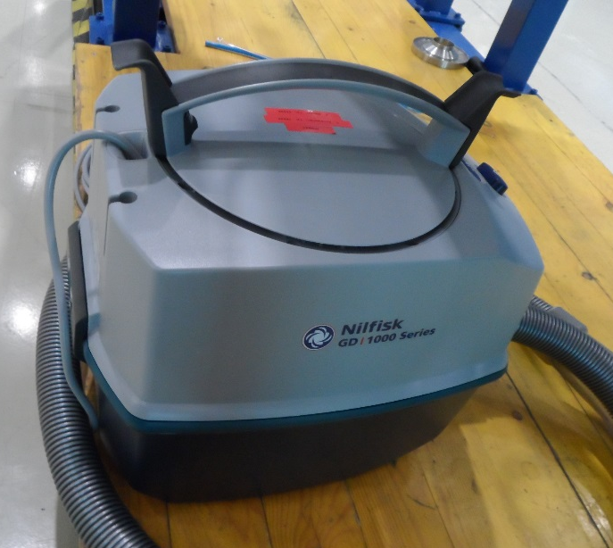
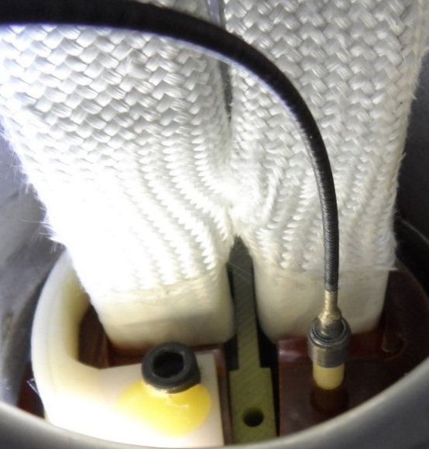
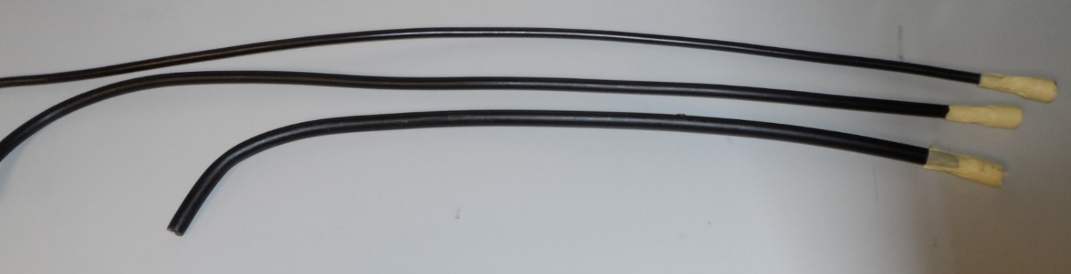
Tooling for cleaning
(a)
Cleaning of the magnet end-cover is performed with vacuum cleaners conforming to the radioprotection requirements.
Semi-flexible extension tubes are used to reach into the magnet end-cover, T-piece and diode container.
The semi-flexible extension tubes can be cut and pre-formed depending on the application.
A flexible insertion tool will be used to insert the threaded rod to ensure cleanliness of the threads.
(b)
(c)
Semi-flexible extension tubes for the cleaning of the diode container, magnet endcover and T-piece.
(a) Videoscope to verify cleanliness. (b) Vacuum cleaner conforming to radio protection requirements. (c) Flexible insertion tool.

Slide 7
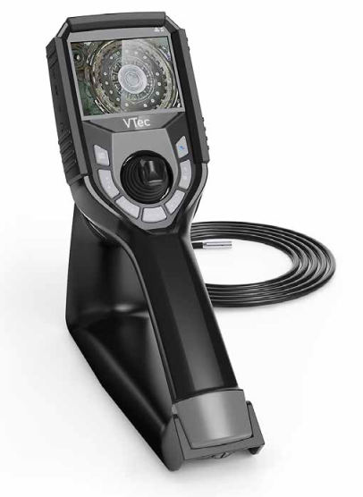
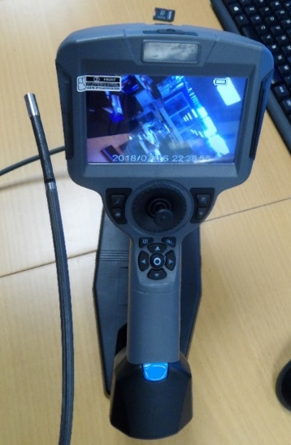
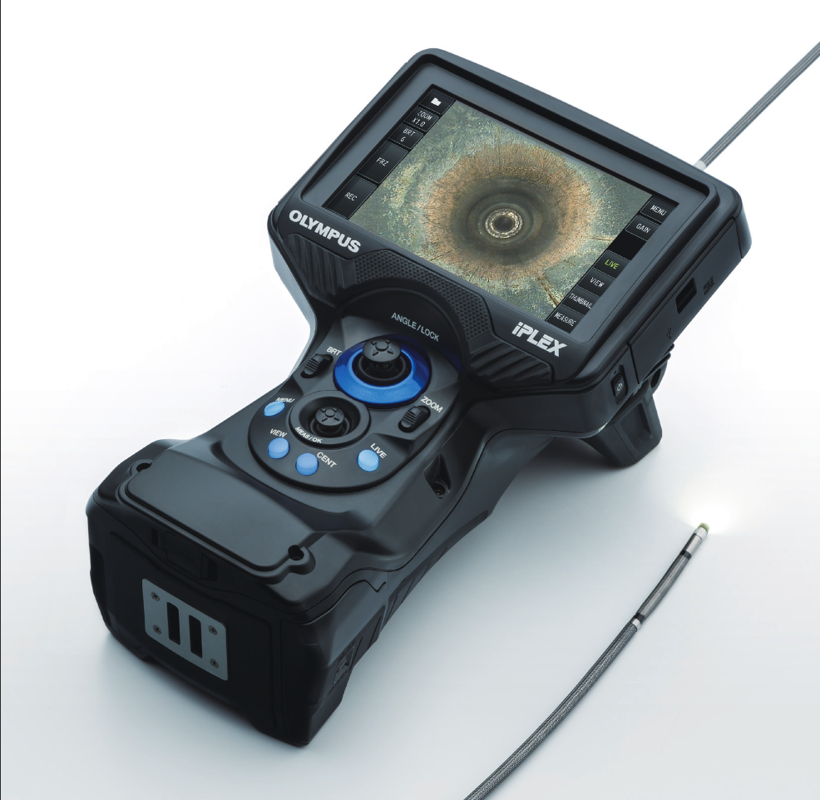
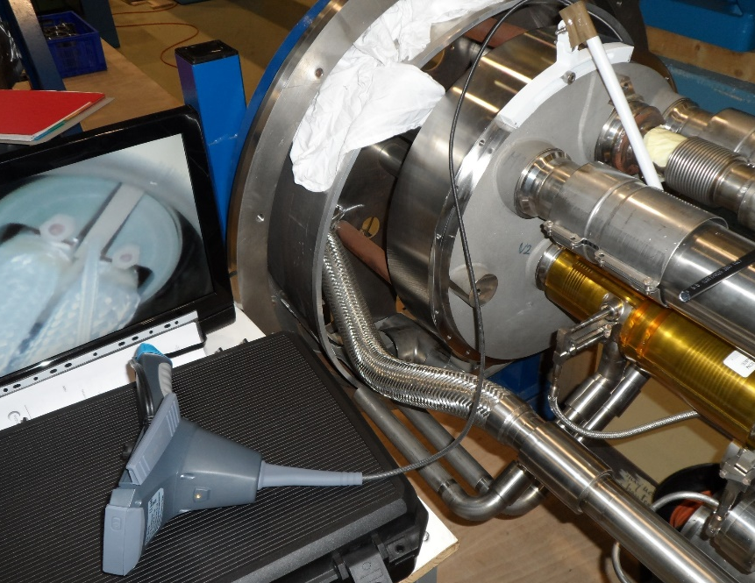
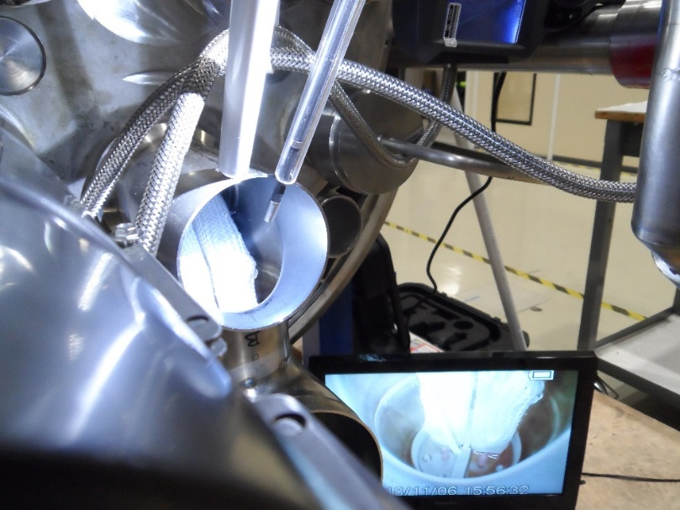
Videoscopes for inspection and insulation installation works
Requirements:
Articulating camera head
probe length max 2 m, probe diameter max 6 mm
Adjustable light source
Easy handling
Possibility to connect an external screen
Robustness
Guide tubes for the probes are used to assure reproducible image quality and to facilitate operation.
For insulation installation videoscopes are connected to an external screen, such that the installation can be followed by both operators of the installation team.
A technical specification is in preparation for the procurement of 8 videoscopes.
(a)
(b)
(c)
A selection of the tested videoscopes. (a) KS-NDTec Vtec-M, (b) Dellon G+ (c) Olympus Iplex.
External screen
External screen
Video probe
The videoscope setup with an external screen installed on a mock-up.

Slide 8
Outline
Introduction to the DISMAC project
Sequence of production and QA procedures
Procedures, insulation components and tooling
LHC-DQDB-IP-0003 (Cleaning)
LHC-DQDB-IP-0002 (Installation of the insulation plates)
LHC-DQDB-IP-0001 (Installation of the insulation insert)
Experience gained during insulation consolidation of LHC spare dipoles
Insulation material qualification

Slide 9
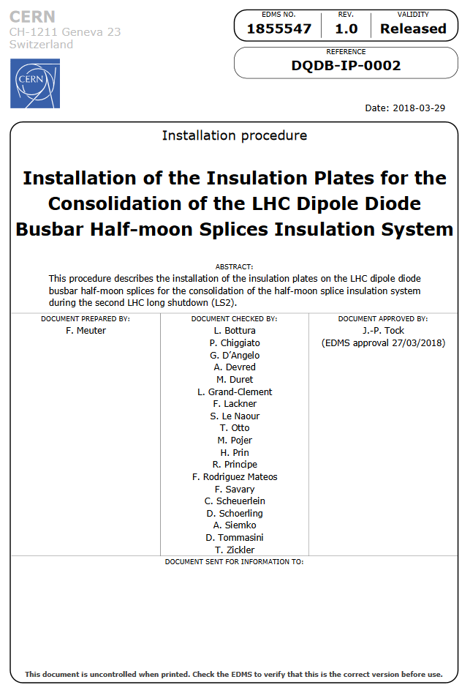
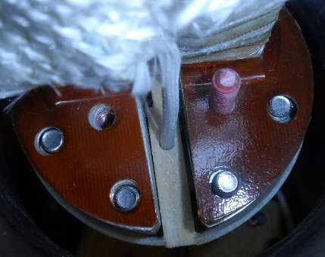
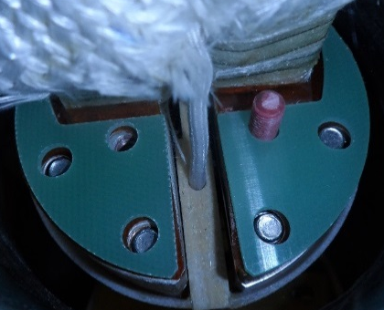
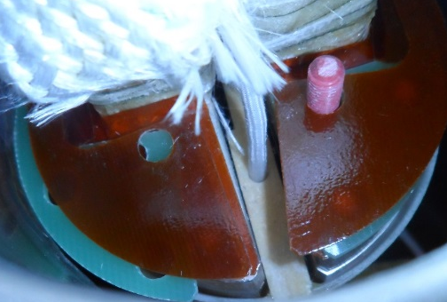
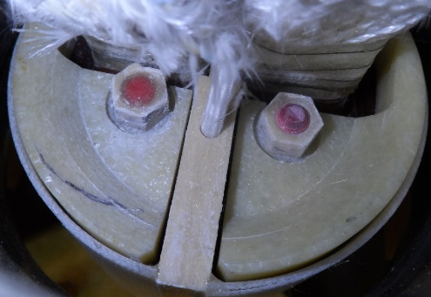
Updated procedure DQDB-IP-0002 Installation of insulation plates
Glass fibre reinforced epoxy threaded rods and nuts for the fixation of insulation sheets and plates
RENY screws are a backup solution for the mounting of the insulation system.
Installation of one 2 mm thick spacer
Installation of redesigned connector block cover
Installation sequence of the half-moon insulation plates.

Slide 10
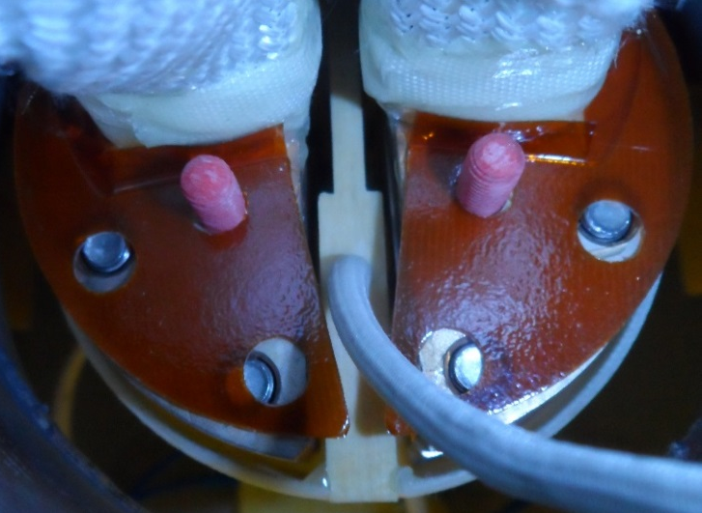

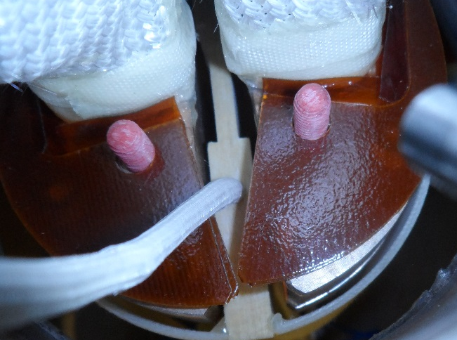
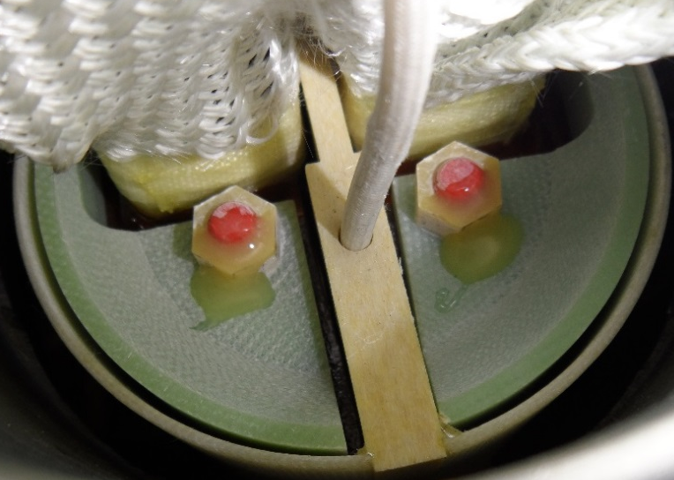
Consolidated insulation system main components
Installation sequence of the half-moon insulation system.
Installation of lower insulation sheets
Installation of optional spacer to accommodate extending screws.
Installation of the upper insulation sheets.
Installation of insulation plates, hexagonal nuts and securing of the nuts with epoxy resin.
Lower sheets LHCMB__E0114
Spacer LHCMB__E0122-vAA (optional)
Upper sheets LHCMB__E0113
Plates LHCMB__E0109 and E0110

Slide 11
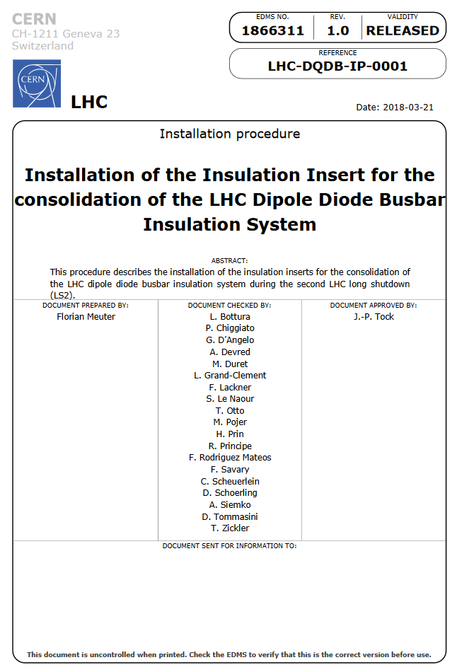
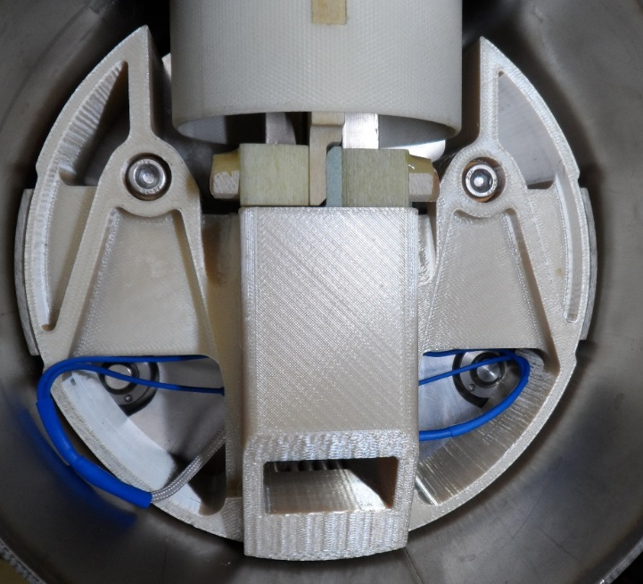
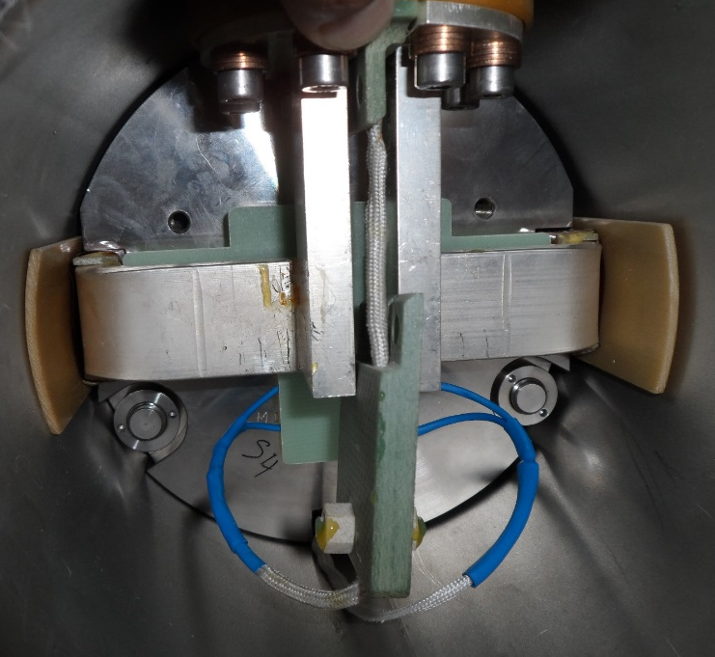
Updated procedure DQDB-IP-0001 Installation of insulation insert
The insert will protect the presently blank diode busbars
The insert is mounted to the diode pressure plate with two 50 mm long A4-70 screws.
The thermal expansion mismatch of about 0.3 mm between the stainless steel screws and the ULTEM 1000 insert during cooling from RT to 1.9 K is compensated by the two CuBe2 (2.2147) Belleville washers.
A new connector block cover will shield the busbars to the diode pressure plate.
Insulation insert mounted in MB2100.
Connector block cover

Slide 12
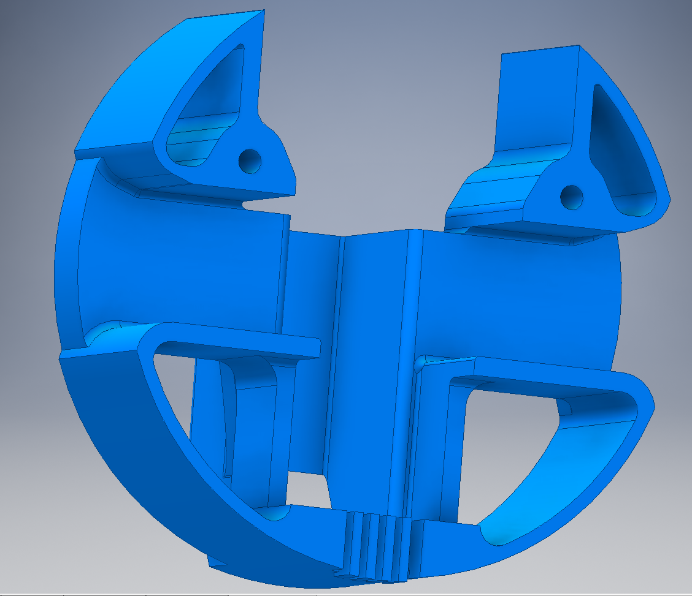
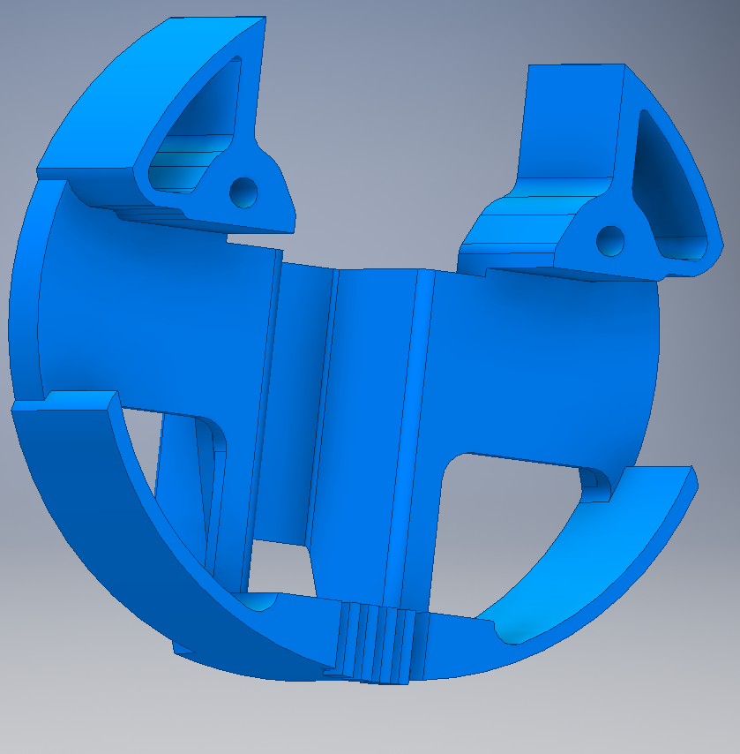
Insulation insert modifications
New design without rips below the busbars where debris could accumulate.
Design as presented at the 2nd review

Slide 13
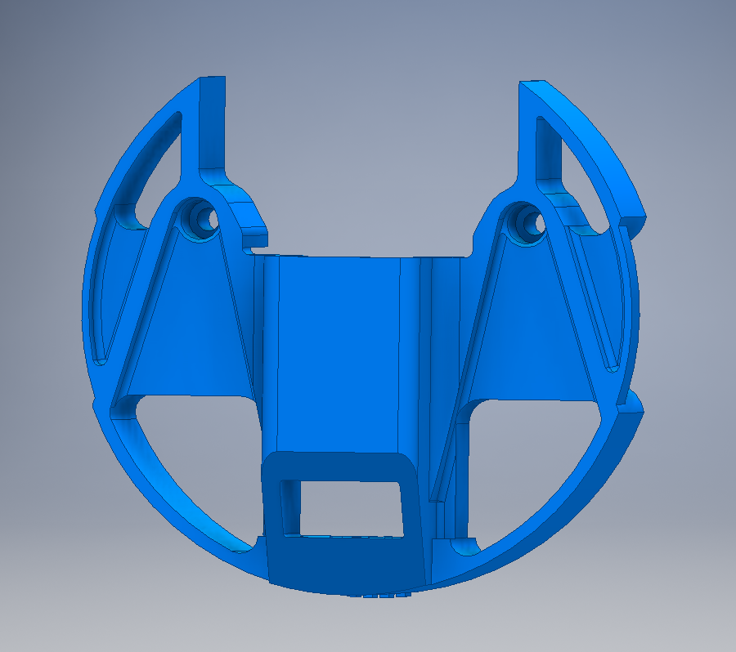
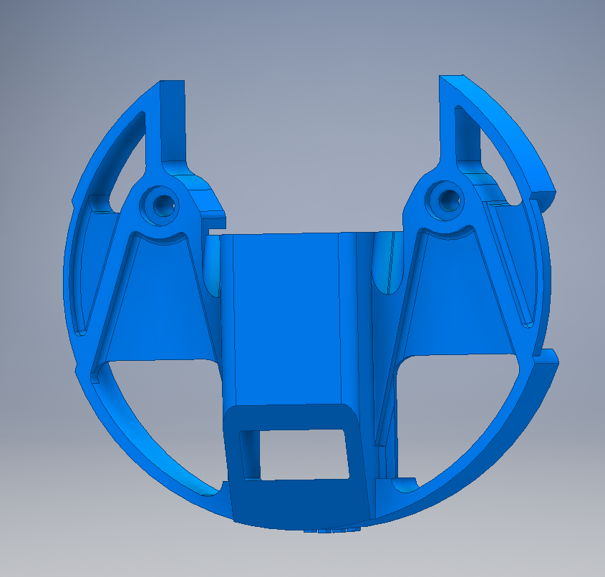
Insulation insert optimisation (reinforced screw connections)
Design as presented at the 2nd review
New design with reinforced screw connections.

Slide 14
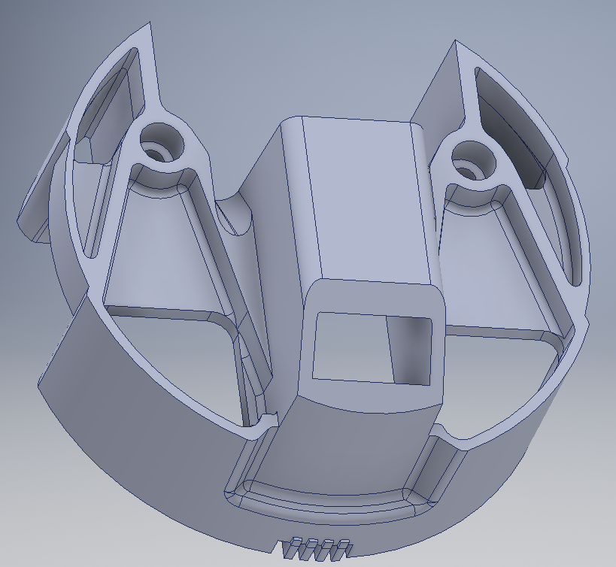
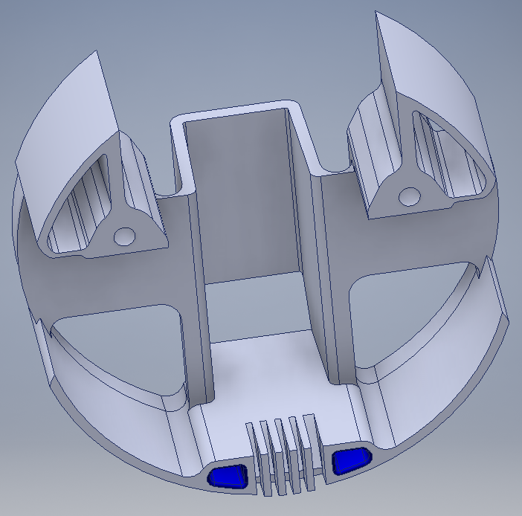
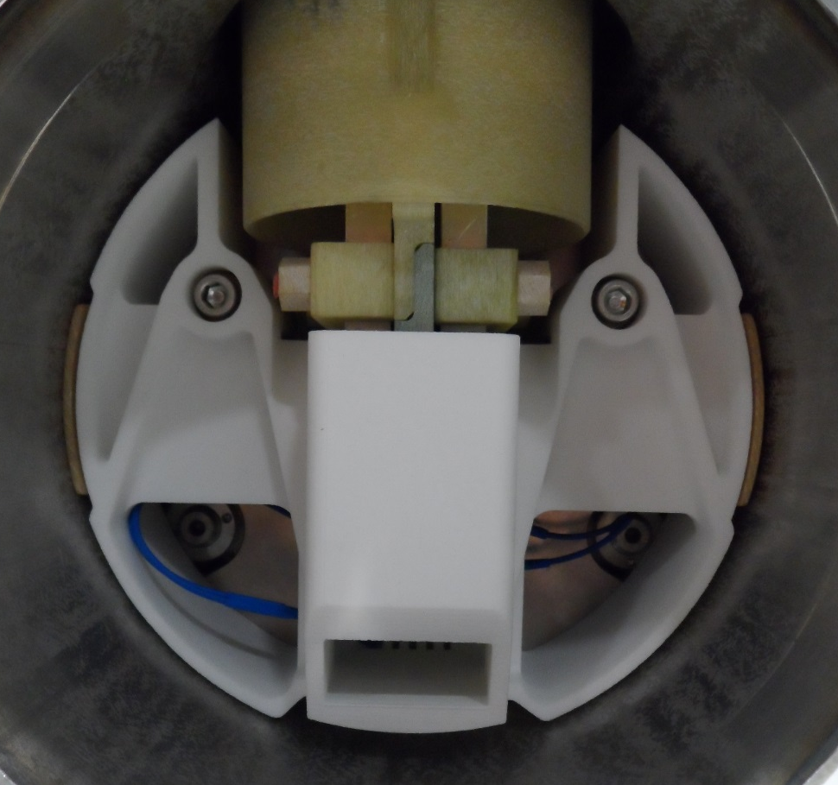
Insulation insert optimised by the company MTN for injection moulding
MTN insert 3D drawing
3D printed insert MTN design installed in MB1154

Slide 15
Outline
Sequence of production and QA procedures
Procedures, insulation components and tooling
LHC-DQDB-IP-0003 (Cleaning)
LHC-DQDB-IP-0002 (Installation of the insulation plates)
LHC-DQDB-IP-0001 (Installation of the insulation insert)
Experience gained during insulation consolidation of LHC spare dipoles
Insulation material qualification

Slide 16
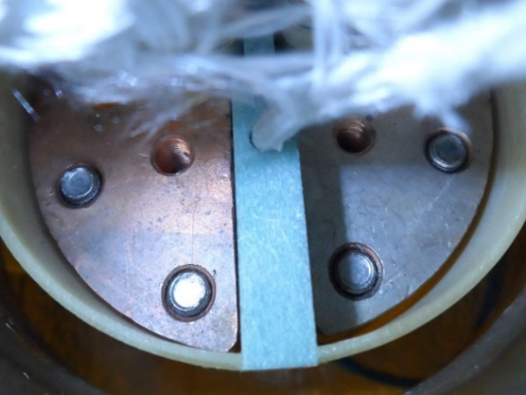
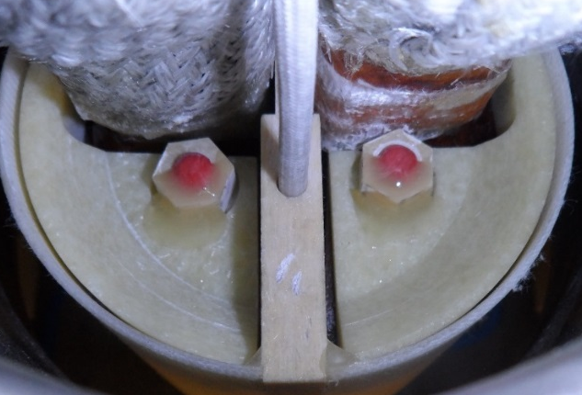
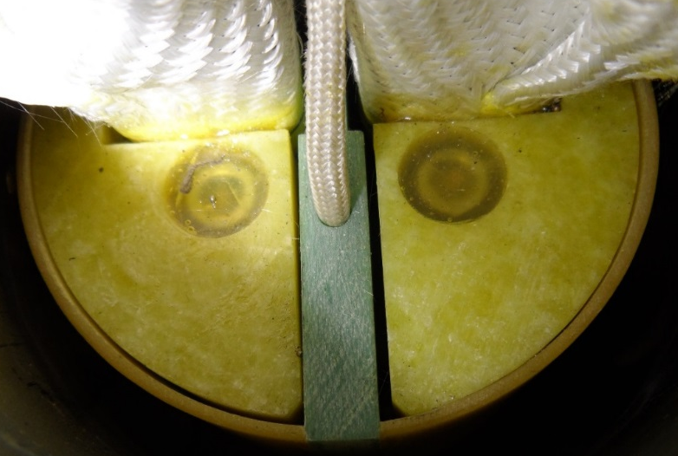
LHC spare dipoles where insulation was consolidated
The installation procedures were validated during consolidation of 20 spare magnets. In 11 magnets the insulation plates were already installed (MB2373, MB2377, MB2395, MB2336, MB2055, MB2357, MB1241, MB1235, MB2353, MB1154, MB2043)
New insulation plates have been installed in 9 spare magnets (MB1084, MB2442, MB2111, MB2372, MB3409, MB3096, MB1007, MB2638, MB2100).
(a)
(b)
Blank half-moon splice (MB1084) and
(b) installed half moon insulation plates (MB2372)
Conform insulation plates installed in MB1235.

Slide 17
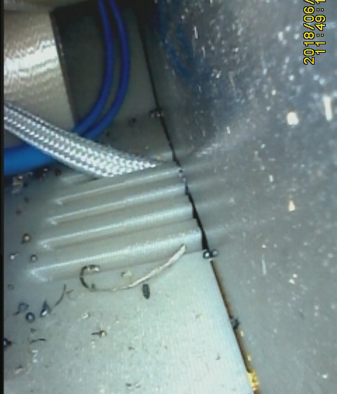
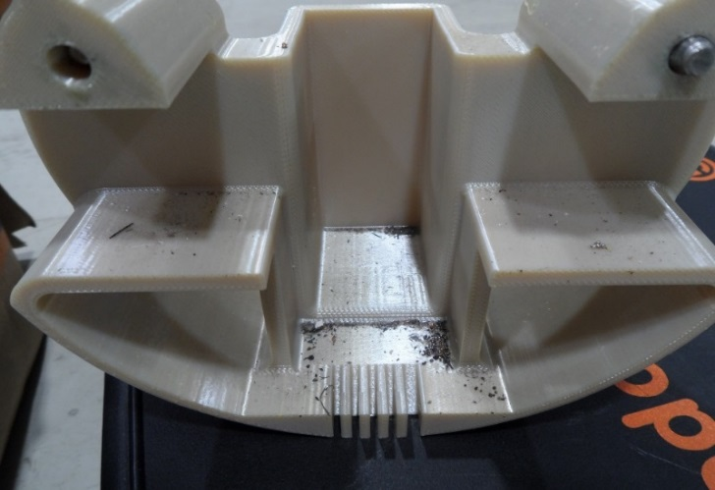
Visual inspection of insulation insert after MB2638 cold test in SM18
MB2638 has been equipped with the prototype consolidated diode insulation system and a special differential pressure measurement set-up for cold test in SM18 to determine the effect of the insert on the helium flow.
The insulation sheets and plates were mounted with EPRS7/EPRS1 fibre reinforced epoxy threaded rods and nuts.
During the SM18 tests the magnet has followed several quenches and thermal cycles.
After the cold tests the diode container has been opened, and the insulation system was examined and dismounted.
After the cold tests all components were found to be intact.
A substantial quantity of metallic debris has been transported by He flow onto the insulation plates and onto the insert.
Metal debris found in the insulation insert after MB2638 cold test.

Slide 18
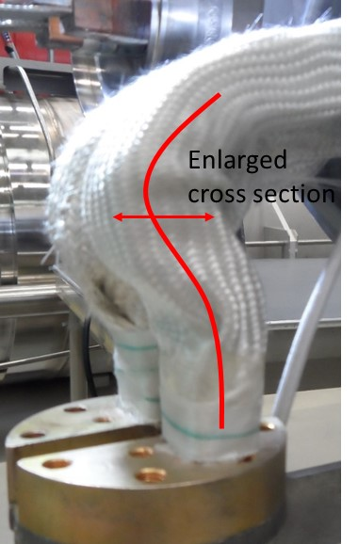
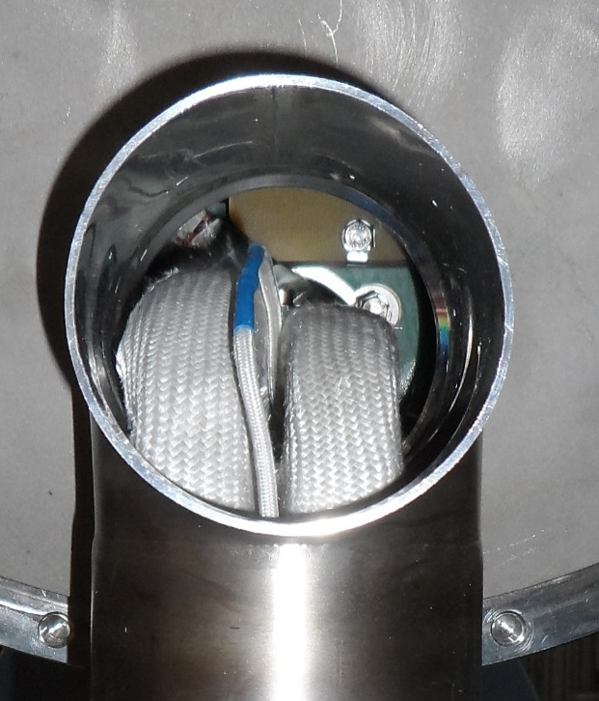
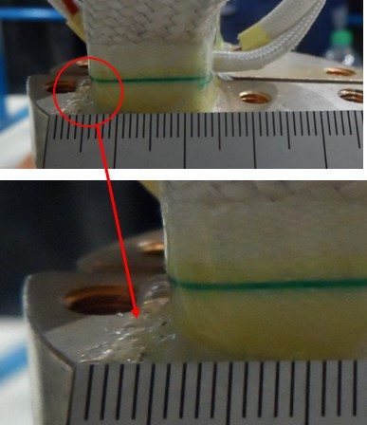
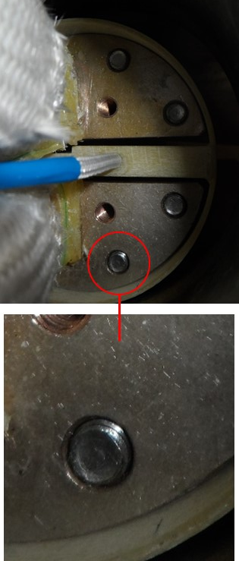
Installation of insulation system in magnets where busbars are misaligned or strongly deformed
The insulation system consisting of flexible sheets and rigid plates with a large cutout around the busbars has been designed such that it can be installed also when busbars are deformed and misaligned, and when half-moon splice screws are extending.
The half-moon insulation could be mounted in all spare dipole, despite misaligned and deformed busbars that were found in several spare LHC dipoles.
Busbars deformed (MB 2950 before welding the T-tube).
Misaligned busbars (MB2950).
Epoxy resin causing larger busbar cross section (MB 2950).
Screws extending from the half moon splice (MB 2950).

Slide 19
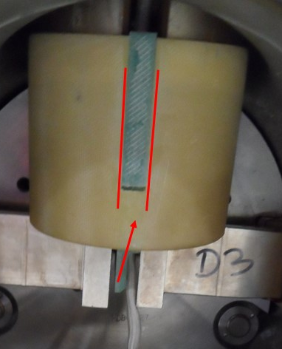
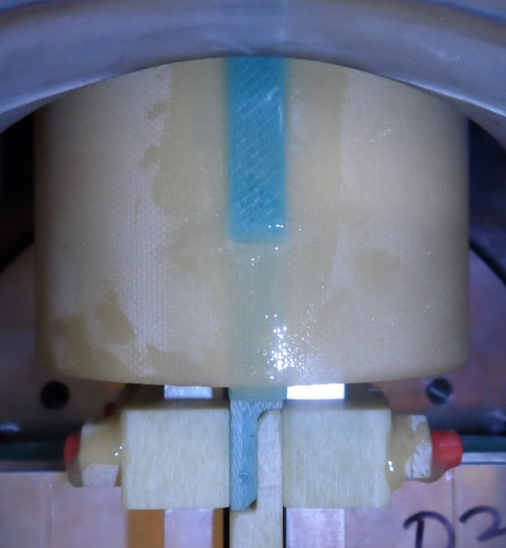
Partly broken insulation tube LHCMB__E0070
In several spare dipoles the inner wall of insulation tube LHCMB__E0070 was detached from the outer tube.
A procedure for the repair of the insulation tubes with Araldite 2011 without half-moon splice opening was developed.
Separated insulation tube and insulation wall in MB 3409 before repair.
Insulation in MB3409 after repair. On the front side Araldite 2011 was applied over the full length of the inner wall.

Slide 20
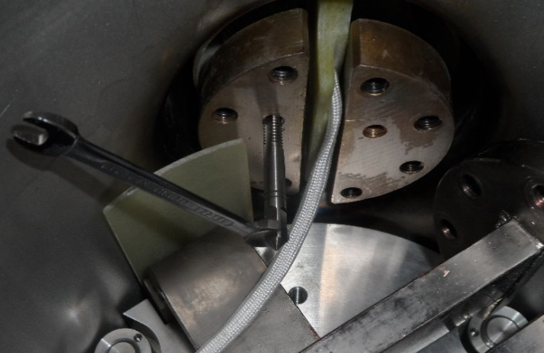
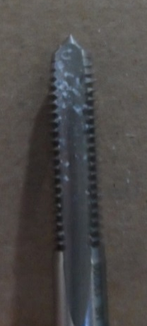
Half-moon splice thread filled with epoxy
During consolidation of MB2638 it was found that one thread in a half-moon splice was partly filled with epoxy resin, which made it impossible to mount the M6x30 mm threaded rod for the fixation of the insulation plates.
One such case was found in the 9 spare magnets where insulation plates had to be mounted.
To rethread, the half-moon splice had to be disconnected. A repair procedure has been developed.
Further development for a tooling that in favourable cases may allow rethreading without splice opening is ongoing.
Cured epoxy resin in the M6 thread for the insulation plates. Diode needed to be disconnected to redo the threads (MB 2638).

Slide 21
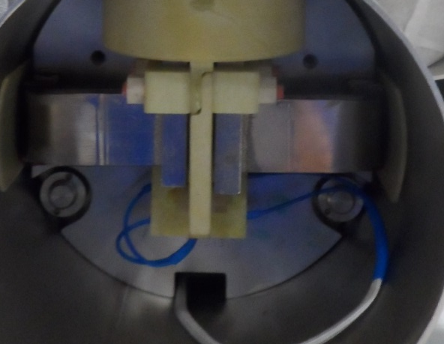
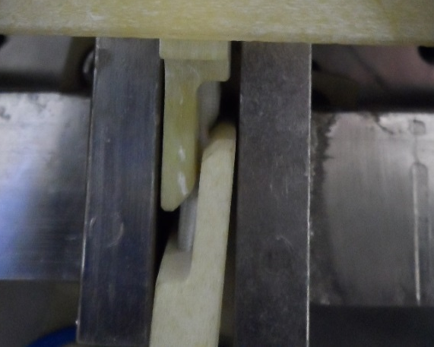
Instrumentation wires too short in order to dismantle the insulation
In one spare magnet (MB2442) the diode instrumentation wires were too short for manipulation of the insulation wall and insulation tube.
In order to extend the wire length, the half-moon splice had to be disconnected and the diode removed from the container.
(a)
(b)
(a) Too short diode instrumentation wires in MB2442. (b) The connector block could not be accessed without disconnecting the wires.

Slide 22
Outline
Sequence of production and QA procedures
Update on procedures and tooling
LHC-DQDB-IP-0003 (Cleaning)
LHC-DQDB-IP-0002 (Installation of the insulation plates)
LHC-DQDB-IP-0001 (Installation of the insulation insert)
Experience gained during insulation consolidation of LHC spare dipoles
Insulation material qualification

Slide 23
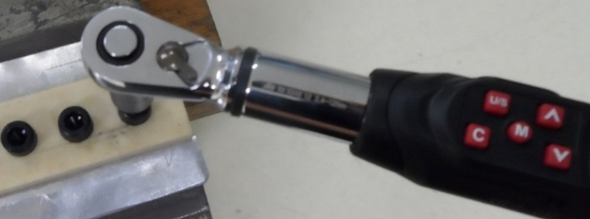
Maximum torque at rupture of screw connection
The maximum tightening torque at RT and at 77 K has been measured for M6 EPRS1/EPRS7 threaded rods and nuts, as well as for RENY screws (back-up solution for insulation plate connection).
The EPR S1 rod/EPR S7 nut and RENY screw can be safely tightened with a torque of 4 Nm and 2 Nm, respectively.
Because of the relatively higher friction coefficient of the EPRS1/EPRS7 combination with respect to the Reny screw/Cu thread, a similar tightening force is achieved when the EPRS7 nut and the Reny screw are tightened with 4 Nm and 2 Nm, respectively.
Irradiation of the RENY screws with 24 GeV protons with a fluence of 4x10¹⁵ p/cm² did not degrade the mechanical properties.
Test setup to determine the maximum tightening torque of the half moon insulation screw connection.
RENY screw and EPRS1/EPRS7 threaded rod and nut tightening torque at rupture at RT and at 77K.
 | Temperature | Average torque at rupture (Nm) | Minimum torque at rupture (Nm) | Number of tests
Reny screw | RT | 4.5±1.08 | 2.8 | 15
 | 77 K* | 5.1±0.35 | 4.6 | 5
Reny screw irradiated
 | RT | 4.4±0.32 | 4.2 | 3
EPR S1 rod/EPR S7 nut | RT | 6.3±0.86 | 4.7 | 15
 | 77 K | 9.1±0.74 | 8.0 | 10

Slide 24
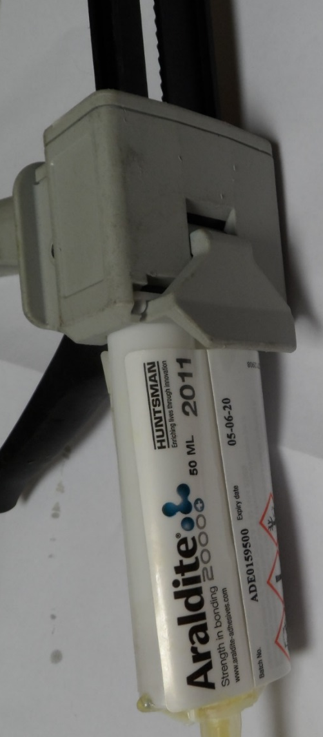
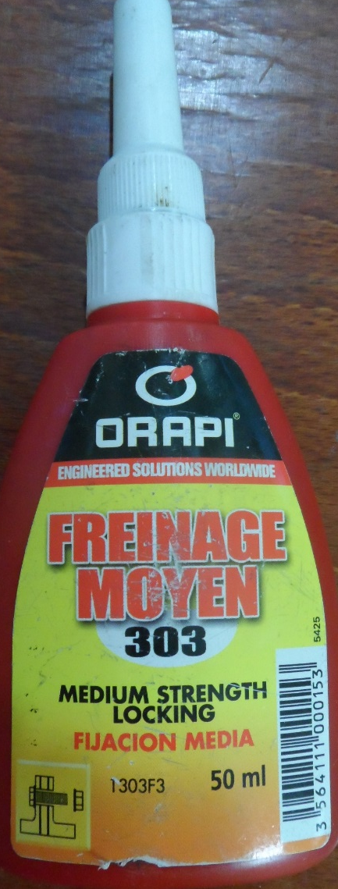
Screw lockers
Araldite 2011 two-component epoxy adhesive (pot life at 25°C is 2 hours) is used for locking of the glass fibre reinforced epoxy threaded rods and nuts. Araldite 2011 was already used for the electrical insulation of the previously used metallic screws connecting the insulation plates (EDMS 1437985).
Araldite 2012 fast curing, two-component epoxy adhesive (pot life at 25°C 5-8 minutes). Is considered as a back up solution for insulation repairs.
ORAPI Freinage Moyen 303 (1,2,3,4-Tetrahydroquinoline) is used for locking of the M6 stainless steel screws connecting the insulation insert. ORAPI 303 is also used for the locking of the half moon splice connecting screws (EDMS 1514936).

Slide 25

ULTEM 1000 compatibility tests
The compatibility of ULTEM 1000 with all products considered for screw locking and/or insulation repair (Araldite 2011, Araldite 2012, Orapi 303) has been tested.
After 9 months Araldite 2011, Araldite 2012 and Orapi 303 exposure in ambient air there is no visual degradation and no effect on the ultimate strength of the ULTEM 1000 samples.
Ultimate tensile stress of ULTEM 1000 before and after 9 months exposure to Araldite 2011, Araldite 2012 and Orapi 303.
 | R_{m} (MPa)
Pure ULTEM 1000 | 102.0±0.9
Orapi 303-1 | 102.1
Orapi 303-2 | 101.6
Araldite 2012-1 | 102.7
Araldite 2012-2 | 103.1
Araldite 2011-1 | 102.0
Araldite 2011-2 | 101.9

Slide 26


Polyimide compatibility tests
Four pieces of self adhesive Kapton tape (CERN SCEM 04.94.70.150.0) have been covered with Araldite 2012, Araldite 2011, ORAPI 303 screw locking compound
After 5 months exposure the Kapton foil did not show visual degradation.
Front side of self adhesive Kapton tape with thread locking compounds after 5 months exposure.
Back side of the self adhesive Kapton tape with thread locking compounds after 5 months exposure.

