Slide 1
ARC: a data-centric overview
Oslo Nordic Data Workshop, 27 February 2019
Balázs Kónya, Lund University
NorduGrid Technical Coordinator
thanks for Oxana Smirnova and David Cameron for some of the slides

Slide 2
What is ARC?
Middleware to enable distributed computing & data handling
  Motivated by the needs of LHC experiments
    Main goal: common interface to disparate computing facilities
    Designed with a distributed Nordic Tier1 in mind, optimised for HPC deployment
    !!! built-in data caching !!!
  Open Source, mostly volunteer contributors
    Coordinated by the NorduGrid Collaboration
    Supported by EU in past, NeIC now (partially)
    Preview in 2002, first release in 2004

Slide 3
ARC major releases 2004-2018
http://www.nordugrid.org/arc/releases/
Release nr | Release Date | Major Change
Version 0.4 | April13, 2004 | First official release of ARC after two-year of development
Version 0.6 | May 22, 2007 | Same protocols nevertheless minimal backward compatibility with v04
Version 0.8 | Sept 30, 2009 | Contains technology preview of SOA ARC
NOX | Nov 30, 2009 | Separate release of SOA ARC
11.05 (v1.0) | May 10, 2011 | Very substantially re-enginered CE & clients
12.05 (v2.0) | May 21, 2012 | Further client-side changes, libarcclient
13.02 (v3.0) | February 28, 2013 | Several obsoleted components, numerous library name changes (libarcdata2 -> libarcdata)
13.11 (v4.0) | November 27, 2013 | new client-side job database
15.03 (v5.0) | March 27, 2015 | arc-ur-logger got replaced by JURA, removed several components, modules (old data staging)
VERSION 6.0 | 2019 (!) | see a dedicated slide later

Slide 4
ARC 6: major release soon out...
ARC6 content:
  Internal scalability improvements
  Much better manageability (configuration redesign)
  Interface consolidation
  New Infosys indexing layer, new RTE framework
  Major clean-up and retirement of unused parts
  Some backward incompatible changes
Stay tuned: http://www.nordugrid.org/arc/arc6/
ARC 7 plans:
  rework security layer
  Data, Data, DATA

Slide 5
Key ARC components
Key components:
  ARC CE – a Compute Element, providing interfaces to computing resources
    Modular, consists of several sub-components (services and utilities)
    Interface for job control
    Interface for exposing resource and job status info
    Data staging and shared cache management utilities
      Jobs do not need to stage data in or out
  CLI client tools to interact with ARC CE and relevant third-party services
    CLI for jobs management
    CLI for X509 proxy management (client to VOMS)
    CLI for file transfer (a wide range of protocols)
  API: C++ and Python, for interfacing to full software stack
    Enables custom services and clients, including arcControlTower (aCT)

Slide 6
ARC-CE instances in GOCDB
cf. CREAM-CE: 371 instances as of today

Slide 7
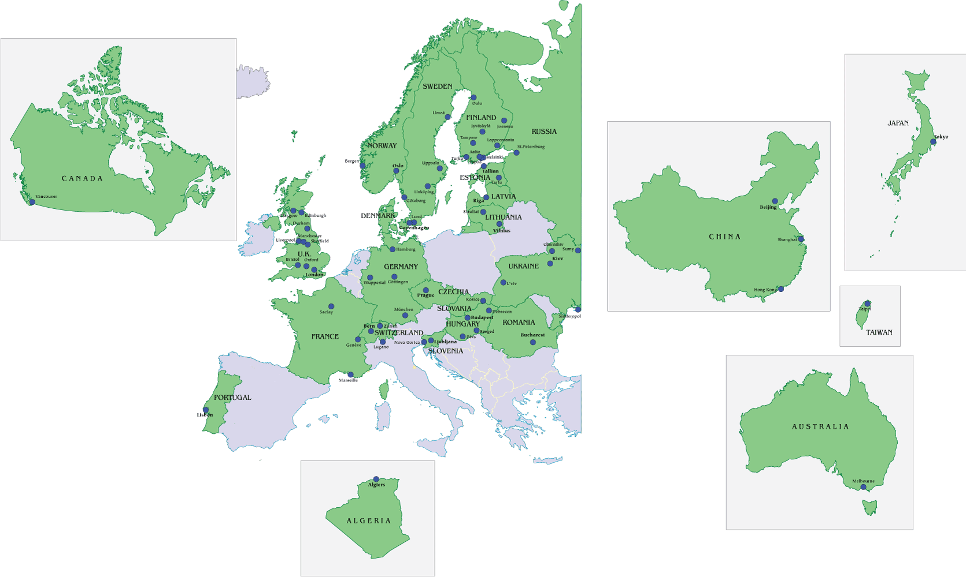
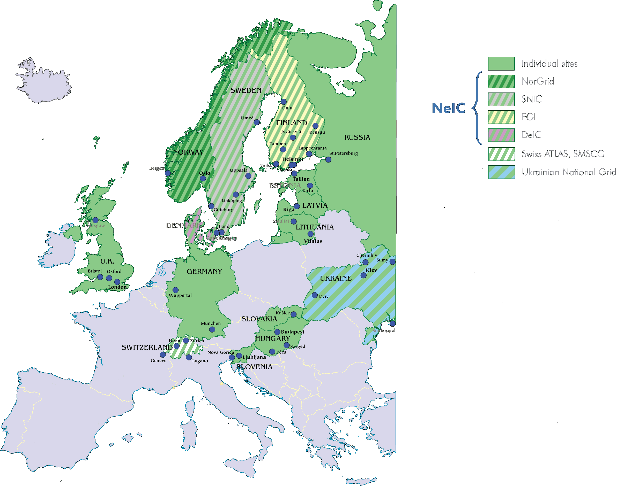
ARC-CE geography
Data as of end-2018

Slide 8
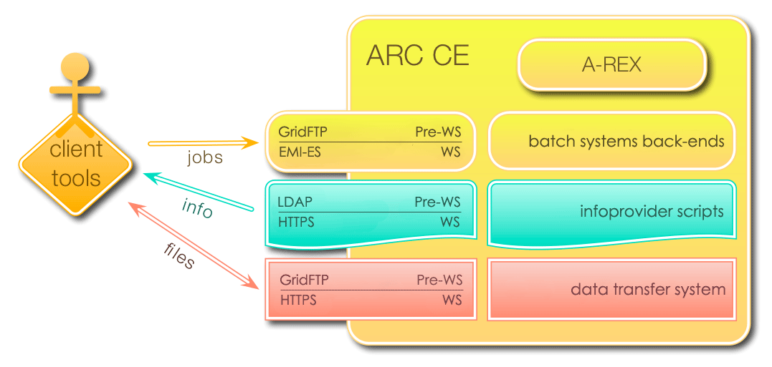
ARC CE internals & interfaces
DATA
DATA
Notes:
Shall REST be added?

Slide 9


Advanced Resource Connector
Connects computing resources in a streamlined standard manner
By delivering, storing and advertising data

Slide 10
Data in ARC.CONF
8+3 data related configuration blocks (out of 37):
[arex/cache]
[arex/cache/cleaner]
[arex/data-staging]
[arex/ws/cache]
[arex/ws/candypond]
[datadelivery-service]
[acix-scanner]
[acix-index]
[gridftpd], [gridftpd/jobs], [gridftpd/filedir]

Slide 11
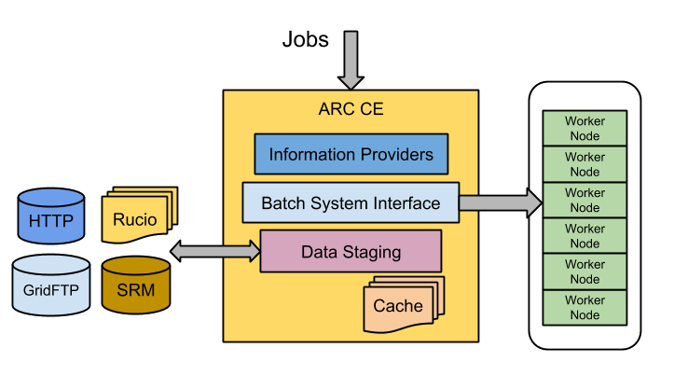
Powerfull data staging with CACHE
The DTR subsystem of ARC CE performs the critical role of transferring input and output data for jobs, [arex/data-staging]
  Generally copying data between a shared file system and Grid storage
  transfershares, speedcontrol, transferretries, etc..
  tech descripition: wiki.nordugrid.org/wiki/Data_Staging
The CACHE module of an ARC CE may keep a cache of input data on the shared file system, [arex/cache], [arex/cache/cleaner]
  Jobs requiring already cached files do not need to re-download them
  Cache is self-managing using LRU and/or a file lifetime based cleanup
  Multiple cachedirs, cache draining
  tech description: Section 6.4 sysadmin guide

Slide 12
Data staging protocols
Largely influenced by WLCG evolution, the current data transfer protocols supported by ARC are:
  ACIX (ARC Cache Index)
  File
  GridFTP
  HTTP(S)
  LDAP
  Rucio (ATLAS data management system)
  SRM (Meta-protocol for access to WLCG storage, now deprecated)
  S3
  Xrootd (Native protocol to access files stored in ROOT format)
  LFC, dcap, rfio, ... (legacy WLCG protocols supported through gfal2 library)
Note that ARC CE does not do 3rd party transfer, all data is transferred to or from a local file system

Slide 13
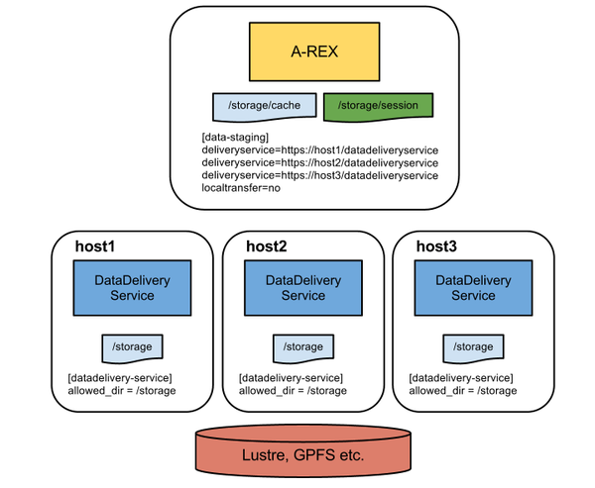
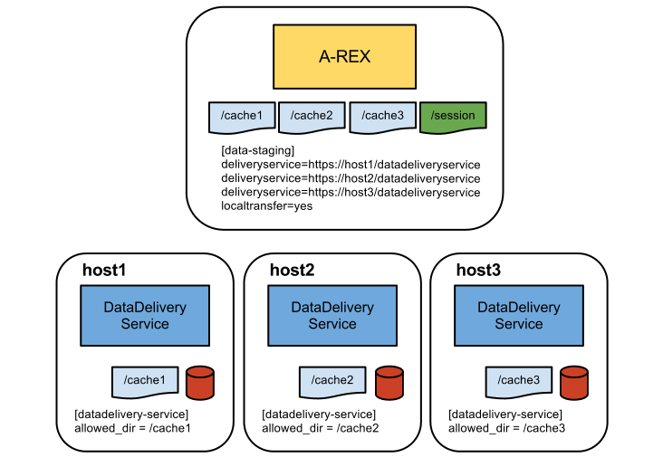
Datadelivery-service: scaling up data staging
Data transfer capability can be scaled up by adding extra data staging hosts, [datadelivery-service]
The master CE hosts delegates data transfer to the other hosts
tech description: https://wiki.nordugrid.org/wiki/Data_Staging/Multi-host
Multiple hosts with one large shared FS
Multiple hosts each with own cache

Slide 14
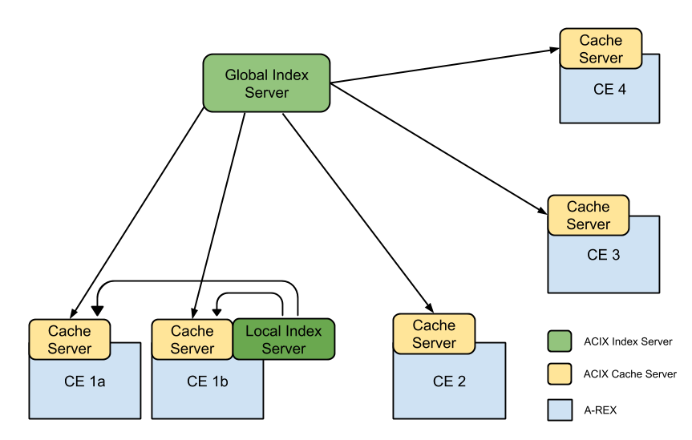
More on cache, ACIX and Candypond
Caching of remote files is a very powerful feature for workloads which require the same input data for many jobs
Several related services also exist:
  CacheAccess: extension of A-REX service allowing the cache to be exposed to the outside, [arex/ws/cache]
  CandyPond (cache and deliver your pilot on-demand data): extension of A-REX service allowing on-demand fetching and caching of files by a running job, [arex/ws/candypond]
  ACIX: A catalog of cache content - useful for brokering jobs to CEs where data is already cached, [acix-scanner], [acix-index]
  Whistleblower: Publication of cache content to an external service (e.g. Rucio) through message queues
Possible ACIX deployment, with one global Index Server and a local Index Server for CE 1a and CE 1b

Slide 15
ARC as of Today: summary
  ARC is serving a well-understood use-case (LHC lockin)
    Data plays a critical role
    Large-scale distributed production
  A middle layer over shared HPC systems (clusters)
    With strong built-in data focus
    Some unnecessary overhead due to standard-compliance
    Security layer rework is necessary
  ARC is mostly known as a CE, nevertheless:
    We’ve realized the importance of DATA from the very beginning
    ARC comes with powerful and unique DATA features
    As of now DATA services/features in ARC strongly coupled to job processing
    We are planning to be more active in the DATA area

Slide 16
Documentation, support, availability
Documentation:
  ARC5: documentation is distributed with the software
    ARC CE sysadmin guide is the must
  ARC6: modernised documentation online at http://www.nordugrid.org
    Still in works
Support:
  For those familiar with GGUS, submit tickets to “ARC” unit
  For community support, subscribe to either:
    nordugrid-discuss@nordugrid.org – generic
    CERN e-group wlcg-arc-ce-discuss@cern.ch – WLCG-specific
  For bug reports and feature requests, submit tickets to:
    https://bugzilla.nordugrid.org
Code:
  https://source.coderefinery.org/nordugrid/arc
Linux packages:
  Global Linux repositories (CentOS, Debian, EPEL)
  Upstream: http://download.nordugrid.org/repos.html

