Slide 1
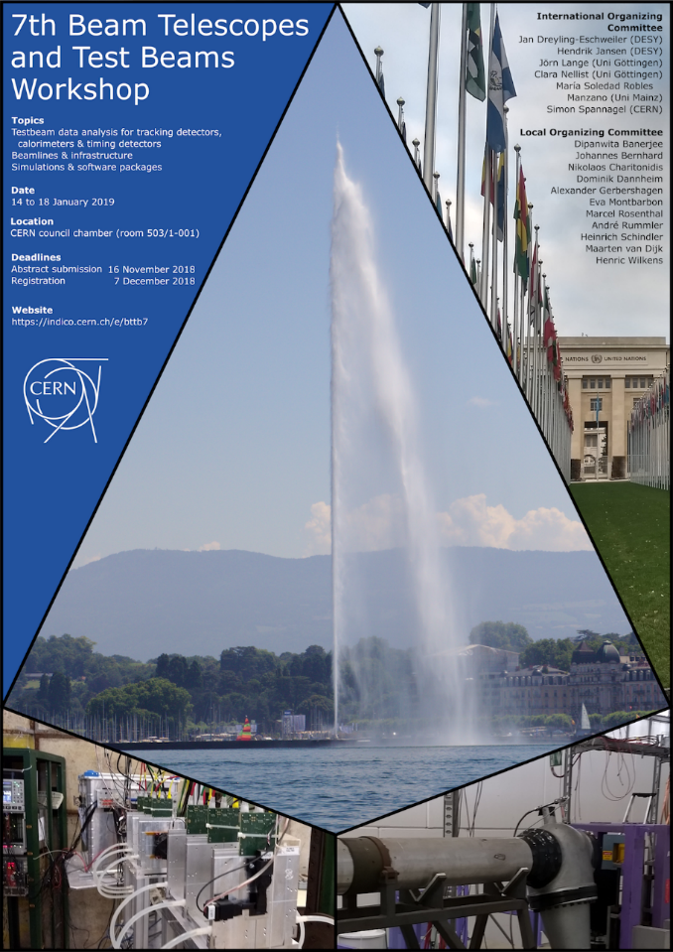
AIDA-2020 WP15
Upgrade of beam and irradiation test infrastructure
Federico Ravotti (CERN) & Marcel Stanitzki (DESY)
WP15 Satellite Meeting @ 7th BTTB Workshop
January 14th, 2019
https://indico.cern.ch/event/780067/

Slide 2
Welcome!
The BTTB series has been a very successful forum for:
  test beam & irradiation facilities users (and coordinators)
  beam telescope users
AIDA-2020 WP15 has a large overlap of activities and participants (Tasks 15.2, 15.3, 15.4) …
Upgrade activities in test-beams and irradiation facilities (Task 15.5) are driven by users requirements …
… natural to take the opportunity to meet and discuss WP15 matters!
Ideas for extension and follow-up of some of the AIDA-2020 WP15 activities, beyond 2019, were born @ BTTB!

Slide 3
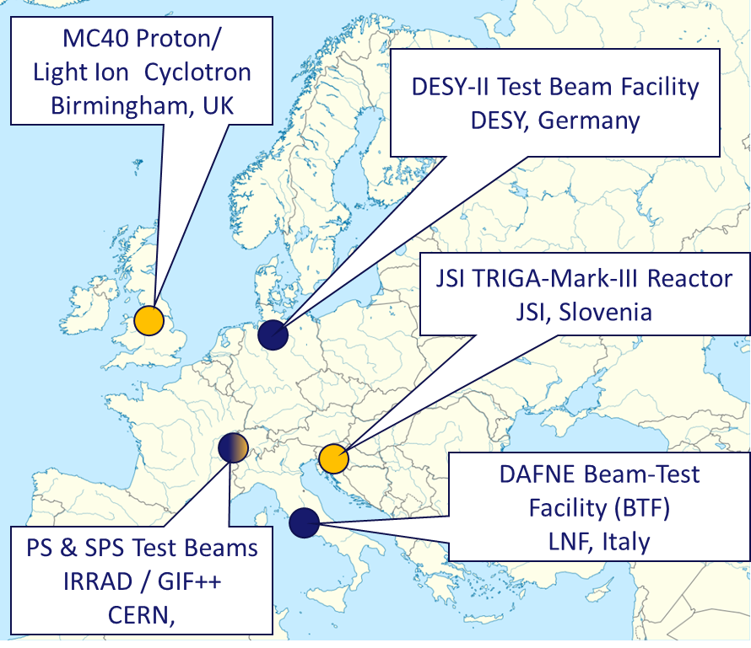
WP 15 Structure
Task 15.1: Scientific coordination (CERN, DESY)
Task 15.2: Improvements of test-beam infrastructure for high precision tracking (CERN, DESY)
Task 15.3: Improvements of the DESY test-beam infrastructure (DESY)
Task 15.4: Improvements of the test-beam infrastructure at LNF (INFN)
Task 15.5: Improvements of the infrastructure for irradiation tests (CERN, INFN, VU, INRNE, JSI, USFD*)
*associated partner linked to CERN
Test Beam Facility
Irradiation Facility

Slide 4
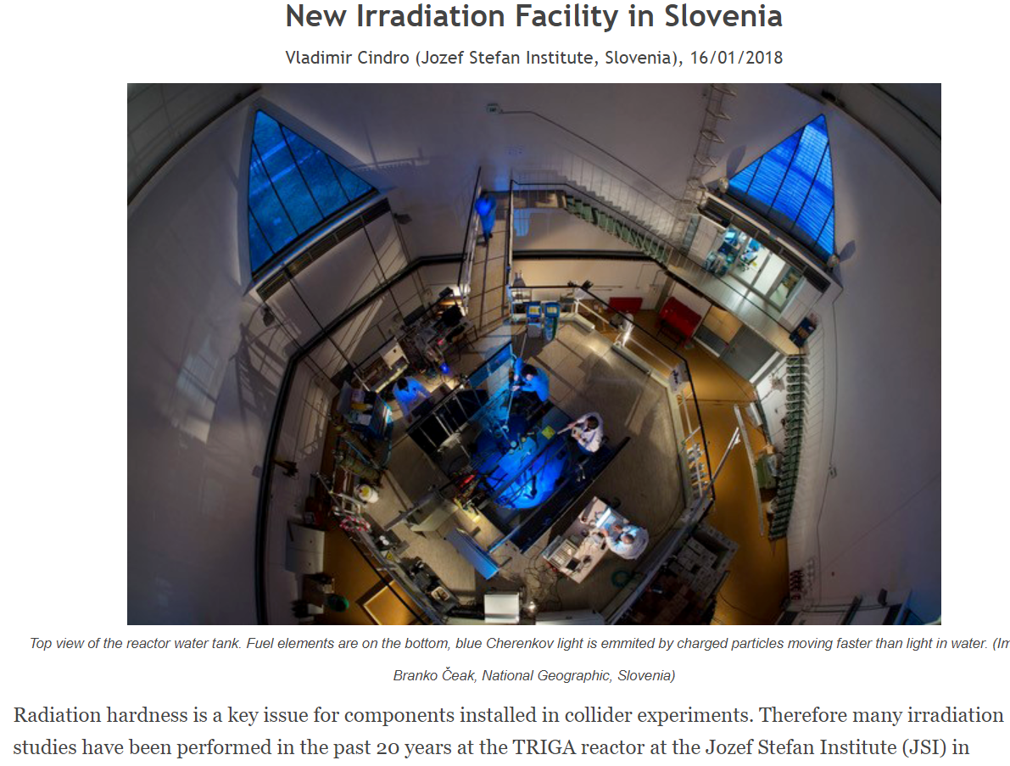
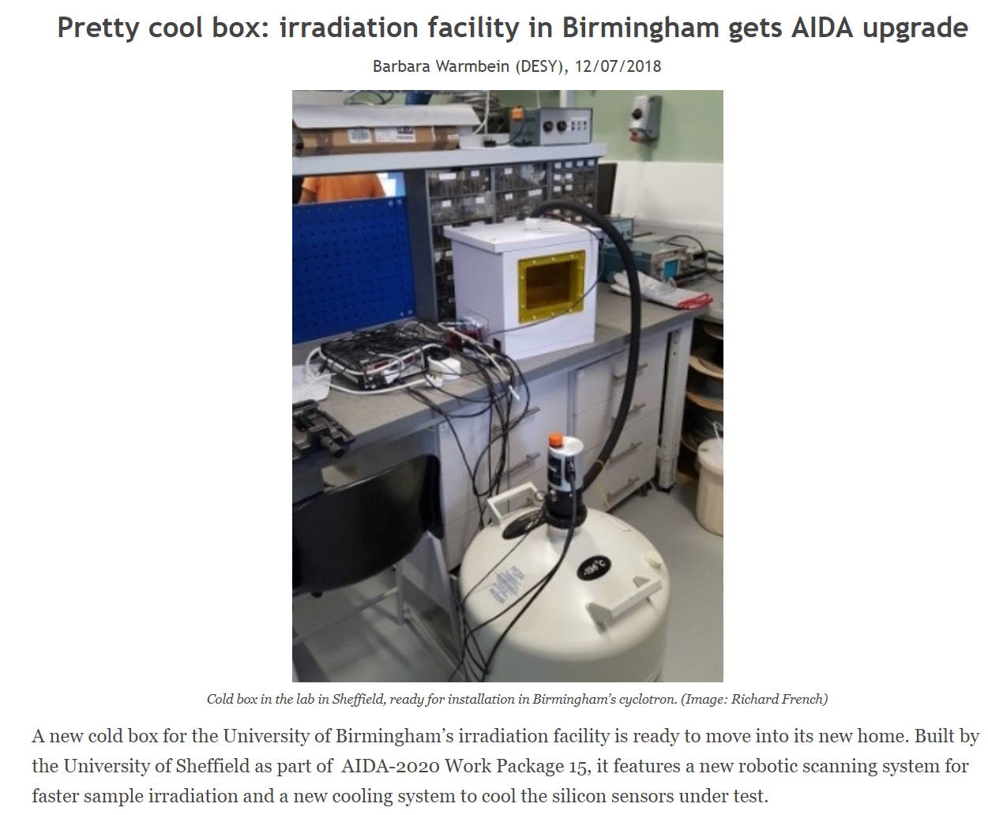
AIDA-2020 News
Fourth Annual Meeting:
  will be held in Oxford, UK
  on April 1st-5th, 2019
  Workshop “Future of Tracking” (1st -2nd)
  AIDA-2020 extended of 1Y
  3rd reporting period: M48 → M60
  call for new EU proposal beyond AIDA-2020 in the period Nov. ’19 – Mar. ‘20 (news Dec. 2018)
  On Track newsletter:
  http://aida2020.web.cern.ch/content/newsletter
  articles about WP15 activities were prepared in 2018
  watch out issues #9 and #10!

Slide 5
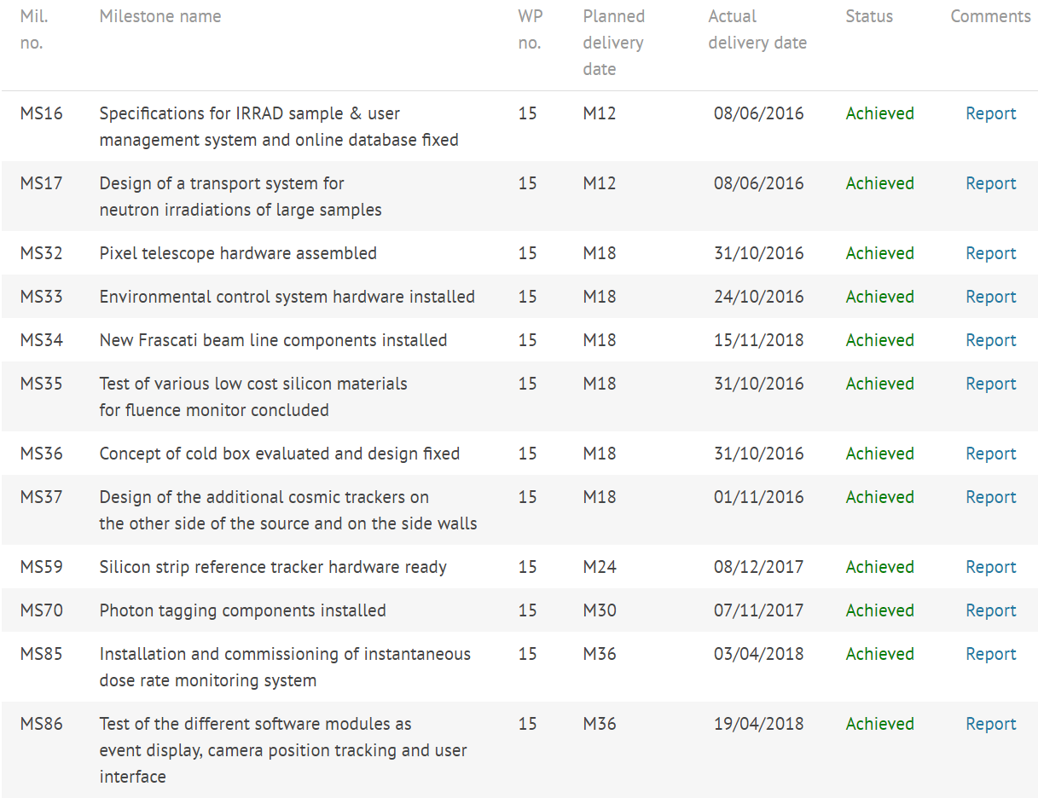
Milestones
ALL MILESTONES ARE NOW ACHIEVED!
→ M41

Slide 6
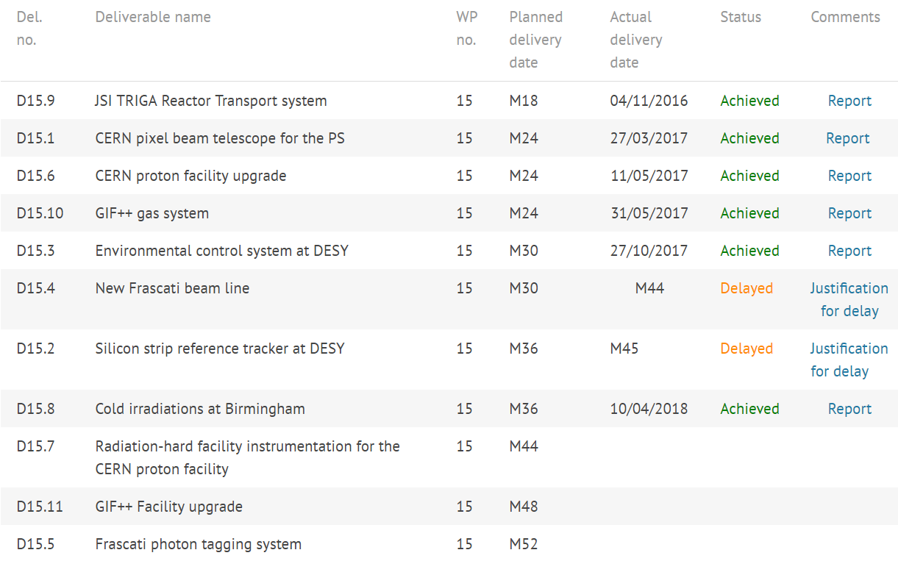
Deliverables
→ report being prepared
→ end of 4th year
→ moved to Y5 (linked to D15.4)

Slide 7
Outreach
Becoming more and more important!
  frequently asked/reminded by AIDA-2020 coordination
54 (+2) records for WP15 in CDS so far (including official reports)
  http://cds.cern.ch/collection/AIDA-2020?ln=en
Please, submit your publications related to WP15 activities:
  http://aida2020.web.cern.ch/content/submit-your-publication
  journal publications, conference/workshop papers, scientific/technical notes, academic dissertations, posters, presentations and handouts, press articles, etc. …
and, please, remember the AIDA-2020 acknowledgement text!
  http://aida2020.web.cern.ch/science/publications

Slide 8
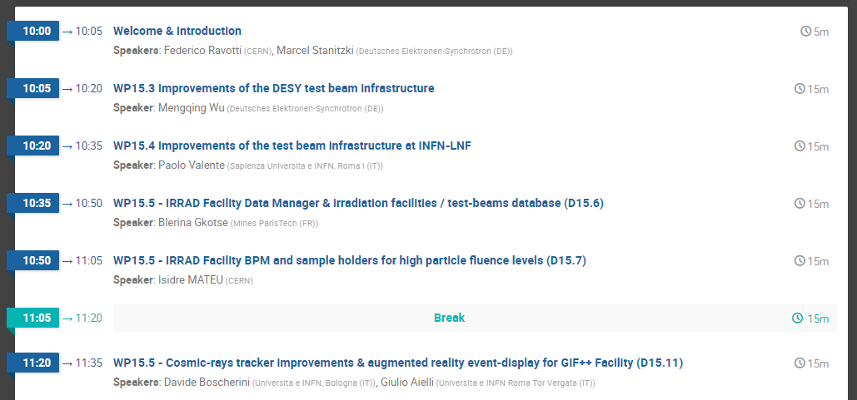
Today’s Program …
PART 1:
reports (15 min) about deliverables/tasks to be completed, delayed or extended

Slide 9
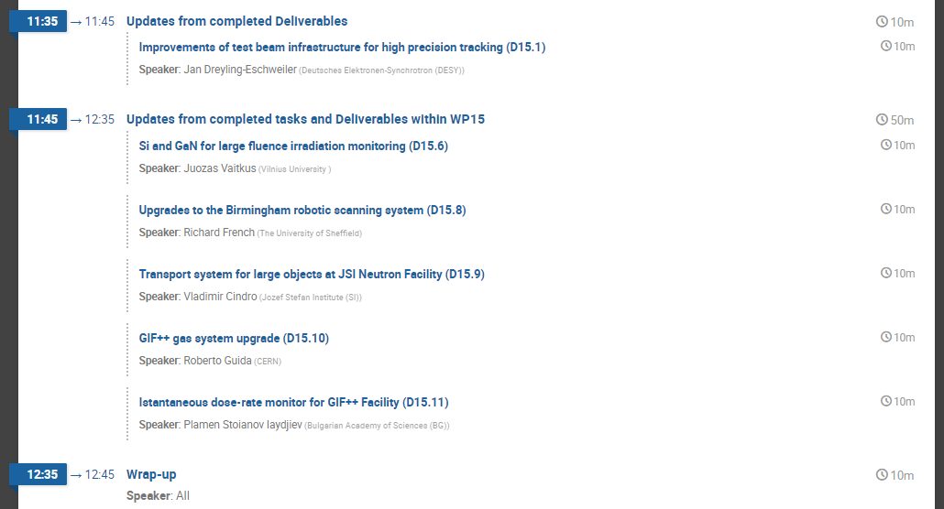
Today’s Program
not confirmed
PART 2:
News, updates and follow-up about completed deliverables/tasks (10 min)

