Slide 1


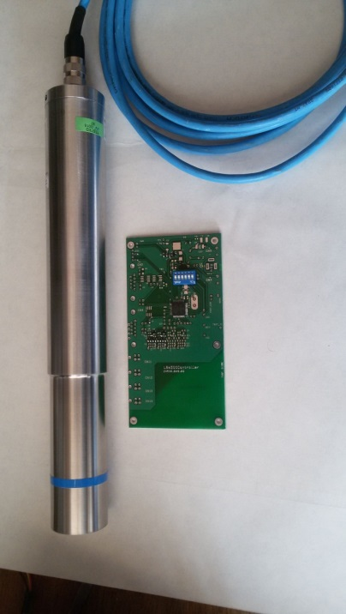
AIDA-2020 WP15 satellite meeting during 7th BTTB Workshop
Radiation Monitoring Systems at GIF++ - INRNE,Sofia,Bulgaria
Instantaneous dose-rate monitor (DRM) for GIF++
and test of SiPM + scintillator as a DRM for Gif++
P.Iaydjiev, L.Dimitrov, I.Vankov, G.Mitev, L. Ratchev (INRNE-Sofia)
User requirements for the instantaneous dose rate monitoring were satisfied with the design and test of the new online dose-rate monitor based on Berthold LB 6500 Geiger-Mueller Dose Rate Probes. The eight-channel monitor with the data transmission via an RS422/485 serial port is a simple and flexible device for measuring the instantaneous dose rate at several positions in GIF++. This work was performed within the framework of AIDA-2020 WP 15.5.
Berthold GM LB6500–3–H10 Technical Data
Dose Rate Range | 10 µSv/h – 1 Sv/h
Energy Range | 50 keV – 1.3 MeV (+/-40%) with regard to Cs-137 at 0⁰
Intrinsic Background | approx. 0.015 cps
Calibration Factor | 7.05 μSv/h per cps
AIDA-2020-MS85 (http://cds.cern.ch/record/2311230)
Plamen Iaydjiev (INRNE-Sofia)

Slide 2
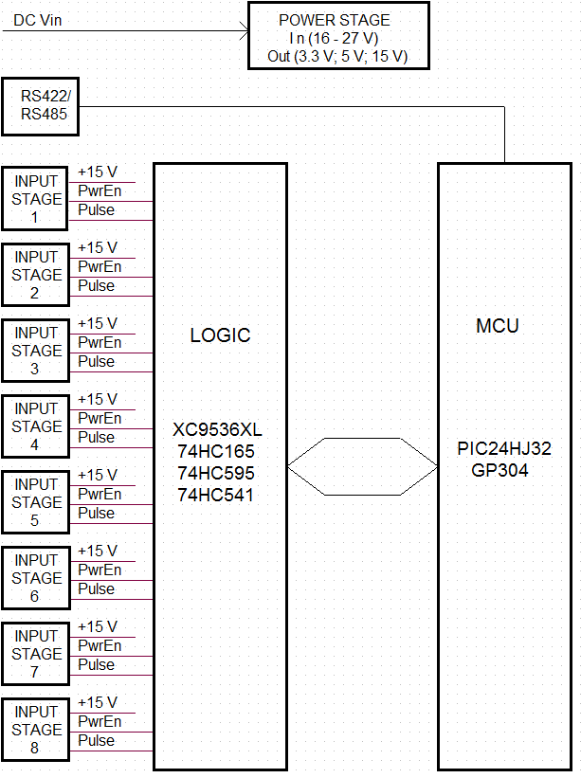
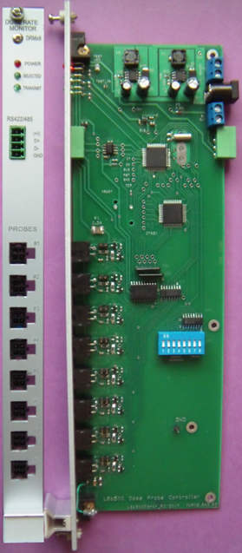
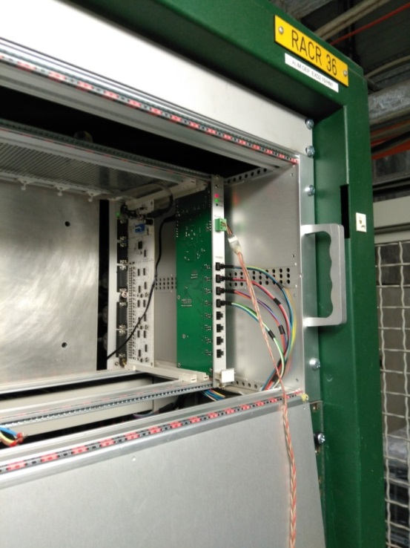
1.Instantaneous dose-rate monitor (DRM) for GIF++
The block diagram and the view of the eight-channel monitoring board and a picture of the installed at GIF++
The board is built around a 16-bit PIC24HJ32GP304 microcontroller (MCU). The block LOGIC includes complex programmable logic device (CPLD) XC9536XL and integrated circuits 74HC165 ( parallel in/ serial out shift register, used for reading 6-bit board address and 2-bit mode set from 8-bit DIP switch), 74HC595 (serial in/ parallel out shift register, used to enable power supply to the dose probes), 74HC541 ( eight stage buffer for input pulses). The self-adapting method of measurement allows automatically selecting of pre-set time depending of input pulse rate. The pre-set time is changing from 1 s to 128 s in steps of the power of two. The pre-set time can be different for each individual channel.
Plamen Iaydjiev (INRNE-Sofia)

Slide 3
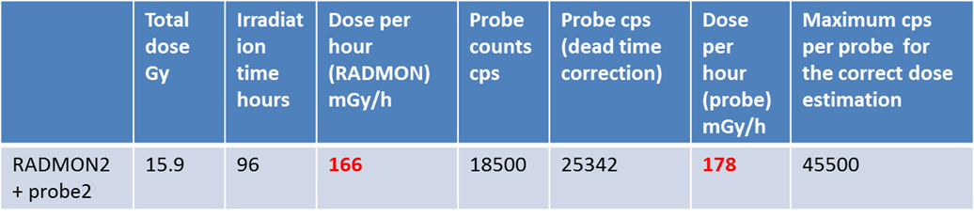
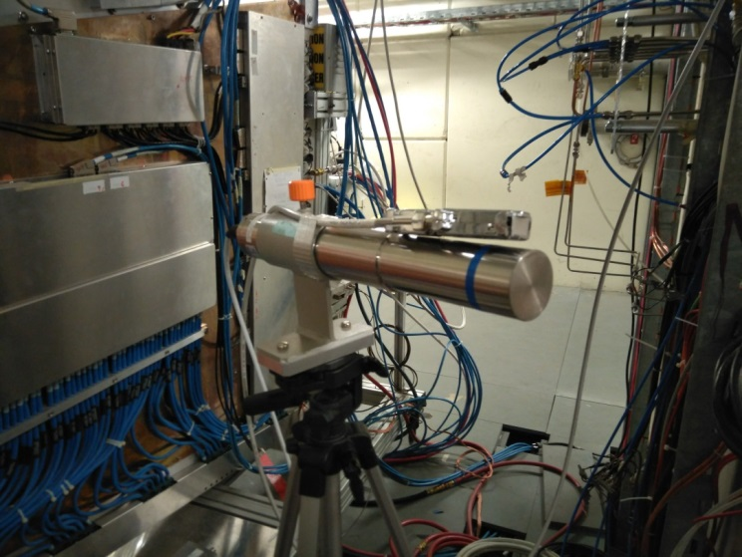
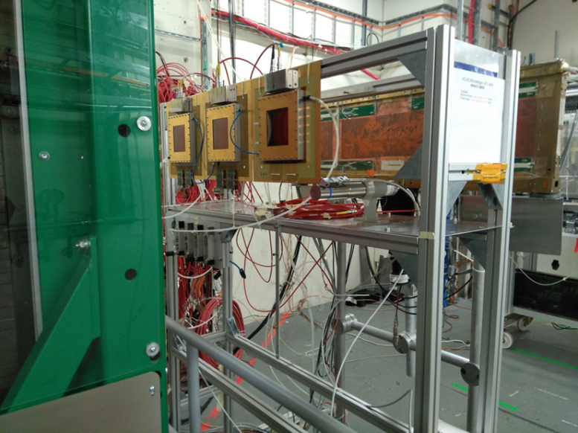
1.Instantaneous dose-rate monitor (DRM) for GIF++
TEST OF THE INSTANTANEOUS DOSE-RATE MONITOR AT GIF++
The eight-channel version was tested in 2017 at GIF++ in parallel with a RADMON accumulated dose sensor. The Berthold LB 6500 Geiger-Mueller Dose Rate Probe was tested and compared with RADMON measurements at the same position in GIF++. The result shows good agreement in the limit of precision for the RADMON and Berthold probe: 166 mGy/h for the RADMON and 178 mGy/h for the Berthold probe.
position of the RADMON+ Berthold GM Upstream and Downstream at Gif++
Plamen Iaydjiev (INRNE-Sofia)

Slide 4
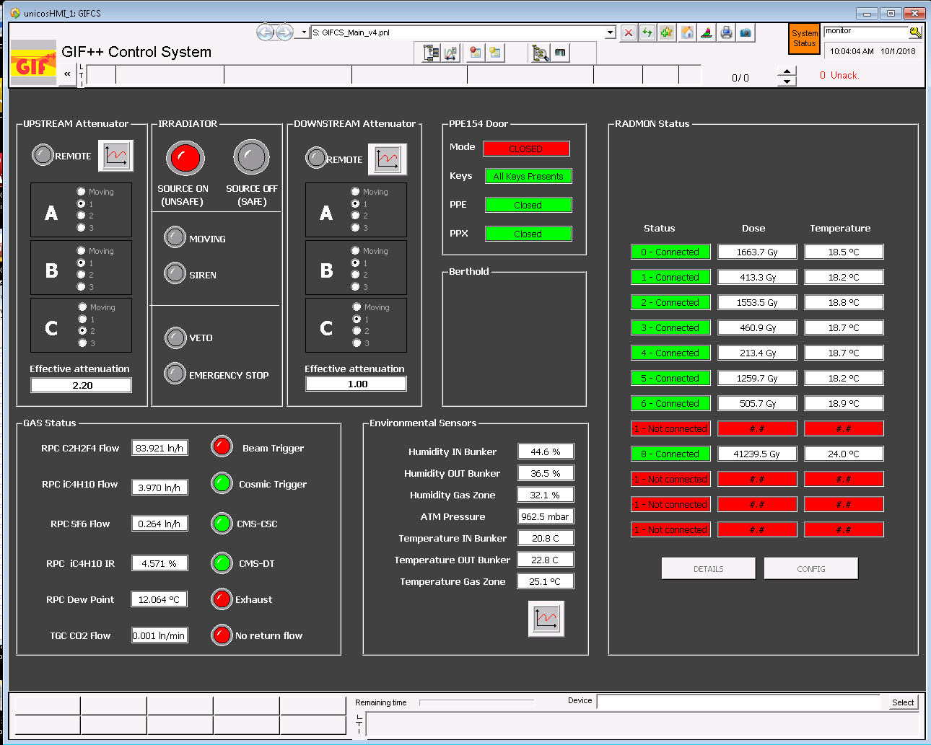
1. Instantaneous dose-rate monitor (DRM) for GIF++
A first version of the counter board designed at INRNE, and tested at GIF++ in June 2016 (2 channels), is being used to integrate the Berthold probes readout the DCS (EP-DT)
Communication via RS485
Data Available in the GIF++ Control system
The final integration of the signals in the control system is expected to be carried out during LS2

Slide 5
2. TEST at INRNE of the SiPM and Plastic scintillator as a dose rate monitor – first results
Counts vs Dose rate measurements
°C | µSv/h | n | cf
22.75 | 0.1 | 3.55 | 0.028
22.28 | 0.3 | 10.91 | 0.027
22.26 | 2.5 | 123.6 | 0.02
22.6 | 5 | 184.4 | 0.027
22.6 | 10 | 366.5 | 0.027
22.54 | 15 | 510.4 | 0.029
22.42 | 20 | 700.3 | 0.029
22.74 | 25 | 1001 | 0.025
Test configuration
SiPM - Hamamatsu S13360-1325CS (57.28V)
Photosensitive area: 1.3 x 1.3 mm, Pixel pitch: 25 μm, reduced crosstalk and dark count,
Gain (typ.) - 7.0×10⁵
Scintillator
- 250x10x7 mm³ , extruded polystyrene bar supplemented with 1.5% paraterphenyl (PTP) and POPOP 0.01%;
- 30-100 micron layer Uniplast actng as a
diffusive reflector;
Light shifter WLS Y11 KURARAY Φ 1 mm
Preamp – simple 2 transistors charge sensitive (RC = 22µs)
Amplifier - Canberra 2024, shaping time 2 µs
ADC – 4k, custom made
Temperature dependences for two SiPM voltages
The calibration factor for SiPM probe with 250 mm scintillator is 0.027 (mean value)
Plamen Iaydjiev (INRNE-Sofia)

Slide 6
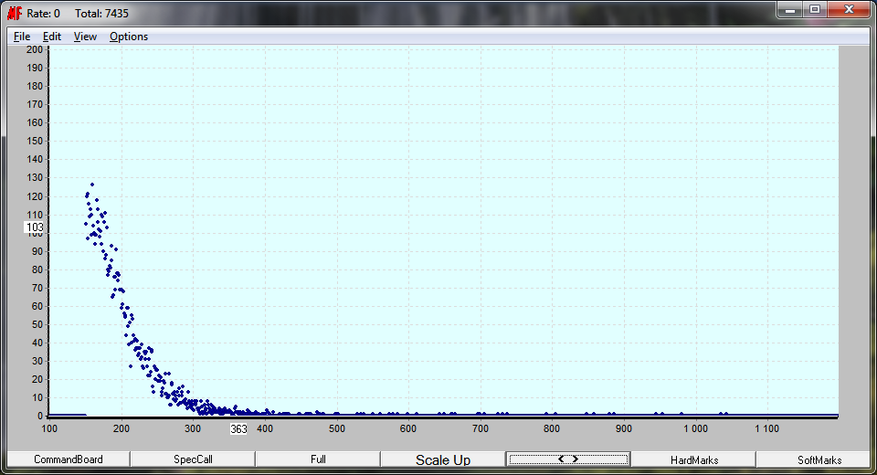
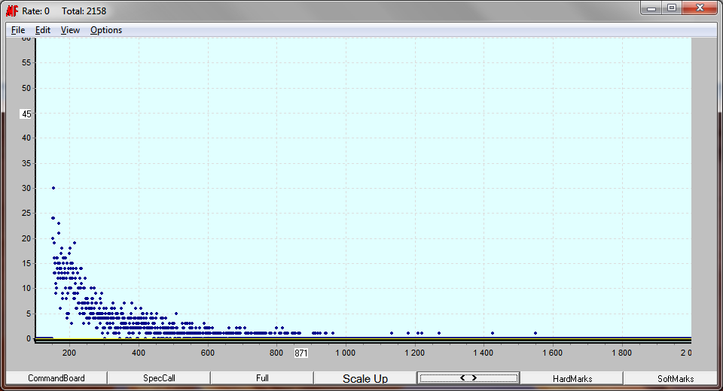
2. TEST of the SiPM and Plastic scintillator as a dose rate monitor – first results
Samples of CS137 and background spectra
Dose rate and energy ranges of the currently available Berthold gamma probes
Berthold GM LB6500–3–H10 Technical Data | LB6500–3 - H10 | LB6500–4 - H10
Dose Rate Range | 10 µSv/h – 1 Sv/h | 500 nSv/h – 3 mSv/h
Energy Range | 50 keV – 1.3 MeV (+/-40%) with regard to Cs-137 at 0⁰ | 65 keV – 1.3 MeV (+/-40%) with regard to Cs-137 at 0⁰
Intrinsic Background | approx. 0.015 cps | approx. 0.08cps
Calibration Factor | 7.05 μSv/h per cps | 0.617 μSv/h per cps
T = 1 min; n = 123.6 cps
Dose = 2.5 µSv/h
Conclusions:
Plastic scintillator + SiPM could be used as an Instantaneous dose-rate monitor (DRM) for GIF++
With the small amount of the scintillator (250x10x10) mm, the calibration factor is 0.027 (mean value) - shorter than for the Berthold probes.
The peak from the Cs-137 photons is not seen because photons could not transfer all energy in the scintillator.
- Test at Gif++ could be made with the larger amount of the present
scintillator, or, with another type of scintillator (NaI(Tl), BaF² …)
for better understanding of the multiple scattering spectra.
T = 10 min; n = 3.55 cps
Background
Plamen Iaydjiev (INRNE-Sofia)

