Slide 1


R. Guida on behalf of the CERN Gas Service Team (EP-DT-FS)
AIDA-2020 WP15 satellite meeting during 7th BTTB Workshop
EP-DT
Detector Technologies
The gas systems infrastructure for
the CERN Gamma Irradiation Facility

Slide 2

Outline
  GIF++
  Gas systems infrastructure
    Distribution panels
    Mixers
    Gas recirculation units
    Gas analysis modules
  Conclusions

Slide 3
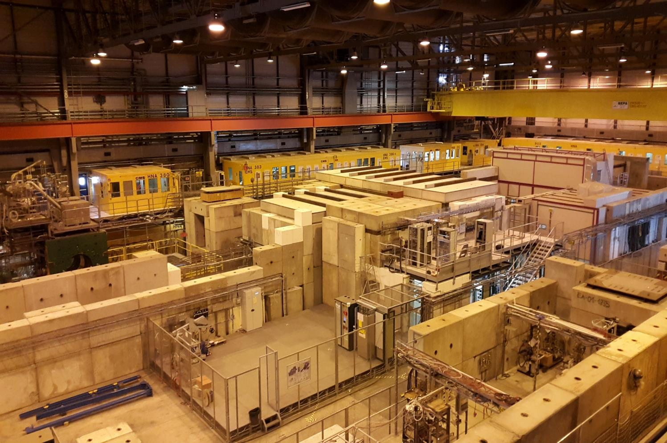


The new CERN - GIF++
  GIF++ is a unique place for detector R&D tests:
    Strong gamma source
    Particle beam available
    Excellent gas and electronic infrastructures
    Unified control/monitoring system
    Setups for beam & cosmic trigger, radiation monitoring, environmental monitoring, DAQ, …

Slide 4
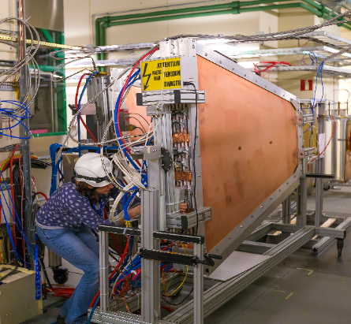
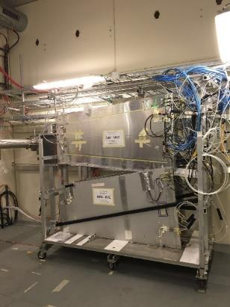
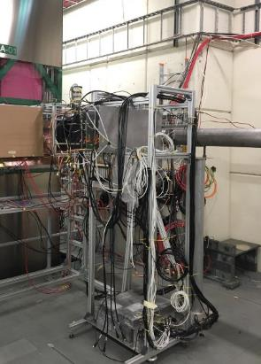
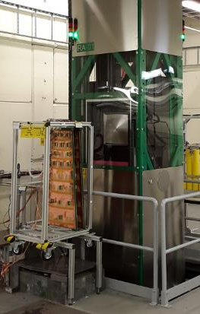
A large variety of tests on gaseous detectors
Detector validation up to new HL-LHC expected dose
Detector and electronic development
Performance of «recent» detector developments
Test on real size detectors (>> m²) and prototype
Studies with new environmentally friendly gases
New gas systems and operation for new detector upgrades
Large detector productions at high rate before installation
6 detector technologies:
DT, MDT
CSC
RPC, iRPC, GRPC
MM
GEM
sTGC

Slide 5
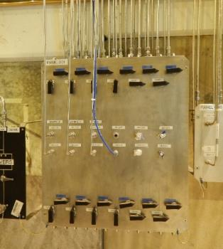
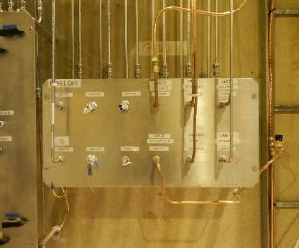
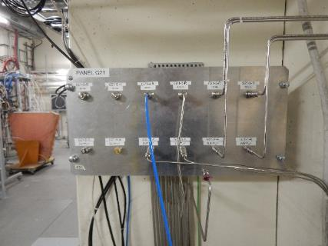
Gas mixture distribution panels
21 distribution panels (6 lines each)
  Two types:
From service area to bunker and preparation area
From service area to bunker only
Corresponding gas panels in the GIF bunker
Most of the gas channels already in use.

Slide 6
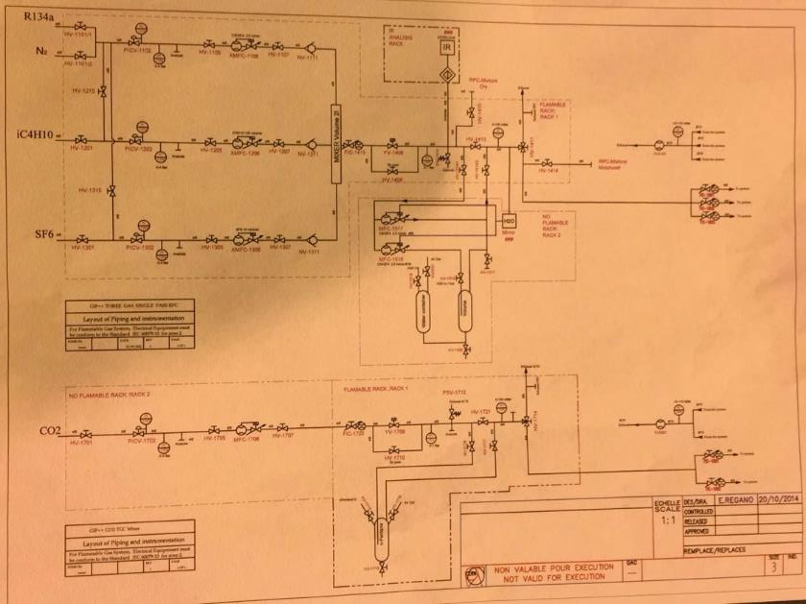
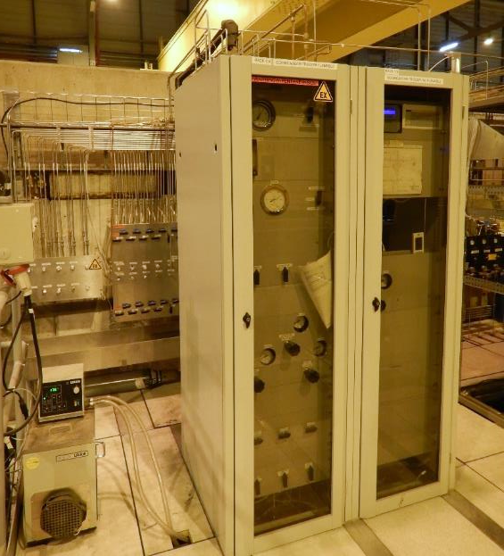
Gas mixers
Beam and cosmic triggers continue to be used
Beam and cosmic mixers: ATEX components
Non ATEX components
P&I diagram
RPC (cosmic trigger)
TGC (beam trigger)

Slide 7
Gas mixers
Many users connected. Originally foreseen only for cosmic and beam trigger. Today used by:
Cosmic trigger
  All RPC community (ATLAS, CMS, RPC R&D development, Glass RPC, …)
Beam trigger
  ATLAS TGC (R&D and NSW)

Slide 8
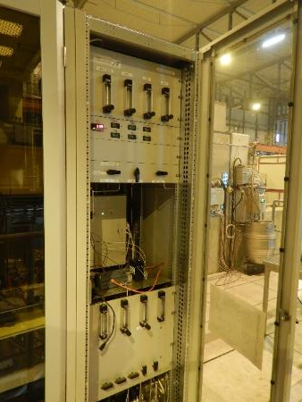
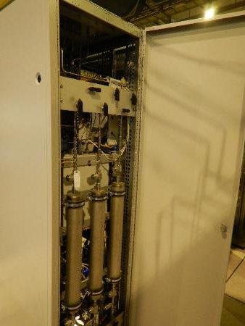
Gas recirculation systems
Two gas recirculation systems are used for
  CMS-CSC detector ageing studies
  Generic R&D on gas systems for GEM detectors
  Eco-gas mixtures for RPC
Mixture distribution
Gas purification cartridges
Monitoring of pressure, O2/H2O, temperature, atmospheric pressure
Additional software controlled pressure regulation for very low flow regimes
Gas mixing unit
B. Mandelli et al., A new portable gas recirculation unit for gaseous detector R&D, 2017 JINST 12 T10002

Slide 9
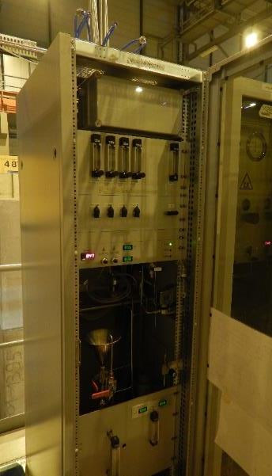
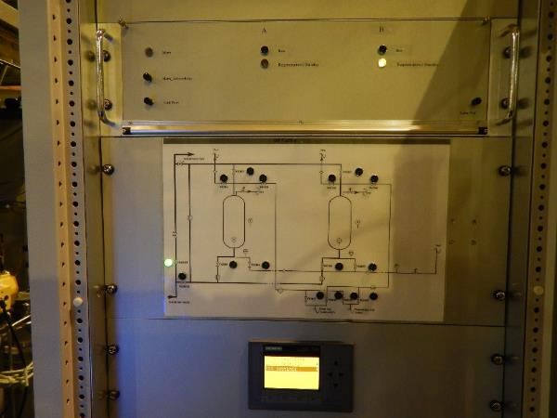
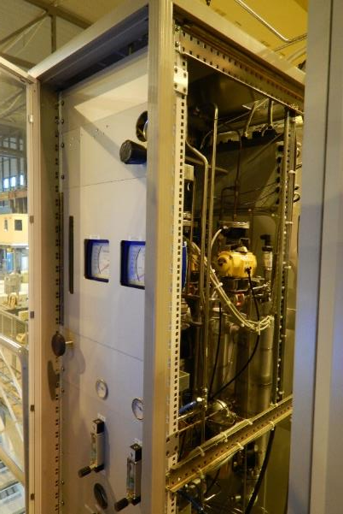
Gas recirculation systems
Second generation of new gas recirculation system
Installation completed;
Commissioned at GIF will start asap (resource problem to be solved)
To be used by RPC community (today high R134a consumption – cost and ghg issue)
Not really AIDA
Gas recirculation module
Gas mixture purification module
Cartridges with cleaning agents
Monitoring and controls panel

Slide 10
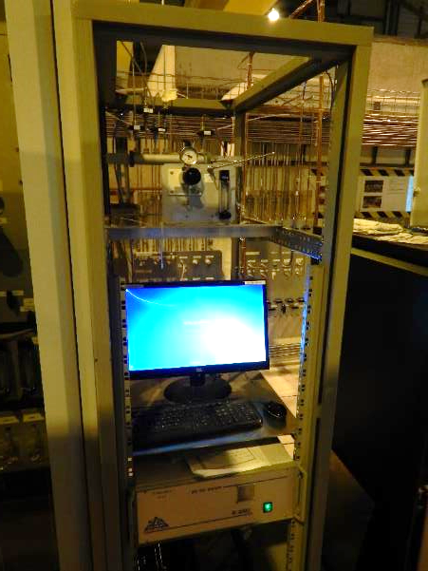
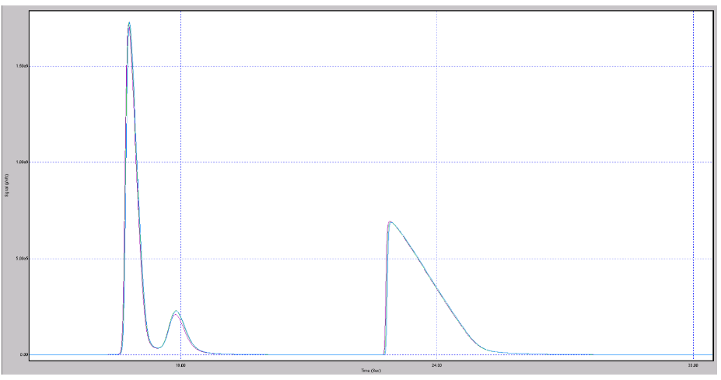
Gas analysis
Gas chromatographic analysis: allows monitoring gas mixture composition and presence of impurities on return from detectors under test – used by all detectors under test
Sampling manifold
PC for GC software controls
GC analyser (3 modules for large spectra gas separation)
Gas chromatogram
Argon
Signal area is proportional to gas concentration
CO2
CF4

Slide 11
Conclusions
The gas systems infrastructure is a key element of the successful R&D programs performed at GIF++
  In the Gas distribution panels most of the lines are already used
  Mixing units (originally built for cosmic and beam triggers) are now used by many other users
  Gas recirculation systems and gas analysis modules are used for detector R&D studies
Gas systems infrastructure is extensively used. Some resource problem:
  to complete commissioning of new gas recirculation unit (really not AIDA but ATL&CMS-RPC)
  Operation rely on EP-DT gas team already fully booked for LHC gas system activities

