Slide 1
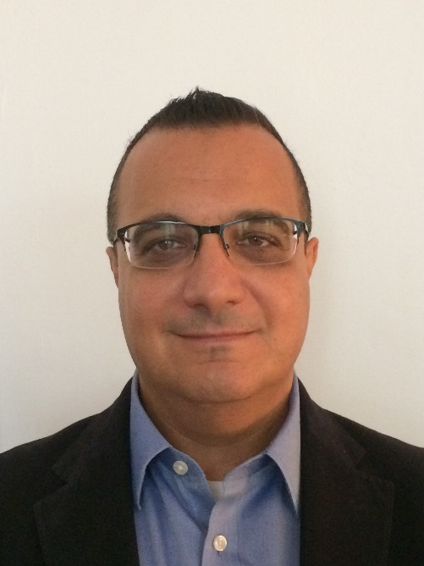


Massimiliano PINDO
Sales Manager France – Isolation Valves
Personal Information
Age: 51
Italian and French citizen, living in Paris
  PhD in Physics (Univ. Milan & CERN Geneva, 1996)
  MBA (Sorbonne Business School, 2010)
Experience
23 years of experience in several industries:
  1996 – 2000 STMicroelectronics Device Engineer
  2000 – 2007 DuPont Acc. Mngr → EU RSM
  2007 – 2015 Toppan Glob. Acc. Mngr
  2015 – 2017 Pentair V&C Site Sales Mngr
  2017 – ? Emerson France Sales Manager ISV
My motto: “Per aspera ad astra”
(Through hardships to the stars)

Slide 2
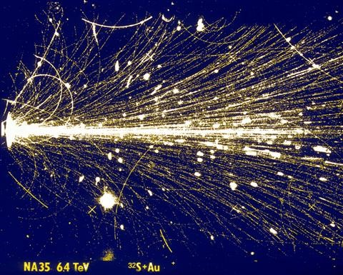
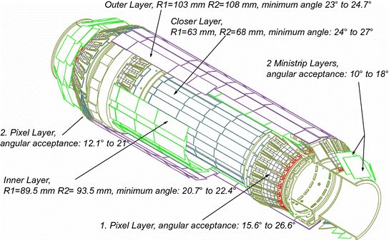
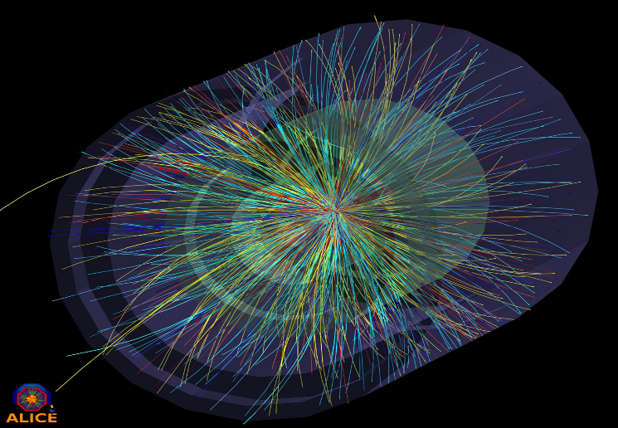
CERN and I
Visited in 1986 with my High School class. Lot of excitement at that time around CERN after the W± and Z⁰ bosons discovery! (Physics Nobel prize 1984)
CERN Summer Student 1990
  Worked 13 weeks under the supervision of Emanuele Quercigh for the WA85 experiment
  Strangeness enhancement as possible signature of Quark Gluon Plasma in heavy ion collisions
  Silicon pixel detectors used for high precision vertex resolution of heavy quark particle decay tracks
Pursued with a PhD thesis on the development of the DELPHI Forward Tracker, one of the first large scale application of pixel detectors now commonly used at the LHC
Late 80s - Early 90s
(SPS NA/WA)
Late 90s – Early 2000s
(LEP)
> 2010
(LHC/HL-LHC)

Slide 3
Sales Manager? What does it mean?
Doing
  Leads a team of account managers
  (a.k.a. sales representatives)
  Involves in high level discussions and negotiations with customers, closes deals
  Removes internal roadblocks to foster business growth
  Manages internal politics to execute the commercial strategy
  Ensures motivation, training and employability of the sales force
  Evaluates individual performance, matches team composition to company needs
Being
  Accountable for the business performance of predefined product(s) and region(s)
  Focused on customer satisfaction
  Interpersonal savvy (empathy)
  Collaborates and engage
  Nimble learning
  Action oriented
  Drives results
  Resilient

