Slide 1
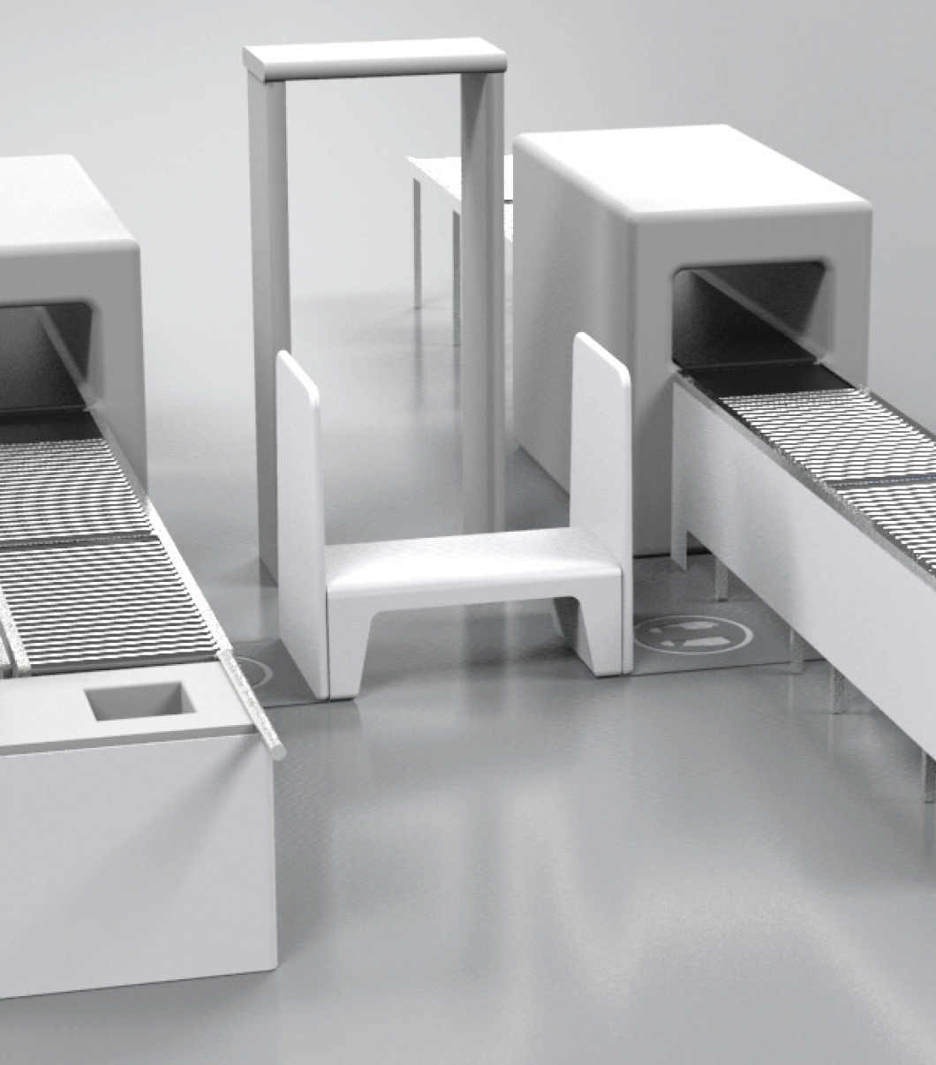
Olivier Denis olivier.denis@sedect.aero
+41 79 300 88 97
SEDECT SA
Head of Sales & Marketing
CERN Alumni
Moving out of Academia to Industrial Engineering

Slide 2

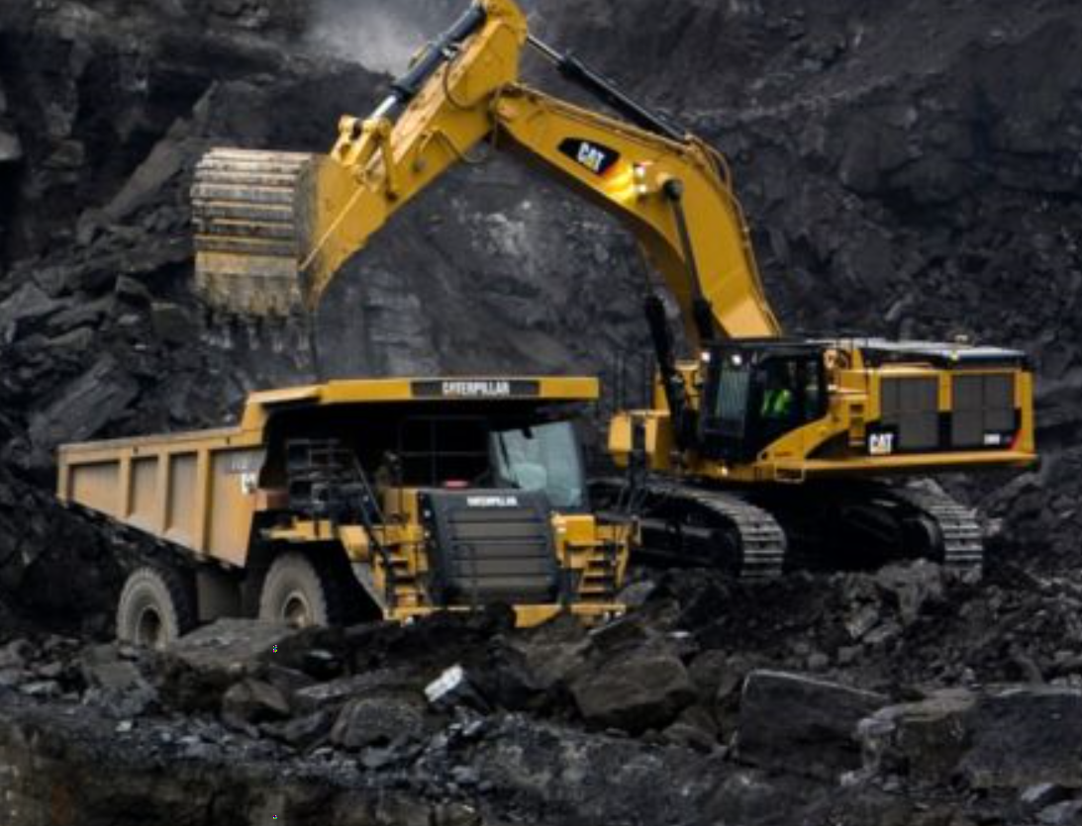
Prior to CERN

Slide 3
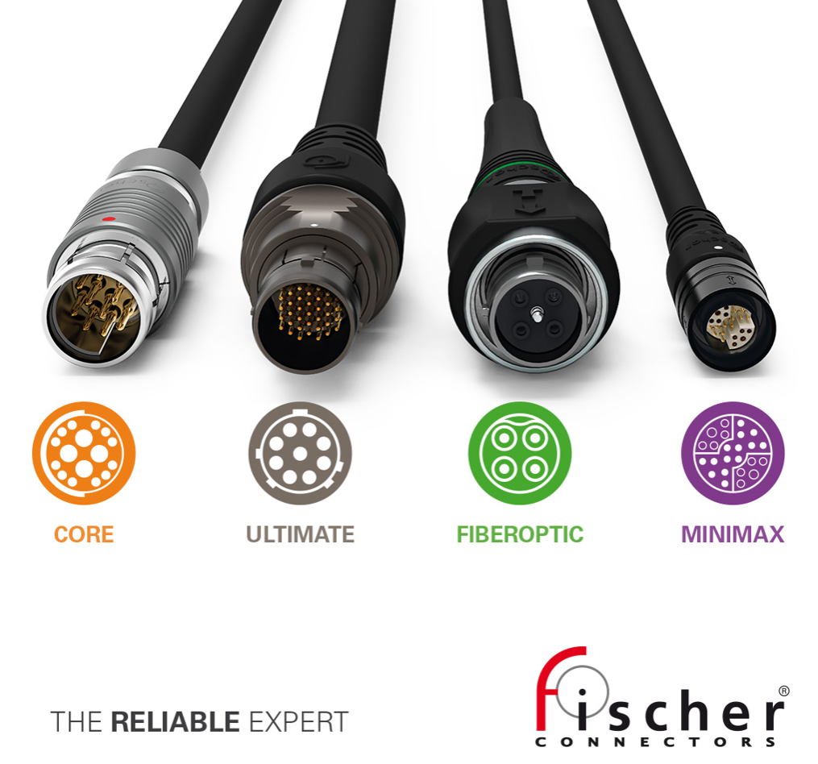
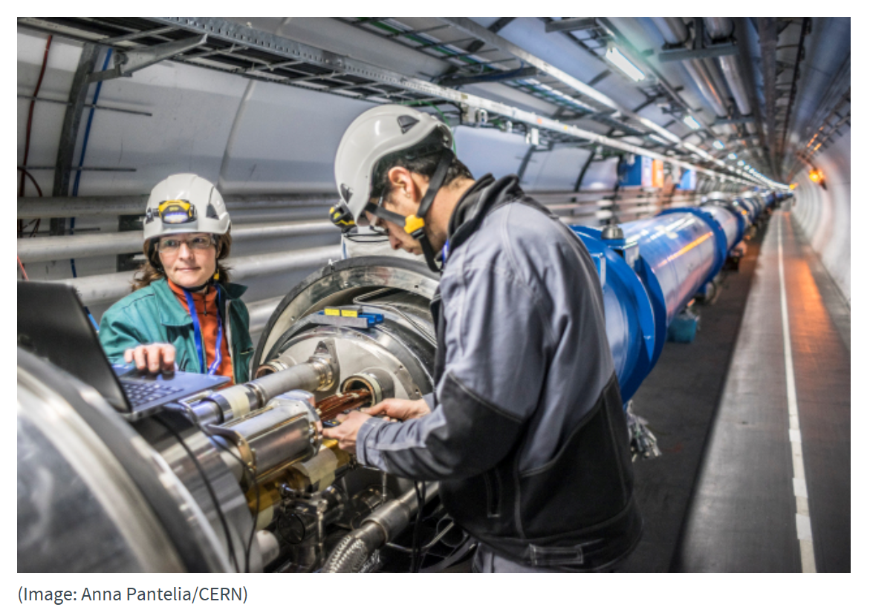


CERN & Transition

Slide 4
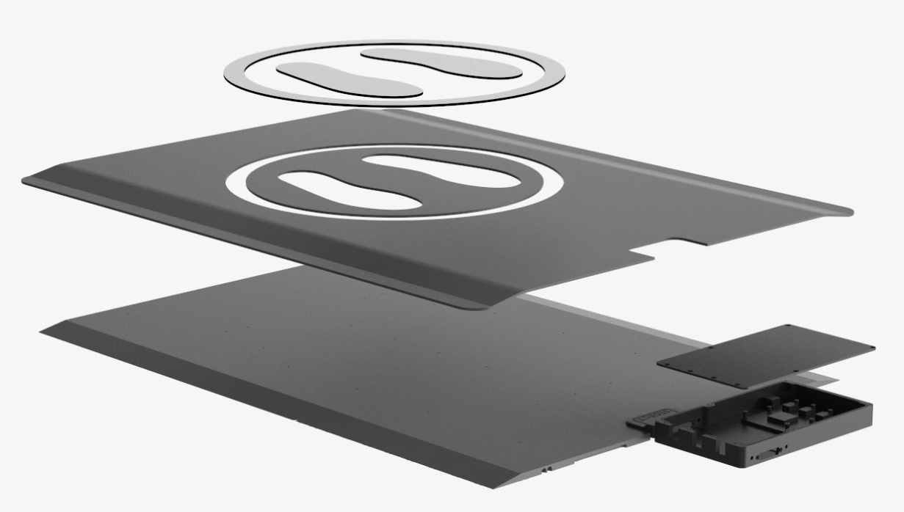
SEDECT : Main responsibilities
Business development :
Developing strategies for driving sales across the business
Participating in the elaboration of new product development strategies
Forming strategic partnerships with other companies to leverage existing networks and create new business opportunities
Speaking at conferences and events about the company’s products
Participating in the creation of technical information datasheets, customer and distributor’s contracts and ensure compliance with new regulations
Working with members of the board on budgeting and planning

Slide 5
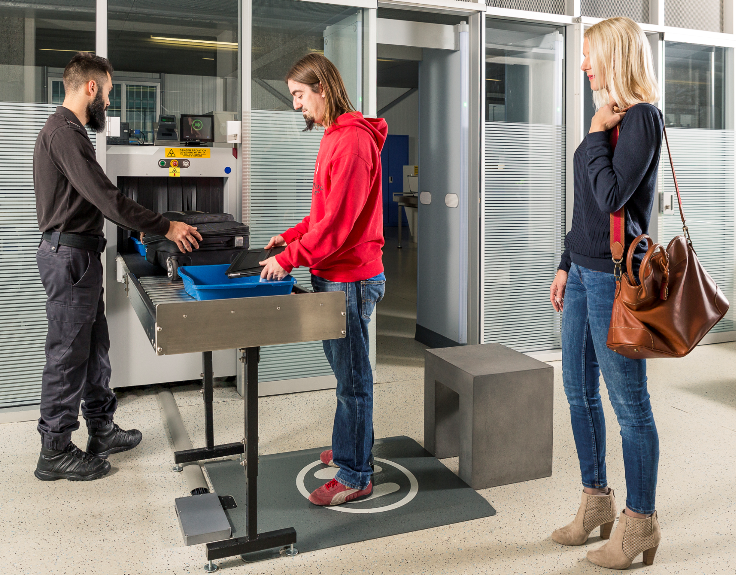
SEDECT : Main responsibilities
Sales :
Identifying sales opportunities and perform competition analysis
Implementing a variety of new business initiatives to drive sales
Acting as a key contact and manage the sales process from lead generation and conversion into customer, providing endless support
Negotiating sales contracts with customers and ensuring their profitability
Marketing :
Working with the external marketing team to develop marketing materials and tools (website, brochures, …)
Organising Trade shows from the ideation to implementation and sales execution

