Slide 1
Review of collimator Vacuum Performance
International review of the HL-LHC collimation system
11th – 12th February 2019
Giuseppe Bregliozzi
TE-VSC

Slide 2

Outline
LHC Room temperature vacuum acceptance requirements
  Overview of collimators acceptance test: From LHC installation phase to present-day
New MoGr based collimators
  Production process optimization
  Series vacuum validation
  New vacuum acceptance criteria & simulations
Molybdenum coating optimization
Summary & Conclusion
G.Bregliozzi - International review of the HL-LHC collimation system – 11-12/02/2019

Slide 3
Vacuum Requirements for Collimators
From EDMS 428155
Materials used in the collimators:
    All materials shall be qualified regarding their outgassing: < 10⁻¹² mbar∙l/s∙cm²
    All trapped volumes shall be avoided as well as contact between large surfaces: Insert outgassing channels
Pumping Speed:
    Effective pumping speed is limited at 20 l∙s by the space available or the conductance of the surrounding vacuum chambers
    In order to be able to achieve the required static pressure of 5∙10⁻⁹ mbar the total flux of the collimator should not exceed ≈ 1∙10⁻⁷ mbar∙l/s
“As an indication, the allowed outgassing flux of the secondary collimator (based on the existing draft design) will be exceeded if assuming an operating temperature below 50°C and 200 cm² of graphite jaws with a local overheating (50°C < T < 100°C)”
“Any deviation from this total outgassing flux or from the operating temperature,….,imply an additional pumping speed to ensure the required gas density profile and the vacuum stability”
G.Bregliozzi - International review of the HL-LHC collimation system – 11-12/02/2019

Slide 4
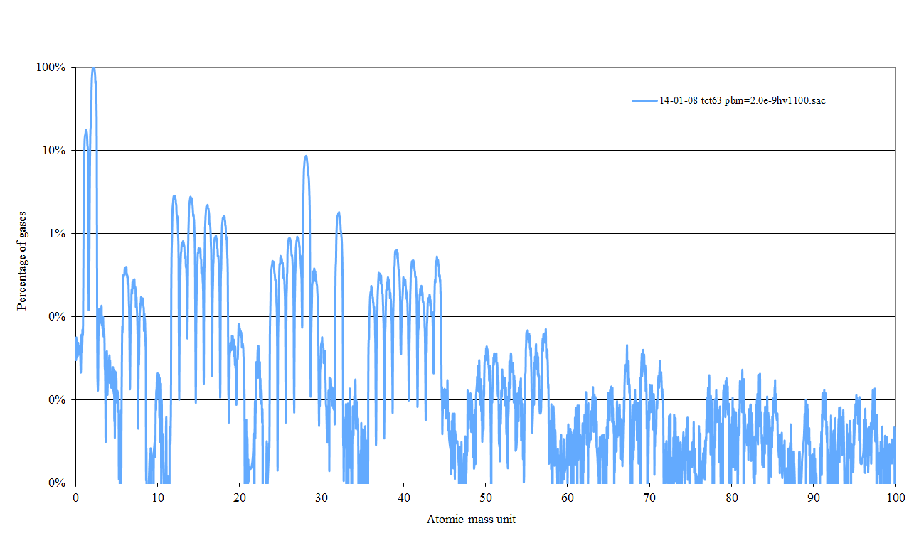
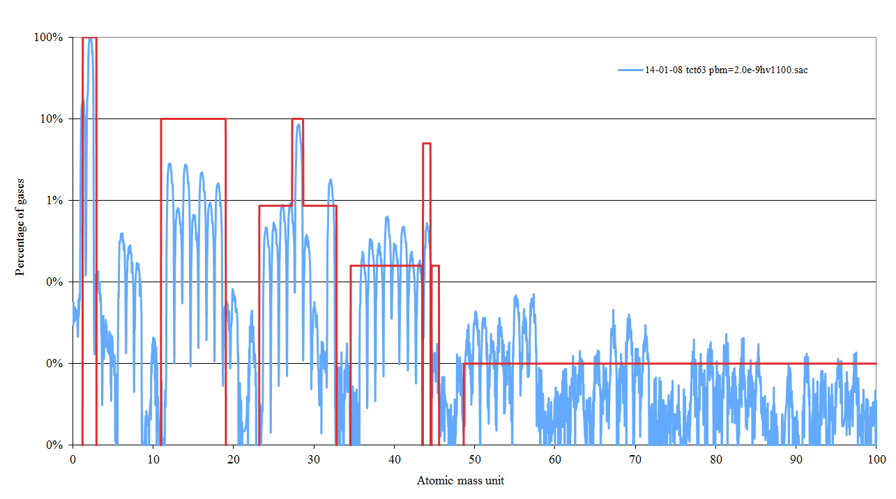
Vacuum Requirements for Collimators
Accepted Gases Species
    Maximum total outgassing ≈ 1∙10⁻⁷ mbar∙l/s
H₂
CH₄
CO
CO₂
Affect the saturation level of NEG coating
Sign of contaminations
G.Bregliozzi - International review of the HL-LHC collimation system – 11-12/02/2019

Slide 5
NEG Alloy: Pumping Mechanism
A NEG material is a metallic alloy that can pump most of the gases present in a vacuum system after thermal dissolution of its native oxide layer (activation process).
T = T_{a}
T = RT
T = RT
Native oxide layer
Heating in vacuum
Oxide dissolution -> activation
Reactive metallic surface
No pumping
Pumping
NEGs do not pump hydrocarbon at room temperature and rare gases.
G.Bregliozzi - International review of the HL-LHC collimation system – 11-12/02/2019

Slide 6
NEG Pumping Mechanism
H₂:
Diffuses into the getter bulk even at room temperature,
Small quantities of H₂ do not affect the pumping of other gases. High quantity could induce embrittlement and consequently peel-off of the coating
CO & CO₂:
Molecules chemically absorbed on the getter surface
No Diffusion in the bulk and affect the pumping speed of all the other gases,
CO capacity ≈ 5·10¹⁴ molecules/cm²
N₂:
No Diffusion in the bulk and the absorption takes place underneath the first monolayer of the surface,
Six adsorption sites to pump a single N₂ molecule -> N₂ capacity ≈ about 7 times lower than for CO
Do not affect the pumping speed of CO
O₂ & H₂O:
The capacity of NEG for O₂ and H₂O is about 10 times larger than for CO
6
G.Bregliozzi - International review of the HL-LHC collimation system – 11-12/02/2019

Slide 7
A small overview of the outgassing measurements for the collimators
From the LHC installation phase to present
G.Bregliozzi - International review of the HL-LHC collimation system – 11-12/02/2019

Slide 8
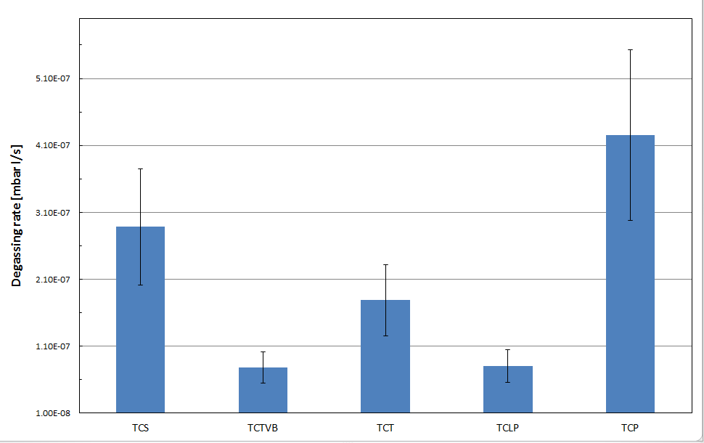

LHC Installation phase: 2007-2009
Averaged outgassing rate of about 160 fully assemblies: Tests performed in Bldg.252
At that time an overestimation of the effective pumping speed was done implying an overestimation of the degassing rate
Further improvement of the bake-out cycles and installation
Tolerated limit of 2⋅10⁻⁷ [mbar∙l/s]
Acceptance limit of 1⋅10⁻⁷ [mbar∙l/s]
* Degassing rate: Average value
G.Bregliozzi - International review of the HL-LHC collimation system – 11-12/02/2019

Slide 9

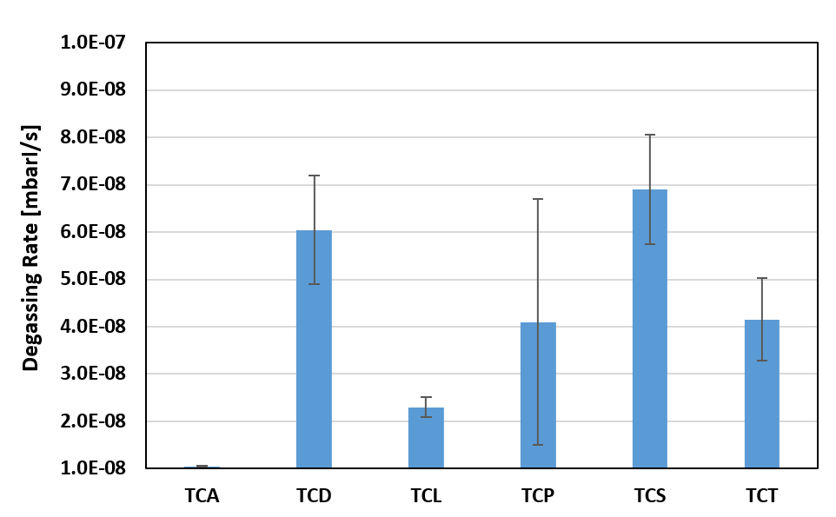
From LS1 to present-day: Overview
Averaged outgassing rate of about 70 fully assemblies: Performed in Bldg.113 & 867
Acceptance limit of 1⋅10⁻⁷ [mbar∙l/s]
* Degassing rate: Average value
G.Bregliozzi - International review of the HL-LHC collimation system – 11-12/02/2019

Slide 10
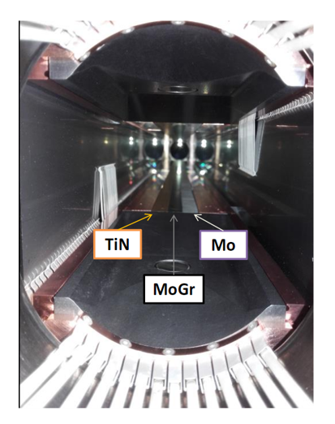
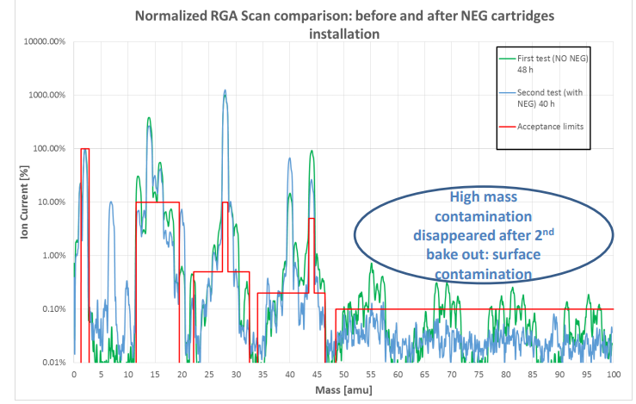
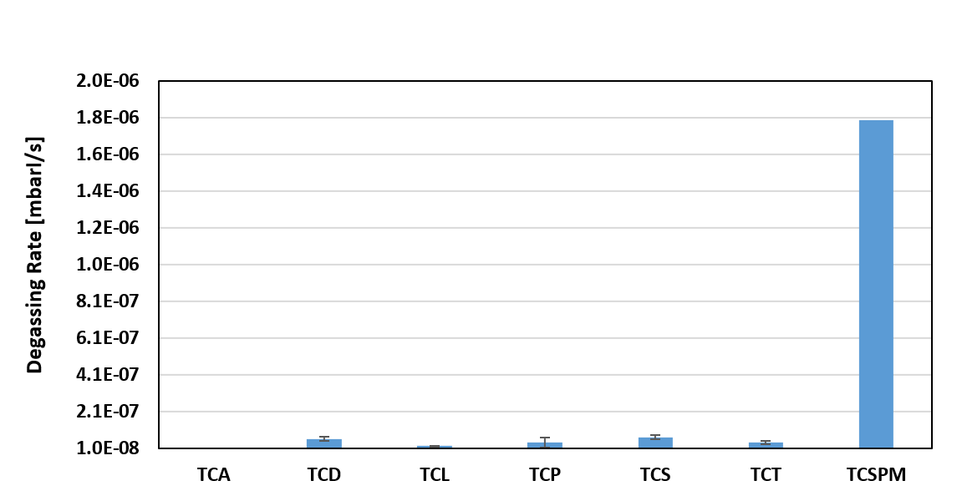

LS1 to present: Case of TCSPM prototype
Averaged outgassing rate of about 70 fully assembly: Performed in Bldg.113 & 867
NEG Cartridges Integration
Acceptance limit of 1⋅10⁻⁷ [mbar∙l/s]
* Degassing rate: Average value
G.Bregliozzi - International review of the HL-LHC collimation system – 11-12/02/2019

Slide 11
Vacuum measurements for the TCSPM & TCPPM with molybdenum carbide-graphite (MoGr) jaws
G.Bregliozzi - International review of the HL-LHC collimation system – 11-12/02/2019

Slide 12
Summary of UHV test on MoGr
2016-2018: Single block optimization -> C.Accettura Master degree
  Validation of production process -> Vacuum tests, TDS, FIB, SEM, …
First half of 2018: Not compliant first pre-series
Up to June 2018: Series of test on samples to reassess production cycle
Second half of 2018: Start production and test of each full batch
  Partial revision of acceptance criteria
  Pre-series 2
  Batch 3
  Batch 4
  Batch 4.5 (1 jaw for coating pre-series, test ongoing)
  Batch 5 -> Ongoing
  Batch 6
  …
Second half of 2018: Coating process optimization
G.Bregliozzi - International review of the HL-LHC collimation system – 11-12/02/2019

Slide 13
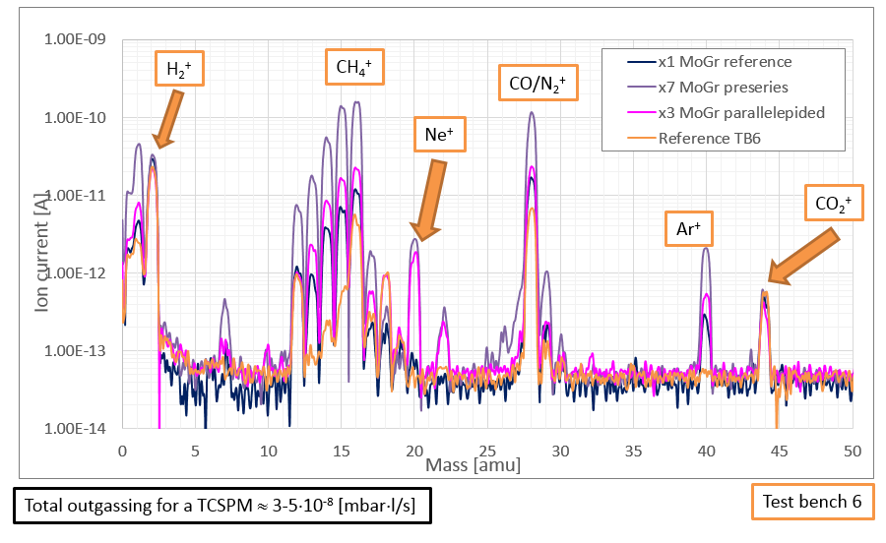
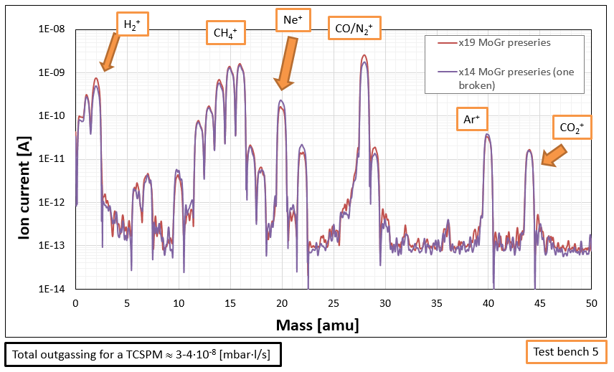
Optimization of the production cycle: Reproducibility
Production cycle was validated and material outgassing was reproducible and no apparent variations among different batches and pieces were detected
Series of tests were performed to asses a new production cycle: More than 44 blocks.
Total H₂ outgassing rate lower than the detection limit of the test bench < 2⋅10⁻¹⁰ [mbar⋅l/s];
Total CO₂ outgassing rate lower than the detection limit of the test bench < 2⋅10⁻¹² [mbar⋅l/s];
High outgassing rate of CH₄ is detected on all the different blocks;
Traces of Ar indication of ‘closed’ porosity of the material;
Clear traces of Ne coming from the venting after vacuum firing;
The scans are clean and no traces of heavy masses higher than 50 amu are detected;
The absolute total outgassing of the blocks is very close to the acceptance limit, however, the dominant gases are CH₄ and N₂, not H₂ as usually expected for baked metallic materials.

Slide 14
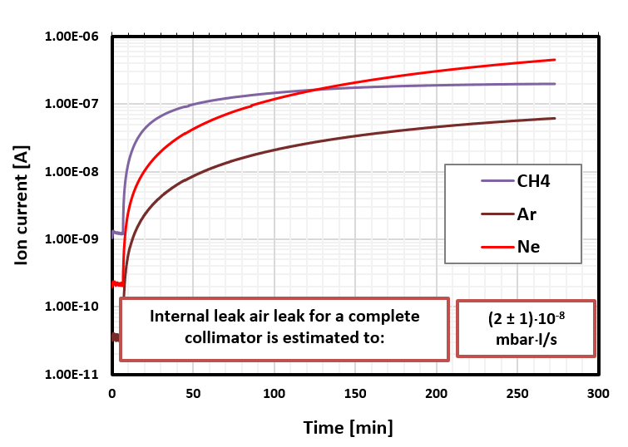
Estimation of internal air leak rate
Accumulation tests were performed and internal leak rate could be estimated by ΔP increase over time and/or by an Ar calibrated leak
Ion pump in the system is switched off
Active NEG is still pumping the system -> H₂, CO/N₂, CO₂
All species not pumped by the NEG should increase
On a metallic not porous materials the pressure increase is due to CH₄ thermal outgassing
CH₄ increase -> As expected
Ne increase -> Neon is used as venting gas after vacuum firing thermal treatments and it fills the porosity present in the materials
Ar -> Constitute 1% of air. Its increase is due to trapped air on pores of the bare material
LHC Acceptance limit: 5⋅10⁻⁹ mbar⋅l/s
Internal air leak needs to be mitigated by the installation of localized remote controlled NEG cartridges
G.Bregliozzi - International review of the HL-LHC collimation system – 11-12/02/2019

Slide 15
Summary of UHV test on MoGr
2016-2018: Single block test to optimize -> C.Accettura Master degree
  Production process -> Vacuum tests, TDS, FIB, SEM, …
First half of 2018: Not compliant pre-series
Up to June 2018: Series of test on samples to reassess production cycle
Second half of 2018: Test on each full batch
  Partial revision of acceptance criteria
  Pre-series 2
  Batch 3
  Batch 4
  Batch 4.5 (1 jaw for coating pre-series, test ongoing)
  Batch 5 -> Ongoing
  Batch 6
  …
Second half of 2018: Coating process optimization
G.Bregliozzi - International review of the HL-LHC collimation system – 11-12/02/2019

Slide 16
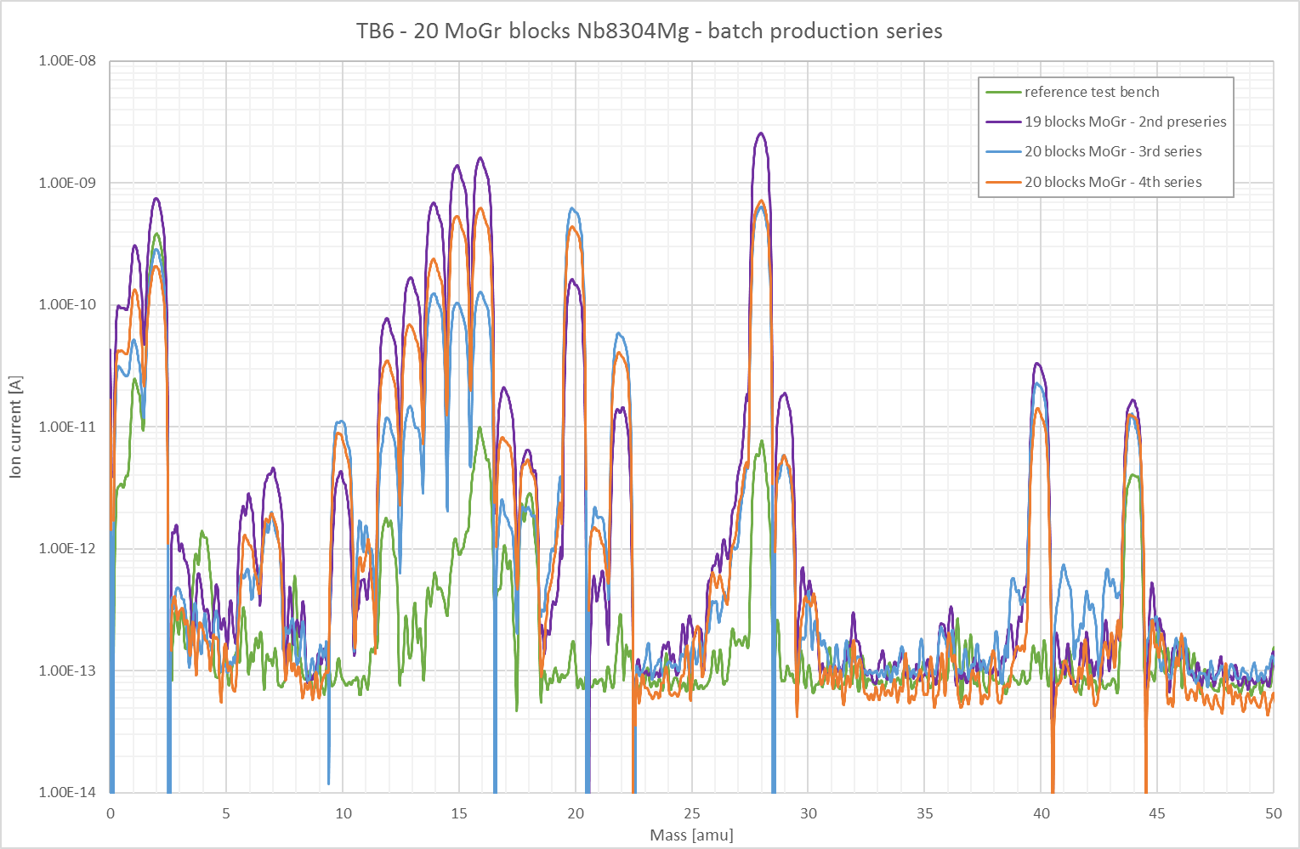
Production batches: Repeatability
Date | Batch # | Thermal treatment | Q [mbar*l/s] Qlimit= 5·10⁻⁸ | Int. leak [mbar*l/s] Qlimit= 5·10⁻⁹
August 2018 | 2 | 72h, 950°C vacuum firing +Ne venting | ≈4.0·10⁻⁸ | ≈2.0·10⁻⁸
October 2018 | 3 | 72h, 950°C vacuum firing +Ne venting | 6.5·10⁻⁹ | ≈4.0·10⁻⁹
December 2018 | 4 | 72h, 950°C vacuum firing +Ne venting | ≈2.0·10⁻⁸ | ⁻
Kept under night in Ne atmosphere after vacuum firing
Total of 59 blocks
Total outgassing rate below acceptance limits;
Hydrogen outgassing lower with respect to the detection limits;
CH₄ and internal leak outgassing rates dominants;
Clear presence of Ne coming from the venting after vacuum firing.
G.Bregliozzi - International review of the HL-LHC collimation system – 11-12/02/2019

Slide 17
Partial revision of the acceptance criteria
Difficult to apply ‘standard’ acceptance criteria due to the undetectable H₂ level: Not possible to normalised to H₂ content.
The material is considered non conform due to the high level of internal air leak
Simulations are used to analyse the impact of:
  Total CH₄ outgassing rate -> Inelastic nuclear ionization cross section
  Internal leak rate -> Possible remedies by the installation of NEG cartridges
G.Bregliozzi - International review of the HL-LHC collimation system – 11-12/02/2019

Slide 18
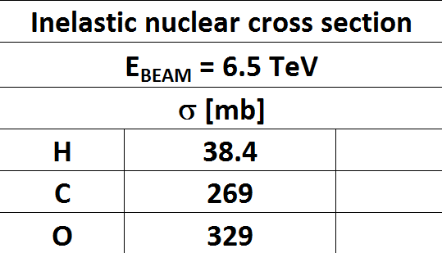
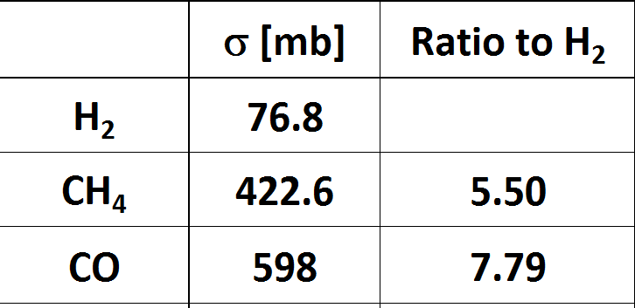
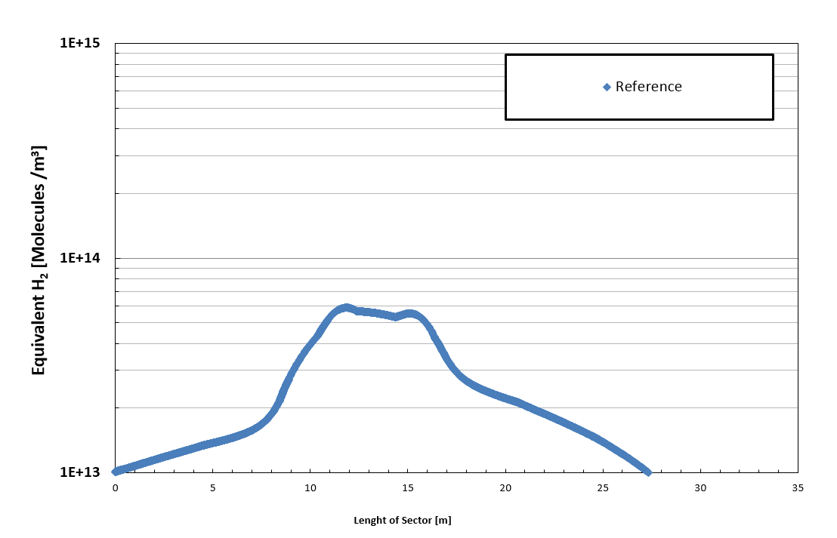
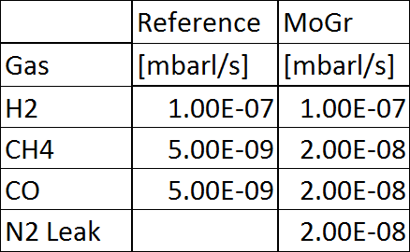
Vacuum simulation: Pressure distribution
Inelastic nuclear cross-section for a specific atom at rest with an LHC beam proton.
2 x TCSG
Example of vacuum sector A5L7
G.Bregliozzi - International review of the HL-LHC collimation system – 11-12/02/2019

Slide 19
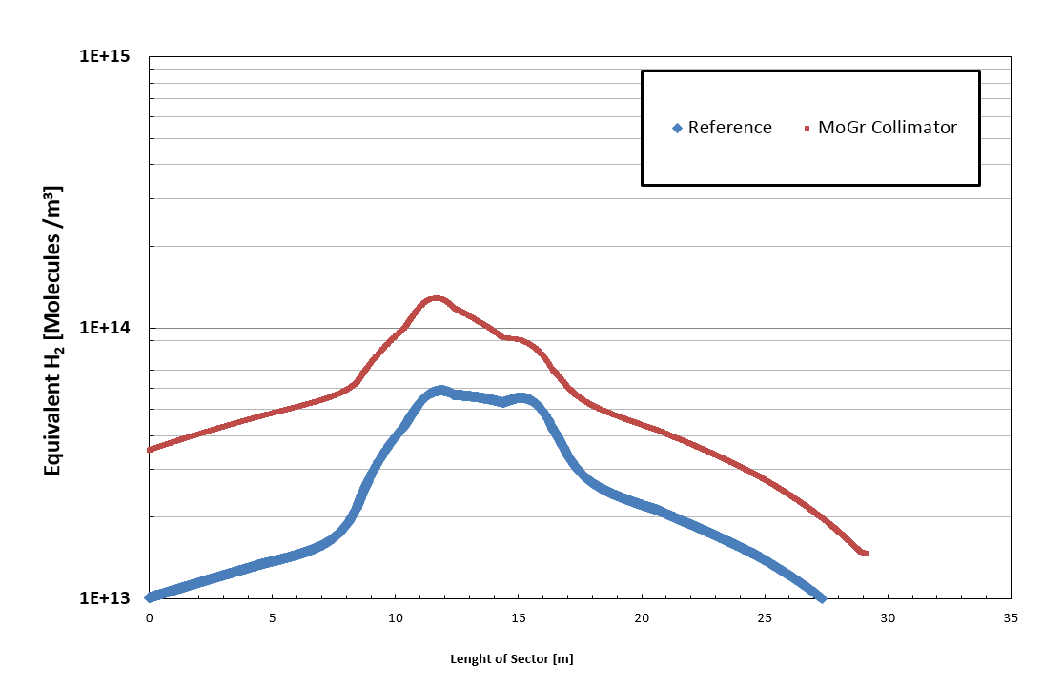
Total impact of CH₄ outgassing
Inelastic nuclear cross-section for a specific atom at rest with an LHC beam proton.
9.8⋅10⁺¹⁴
Limit for H₂ gas density for a 100h beam lifetime
1 TCSPM
1 x TCSG
CH₄ outgassing is within the limit
2 x TCSG
Example of vacuum sector A5L7
G.Bregliozzi - International review of the HL-LHC collimation system – 11-12/02/2019

Slide 20
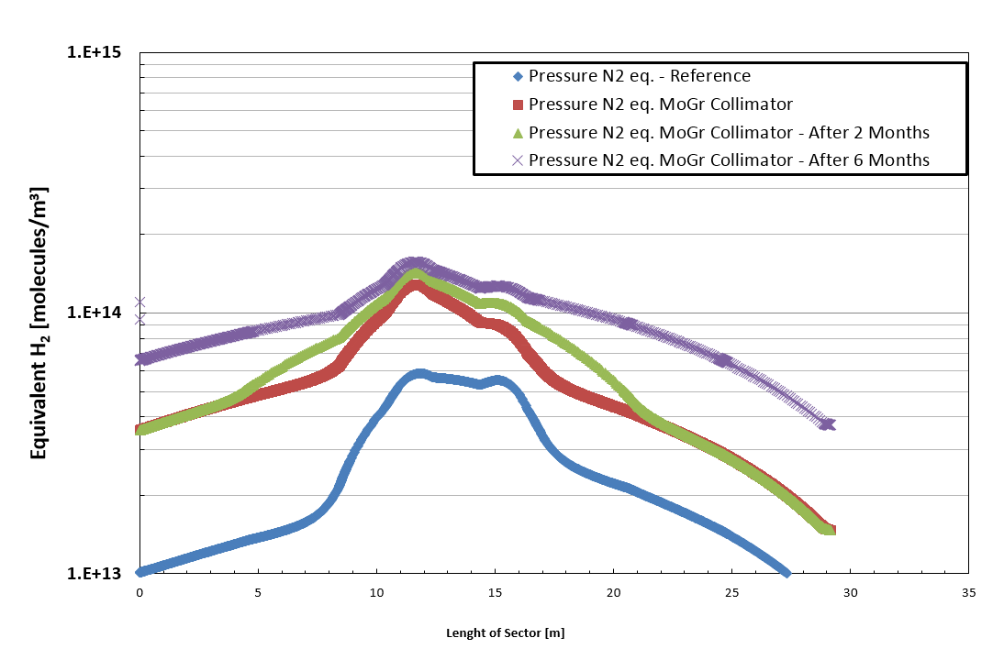
Total impact of internal air leak: NEG saturation
Air leak 2⋅10⁻⁸ [mbar⋅l/s]
NEG saturation evolution uncontrolled
G.Bregliozzi - International review of the HL-LHC collimation system – 11-12/02/2019

Slide 21
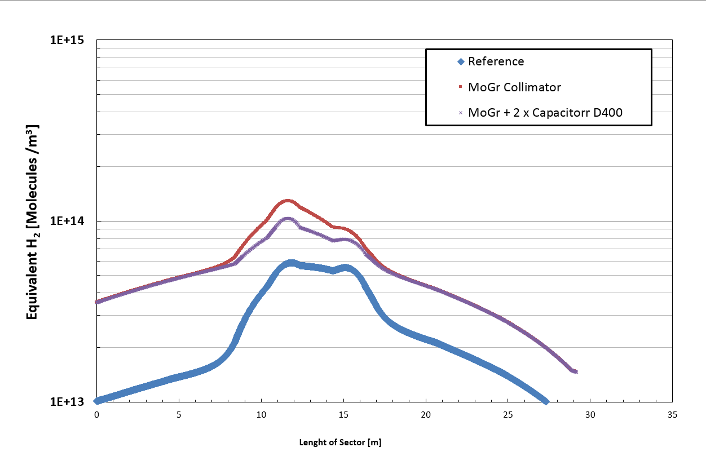
Mitigation of internal leak: NEG cartridge installation
1 TCSPM
1 x TCSG
NEG saturation under control
Example of vacuum sector A5L7
G.Bregliozzi - International review of the HL-LHC collimation system – 11-12/02/2019

Slide 22
Final Summary: Uncoated MoGr
CH₄ impact on the total outgassing rate:
  The impact of CH₄ molecules considering the inelastic nuclear cross-section is about factor 5 and within the acceptance limits.
High internal air leak rate:
  The measured internal leak rate would saturate 3m on NEG-coated beam pipe in less than a months inducing a further pressure increase: dominated by N₂;
  The use of NEG cartridges allows to keep N₂ level under control and within the acceptance limits;
Can we accept higher outgassing rate?
What’s the impact on the machine performance?
G.Bregliozzi - International review of the HL-LHC collimation system – 11-12/02/2019

Slide 23
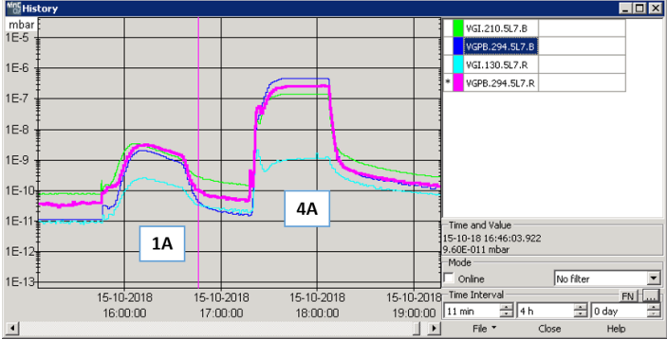
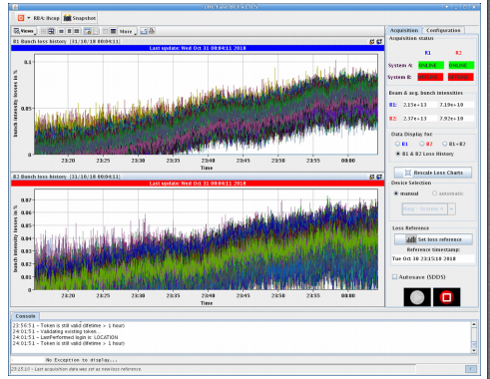
LSS7 MD4828: Vacuum bump
Motivation: Testing the effect of pressure bumps in LSS7 on beam losses and beam lifetime. This test could allow reviewing the vacuum specifications for new equipment in the LSS7 (Just in the LSS7) and could be of input for the future collimator production.
Principle: Heating up all NEG getters cartridges in both lines of vacuum sector A5L7 (about 20 m in length). 100% of H₂ is released up to a maximum pressure of about 1⋅10⁻⁶ mbar.
Increase of bunch intensity losses ≈ 0.05%
300 BCMs Bunches
G.Bregliozzi - International review of the HL-LHC collimation system – 11-12/02/2019

Slide 24
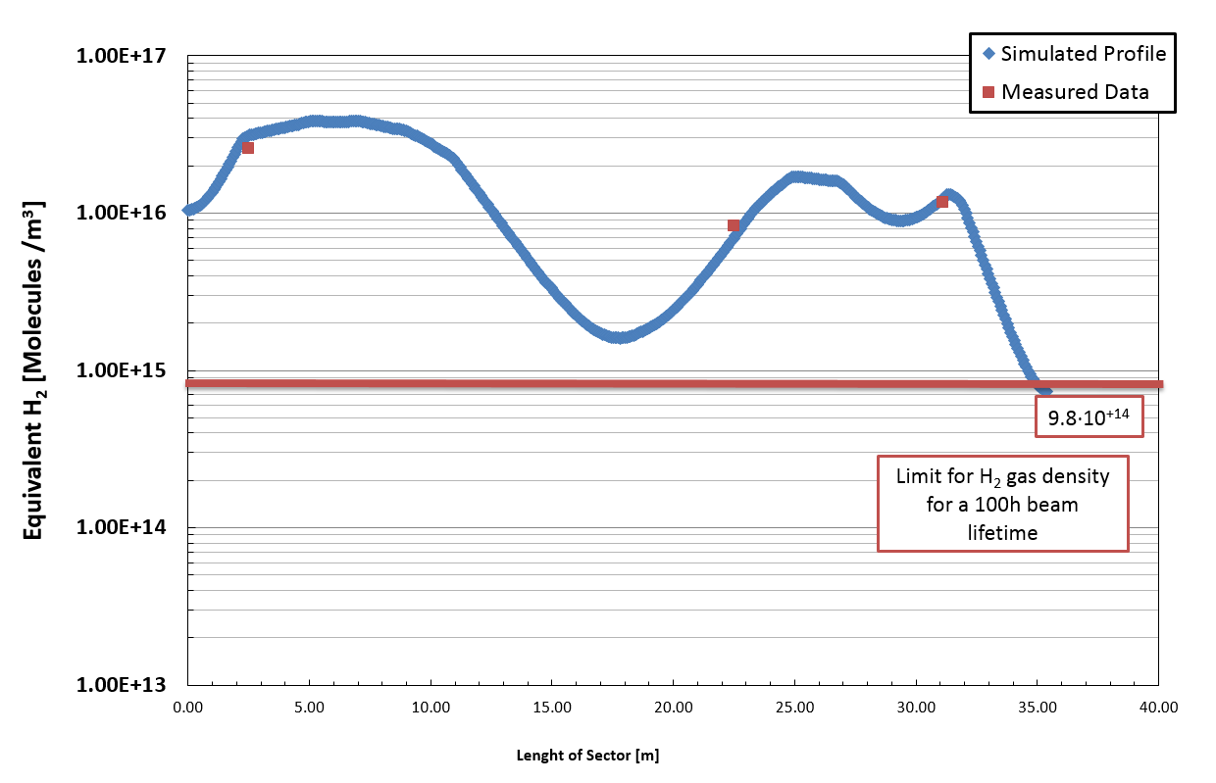
Pressure profile simulation: H₂ gas density
Localized H₂ outgassing rate of ≈ 6 x 5⋅10⁻⁵ mbarl/s
3 order of magnitudes than the acceptance criteria
It is clear that in LSS7 we could have the margin to increase the vacuum acceptance criteria
However, the total H₂ outgassing rate and equivalent CH₄ and N₂ should be carefully analyzed.
No important impact on beam lifetime and beam losses
At the limits of embrittlement for the NEG coating!
G.Bregliozzi - International review of the HL-LHC collimation system – 11-12/02/2019

Slide 25
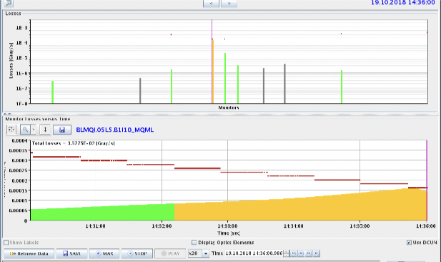
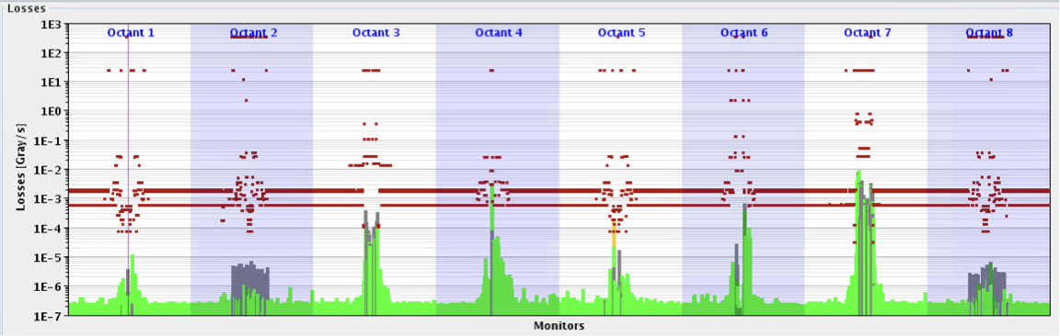
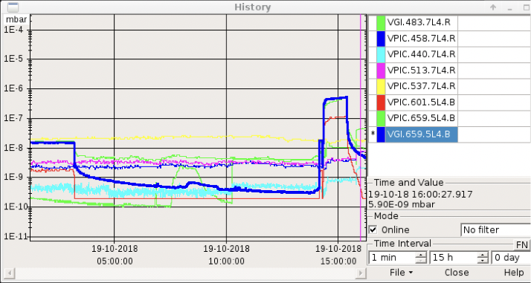
Reminder: IP4 gas injection
Friday @2:35pm
Gas injection in IP4 for fluorescence studies
Pressure was increased to ~4E⁻⁷ mbar of Neon (~4 times higher than what in the BGVs)
Losses on TCTPH.4L5.B1 slowly rising up over minutes, which eventually led to dump at ~5 TeV

Slide 26
Summary of UHV test on MoGr
2016-2018: Single block test to optimize -> C.Accettura Master degree
  Production process -> Vacuum tests, TDS, FIB, SEM, …
First half of 2018: Not compliant pre-series
Up to June 2018: Series of test on samples to reassess production cycle
  Revision of acceptance criteria
Second half of 2018: Test on each full batch
  Pre-series 2
  Batch 3
  Batch 4
  Batch 4.5 (1 jaw for coating pre-series, test ongoing)
  Batch 5 -> Ongoing
  Batch 6
  …
Second half of 2018: Coating process optimization
G.Bregliozzi - International review of the HL-LHC collimation system – 11-12/02/2019

Slide 27
Coating producer evaluation
 | Surface + Thermal treatment | Q [mbar*l/s] | Int. leak [mbar*l/s]
Uncoated samples | US+72h, 950°C vacuum firing +Ne venting | ≈2.0·10⁻⁸ | ≈2.0·10⁻⁸
CERN Coating | US+72h, 950°C vacuum firing +Ne venting | ≈1.0·10⁻⁷ | ≈4.0·10⁻⁸
DTI Coating | US+72h, 950°C vacuum firing +Ne venting | ≈5.0·10⁻⁸ | ≈2.0·10⁻⁸
Polytechnic Coating | US+72h, 950°C vacuum firing +Ne venting | ≈1.0·10⁻⁷ | ≈3.0·10⁻⁸
DTI sample individuated as the best one
Compliant for electrical resistivity and adhesion
Company | Technique | Sputtering | Venting gas
DTI | PVD-HiPIMS | Krypton | No info
Polyteknik | PVD | Argon | No info
CERN | PVD | Krypton | Argon
G.Bregliozzi - International review of the HL-LHC collimation system – 11-12/02/2019

Slide 28
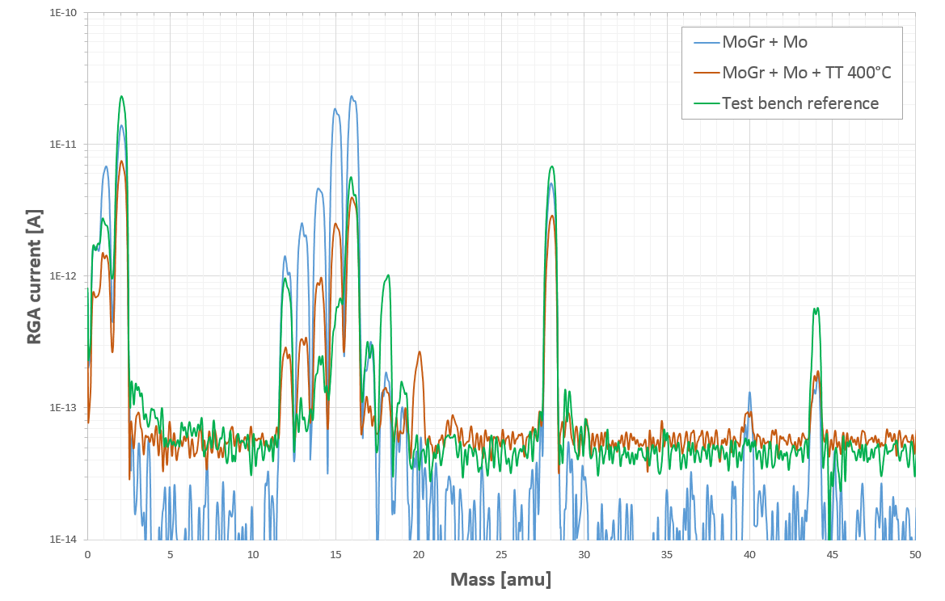
DTI sample
 | Q [mbar*l/s] | Int. leak [mbar*l/s]
Uncoated | ≈2.0·10⁻⁸ | ≈2.0·10⁻⁸
DTI Coating | ≈5.0·10⁻⁸ | ≈2.0·10⁻⁸
DTI Coating after 400C thermal treatment | ≈2.0·10⁻⁸ | ≈2.0·10⁻⁸
CH₄
As before coating
Total outgassing within acceptance limits after the coating
Thermal treatment at 400°C for 6h and Neon venting overnight
After thermal treatment back to pre-coating values
G.Bregliozzi - International review of the HL-LHC collimation system – 11-12/02/2019

Slide 29
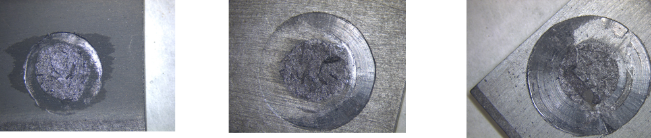
Coating validation: Pat-Handy Pull-test
Adhesion test: Rupture at 5.2 MPa in the bulk
No delamination between coating and substrate
CERN
DTI
Poly
G.Bregliozzi - International review of the HL-LHC collimation system – 11-12/02/2019

Slide 30
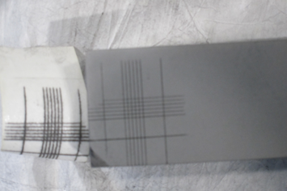
Coating validation: bake-out in degraded vacuum
Following the 8th HL-LHC collaboration meeting (S.Gilardoni presentation), further investigation in coating adhesion after thermal treatment in a vacuum degraded environment were assessed:
  1st Bake-out: 24h @ 250 ºC with air-leak @ P = 2*10⁻³ mbar→ No peel-off observed with cross-hatch scotch test.
  2nd Bake-out: 24h @ 250 ºC with air-leak @ P = 1*10⁻² mbar→ No peel-off observed with cross-hatch scotch test.
The coated block has already undergone 6h @ 400°C thermal treatment.
G.Bregliozzi - International review of the HL-LHC collimation system – 11-12/02/2019

Slide 31
Summary & Conclusion (1/2)
Vacuum acceptance tests:
  Since the LHC installation phase, about 230 fully assembled collimators were tested and just a few of them resulted non conform from the vacuum point of view;
  Quality check allows detecting non-conformities during all these years;
For the LS2 collimators upgrade, a close collaboration between WP12 and WP5 allow having overcome problems and better understand this new material for low impedance collimators.
Vacuum simulations & Pressure bump MD
Simulations have shown that a high CH₄ outgassing rate is within the acceptance criteria and does not have an impact on beam lifetime;
Pressure bump machine development has shown that we could potentially increase the existing vacuum acceptance criteria in LSS7, but a careful and detailed analysis should be performed to address embrittlement, beam losses, impact on radiation and possible NEG saturation mitigations.
G.Bregliozzi - International review of the HL-LHC collimation system – 11-12/02/2019

Slide 32
Summary & Conclusion (2/2)
Molybdenum carbide-graphite bulk material:
The total outgassing rate is close to the acceptance limit 5x10⁻⁸ [mbar⋅l/s] when scaled to the whole collimator;
Despite the fact that the total outgassing rate is dominated by methane, the effect on the beam lifetime will be negligible;
The virtual leak rate in some cases is higher than the acceptance threshold by at least a factor of 2: This negative effect could be mitigated by the installation of remote-controlled NEG cartridges.
The Mo coating provided by DTI company complies with our standard of adherence and total outgassing rate
At present and from a vacuum requirement point of view, TE-VSC does not see any obstacle to the continuation of the production of such collimators
G.Bregliozzi - International review of the HL-LHC collimation system – 11-12/02/2019

Slide 33
Thanks you for your attention
Special thanks to the VSC-BVO teams for all the acceptance tests, the VSC-SSC teams for all the CERN coatings, adherence tests and TDS measurements, C.Accettura and F.Carra for some slides, the fruitful discussion and support for the acceptance tests and a better understanding of the materials.
G.Bregliozzi - International review of the HL-LHC collimation system – 11-12/02/2019

Slide 34
Coating validation: Focus ion beam imaging
Bulk-coating interface: No apparent local defect and significant interface at the interface
CERN
DTI
Poly
Pictures from E. Garcia (MME/MM)
G.Bregliozzi - International review of the HL-LHC collimation system – 11-12/02/2019

