Slide 1
Combining Reliability Statistics with Physics of Failure to Study and Simulate the Operational Availability of Redundant Power Converters
Lukas Felsberger
With helpful discussions and inputs from Benjamin Todd, Yves Thurel and Christophe Martin

Slide 2
Contents
Problem statement
Method
Example
  CIBD simulation
Summary and Conclusions

Slide 3
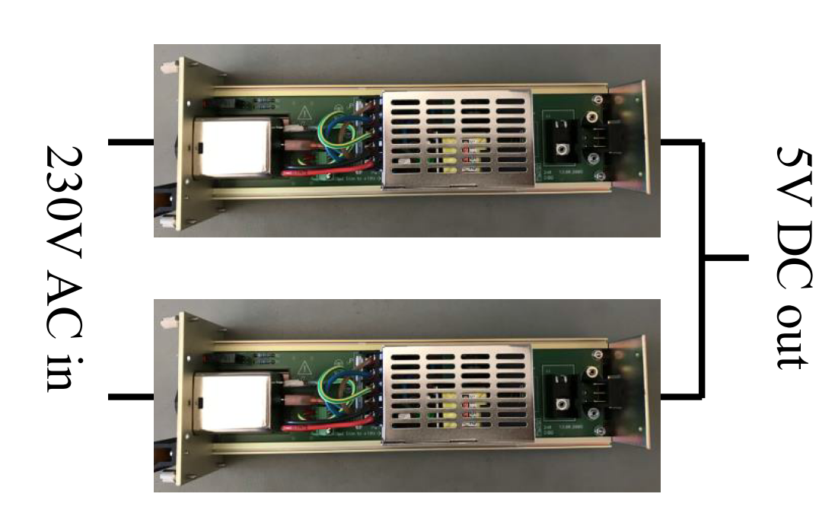
Last time…
Three rules to achieve fault tolerance
Redundancy and fault isolation
  Avoid single point, common or cascading failures
  By separation, variation, protection ….
Fault localization and diagnosis
Fault notification and on-line repair

Slide 4
Problem statement
Given a redundant system and its inherent failure modes:
What’s the chance of simultaneous failure within a certain repair duration?
What’s the cost of ownership?
What’s the cost to the organization due to system downtime (due to simultaneous failures)?
For different possible operational modes –
Load sharing (50:50) vs hot-spare (100:0) vs something in-between (x:y):

Slide 5
In the literature…
Simple analytic models based on constant failure rates
Methods for non-constant failure modes with simple load sharing assumptions and no consideration of multiple failure modes or failure mechanisms

Slide 6
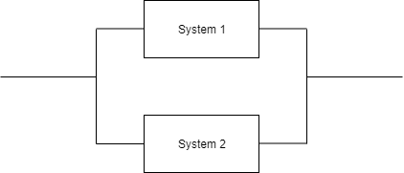
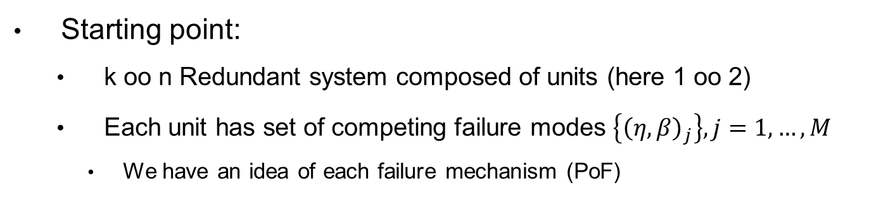
Method
Starting point:
  k oo n Redundant system composed of units (here 1 oo 2)
  Each unit has set of competing failure modes $\left\{{\left(η,β\right)}_{j}\right\},j=1,…,M$
    We have an idea of each failure mechanism (PoF)
Unit 1
Unit 2

Slide 7

Method – Modeling degradation
McPherson, Joe W. Reliability physics and engineering. New York: Springer, 2010.
Material strength -/
Stress - -
$TTF∝Weibull\left(η,β\right)$
Failures
Operational time/cycles

Slide 8

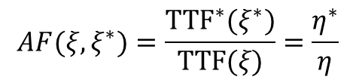


Method – Modeling degradation
McPherson, Joe W. Reliability physics and engineering. New York: Springer, 2010.
Material strength -/
Stress $ξ$ - -
${TTF}^{∗}∝Weibull\left(η^{∗},β \right)$
$TTF∝Weibull\left(η,β\right)$
$$AF(ξ,ξ^{∗})=\frac{{TTF}^{∗}(ξ^{∗})}{TTF(ξ)}=\frac{η^{∗}}{η}$$
Load
Operational time/cycles
Notes:
TTF models usually follow power law or exponential model → same for acceleration factor
If acceleration is carried out properly → beta does not change

Slide 9





Method – Acceleration factors
The acceleration of a failure depends on its mechanism
Temperature driven?
Humidity driven?
Voltage driven?
Combined drivers?
Failure drivers: $(x,y/2,z(x,\frac{y}{2}))$
Failure drivers: $(x,y,z)$
Failure drivers: $(U,I,T)$
Failure drivers: $(U,\frac{I}{2},T\left(\frac{I}{2}\right))$

Slide 10
Method – Load Sharing Modeling
The deceleration of a failure due to redundancy depends on its mechanism
Temperature driven?
Humidity driven?
Voltage driven?
Combined drivers?
System Load:
$$\tilde{L}$$
System Load:
𝐿 ̃
Load on unit $U_{i}$ under Load Sharing Policy $LSP$:
$$L_{i}=LSP_{i}(\tilde{L})$$
Load on unit U_i under Load Sharing Policy 𝐿𝑆𝑃:
𝐿_𝑖=𝐿𝑆𝑃_𝑖 (𝐿 ̃)
Stress for failure mode $j$ on unit $i$:
$$ξ_{i,j}\left(LSP_{i}(\tilde{L})\right)$$
Stress for failure mode 𝑗 on unit 𝑖:
𝝃_(𝒊,𝒋) (𝐿𝑆𝑃_𝑖 (𝐿 ̃))
Acceleration factor for failure mode $j$ on unit $U_{i}$:
$$AF_{i,j}(ξ_{i,j},ξ_{ref})$$
Acceleration factor for failure mode 𝑗 on unit U_i:
𝐴𝐹_(𝑖,𝑗) (𝝃_(𝒊,𝒋),𝝃_𝒓𝒆𝒇)

Slide 11
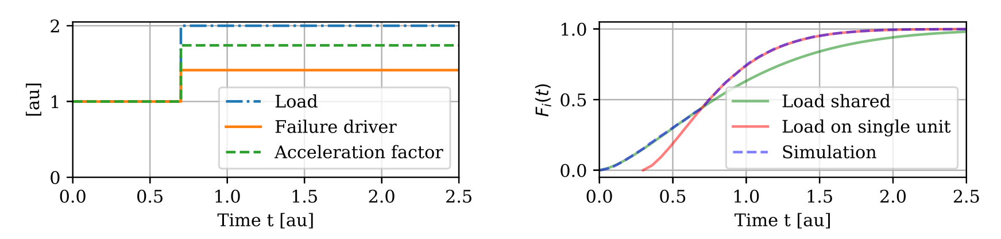
Method – Cumulative Damage Model
Notes:
TTF models usually follow power law or exponential model → same for acceleration factor
If acceleration is carried out properly → beta does not change

Slide 12

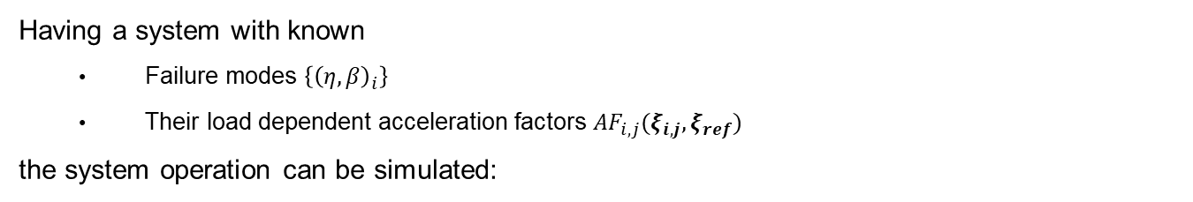
Method – Simulation
Having a system with known
  Failure modes $\left\{{\left(η,β\right)}_{i}\right\}$
  Their load dependent acceleration factors $AF_{i,j}(ξ_{i,j},ξ_{ref})$
the system operation can be simulated:
$$Strength$$
System 1
$$time$$
$$Strength$$
System 2
$$time$$

Slide 13
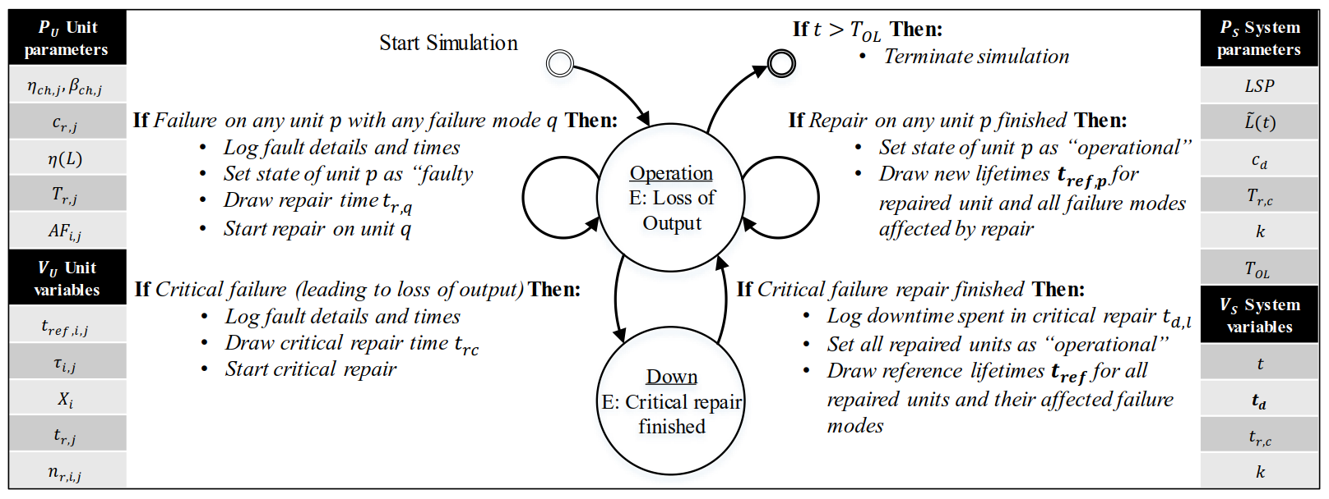
Method - Simulation

Slide 14
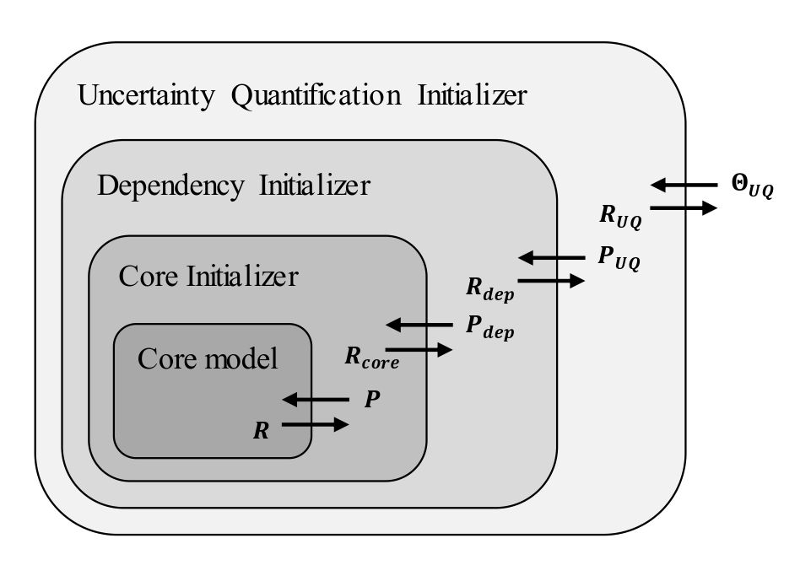
Method - Simulation

Slide 15
Contents
Problem statement
Method
Example
  CIBD simulation
Summary and Conclusions

Slide 16
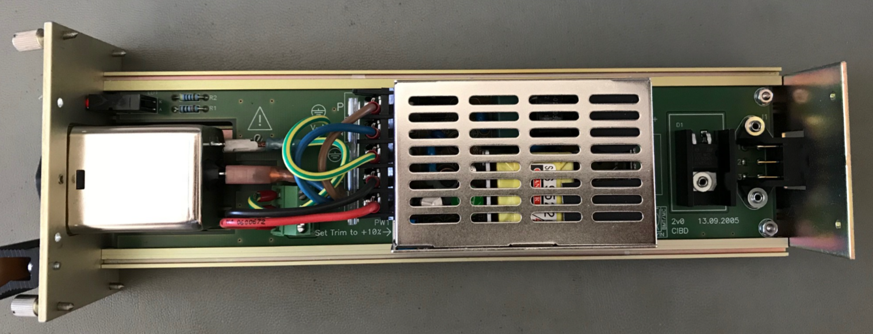
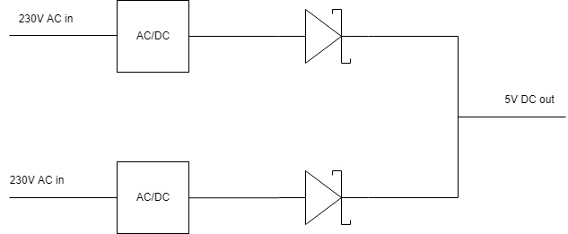
Example - CIBD
Three failure modes
Fuse
Other (not closer studied)
Capacitor wear-out
Operated at three load levels
→ Consider as accelerated testing

Slide 17
Example - CIBD
For each failure mode
Determine failure mechanism
Determine acceleration factor

Slide 18
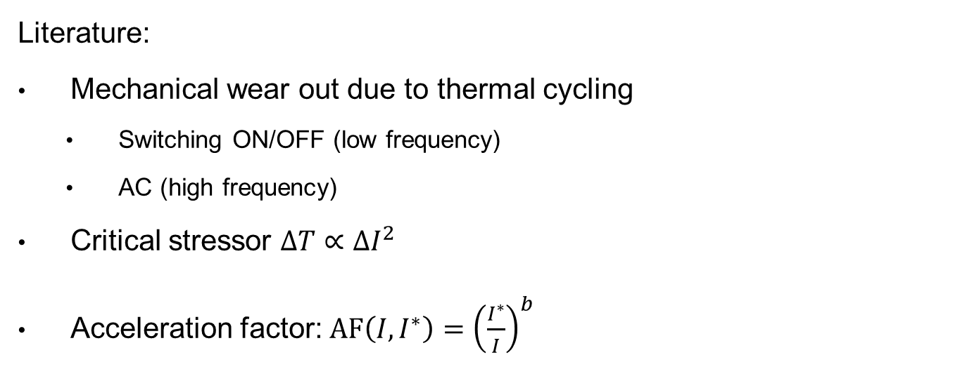
Example – CIBD – Fuse failure mode
Literature:
Mechanical wear out due to thermal cycling
  Switching ON/OFF (low frequency)
  AC (high frequency)
Critical stressor $ΔT∝ΔI^{2}$
Acceleration factor: $AF\left(I,I^{∗}\right)={\left(\frac{I^{∗}}{I}\right)}^{b}$
Meng, X. Z., and J. G. J. Sloot. "Reliability concept for electric fuses." IEE Proceedings-Science, Measurement and Technology 144.2 (1997): 87-92.

Slide 19
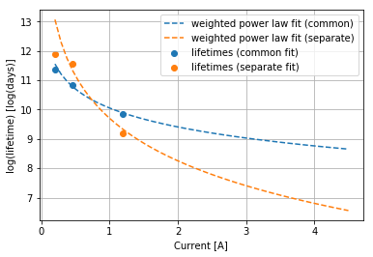
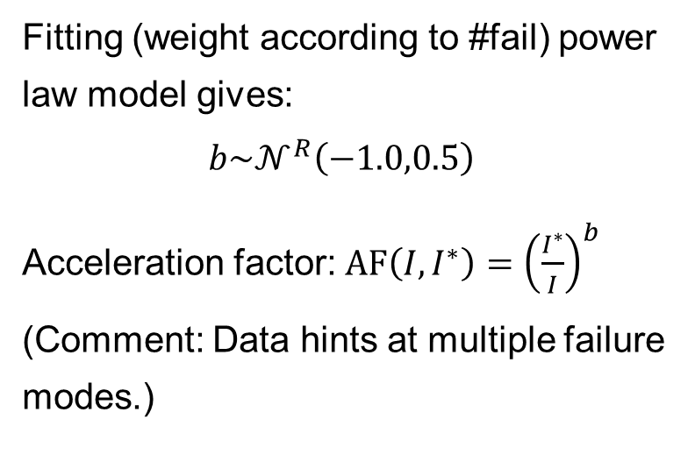
Example – CIBD – Fuse failure mode
Fitting (weight according to #fail) power law model gives:
$$b\sim 𝒩^{R}\left(−1.0,0.5\right)$$
Acceleration factor: $AF\left(I,I^{∗}\right)={\left(\frac{I^{∗}}{I}\right)}^{b}$
(Comment: Data hints at multiple failure modes.)
 | I [A] | #fail
Dev 1 | 0.2 | 2/95
Dev 2 | 0.45 | 22/605
Dev 3 | 1.2 | 15/145

Slide 20
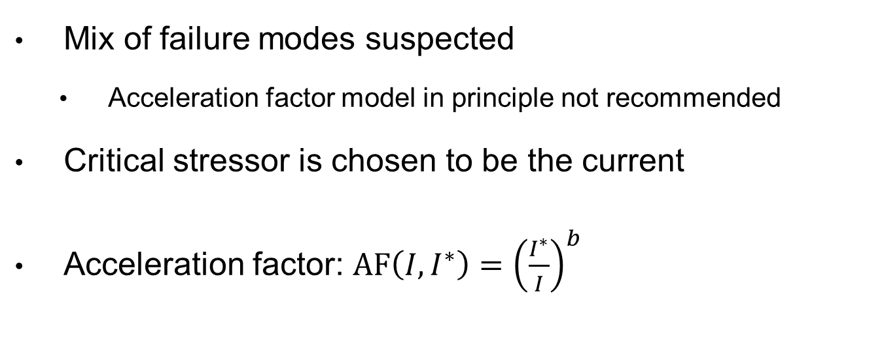
Example – CIBD – Failure mode 2
Mix of failure modes suspected
  Acceleration factor model in principle not recommended
Critical stressor is chosen to be the current
Acceleration factor: $AF\left(I,I^{∗}\right)={\left(\frac{I^{∗}}{I}\right)}^{b}$

Slide 21
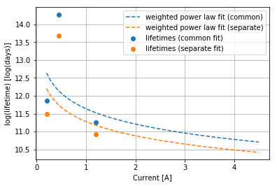
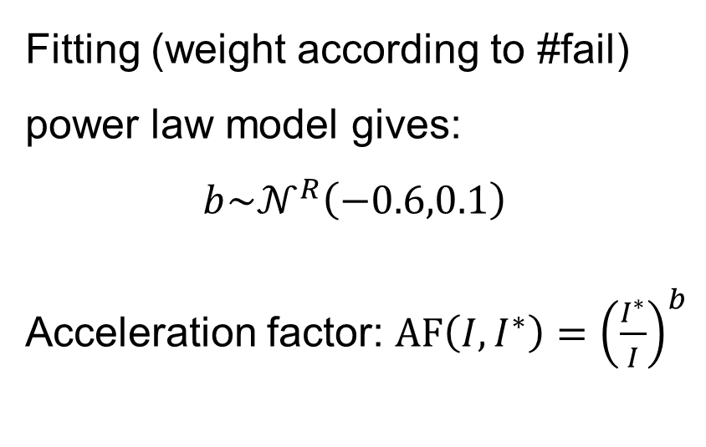
Example – CIBD – Failure mode 2
Fitting (weight according to #fail) power law model gives:
$$b\sim 𝒩^{R}\left(−0.6,0.1\right)$$
Acceleration factor: $AF\left(I,I^{∗}\right)={\left(\frac{I^{∗}}{I}\right)}^{b}$
 | I [A] | #fail
Dev 1 | 0.2 | 3/95
Dev 2 | 0.45 | 2/605
Dev 3 | 1.2 | 7/145

Slide 22
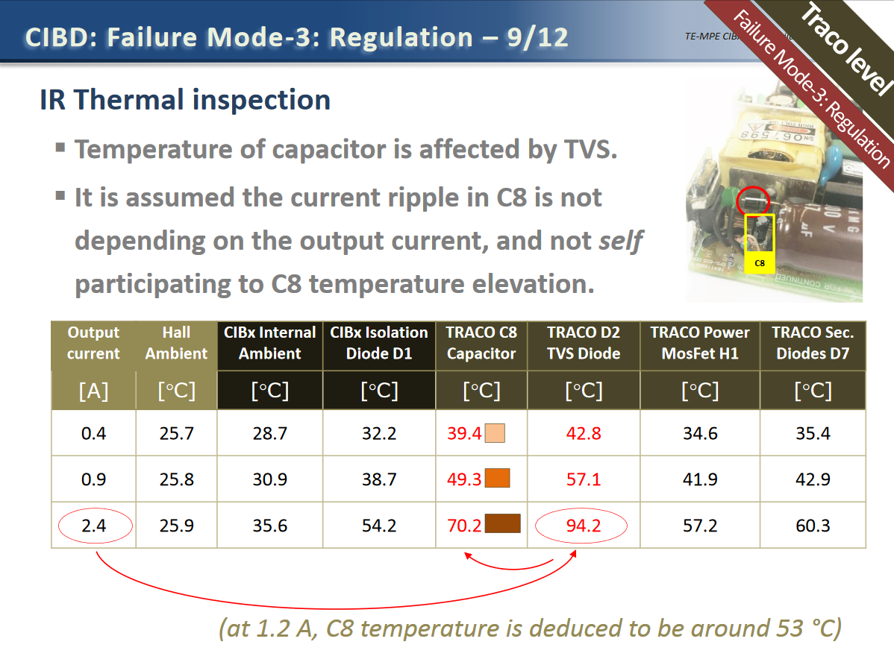
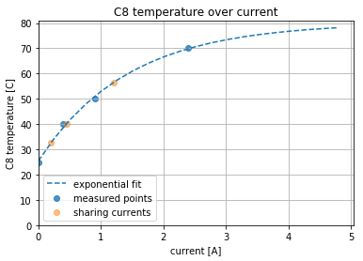
Example – CIBD – Failure mode 3

Slide 23
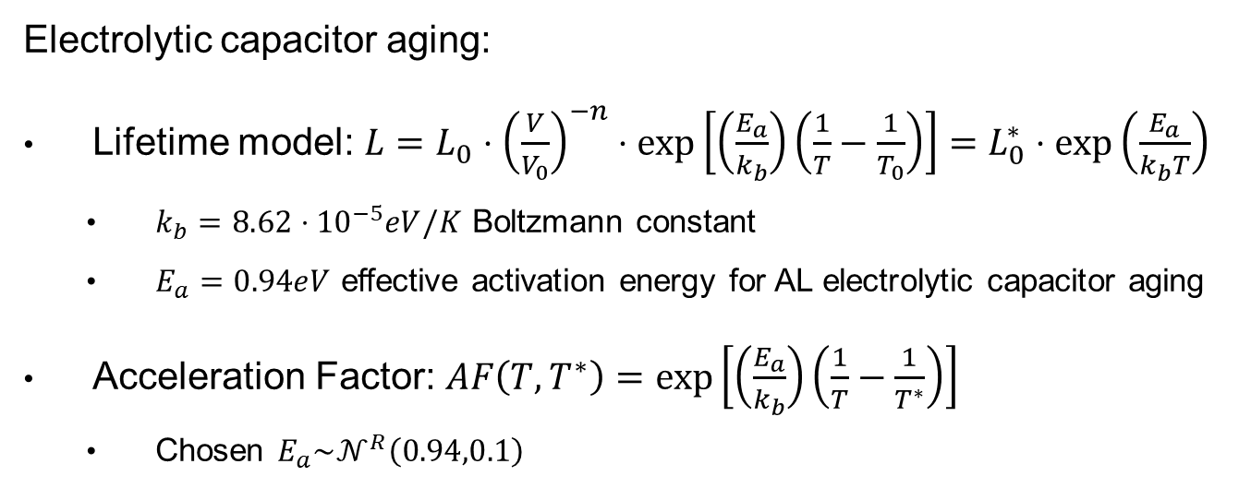
Example – CIBD – Failure mode 3
Electrolytic capacitor aging:
Lifetime model: $L=L_{0}⋅{\left(\frac{V}{V_{0}}\right)}^{−n}⋅\exp\left[\left(\frac{E_{a}}{k_{b}}\right)\left(\frac{1}{T}−\frac{1}{T_{0}}\right)\right]=L_{0}^{∗}⋅exp⁡\left(\frac{E_{a}}{k_{b}T}\right)$
  $k_{b}=8.62⋅{10}^{−5}eV/K$ Boltzmann constant
  $E_{a}=0.94eV$ effective activation energy for AL electrolytic capacitor aging
Acceleration Factor: $AF\left(T,T^{∗}\right)=\exp\left[\left(\frac{E_{a}}{k_{b}}\right)\left(\frac{1}{T}−\frac{1}{T^{∗}}\right)\right]$
  Chosen $E_{a}\sim 𝒩^{R}\left(0.94,0.1\right)$

Slide 24
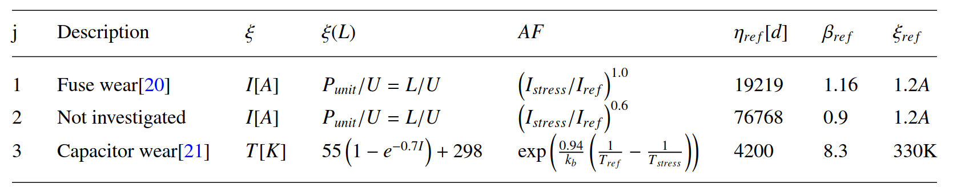
Example – CIBD – Failure mode summary

Slide 25
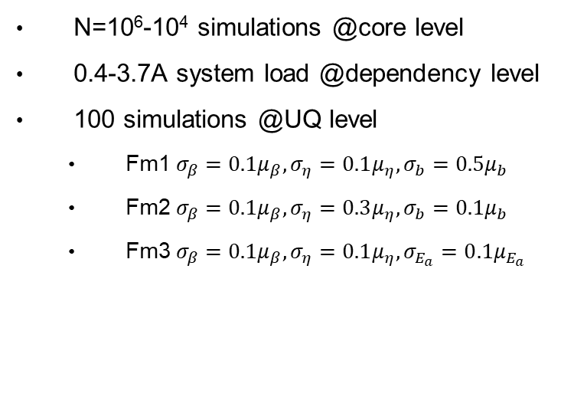
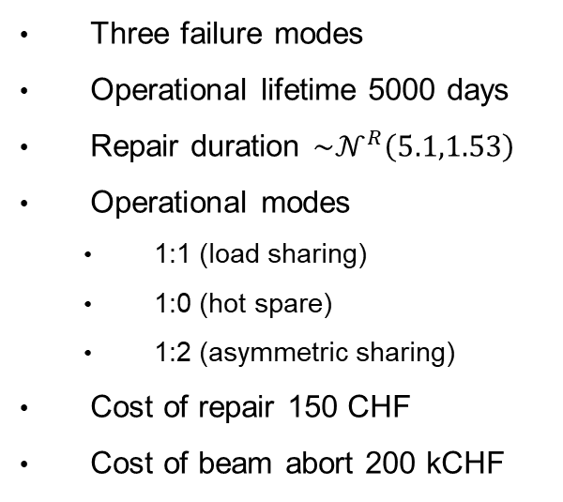
Example – CIBD– Simulate operation
Three failure modes
Operational lifetime 5000 days
Repair duration $\sim 𝒩^{R}\left(5.1,1.53\right)$
Operational modes
  1:1 (load sharing)
  1:0 (hot spare)
  1:2 (asymmetric sharing)
Cost of repair 150 CHF
Cost of beam abort 200 kCHF
N=10⁶-10⁴ simulations @core level
0.4-3.7A system load @dependency level
100 simulations @UQ level
  Fm1 $σ_{β}=0.1μ_{β},σ_{η}=0.1μ_{η},σ_{b}=0.5μ_{b}$
  Fm2 $σ_{β}=0.1μ_{β},σ_{η}=0.3μ_{η},σ_{b}=0.1μ_{b}$
  Fm3 $σ_{β}=0.1μ_{β},σ_{η}=0.1μ_{η},σ_{E_{a}}=0.1μ_{E_{a}}$

Slide 26
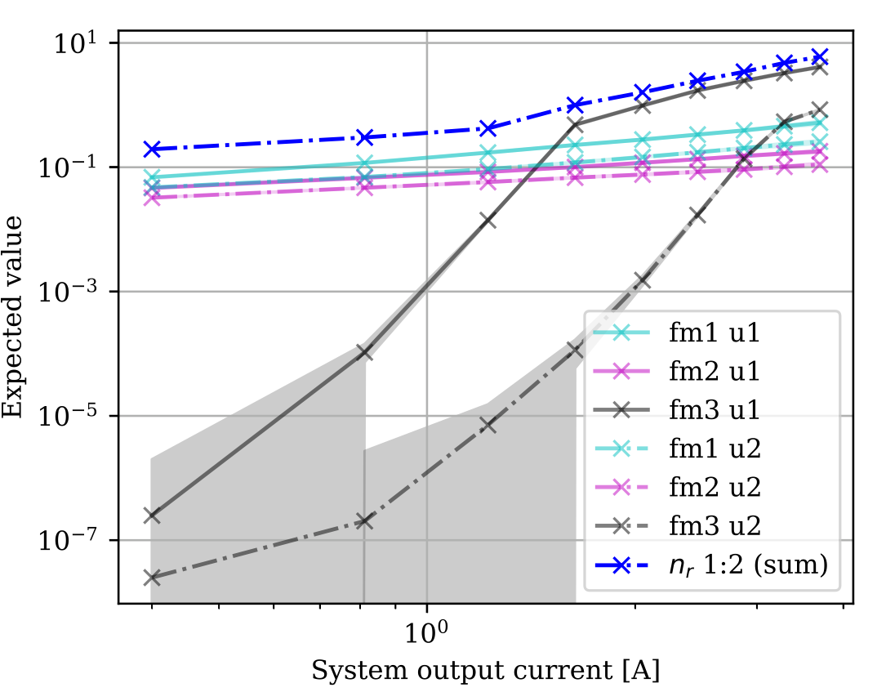
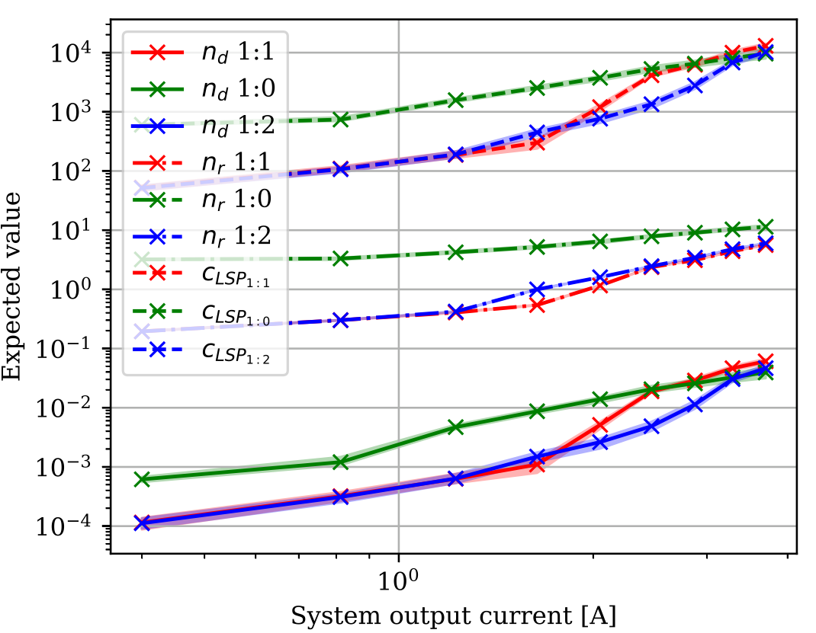
Simulation results

Slide 27
Contents
Problem statement
Method
Example
  Synthetic example
  CIBD simulation
Summary and Conclusions

Slide 28
Conclusions
There is no general answer for optimal operational mode
  Optimal mode can be determined when
    Failure modes are understood and quantified
    Failure mode acceleration modeling can be applied
Requires data and analysis obtained from
  Accelerated testing or
  Operations and/or
  PoF references
The results shown in this presentation are based on very limited data
  Partially addressed by uncertainty quantification layer
  Further verification necessary
The results are unique for CIBD and not transferable to other power supplies
More details – https://cernbox.cern.ch/index.php/s/tItP1TR0RrSKML1

Slide 29
Backup slides

Slide 30
Cost of Beam Abort
CERN budget =1B CHF
  LHC physics is main output
3840 – 4800h physics → 200-250k CHF per hour…
assume 50% in stable beams → 100kCHF/h
Average turnaround-time: ~2h → 200kCHF

Slide 31
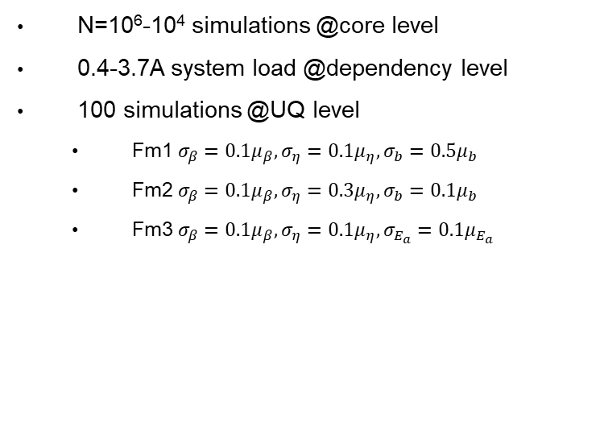
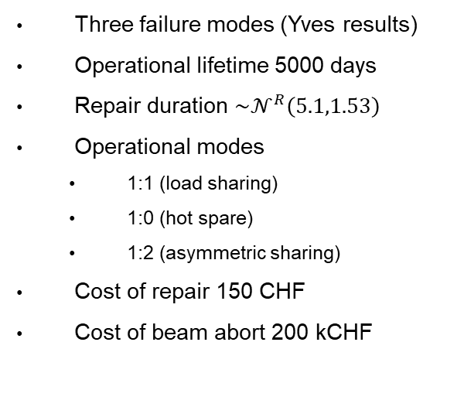
Example – CIBD– Simulate operation
Three failure modes (Yves results)
Operational lifetime 5000 days
Repair duration $\sim 𝒩^{R}\left(5.1,1.53\right)$
Operational modes
  1:1 (load sharing)
  1:0 (hot spare)
  1:2 (asymmetric sharing)
Cost of repair 150 CHF
Cost of beam abort 200 kCHF
N=10⁶-10⁴ simulations @core level
0.4-3.7A system load @dependency level
100 simulations @UQ level
  Fm1 $σ_{β}=0.1μ_{β},σ_{η}=0.1μ_{η},σ_{b}=0.5μ_{b}$
  Fm2 $σ_{β}=0.1μ_{β},σ_{η}=0.3μ_{η},σ_{b}=0.1μ_{b}$
  Fm3 $σ_{β}=0.1μ_{β},σ_{η}=0.1μ_{η},σ_{E_{a}}=0.1μ_{E_{a}}$

Slide 32
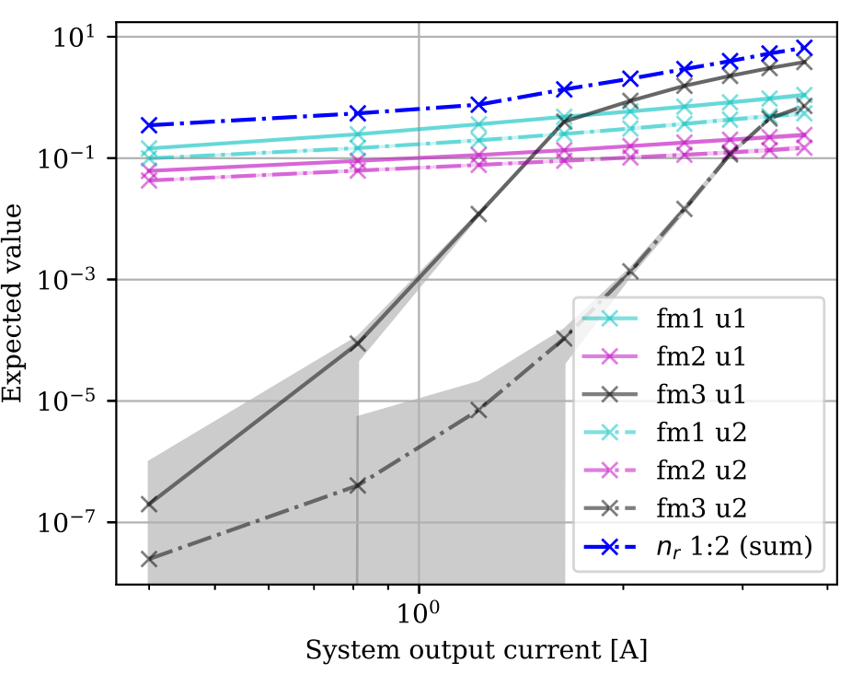
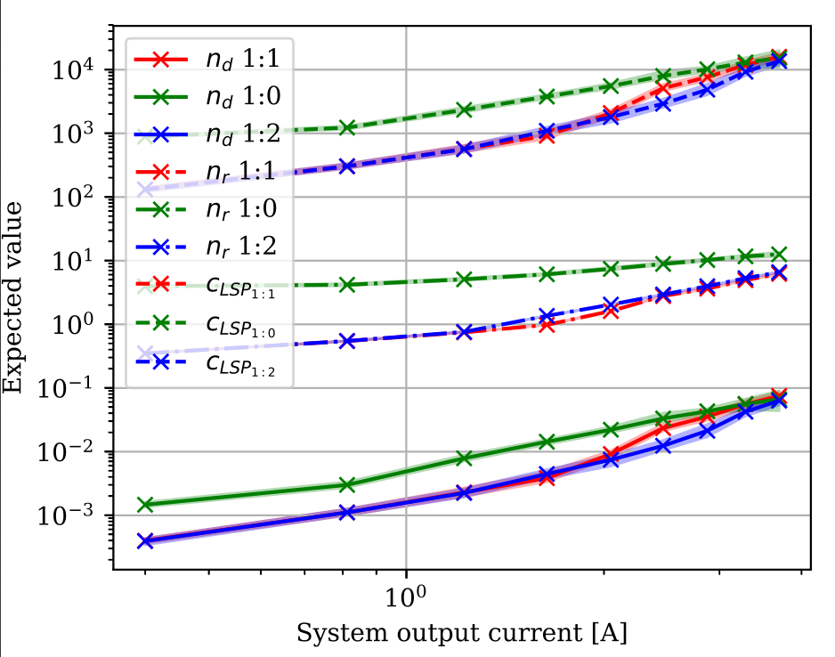
Simulation results

Slide 33
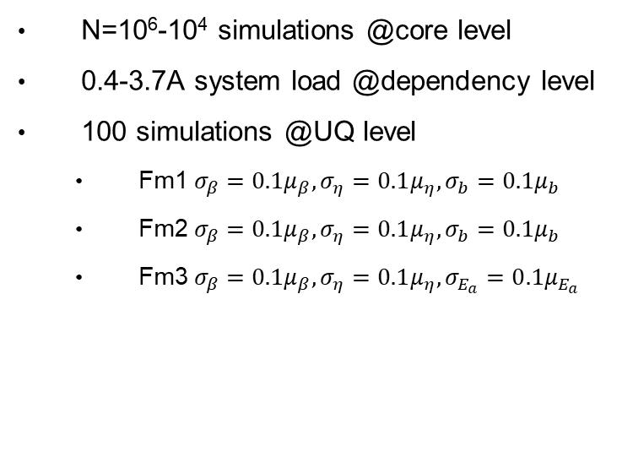
Example – CIBD– Simulate operation
Three failure modes
Operational lifetime 5000 days
Repair duration $\sim 𝒩^{R}\left(5.1,1.53\right)$
Operational modes
  1:1 (load sharing)
  1:0 (hot spare)
  1:2 (asymmetric sharing)
Cost of repair 150 CHF
Cost of beam abort 200 kCHF
N=10⁶-10⁴ simulations @core level
0.4-3.7A system load @dependency level
100 simulations @UQ level
  Fm1 $σ_{β}=0.1μ_{β},σ_{η}=0.1μ_{η},σ_{b}=0.1μ_{b}$
  Fm2 $σ_{β}=0.1μ_{β},σ_{η}=0.1μ_{η},σ_{b}=0.1μ_{b}$
  Fm3 $σ_{β}=0.1μ_{β},σ_{η}=0.1μ_{η},σ_{E_{a}}=0.1μ_{E_{a}}$

Slide 34
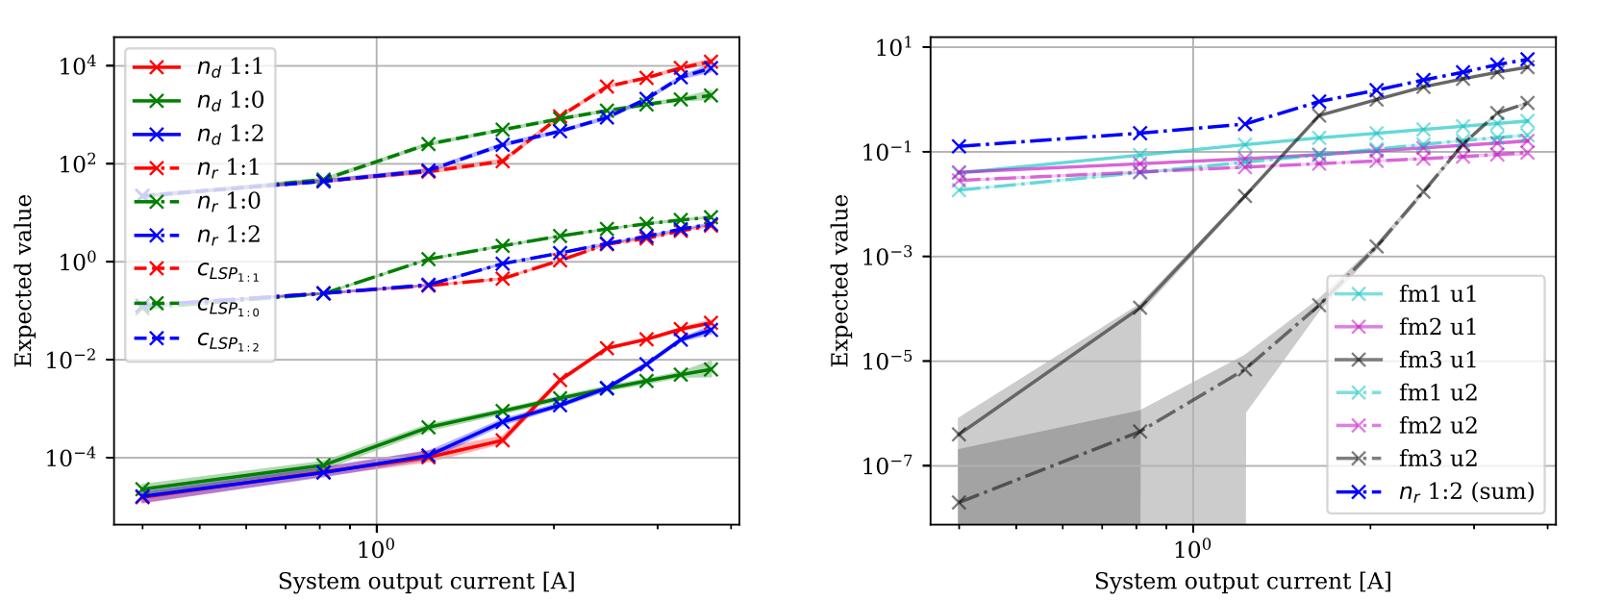
Simulation results

Slide 35
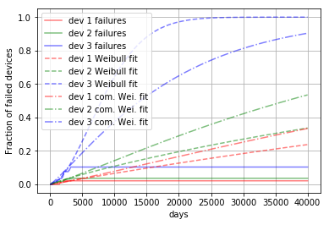
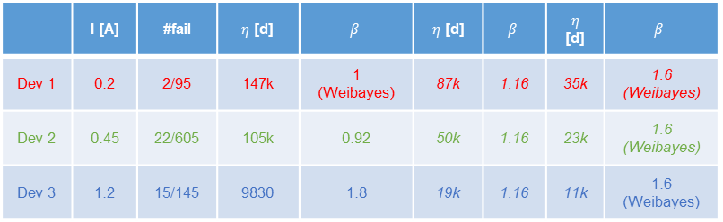
Example – CIBD – Fuse failure mode
 | I [A] | #fail | $η$ [d] | $$β$$ | $η$ [d] | $$β$$ | $η$ [d] | $$β$$
Dev 1 | 0.2 | 2/95 | 147k | 1 (Weibayes) | 87k | 1.16 | 35k | 1.6 (Weibayes)
Dev 2 | 0.45 | 22/605 | 105k | 0.92 | 50k | 1.16 | 23k | 1.6 (Weibayes)
Dev 3 | 1.2 | 15/145 | 9830 | 1.8 | 19k | 1.16 | 11k | 1.6 (Weibayes)
Less than 10% of the population failed
→ Estimation quite uncertain

Slide 36
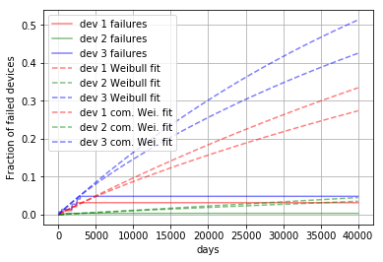
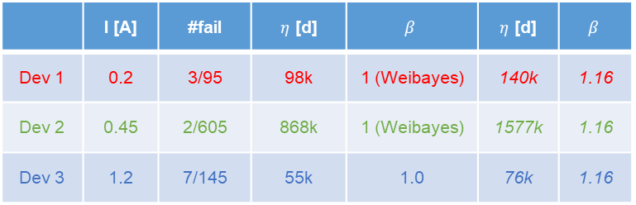
Example – CIBD – Failure mode 2
 | I [A] | #fail | $η$ [d] | $$β$$ | $η$ [d] | $$β$$
Dev 1 | 0.2 | 3/95 | 98k | 1 (Weibayes) | 140k | 1.16
Dev 2 | 0.45 | 2/605 | 868k | 1 (Weibayes) | 1577k | 1.16
Dev 3 | 1.2 | 7/145 | 55k | 1.0 | 76k | 1.16
Less than 5% of the population failed
→ Estimation very uncertain

Slide 37
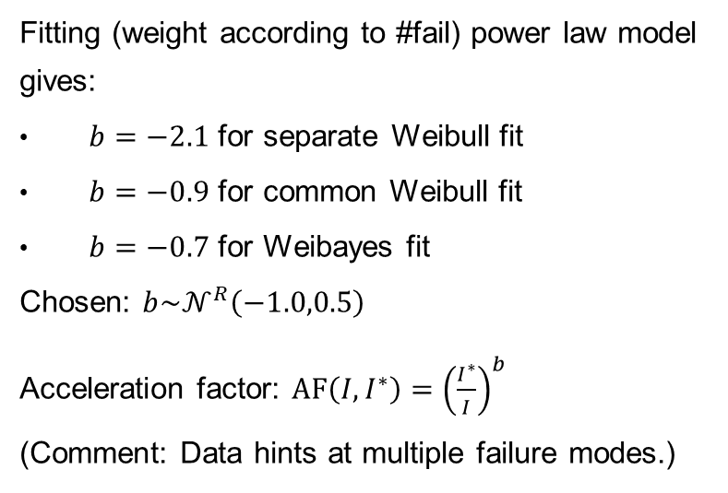
Example – CIBD – Fuse failure mode
Fitting (weight according to #fail) power law model gives:
$b=−2.1$ for separate Weibull fit
$b=−0.9$ for common Weibull fit
$b=−0.7$ for Weibayes fit
Chosen: $b\sim 𝒩^{R}\left(−1.0,0.5\right)$
Acceleration factor: $AF\left(I,I^{∗}\right)={\left(\frac{I^{∗}}{I}\right)}^{b}$
(Comment: Data hints at multiple failure modes.)

Slide 38
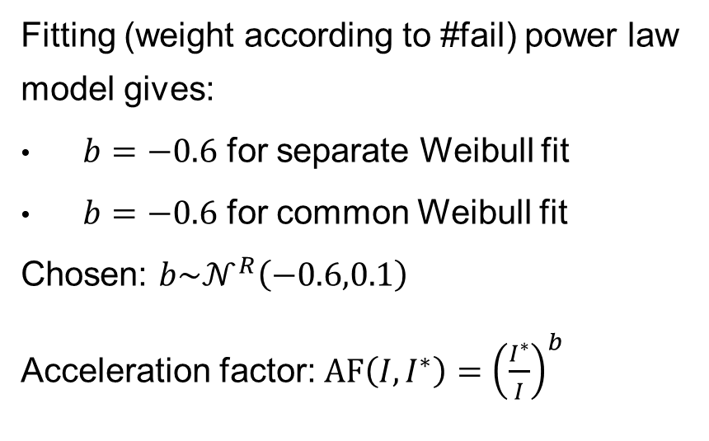
Example – CIBD – Failure mode 2
Fitting (weight according to #fail) power law model gives:
$b=−0.6$ for separate Weibull fit
$b=−0.6$ for common Weibull fit
Chosen: $b\sim 𝒩^{R}\left(−0.6,0.1\right)$
Acceleration factor: $AF\left(I,I^{∗}\right)={\left(\frac{I^{∗}}{I}\right)}^{b}$

Slide 39
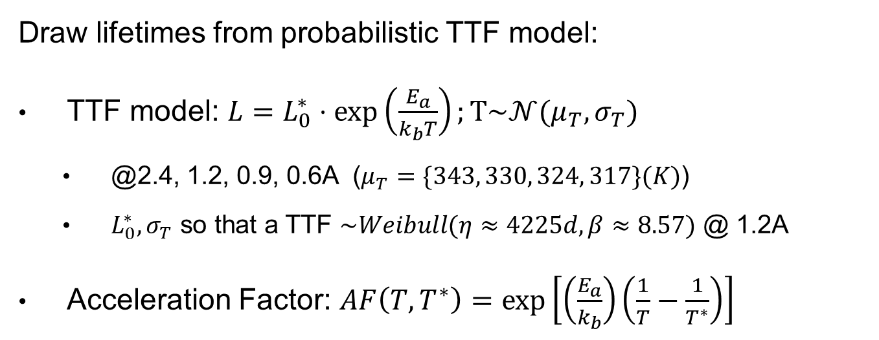
Failure mode 3 – Generating Failure data
Draw lifetimes from probabilistic TTF model:
TTF model: $L=L_{0}^{∗}⋅\exp\left(\frac{E_{a}}{k_{b}T}\right);T\sim 𝒩(μ_{T},σ_{T})$
  @2.4, 1.2, 0.9, 0.6A ($μ_{T}=\{343, 330, 324, 317\}(K)$)
  $L_{0}^{∗},σ_{T}$ so that a TTF $\sim Weibull(η≈4225d,β≈8.57)$ @ 1.2A
Acceleration Factor: $AF\left(T,T^{∗}\right)=\exp\left[\left(\frac{E_{a}}{k_{b}}\right)\left(\frac{1}{T}−\frac{1}{T^{∗}}\right)\right]$
Hall, P. L., and J. E. Strutt. "Probabilistic physics-of-failure models for component reliabilities using Monte Carlo simulation and Weibull analysis: a parametric study." Reliability Engineering & System Safety 80.3 (2003): 233-242.

Slide 40
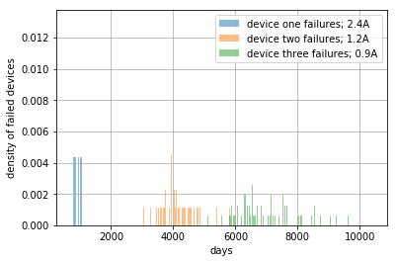
Failure mode 3– Generating Failure data
N=145 systems
Failure onset for 1.2A as observed for CIBD
Notes:
Would also work for fewer systems

Slide 41
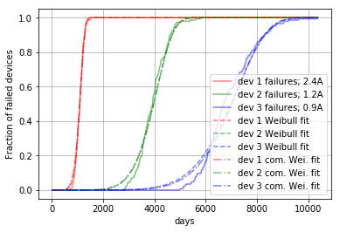
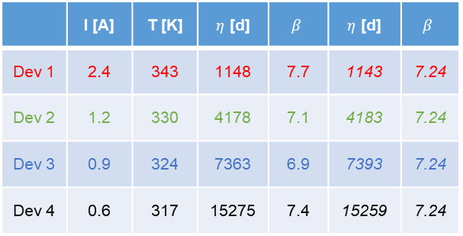

Failure mode 3 – Obtaining AF
 | I [A] | T [K] | $η$ [d] | $$β$$ | $η$ [d] | $$β$$
Dev 1 | 2.4 | 343 | 1148 | 7.7 | 1143 | 7.24
Dev 2 | 1.2 | 330 | 4178 | 7.1 | 4183 | 7.24
Dev 3 | 0.9 | 324 | 7363 | 6.9 | 7393 | 7.24
Dev 4 | 0.6 | 317 | 15275 | 7.4 | 15259 | 7.24
Same $β$
for all distributions
Accelerating the failure mode should leave the $β$ (shape) of the Weibull untouched!
→ Otherwise we change the failure mechanism and acceleration factor modeling is not possible.

Slide 42
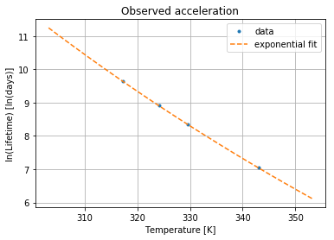
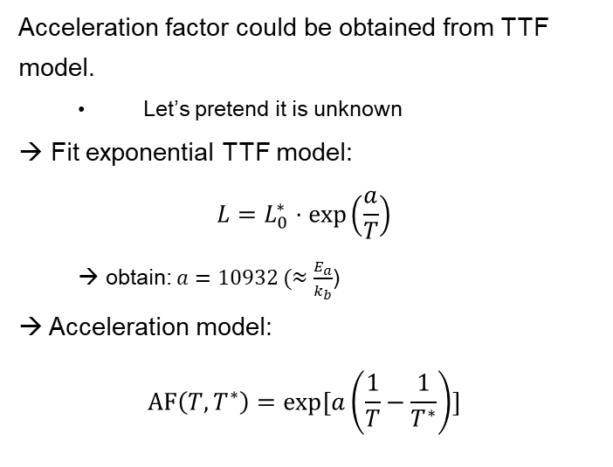
Failure mode 3 – Obtaining AF
Acceleration factor could be obtained from TTF model.
  Let’s pretend it is unknown
→ Fit exponential TTF model:
$$L=L_{0}^{∗}⋅\exp\left(\frac{a}{T}\right)$$
  → obtain: $a=10932 (≈\frac{E_{a}}{k_{b}}$)
→ Acceleration model:
$$AF\left(T,T^{∗}\right)=exp⁡[a\left(\frac{1}{T}−\frac{1}{T^{∗}}\right)]$$

Slide 43
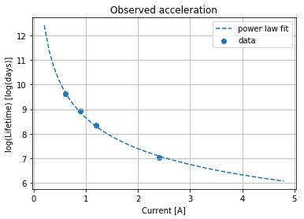
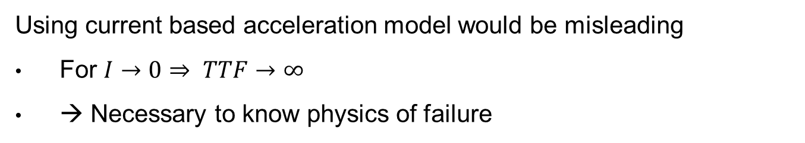
Failure mode 3 – AF
Using current based acceleration model would be misleading
For $I→0⇒ TTF→∞$
→ Necessary to know physics of failure

Slide 44
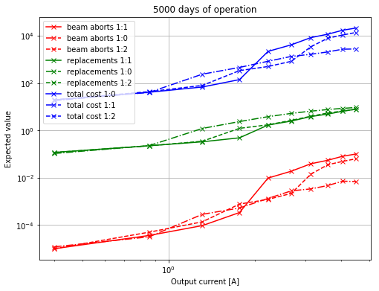
Example – CIBD– Simulate operation
Comments:
Expected beam aborts are opposite to expected number of replacements
  1:1 has the most beam aborts but the least replacements
  Opposite for 1:0
Failure mode three only “kicks in” for output currents of ~1A
Total cost mostly depends on chosen ratio of cost for replacements vs cost of beam abort

Slide 45
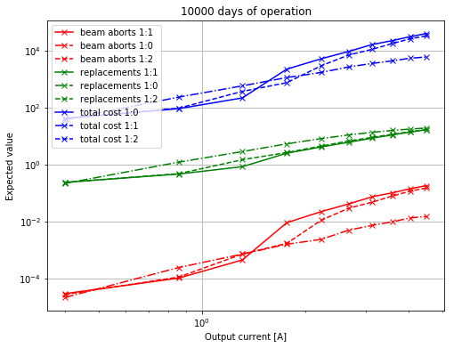
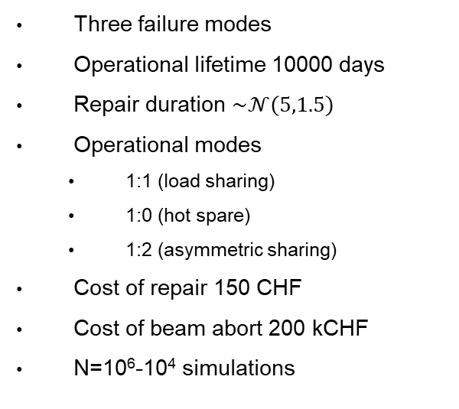
Example – CIBD – Simulate operation
Three failure modes
Operational lifetime 10000 days
Repair duration $\sim 𝒩\left(5,1.5\right)$
Operational modes
  1:1 (load sharing)
  1:0 (hot spare)
  1:2 (asymmetric sharing)
Cost of repair 150 CHF
Cost of beam abort 200 kCHF
N=10⁶-10⁴ simulations

Slide 46
Outlook
Current Limitations
  Same cost for all failure modes
  Only two devices
  Stressor dependent only on load of its unit, not other units (e.g. heating from external unit is not considered)
  No switching effects
  No repair efficiency
  No acceleration by multiple factors
Can all be added to the simulation
  But: data and models need to be available

Slide 47
Contents
Problem statement
Method
Example
  Synthetic example
  CIBD simulation
Summary and Conclusions

Slide 48
Synthetic Example (inspired by CIBD)

Slide 49
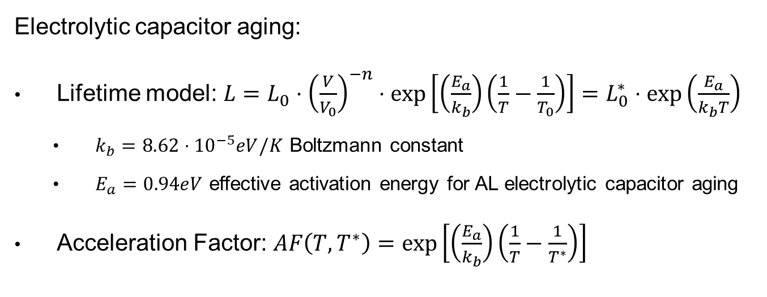
Synthetic Example (inspired by CIBD)
Electrolytic capacitor aging:
Lifetime model: $L=L_{0}⋅{\left(\frac{V}{V_{0}}\right)}^{−n}⋅\exp\left[\left(\frac{E_{a}}{k_{b}}\right)\left(\frac{1}{T}−\frac{1}{T_{0}}\right)\right]=L_{0}^{∗}⋅exp⁡\left(\frac{E_{a}}{k_{b}T}\right)$
  $k_{b}=8.62⋅{10}^{−5}eV/K$ Boltzmann constant
  $E_{a}=0.94eV$ effective activation energy for AL electrolytic capacitor aging
Acceleration Factor: $AF\left(T,T^{∗}\right)=\exp\left[\left(\frac{E_{a}}{k_{b}}\right)\left(\frac{1}{T}−\frac{1}{T^{∗}}\right)\right]$

Slide 50
Synthetic Example – Generating Failure data
Draw lifetimes from probabilistic TTF model:
TTF model: $L=L_{0}^{∗}⋅\exp\left(\frac{E_{a}}{k_{b}T}\right);T\sim 𝒩(μ_{T},σ_{T})$
  @2.4, 1.2, 0.9, 0.6A ($μ_{T}=\{343, 330, 324, 317\}(K)$)
  $L_{0}^{∗},σ_{T}$ so that a TTF $\sim Weibull(η≈4225d,β≈8.57)$ @ 1.2A
Acceleration Factor: $AF\left(T,T^{∗}\right)=\exp\left[\left(\frac{E_{a}}{k_{b}}\right)\left(\frac{1}{T}−\frac{1}{T^{∗}}\right)\right]$
Hall, P. L., and J. E. Strutt. "Probabilistic physics-of-failure models for component reliabilities using Monte Carlo simulation and Weibull analysis: a parametric study." Reliability Engineering & System Safety 80.3 (2003): 233-242.

Slide 51
Synthetic Example – Generating Failure data
N=145 systems
Failure onset for 1.2A as observed for CIBD
Notes:
Would also work for fewer systems

Slide 52
Synthetic Example – Obtaining AF
 | I [A] | T [K] | $η$ [d] | $$β$$ | $η$ [d] | $$β$$
Dev 1 | 2.4 | 343 | 1148 | 7.7 | 1143 | 7.24
Dev 2 | 1.2 | 330 | 4178 | 7.1 | 4183 | 7.24
Dev 3 | 0.9 | 324 | 7363 | 6.9 | 7393 | 7.24
Dev 4 | 0.6 | 317 | 15275 | 7.4 | 15259 | 7.24
Same $β$
for all distributions
Accelerating the failure mode should leave the $β$ (shape) of the Weibull untouched!
→ Otherwise we change the failure mechanism and acceleration factor modeling is not possible.

Slide 53
Synthetic Example – Obtaining AF
Acceleration factor could be obtained from TTF model.
  Let’s pretend it is unknown
→ Fit exponential TTF model:
$$L=L_{0}^{∗}⋅\exp\left(\frac{a}{T}\right)$$
  → obtain: $a=10932 (≈\frac{E_{a}}{k_{b}}$)
→ Acceleration model:
$$AF\left(T,T^{∗}\right)=exp⁡[a\left(\frac{1}{T}−\frac{1}{T^{∗}}\right)]$$

Slide 54
Synthetic Example – AF
Using current based acceleration model would be misleading
For $I→0⇒ TTF→∞$
→ Necessary to know physics of failure

Slide 55
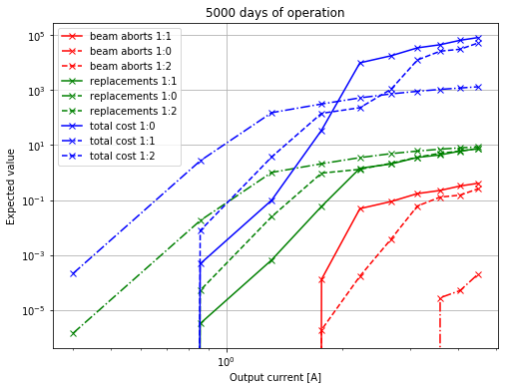
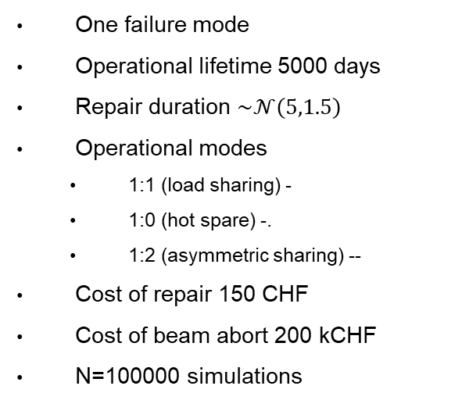
Synthetic Example – Simulate operation
One failure mode
Operational lifetime 5000 days
Repair duration $\sim 𝒩\left(5,1.5\right)$
Operational modes
  1:1 (load sharing) -
  1:0 (hot spare) -.
  1:2 (asymmetric sharing) --
Cost of repair 150 CHF
Cost of beam abort 200 kCHF
N=100000 simulations
Notes:
Model might not be valid all the way to 4.8A

Slide 56
Synthetic Example – Simulate operation
Comments:
Expected beam aborts are opposite to expected number of replacements
  1:1 has the most beam aborts but the least replacements
  Opposite for 1:0
Failure mode only “kicks in” for output currents of ~1A
Total cost mostly depends on chosen ratio of cost for replacements vs cost of beam abort
  Depending on output current each mode can be the most economic
Notes:
Model might not be valid all the way to 4.8A

Slide 57


Synthetic Example – Simulate operation
One failure mode
Operational lifetime 10000 days
Repair duration $\sim 𝒩\left(5,1.5\right)$
Operational modes
  1:1 (load sharing)
  1:0 (hot spare)
  1:2 (asymmetric sharing)
Cost of repair 150 CHF
Cost of beam abort 200 kCHF
N=100000 simulations

Slide 58
Redundancy – Load distribution
Thought experiment
Imagine two sub systems. Both have one wear out failure mode
  Load sharing (50:50) operation: At the time that device #1 fails, device #2 is likely to fail as well
  Hot spare operation (100:0): At the time that device #1 fails, device #2 is unlikely to fail (as good as new)

Slide 59
Redundancy – Load distribution
Considering wear-out the load distribution does affect the chance of simultaneous failure:
Simple to give qualitative answer for a single failure mode
  In reality we have a mix of failure modes, different wear-out “drivers” and need quantitative answers
→ This calls for a simulation

Slide 60
Reliability concepts
Physics of Failure
Studies failure mechanisms
Power supplies
Somewhere in between
Reliability statistics
Studies failure probabilities of systems
Mathematics/Statistics
Relevant for e.g. semiconductor industry
Physics, Materials Science,…
Relevant for e.g. reliability study of large projects
For some problems it is sufficient to look at failure rates, for others we need to fully understand the failure mechanism and physics
Failure mode thinking
System component thinking

Slide 61

Failure mode “thinking”
Flowchart depicts the cycle of failure modes in systems
Reliability block diagrams can be misleading
  Failure modes do not stay within one “block”
  FTA is more intuitive in certain cases

Slide 62
Situation at TE-EPC
Budget and time limitations (obviously)
Most systems are built with externally fabricated components (COTS)
  Coming without accurate reliability specification
  Source of uncertainty
Systems are designed (or reviewed) by experienced engineers
  Reliability data shows little evidence for major design flaws
Many efforts are already invested in increasing the reliability and availability
  Experience in designing, manufacturing and operating power converters
  Redundancy
  Equipment monitoring and “smart” maintenance
  …

Slide 63
Redundancy – Load distribution
What’s the chance of simultaneous failure within a certain repair duration?
Assuming constant failure rates the load distribution does not affect the chance of simultaneous failure
Considering wear-out the load distribution does affect the chance of simultaneous failure

Slide 64
Redundancy – Load distribution
Simulation study
Will put a super short explanation

Slide 65
Simulation study - discussion
Depending on failure modes and operational parameters one load-sharing scheme is optimal
  Can be determined with data from
    Accelerated testing
    Past operation

