Slide 1
DFX interfaces in the tunnel
& installation: sequence of operations
R. Betemps
11/12/2018

Slide 2
Integration situation
Reference : IP 5R & IP5L EDMS 1991506
ST0999873_01 & ST1001705_01
Integration of the last version of the DFX design
(2018/11/23)
Integration last version Cold diode (ST0997561_01)

Slide 3
interfaces in the tunnel

Slide 4
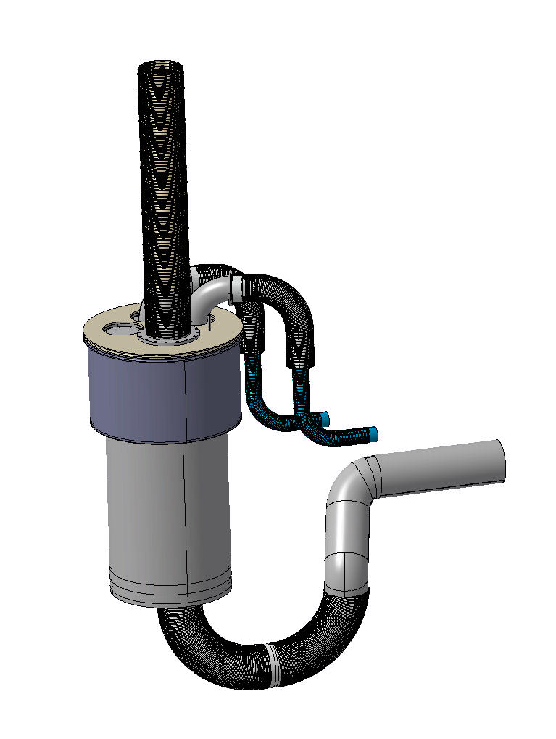
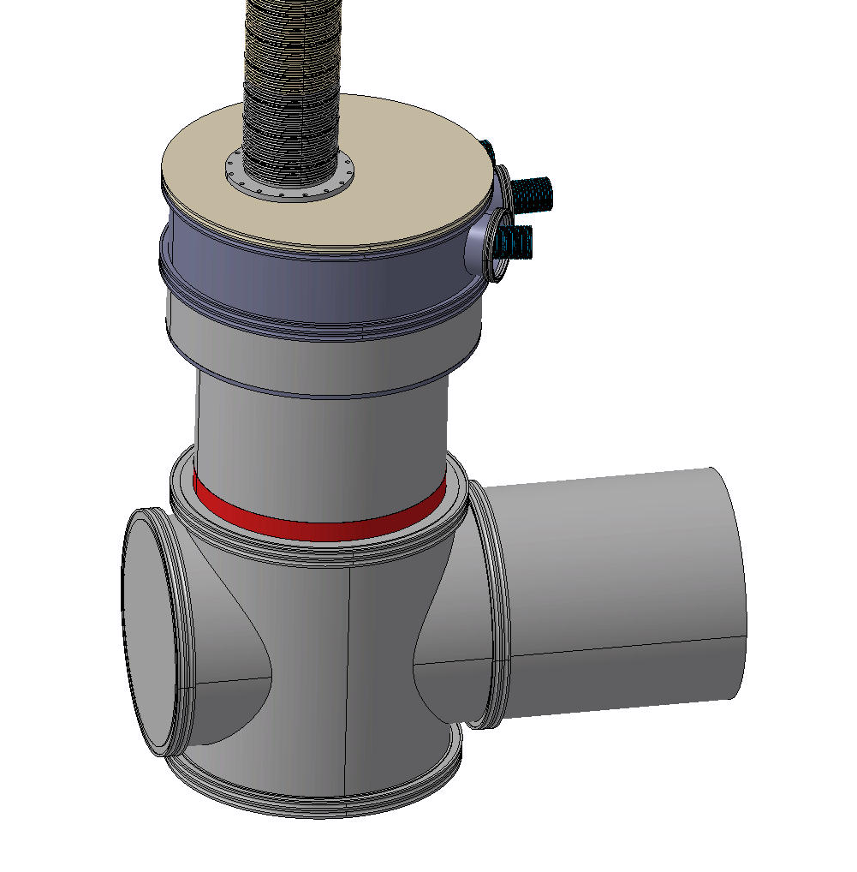
Last version of the DFX

Slide 5
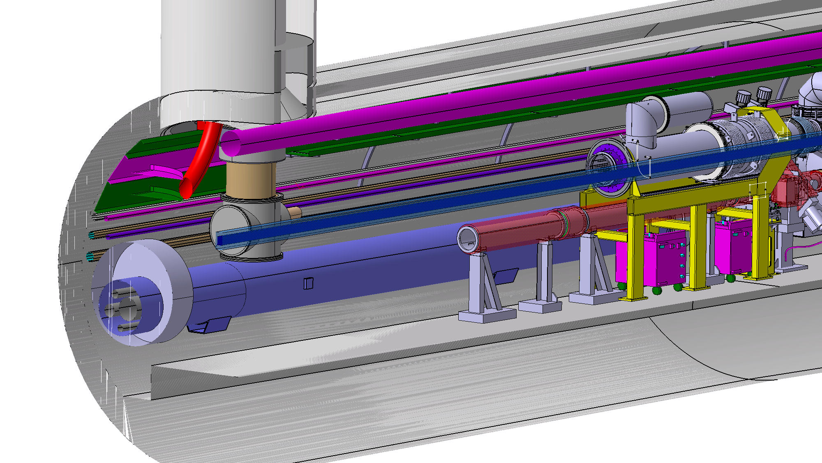
IP5 Left

Slide 6
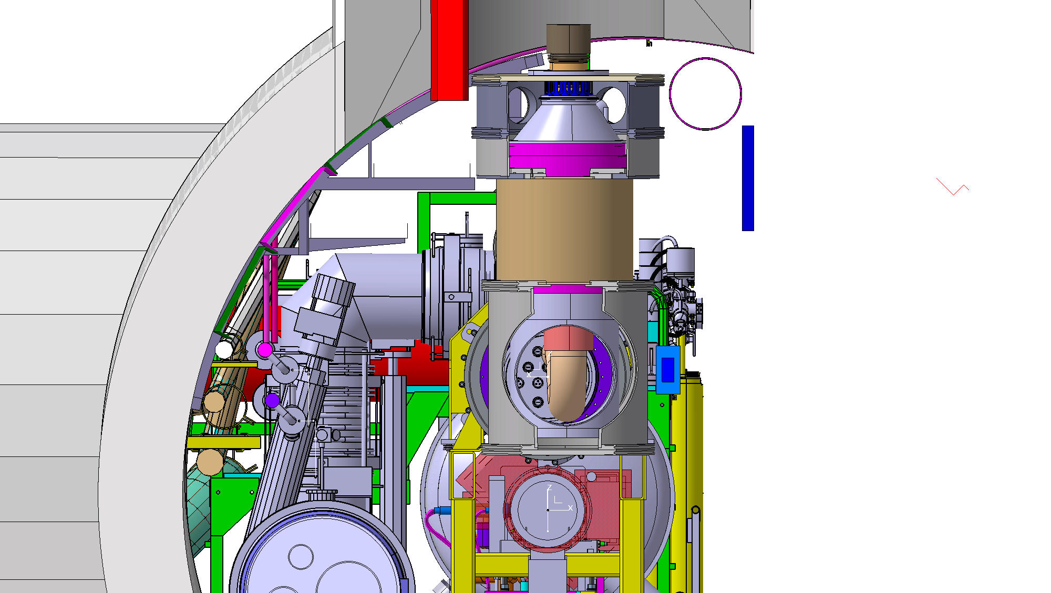
IP5 Left

Slide 7
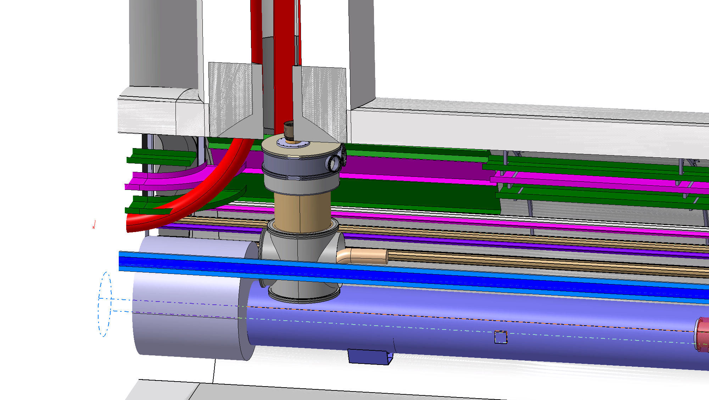
IP5 Left

Slide 8
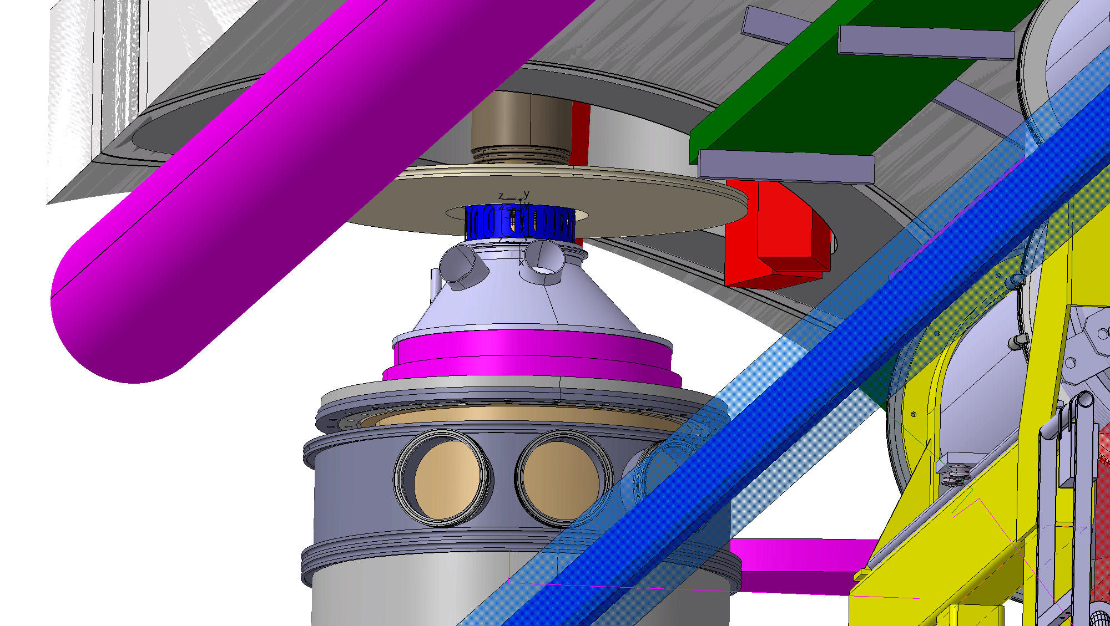
IP5 Left assembly

Slide 9
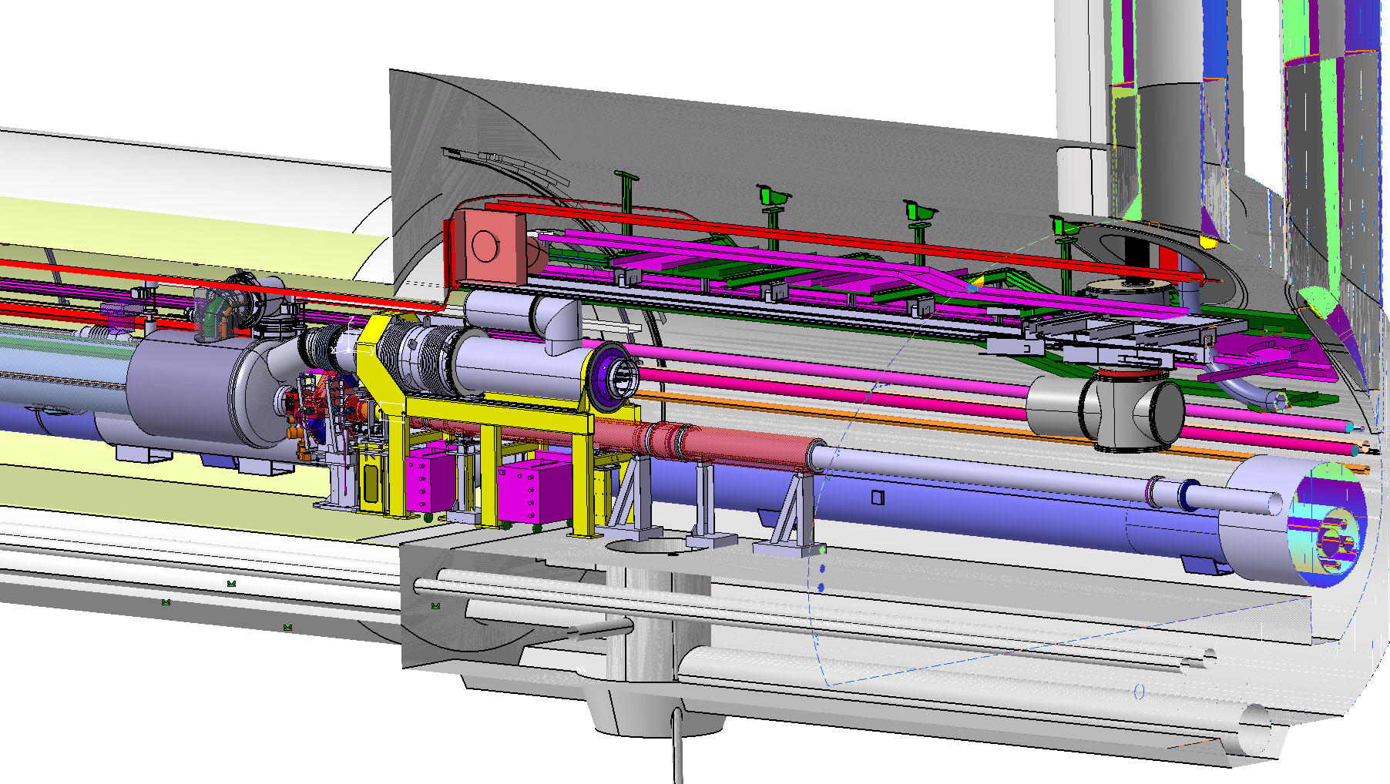
Check Point IP5 RIGHT

Slide 10
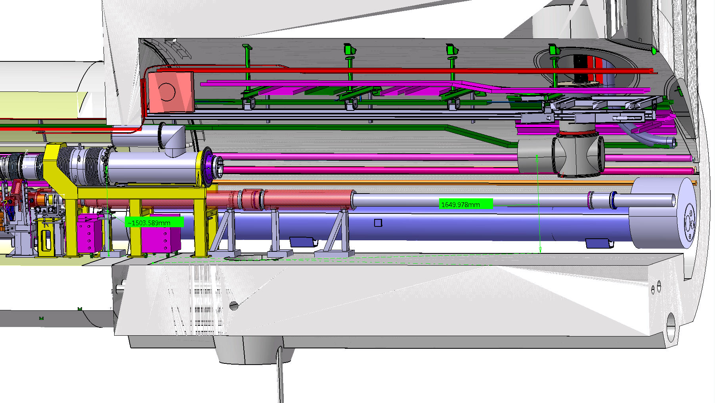
Check Point IP5 RIGHT

Slide 11
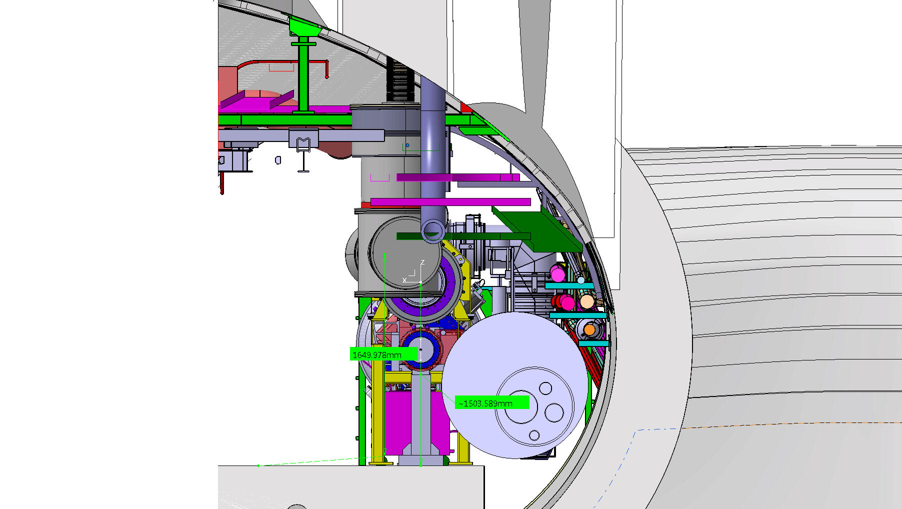
Check Point IP5 RIGHT

Slide 12
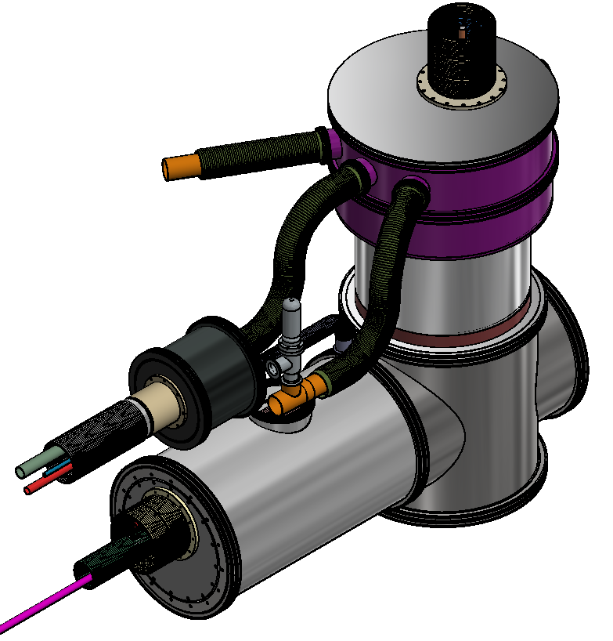
Next point
Check the complet integration
Check the Jumper
Vacuum pipe
Frame
….

Slide 13
installation: sequence of operations

Slide 14
Assembling process off the DFX
First proposition to be consider for discussion
  Lot of points open
  Tollings & support to be design

Slide 15
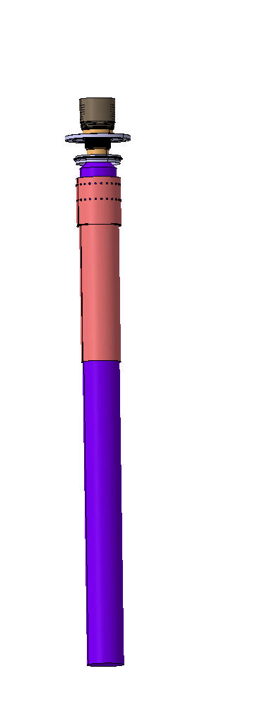
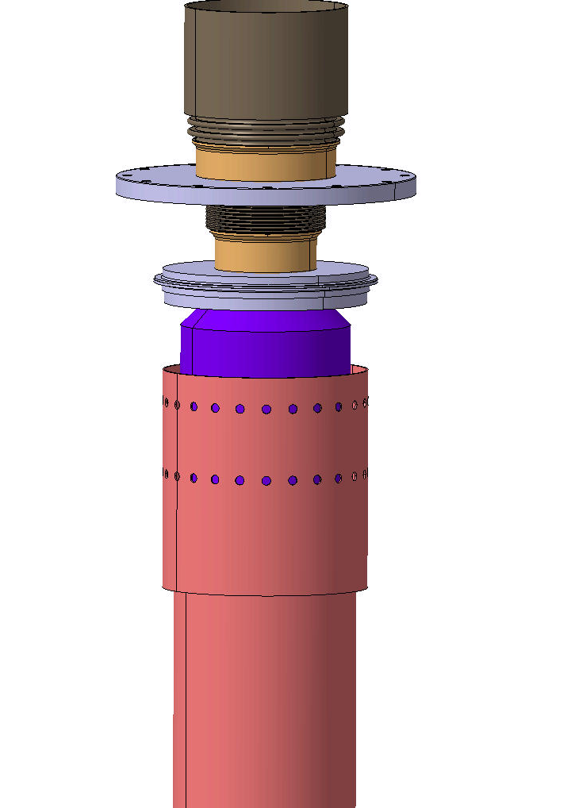
PRE - Assembling Process
~1200
~1500

Slide 16
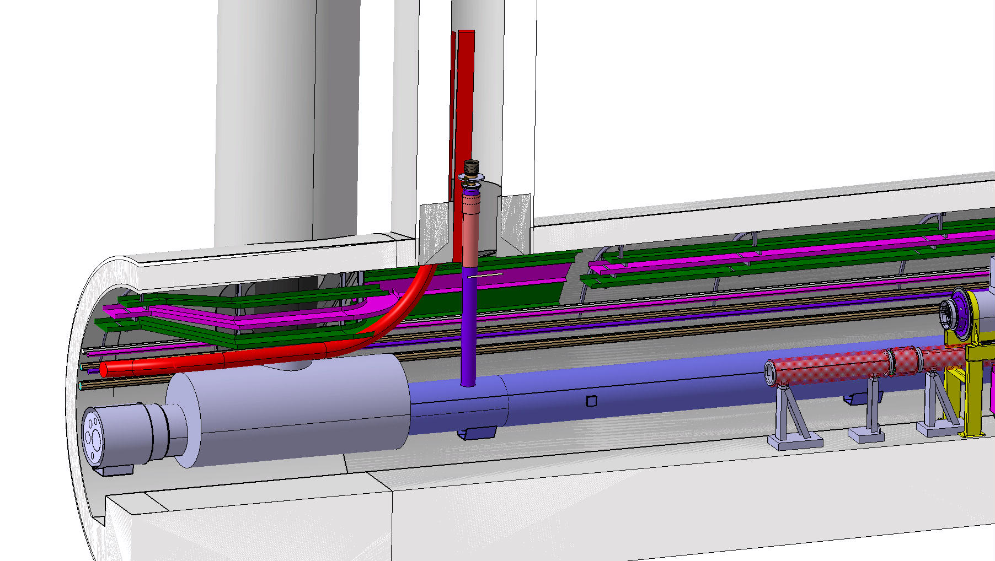
Insert the link
Flange
DFX

Slide 17
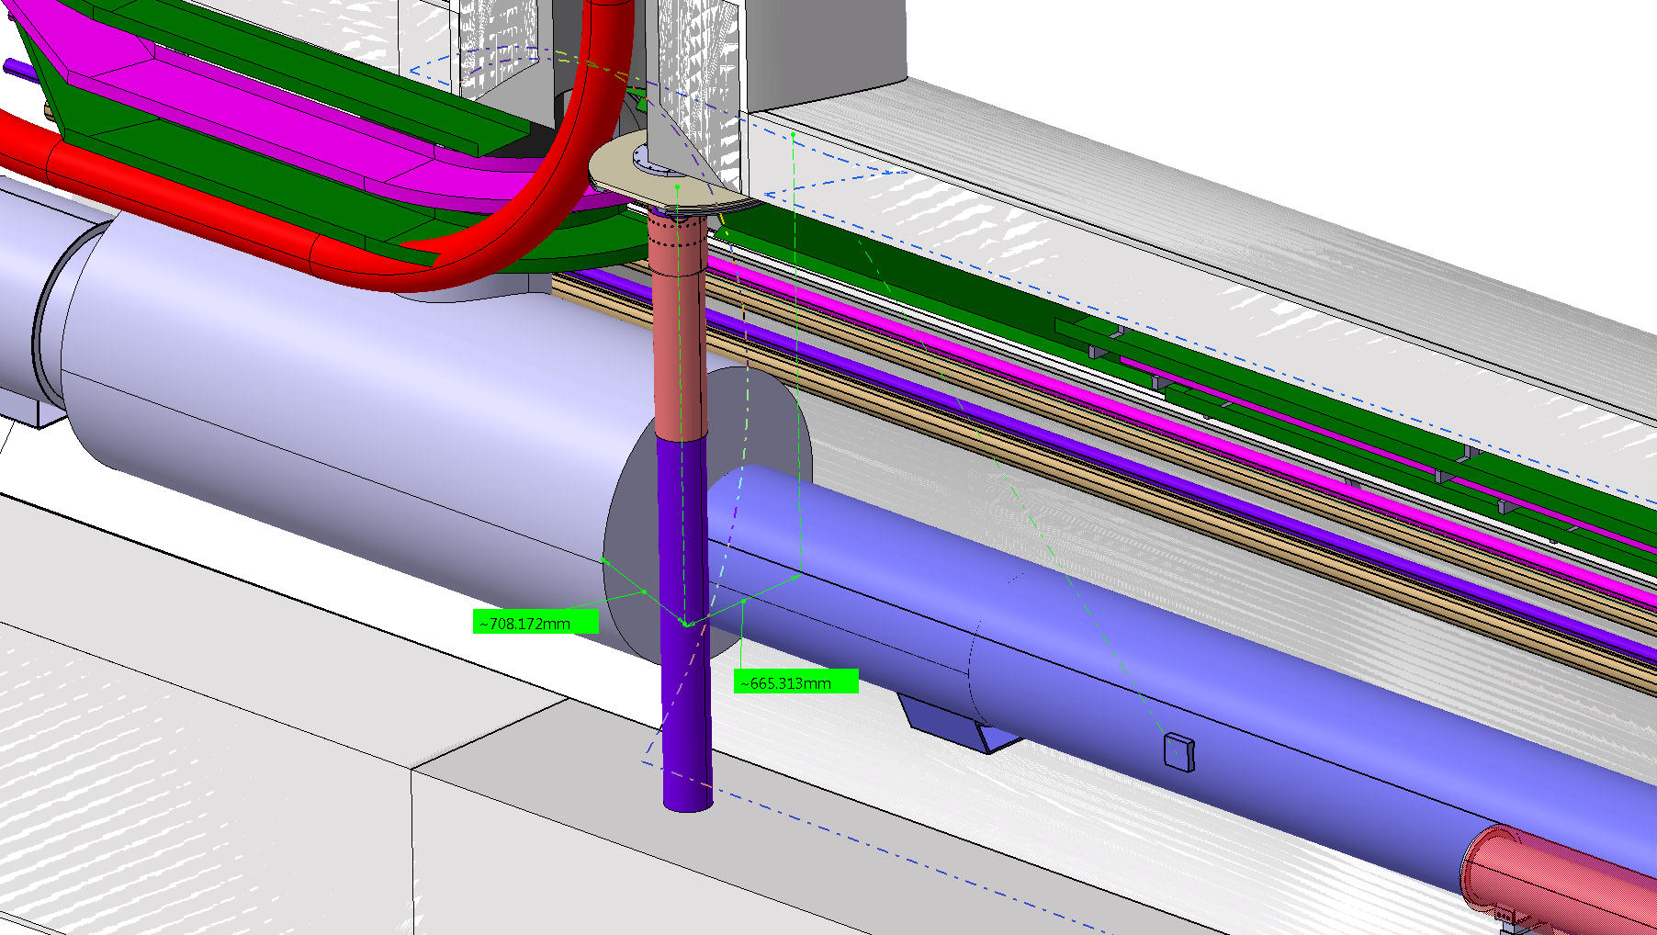
Space

Slide 18
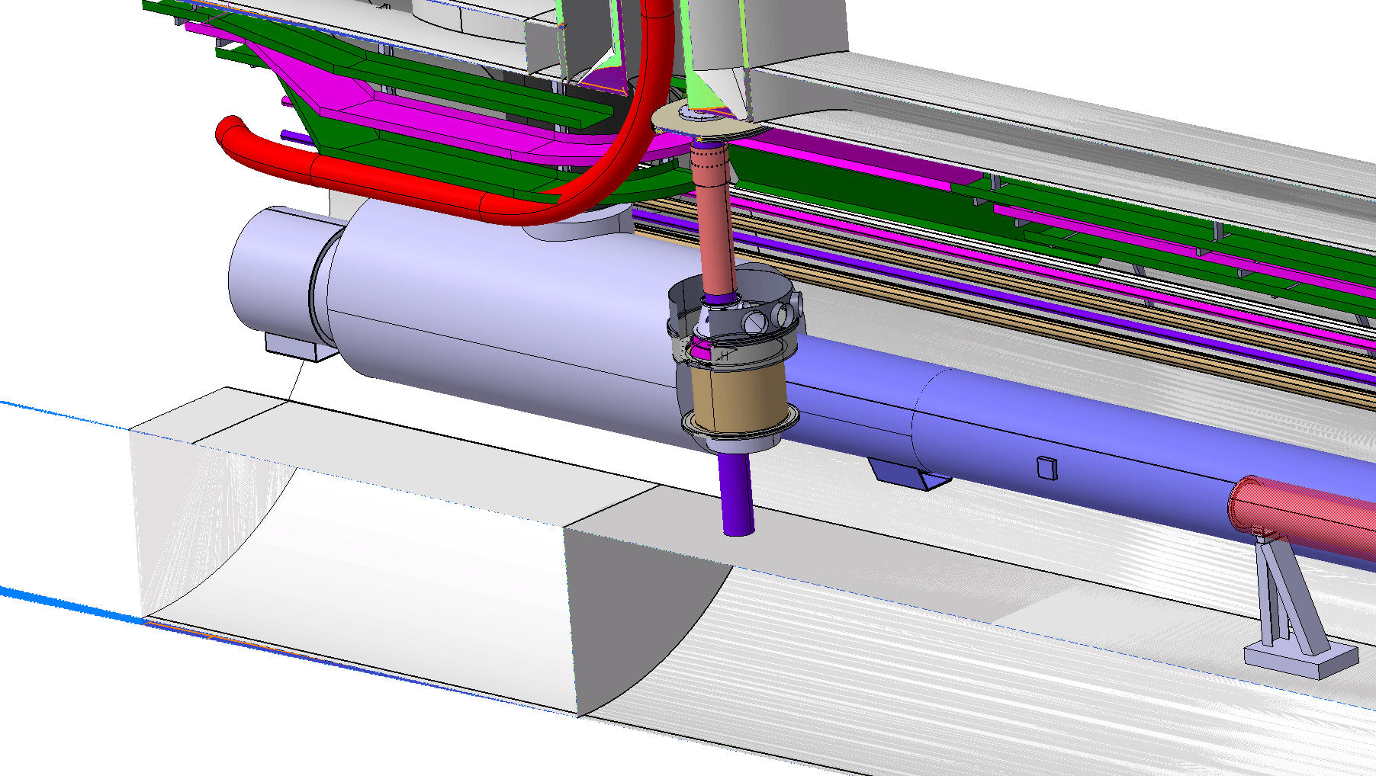
Insert the link

Slide 19
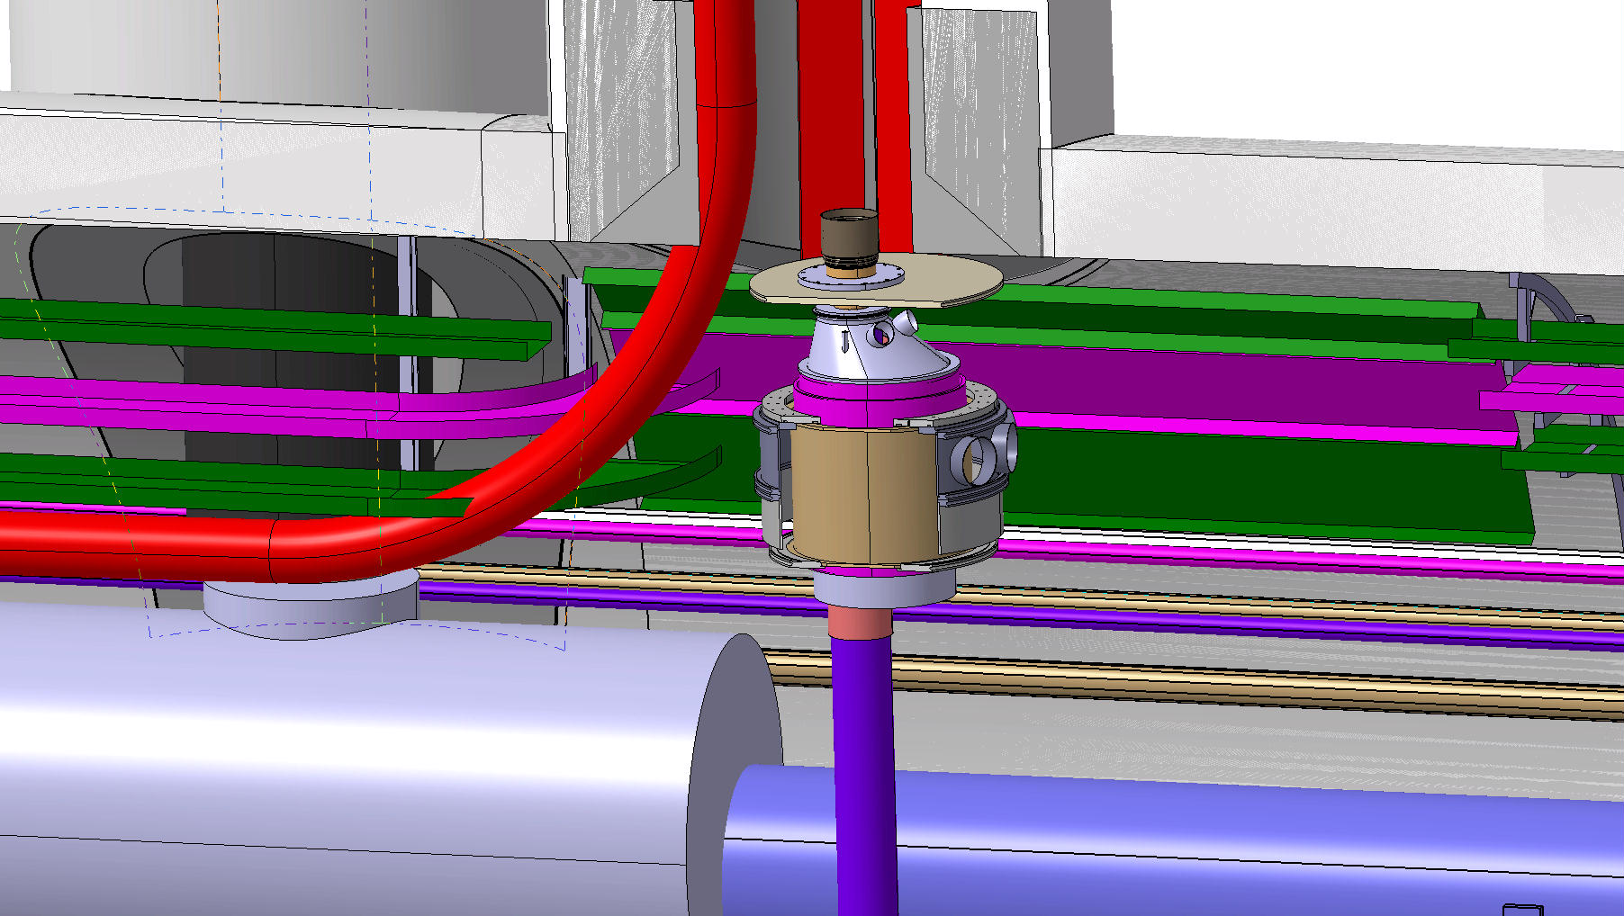
Move DFX

Slide 20
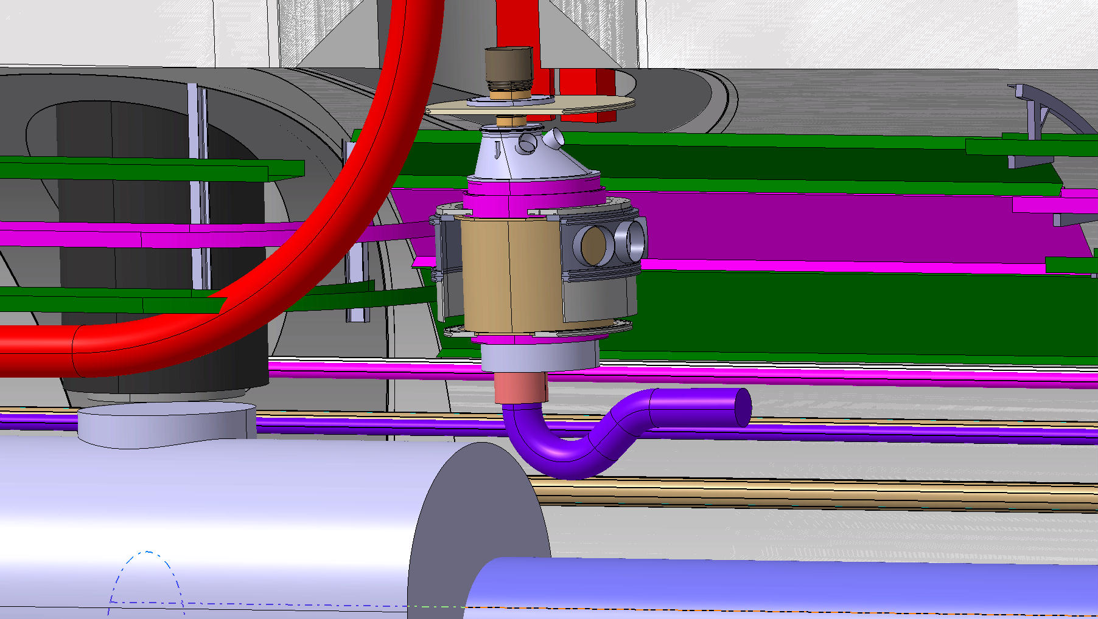
Weld the Flange & bend the NbTi cable

Slide 21
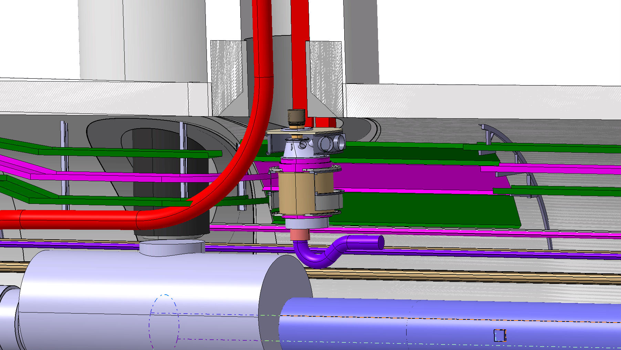
Move the vacuum ½ chamber up

Slide 22
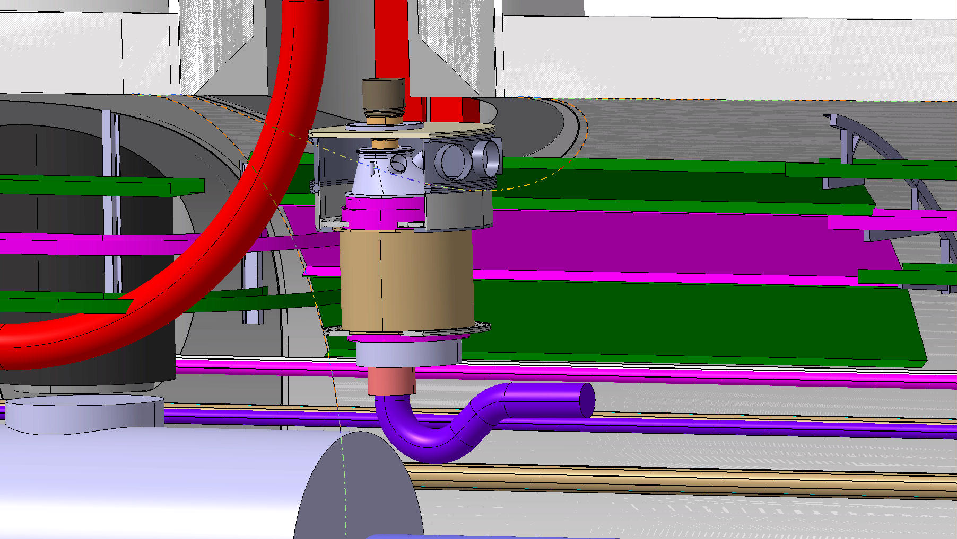
Close the vacuum chamber

Slide 23
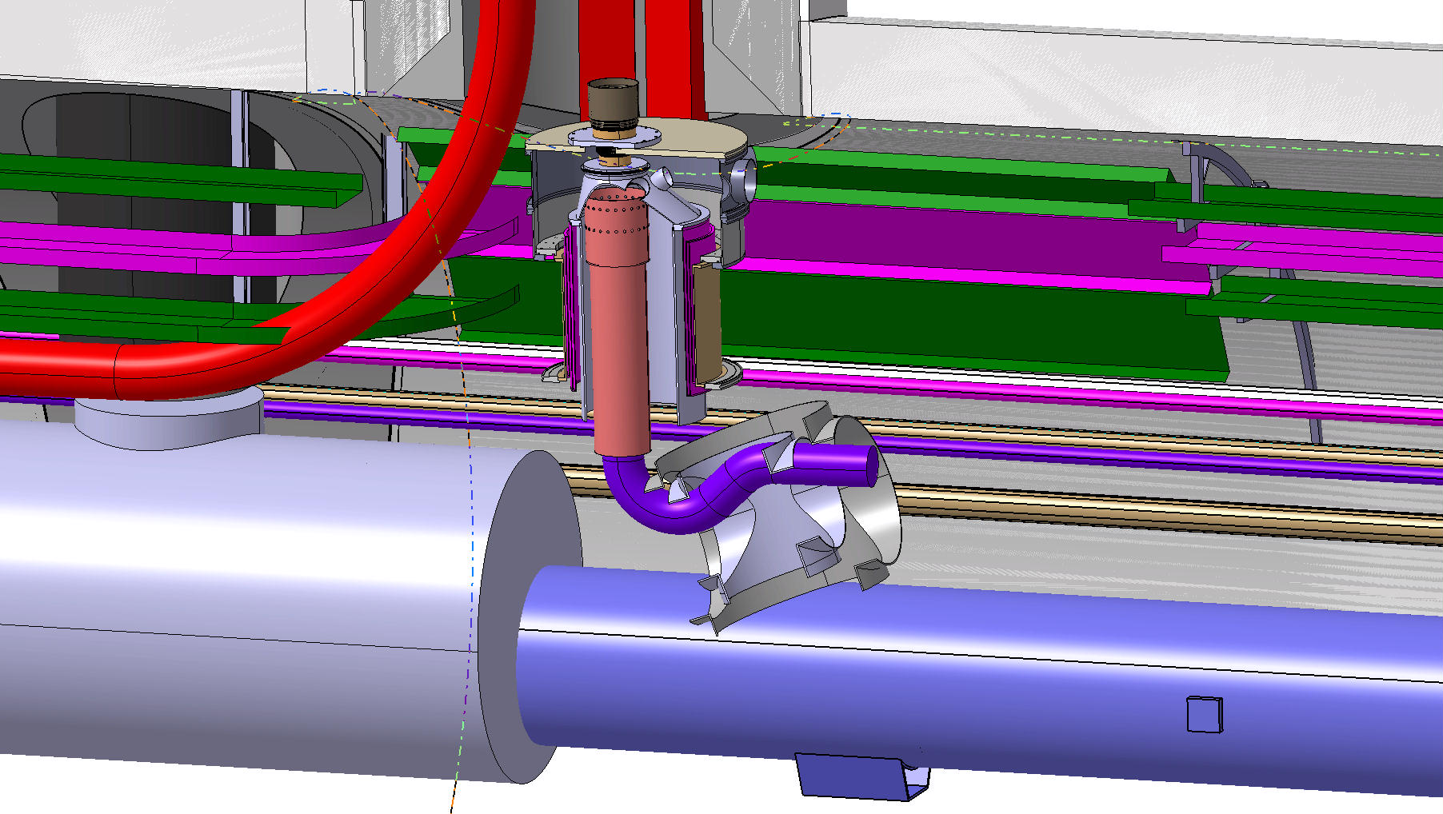
Insert the low part of the chamber

Slide 24
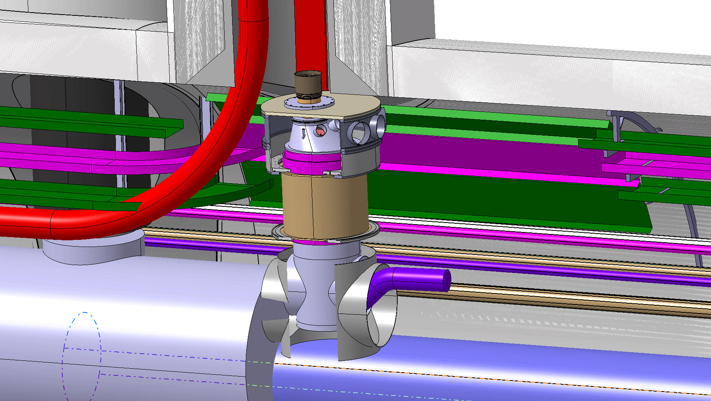
Weld the helium chamber

Slide 25
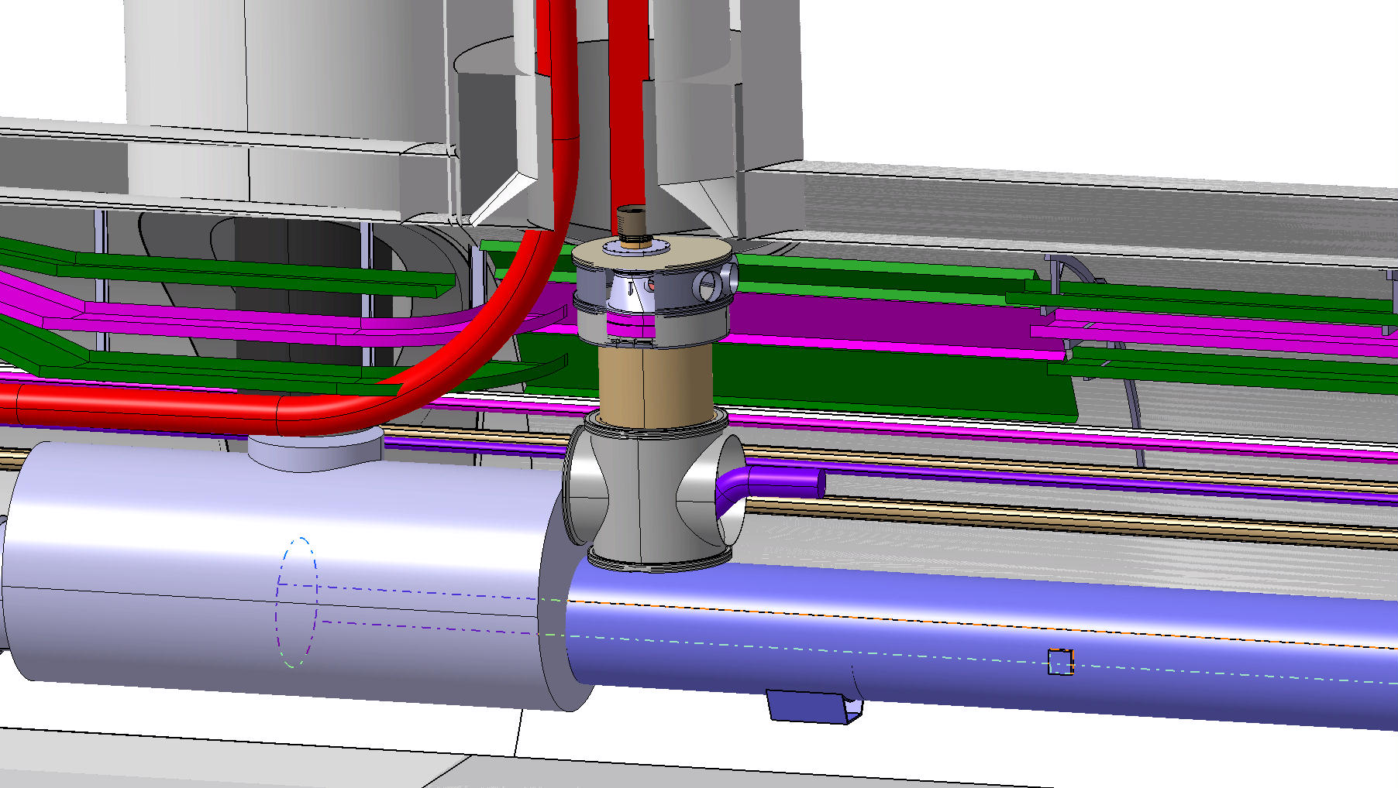
Close the chamber

