Slide 2
LHC BIF test setup - update
S. Mazzoni, 13/12/2018

Slide 3
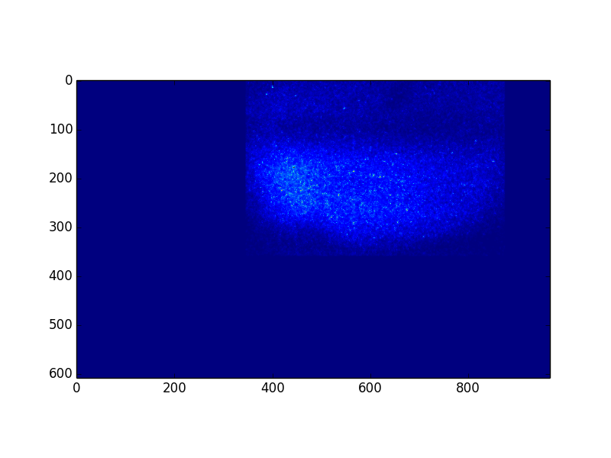
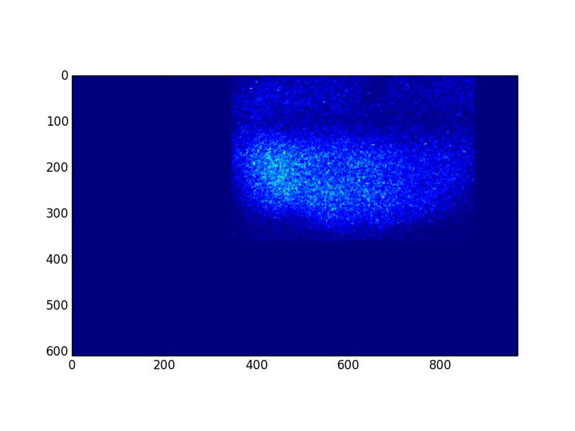
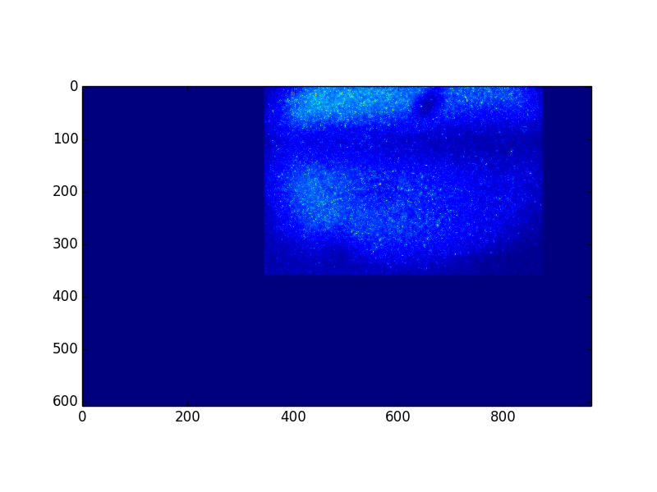
Data from Pb+ at injection
Fill 7481, 28/11/2018. Acquired data at injection:
  with / without gas and block filter, beam on
  with / without gas and 585 nm filter, beam on
Fill 7487, 30/11/2018. Acquired data at injection:
  With gas, no beam, 585 nm filter
  With gas, with beam, 585 nm filter
585 nm, gas ON, beam OFF
“photon counting” over 577.6 s
(1440 frames, 400 ms exp time)
585 nm, gas OFF, beam ON
“photon counting” over 210.8 s
(527 frames, 400 ms exp time)
585 nm, gas ON, beam ON
“photon counting” over 1286.4 s
(3216 frames, 400 ms exp time)

Slide 4
Data from Pb+ at injection
Fill 7481, 28/11/2018. Acquired data at injection:
  with / without gas and block filter, beam on
  with / without gas and 585 nm filter, beam on
Fill 7487, 30/11/2018. Acquired data at injection:
  With gas, no beam, 585 nm filter
  With gas, with beam, 585 nm filter
585 nm, gas ON, beam OFF
“photon counting” over 577.6 s
(1440 frames, 400 ms exp time)
585 nm, gas OFF, beam ON
“photon counting” over 210.8 s
(527 frames, 400 ms exp time)
585 nm, gas ON, beam ON
“photon counting” over 1286.4 s
(3216 frames, 400 ms exp time)

Slide 5
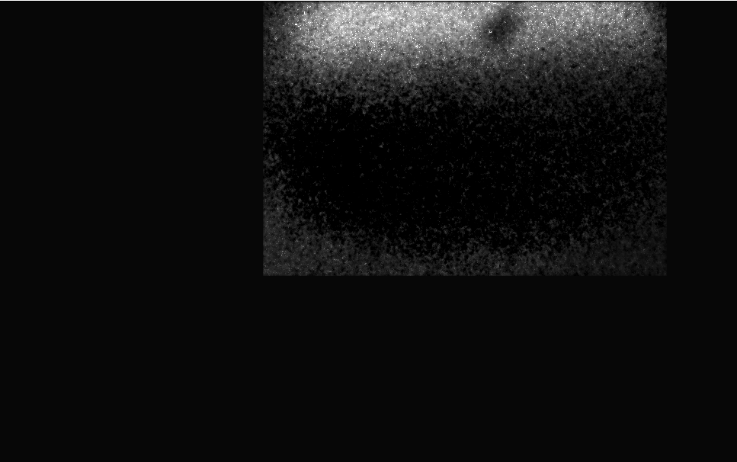
Data from Pb+ at injection
Background (beam off gas on, beam on gas off) subtracted from data. Different exposure times accounted for:
  Result(x,y) = Signal(x,y)-(3216/1440)BG(gas ON, beam OFF)(x,y)- (3216/527)BG(gas OFF, beam ON)(x,y)

Slide 6
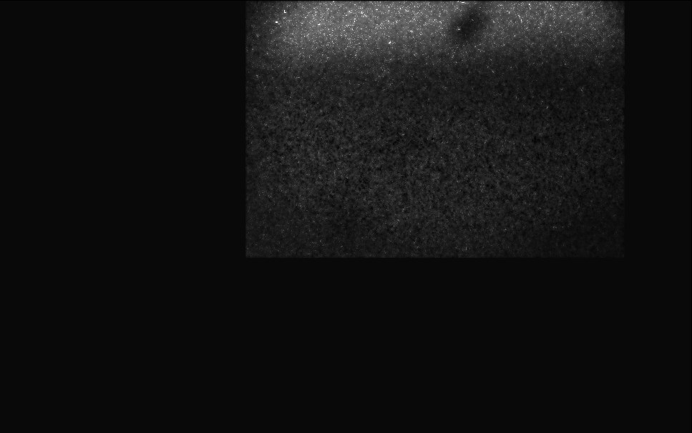
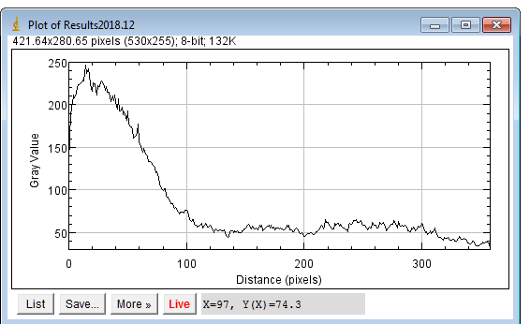
Data from Pb+ at injection
Transverse size? Streak at the edge of image, difficult to analyse.
From vertical projection, compatible with a line of
FWHM = 90x40 um = 3600 um +/- error to be estimated
σ = 2.35 FHWM = 1500 um +/- error to be estimated
PRELIMINARY!
Within order of magnitude from expected σ (1 mm). Long exp time, no orbit feedback at injection

Slide 7
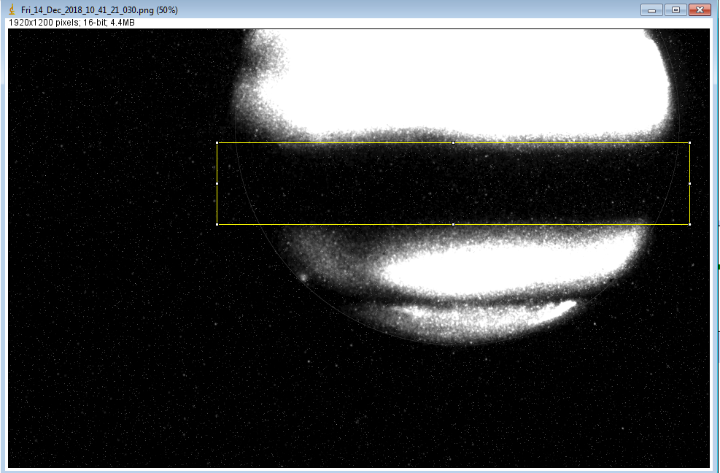
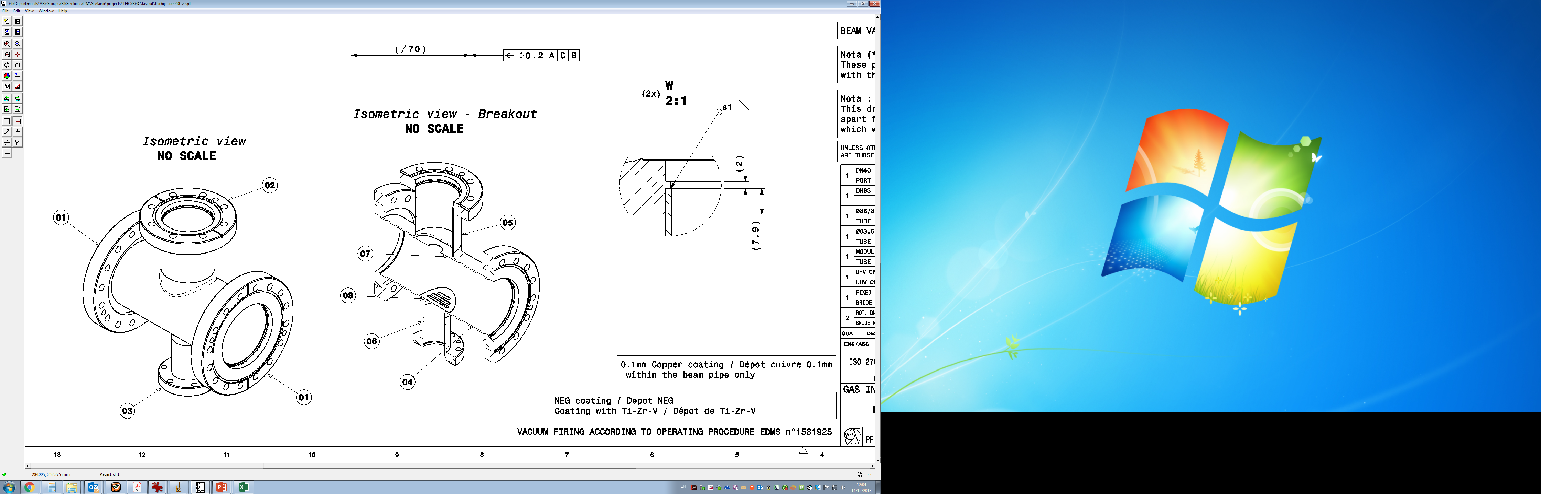
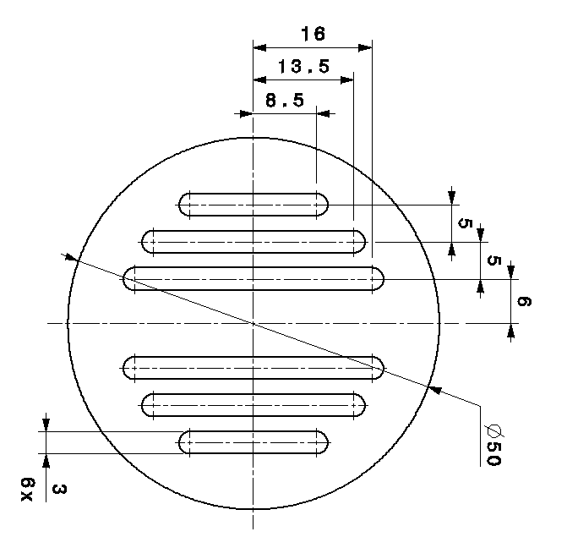
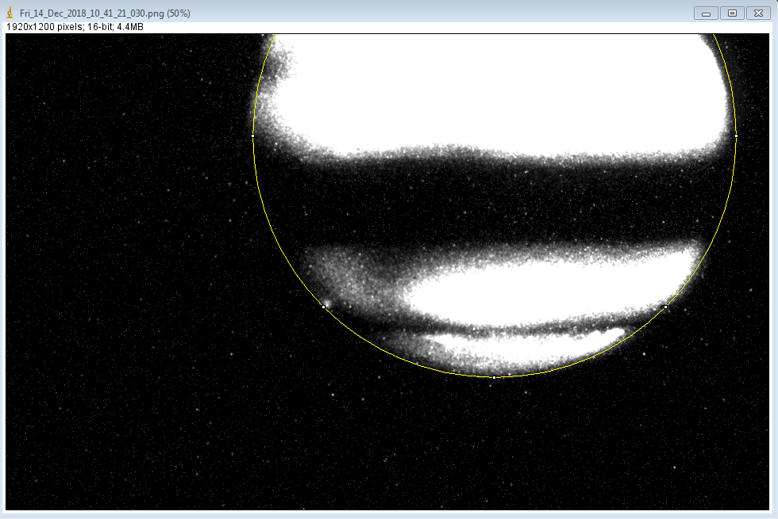
Data from Pb+ at injection
HOWEVER Horizontal position off by several mm.
DN40 port grid
20 mm dia circular aperture

Slide 8
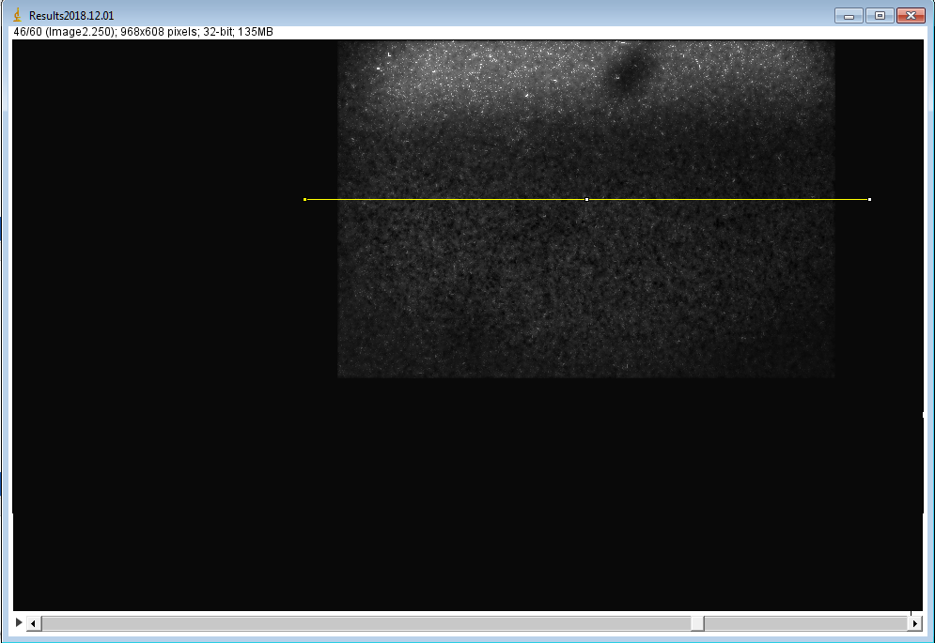
Data from Pb+ at injection
HOWEVER Horizontal position off by several mm.
Vertical offset: 5.5 mm

Slide 9
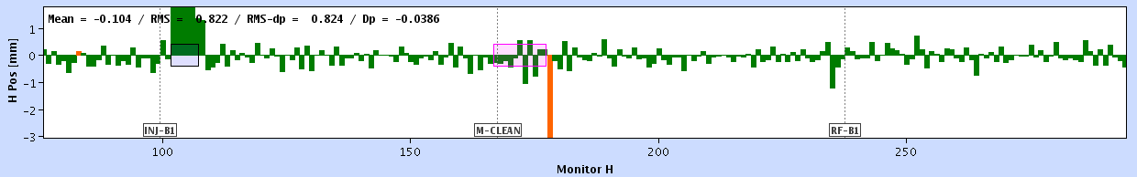
Data from Pb+ at injection
Orbit position during injection deviates of max 1.2 mm. (shown 30/11/2018, 18:30:59 hh:mm:ss)
Will check with BPM team to find out exact absolute displacement
Vacuum chamber aligment? Check it tilted wrt vertical
BPMYA.5L4.B1
BPMWI.5L4
BPMWA.5L4

Slide 10
Conclusions & outlook
Some signal found with Pb+ at injection only when both gas and beam are present
Signal compatible with a 1.5 mm sigma streak.
Apparent position is 5.5 mm off the BP centre in the H plane: excessive for LHC beam
TO BE CHECKED:
Position of beam from BPMs during injection
Beam jitter during injection (orbit feedback is off at injection)
Alignment of chamber, lab tests to confirm (or not) the 5.5 mm offset

