Slide 1
EDIPO magnet assembly
Flared-end block-coil designs
December 12th, 2018
X. Sarasola
(EPFL - Swiss Plasma Center)

Slide 2
Outline
Goals and design constraints
Strand and cable
Flared-end block-coil designs
  Magnet layout
  Magneto-static analysis
  Mechanical 2D model
Conclusions

Slide 3
Goals
Main targets of the upgraded test facility:
  15 T in a large aperture
  Operation at 4.2K and 85% of short sample limit
  Homogeneous field length of 1000 mm
  Wide range of temperature: T_{sample} = 4.2 - 80 K
  High-current: I_{sample} ≤ 100 kA

Slide 4
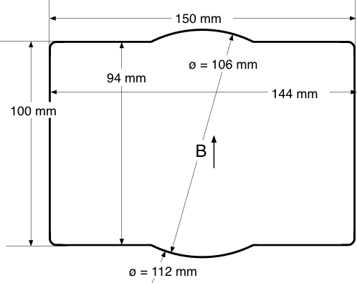
Design constraints
The coil aperture shall fit a 3-mm-thick vacuum chamber able to host:
  SULTAN samples (94×144 mm aperture)
  A counter-cryostat to test 100-mm-OD dipole inserts at variable temperature

Slide 5
Design constraints
The coil aperture shall fit a 3-mm-thick vacuum chamber able to host:
  SULTAN samples (94×144 mm aperture)
  A counter-cryostat to test 100-mm-OD dipole inserts at variable temperature
Overall assembly length ≤ 2500 mm
Overall assembly diameter ≤ 1420 mm
Overall assembly weight ≤ 20 t
Operating temperature: 4.2 K
Operating current ≤ 17 kA
Dump voltage to ground ≤ 1 kV (sym ground)
Allowable coil hot spot temperature: 350 K

Slide 6
Outline
Goals and design constraints
Strand and cable
Flared-end block-coil designs
  Magnet layout
  Magneto-static analysis
  Mechanical 2D model
Conclusions

Slide 7
Strand and cable
A 1.1 mm strand proposed for the magnets of the FCC could be also appropriate for EDIPO
The proposed cable is a high aspect ratio Rutherford cable
Strand parameters
Cable parameters
Strand type | FCC
Diameter | 1.1 | mm
Technology | RRP 108/127
Cu:non-Cu | 1
RRR | >150
Min. J_{c} @ 15 T (12 T), 4.2 K | 1640 (3000) | A/mm²
D_{eff,max} | 60 | µm
Number of strands | 44
Bare width* | 26.2 | mm
Bare thickness* | 1.95 | mm
Compaction | 81 | %
Insulation thickness | 150 | µm
*After reaction

Slide 8
Outline
Goals and design constraints
Strand and cable
Flared-end block-coil designs
  Magnet layout
  Magneto-static analysis
  Mechanical 2D model
Conclusions

Slide 9
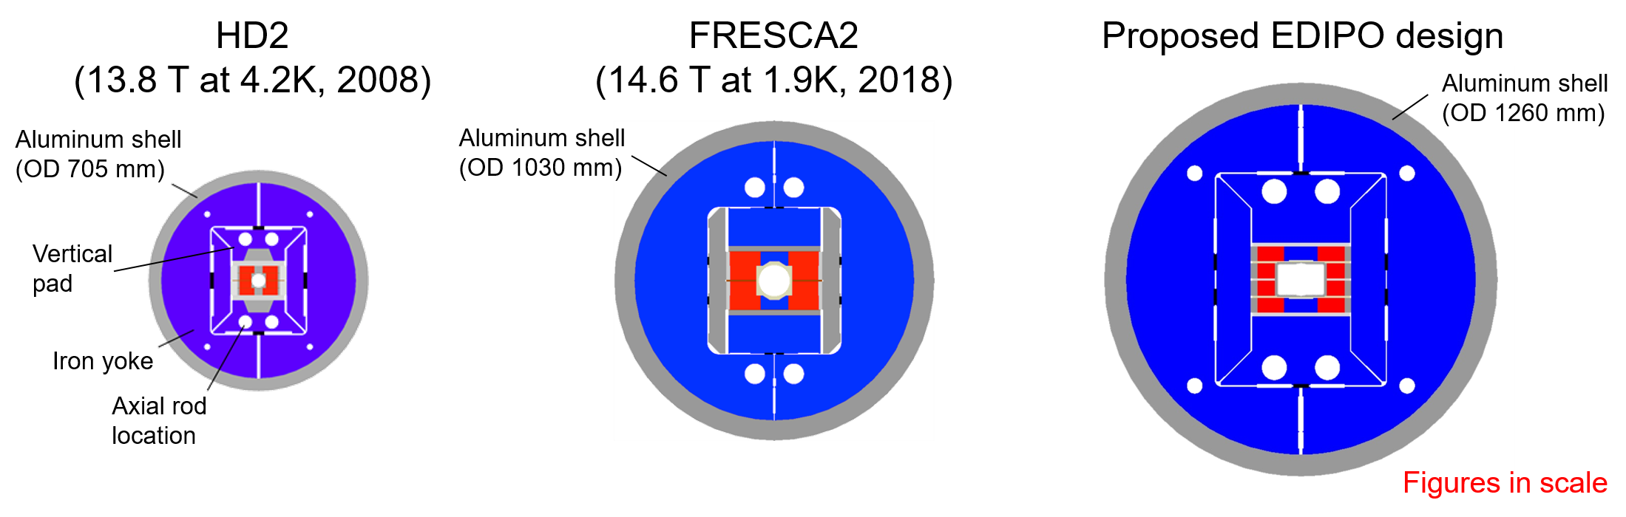
Flared-ends coil-block designs
The former EDIPO was a 12.35 T dipole based on a CICC design
The new dipole will look more like an accelerator-type magnet
The main features of the proposed flared-ends designs have been validated in HD2 and FRESCA2
The designs also rely on the conceptual design of LD1

Slide 10
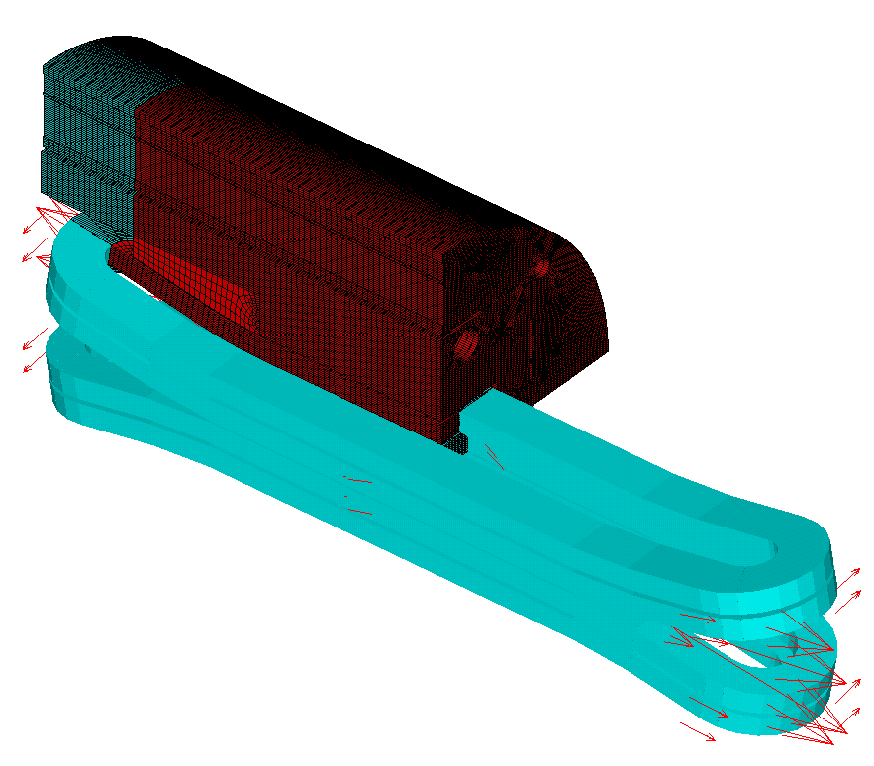
Flared-ends coil-block designs
The former EDIPO was a 12.35 T dipole based on a CICC design
The new dipole will look more like an accelerator-type magnet
The main features of the proposed flared-ends designs have been validated in HD2 and FRESCA2
The designs also rely on the conceptual design of LD1

Slide 11
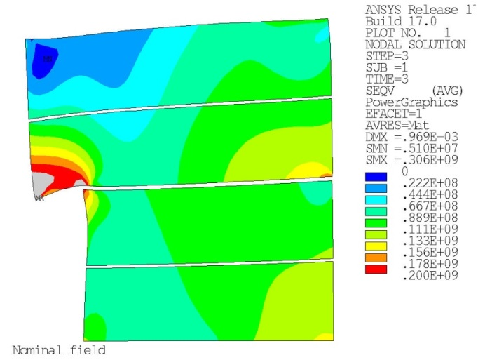
Main design drivers
Minimization of the stress in the coil windings
  Test samples of Nb₃Sn Rutherford cables [1]:
    Up to 140 MPa, the degradation is almost reversible
    Beyond 160 MPa, permanent degradation observed
Particularly challenging given the shape of the aperture
If the reluctance forces in the iron parts are included, the peak stress can exceed 300 MPa
[1] J. Duvauchelle, B. Bordini, et al., IEEE Trans. Appl. Supercond., 28, 2018, 4802305.

Slide 12
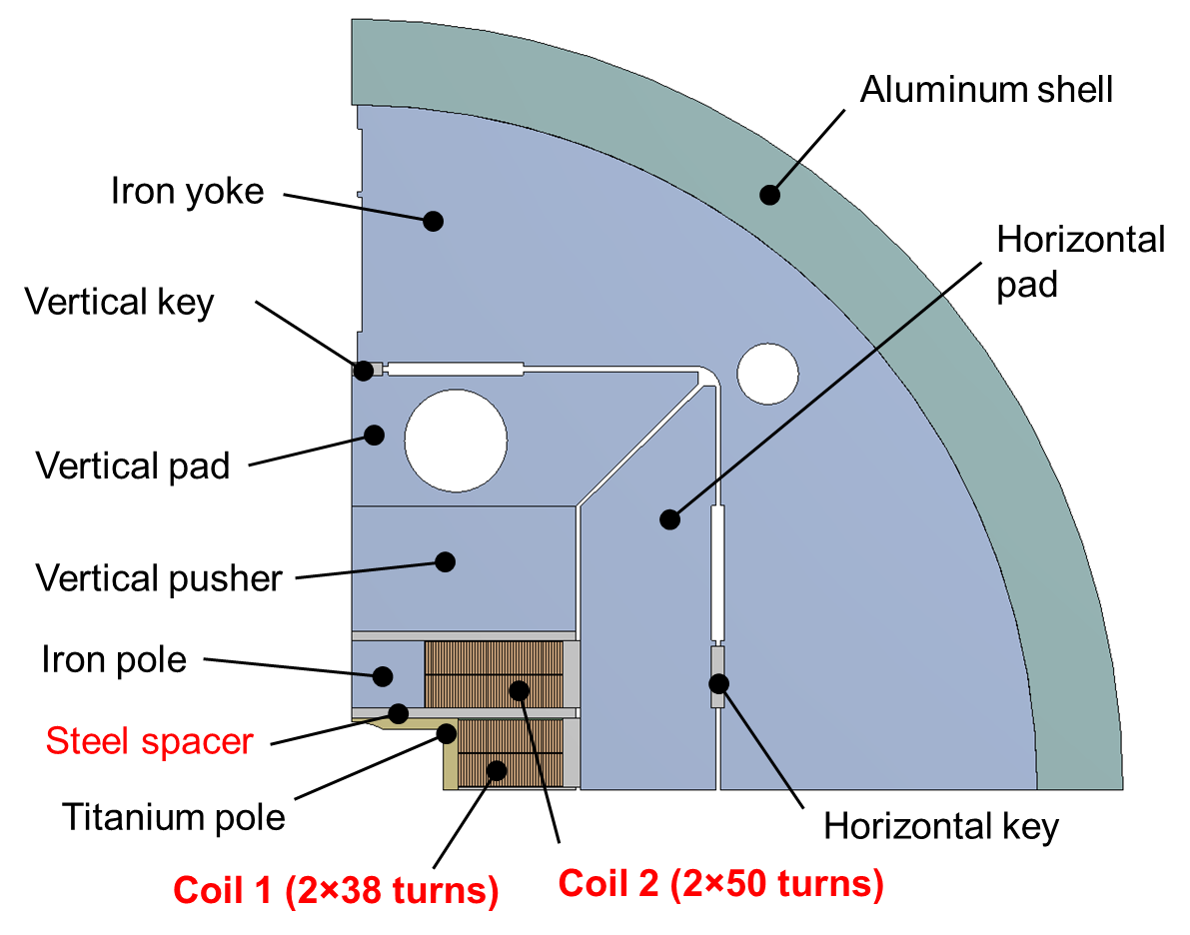
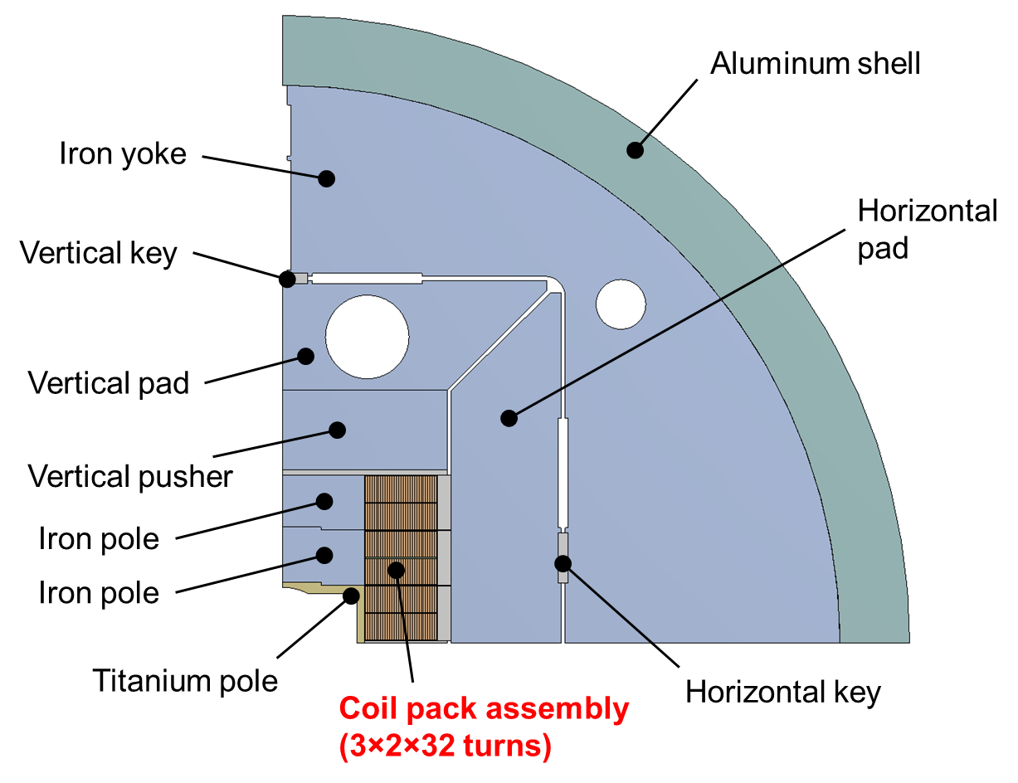
Magnet layout
Both flared-ends designs are based in the conceptual design of LD1
Both are non-graded designs
1. Window frame design
2×38 + 2×50 turns
Steel spacer between coils
2. High aspect ratio rect. coil pack
3×2×32 turns

Slide 13
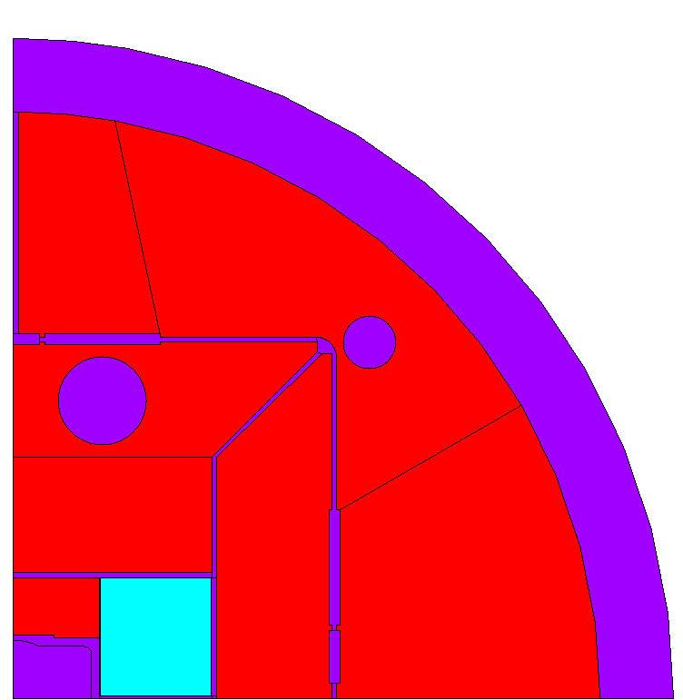
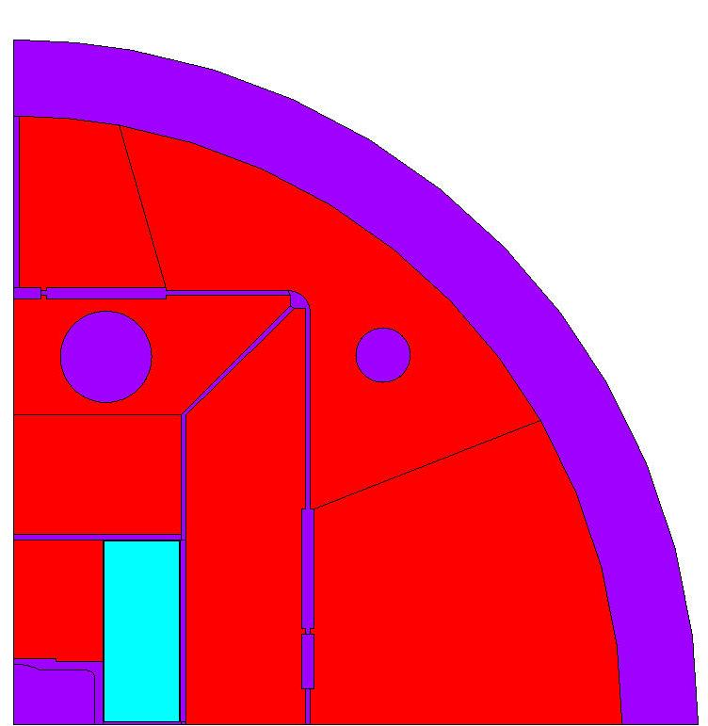
Design 2: optimization cross-section
A wide range of height-to-width aspect ratios (b/a) have been explored to generate the required field in the aperture, minimizing the winding cross section and conductor peak field
Optimal aspect ratio (b/a) is found between 3 and 4
Trade-off found at b/a = 2.37 (3 double pancakes of 32 turns)
Aspect ratio = 2.37
Aspect ratio = 1.05

Slide 14
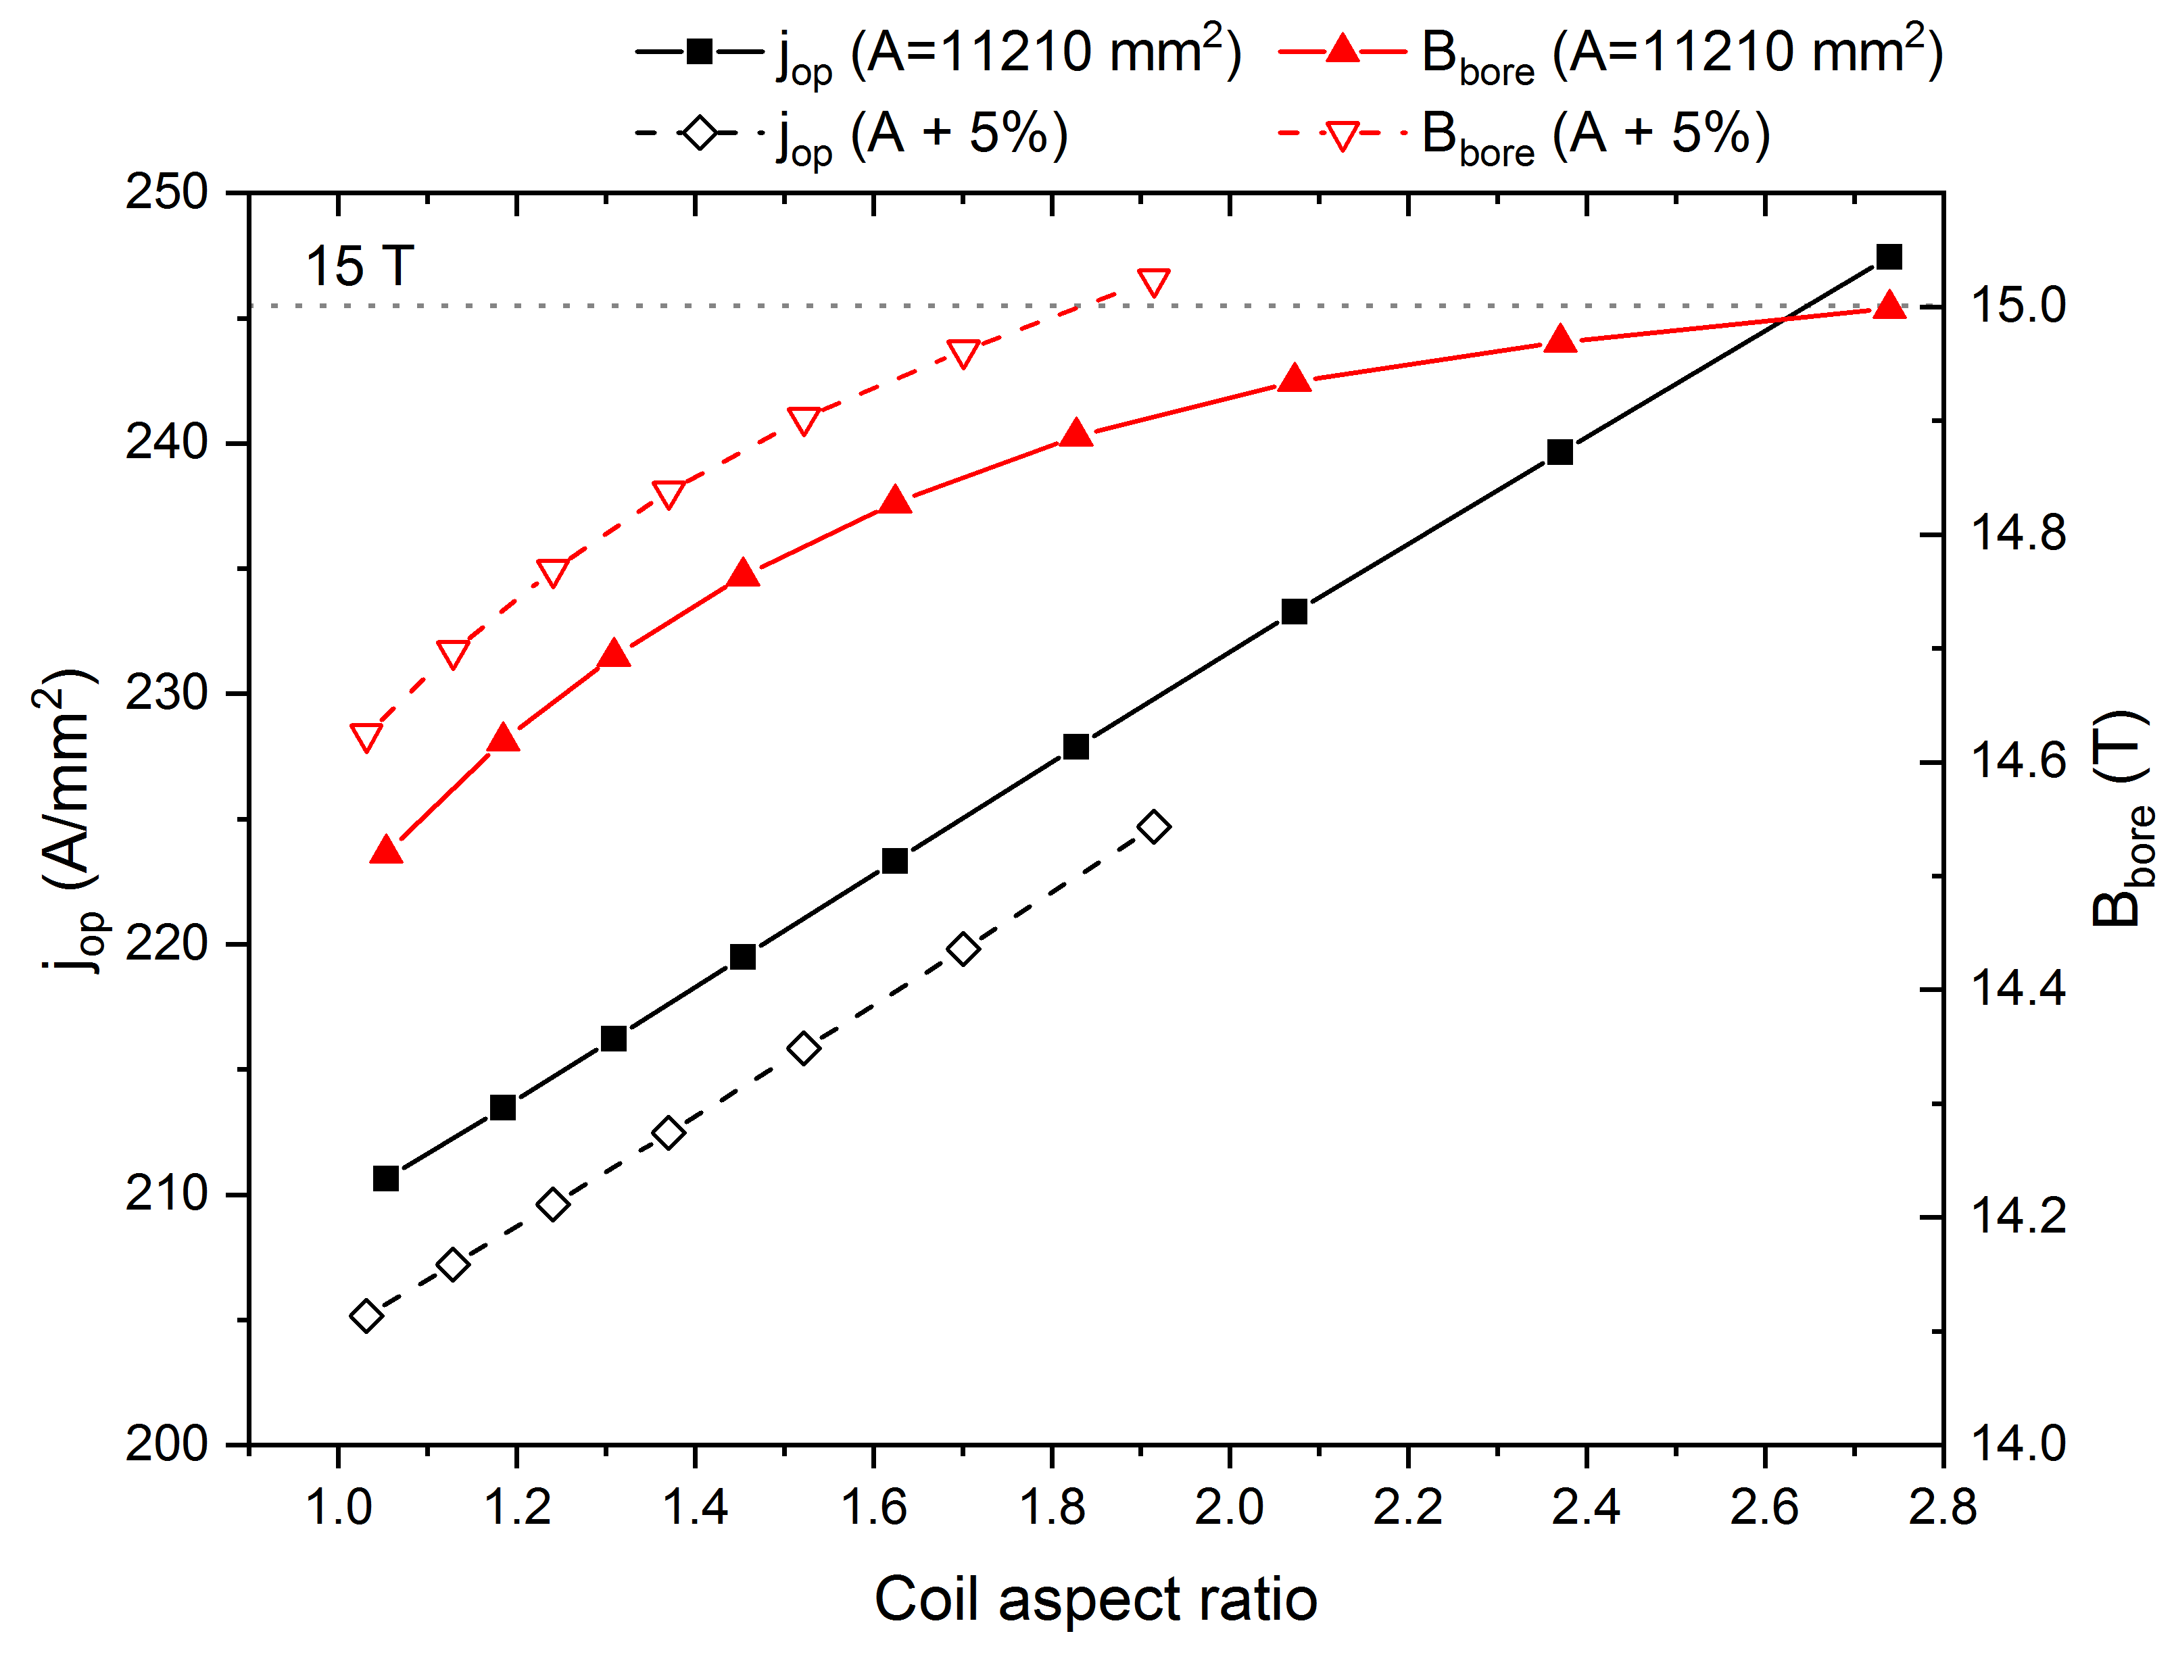
B_{bore} vs aspect ratio

Slide 15
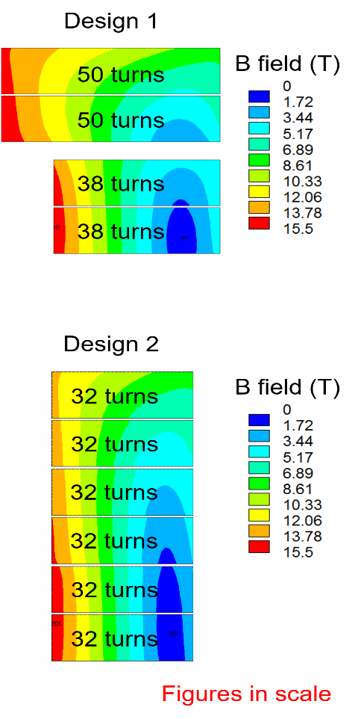
Magneto-static analysis
 |  | Design 1 | Design 2
Number of turns / pole |  | 2×38+2×50 | 3×2×32
A_{conductor} / pole |  | 10494 | 11448 (+9%) | mm²
I_{op} (0.85×I_{ss}) |  | 14.43 | 14.11 | kA
Current density (insulated cable) |  | 242.0 | 236.6 | A/mm²
B_{bore} |  | 15.03 | 15.00 | T
Max B_{cond} |  | 15.34 | 15.42 | T
Stored magnetic energy |  | 6.5 | 6.7 | MJ/m
Homogeneous field length (1%) |  | 975 | 977 | mm
Total coil Lorentz force | F_{x} | 13.9 | 14.2 | MN/m
 | F_{y} | -7.6 | -7.2 | MN/m
 | F_{z} | 1.5 | 1.7 | MN
Reluctance force (Vertical pad+ pusher) | F_{x} | -4.3 | -3.0 | MN/m
 | F_{y} | -2.3 | -2.0 | MN/m
Operational
(85% × short sample)

Slide 16
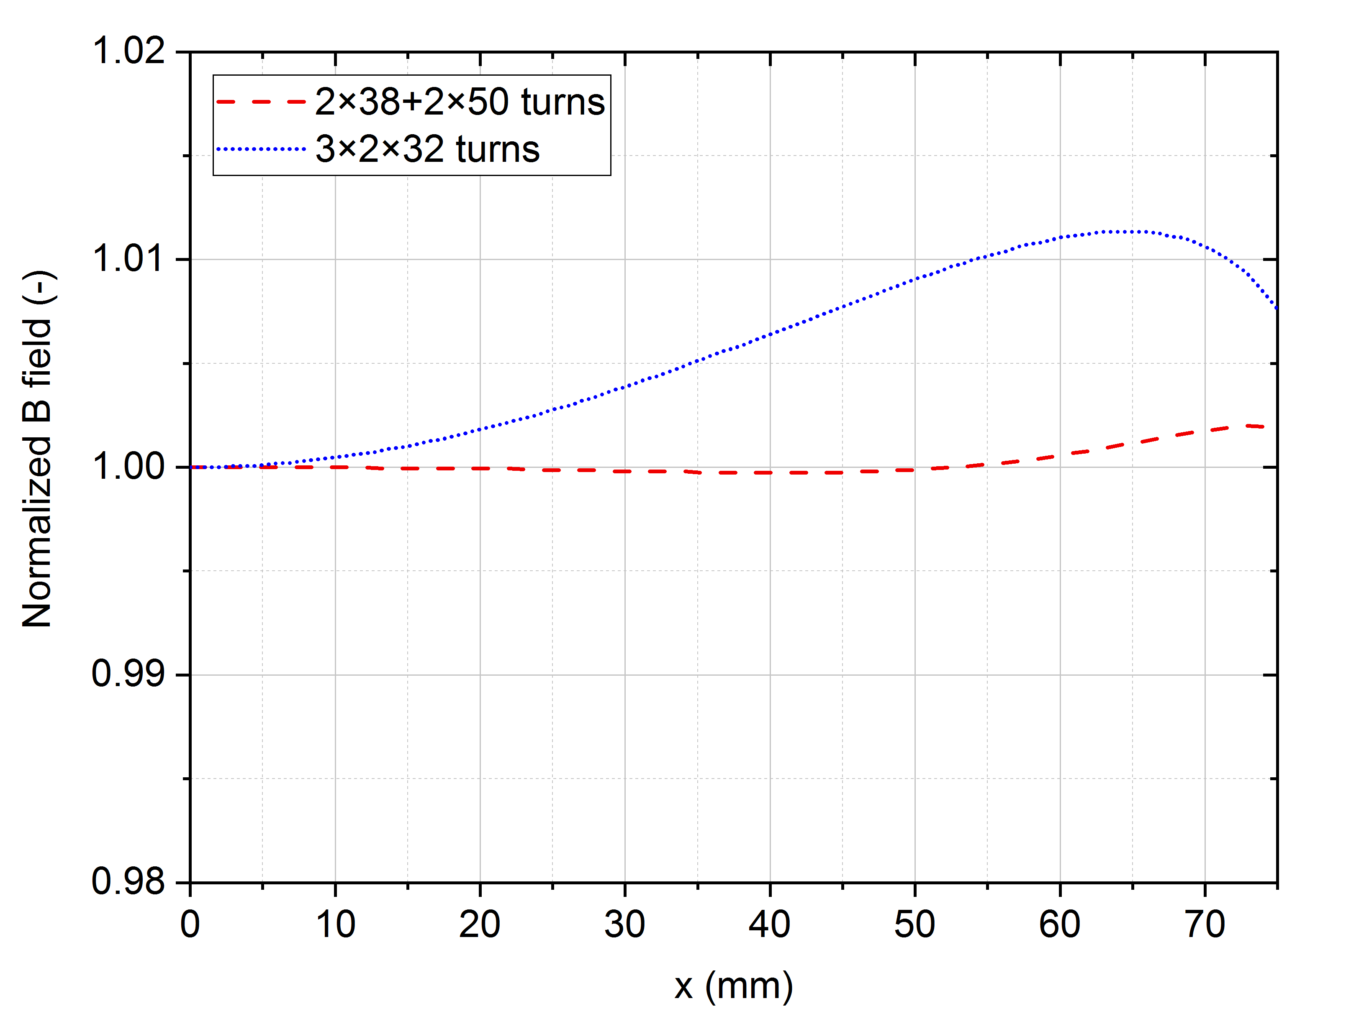
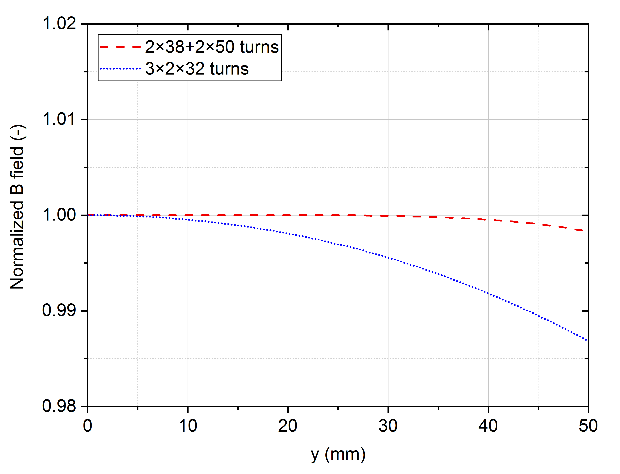
Magnetic field quality
The field quality of the design 1 has been optimized to accelerator quality levels
But EDIPO is a conductor test facility
  Field homogeneity of ±1 % is acceptable
Normalized B field along x axis
Normalized B field along y axis

Slide 17
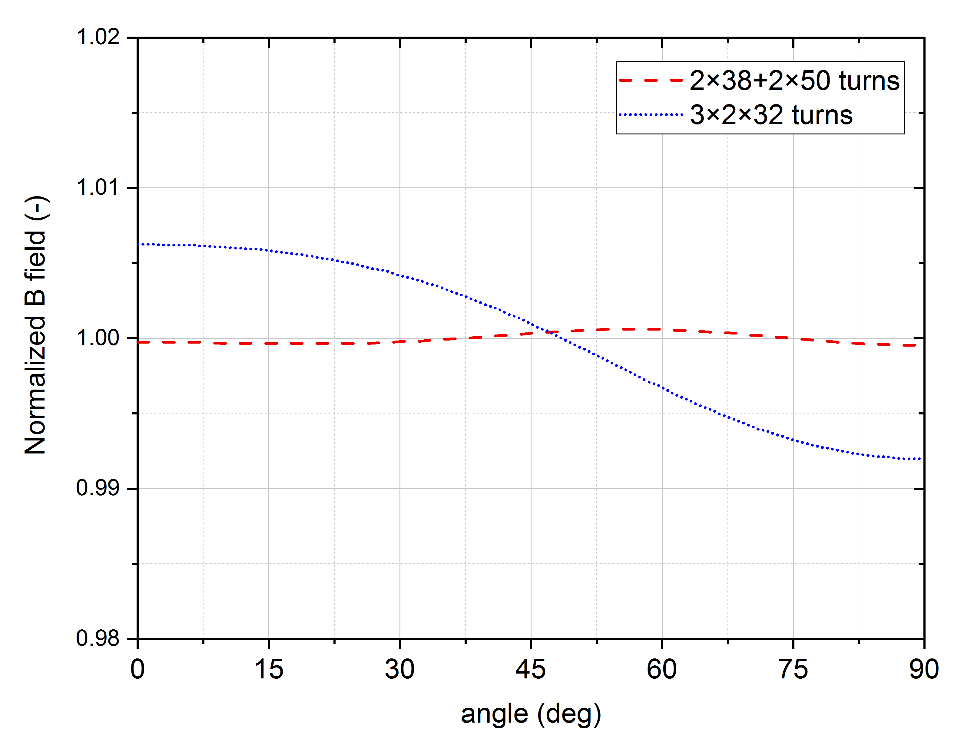
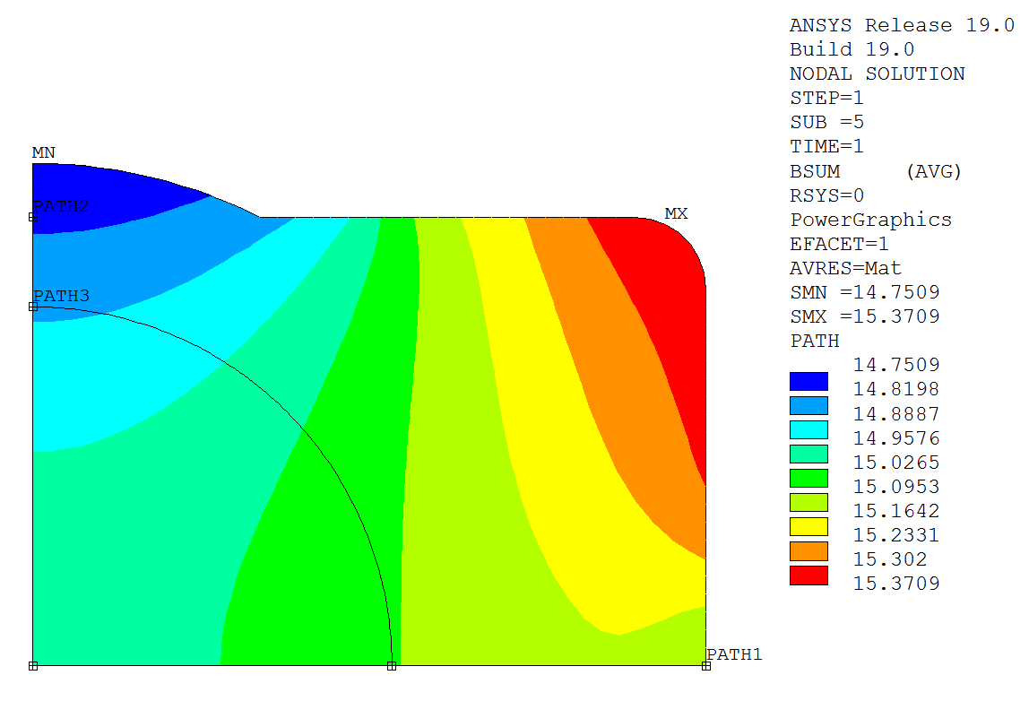
Magnetic field quality
The field quality of the design 1 has been optimized to accelerator quality levels
But EDIPO is a conductor test facility
  Field homogeneity of ±1 % is acceptable
Field in the aperture (3×2×32)
Normalized B field around R_{ref} = 40 mm
R_{ref} = 40 mm

Slide 18
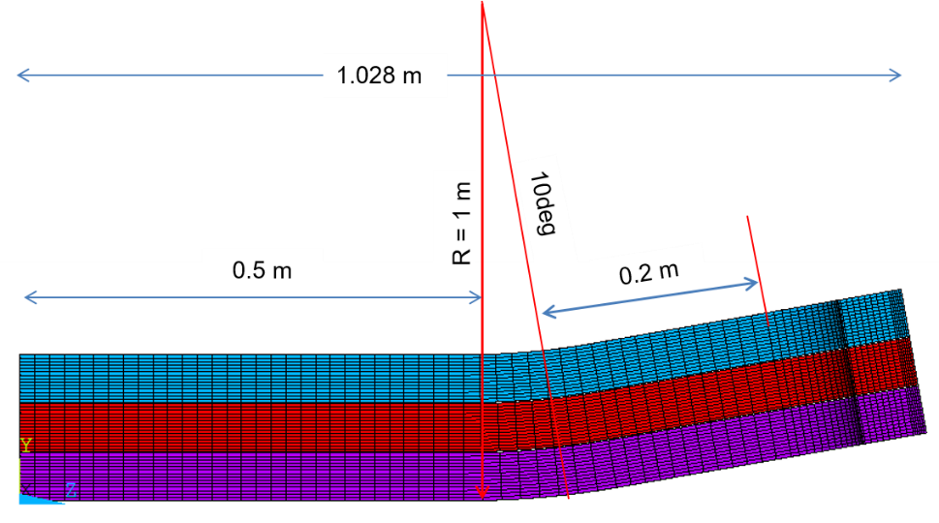
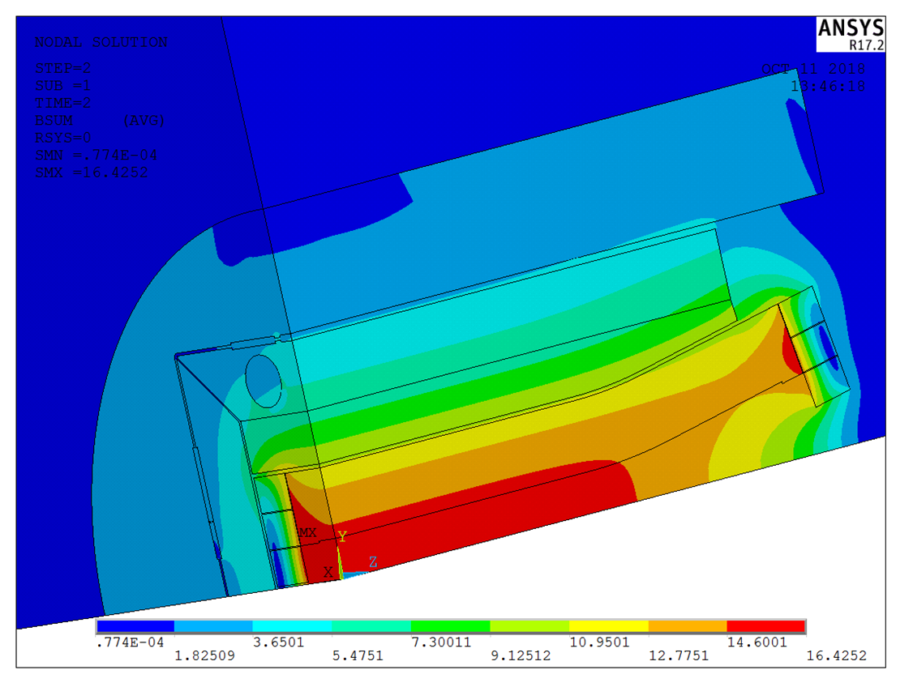
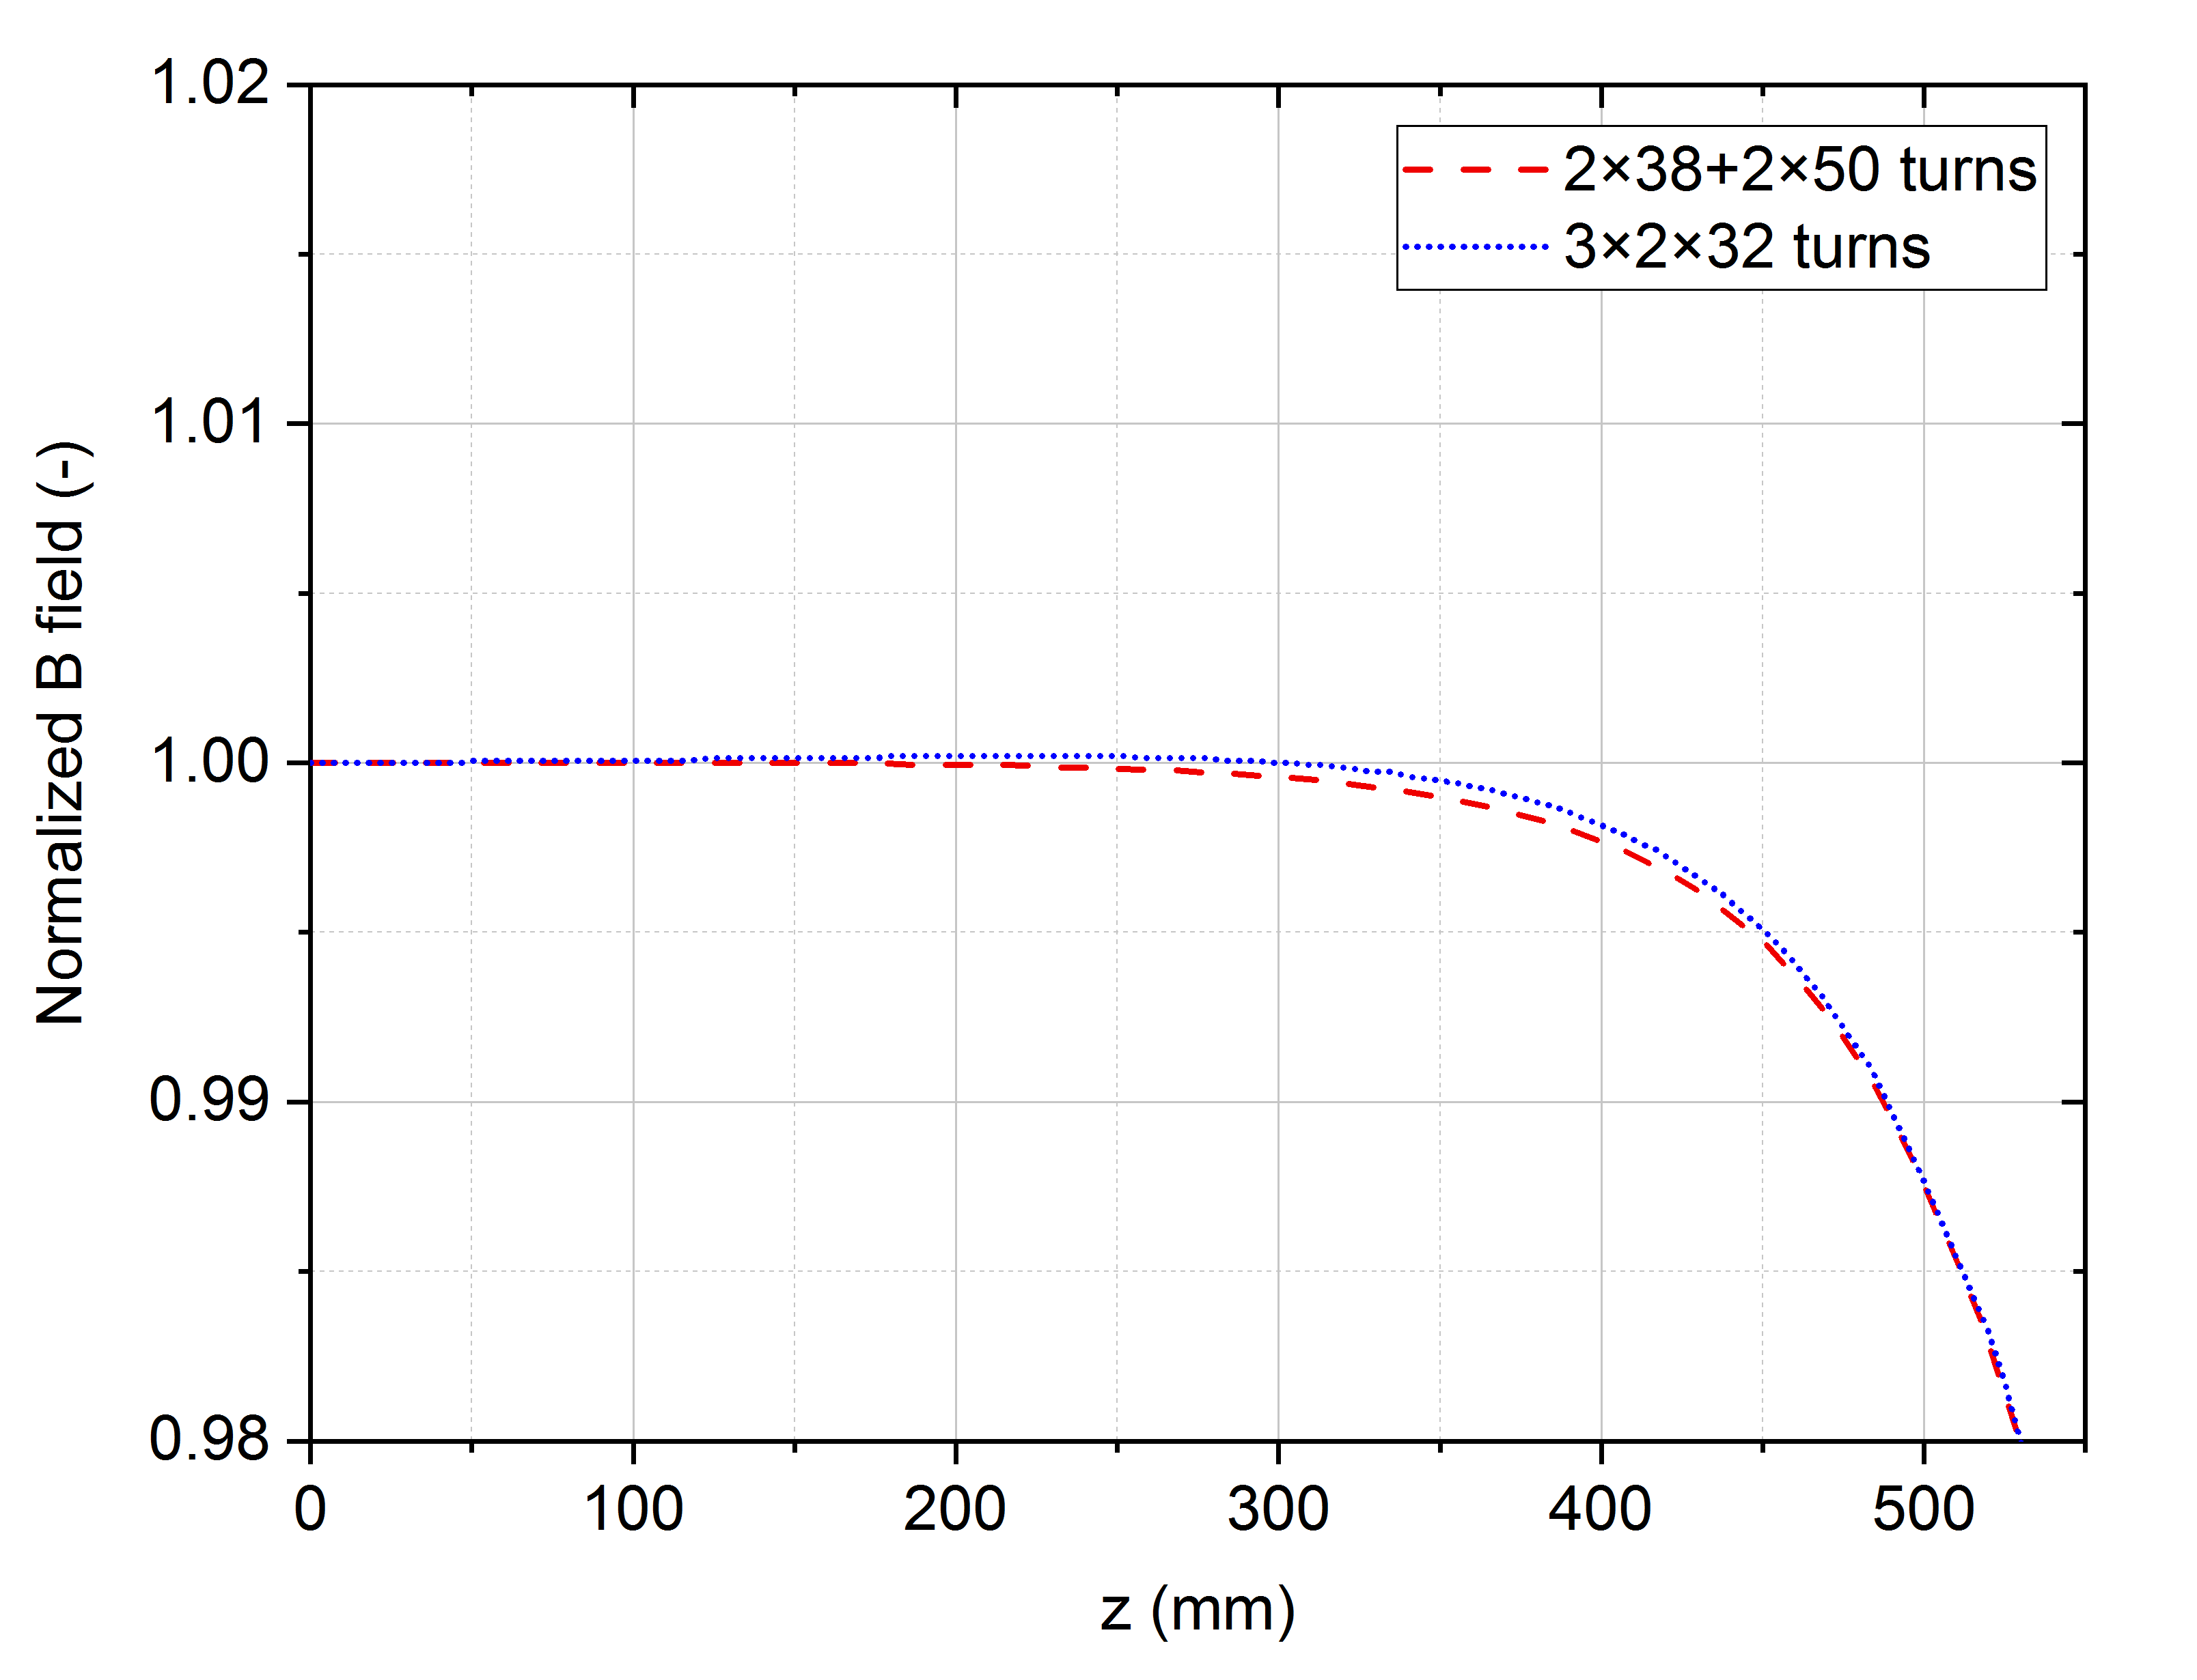
Magnetic field quality
Normalized B field along z axis

Slide 19
Mechanical 2D model
Shell-based mechanical structure:
  Al shell preloaded with pressurized bladders and locked with keys
  Axial preload given by end-plates and rods
  Coil pre-stress minimizes motion during coil powering
Mechanical properties:
  Coil: latest agreed properties for the design of the FCC dipoles [2]:
    E = 25 GPa (at 293 K and 4.2 K)
    α = 0.38 % (between 293 and 4.2 K)
  SS, aluminum, iron and titanium: specified for EuroCirCol magnets [3]
Contacts:
  Bonded between poles and coils (detachable poles also considered)
  Standard sliding contacts elsewhere (µ = 0.2)
[2] D. Schoerling, Private email communication. 13 June 2018
[3] D. Tommasini, “Baseline specifications and assumptions for accelerator magnet: Milestone M5.2,”
https://cds.cern.ch/record/2150689/files/CERN-ACC-2016-0030.pdf

Slide 20
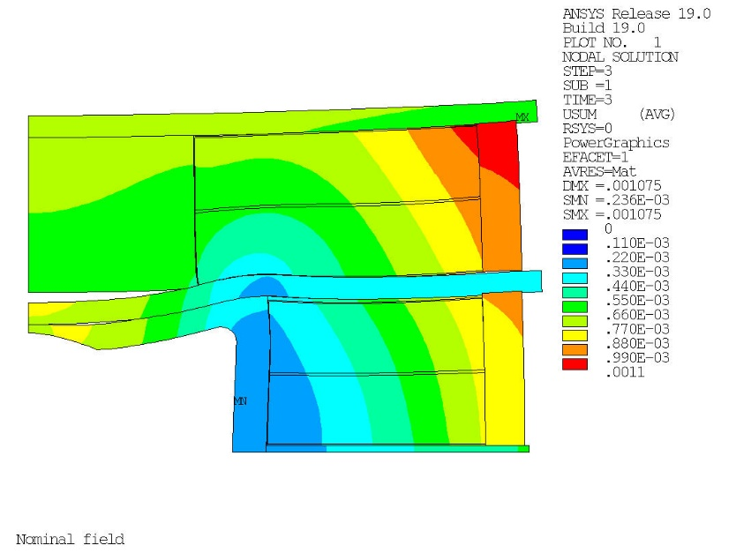
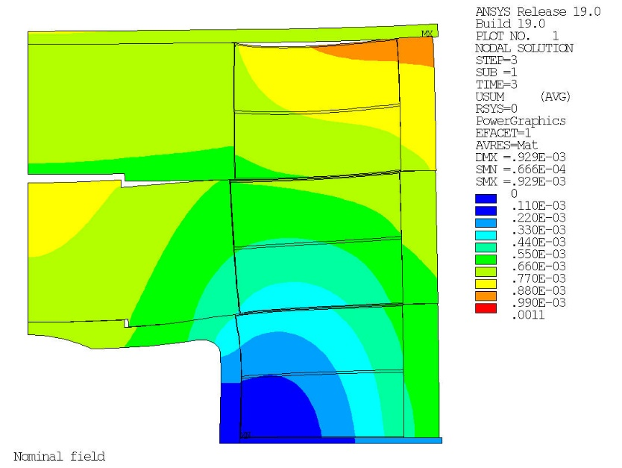
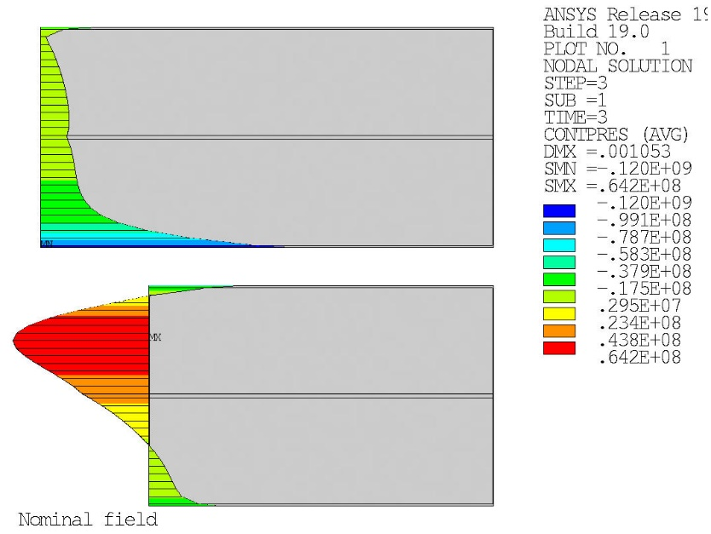
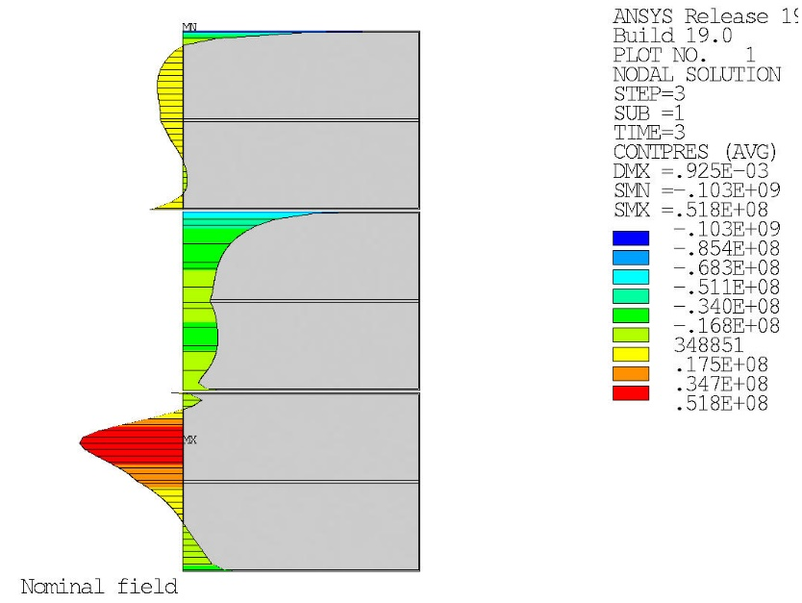
Mechanical 2D model
Design 1 (2×38+2×50 turns)
Design 2 (3×2×32 turns)
Displacement nominal field
Displacement nominal field
Contact pressure nominal field
Contact pressure nominal field
<σ_{pole-coil2}> = -20.0 MPa
<σ_{pole-coil2}> = -19.8 MPa

Slide 21
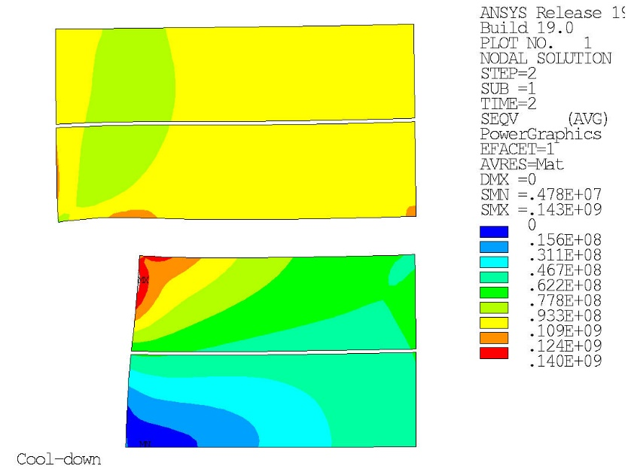
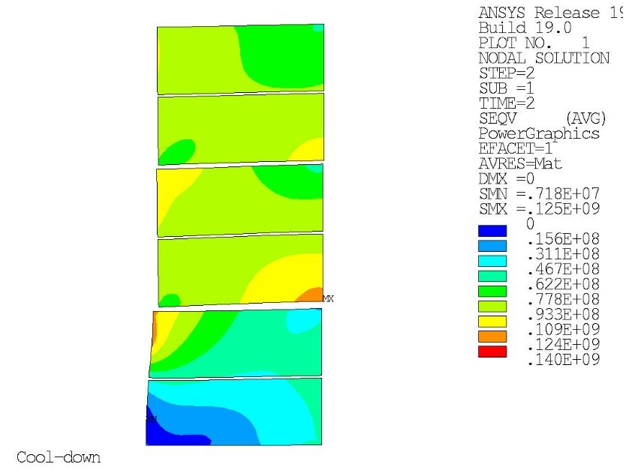
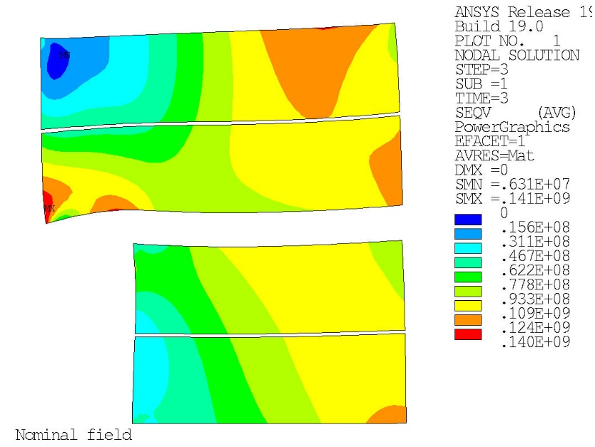
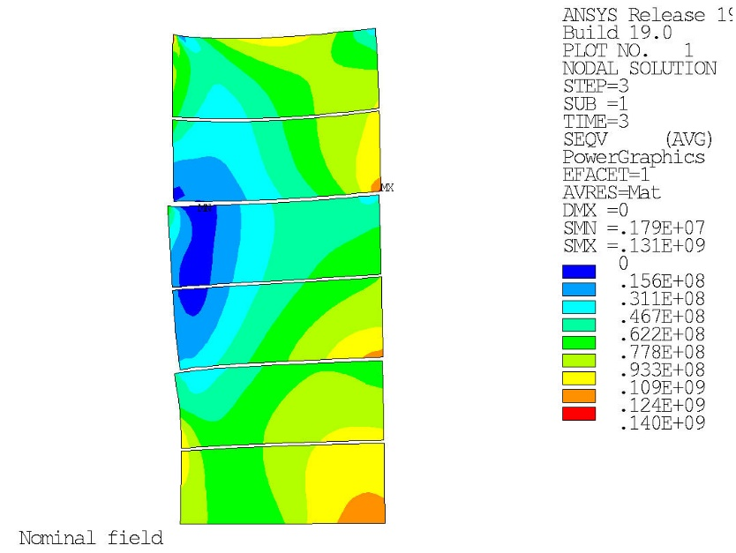
Equivalent stress in the coils
Design 1 (2×38+2×50 turns)
Design 2 (3×2×32 turns)
Cool-down
Cool-down
Nominal field
Nominal field

Slide 22
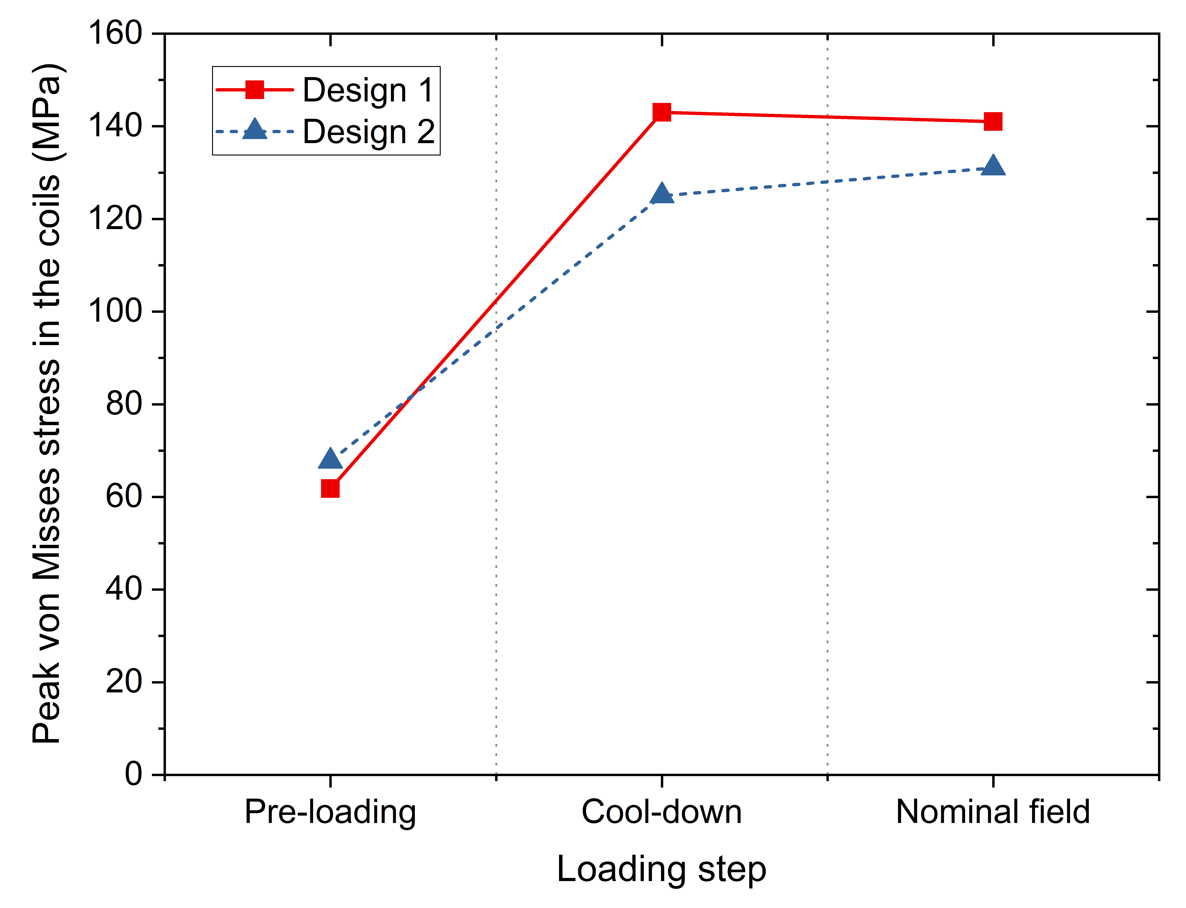
Max equiv. stress in the coils

Slide 23
Outline
Goals and design constraints
Strand and cable
Flared-end block-coil designs
  Magnet layout
  Magneto-static analysis
  Mechanical 2D model
Conclusions

Slide 24
Conclusions
Both flared-end designs satisfy the stringent design requirements:
  Generate 15 T at 4.2 K with the required field homogeneity
  Minimize the stress in the coils below 160 MPa
No major drawbacks are found in either design
 |  | Design 1 | Design 2
Number of turns / pole |  | 2×38+2×50 | 3×2×32
A_{conductor} / pole |  | 10494 | 11448 (+9%) | mm²
I_{op} |  | 14.43 | 14.11 | kA
Current density (insulated cable) |  | 242.0 | 236.6 | A/mm²
B_{bore} |  | 15.03 | 15.00 | T
Field homogeneity | x/y axes | ±0.2% | ±1%
 | R_{ref}=40mm | ±0.1% | ±1%
Homogeneous field length (1%) |  | 975 | 977 | mm
Peak stress |  | 143 | 131 | MPa
Operational
(85% × short sample)

Slide 25
Comparison
Design 1: 2×38 + 2×50 turns
Design 2: 3×2×32 turns
More efficient
Requires the use of a buffer plate between coils
Peak stress in high field region
Constrained to use a very wide cable (given by aperture height)
Has to be wound as 2 double pancakes
9% more conductor to generate the same field
Intrinsically lower stress in the coils
Peak stress in low field region
Not constrained to use a wide cable
More winding flexibility:
  Can be wound as a set of double pancakes, but also…
  Can be wound in layers (instead of pancakes)
Layer winding (1 coil/pole):
  Minimizes manufacturing effort
  Avoids joints & interfaces btw coils

Slide 26
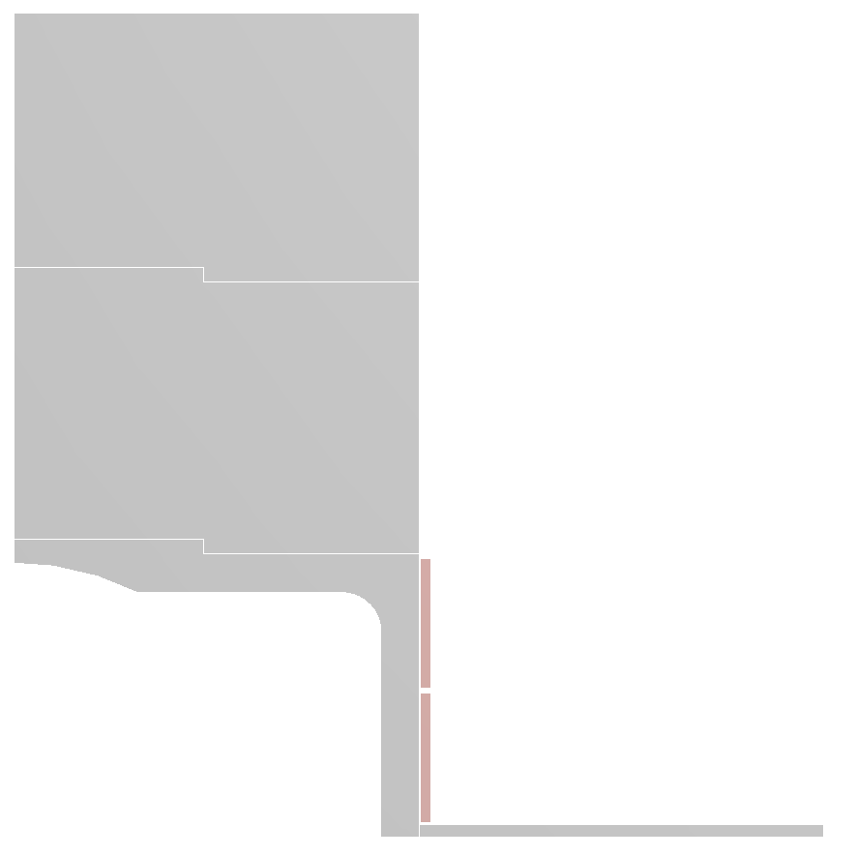
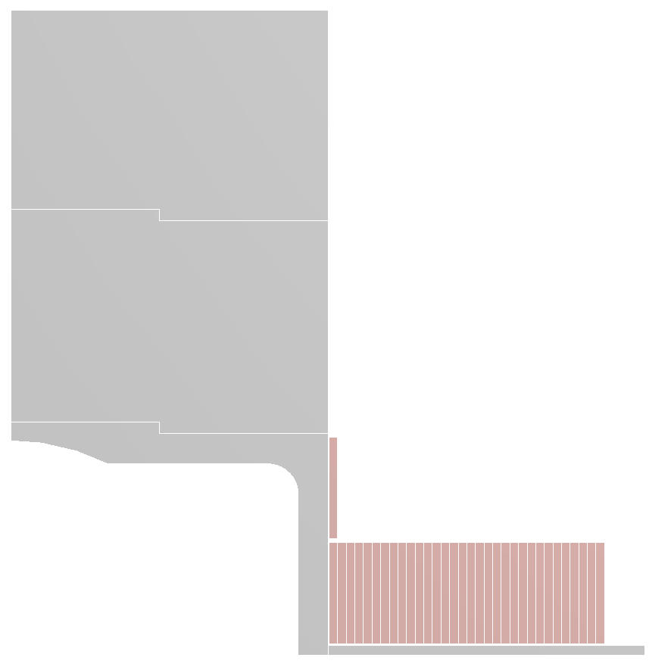
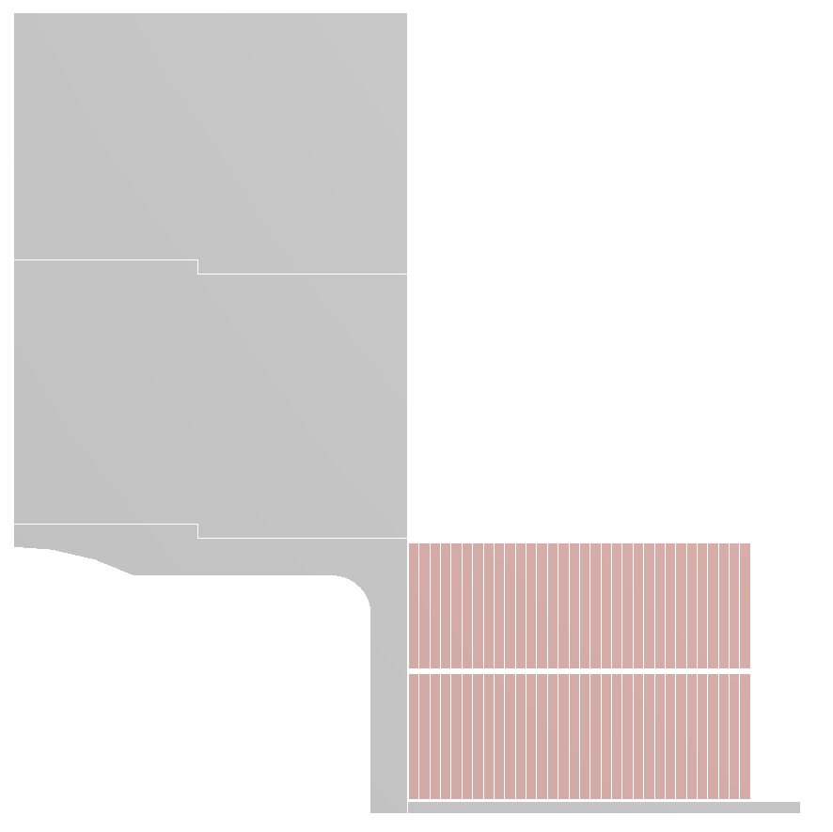
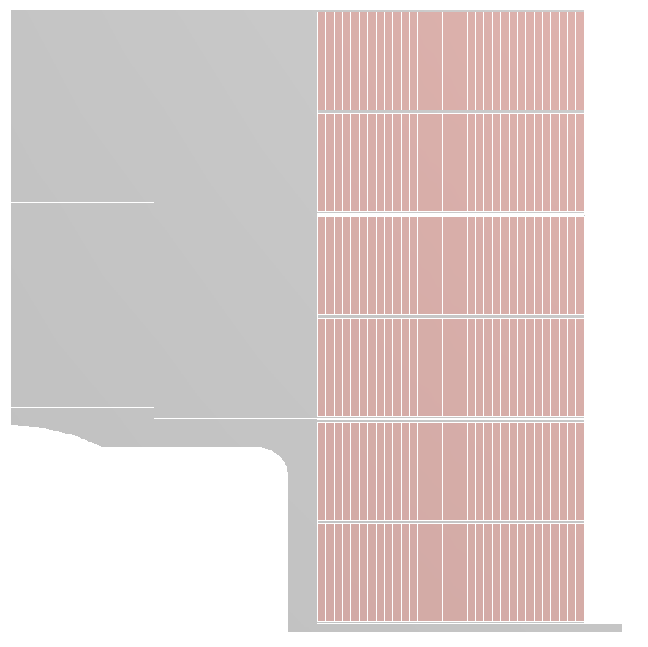
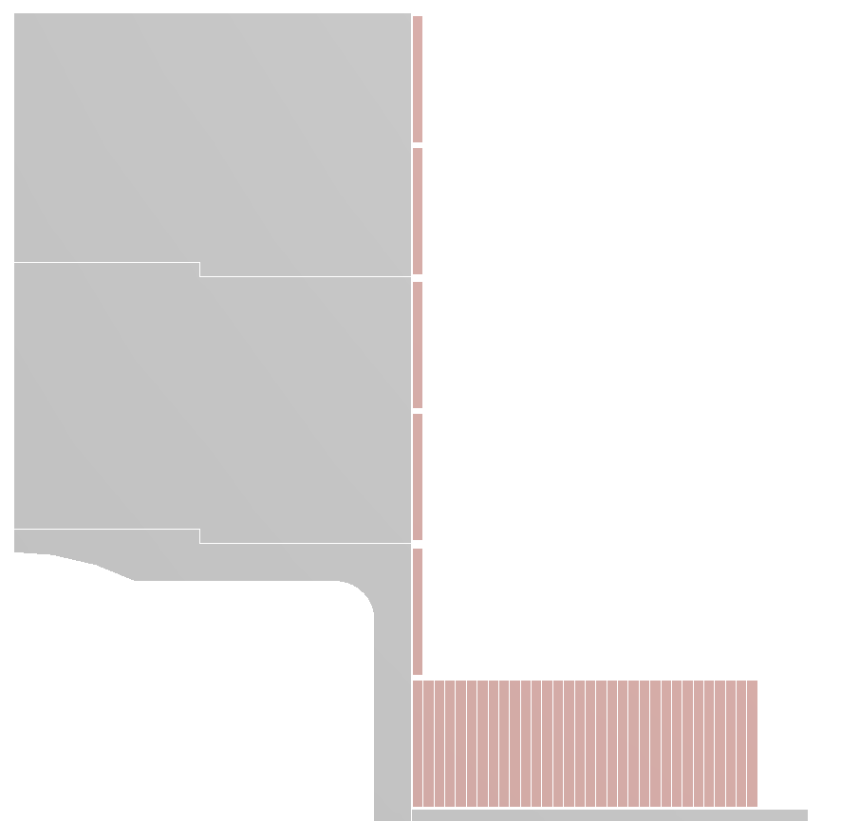

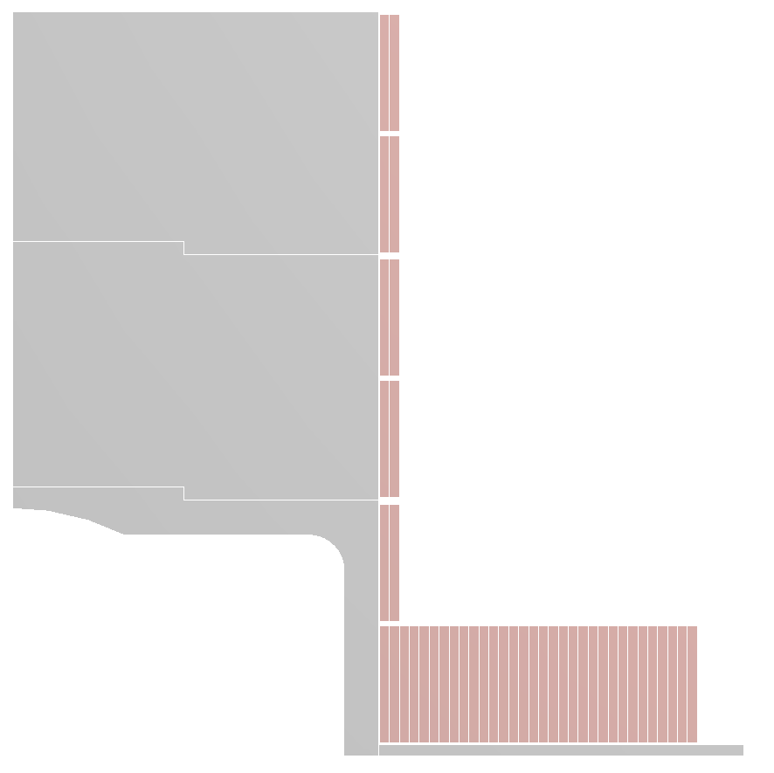
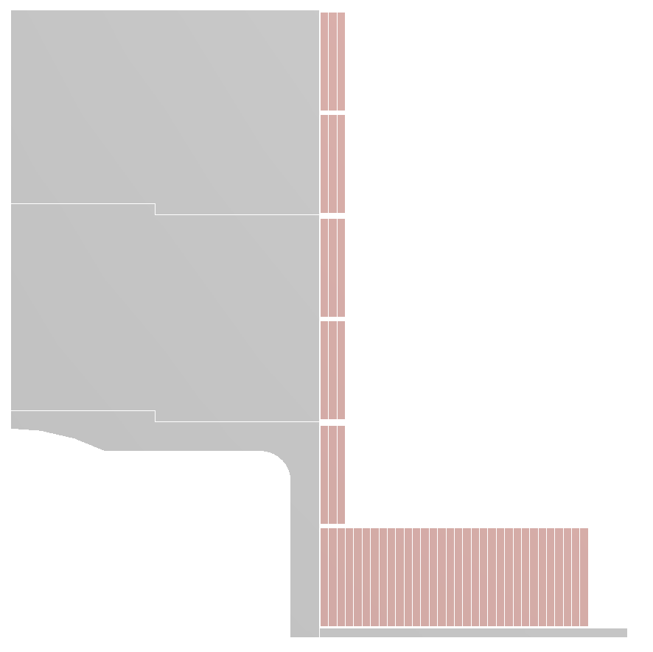
Pancake vs layer winding
Winding in pancakes
Alternative (pancake + layer winding)
  1 coil per magnet pole
  Avoids joints and interfaces between coils
+
-
+
-
+
+
-
-

Slide 27
Additional slides

Slide 28
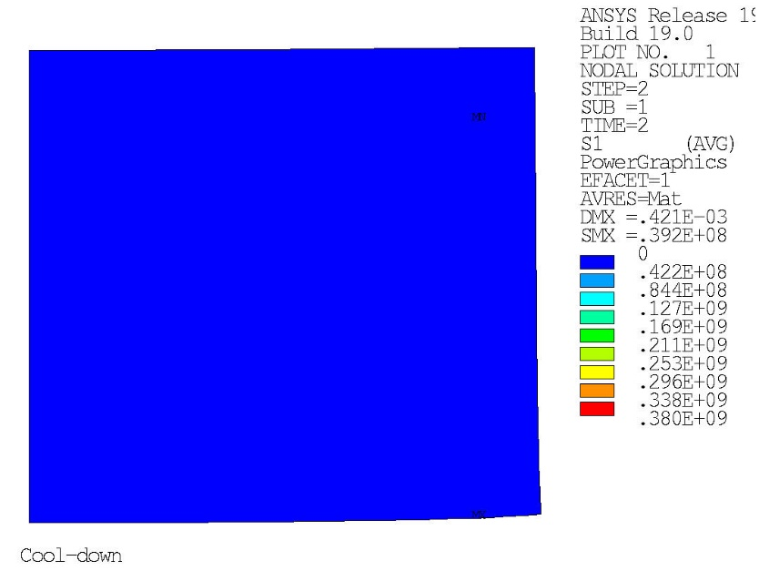
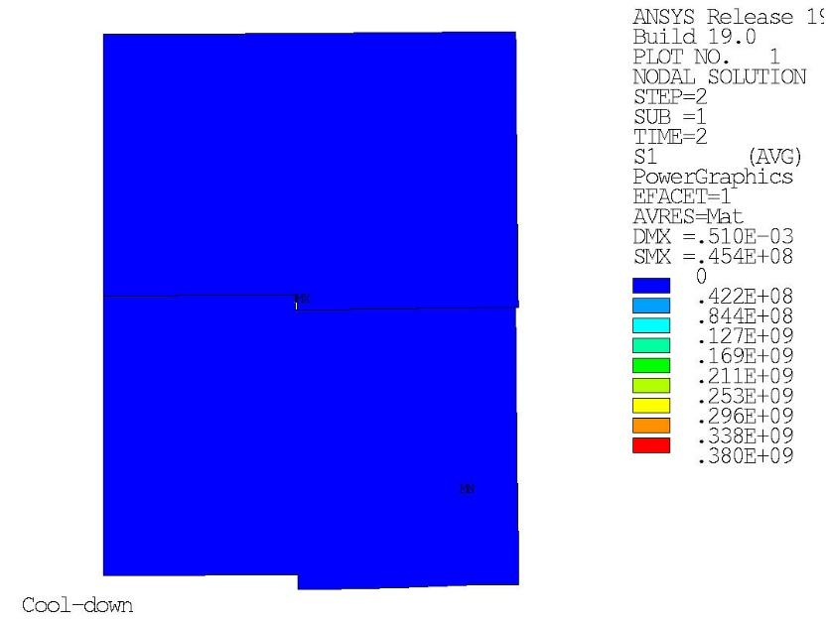
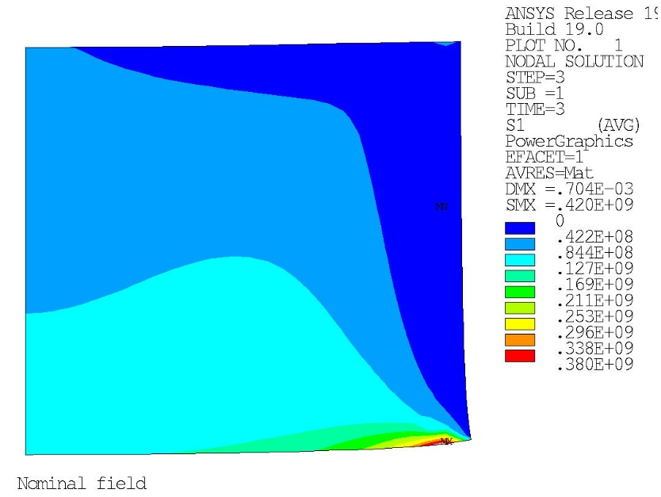
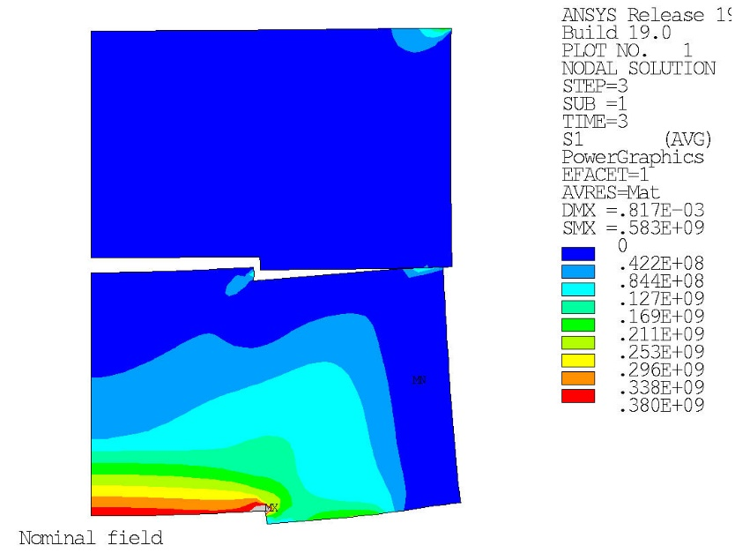
Max principal stress in iron poles
Design 1 (2×38+2×50 turns)
Design 2 (3×2×32 turns)
Cool-down
Cool-down
Nominal field
Nominal field

