Slide 1
STUDY ON HEPDIPO
WP ASPECT RATIO single racetrack option
P. Testoni, A. Portone, X. Sarasola
12/12/2018

Slide 2
Outline
Optimization of 2D cross section of the “racetrack coils option”
2D emag detailed analysis of the optimized layouts
2D mech detailed analysis of the optimized layouts
3D analyses
Conclusions

Slide 3
Optimization of 2D cross section

Slide 4
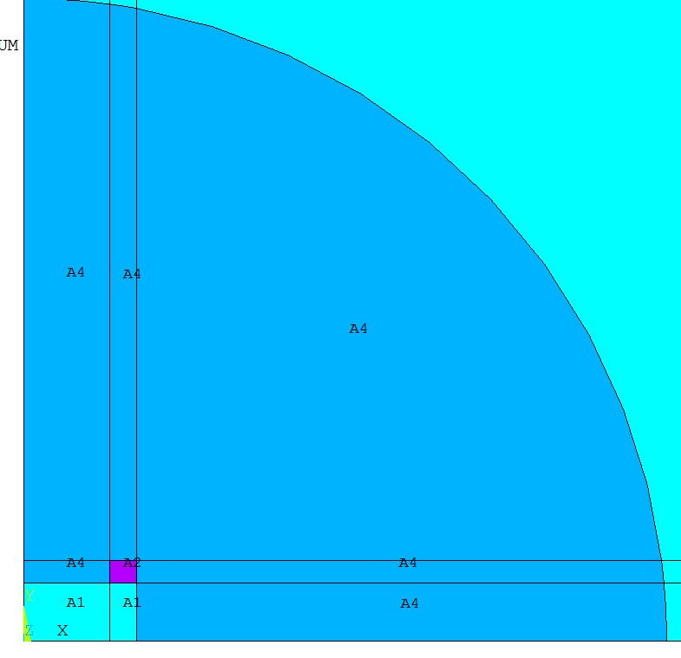
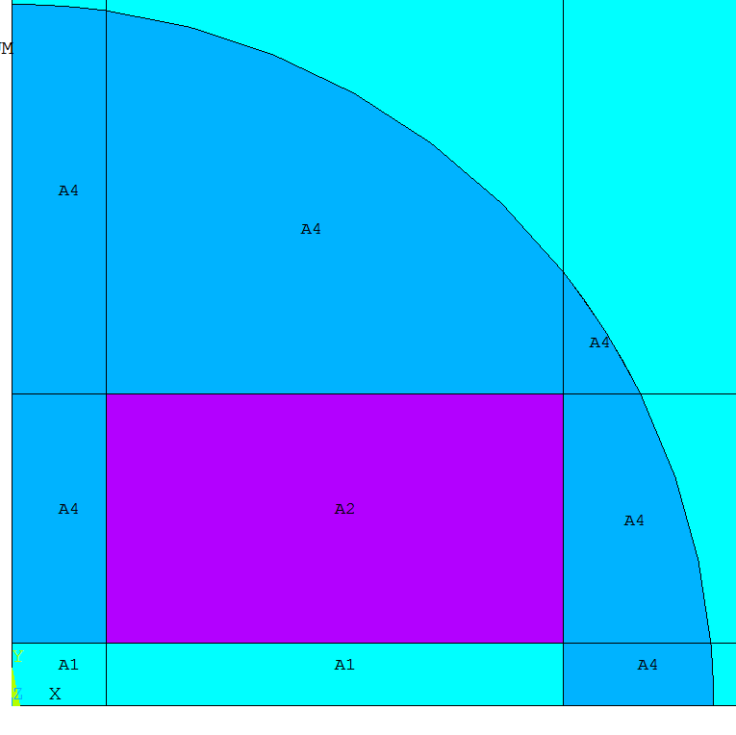
Methodology
For each layout, 20x10 non linear FEM solutions have been run by changing the WP dimensions.
i=1, j=1
i=20, j=10
Y
Y0=50e-3 m
X
X0=75e-3 m

Slide 5
Methodology
An iterative procedure has been developed to obtain for each configuration (i,j) the engineering current density producing 15T in the bore center
The following post processing quantities have been computed for each configuration after convergence:
Engineering current density
max magnetic field in the conductor and its coordinates
Fractional area of the WP with respect to reference design
Lorentz forces in the lower coil in X and Y direction
Magnetic pressure
Magnetic energy
Finally the optimized configurations have been compared and analyzed

Slide 6
RESULTS

Slide 7
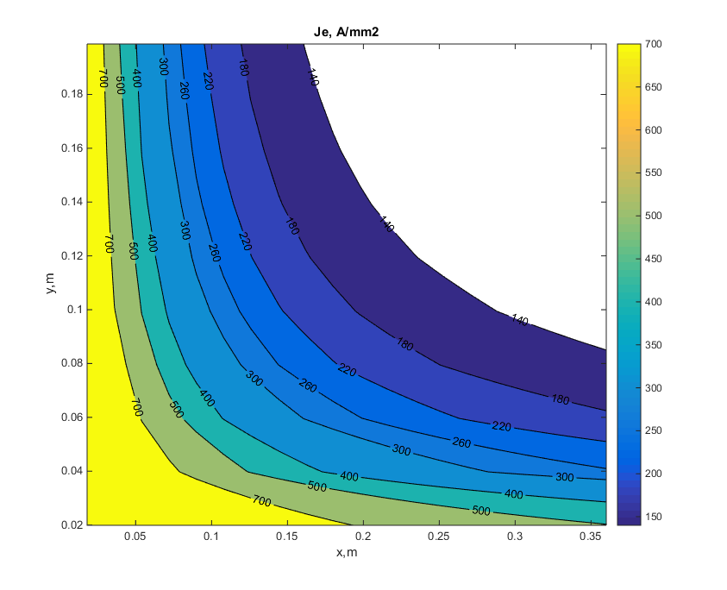
Engineering current density
opt2
opt3
opt1

Slide 8
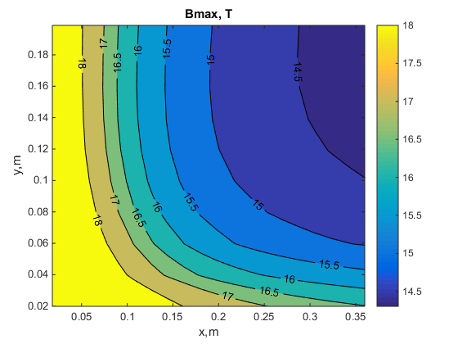
Maximum field
opt2
opt3
opt1

Slide 9
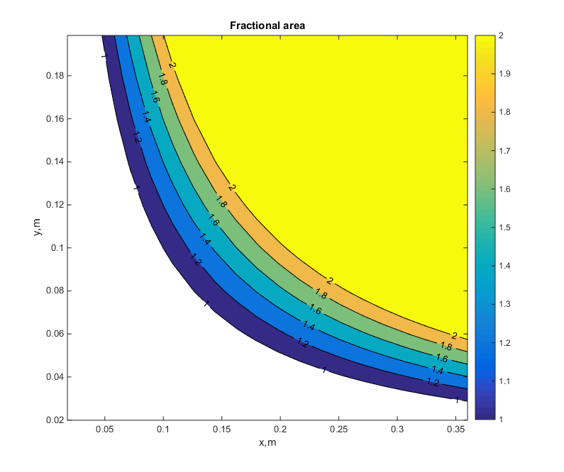
Fractional Area with respect to reference
opt2
opt3
opt1
Notes:
Superconductor fractional area

Slide 10
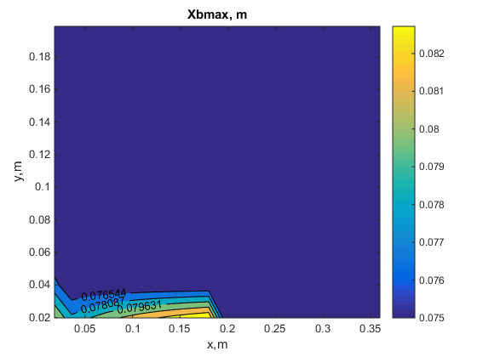
X coordinate @ max B
opt2
opt3
opt1

Slide 11
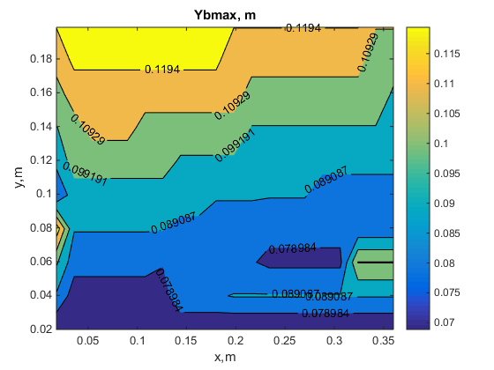
Y coordinate @ max B
opt2
opt3
opt1

Slide 12
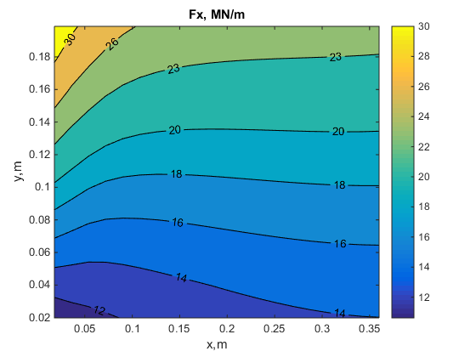
Lorentz forces Fx
opt2
opt3
opt1

Slide 13
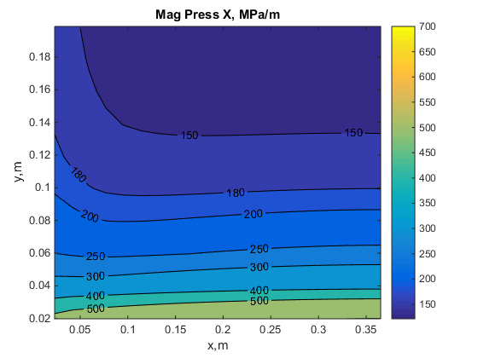
Magnetic pressure X direction
opt2
opt3
opt1

Slide 14
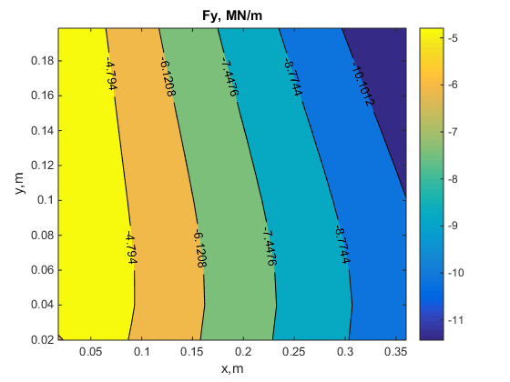
Lorentz forces Fy
opt2
opt3
opt1

Slide 15
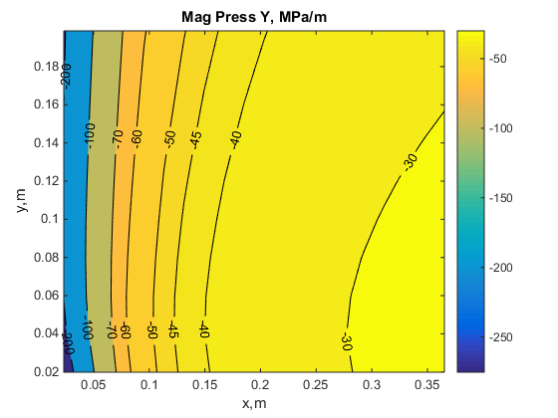
Magnetic pressure Y direction
opt2
opt3
opt1

Slide 16
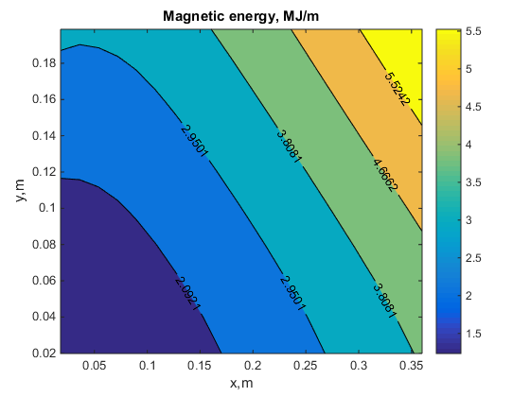
Magnetic energy per quadrant (MJ/m)
opt2
opt3
opt1
Notes:
Superconductor fractional area

Slide 17
Emag analysis of optimized layout

Slide 18
Comparison among options
 | opt1 | opt2 | opt3
ΔX[m] | 0.23525 | 0.15075 | 0.192
ΔY[m] | 6E-02 | 0.106 | 8.3E-02
J [A/mm2] | 237 | 212 | 210
Iop [kA] | 8 | 12.6 | 9.80
τ [s]* | 0.73 | 0.41 | 0.55
Bmax [T] | 15.4 | 15.9 | 15.6
F Lor x [MN/m] | 15.3 | 17.8 | 16.5
Mag Press X [Mpa] | 255 | 167 | 198.5
F Lor y [MN/m] | -7.4 | -6 | -6.7
Mag Press Y [Mpa] | 31.5 | 40 | 35
Fract area | 1.34 | 1.52 | 1.52
Energy[MJ/m] | 2.92 | 2.62 | 2.7
*Vmax=1kV

Slide 19
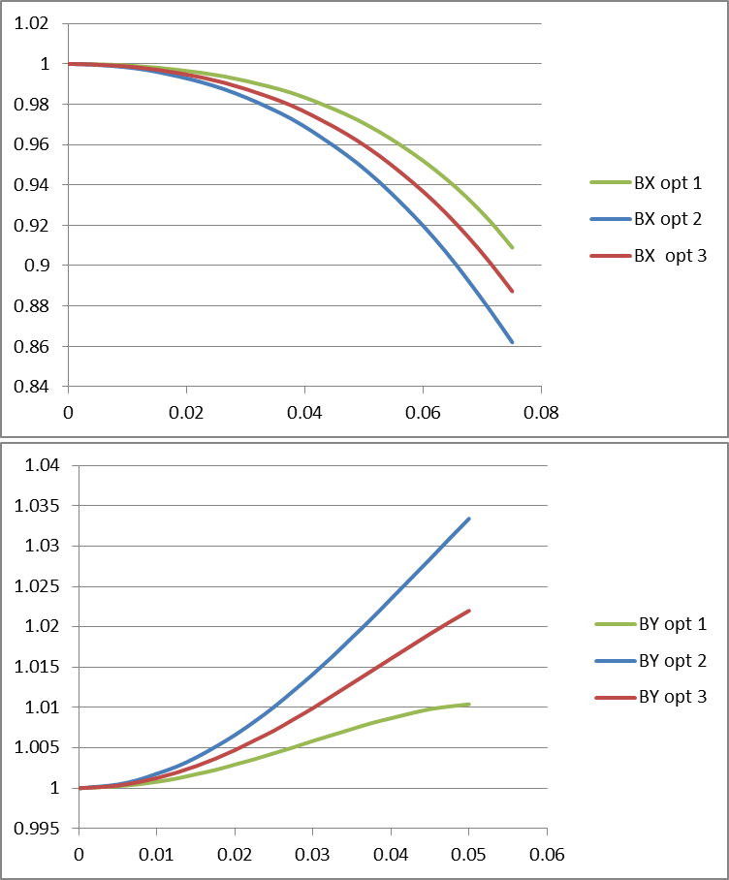
Field uniformity

Slide 20
Mech analysis of optimized layout

Slide 21
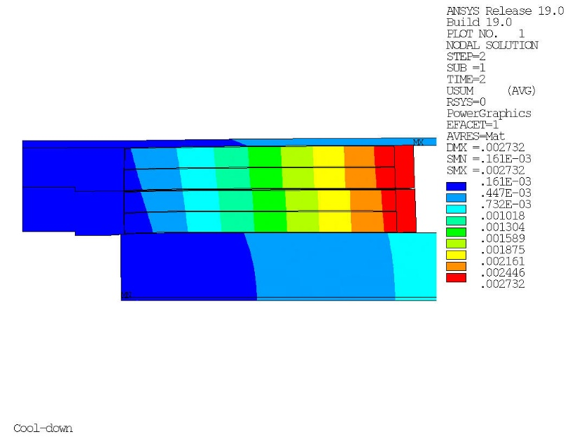
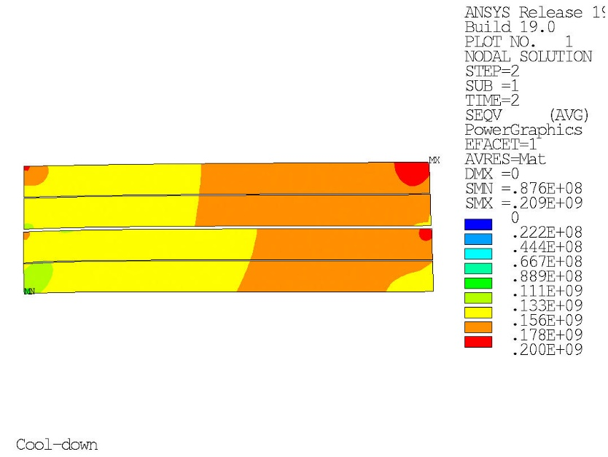
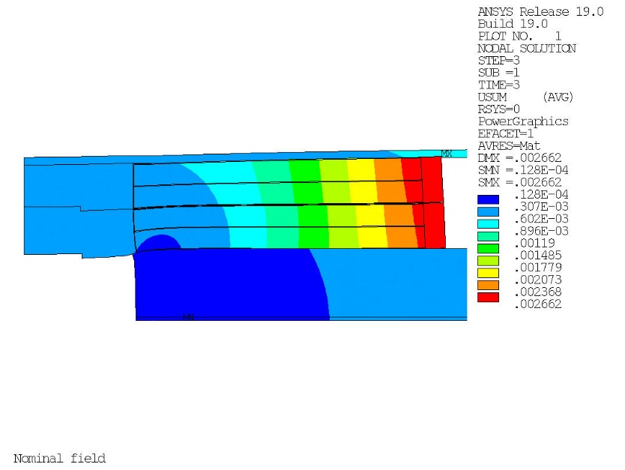
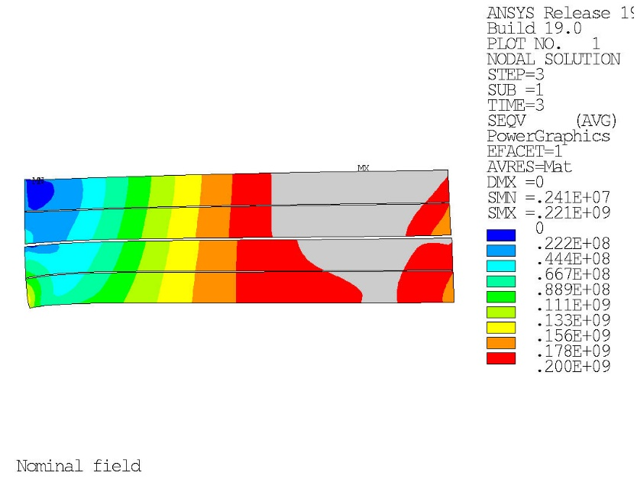
Option 1: min coil area
Deformation coil structure
Stress in the coils
Cool-down
Cool-down
Nominal field
Nominal field

Slide 22
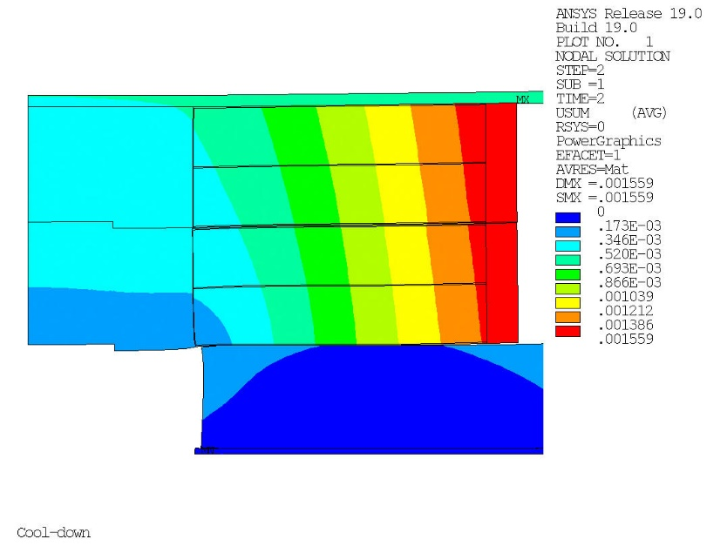
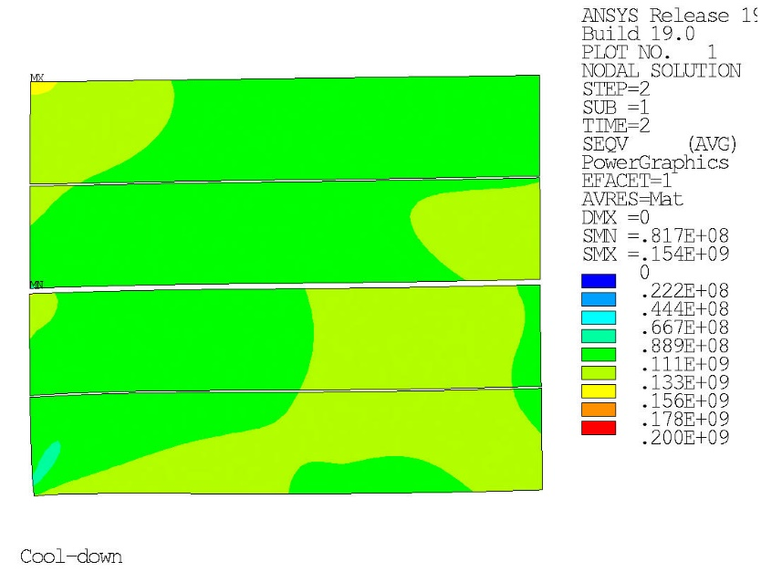
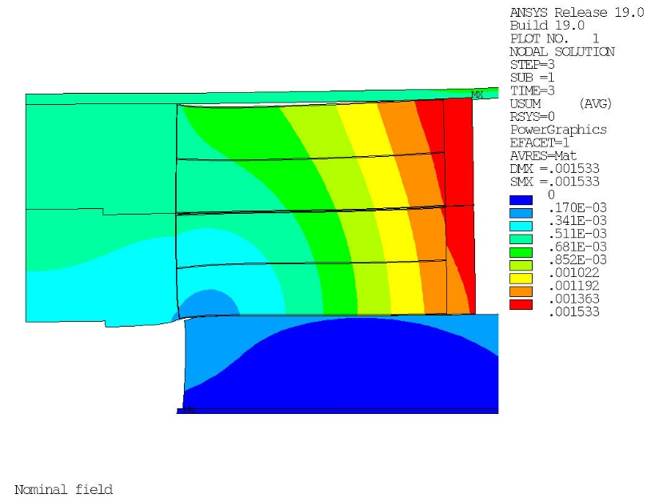
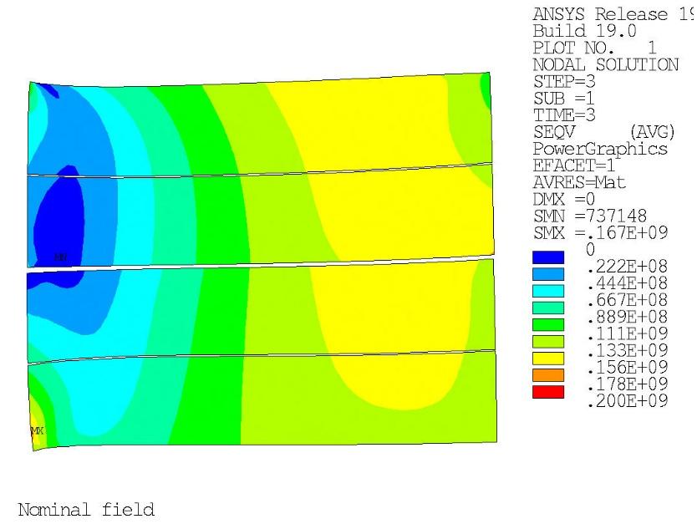
Option 2: min coil stress
Deformation coil structure
Stress in the coils
Cool-down
Cool-down
Nominal field
Nominal field

Slide 23
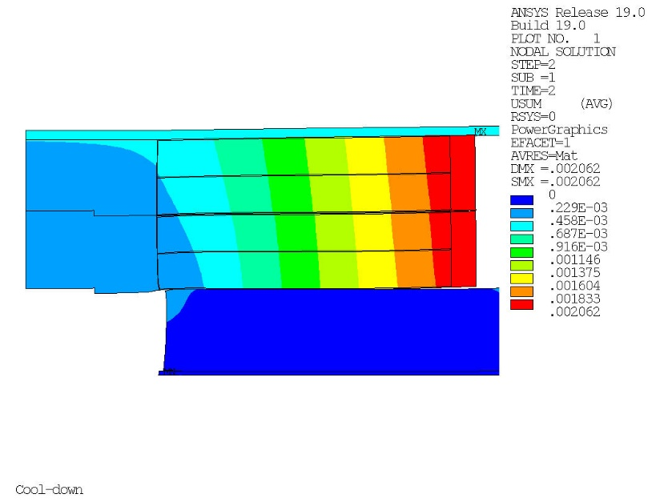
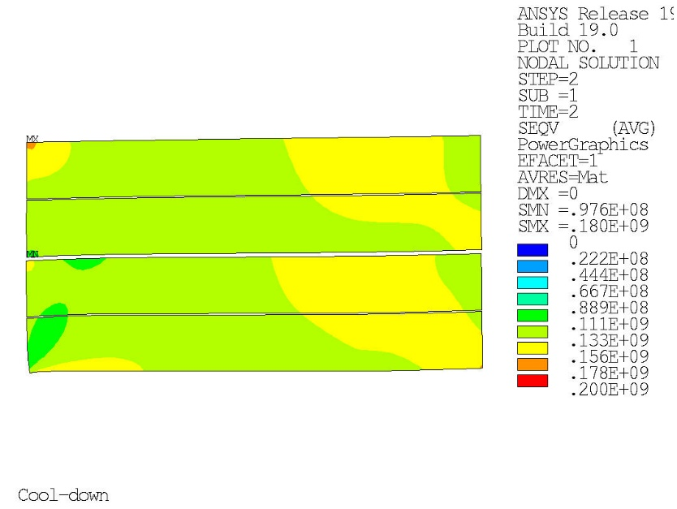
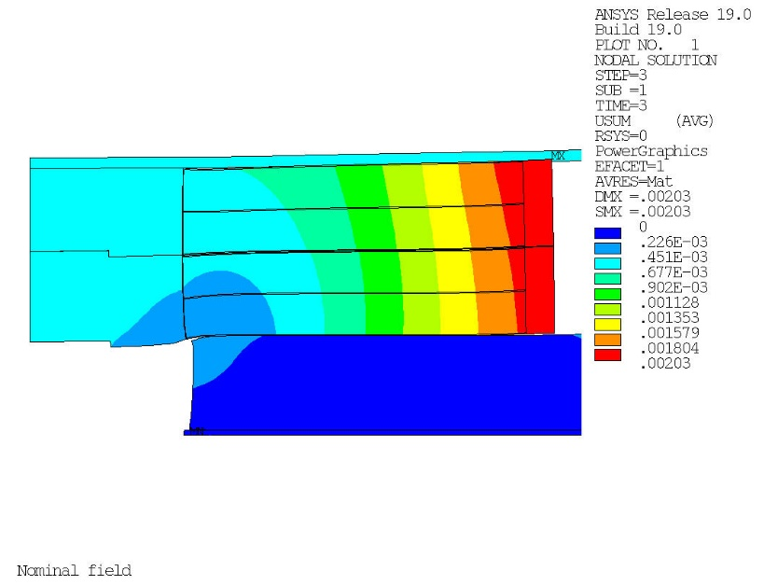
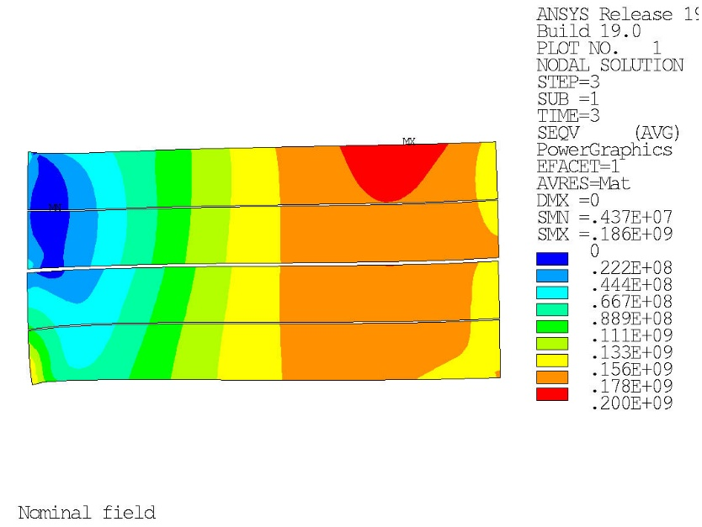
Option 3: Intermediate
Deformation coil structure
Stress in the coils
Cool-down
Cool-down
Nominal field
Nominal field

Slide 24
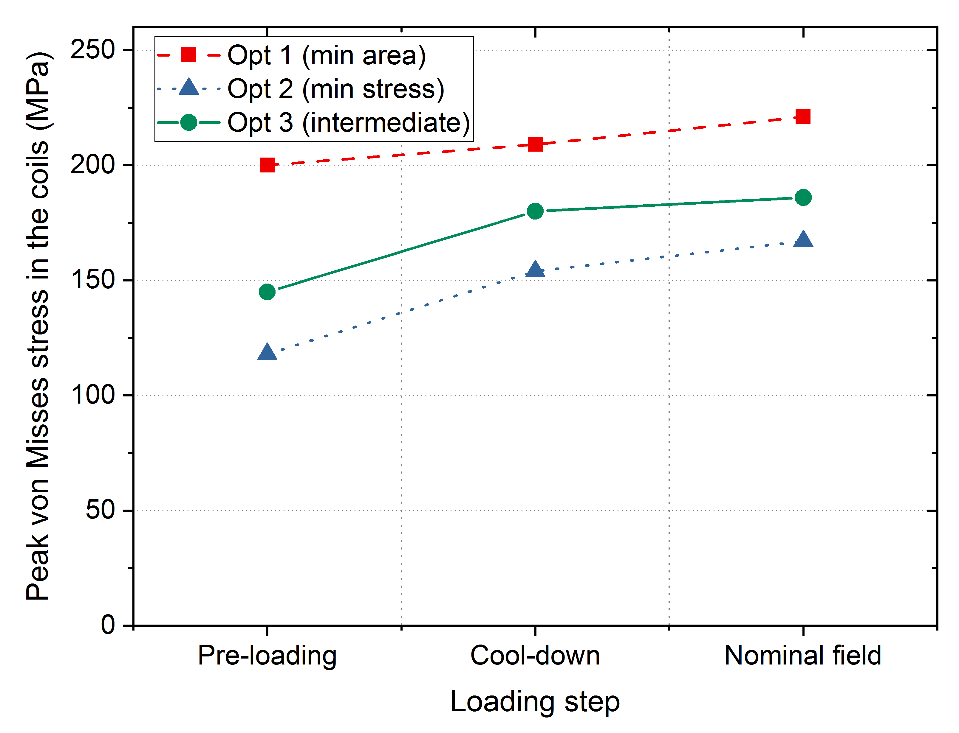
Comparison 3 options

Slide 25
3D Analysis

Slide 26
Comparison among options
 | reference | opt1 | opt2 | opt3
J [A/mm2] | 218 | 225 | 203.25 | 201
Bmax [T] | 15.5 | 18.26 | 18.34 | 18.17
Δ volume % | 0 | 0.2 | 4 | 8
Energy[MJ] | 11.1 | 15.6 | 13 | 14.1

Slide 27
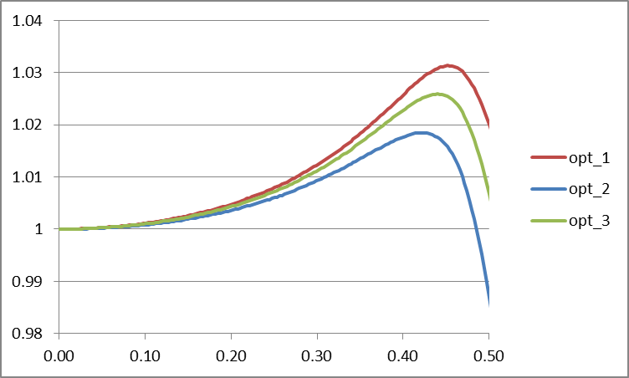
Field uniformity along z axis

Slide 28
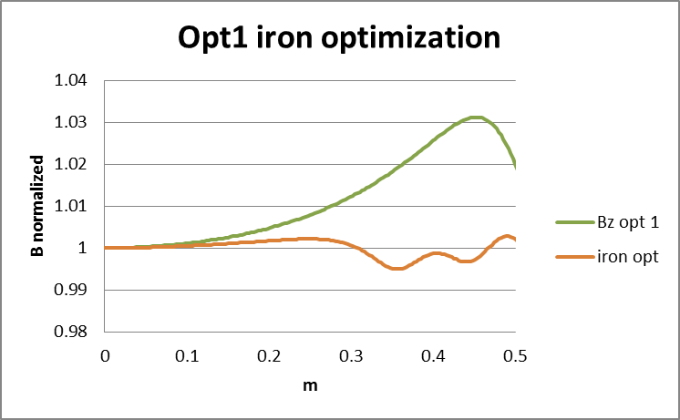
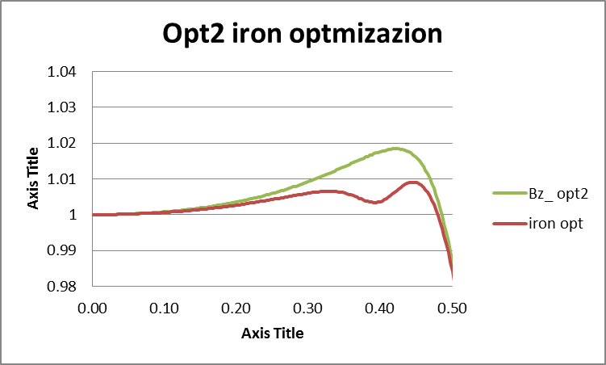
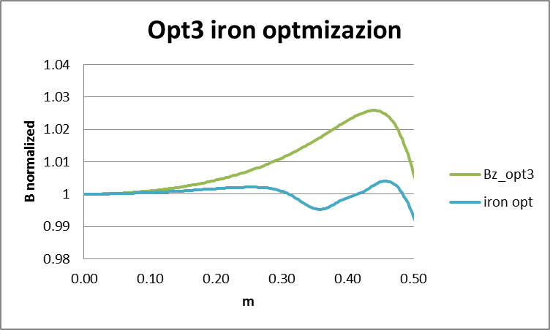
Field uniformity optimization

Slide 29
Conclusions
The “single racetrack option” has bee studied.
It has been shown that:
  Target performances can be achieved
  Volume increase can be kept below 1.1
  Magnetic pressure can be lowered to safe values
  Field uniformity can be optimized to target values
  Magnetic field at the curved parts of the racetrack can be lowered by using spacers (at the expenses of a volume increase)

