Slide 1
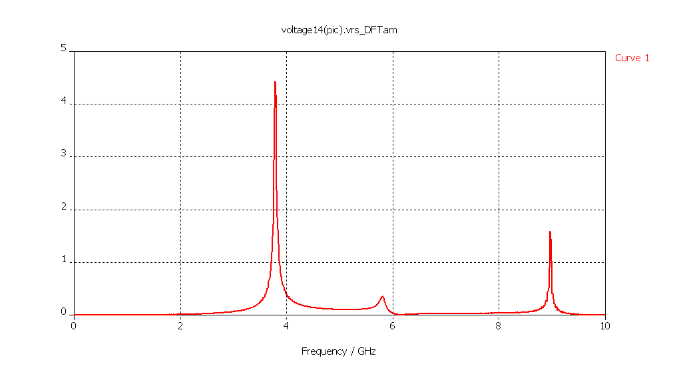
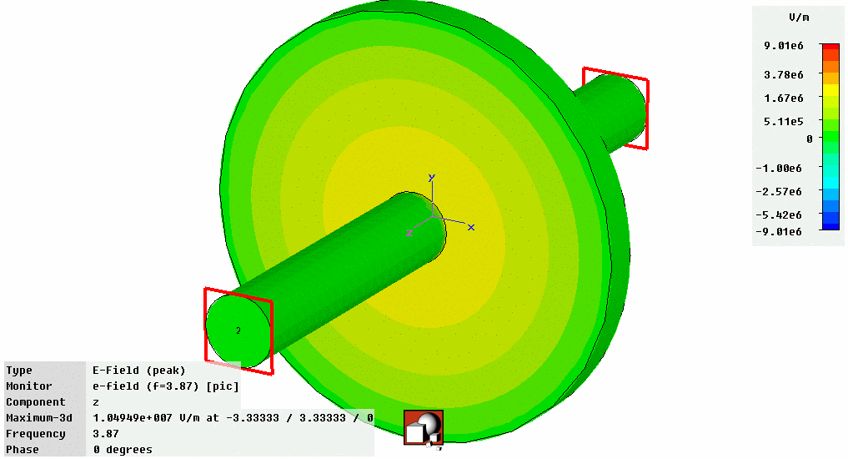
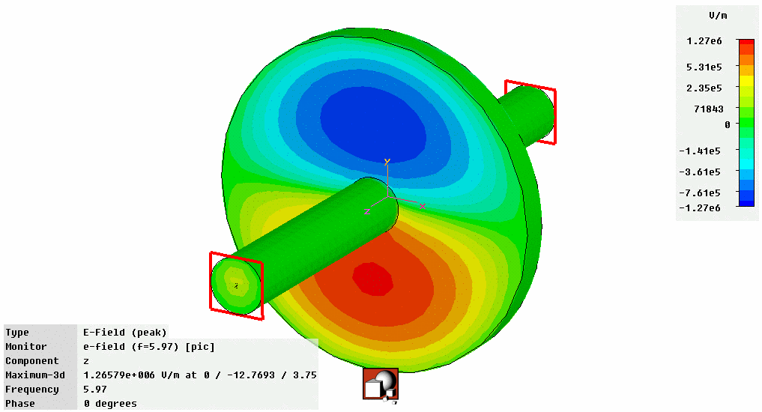
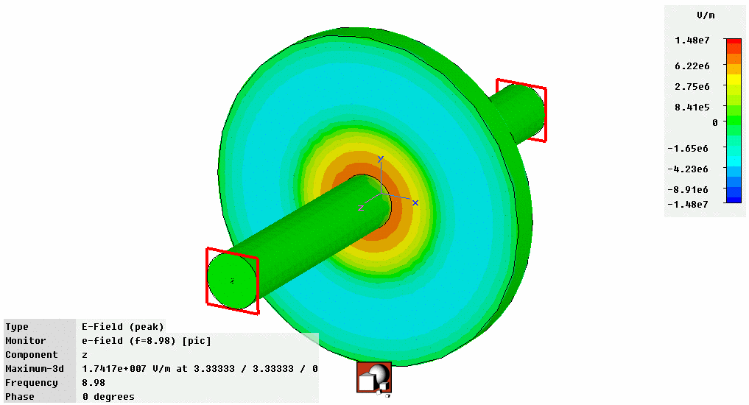
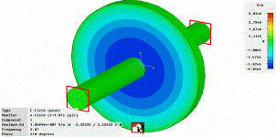
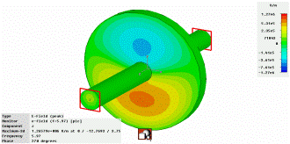
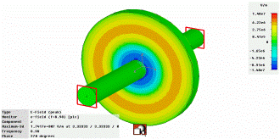
Improving the Precision for Next Generation Accelerators
Standard BPMs give intensity signals which need to be subtracted to obtain a difference which is then proportional to position
  Difficult to do electronically without some of the intensity information leaking through
    When looking for small differences this leakage can dominate the measurement
    Typically 40-80dB (100 to 10000 in V) rejection ⇒ tens micron resolution for typical apertures
Solution – cavity BPMs allowing sub micron resolution
  Design the detector to collect only the difference signal
    Dipole Mode TM₁₁ proportional to position & shifted in frequency with respect to monopole mode
Frequency Domain
TM₀₁
TM₀₁
U / V
TM₀₂
TM₀₂
TM₁₁
TM₁₁
f / GHz
Courtesy of D. Lipka,
DESY, Hamburg
U~Q
U~Qr
U~Q

Slide 2
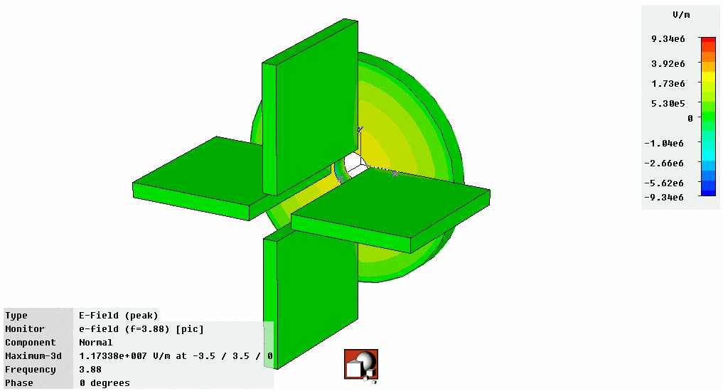
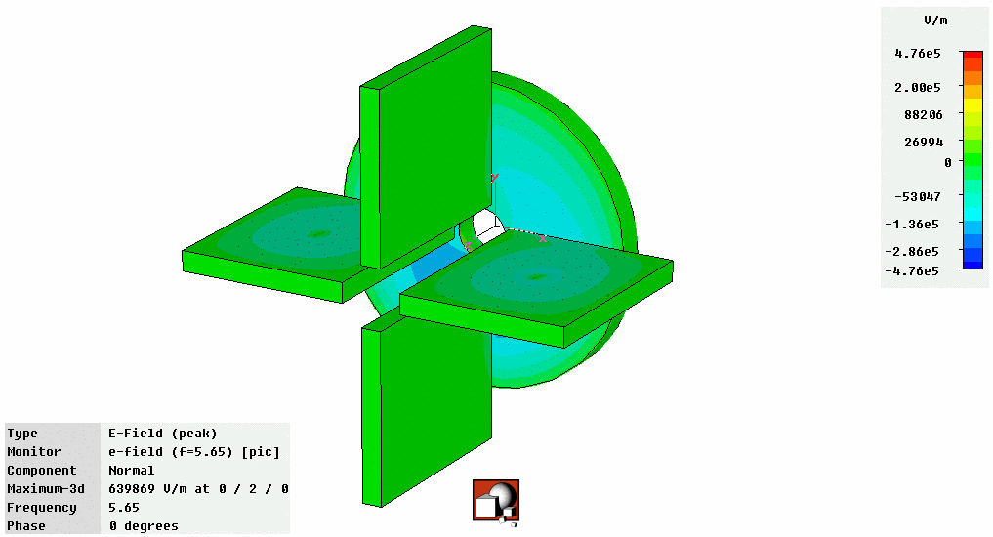
Today’s State of the Art BPMs
Obtain signal using waveguides that only couple to dipole mode
  Further suppression of monopole mode
Monopole Mode
Dipole Mode
Courtesy of D. Lipka,
DESY, Hamburg

Slide 3
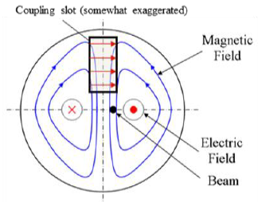
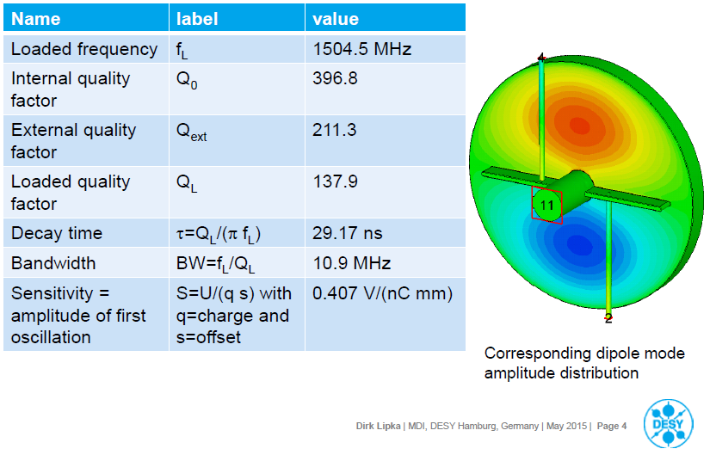
Design of Cavity with waveguides

Slide 4
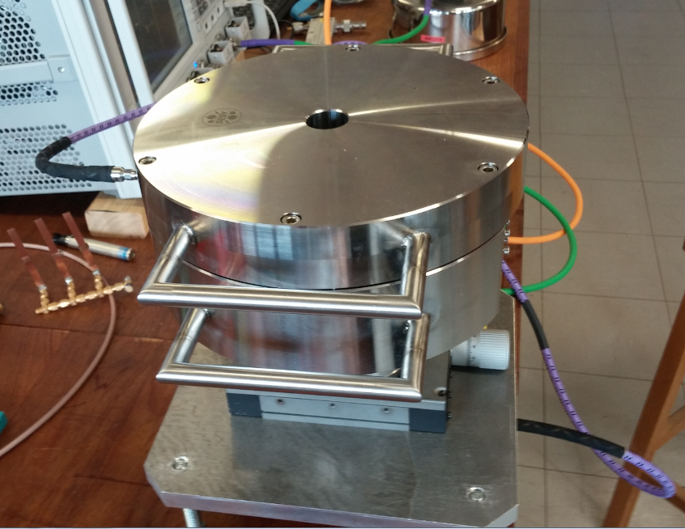
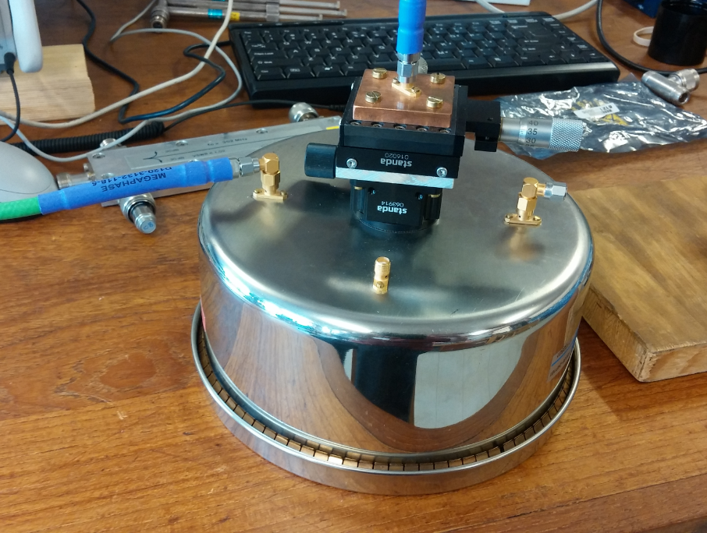
Cavity with waveguides
Signal to antenna (beam)
Response of cavity
Pillbox cavity

Slide 5
