Slide 2
Instabilities Part II:
Longitudinal wake fields – impact on machine elements and beam dynamics
Giovanni Rumolo and Kevin Li

Slide 3

Signpost
We have learned about the concept of particle distributions as well as some peculiarities of multiparticle dynamics in accelerators, decoherence, filamentation.
We will learn the basic concept of wake fields and how these can be characterized as a collective effect in that they depend on the particle distribution.
We will have a basic understanding of multiparticle systems and wakefields and are now ready to look at the impact of these in the longitudinal and transverse planes.
Part 2: Multiparticle dynamics with wake fields –
impact on machine elements and longitudinal beam dynamics
  General introduction to wake fields
  Longitudinal wake fields and the longitudinal wake function
  Energy loss – beam induced heating and stable phase shift
  Potential well distortion, bunch lengthning and microwave instability
Notes:
Perhaps other way round

Slide 4
Signpost
We have learned about the concept of particle distributions as well as some peculiarities of multiparticle dynamics in accelerators, decoherence, filamentation.
We will learn the basic concept of wake fields and how these can be characterized as a collective effect in that they depend on the particle distribution.
We will have a basic understanding of multiparticle systems and wakefields and are now ready to look at the impact of these in the longitudinal and transverse planes.
Part 2: Multiparticle dynamics with wake fields –
impact on machine elements and longitudinal beam dynamics
  General introduction to wake fields
  Longitudinal wake fields and the longitudinal wake function
  Energy loss – beam induced heating and stable phase shift
  Potential well distortion, bunch lengthning and microwave instability
Notes:
Perhaps other way round

Slide 5
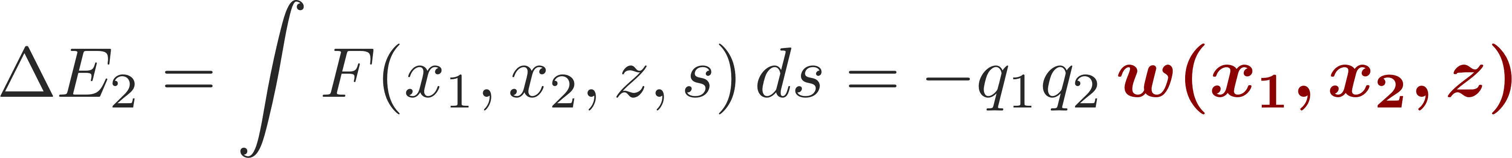
Wake functions: general definition
L
Source, q₁
Witness, q₂
Δx₁ (or Δy₁)
2b
z
Δx₂ (or Δy₂)
Wake function is the integrated force felt by a witness charge following a source charge, thus associated to an ‘energy kick’:
In general, for two point-like particles, we have
w is typically expanded in the transverse offsets of source and witness particles. This yields the different types of wake fields (dipole, quadrupole, coupling wakes)

Slide 6
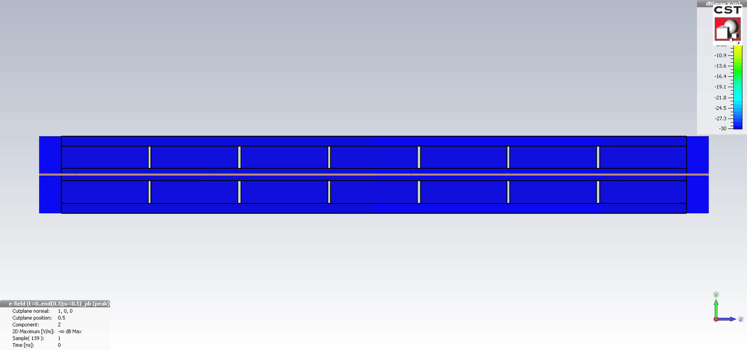
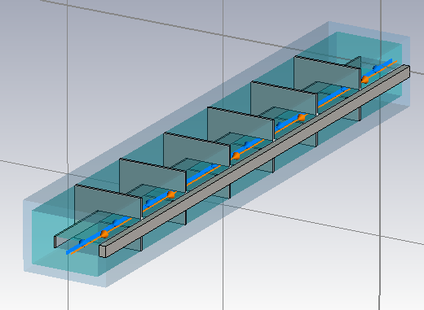
Wakefields as sources of collective effects
The wake function is a type of electromagnetic response of a device to a charge pulse. It is an intrinsic property of this device and depends on
  The device’s geometry (transitions, cavities, etc.)
  The electromagnetic properties of the materials exposed to the beam (e.g. PEC, finite conductivity, lossy materials, metamaterials, etc.)
The wake function describes the electromagnetic coupling between two point charges as a function of the distance between them.

Slide 7
Longitudinal wake function
L
Source, q₁
Witness, q₂
Δx₁ (or Δy₁)
2b
z
Δx₂ (or Δy₂)
Longitudinal wake fields
Zeroth order with source and test centred
usually dominant
Higher order terms
Usually negligible for small offsets

Slide 8
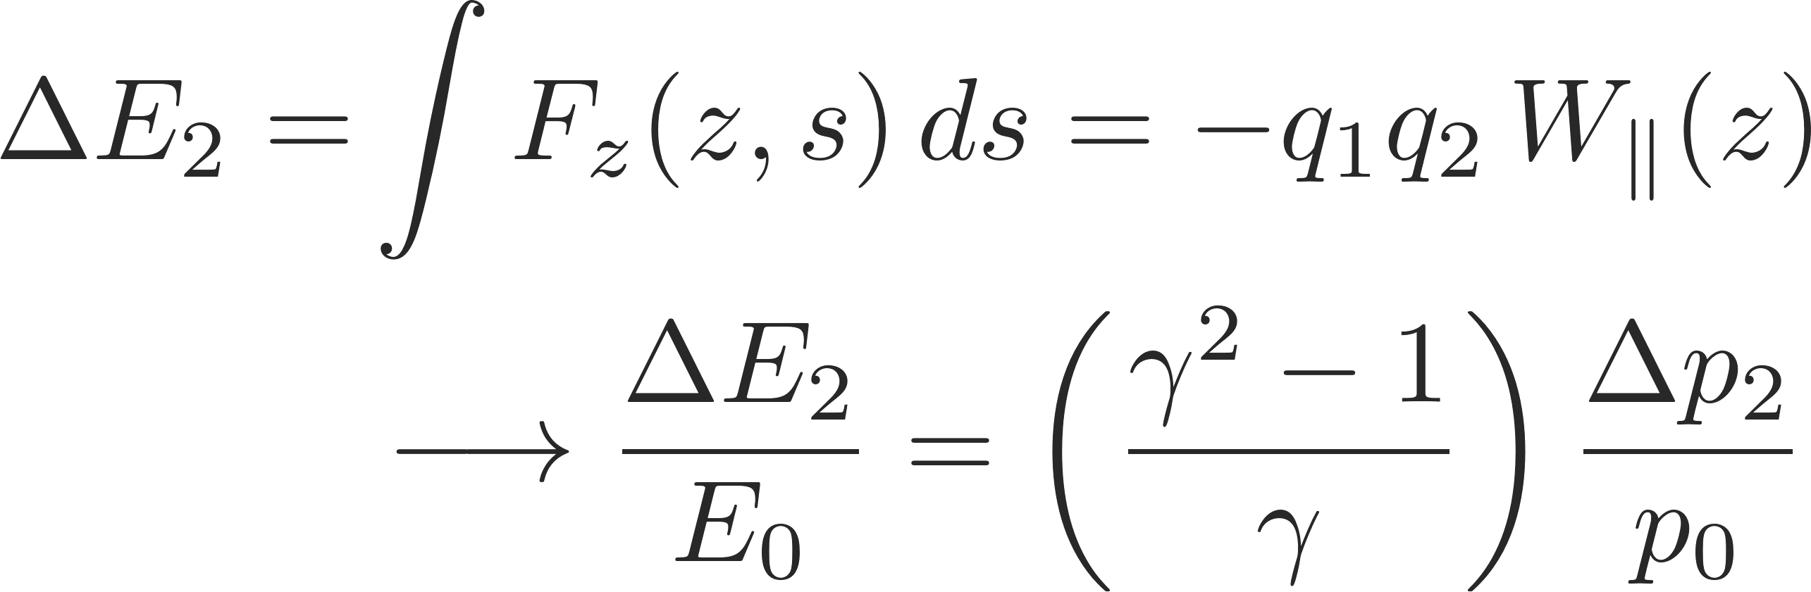
Longitudinal wake function
L
Source, q₁
Witness, q₂
Δx₁ (or Δy₁)
2b
z
Δx₂ (or Δy₂)
Longitudinal wake fields
Energy kick of the witness particle from longitudinal wakes

Slide 9
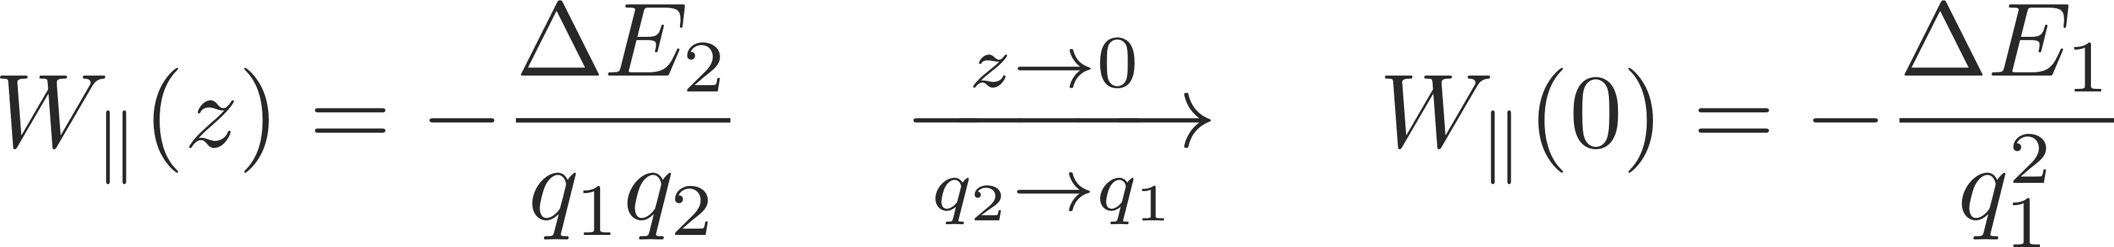
Longitudinal wake function
  The value of the wake function in z=0 is related to the energy lost by the source particle in the creation of the wake
  W||(0)>0 since ΔE₁<0
  W||(z) is discontinuous in z=0 and it vanishes for all z>0 because of the ultra-relativistic approximation
W||(z)
Beam loading theorem
z

Slide 10
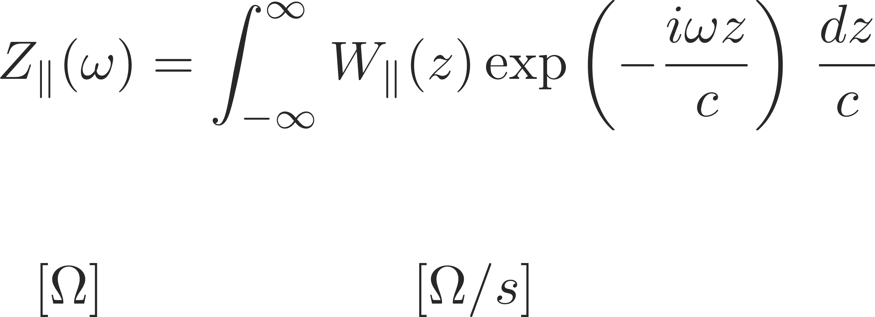
Longitudinal impedance
  The wake function of an accelerator component is basically its Green function in time domain (i.e., its response to a pulse excitation)
    Very useful for macroparticle models and simulations, because it can be used to describe the driving terms in the single particle equations of motion!
  We can also describe it as a transfer function in frequency domain
    This is the definition of longitudinal beam coupling impedance of the element under study

Slide 11
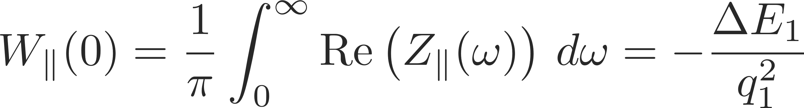
The energy balance
What happens to the energy lost by the source?
  In the global energy balance, the energy lost by the source splits into:
    Electromagnetic energy of the modes that remain trapped in the object
      Partly dissipated on lossy walls or into purposely designed inserts or HOM absorbers
      Partly transferred to following particles (or the same particle over successive turns), possibly feeding into an instability!
    Electromagnetic energy of modes that propagate down the beam chamber (above cut-off), eventually lost on surrounding lossy materials

Slide 12
The energy balance
What happens to the energy lost by the source?
  In the global energy balance, the energy lost by the source splits into
    Electromagnetic energy of the modes that remain trapped in the object
      Partly dissipated on lossy walls or into purposely designed inserts or HOM absorbers
      Partly transferred to following particles (or the same particle over successive turns), possibly feeding into an instability!
    Electromagnetic energy of modes that propagate down the beam chamber (above cut-off), eventually lost on surrounding lossy materials
  The energy loss of a particle bunch
    causes beam induced heating of the machine elements (damage, outgassing) or sparking due to high field
    feeds into both longitudinal and transverse instabilities through the associated EM fields
    is compensated by the RF system determining a stable phase shift

Slide 13
How are wakes and impedances computed?
Analytical or semi-analytical approach, when geometry is simple (or simplified)
  Solve Maxwell’s equations with the correct source terms, geometries and boundary conditions up to an advanced stage
  Find closed expressions or execute the last steps numerically to derive wakes and impedances
  An example: axisymmetric beam chamber with several layers with different EM properties
b
+ Boundary conditions

Slide 14
How are wakes and impedances computed?
Analytical or semi-analytical approach, when geometry is simple (or simplified)
  Solve Maxwell’s equations with the correct source terms, geometries and boundary conditions up to an advanced stage
  Find closed expressions or execute the last steps numerically to derive wakes and impedances
We are interested in the longitudinal force on a test charge q₂ following the source q₁ at a distance z (wake per unit length of chamber)
q₁
s
q₂
F_{S}
L = 1 m

Slide 15
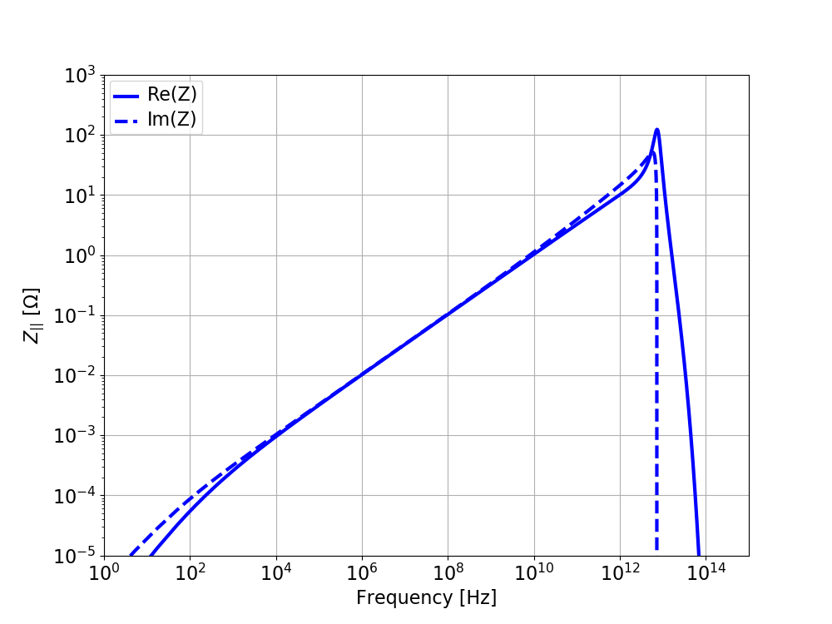
How are wakes and impedances computed?
Analytical or semi-analytical approach, when geometry is simple (or simplified)
  Solve Maxwell’s equations with the correct source terms, geometries and boundary conditions up to an advanced stage
  Find closed expressions or execute the last steps numerically to derive wakes and impedances
  An example: a 1 m long Cu pipe with radius b=2 cm and thickness t = 4 mm in vacuum
b
t
Highlighted region shows the typical ω^{1/2} scaling
Scaling is with respect to b:
  Longitudinal impedance ∼b⁻¹

Slide 16
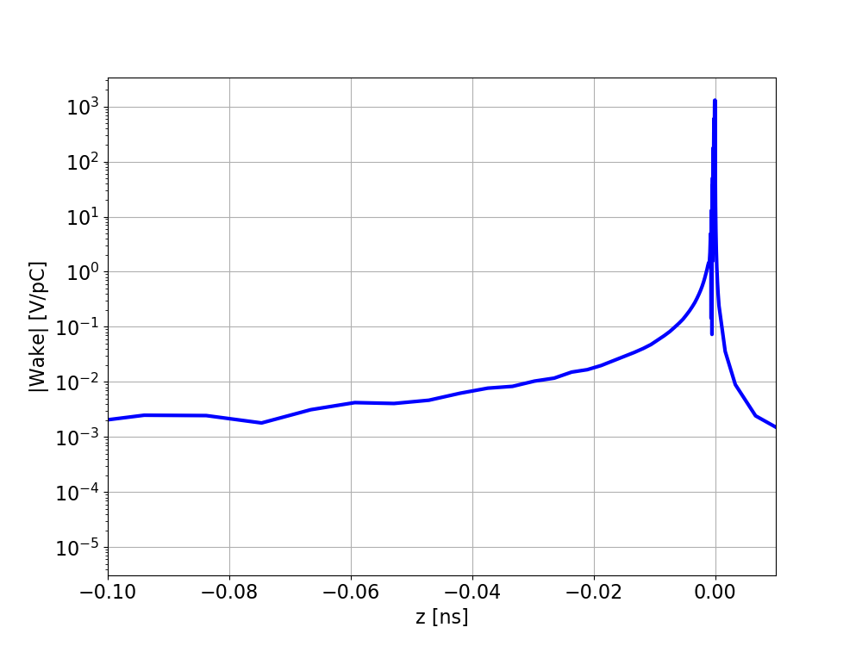
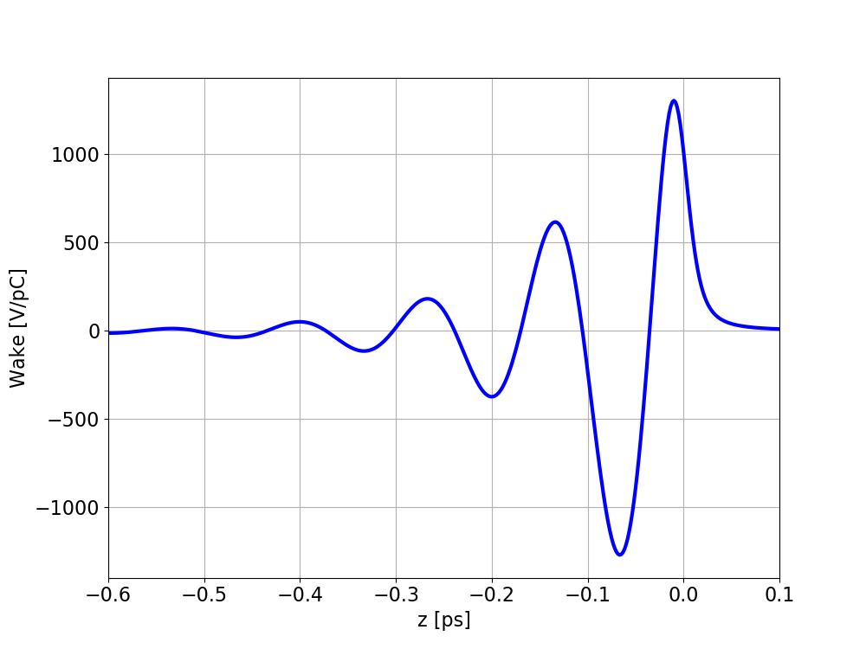
How are wakes and impedances computed?
Analytical or semi-analytical approach, when geometry is simple (or simplified)
  Solve Maxwell’s equations with the correct source terms, geometries and boundary conditions up to an advanced stage
  Find closed expressions or execute the last steps numerically to derive wakes and impedances
  An example: a 1 m long Cu pipe with radius b=2 cm and thickness t = 4 mm in vacuum
𝔉⁻¹

Slide 17
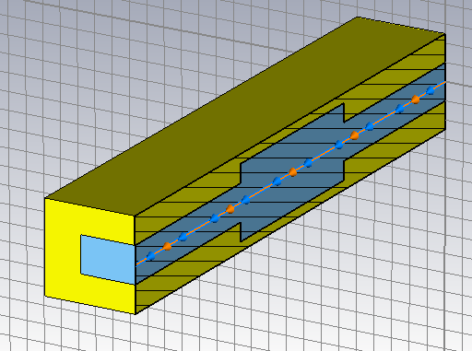
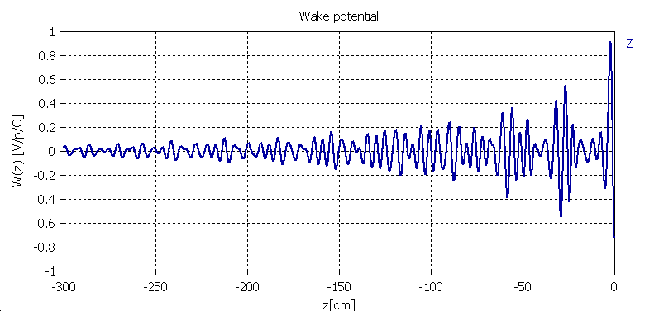
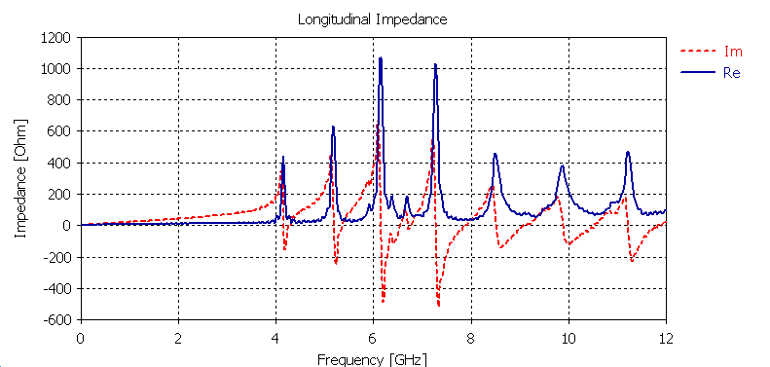
How are wakes and impedances computed?
Numerical approach
  Different codes have been developed over the years to solve numerically Maxwell’s equations in arbitrarily complicated structures
  Examples are CST Studio Suite (Particle Studio, Microwave Studio), ABCI, GdFidL, HFSS, ECHO2(3)D. Exhaustive list can be found from the program of the ICFA mini-Workshop on “Electromagnetic wake fields and impedances in particle accelerators”, Erice, Sicily, 23-28 April, 2014
  Computations can become very challenging if high frequency resolution (long wake) or knowledge of impedance spectrum at high frequency (short excitation) are required, especially for large/complicated geometries
Example of a cavity definition in CST
Longitudinal wake
𝔉
Longitudinal impedance
Re[Z||]
Im[Z||]

Slide 18
How are wakes and impedances computed?
Numerical approach
  To limit numerical noise, in cases with many resonances, the resonances are first characterized through their frequencies (ω_{ri}), shunt impedances (R_{si}) and quality factors (Q_{i})
  Then analytical formulae for resonators are used in computations
Longitudinal impedance
ω_{r3} – R_{s3} – Q₃
ω_{r4} – R_{s4} – Q₄
ω_{r2} – R_{s2} – Q₂
ω_{r5} – R_{s5} – Q₅
ω_{r6} – R_{s6} – Q₆
ω_{r1} – R_{s1} – Q₁
ω_{r7} – R_{s7} – Q₇
Notes:
To limit

Slide 19
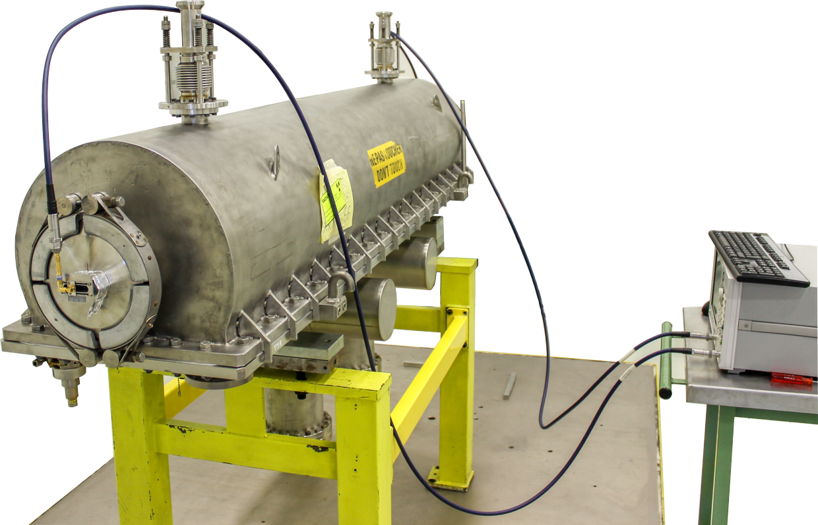
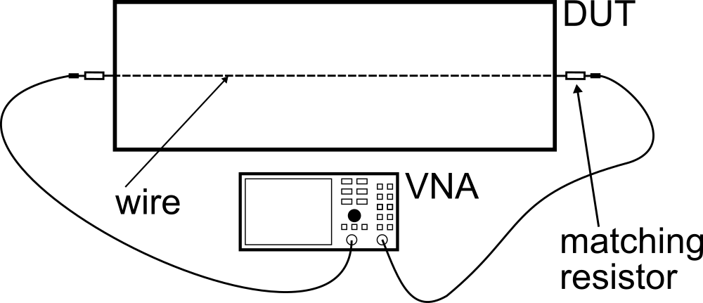

How are wakes and impedances computed?
Bench measurements based on transmission/reflection measurements with stretched wires
  Seldom used independently to assess impedances due to the perturbation introduced by the measurement set up (flanging, presence of wire)
  Usefulness mainly lies in that they can be used for validating 3D EM models for simulations
A wire is stretched in the middle of the device to simulate the beam
Reflection and transmission coefficients are measured via a VNA
The impedance can be calculated by plugging the measured scattering parameters into the LOG formula
$$Z_{||}={2Z}_{L}ln(S_{21})$$

Slide 20
Signpost
We have learnt what is a wake function and how it is defined in the longitudinal plane. We have introduced the longitudinal impedance
We have seen how longitudinal wake functions are related to the energy loss of the source particles.
We have discussed the energy balance which contains all the fundamental underlying mechanisms for collective effects related to wake fields and impedances.
We have shown how wake functions and impedances can be computed
Part 2: Multiparticle dynamics with wake fields –
impact on machine elements and longitudinal beam dynamics
  General introduction to wake fields
  Longitudinal wake function and impedance
  Energy loss – beam induced heating and stable phase shift
  Potential well distortion, bunch lengthning and microwave instability
Notes:
Perhaps other way round

Slide 21
Bunch energy loss per turn
Single traversal of a bunch through an impedance source
  We assume a single bunch of particles that goes only once through a known (characterized) wake/impedance source, representing both
    Single passage (e.g. in a line)
    Energy loss per turn if the bunch passes every turn but the wake fully decays between subsequent turns
  Our goal is to calculate how much energy the bunch loses in this passage due to the electromagnetic interaction

Slide 22
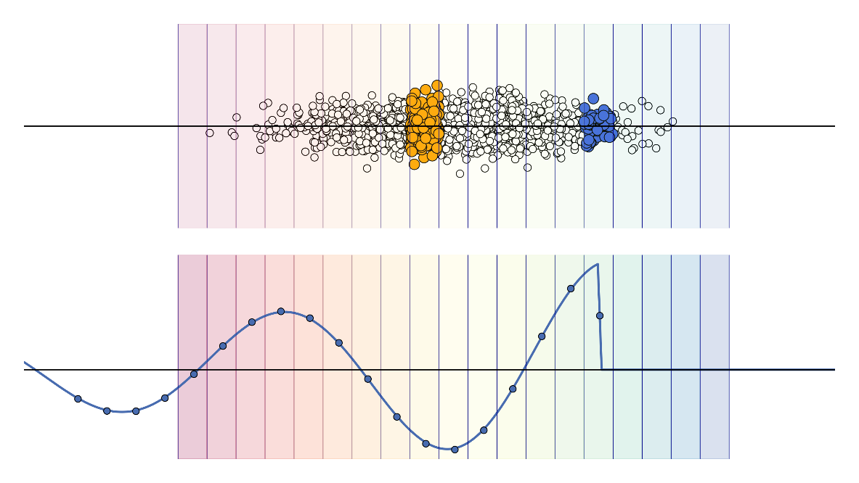
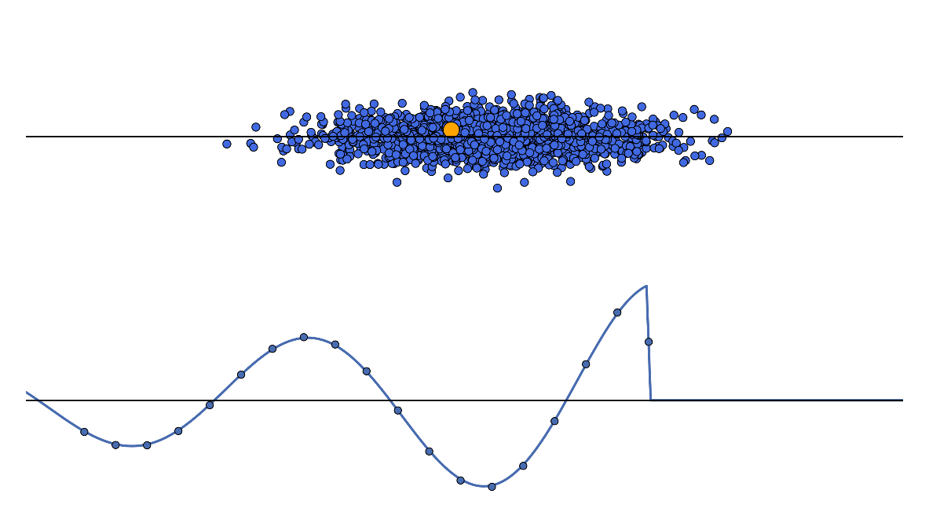
Bunch energy loss per turn
Single traversal of a bunch through an impedance source
Slice j
excites
Particle i
receives kick
Particle j
excites
Slice i
receives kick

Slide 23
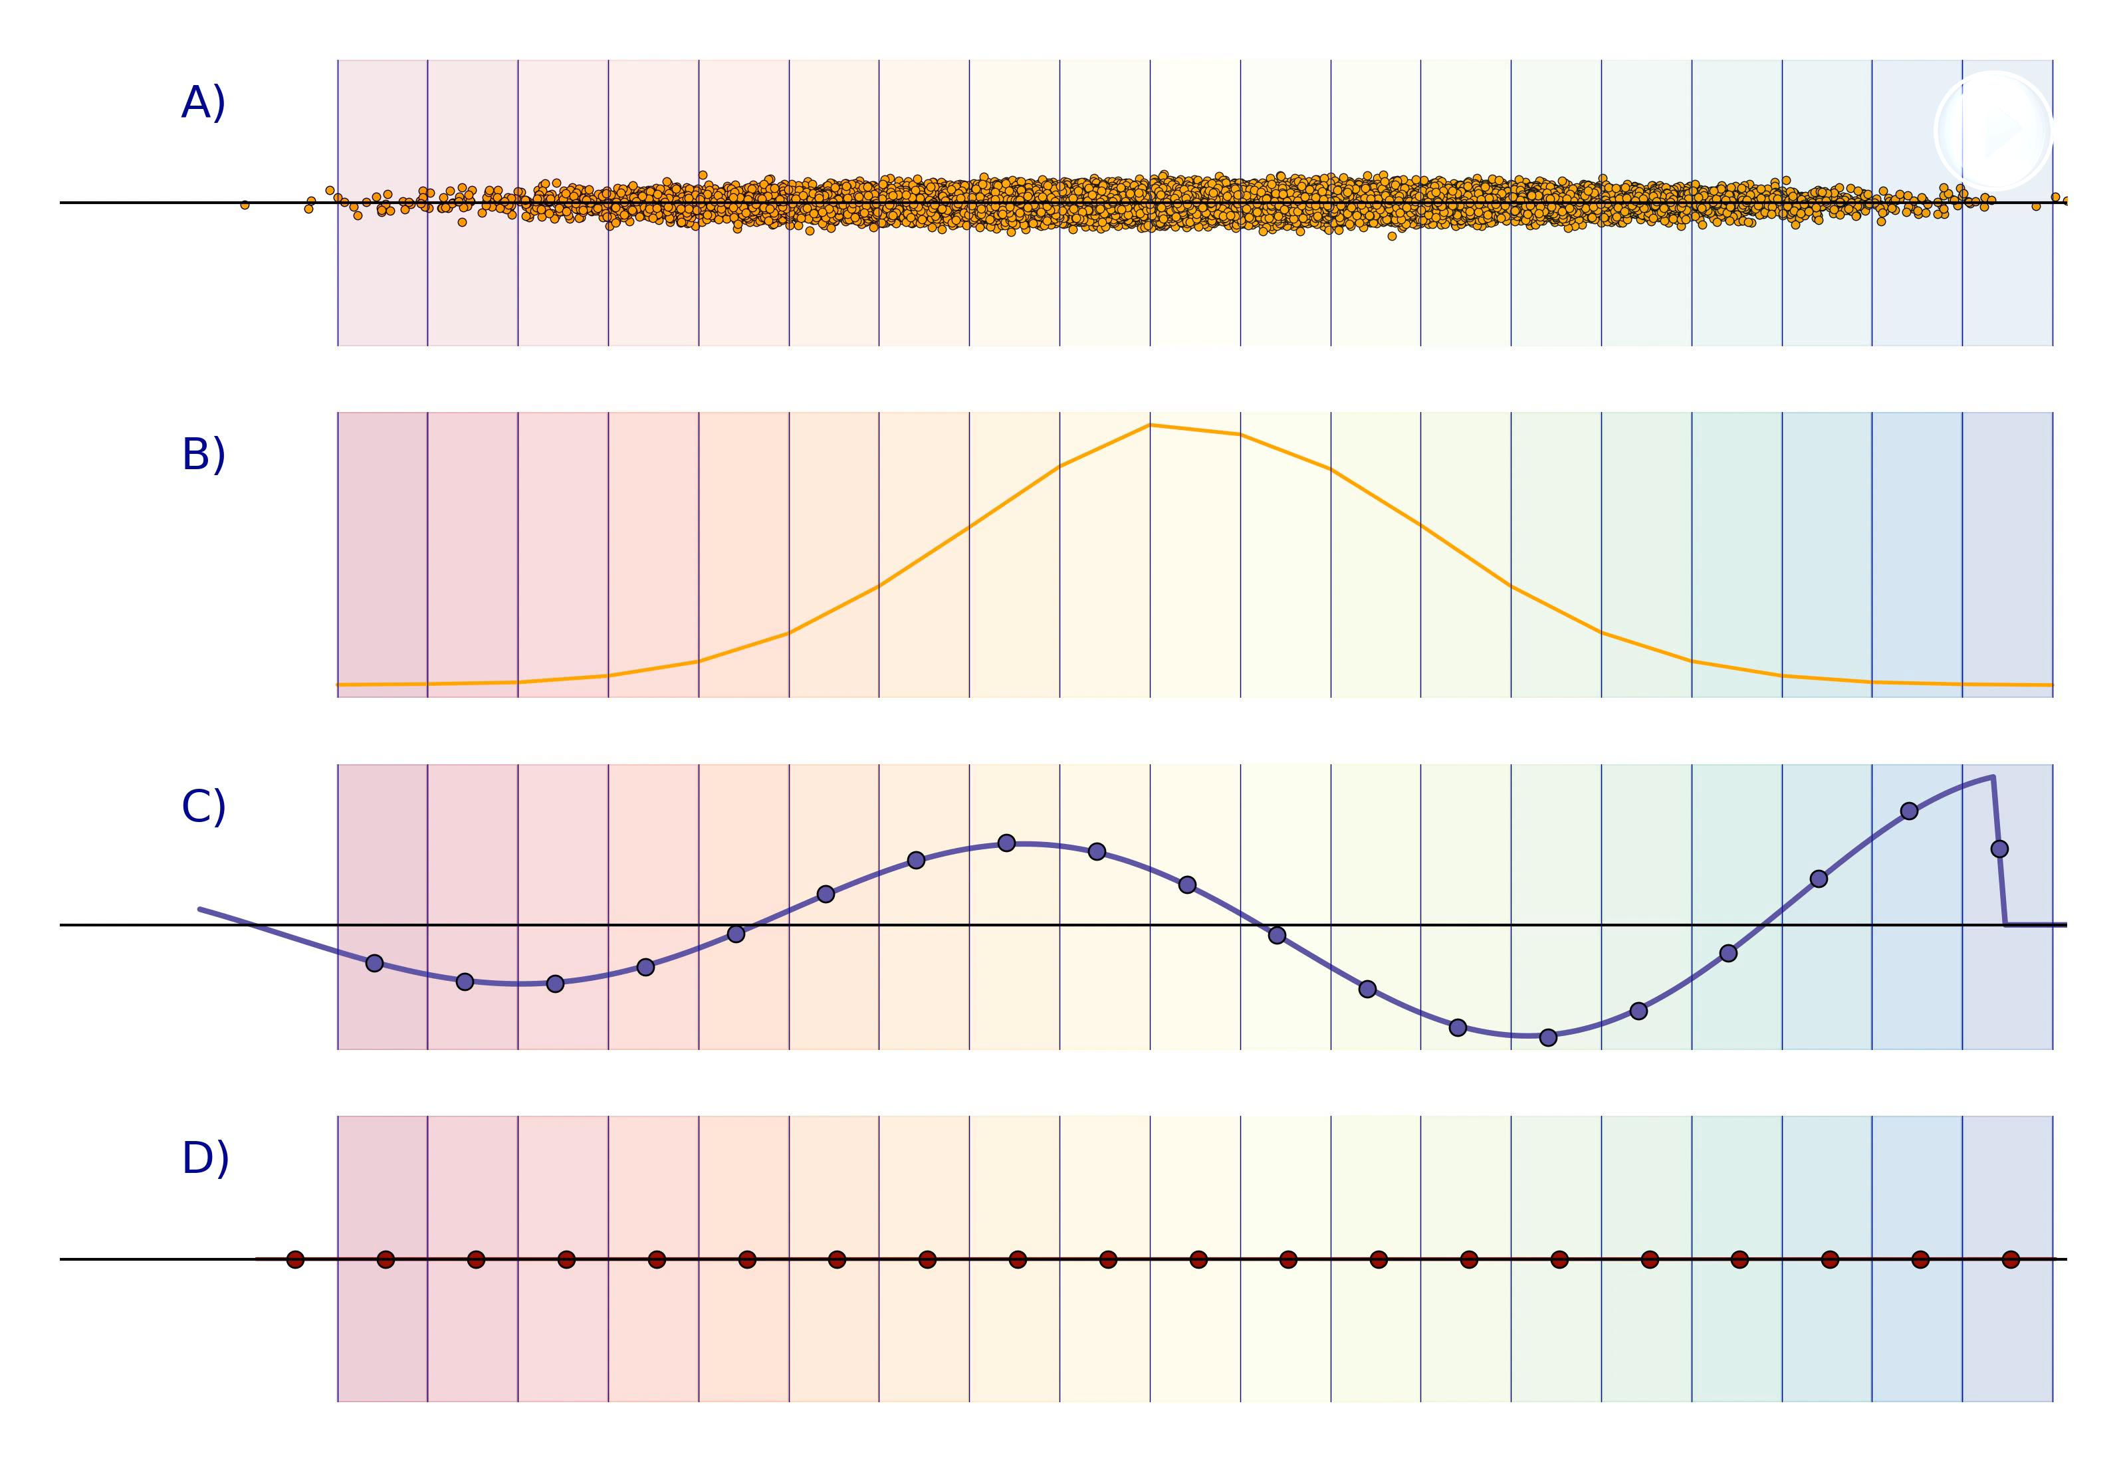
Bunch energy loss per turn
Single traversal of a bunch through an impedance source

Slide 24
Bunch energy loss per turn
Single traversal of a bunch through an impedance source
Slice j
excites
Slice i
receives kick

Slide 25
Bunch energy loss per turn
Single traversal of a bunch through an impedance source
Slice j
excites
Slice i
receives kick

Slide 26
Bunch energy loss per turn
Multiple traversal of a bunch through an impedance source
  We assume a single bunch of particles that goes multiple times through a known (characterized) wake/impedance source, representing
    Energy loss per turn if the bunch passes every turn and the wake fully keeps ringing between subsequent turns
  Our goal is to calculate how much energy the bunch loses at each passage due to the electromagnetic interaction over several turns

Slide 27
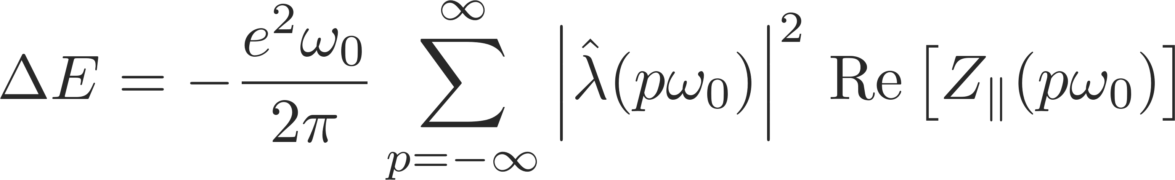
Bunch energy loss per turn
λ(z’ + kC) = λ(z’), i.e. assuming that the distribution doesn’t change from turn to turn

Slide 28
Beam energy loss per turn
Replacing the bunch spectrum with the beam spectrum, we can calculate the energy loss from a beam
Bunch profile and spectrum
Beam profile and spectrum

Slide 29
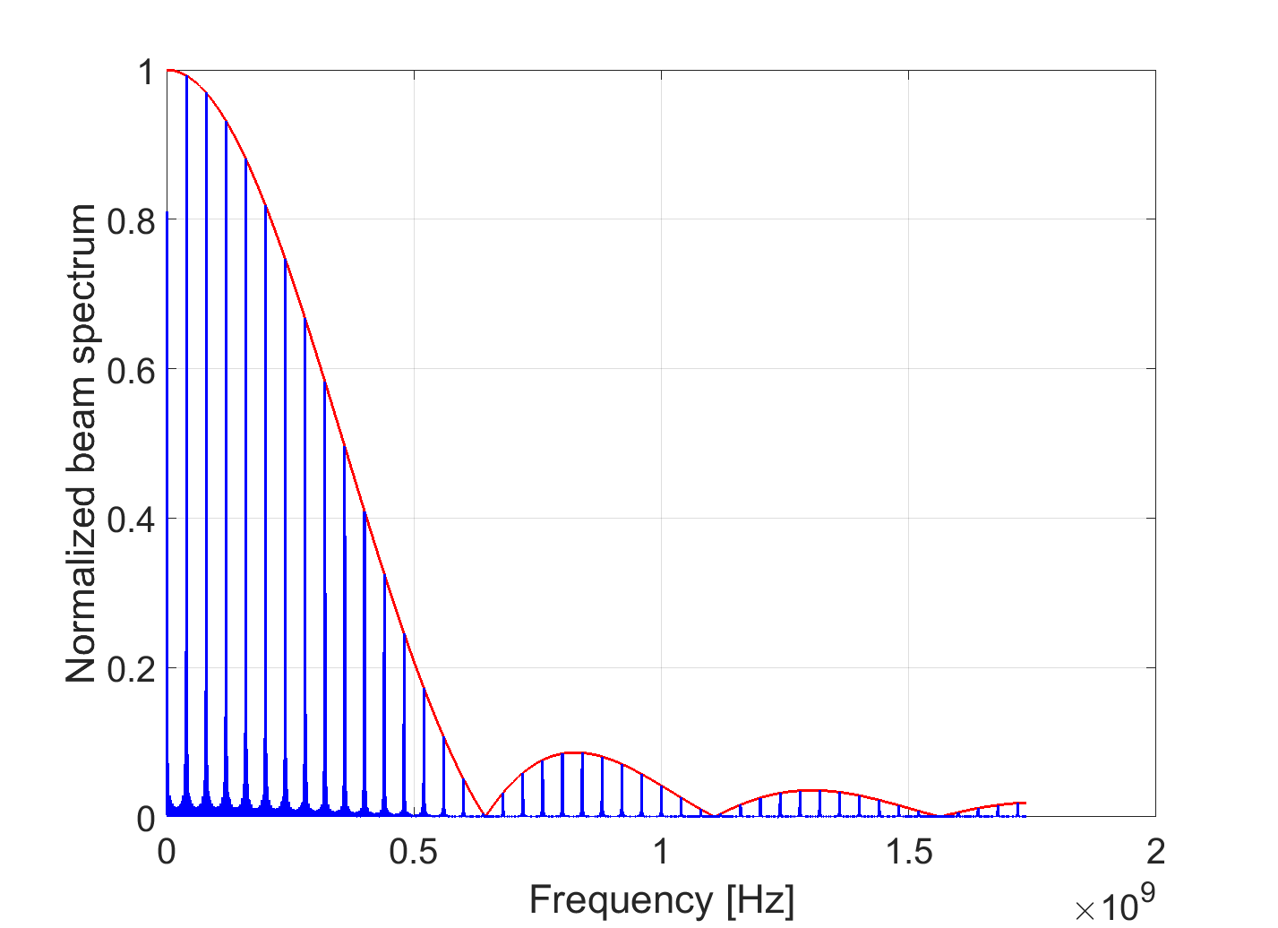
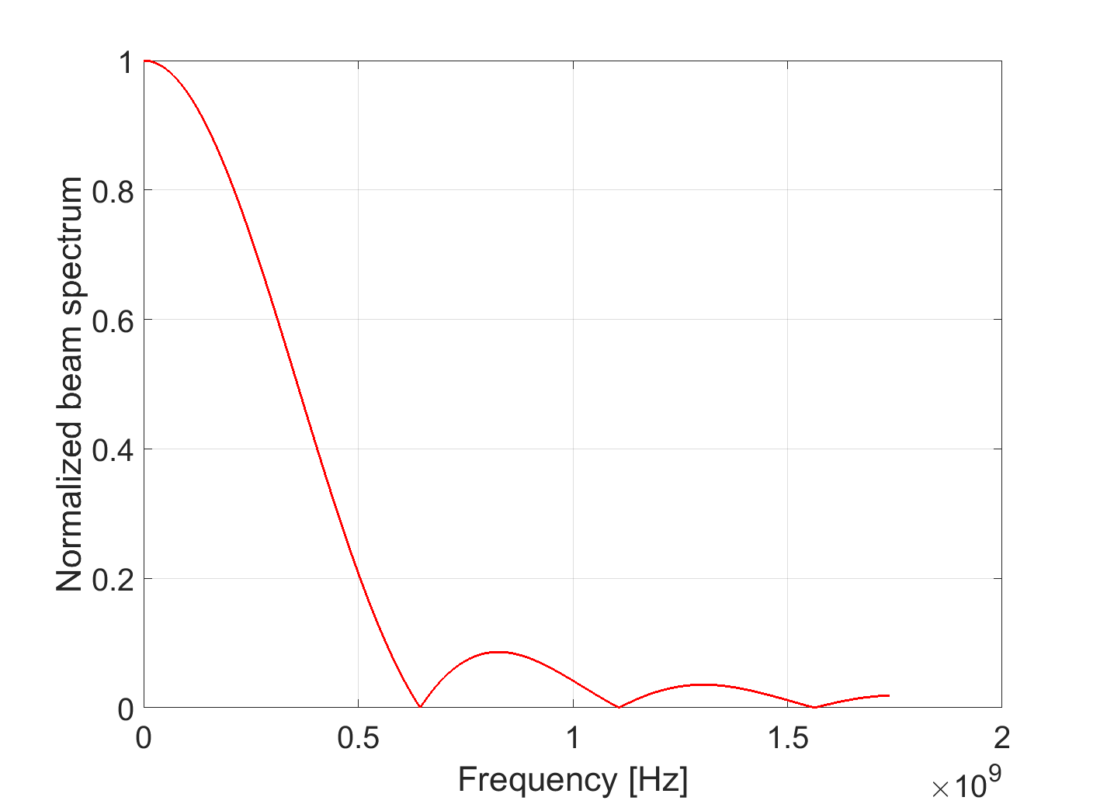
Beam energy loss per turn
Replacing the bunch spectrum with the beam spectrum, we can calculate the energy loss from a beam
Bunch profile and spectrum
Beam profile and spectrum
Ex. parabolic, as shown in the previous slide

Slide 30
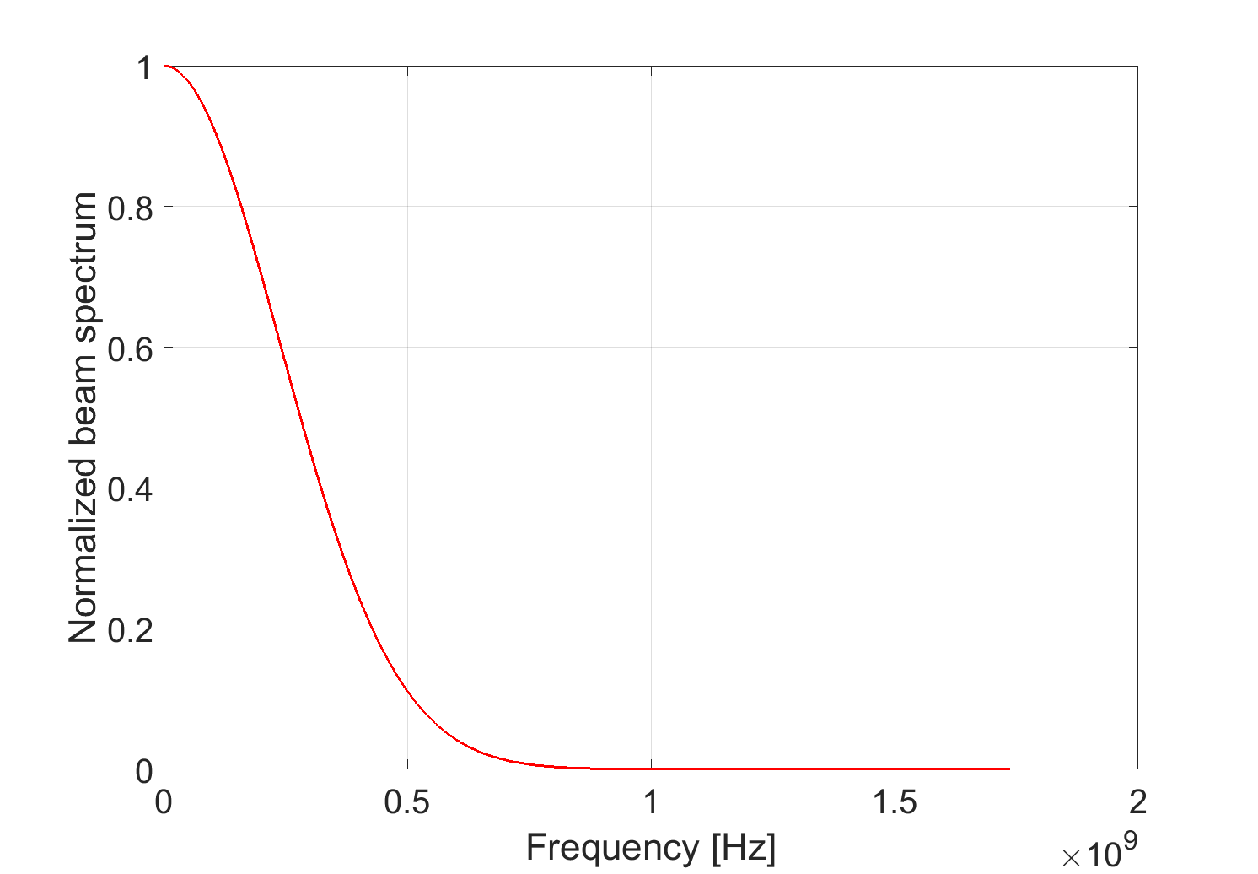
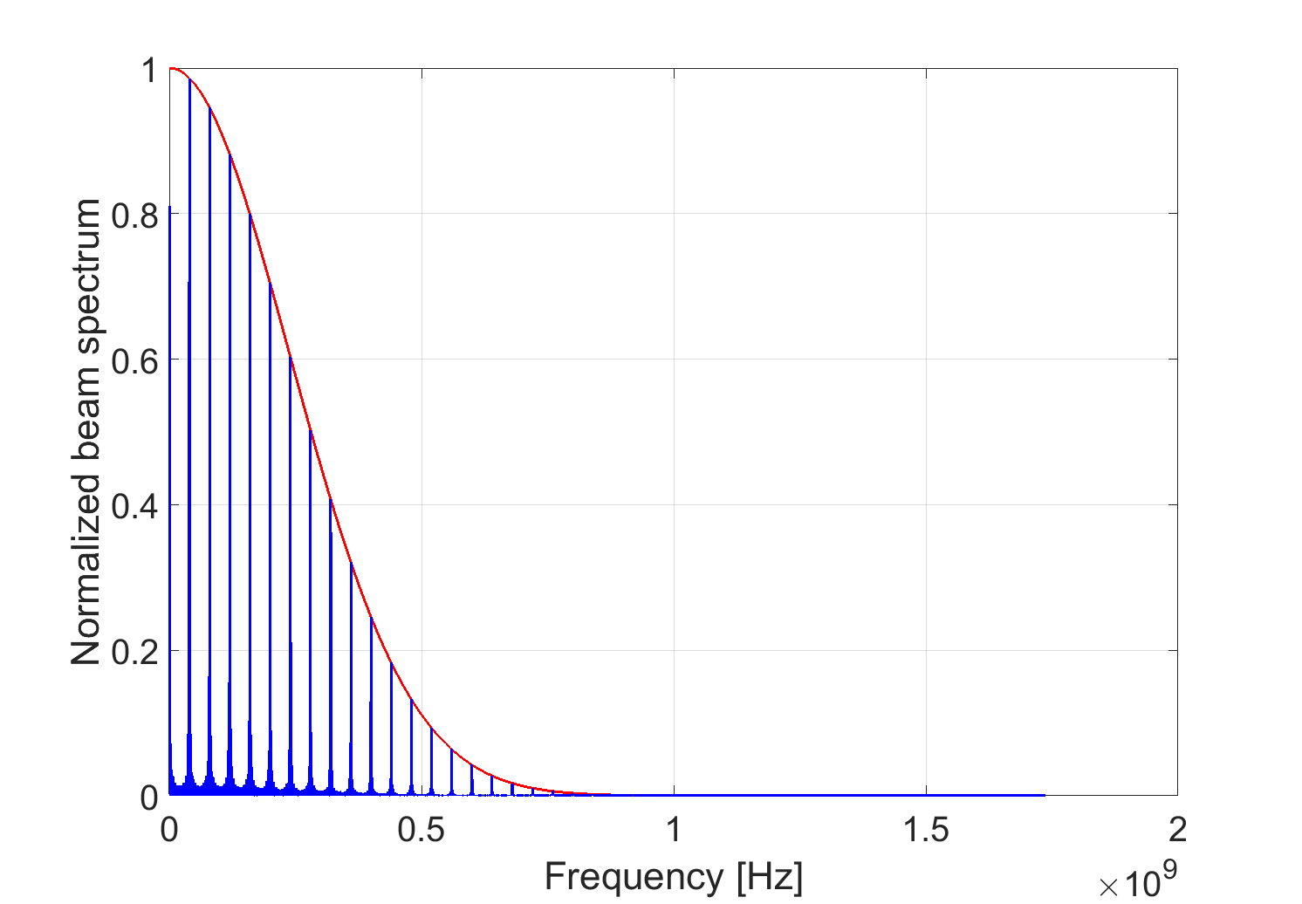
Beam energy loss per turn
Replacing the bunch spectrum with the beam spectrum, we can calculate the energy loss from a beam
Bunch profile and spectrum
Beam profile and spectrum
Or for a train of Gaussian bunches

Slide 31
Energy loss of a train of M identical bunches
A train of M identical equally spaced bunches circulating in a ring

Slide 32
Energy loss of a train of M identical bunches
A train of M identical equally spaced bunches circulating in a ring

Slide 33
Energy loss of a train of M identical bunches
  The potential leading terms in the summation are those with p = k · h, as the ratio in brackets tends to M².
  Narrow-band impedances peaked around multiples of the harmonic number of the accelerator are the most efficient to drain energy from the beam → beam induced heating, instabilities.
  This type of impedances, usually associated to the RF systems and their higher order modes (HOMs), need mitigation in the accelerator design (e.g. detuners, HOM absorbers).

Slide 34
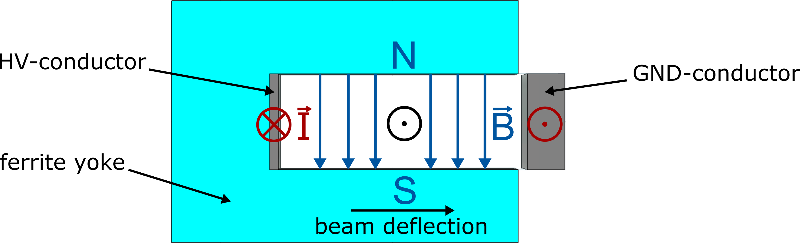
Application to the SPS extraction kickers
Problem with SPS extraction kickers (MKE)
  Extraction elements through which the beam passes every turn
    Based on a fast pulsed magnet capable of deflecting the whole beam over one turn
    Active only on turn in which beam has to be extracted, otherwise passive but with all its elements (ferrite, conductors) exposed to the beam

Slide 35
Application to the SPS extraction kickers
Problem with SPS extraction kickers (MKE)
  Extraction elements through which the beam passes every turn
    Based on a fast pulsed magnet capable of deflecting the whole beam over one turn
    Active only on turn in which beam has to be extracted, otherwise passive but with all its elements (ferrite, conductors) exposed to the beam
  Use of beam for LHC filling (4x 200-ns spaced trains of 72x 25-ns spaced bunches) led to inacceptable heating of these elements)
    Heating above Curie temperature leads to ferrite degradation → Beam cannot be extracted anymore from the SPS
    Heating causes outgassing and strong pressure rise in the kicker sector, with consequent beam interlocking due to poor vacuum

Slide 36
Application to the SPS extraction kickers
We need to calculate the power loss in the kicker
  Kicker impedance can be evaluated semi-analytically or via simulations
  Then we apply the energy loss formula

Slide 37
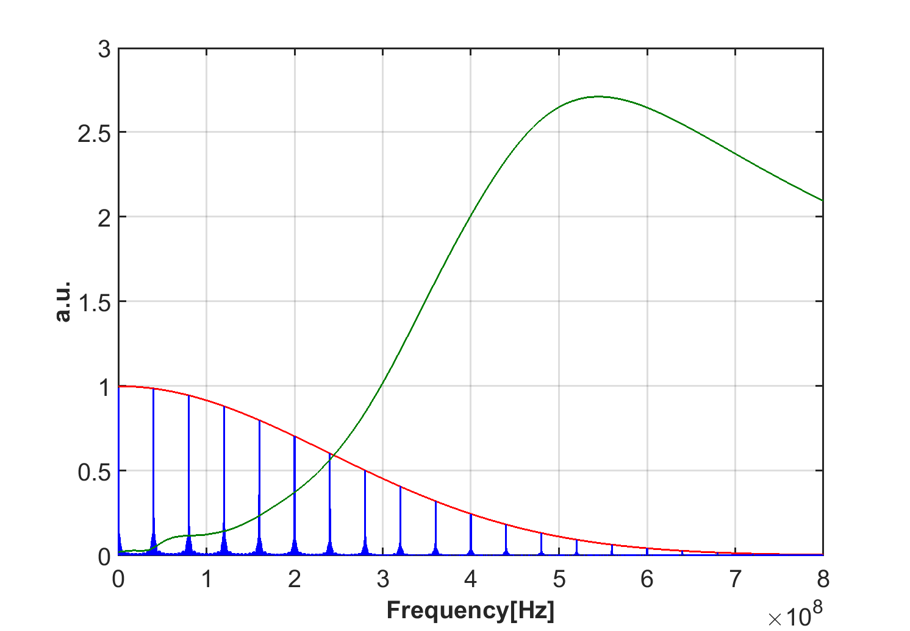
Application to the SPS extraction kickers
We need to calculate the power loss in the kicker
  Kicker impedance can be evaluated semi-analytically or via simulations
  Then we apply the energy loss formula
Kicker impedance already becomes significant at frequencies for which the beam spectrum has not fully decayed, causing the undesired heating
We need to lower the kicker impedance → Impedance dominated by losses in ferrite → Ferrite shielding

Slide 38
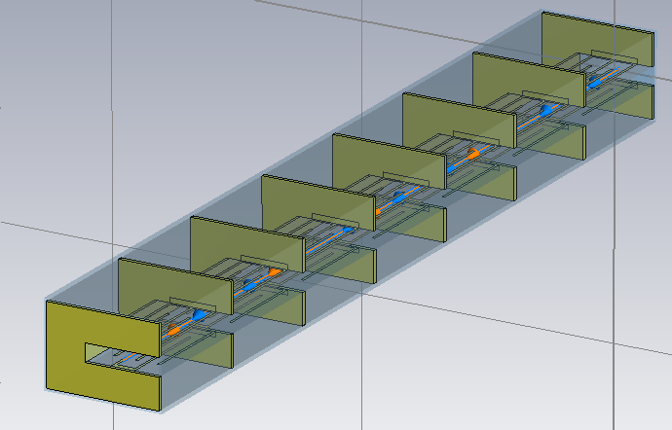
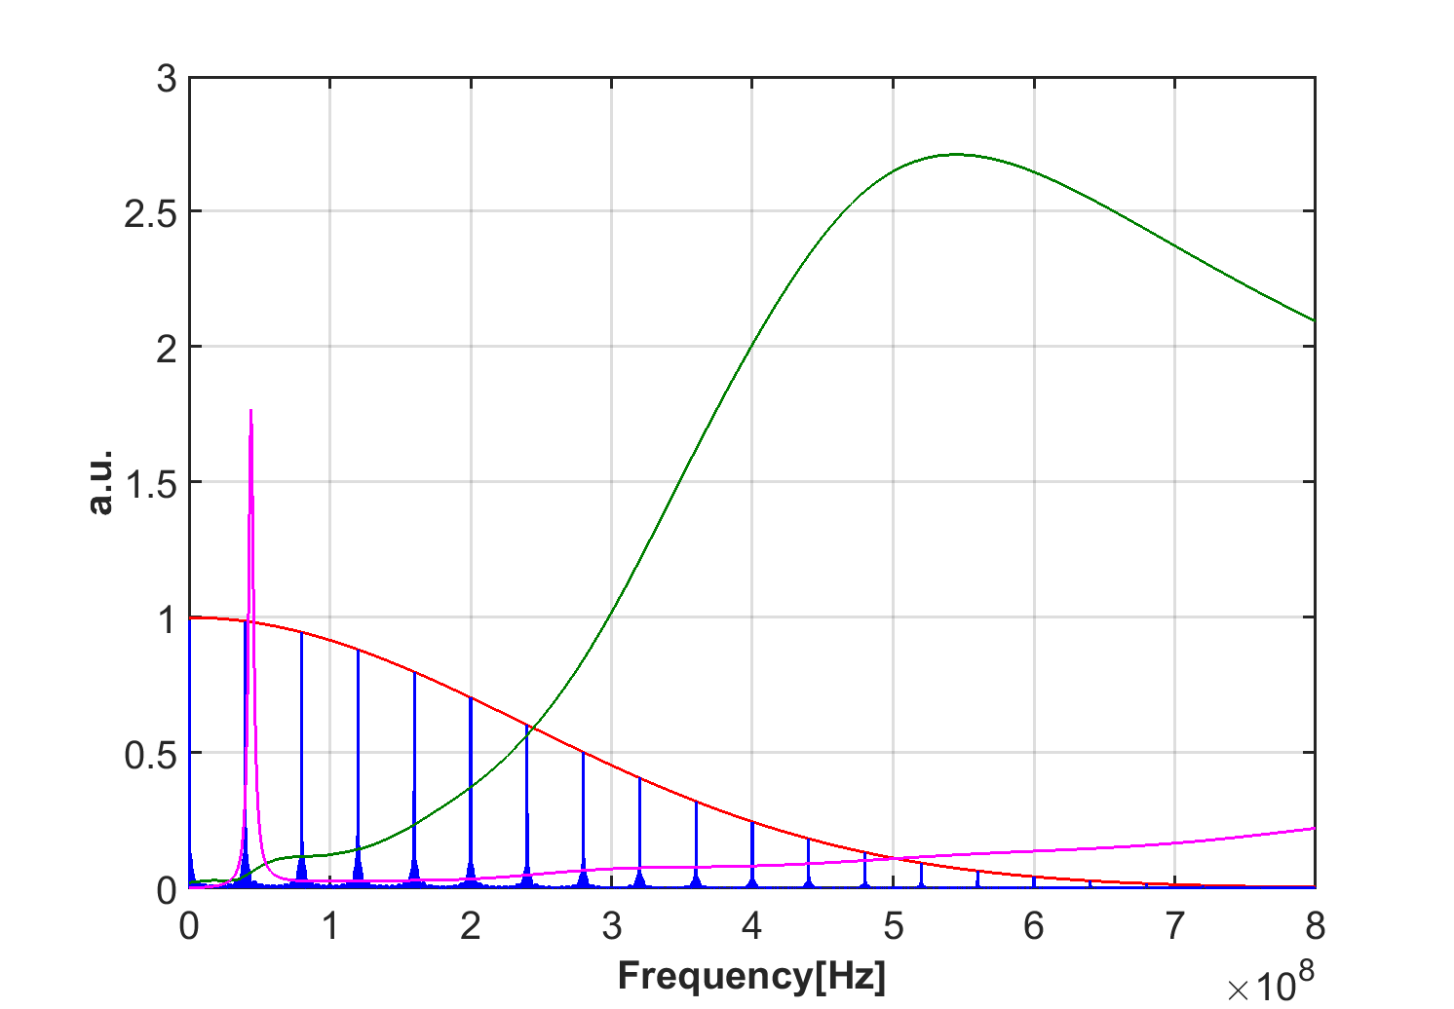
Application to the SPS extraction kickers
Print striped pattern of good conductor on ferrite (serigraphy)

Slide 39
Application to the SPS extraction kickers
This almost suppresses the impedance over the bunch spectrum
It however introduces a low frequency peak, which needs to be kept far from beam spectral lines
  Pay attention to do that for all needed bunch spacings

Slide 40
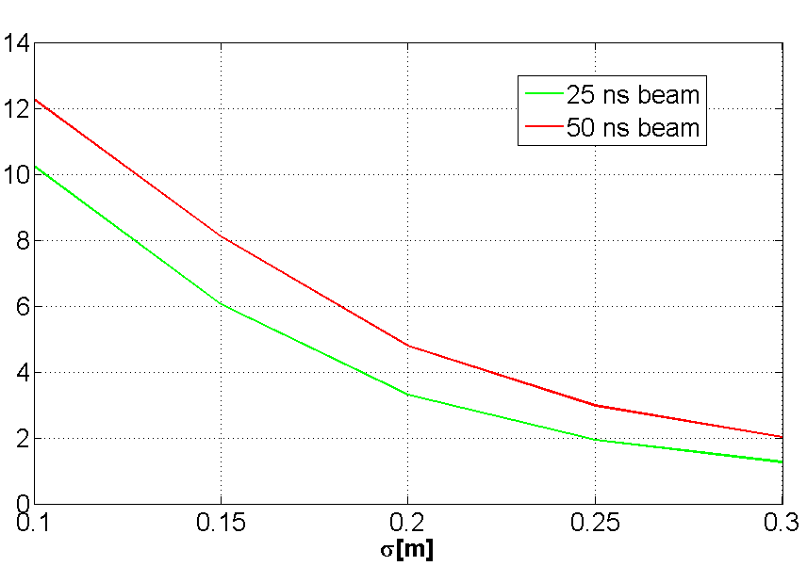
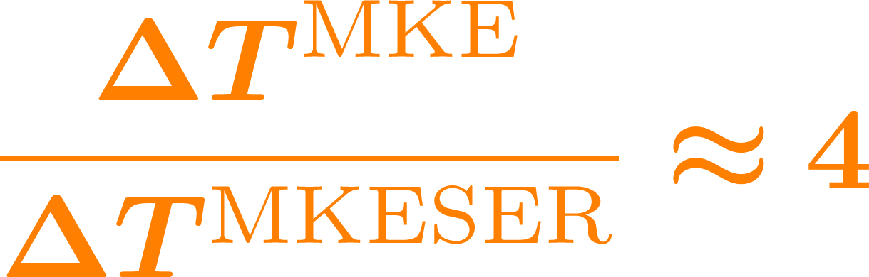
Application to the SPS extraction kickers
This almost suppresses the impedance over the bunch spectrum
It however introduces a low frequency peak, which needs to be kept far from beam spectral lines
Expected up to 12-fold reduction of heat load, depending on bunch length and bunch spacing
  Factor 4 for 25-ns LHC-type beam at 26 GeV

Slide 41
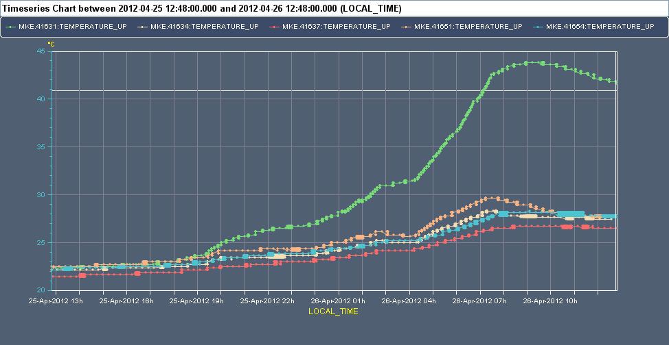


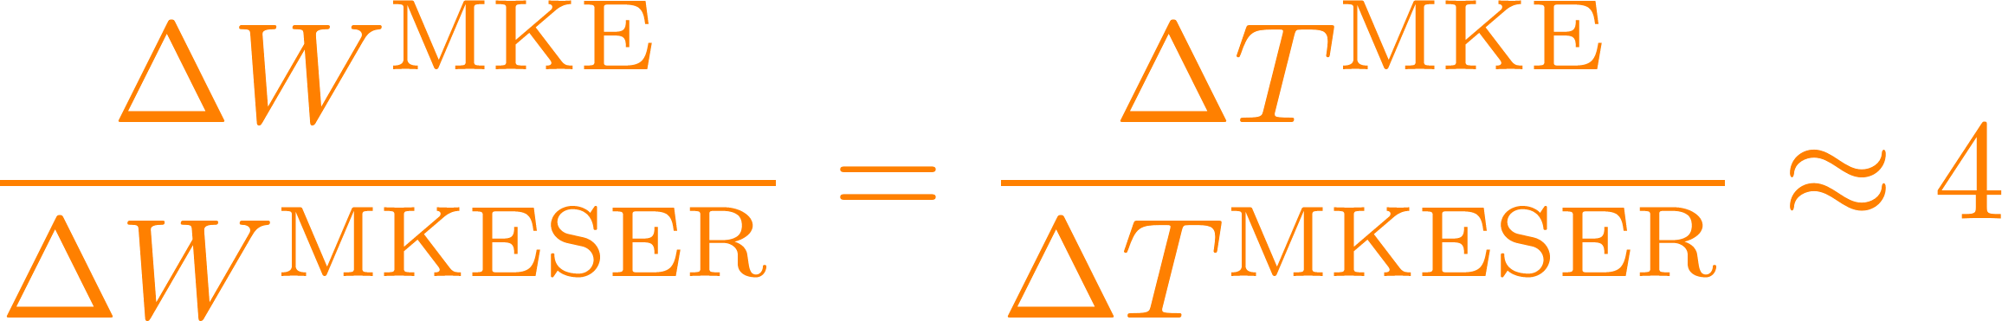
Application to the SPS extraction kickers
This almost suppresses the impedance over the bunch spectrum
It however introduces a low frequency peak, which needs to be kept far from beam spectral lines
Expected up to 12-fold reduction of heat load, depending on bunch length and bunch spacing
  Factor 4 for 25-ns LHC-type beam at 26 GeV → Experimentally measured!
~ 17h run with 25 ns beams at 26 GeV after technical stop

Slide 42
Signpost
We have further looked into the mechanism of energy loss and have seen the impact of longitudinal impedances on machine elements as these lead to beam induced heating.
We have found that beam induced heating depends on the overlap of the beam power spectrum and the impedance of a given object.
We have seen a real world example of the impact of an objects impedance on the beam induced heating.
Part 2: Multiparticle dynamics with wake fields –
impact on machine elements and longitudinal beam dynamics
  General introduction to wake fields
  Longitudinal wake fields and the longitudinal wake function
  Energy loss – beam induced heating and stable phase shift
  Potential well distortion, bunch lengthning and microwave instability
Notes:
Perhaps other way round

Slide 43
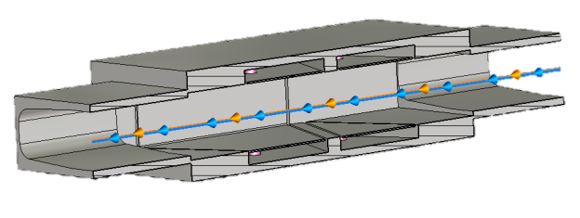
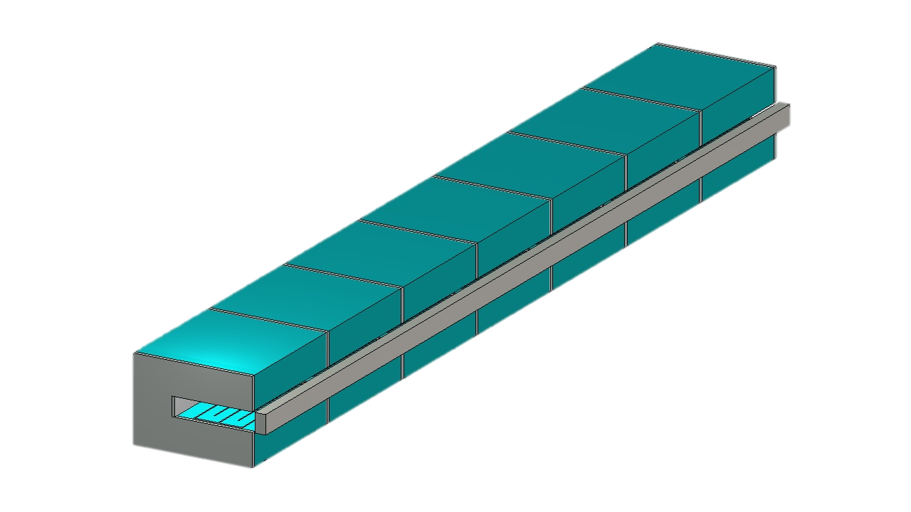
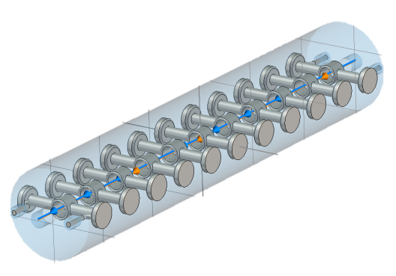
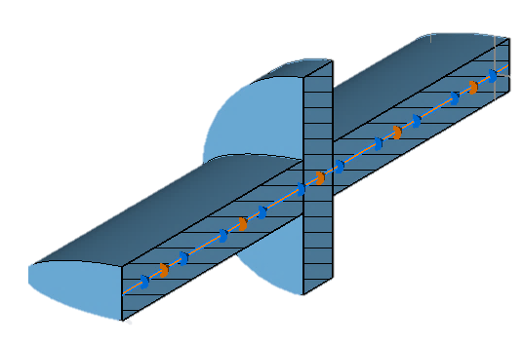
Longitudinal wakes in beam dynamics
The effect of each localised wake/impedance on each particle in a beam can be described as an energy kick
The accelerator is made of many components, each giving a small kick to the beam particles, which drift freely in between

Slide 44

Longitudinal wakes in beam dynamics
The effect of each localised wake/impedance on each particle in a beam can be described as an energy kick
The accelerator is made of many components, each giving a small kick to the beam particles, which drift freely in between
For simulations, the impedance is lumped in one place and kicks to beam particles are applied once per turn, with free drift over one turn

Slide 45
Longitudinal wakes in beam dynamics
The effect of each localised wake/impedance on each particle in a beam can be described as an energy kick
The accelerator is made of many components, each giving a small kick to the beam particles, which drift freely in between
For simulations, the impedance is lumped in one place and kicks to beam particles are applied once per turn, with free drift over one turn
For analytical calculations, both global impedance and RF are smeared over the ring

Slide 46
Longitudinal wakes in beam dynamics
  For a bunch under the effect of longitudinal wake fields, two different regimes can be found:
    Regime of potential well distortion, i.e. due to the impedance a new equilibrium distribution can be found for the bunch
    Stable phase shift
    Synchrotron frequency shift
    Different matching (→ bunch lengthening for lepton machines)
  Regime of longitudinal instability, i.e. no equilibrium distribution can be found under the effect of the impedance, a perturbation grows exponentially
    Dipole mode instabilities
    Coupled bunch instabilities
    Microwave instability (longitudinal mode coupling)

Slide 47
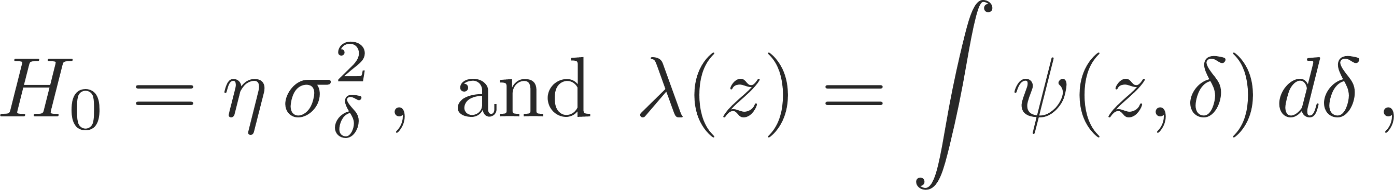
Potential well distortion and Haissinki equation
The equilibrium distribution in the presence of a longitudinal wake field can be found analytically. The (linearized) longitudinal Hamiltonian with longitudinal wake fields is given as:
We assume a Gaussian matched beam distribution, hence:
Now, choosing for H₀ and consider for λ that:
The equilibrium (matched) line charge density is then given by the self-consistency equation (Haissinski equation):
A simple Taylor expansion in z already qualitatively reveals some of the effects of the longitudinal wake fields onto the beam:
First order:
shift in the mean position (stable phase shift)
Second order:
change in bunch length accompanied by an (incoherent) synchrotron tune shift

Slide 48
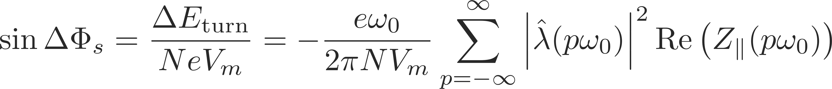
Bunch energy loss per turn and stable phase
  The RF system compensates for the energy loss by imparting a net acceleration to the bunch
  Therefore, the bunch readjusts to a new equilibrium distribution in the bucket and moves to an average synchronous angle ΔΦ_{s}
Below transition
Above transition

Slide 49
Bunch lengthening and μW instability
SPS ring
C = 6900 m
E_{kin}=25 GeV
Single Gaussian bunch
σ_{z} = 0.2 m (0.67 ns)
Ring impedance modeled as broad band resonator with
ω_{r} = 700 MHz
Q=1
R_{s}=
Single RF system
ω_{rf} = 200 MHz
V_{rf}^{max} = 3 MV
y
z
x

Slide 50
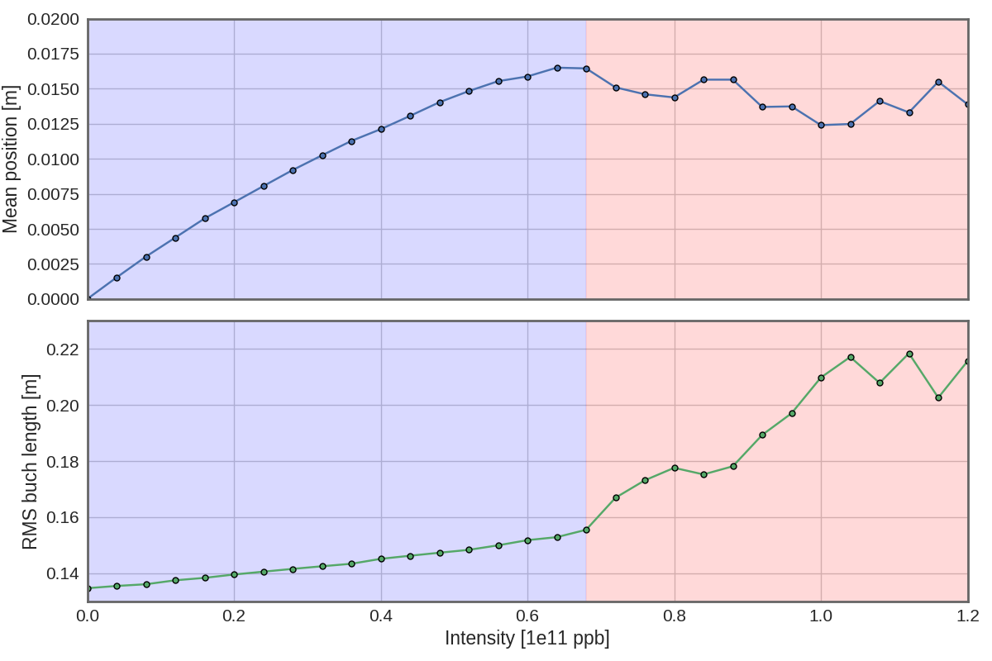
Bunch lengthening and μW instability
Running the numerical simulation for this case:
Bunch is matched at low intensity (i.e. without impedance)
Two regimes are found:
Bunch lengthening/emittance blow up regime with roughly linear increase of the synchronous phase and bunch length with intensity
Unstable regime (turbulent bunch lengthening)
Below MWI threshold
Above MWI threshold

Slide 51
Bunch lengthening and μW instability
Below MWI threshold
Above MWI threshold

Slide 52
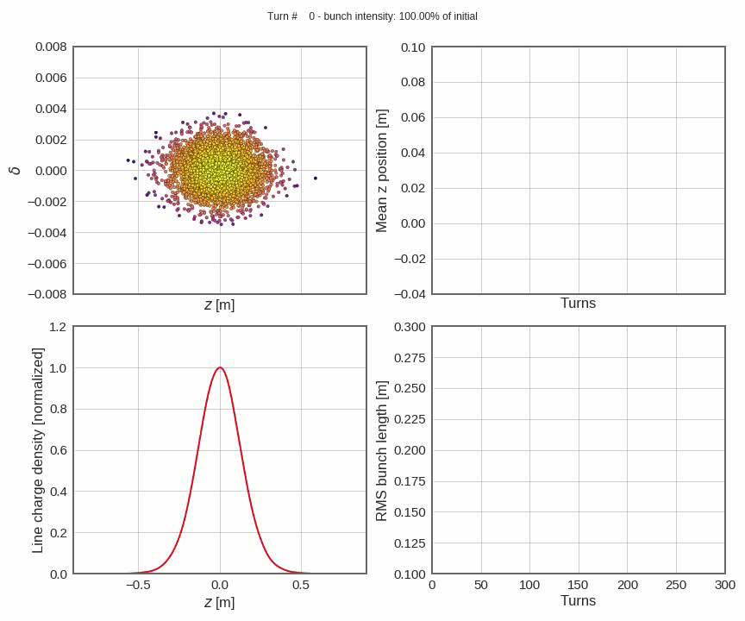
Bunch lengthening and μW instability
Below MWI threshold
Below MWI threshold
Above MWI threshold

Slide 53

Bunch lengthening and μW instability
Above MWI threshold
Below MWI threshold

Slide 54
Signpost
We have discussed longitudinal wake fields and impedances and examples of their impact on both the machine as well as the beam.
We have learned about beam induced heating and how it is related to the beam power spectrum and the machine impedance.
We have discussed the effects of potential well distortion (stable phase and synchrotron tune shifts, bunch lengthening and shortening).
We have seen one example of longitudinal instability (microwave).
Tomorrow Part 3
→ Transverse wake fields and impedances and their effects on the beam
Notes:
Perhaps other way round

Slide 55

End part 2

Slide 56
Backup - wakefields

Slide 57
Signpost
We have learned about the impact of the longitudinal impedance on the beam.
We found the Haissinki equation and discussed the potential well distortion along with the stable phase shift and synchrotron tune shift.
We looked at some generic wake fields and the two regimes of potential well distortion with bunch lenthening and its transition to the microwave instability.
We will now look specifically at multi-turn wake fields and the phenomenon of Robinson instability and damping.
Part 2: Longitudinal wakefields –
impact on machine elements and beam dynamics
  Longitudinal wake fields and the longitudinal wake function
  Energy loss – beam induced heating and stable phase shift
  Potential well distortion, bunch lengthning and microwave instability
  Robinson instability
Notes:
Perhaps other way round

Slide 58
The Robinson instability
  To illustrate the Robinson instability we will use some simplifications:
    The bunch is point-like and feels an external linear force (i.e. it would execute linear synchrotron oscillations in absence of the wake forces)
    The bunch additionally feels the effect of a multi-turn wake
δp/p₀
z
Unperturbed: the bunch executes synchrotron oscillations at ω_{s}

Slide 59
The Robinson instability
  To illustrate the Robinson instability we will use some simplifications:
    The bunch is point-like and feels an external linear force (i.e. it would execute linear synchrotron oscillations in absence of the wake forces)
    The bunch additionally feels the effect of a multi-turn wake
δp/p₀
z
The perturbation also changes the oscillation amplitude – unstable motion
Unperturbed: the bunch executes synchrotron oscillations at ω_{s}

Slide 60
The Robinson instability
  To illustrate the Robinson instability we will use some simplifications:
    The bunch is point-like and feels an external linear force (i.e. it would execute linear synchrotron oscillations in absence of the wake forces)
    The bunch additionally feels the effect of a multi-turn wake
δp/p₀
z
The perturbation also changes the oscillation amplitude – damped motion
Unperturbed: the bunch executes synchrotron oscillations at ω_{s}

Slide 61
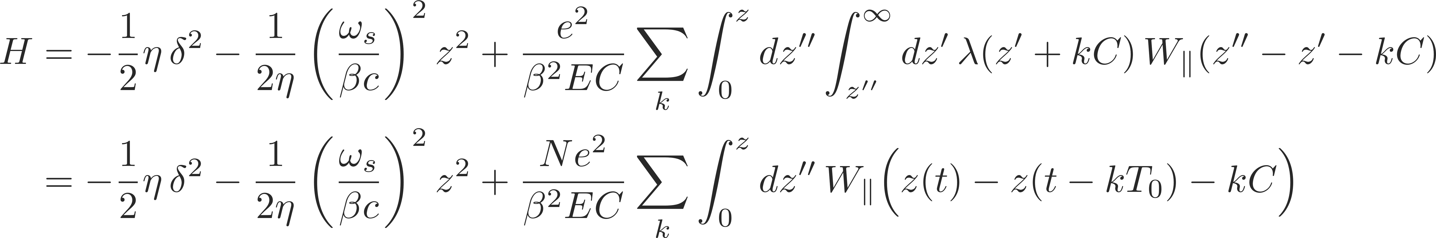
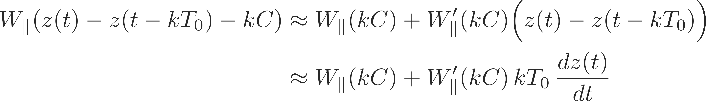
The Robinson instability
  To illustrate the Robinson instability we will use some simplifications:
    The bunch is point-like and feels an external linear force (i.e. it would execute linear synchrotron oscillations in absence of the wake forces)
    The bunch additionally feels the effect of a multi-turn wake
  Longitudinal Hamiltonian
  Expansion of wake field (we assume that the wake can be linearized on the scale of a synchrotron oscillation)

Slide 62
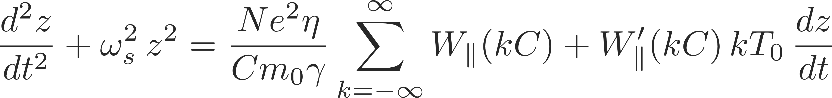
The Robinson instability
  The first term only contributes as a constant term in the solution of the equation of motion, i.e. the synchrotron oscillation will be executed around a certain z0 and not around 0. This term represents the stable phase shift that compensates for the energy loss
  The second term is a dynamic term introduced as a “friction” term in the equation of the oscillator, which can lead to instability!
  Equations of motion

Slide 63
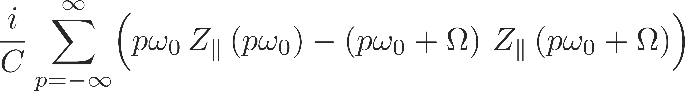
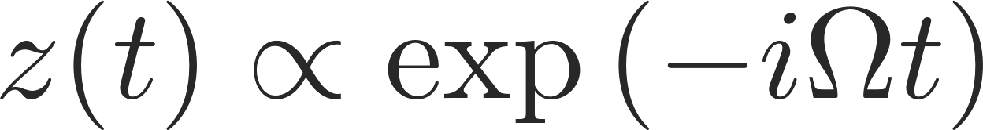
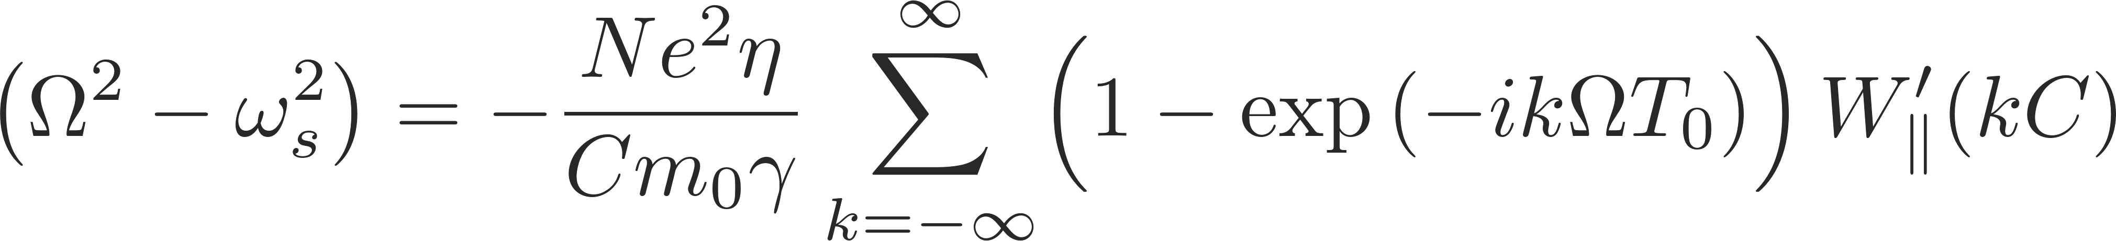
The Robinson instability
  The first term only contributes as a constant term in the solution of the equation of motion, i.e. the synchrotron oscillation will be executed around a certain z0 and not around 0. This term represents the stable phase shift that compensates for the energy loss
  The second term is a dynamic term introduced as a “friction” term in the equation of the oscillator, which can lead to instability!
  Equations of motion
  Ansatz
  Solution
Expressed in terms of impedance

Slide 64
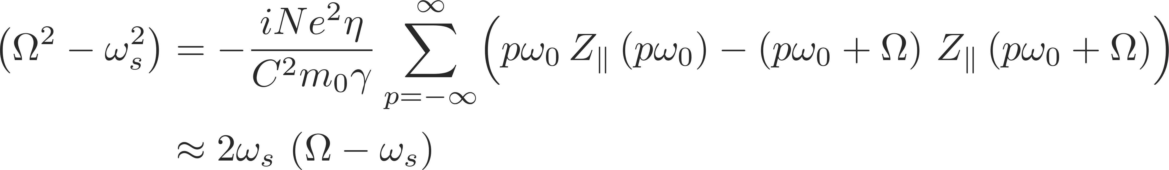
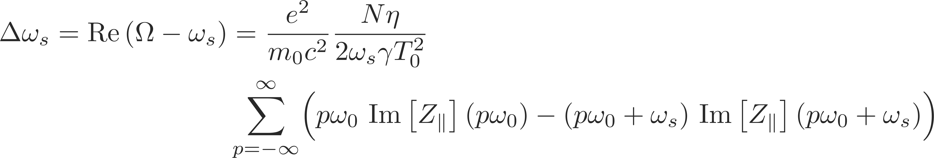
The Robinson instability
  We assume a small deviation from the synchrotron tune:
    Re(Ω - ω_{s}) → Synchrotron tune shift
    Im(Ω - ω_{s}) → Growth/damping rate, only depends on the dynamic term, if it is positive there is an instability!
  Solution:
  Tune shift:
  Growth rate:

Slide 65
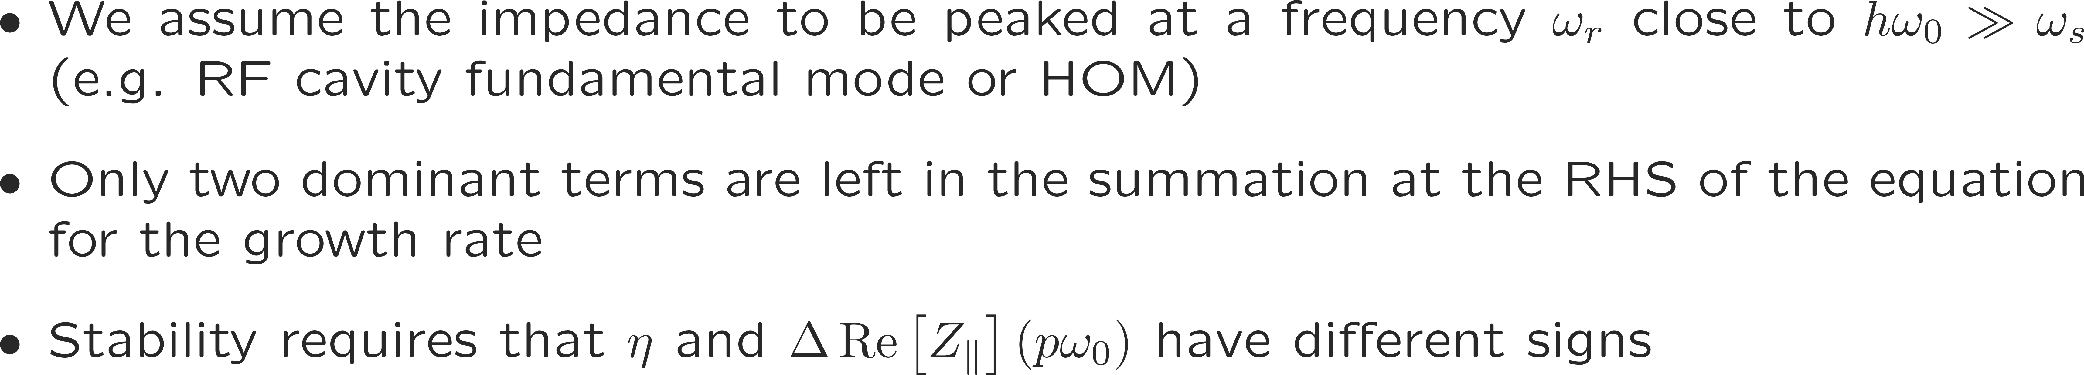
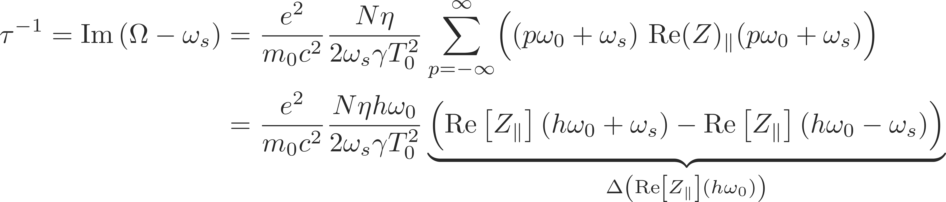
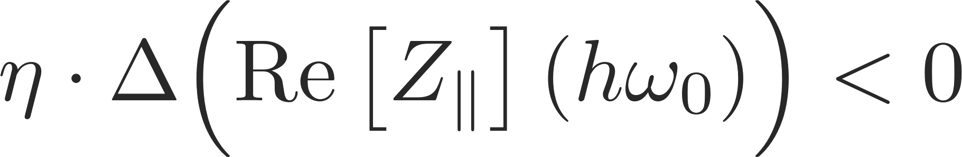
The Robinson instability
  Solution:
  Stability criterion:
Re[Z||]
Im[Z||]
ω_{r} ≈ hω₀

Slide 66



The Robinson instability
  Stability criterion:
 | ω_{r} < hω₀ | ω_{r} > hω₀
Above transition (η > 0) | stable | unstable
Below transition (η < 0) | unstable | stable

Slide 67

Robinson damping and instability
Examples of numerical simulations – SPS bunch with single narrow-band resonator wake:
Initializing an otherwise matched bunch with a slight momentum error, two regimes are found:
Regime of Robinson damping when the resonator is detuned to hω₀ – ω_{s}. Initial dipole oscillations are damped.
Regime of Robinson instability when the resonator is detuned to hω₀ + ω_{s}. Initial dipole oscillations start to are grow exponentially.
Below MWI threshold
Above MWI threshold

Slide 68
Robinson damping and instability
Below MWI threshold
Above MWI threshold

Slide 69

Robinson damping and instability
Below MWI threshold
Above MWI threshold

Slide 70

Robinson damping and instability
Below MWI threshold
Above MWI threshold

Slide 71
Other longitudinal instabilities
The Robinson instability occurs for a single bunch under the action of a multi-turn wake field
  It contains a term of coherent synchrotron tune shift which depends only on the imaginary part of the longitudinal impedance
  It results into an unstable rigid bunch dipole oscillation where the growth rate depends on the real part of the longitudinal impedance
Other important collective effects can affect a bunch in a beam – some of them of which we have also seen
  Potential well distortion (resulting in synchronous phase shift, bunch lengthening or shortening, synchrotron tune shift/spread)
  High intensity single bunch instabilities (e.g. microwave instability)
  Coasting beam instabilities (e.g. negative mass instability)
  Coupled bunch instabilities
To be able to study these effects we would need to resort to a more detailed description of the bunch(es)
  Vlasov equation (kinetic model)
  Macroparticle simulations

Slide 72

Bunch energy loss per turn
Single traversal of a bunch through an impedance source
Particle i
receives kick
Particle j
excites
Slice i
receives kick
Slice j
excites

Slide 73

Application to the LHC beam screen
  All along the arcs and in other cold regions of the LHC, a beam screen is interposed between the beam and the cold bore
  The LHC beam screen is made of stainless steel with a layer of few mm of co-laminated copper
  Due to the production procedure, there is a stainless steel weld on one side of the beam screen that remains exposed to the beam.
  The screen has holes for pumping on top and bottom

Slide 74


Application to the LHC beam screen
  The impedance model includes the weld on one side of the beam screen, which means a small longitudinal stripe of exposed StSt, as well as the pumping holes

Slide 75


Application to the LHC beam screen
Estimation (impedance + synchrotron rad.)
Heat load measurement from cryogenics
  The heat dissipated on the beam screen can be calculated for a beam made of bunches spaced by 50 ns and compared to the measurement from cryogenics

Slide 76
Beam energy loss: a doublet beam
N.B. in this example the doublet has double total intensity than single beam

Slide 77

Beam energy loss: a doublet beam
No additional impedance energy loss is expected with the doublet beam with respect to nominal beam for same total intensity
  Beam power spectrum is modulated with cos² function and lines are weakened by this modulation
  For higher doublet intensity, global effect depends on the impedance spectrum
  Example → LHC injection beam stopper (TDI)
Example for LHC beam in TDI:
25 ns (1.2 x 10¹¹ p/b) vs. 20+5 ns doublet (1.5 x 10¹¹ p/doublet )
W(25 ns) = 456 W
W(doublet) = 338 W

Slide 78
Beam energy loss: collider’s common chamber
s
IP
s
y₁
y₂

Slide 79
Beam energy loss: collider’s common chamber
s
IP
s

Slide 80

Beam energy loss in the LHC triplets
Application to the LHC inner triplets
  Beams are separated vertically (IP1) or horizontally (IP5)
  Strongly off-axis for ~30m, all relative delays between beams swept
  Asymmetric chamber in the direction of separation because of the weld

Slide 81

Beam energy loss in the LHC triplets
for a typical 50 ns fill of the LHC

Slide 82


Beam energy loss in the LHC triplets
Estimation from impedance model
Comparison with measured data (L. Tavian)
  Estimated heat load more than a factor 10 below measurement
  Indication of a dominant contribution from electron cloud, also enhanced by the two-beam effect
for a typical 50 ns fill of the LHC

Slide 83
Panofsky-Wenzel Theorem

Slide 84
Relation between transverse and longitudinal wakes (Panofsky-Wenzel theorem)
Source terms (displaced point charge traveling along s with speed v) in Cartesian coordinates:

Slide 85
Relation between transverse and longitudinal wakes (Panofsky-Wenzel theorem)
Source terms (displaced point charge traveling along s with speed v) in cylindrical coordinates:

Slide 86
Relation between transverse and longitudinal wakes (Panofsky-Wenzel theorem)

Slide 87
Relation between transverse and longitudinal wakes (Panofsky-Wenzel theorem)
We want to find relations between the forces on the witness charge:
with

Slide 88
Relation between transverse and longitudinal wakes (Panofsky-Wenzel theorem)
We first use this set of equations

Slide 89
Relation between transverse and longitudinal wakes (Panofsky-Wenzel theorem)
Result known as Panofsky-Wenzel theorem

Slide 90
Relation between transverse and longitudinal wakes (Panofsky-Wenzel theorem)

Slide 91
Relation between transverse and longitudinal wakes (Panofsky-Wenzel theorem)
The longitudinal and transverse wake functions are not independent, although in general no relation can be established between W||(z) and W_{x,y}(z), which are the main wakes in the longitudinal and transverse planes, respectively.

Slide 92
Relation between transverse and longitudinal wakes (Panofsky-Wenzel theorem)
We can now use also these two sets of equations to find additional properties of the wakes

Slide 93
Relation between transverse and longitudinal wakes (Panofsky-Wenzel theorem)
This is an interesting result!
The quadrupolar wakes in x and y must be equal with opposite signs
This relation means that the cross-wakes between x and y must be equal.
We have so far ignored these terms in our derivations.

Slide 94
Instabilities

Slide 95

Synchrotron tune shift
The equilibrium distribution in the presence of a longitudinal wake field can be found analytically. The (linearized) longitudinal Hamiltonian with longitudinal wake fields is given as:
Remember the example of the harmonic oscillator:
Coefficient determines frequency/tune

Slide 96
Synchrotron tune shift
The equilibrium distribution in the presence of a longitudinal wake field can be found analytically. The (linearized) longitudinal Hamiltonian with longitudinal wake fields is given as:
Remember the example of the harmonic oscillator:
Coefficient determines frequency/tune
Term determines center position/orbit

Slide 97




Synchrotron tune shift
The equilibrium distribution in the presence of a longitudinal wake field can be found analytically. The (linearized) longitudinal Hamiltonian with longitudinal wake fields is given as:
It follows then quite easily that:
The synchrotron tune shift from an impedance is, hence, given as:

Slide 98


Measurements of synchrotron tune shift at SPS
The slope of the incoherent synchrotron tune shift with intensity, measured in reproducible conditions over the years, shows the evolution of the imaginary part of the machine impedance (E. Shaposhnikova, T. Bohl, J. Tuckmantel)
  The technique uses the quadrupole oscillations of a bunch injected with a mismatch
  Qs can be extrapolated from bunch length or peak amplitude measurements

Slide 99


Measurements of potential well distortion
Stable phase and bunch lengthening
Measurements at light sources
  Bunch lengthening @DIAMOND (left, R. Bartolini)
  Energy loss measured through the synchronous phase shift @Australian light source (right, R. Dowd, M. Boland, G. LeBlanc, M. Spencer, Y. Tan, PAC07)

Slide 100






Examples of numerical simulations debunching bunch with SPS impedance model
Microwave instability on a debunching bunch is used at SPS for probing the machine impedance (E. Shaposhnikova, T. Bohl, H. Timkó, et al.)
  Long bunch injected into SPS with RF off slowly debunches due to low momentum spread
  Spectrum of bunch profile reveals important components for the impedance

Slide 101


Examples of numerical simulations debunching bunch with SPS impedance model
Microwave instability on a debunching bunch is used at SPS for probing the machine impedance (E. Shaposhnikova, T. Bohl, H. Timkó, et al.)
  Long bunch injected into SPS with RF off slowly debunches due to low momentum spread
  Spectrum of bunch profile reveals important components for the impedance
  Simulations with impedance model are used to match measured profile
Measured
Simulated with impedance from cavities, kickers, BPMs & (ZS)

