Slide 1
Marco Kirm marco.kirm@ut.ee
University of Tartu activities at CERN:
CLIC and CCC collaborations
3rd Baltic Group meeting 29.01.2019, Tallinn

Slide 2
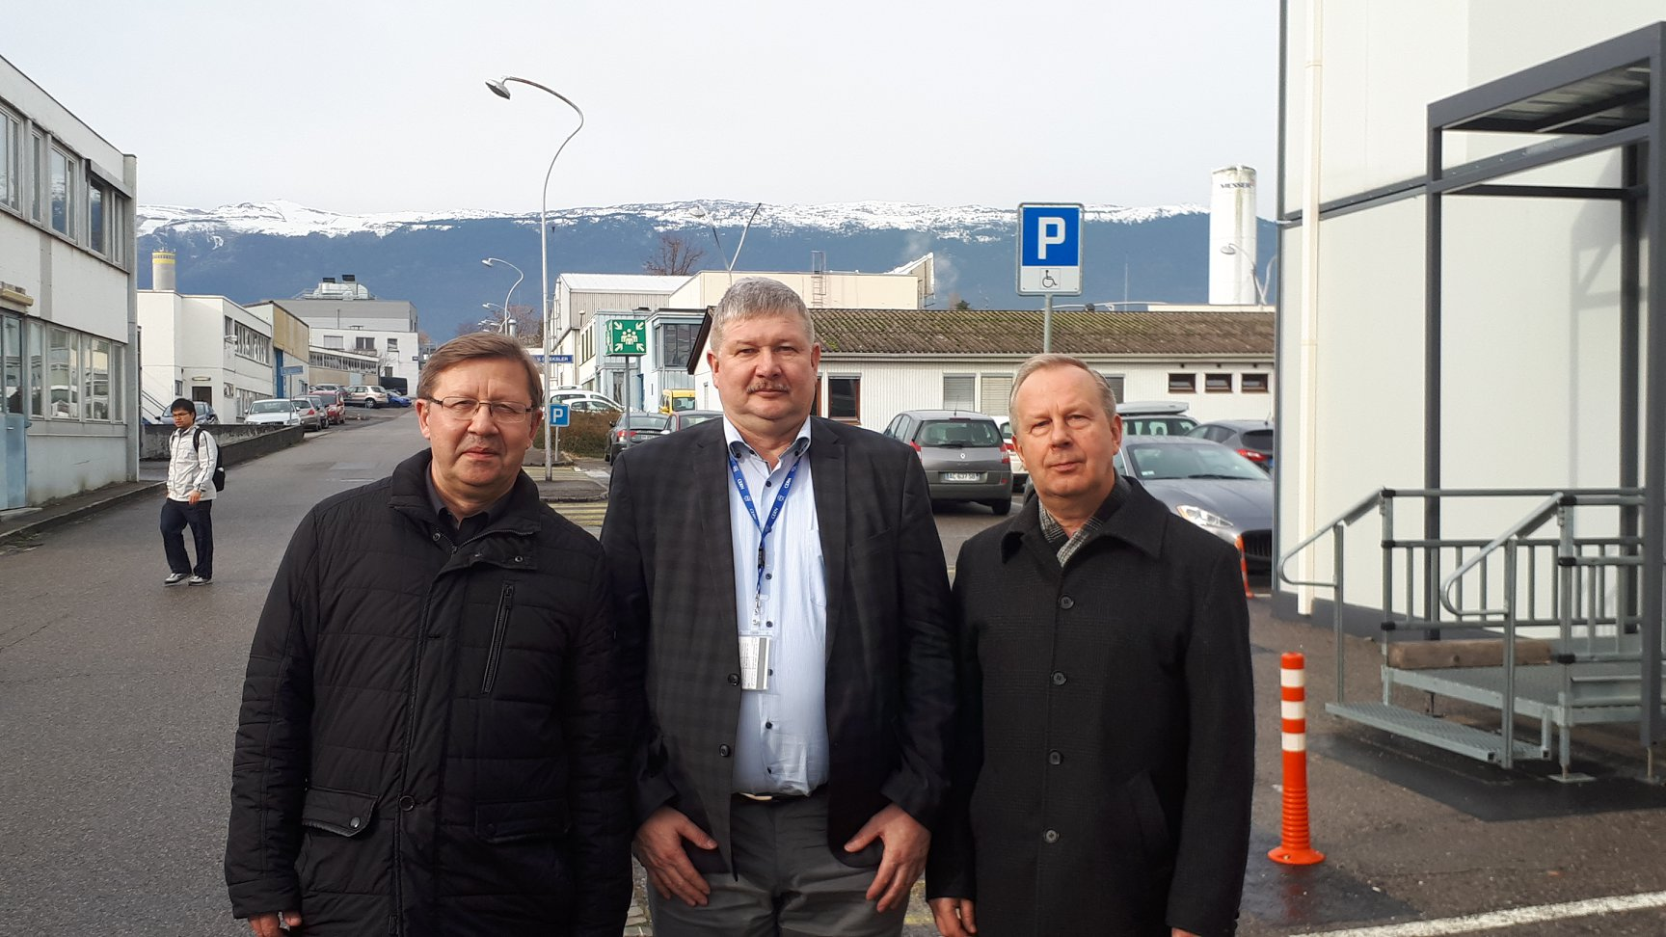
Institute of Physics and Crystal Clear Collaboration (RD-18) at CERN:
The CCC 70. annual meeting - Baltic cooperation
30.11.2018 CERN

Slide 3
CCC collaboration membership since 2012, when MoU signed between CERN and University of Tartu
But the research collaboration with the CCC members actually dates back to:
V. Mürk, M. Nikl, E. Mihokova, K. Nitsch, „ A study of electron excitations in CaWO₄ and PbWO₄ single crystals“ J. Phys. Cond. Matter 9 (1997) 249-256.
1997 …2017 - tens of joint papers
S.I. Omelkov, V. Nagirnyi, S. Gundacker, D.A. Spassky, E. Auffray, P. Lecoq, M. Kirm, Scintillation yield of hot intraband luminescence, J. of Luminescence 198 (2018) 260-271.
DRIVEN BY A NEED FOR FASTER SCINTILLATORS - FUTURE CIRCULAR COLLIDER
- MEDICAL APPLICATIONS
- free electron lasers
- other novel applications ☺?!

Slide 4
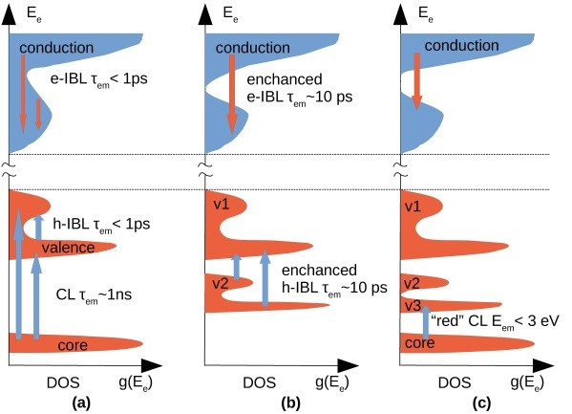
Band structure engineering – facilitating ultrafast emissions
CL and IBL in the multication
material K₂SiF₆

Slide 5
Joint Research Projects
“Fast Advanced Scintillator Timing “(FAST) TD1401 COST Action 2014-2018
The Attract H2020 proposal „ Development of novel CL-IBL matERials for ultrafast
scintillation applications (CIBLER) „ - UT is a lead partner, status submitted.
MCurie ITN network „ Light engineering materials and devices “
UT is a lead partner, status in preparation.
National Funding
National Center of Excellence TK141 „“Advanced materials and high-
technology devices for sustainable energetics, sensorics and nanoelectronics“ 2023
Estonian Research Council IUT2-26 „ Transformation of electronic excitations into
luminescence and radiation defects in wide-gap functional materials“ 2018
Estonian Research Council PUT-RG111 „ Interrelations between the properties
of impurities and hosts in novel optical materials: fundamental and
applied aspects“ 2022

Slide 6




CLIC collaboration and Institute of Technology
Vahur Zadin, Simon Vigonski, Robert Aare, Kristian Kuppart, Alvo Aabloo
MoU with University of Tartu signed in 2013
IMS Lab, http://www.ims.ut.ee, Institute of Technology, University of Tartu, Estonia
Department of Physics and Helsinki Institute of Physics

Slide 7


National Funding for CLIC cooperation
PUT 57 “Multiscale simulations of dislocation generation in rf electric fields in the linear accelerator design” 288 000 EUR. Project duration 01.01.2013-31.12.2016
PUT 1372 “Mechanisms of vacuum arching in high electric field systems” 206 400 EUR. Project duration 01.01.2017-31.12.2020

Slide 8
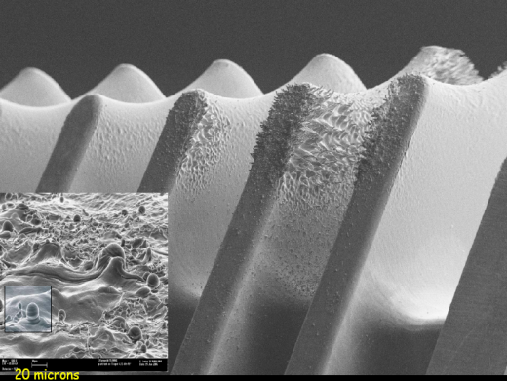
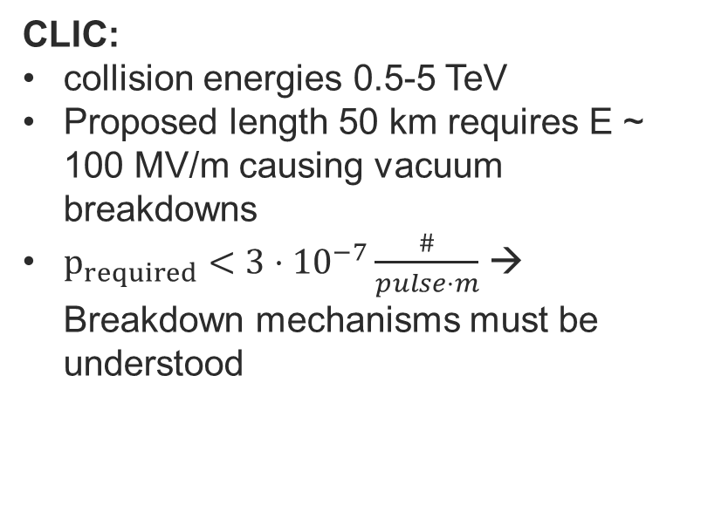
Current collaboration:
CLIC – Compact Linear Collider
Applications:
CLIC collider in CERN
vacuum switches
novel nanofabrication applications
x-ray sources
medical linear accelerators
RF components for microwave devices
CLIC:
collision energies 0.5-5 TeV
Proposed length 50 km requires E ~ 100 MV/m causing vacuum breakdowns
$p_{required}<{3⋅10}^{−7}\frac{\#}{pulse⋅m}$ → Breakdown mechanisms must be understood
Surface damage in CLIC accelerating structures after the breakdown

Slide 9
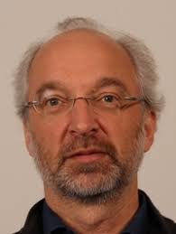
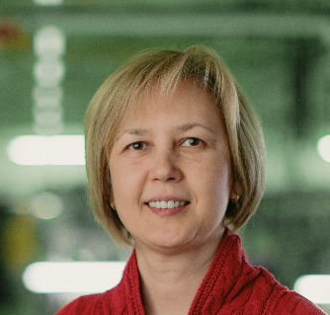
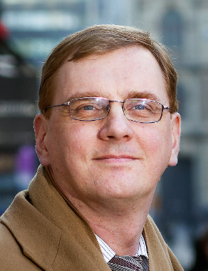
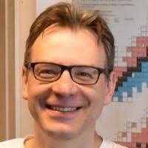
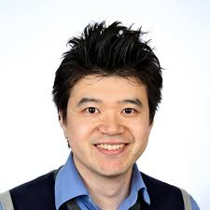
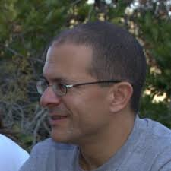
Collaboration network
CLIC & UT MoU signed in 2013
  Renewal currently in progress
Main Research Focus:
  Simulations of conditions and reasons leading to electrical breakdowns in CLIC accelerating structures
Funded from Estonian National Research grants
Main collaboration network:
  University of Helsinki (Flyura Djurabekova)
  CLIC RF studies (Walter Wuensch)
  Hebrew University of Jerusalem (Yinon Ashkenazy)
  Uppsala University (Marek Jacewicz)
  Ludwig-Maximilians-University of Munich (Hirofumi Yanagisawa)
  Flyura Djurabekova - UH
  Walter Wuensch - CLIC RF
  Kai Nordlund - UH
  Marek Jacewicz - UU
Involved research staff and students from Tartu:
Vahur Zadin
Alvo Aabloo
Simon Vigonski
Artur Tamm
Robert Aare
Tarvo Metspalu
Mihkel Veske
Kristjan Eimre
Kristian Kuppart
  Hirofumi Yanagisawa - LMU of Munich
  Yinon Ashkenazy – HU of Jerusalem

Slide 10
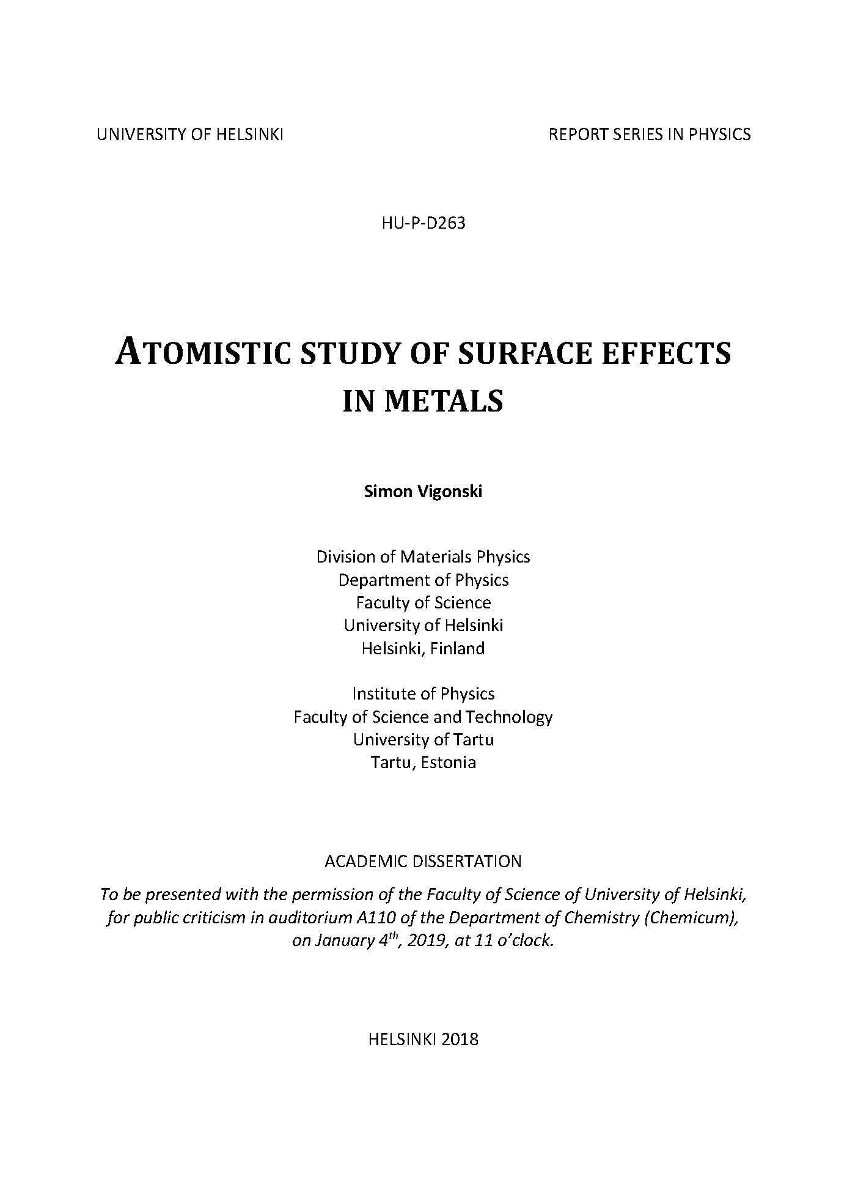
I. S. Vigonski, F. Djurabekova, M. Veske, A. Aabloo, V. Zadin, Molecular
dynamics simulations of near-surface Fe precipitates in Cu under high
electric fields, Modelling Simul. Mater. Sci. Eng. 23 (2015) 025009.
doi:10.1088/0965-0393/23/2/025009.
II. V. Zadin, M. Veske, S. Vigonski, V. Jansson, J. Muszinsky, S. Parviainen,
A. Aabloo, F. Djurabekova, Simulations of surface stress effects in
nanoscale single crystals, Modelling Simul. Mater. Sci. Eng. 26 (2018)
035006. doi:10.1088/1361-651X/aaa928.
III. S. Vigonski, M. Veske, A. Aabloo, F. Djurabekova, V. Zadin, Verification
of a multiscale surface stress model near voids in copper under the
load induced by external high electric field, Applied Mathematics and
Computation. 267 (2015) 476–486. doi:10.1016/j.amc.2015.01.102.
IV. E. Baibuz, S. Vigonski, J. Lahtinen, J. Zhao, V. Jansson, V. Zadin, F.
Djurabekova, Migration barriers for surface diffusion on a rigid lattice:
challenges and solutions, Computational Materials Science. 146 (2017)
287–302. doi: 10.1016/j.commatsci.2017.12.054.
IV.a. E. Baibuz, S. Vigonski, J. Lahtinen, J. Zhao, V. Jansson, V. Zadin,
F. Djurabekova, Data sets of migration barriers for atomistic Kinetic
Monte Carlo simulations of Cu self-diffusion via first nearest
neighbour atomic jumps, Data in Brief. 17 (2018) 739–743.
doi:10.1016/j.dib.2018.01.066.
IV.b. E. Baibuz, S. Vigonski, J. Lahtinen, J. Zhao, V. Jansson, V. Zadin,
F. Djurabekova, Data sets of migration barriers for atomistic Kinetic
Monte Carlo simulations of Fe self-diffusion, Data in Brief. 19
(2018) 564–569. doi:10.1016/j.dib.2018.04.060.
V. S. Vigonski, V. Jansson, S. Vlassov, B. Polyakov, E. Baibuz, S. Oras, A.
Aabloo, F. Djurabekova, V. Zadin, Au nanowire junction breakup
through surface atom diffusion, Nanotechnology. 29 (2018) 015704.
doi:10.1088/1361-6528/aa9a1b.

Slide 11
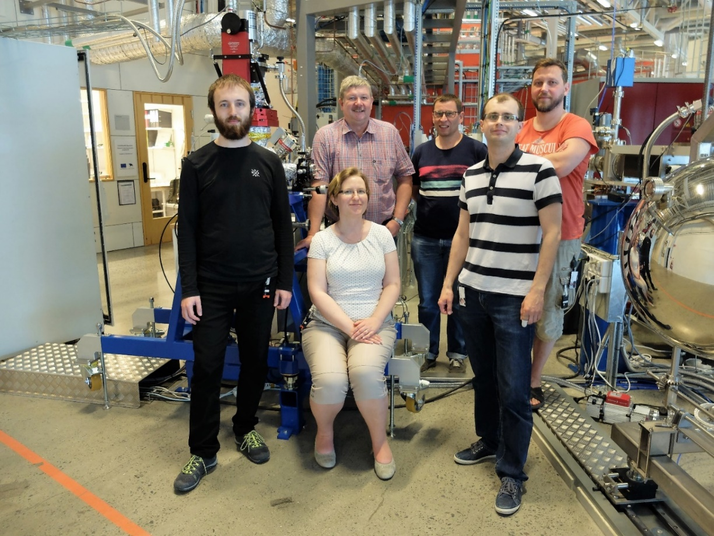
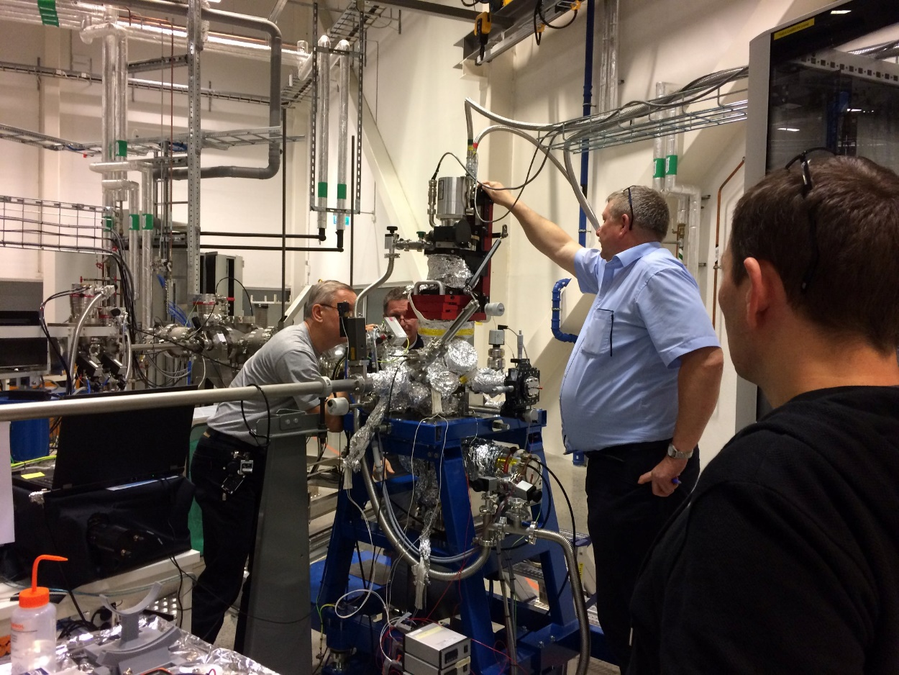
Thank You – AITÄH !
NEW HORIZONS for time-resolved low temperature VUV-XUV spectroscopy at FinEstBeAMS at MAX IV !
October 2018
June 2018
Photos by Antti Kivimäki and Ivo Romet

