Slide 2
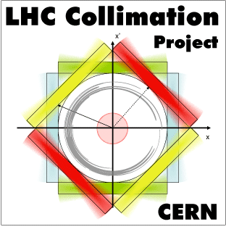
MD4168 - Crystal Collimation Tests with Pb Ion Beams
M. D’Andrea, E. Belli, A. Fomin, D. Mirarchi, S. Redaelli, R. Rossi, W. Scandale
Acknowledgements: UA9 Collaboration, BE-ABP, BE-OP, EN-SMM, EN-STI

Slide 3
Overview of measurements
27th November 2018 – 12 hours
Goal of the MD
Complete characterization of crystal devices and evaluation of crystal collimation performance with Pb ion beams
Program completed
  Angular and linear scans at injection and flat top
  Loss maps at flat top with different collimator settings
  Crystals kept in channeling during squeeze
  Crystals left in with sustained losses on all four planes at the same time
High intensity fill originally planned but not performed in favor of more measurements at top energy in the first fill

Slide 4
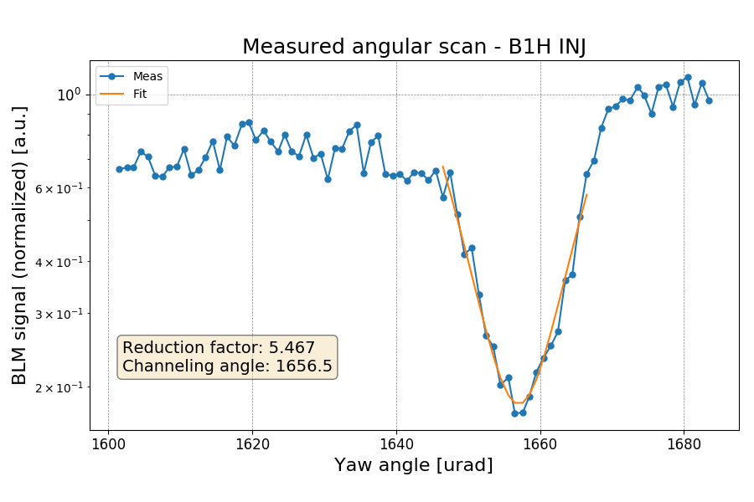
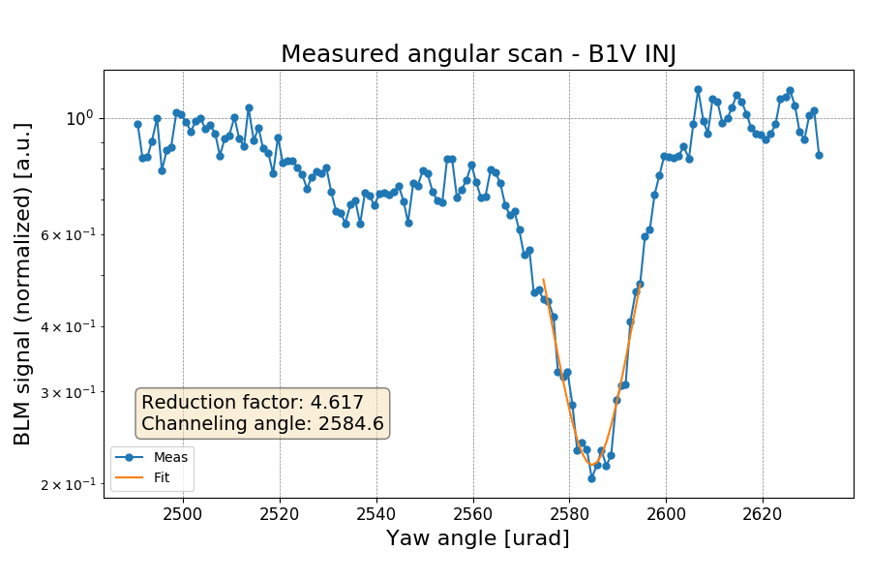
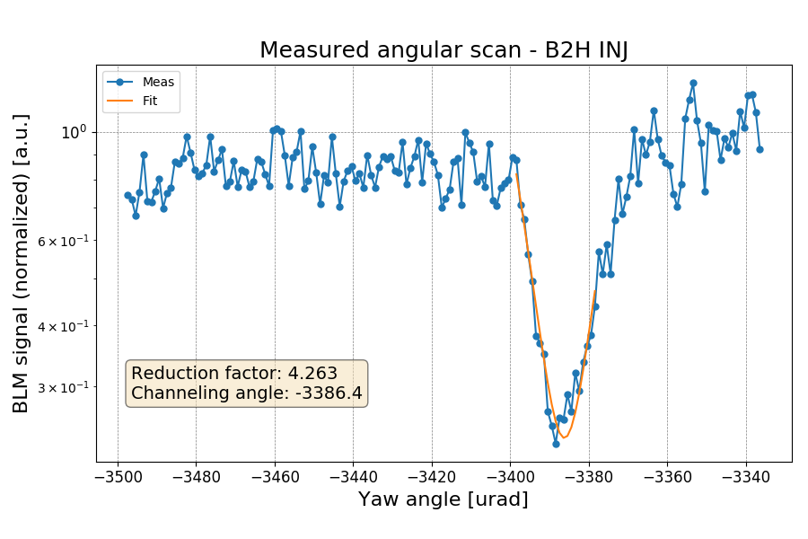
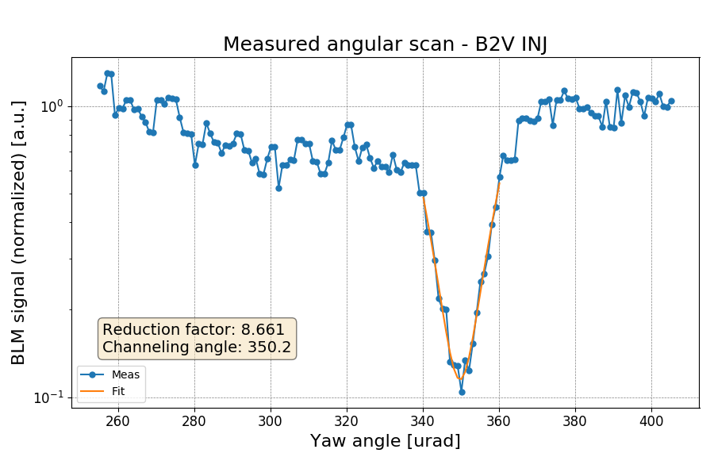
Angular scans at injection

Slide 5
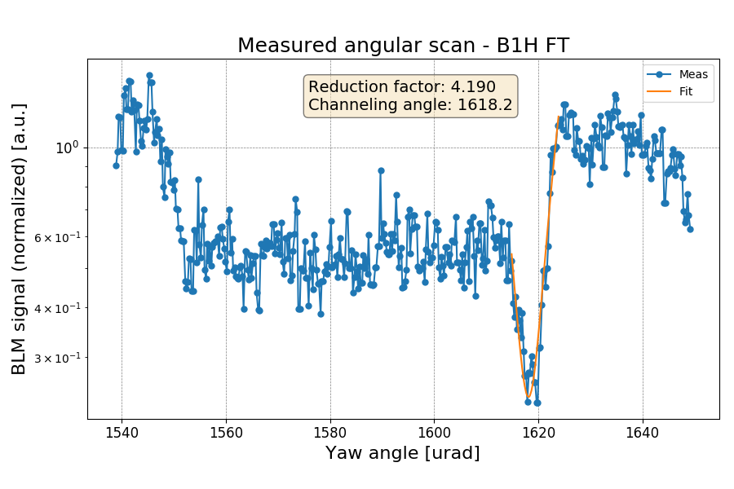
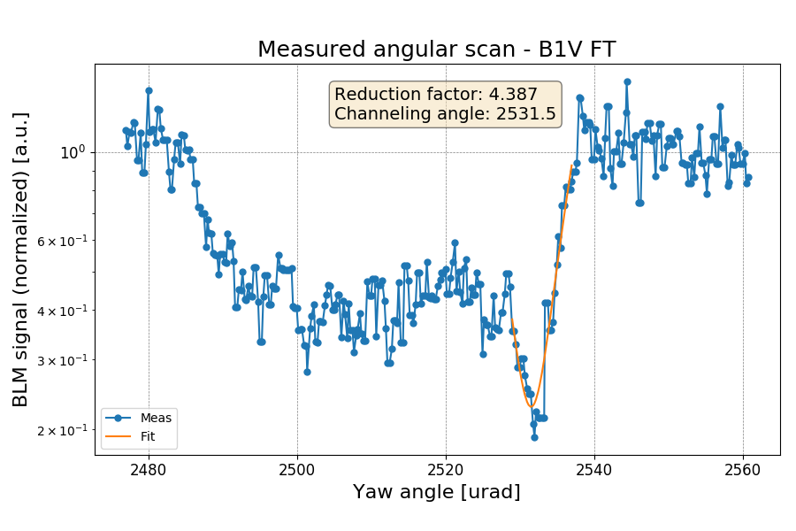
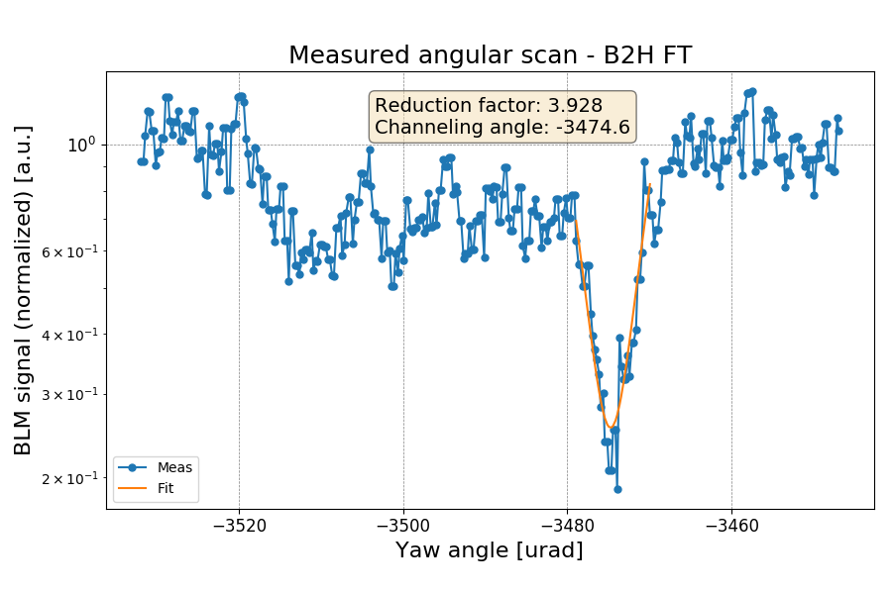
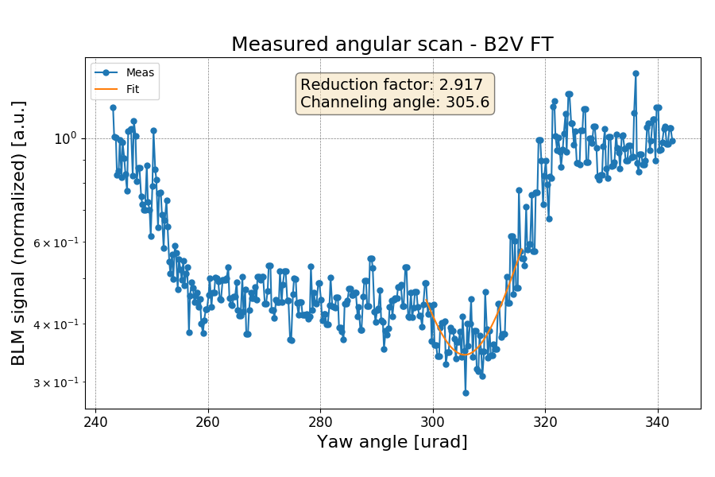
Angular scans at flat top

Slide 6
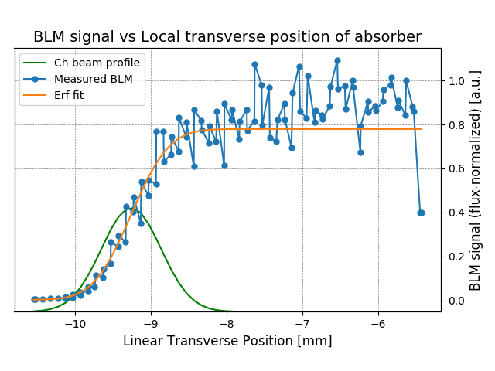
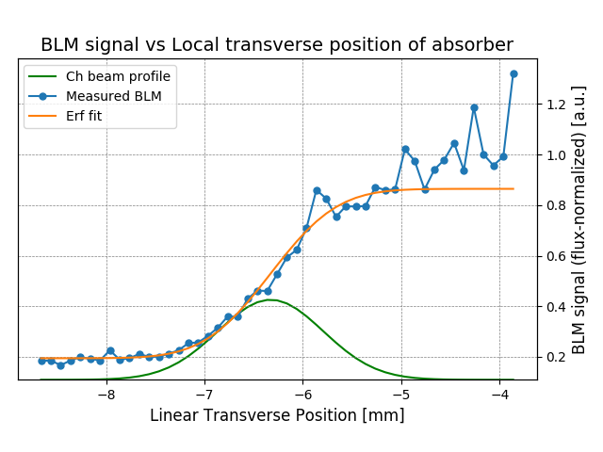
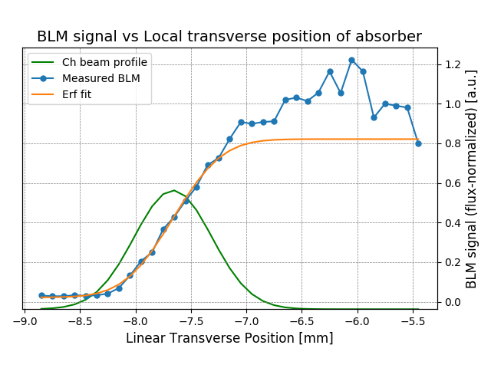
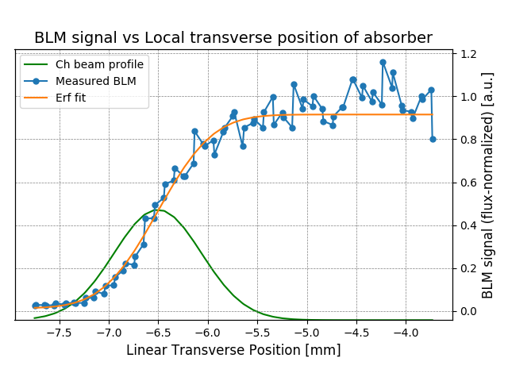
Linear scans at injection
~78%
~86%
B1H
B1V
B2H
B2V
~82%
~91%

Slide 7
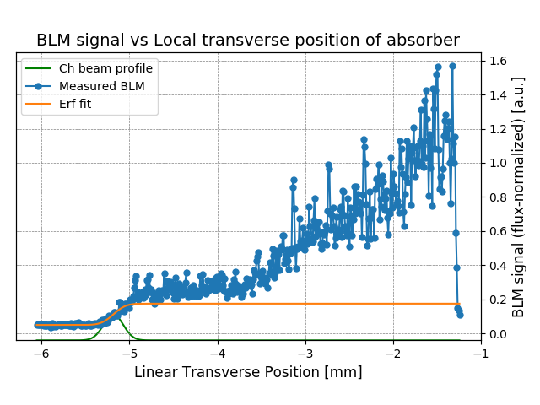
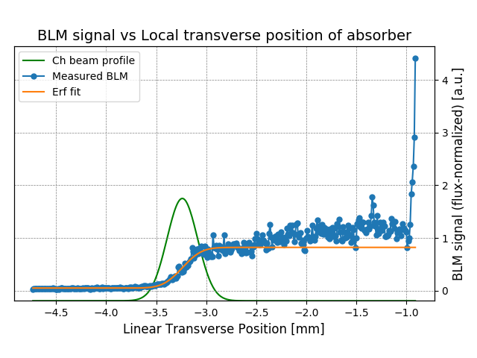
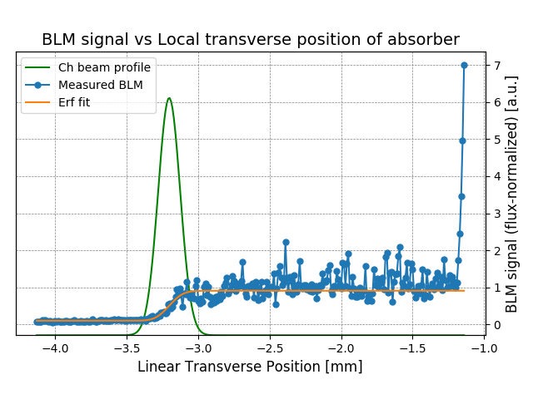
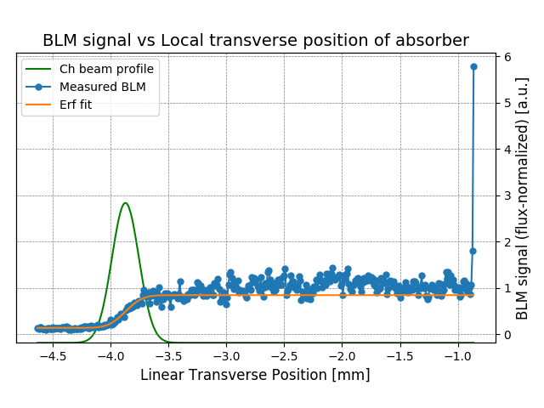
Linear scans at flat top
Radius close to critical value: high dechanneling population and low efficiency
~20%
~82%
B1H
B1V
Smaller radius: much lower dechanneling population and higher efficiency
B2H
B2V
~91%
~84%

Slide 8
Loss maps at flat top
Extensive loss map campaign (~ 90 in total) with many different configurations to be compared with the standard collimation system
Crystals kept at 5.0 σ
Downstream TCSGs | TCLAs
6.5 σ | 10.0 σ
6.5 σ | 9.0 σ
6.5 σ | 8.0 σ
6.5 σ | 7.0 σ
Downstream TCSGs | TCLAs
9.0 σ | 9.0 σ
8.0 σ | 8.0 σ
7.0 σ | 7.0 σ
6.0 σ | 6.0 σ
Loss maps with the standard system are performed with TCPs and TCSGs upstream the crystals in place, while applying the same changes above to the downstream collimators

Slide 9
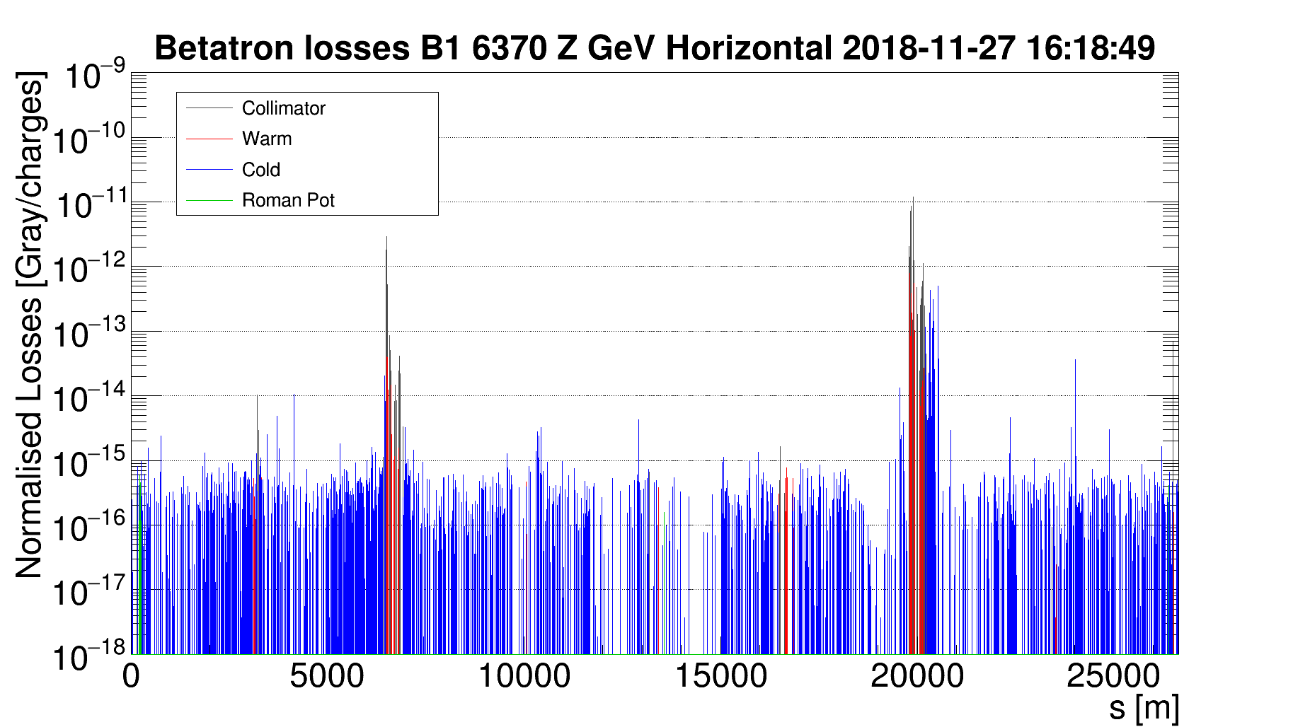
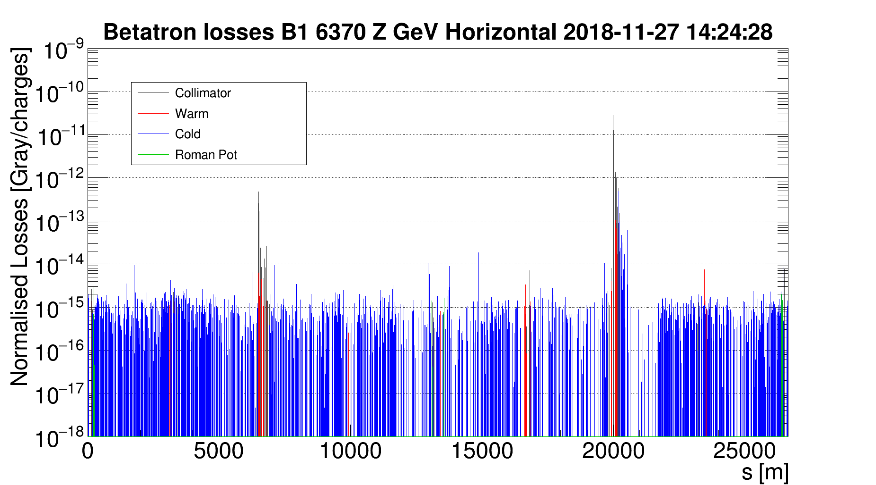
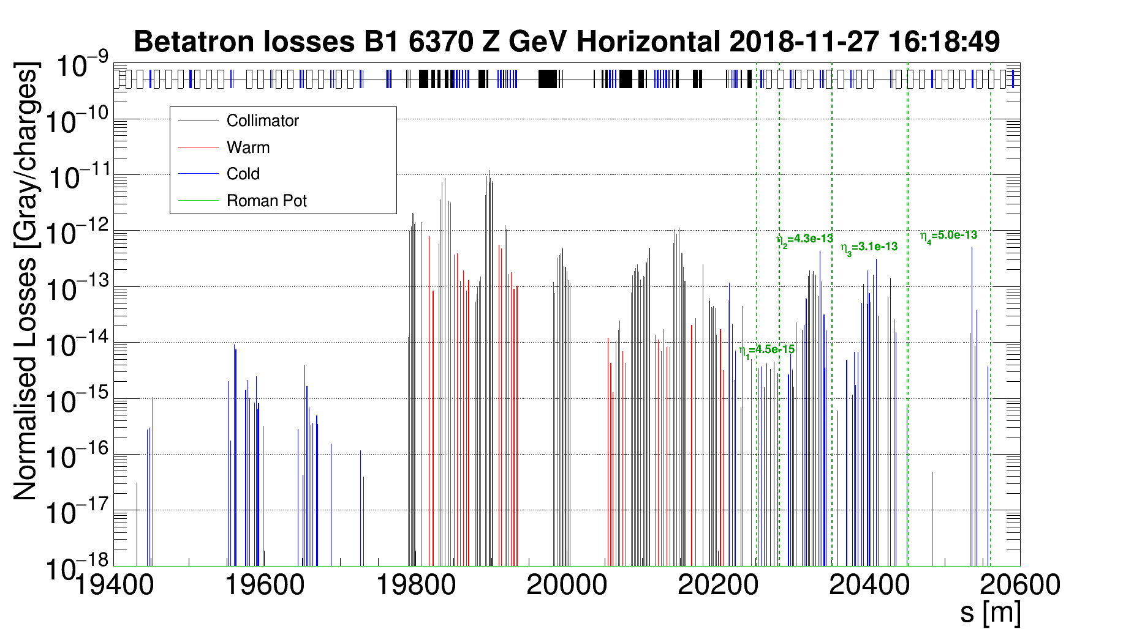
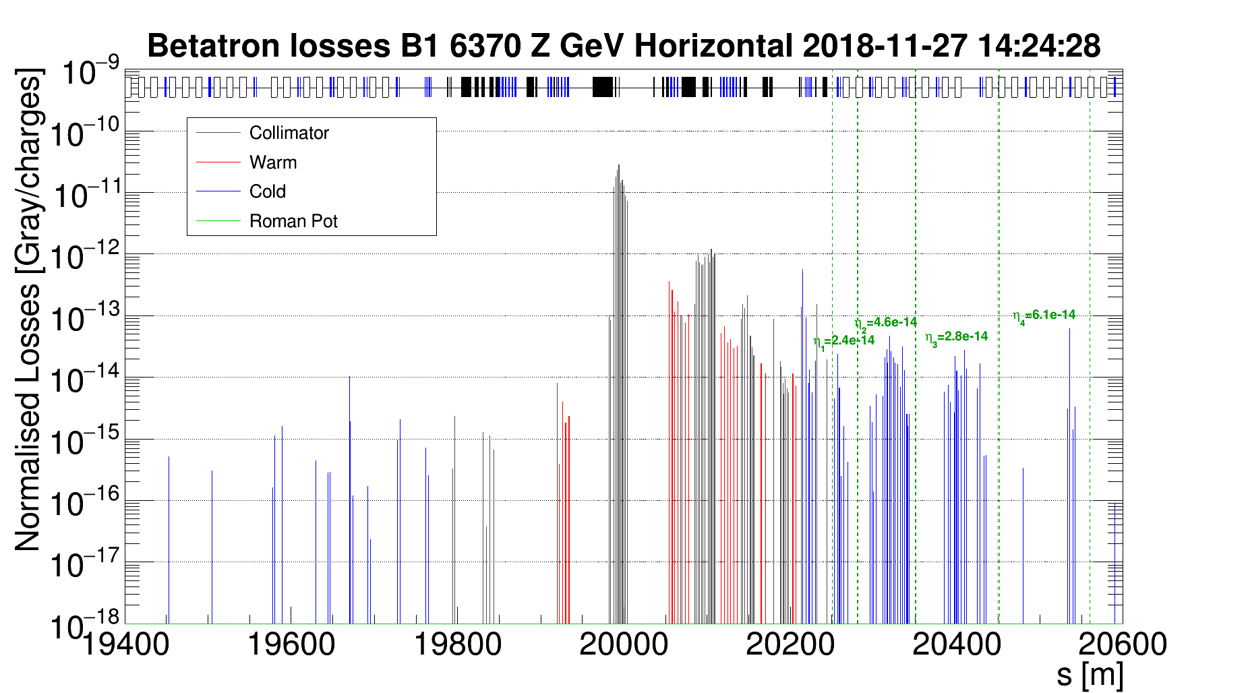
Std and Cry system comparison
STD
CRY
Normalization to particle flux
Generally cleaner pattern

Slide 10
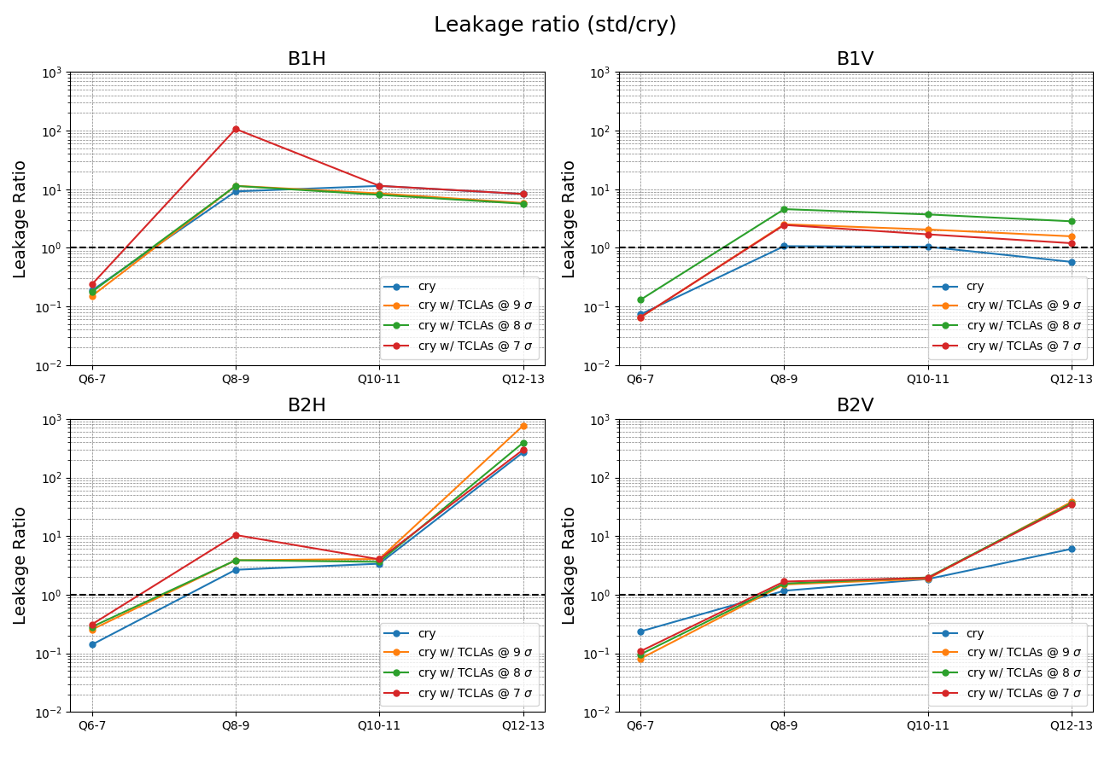
Cleaning inefficiency comparison
Only TCLAs moved

Slide 11
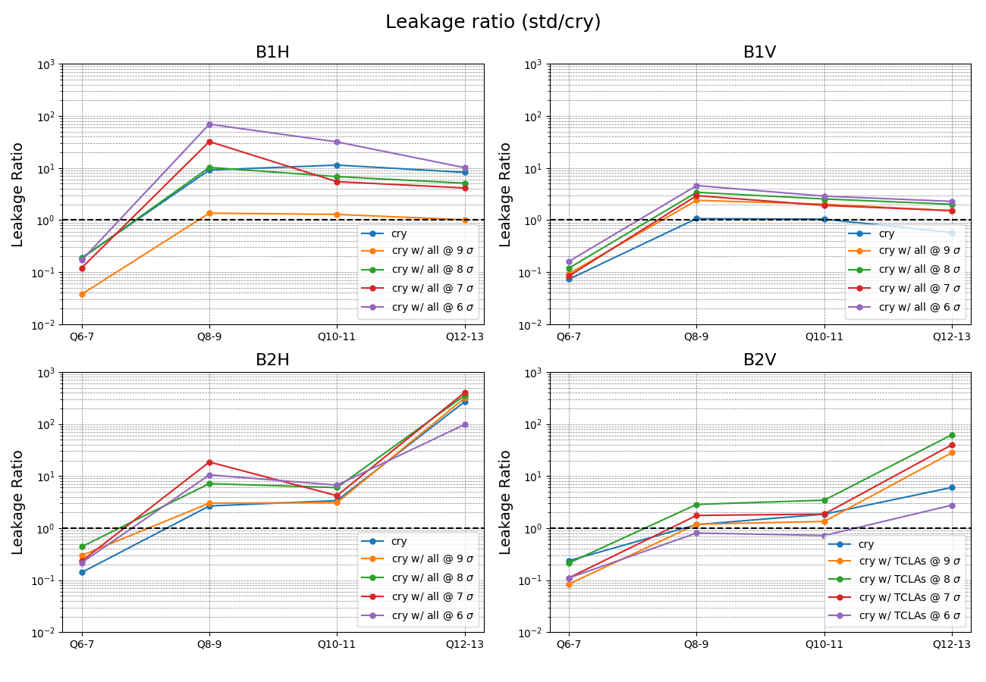
Cleaning inefficiency comparison
Downstream TCSGs and TCLAs moved

Slide 12
Cry collimation in dynamical phases
Channeling conditions assessed by means of continuous loss maps
Figure of merit: ratio of losses at the crystal and at the corresponding absorber
Channeling conditions are kept if the ratio is below 10⁻²
channeling
amorphous
R. Rossi
R. Rossi

Slide 13
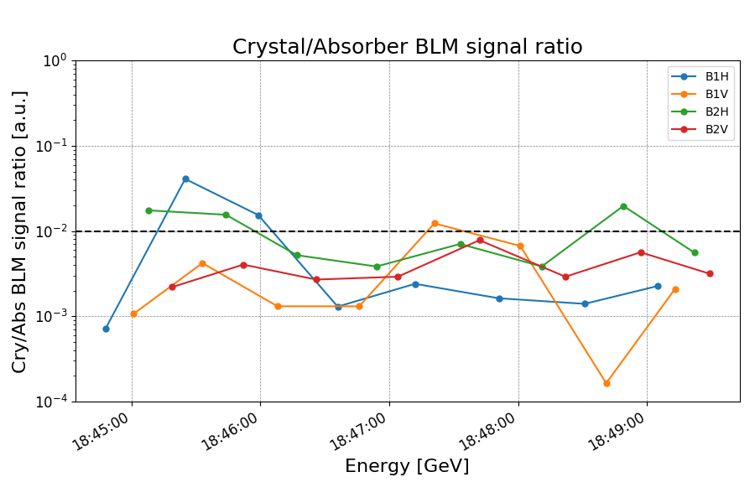
Channeling during squeeze
Channeling was well kept for the whole duration of the squeeze

Slide 14
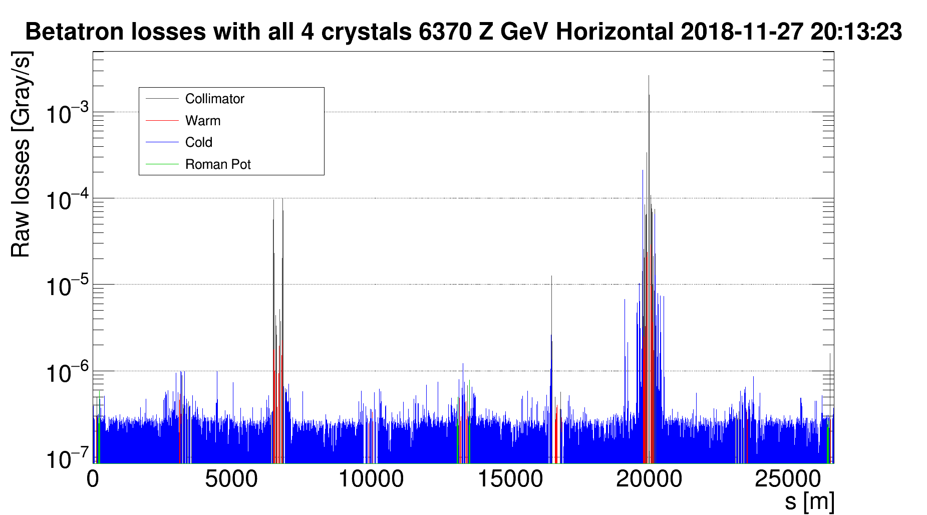
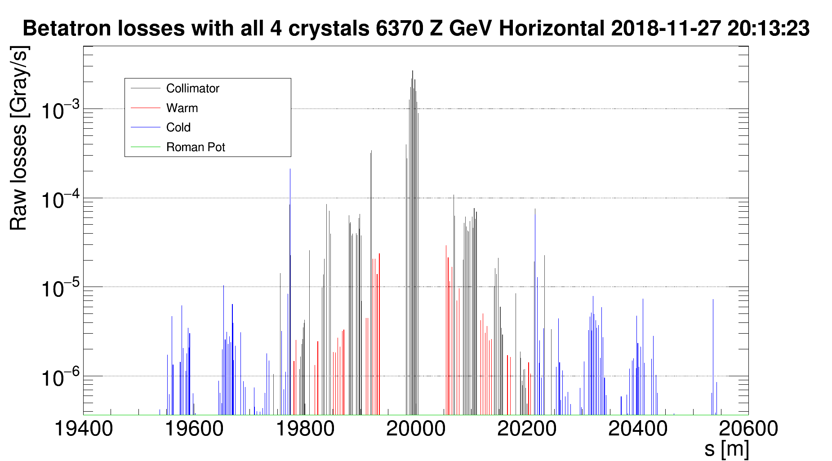
Sustained losses on all four planes
Similar test performed during Ion Run setup

Slide 15
Conclusions
Full program of crystal collimation tests with ions completed
  Complete characterization of all crystal devices with Pb ion beams
  Loss map campaign with different settings to be compared with standard collimation and previous measurements
  Crystals kept in during squeeze
  Test with sustained losses on all four planes at the same time
Preliminary results
  General improvement in cleaning inefficiency with crystal collimation
  Crystals successfully kept in channeling during squeeze
  Crystal collimation is able to sustain high losses in all planes at the same time (also tested during ion setup)
Detailed analysis still ongoing…

