Slide 1
Starting from Dec. 23
FM 8 Thermal Cycle: 4 d (pump OFF)
  Thermal cycle
  Functional check after thermal cycle
Accumulator control stability verification : 1 d (pump 1a)
  Accumulator 10 C, 5C, 0 C, radiator outlet temp. orbital variation (-20 C to -5 C), chamber -5C
  Heat load ON /OFF
System curve : Accumulator 0 C, radiator outlet temperature -5 C, chamber -5 C
  Constant heat load from evaporator, change pump speed. 5500-6000-6500-7000 RPM : 1 d (four pumps, 1a, 2a, 1b, 2b)
  Constant pump speed 6500 RPM, increase heat load: 1 d (pump 1a)
Note: Input from EVA team about the neck-down on the cutting line, 30% reduction in the diameter, the worst case about the total system pressure drop would be 480 mbar.
Verify the pump protections : cavitation, overheating: 0.25 d (pump 1a, 1b)
  One pump from A
  One pump from B
Verify the maximum power drain from UTTPE : 0.25 d (pump 1a, 1b)
Verify the leak test procedure for AAF fitting : 2 d (pump OFF)
In total of 10 days. During night run pump, without heat load from evaporator.
Test Plan over X-mas

Slide 2
EVA Fitting (Plan-B) Leak Check in Space
Zhan Zhang (MIT)
October 02, 2018

Slide 3
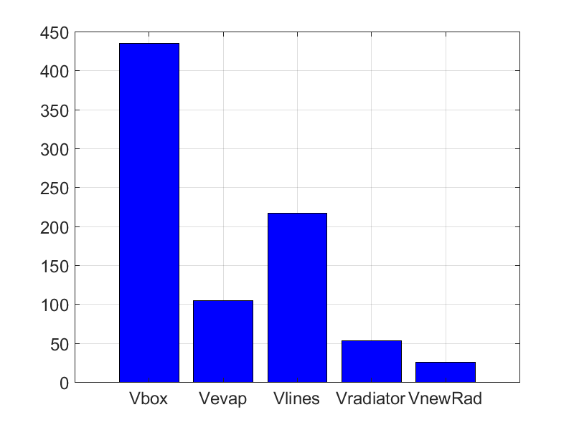
UTTPS FM Volume
The UTTPS loop volume is 835 mL
Vbox: including the volume of all the components and connecting pipes inside the UTTPS box, except the accumulator and new radiator
Vevap: the volume of the Upper and lower evaporators
Vlines: the transportation lines volume, between the evaporators and the radiators, between the UTTPS box and evaporators.
Vradiator: the volume of the TTCS RAM and Wake radiator
VnewRad: UTTPS new radiator volume
Volume [mL]

Slide 4
Operation Needed before EVA Fitting (Plan B) Leak Check
Operation:
Power on UTTPE to read the pressure measurement and operate heaters
Astronauts is to close off the Accumulator hand valve to isolate the accumulator from the loop
Open the refill vessel hand valve
Component | Temperature [ºC] | State | Operation
Evaporators | ≥ 30 | Vapor | Set the Tracker in the ConfigB
UTTPS Radiator | -25 , -15 | Liquid | Turn on the RAP heater, TS controlled
TTCS Radiators | -25 , -15 | Liquid | Turn on the RAM and Wake heaters, TS controlled
Transp. Lines | -5 , +5 (assumed) | Liquid | N/A
UTTPS Box | [-15 25] | Liquid | N/A

Slide 5
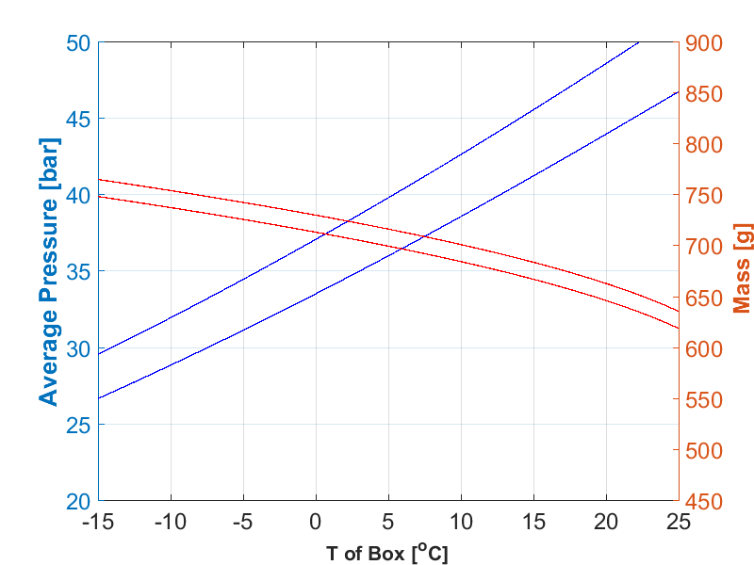
Estimated Pressure and Mass for EVA Fitting (Plan B) Leak Check
The box has the largest volume, its temperature will dominate the pressure of the loop and the CO2 mass is needed for the leak check
Component | Case 1 Temp. [ºC] | Case 2 Temp.[ºC]
Transp. Lines | -5 | +5
UTTPS Radiator | -25 | +15
TTCS Radiators | -25 | +15
UTTPS Box | [-15 25] | [-15 25]
Evaporators | 30 | 30
Case 2
Case 1
Maximum mass 770 g
Case 1
Case 2
Minimum pressure 27 bar

Slide 6
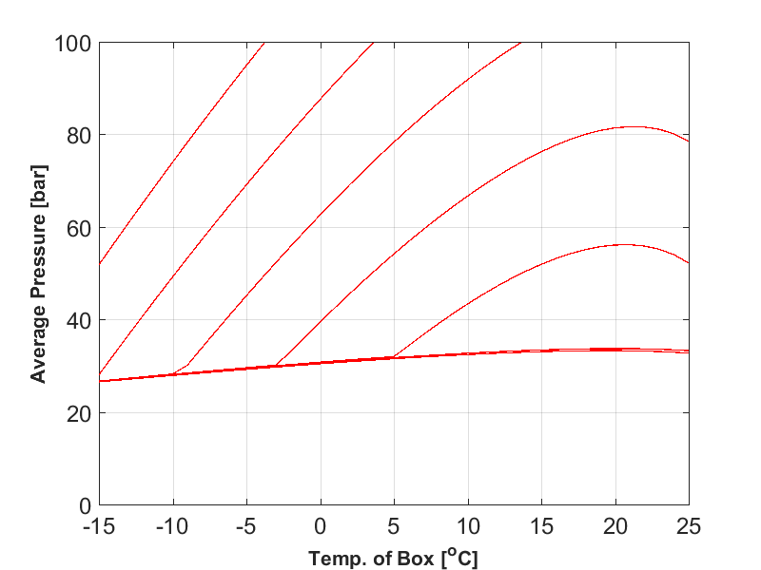
Component | Case 1 Temp. [ºC]
Transp. Lines | -5
UTTPS Radiator | -25
TTCS Radiators | -25
UTTPS Box | [-15 25]
Evaporators | 30
830 g
820 g
810 g
800 g
790 g
780 g
770 g
Mass : 770 g to 830 g
If the box is at -15 C, more than 820 g of CO2 are required to generate a higher pressure for leak check

Slide 7
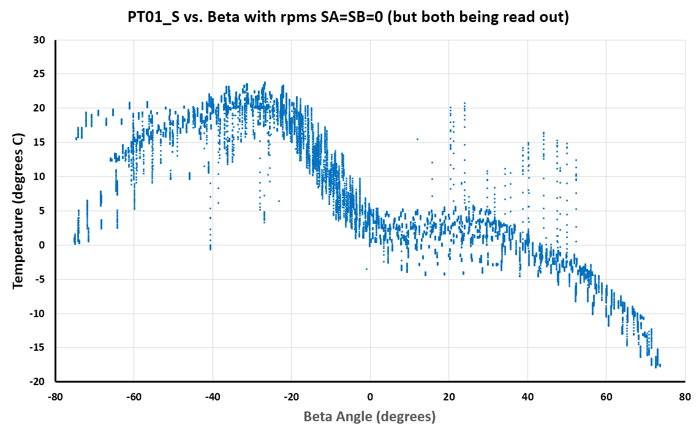
TTCS Secondary Box Non-operation Temperature
EVA happens when the beta is in the range of [-60º +60º] . In this beta range,
from TTCS data, the box temperature can be above -10 ºC
TTCS Secondary box temperature, pump SA=SB=0 RPM
ISS Operation

