Slide 1

MQYY E-modulus press
Status report
Salvador FERRADAS
Juan Carlos PEREZ
927 – 18 December 2018

Slide 2
Outline
Centering of the tooling
Shimming of the bars
Troubleshooting
Conclusions

Slide 3
Outline
Centering of the tooling
Shimming of the pusher
Troubleshooting
Conclusions

Slide 4
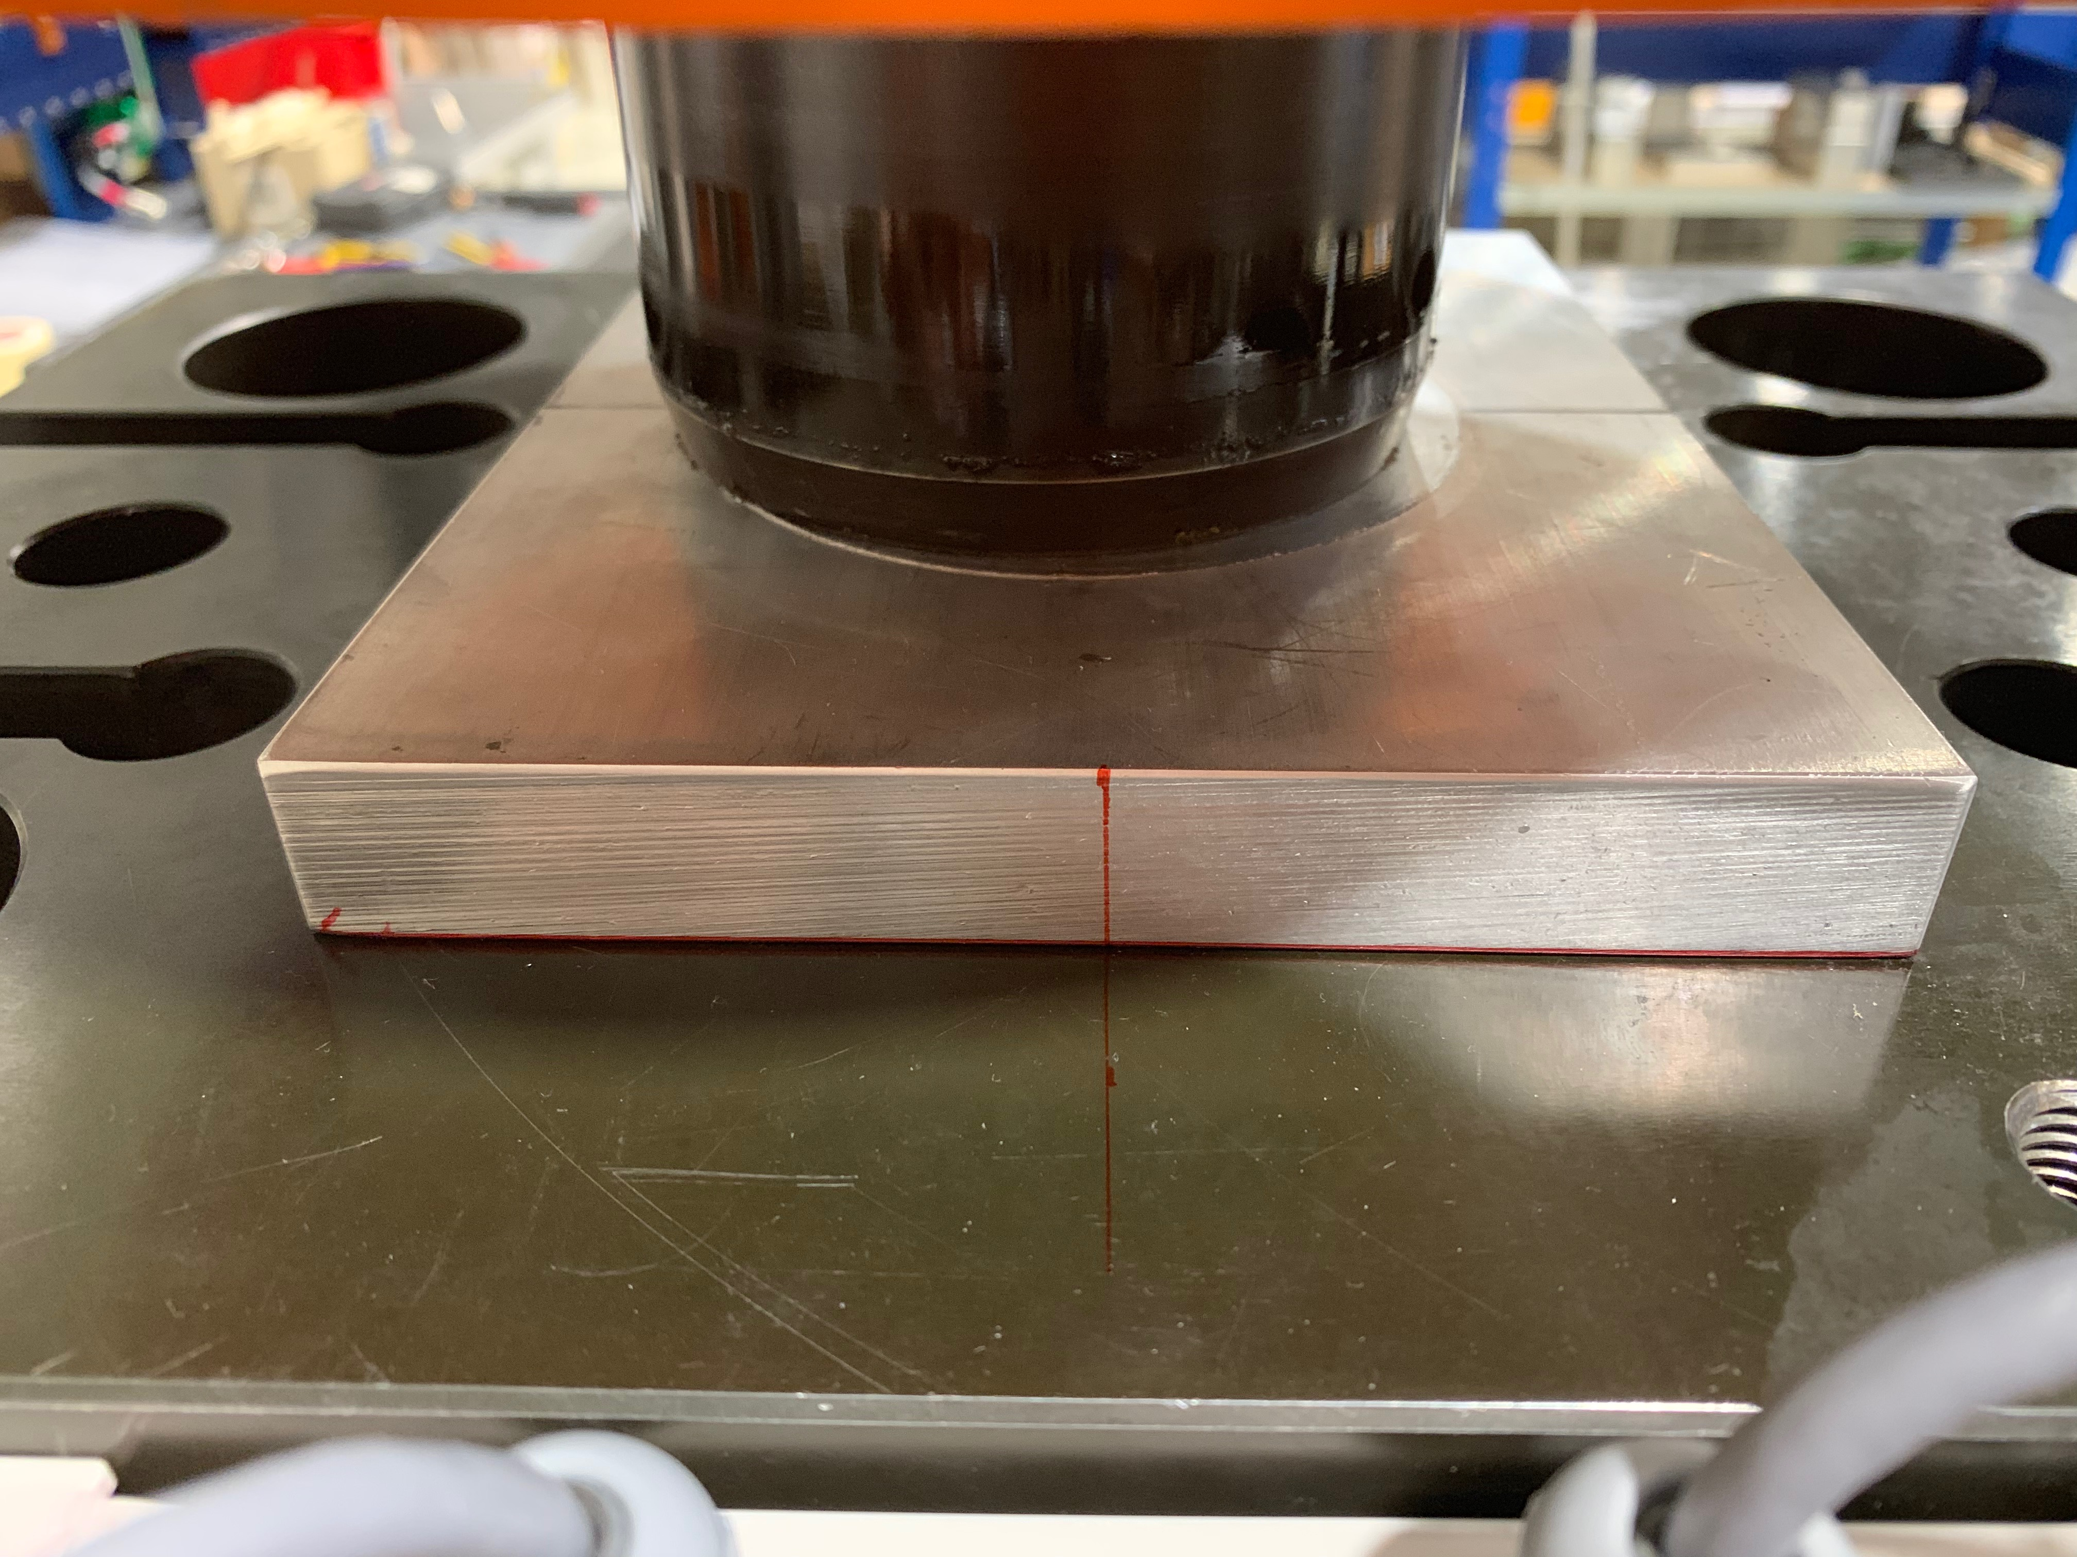
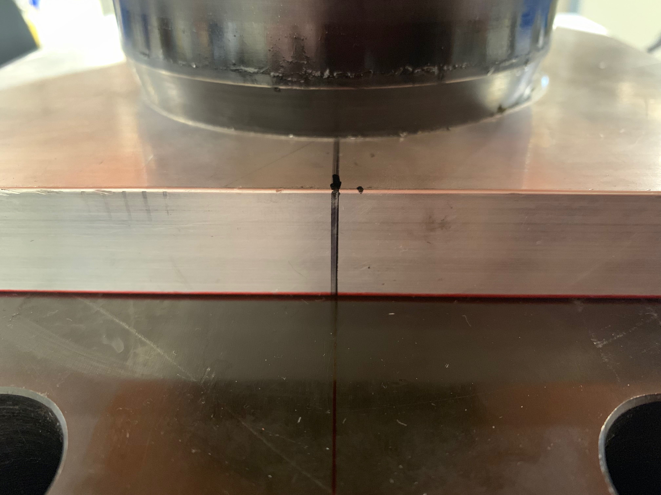
Centering of the tooling
Centering of the pressure plate

Slide 5
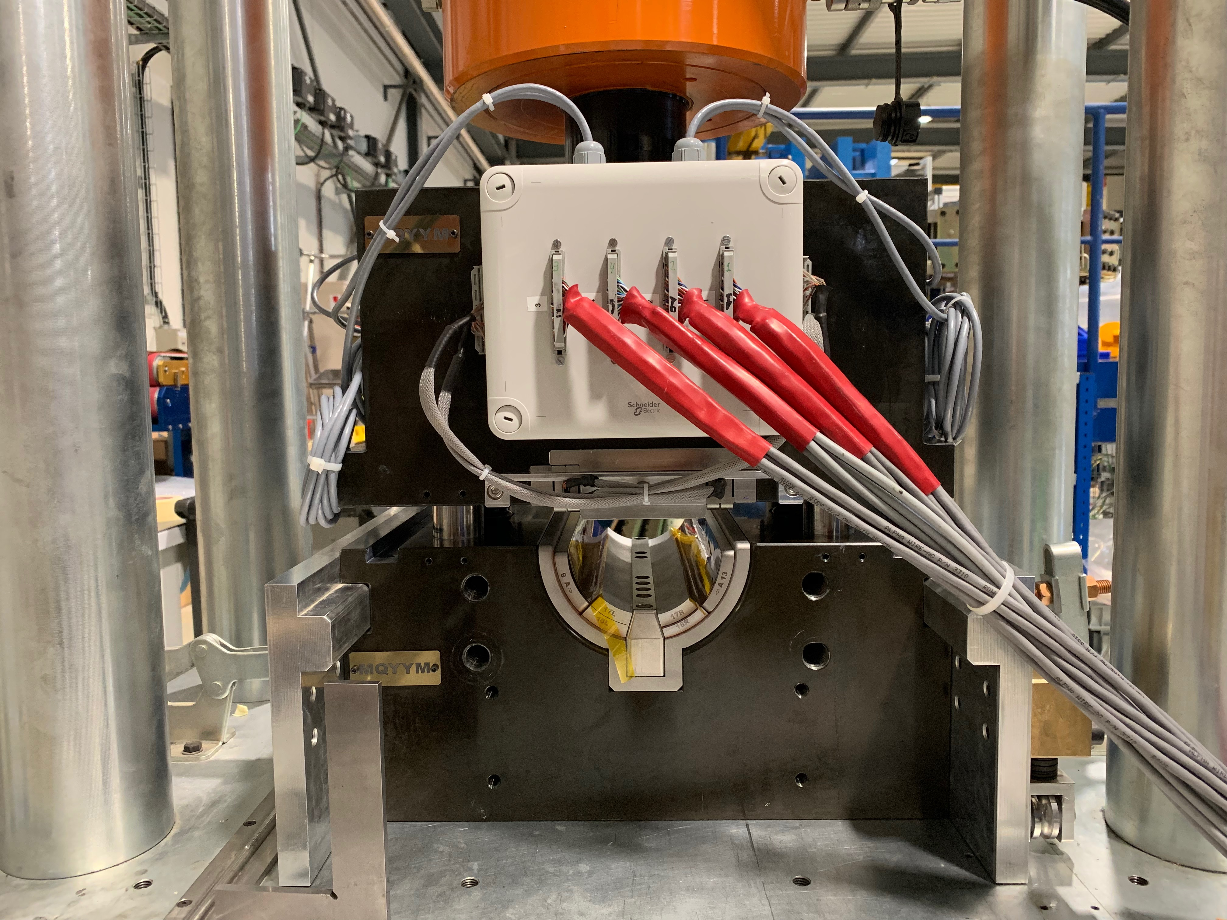
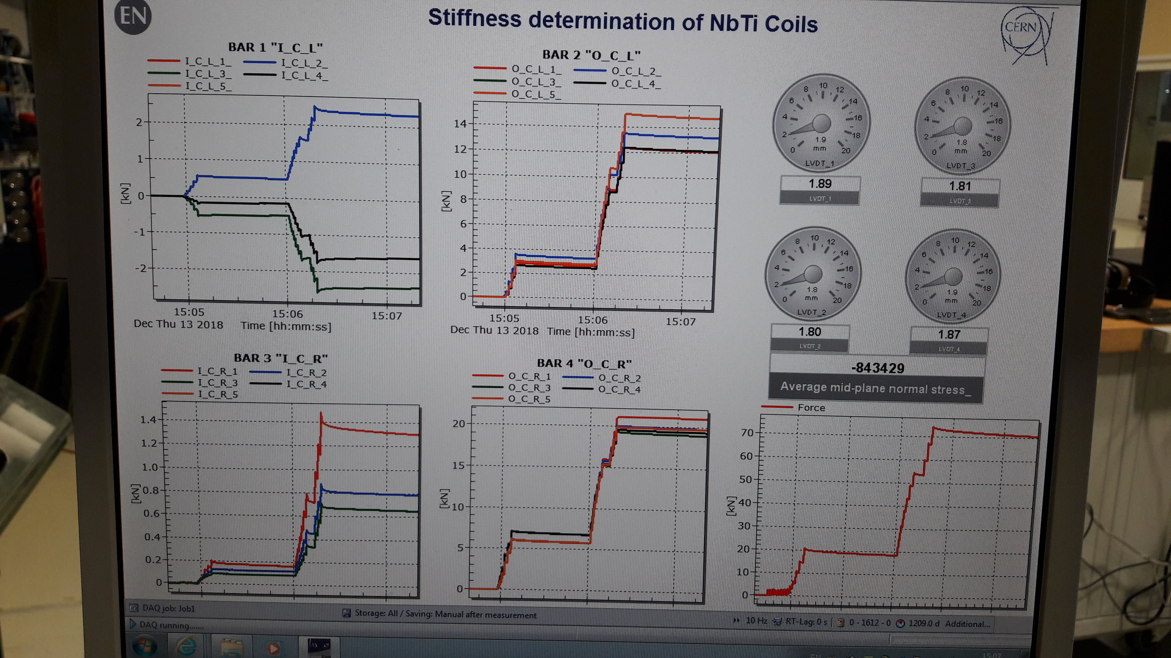
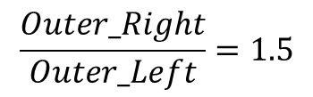
Centering of the tooling
Centering of the main tooling
Thursday 13 December 2018
$$\frac{Outer_Right}{Outer_Left}=1.5$$
Inner bars barely in contact
Stainless steel sectors

Slide 6
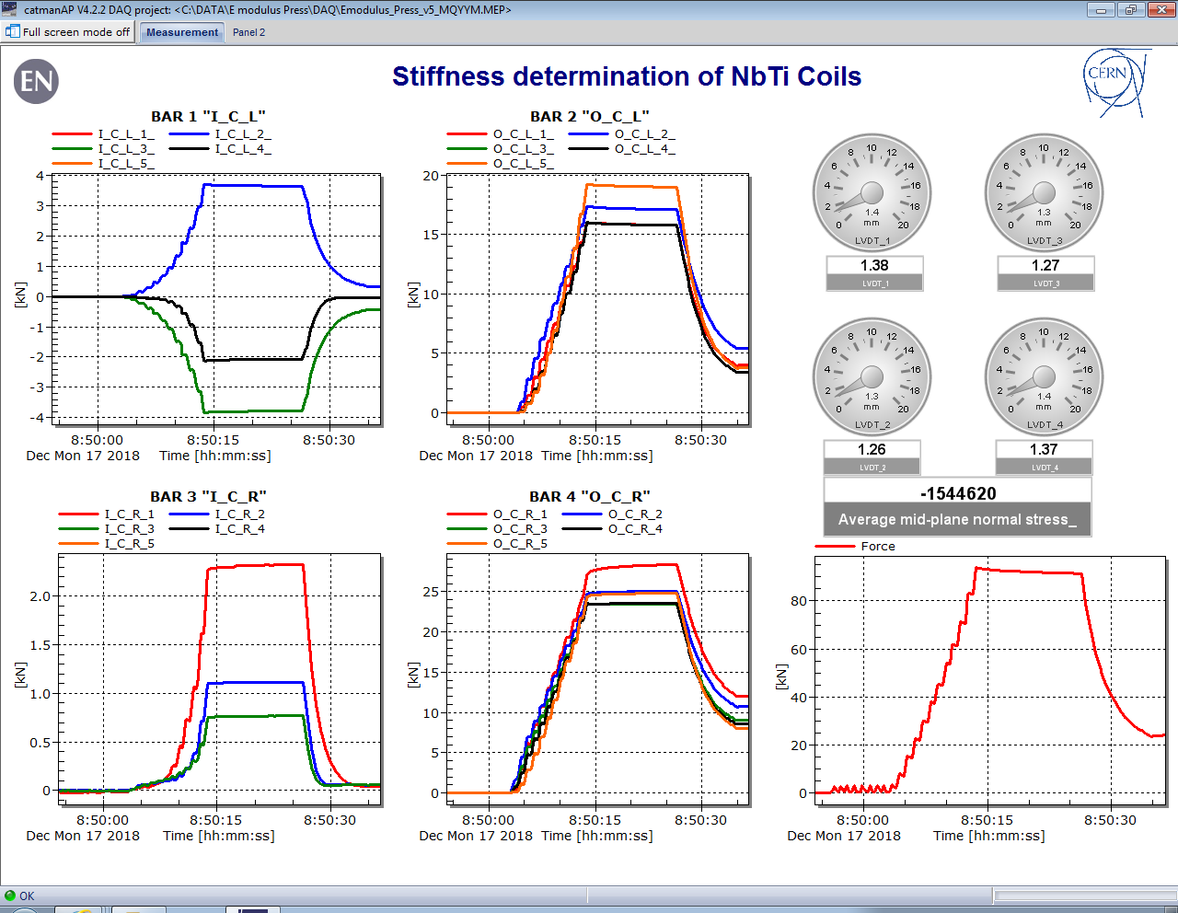
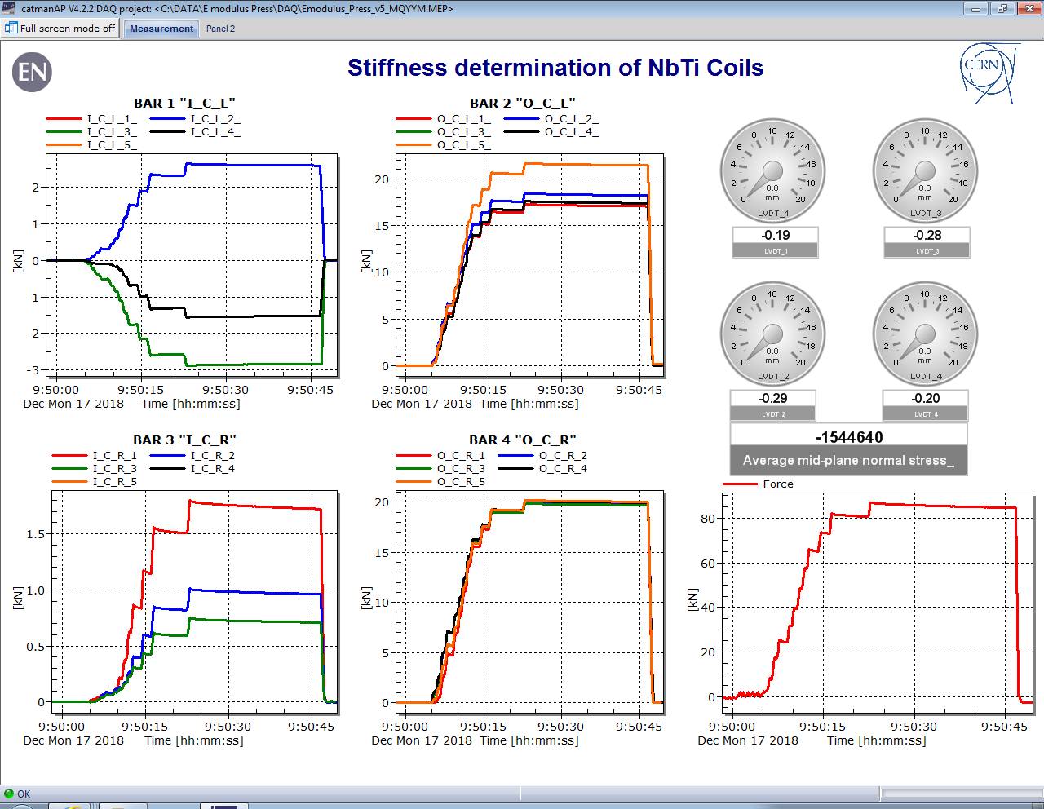


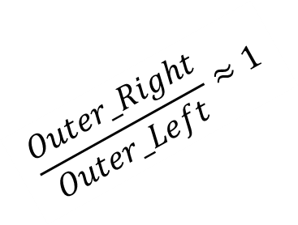
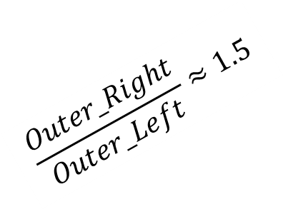
Centering of the tooling
Centering of the main tooling
Monday 18 December 2018
Iteration 1
Monday 18 December 2018
Iteration 2
$$\frac{Outer_Right}{Outer_Left}≈1.5$$
$$\frac{Outer_Right}{Outer_Left}≈1$$
Inner bars barely in contact
Stainless steel sectors

Slide 7
Outline
Centering of the tooling
Shimming of the bars
Troubleshooting
Conclusions

Slide 8
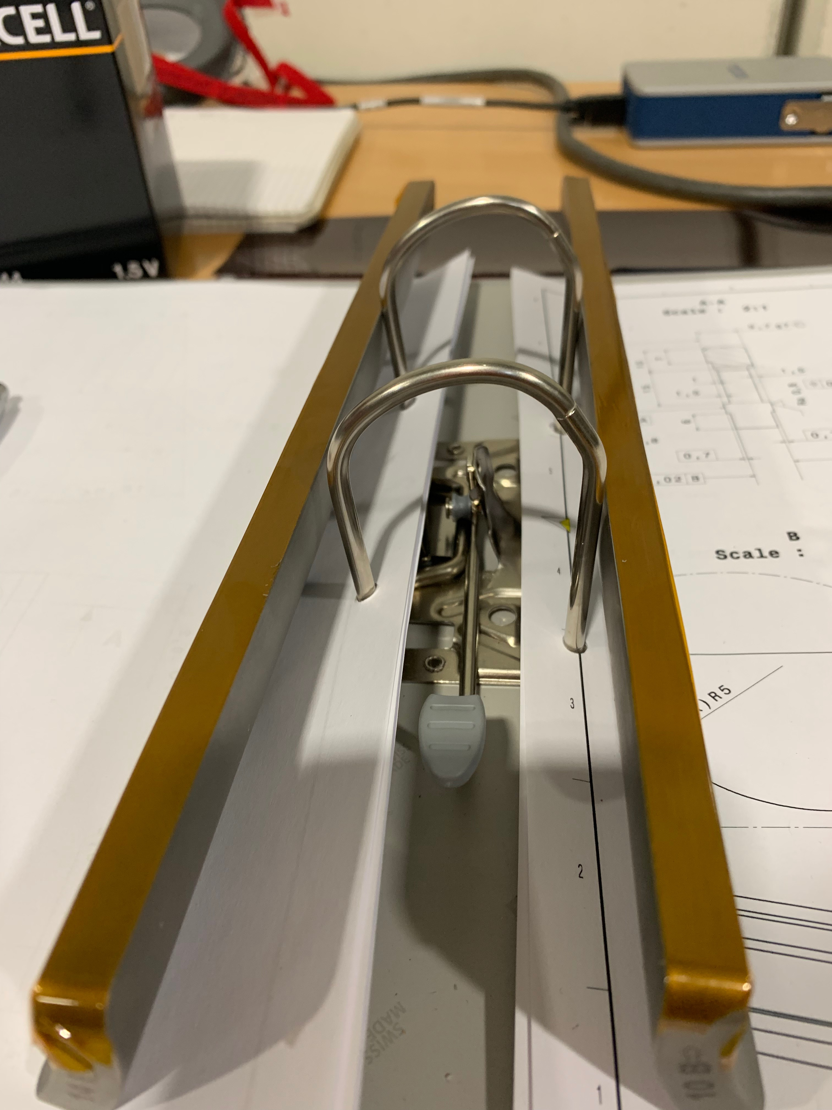
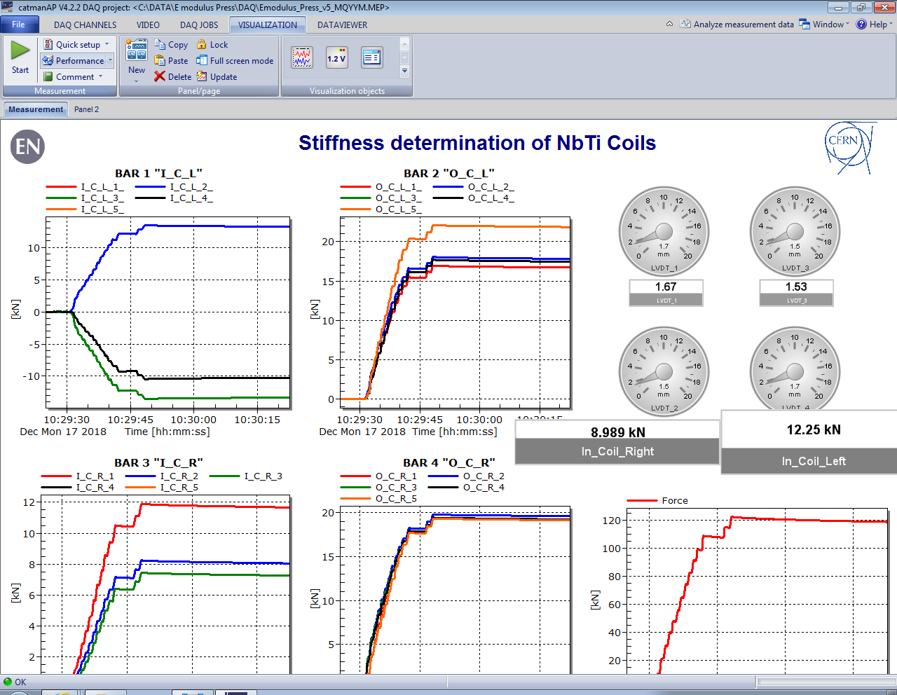
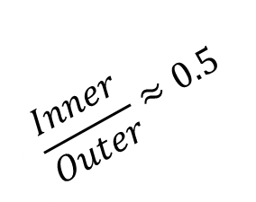
Shimming of the bars
Monday 18 December 2018
Iteration 3, 0.07 mm shimming on 10B and 14B
$$\frac{Inner}{Outer}≈0.5$$
Stainless steel sectors

Slide 9
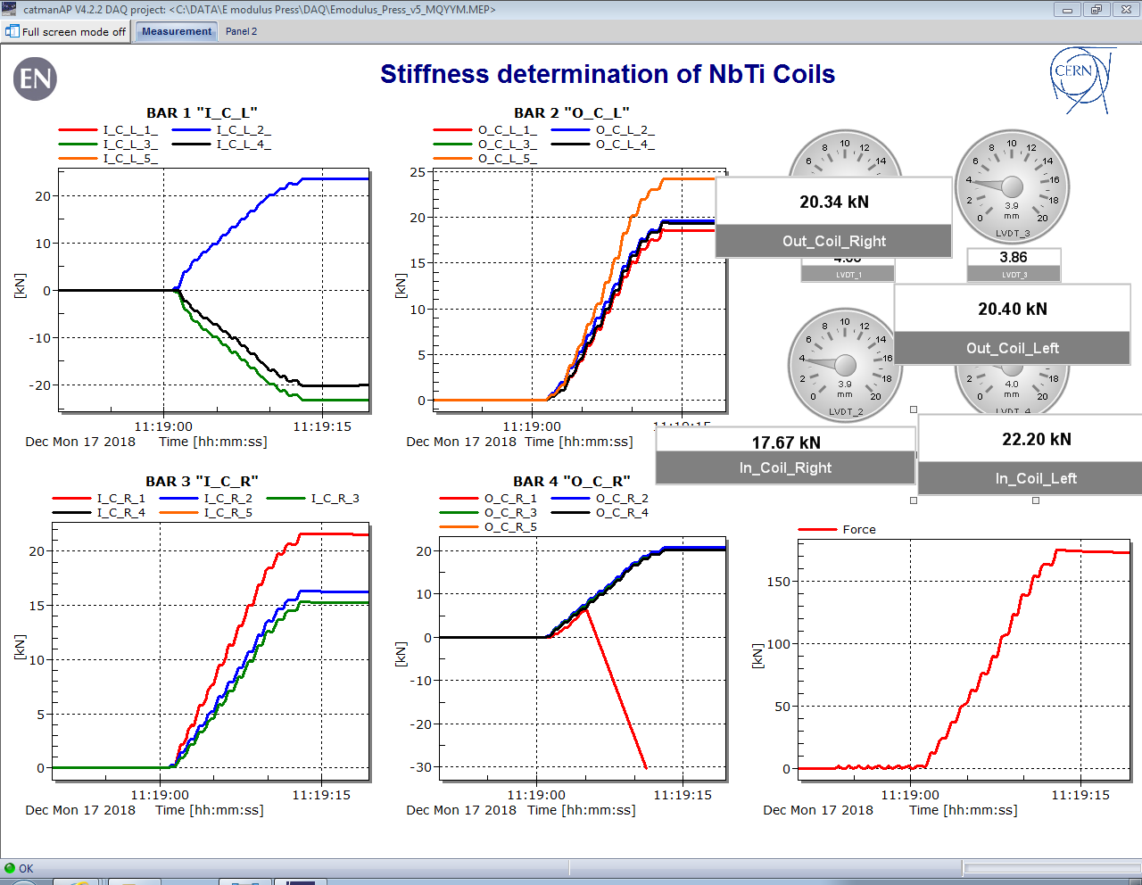
Shimming of the bars
Monday 18 December 2018
Iteration 4, 0.07 mm shimming on 10B and 14B + 0.025 mm Midplane
Stainless steel sectors

Slide 10
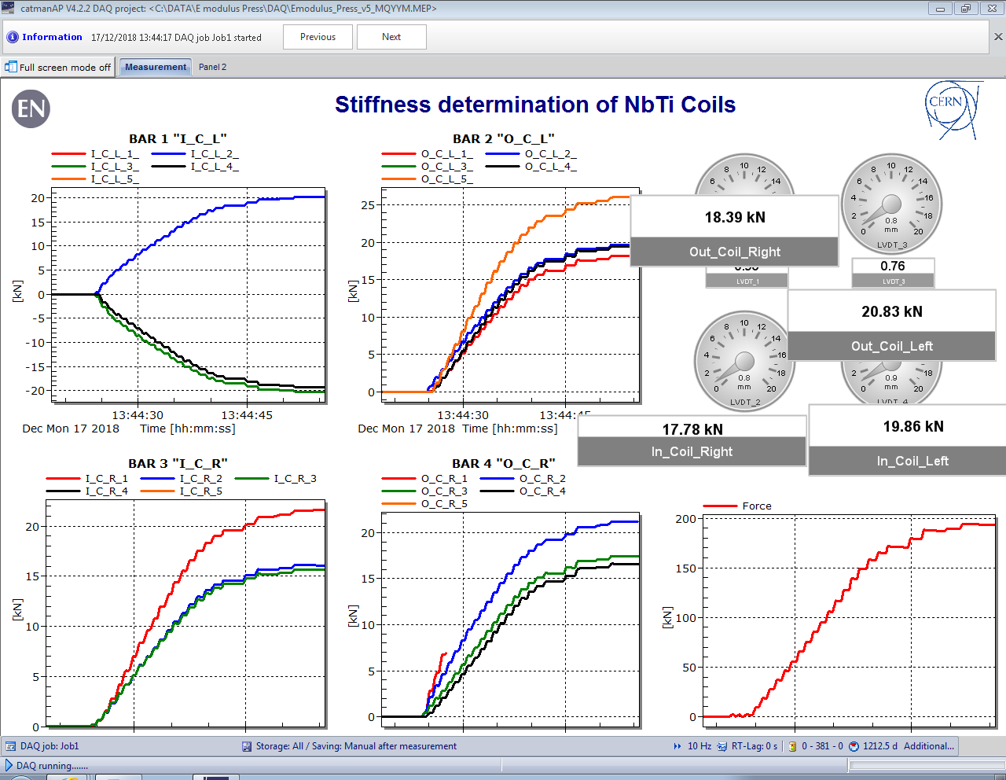
Shimming of the bars
Monday 18 December 2018
Iteration 5, 0.07 mm shimming on 10B and 14B + 0.025 mm Midplane
Alu sectors

Slide 11
Outline
Centering of the tooling
Shimming of the bars
Troubleshooting
Conclusions

Slide 12
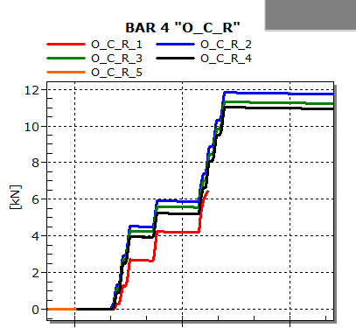
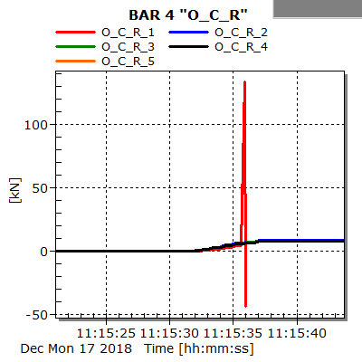
Troubleshooting
I_C_R_1 and O_C_L_5 are always ~4kN above the avg.
O_C_R was the only bar with 5 working strain gauges (see iteration 1)
Between the 3rd and 4th iteration O_C_R_1 and O_C_R_5 started to report unexpected values
Iteration 4
Test between Iteration 4 and 5
OCR5 and OCR 1, connection lost
Test between Iteration 4 and 5
OCR1 overshooting

Slide 13
Outline
Centering of the tooling
Shimming of the bars
Troubleshooting
Conclusions

Slide 14
Conclusions
0.09 mm of shim on the inner layer
List of strain gauges not working:
  OCR1
  OCR5
  ICL1
  OCL3
  ICR5
  ICR4
Change the computation sign of ICL3 and ICL4
Setup is ready.

Slide 15
Thanks for your attention

