Slide 1
Isotope Production at European Spallation Source
A potential new access to neutrons
Yong Joong LEE (ESS)
Mikael Jensen (DTU-NUTECH)
April 30, 2019
Kick-off Meeting on New H2020 Project, Erice, Italy

Slide 2
Mission Statement: ESS Radioisotope Production Station
Exploration of a potential to position ESS as a key research infrastructure providing a high flux neutron sources for radioisotopes production dedicated to medical and pharmaceutical applications, while not compromising the performance and availability of the facility’s main mission.

Slide 3
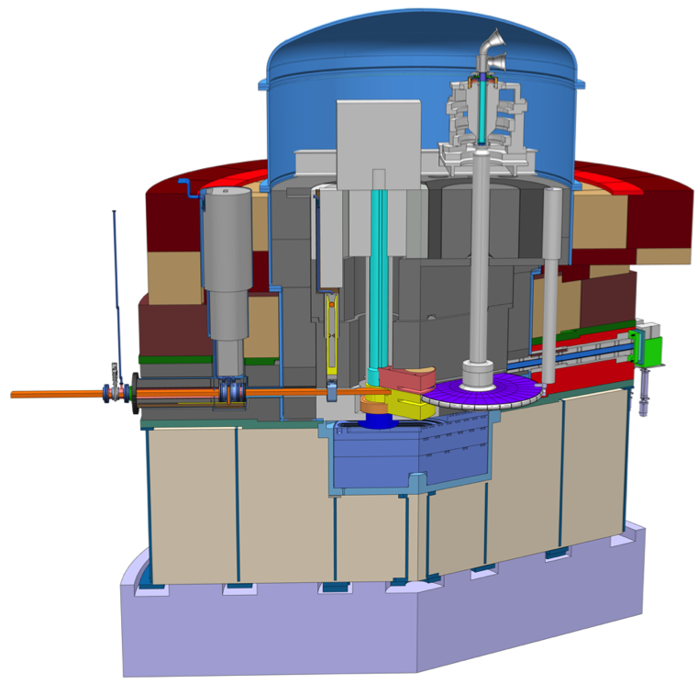
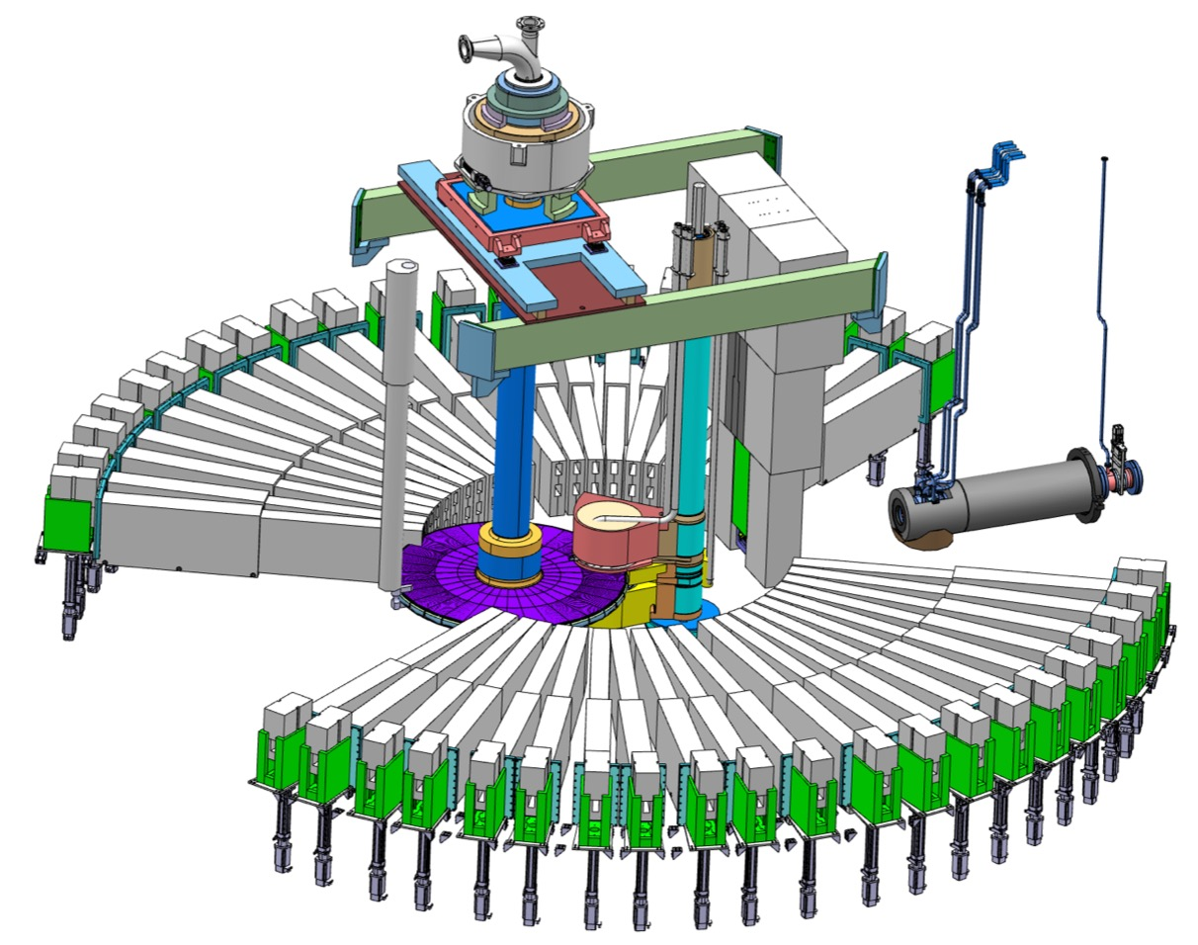
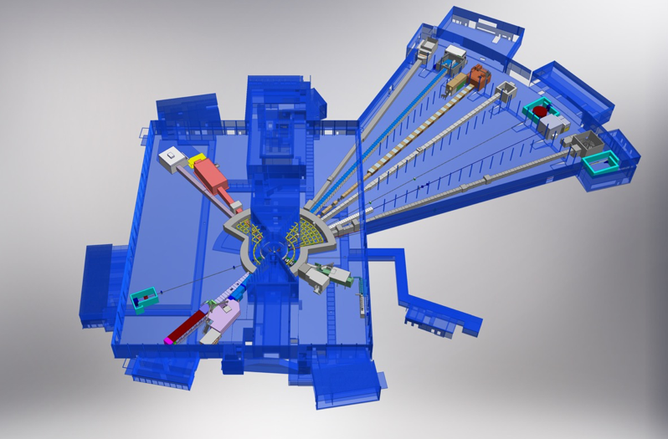
Potential Access Point 1: Unoccupied Beam-Port
Beam on Target: 2 GeV, 2.5 mA.
In the experimental hall, there is a space for the transport of the isotope production target.
Unoccupied beam-port could be used for insertion and extraction path for the isotope production target.
Space allocation adjacent to a moderator in a carefully chosen location not shadowing any beamline

Slide 4
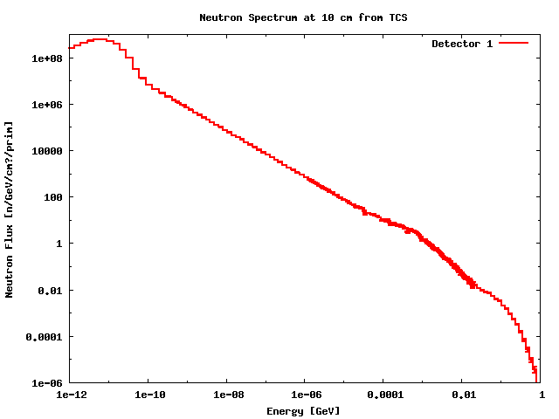
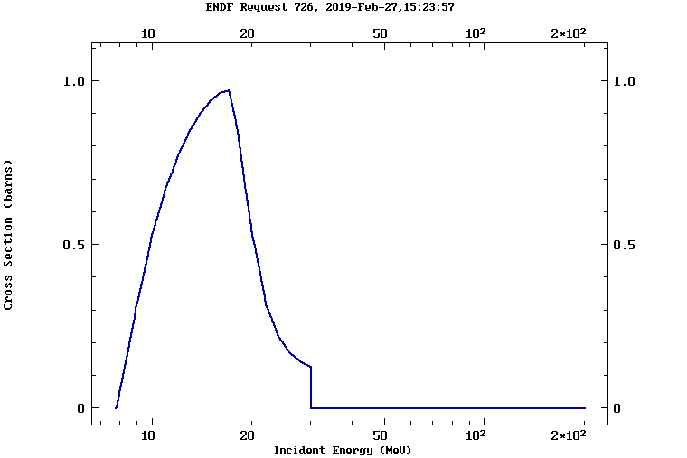
Potential Target Location
Potential target location in the vicinity of spallation target and bottom moderator
  Thermal neutron flux: Order of 10¹⁴ n/cm²/s
  Fast neutron flux (10 MeV < E < 20 MeV): Order of 10¹³ n/cm²/s
Reference isotopes yields after 1 week beamtime, for benchmarking:
Product | Target | Neutron Energy | Reaction Chain | E.o.B. yield [GBq/g]
Mo-99 | Mo-98 | E < 0.625 eV | Mo98(n,g)Mo99 | 100
Mo-99 | Mo-100 | 10 MeV < E < 20 MeV | Mo100(n,2n)Mo99 | 100
I-131 | Te-130 | E < 0.625 eV | Te130(n,g)Te131(β⁻)I131 | 100
Lu-177 | Yb-176 | E < 0.625 eV | Yb176(n,g)Yb177(β⁻)Lu177 | 1000
Ac-225 | Ra-226 | 5 MeV < E < 15 MeV | Ra226(n,2n)Ra225(β⁻)Ac225 | 10

Slide 5
Way Forward
Propose to participate in INFRAIA consortium
  Potential key research infrastructure facility providing neutron sources for isotope production
  A Ph.D. position on isotope production target, under co-supervision
Preparation of an application for INFRADEV-01-2019 in progress:
  Call Specification: Conceptual and technical design for new research infrastructures which are of a clear European dimension and interest.
  Application Submission Deadline: 17:00 Nov. 12, 2019
  Interested Parties:
    ESS, Sweden (Yongjoong Lee): Isotope production target station
    DTU-NUTECH, Denmark (Mikael Jensen): Post irradiation target processing
    Suzanne V Smith AB, Sweden: Commercialization
  Partners are in search:
    Identification of isotopes that ESS could specialize
    Exploration of commercial route and research demand
    Hot-cell radiochemistry and hot isotope separation techniques for the identified isotopes

Slide 6
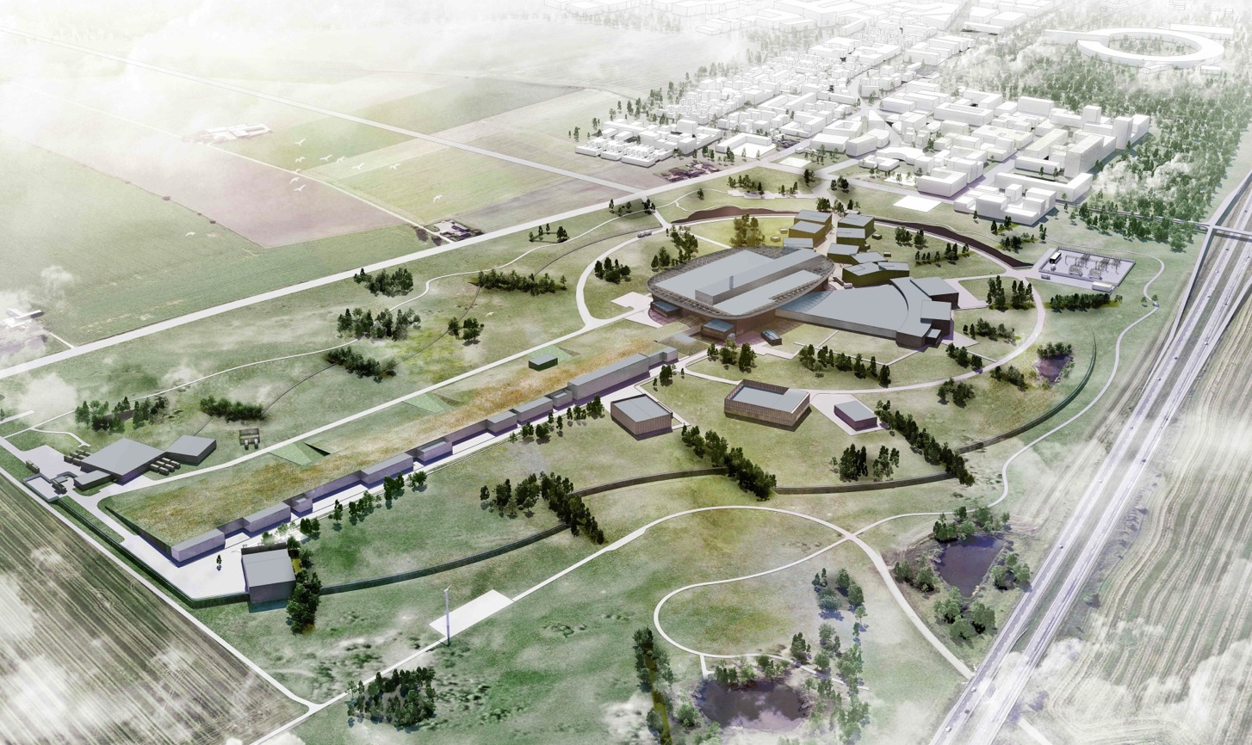
Thank you for your attention

