Slide 1



LEMs for ProtoDUNE-DP (NP02)
Edoardo Mazzucato CEA/Irfu/DPhP

Slide 2
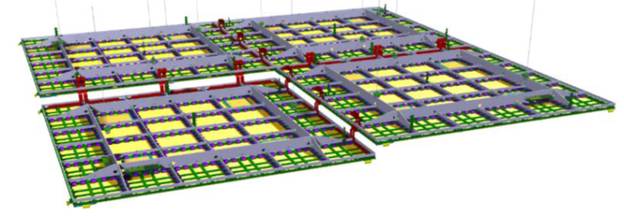
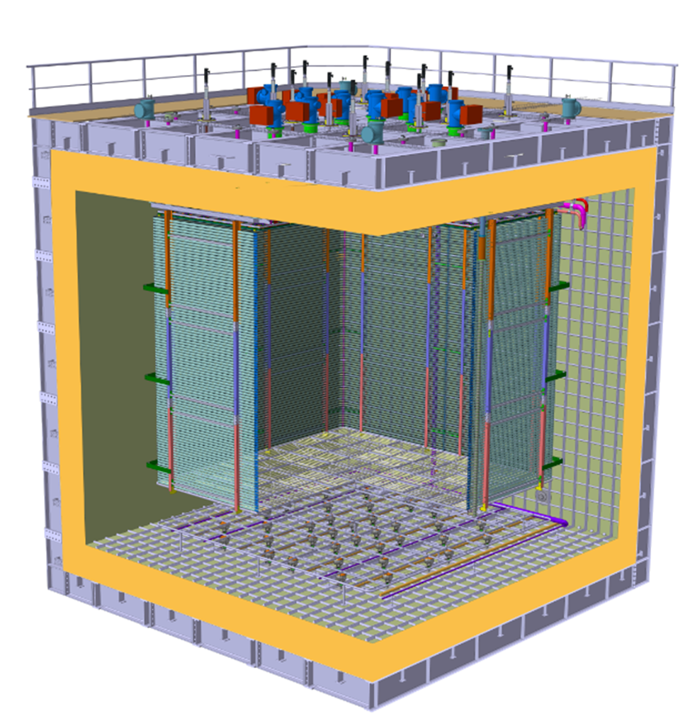
ProtoDUNE-DP : a 300t LArTPC
3m
3m
Charge Readout
Planes (CRP)
1 CRP = 36 Anodes + 36 LEMs (50×50 cm²)
+ 3×3 m² Extraction Grid
6m
Dual phase principle
Field Cage
Cathode
6m
6m
Ground Grid
PMTs

Slide 3
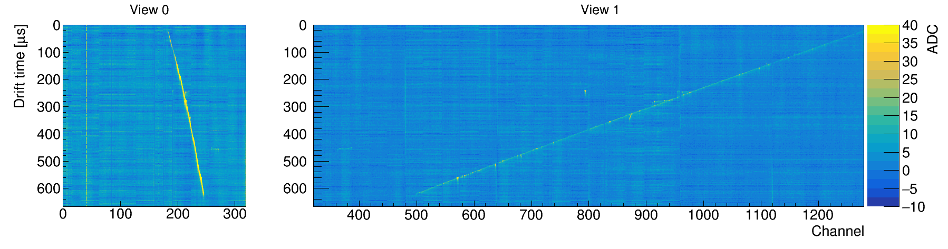
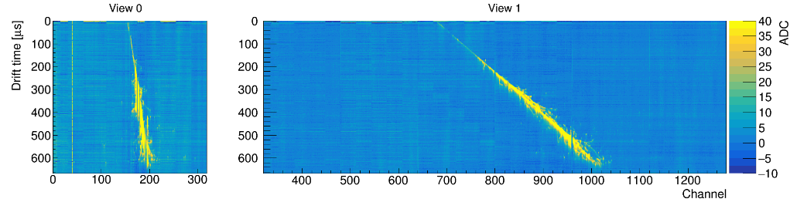
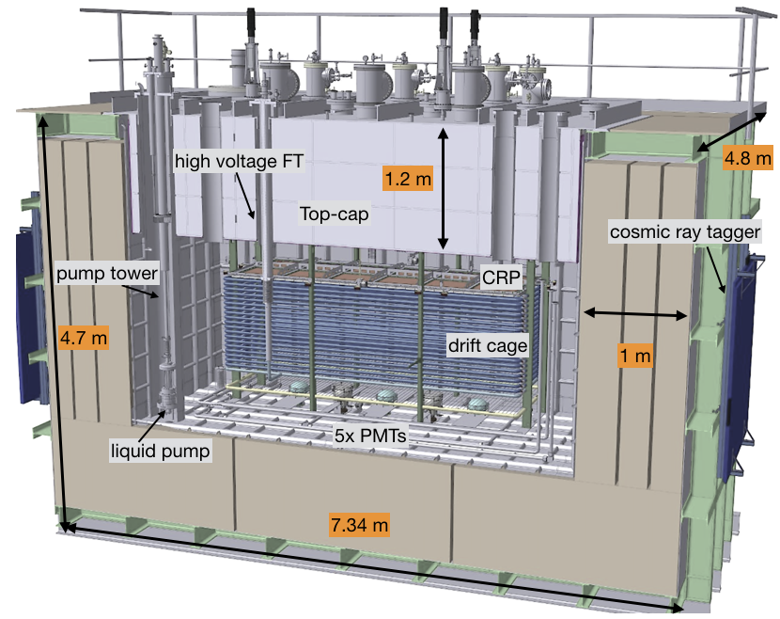
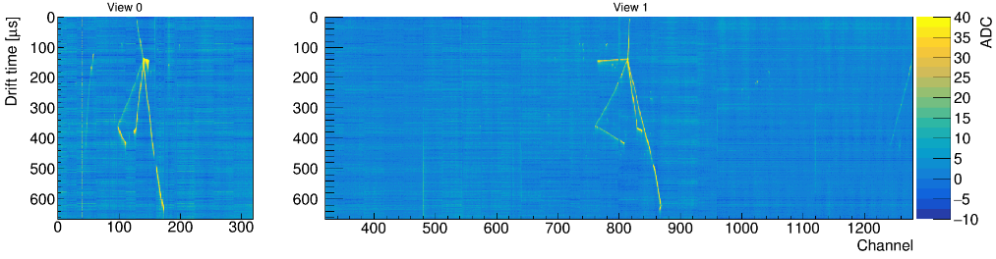
Dual phase concept validation @ 4-ton scale
Through-going muon
(B. Aimard et al., JINST 13 (2018) 11, P11003)
EM shower
The 311 prototype
HAD interaction
Prototype operated from June until November 2017
Proportional scintillation (S2) observed
Extraction of electrons over 3 m² area achieved
Amplification through LEMs measured
But … HV stability issues with Grid and LEMs encountered
Bldg. 182
@ CERN
3 m³ TPC

Slide 4
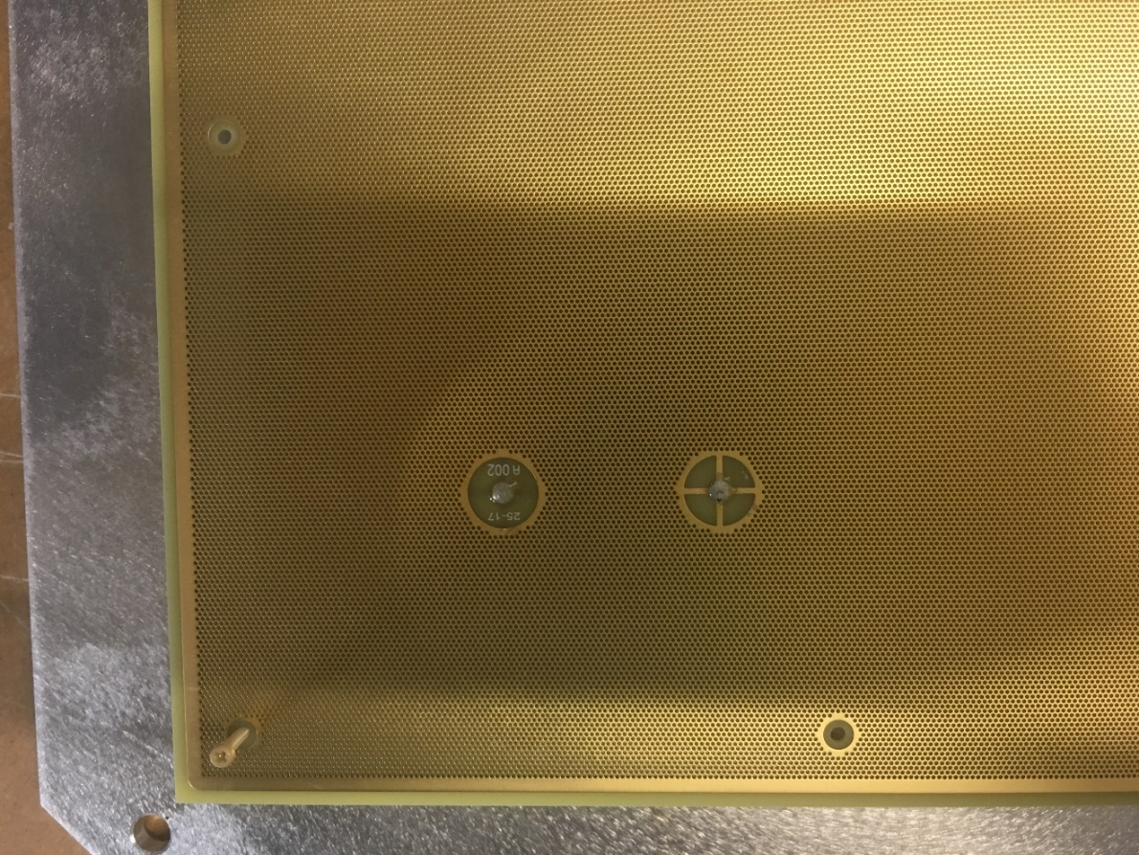
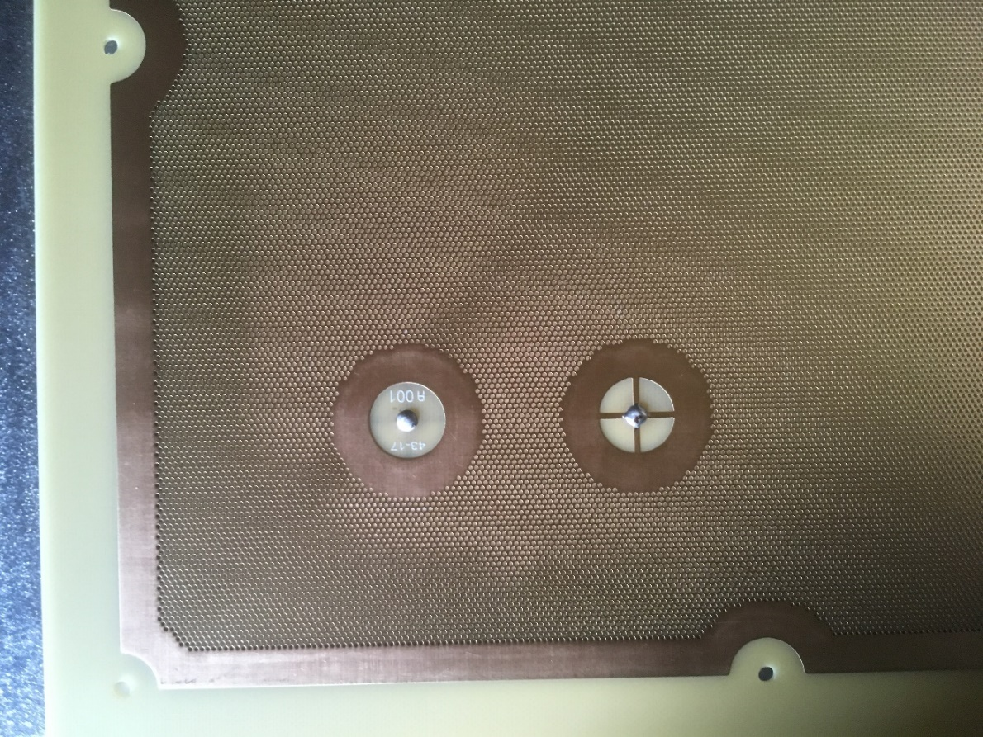
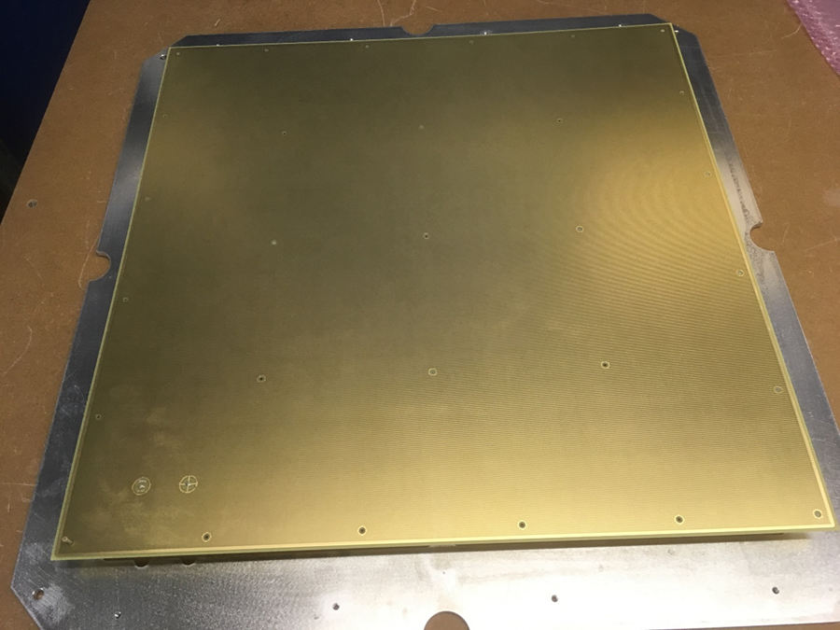
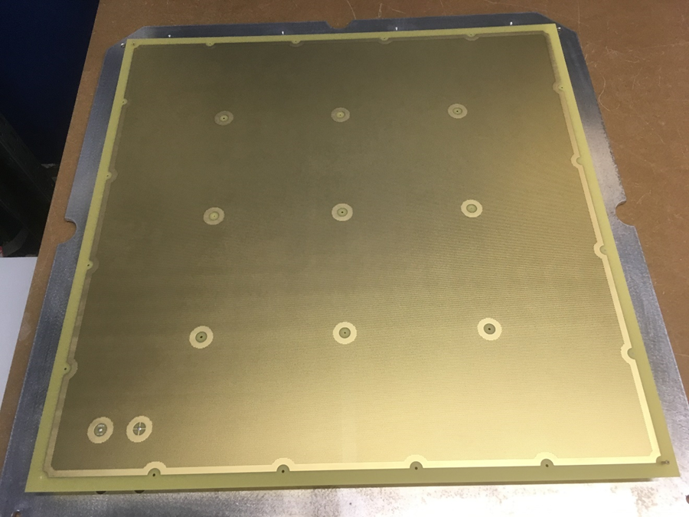
LEM Design for ProtoDUNE-DP
CFR-34 – 311 prototype
CFR-35 – NP02
2 + 2 mm
clearance
5 + 10 mm
clearance
∼ 96% active area
∼ 86% active area
Not necessarily the final design for a DUNE 10 kt detector!

Slide 5
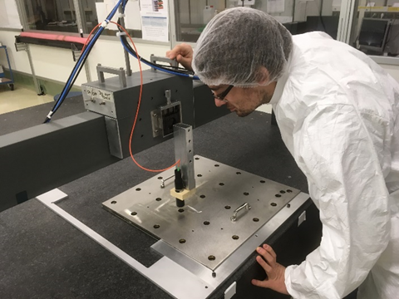
LEM manufacturing by ELTOS (Italy) – requested specifications met (FR4 and copper thicknesses, hole, rim and LEM size)
Characterization and tests @ CEA/Irfu
74 LEMs produced and validated for 2 CRPs
LEM production
(Jan. – Oct. 2018)
Ultrasonic bath
LEM Survey
Soldering HV pins +
glueing MACOR insulation
Cleaning + drying
+ polymerization

Slide 6
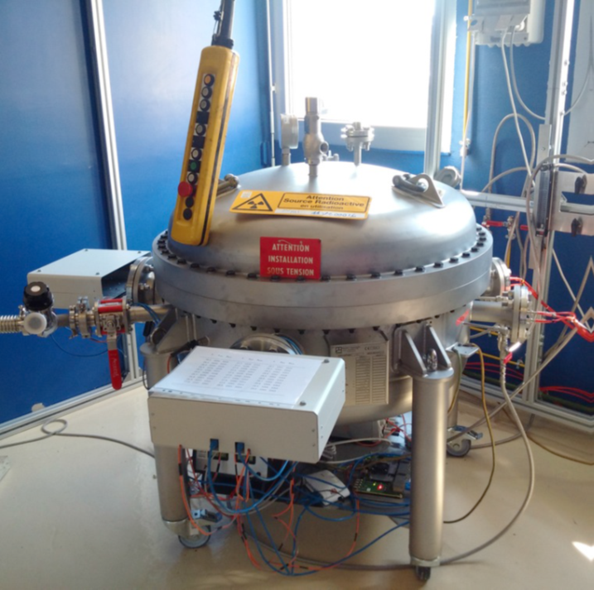
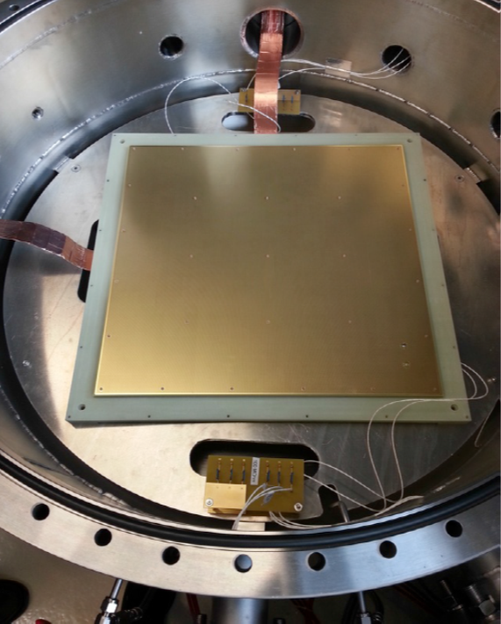
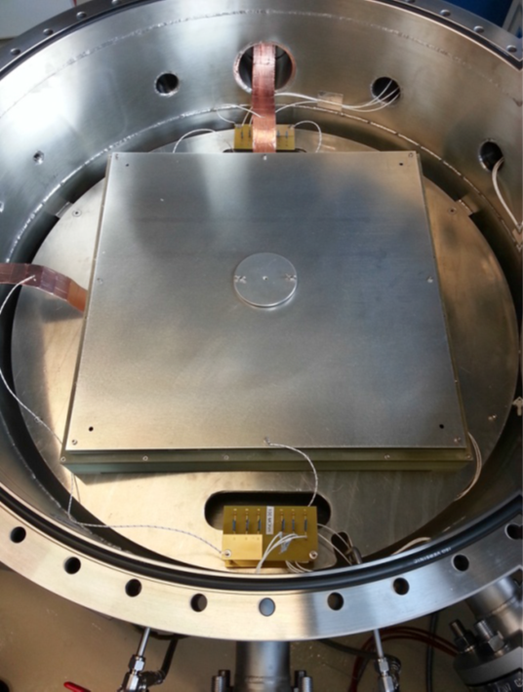
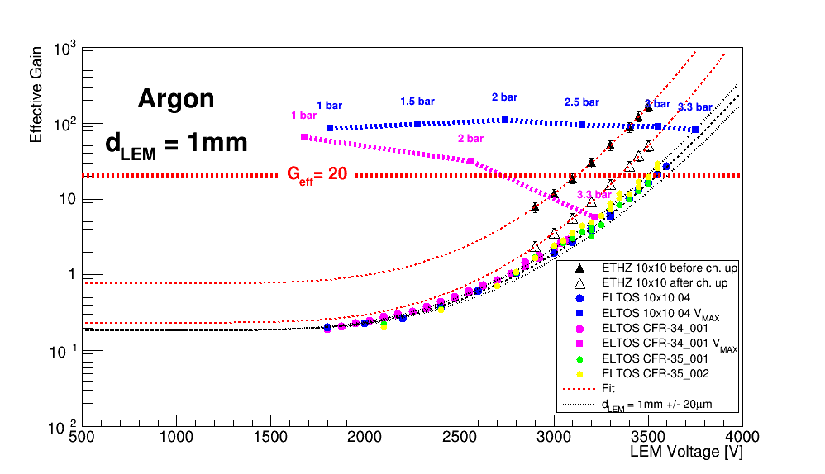
LEM HV Tests in a High Pressure Chamber
Stack of 6 LEMs
LEM + ANODE
CATHODE
collimated
α source
Amplification gain inside the LEM depends on gas density ρ or P/T :
G_{eff} = Ce^{αd} with α = Aρe^{-Bρ/E}
GAr @ 88°K and ∼1 bar ⇔ T = 20°C and P ∼3.3bar.

Slide 7
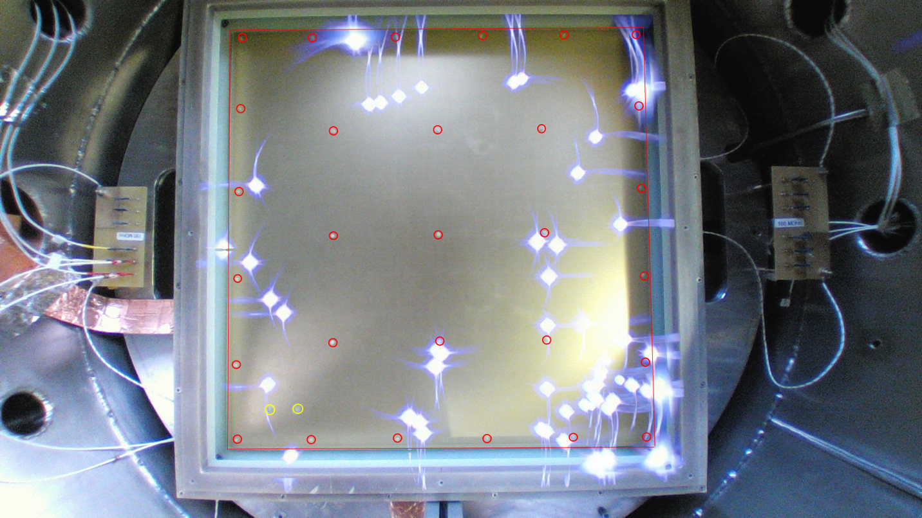
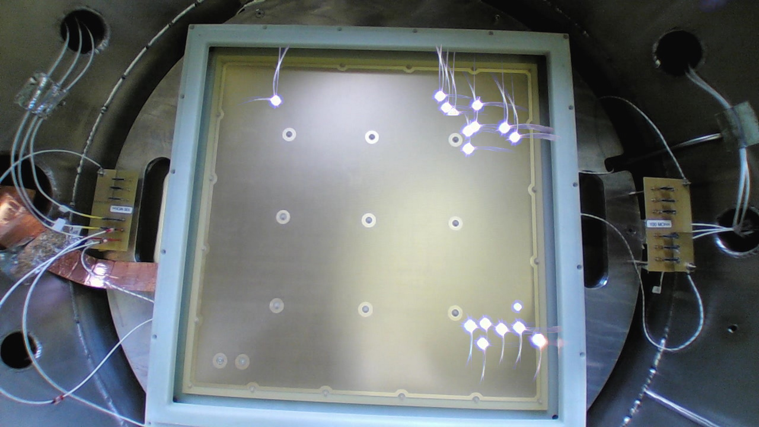
LEM HV Tests in Ar @ 3.3 bar
CFR-34 – 311
CFR-35 – NP02
ΔV_{LEM} = 3.3-3.5 kV in Ar @ 3.3 bar
ΔV_{LEM} = 3.5 kV in Ar @ 3.3 bar
multiple
sparks
- gain > 100 in DLAr (before charging up)
- no PS trip for > 40h
- spark rate : ∼3/h
- spark rate : ∼20/h
(> 45% of sparks near edges or corners)

Slide 8
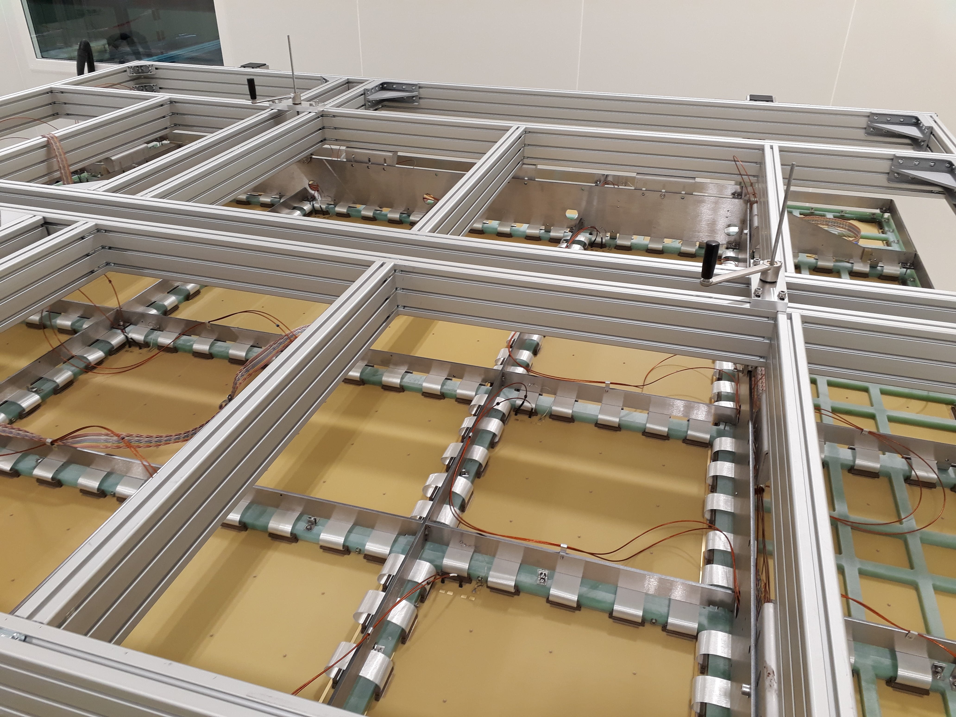
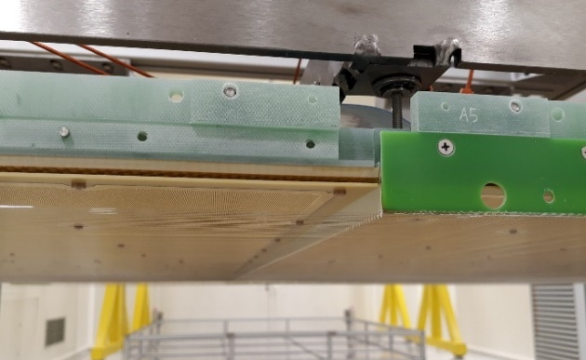
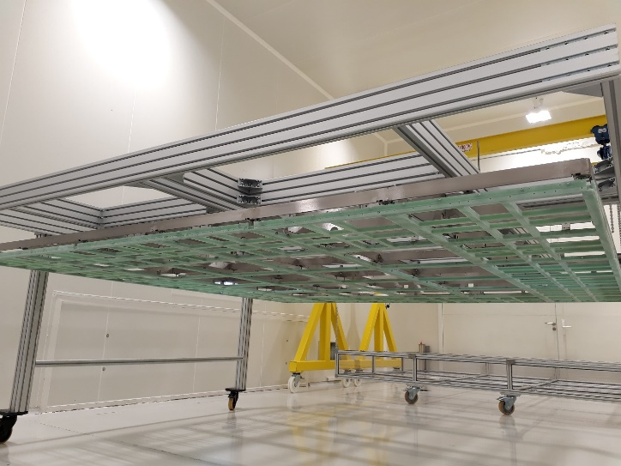
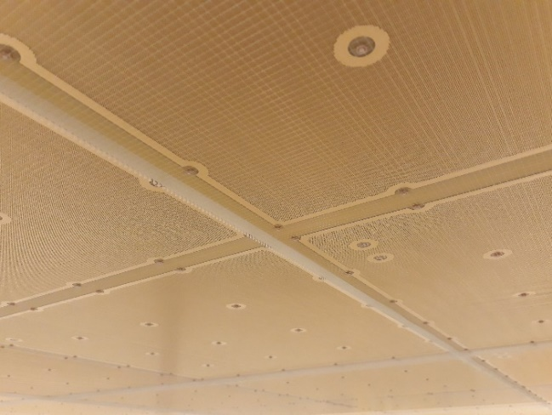
CRP assembly @ CERN (I)
Assembling the 3x3 m² G10 frame and coupling to the INVAR structure
Mounting the anodes and the LEMs on the G10 frame
Weaving 30 Grid modules and installation on the CRP
Cabling and instrumentation (T probes, level meters, …)
Survey and planarity adjustments
Transport
Anodes
HV cabling
CRP
INVAR structure
Grid module
Grid wires
1 cm spacing
between LEMs
and Grid
G10 frame
36 anodes + 36 LEMs
Combs

Slide 9
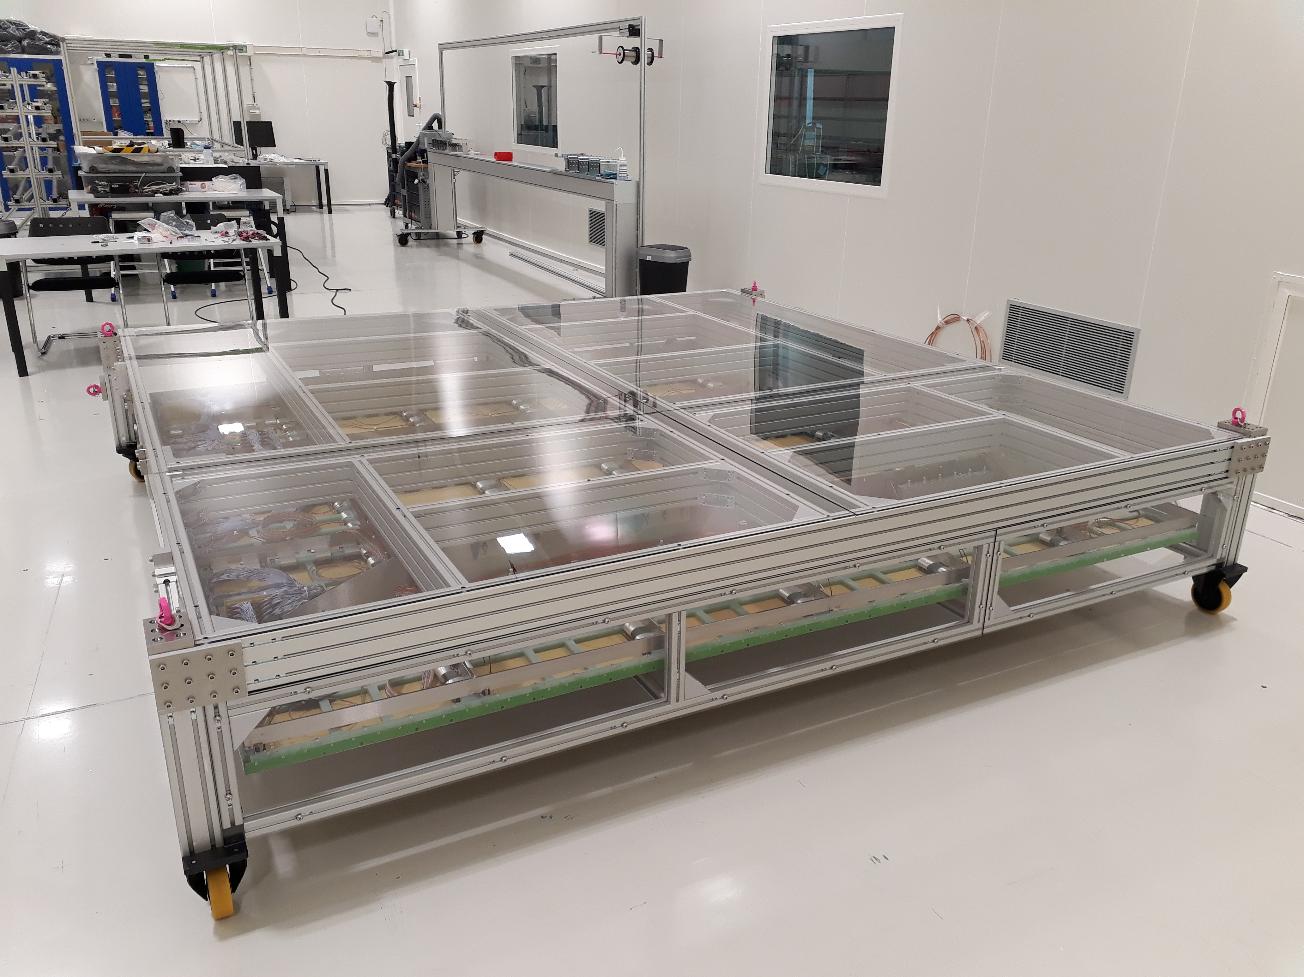
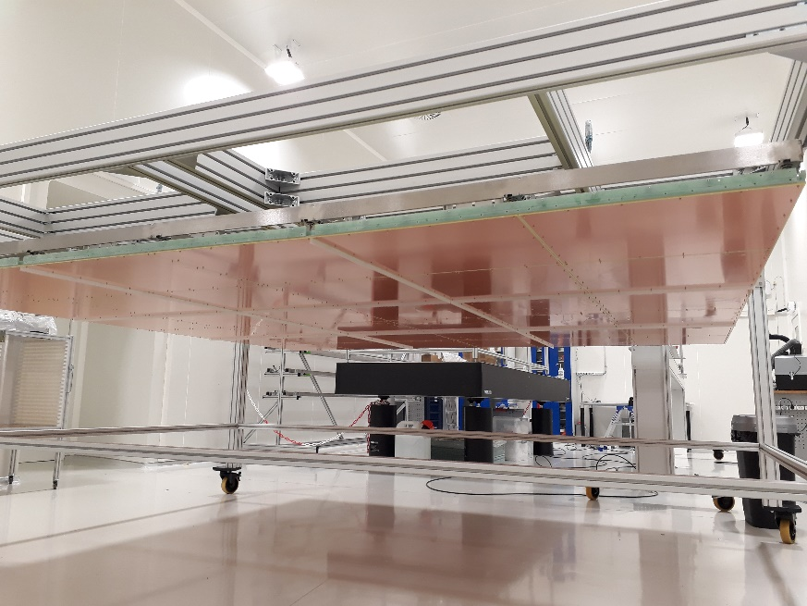
CRP assembly @ CERN (II)
ProtoDUNE-DP will have 2 fully instrumented CRPs (CRP1 & 2) and 2 fake CRPs (CRP3 & 4)
with an Extraction Grid and ground plates to close the E-field
Transport box
Ground plates
Fully instrumented CRP
Fake CRP

Slide 10
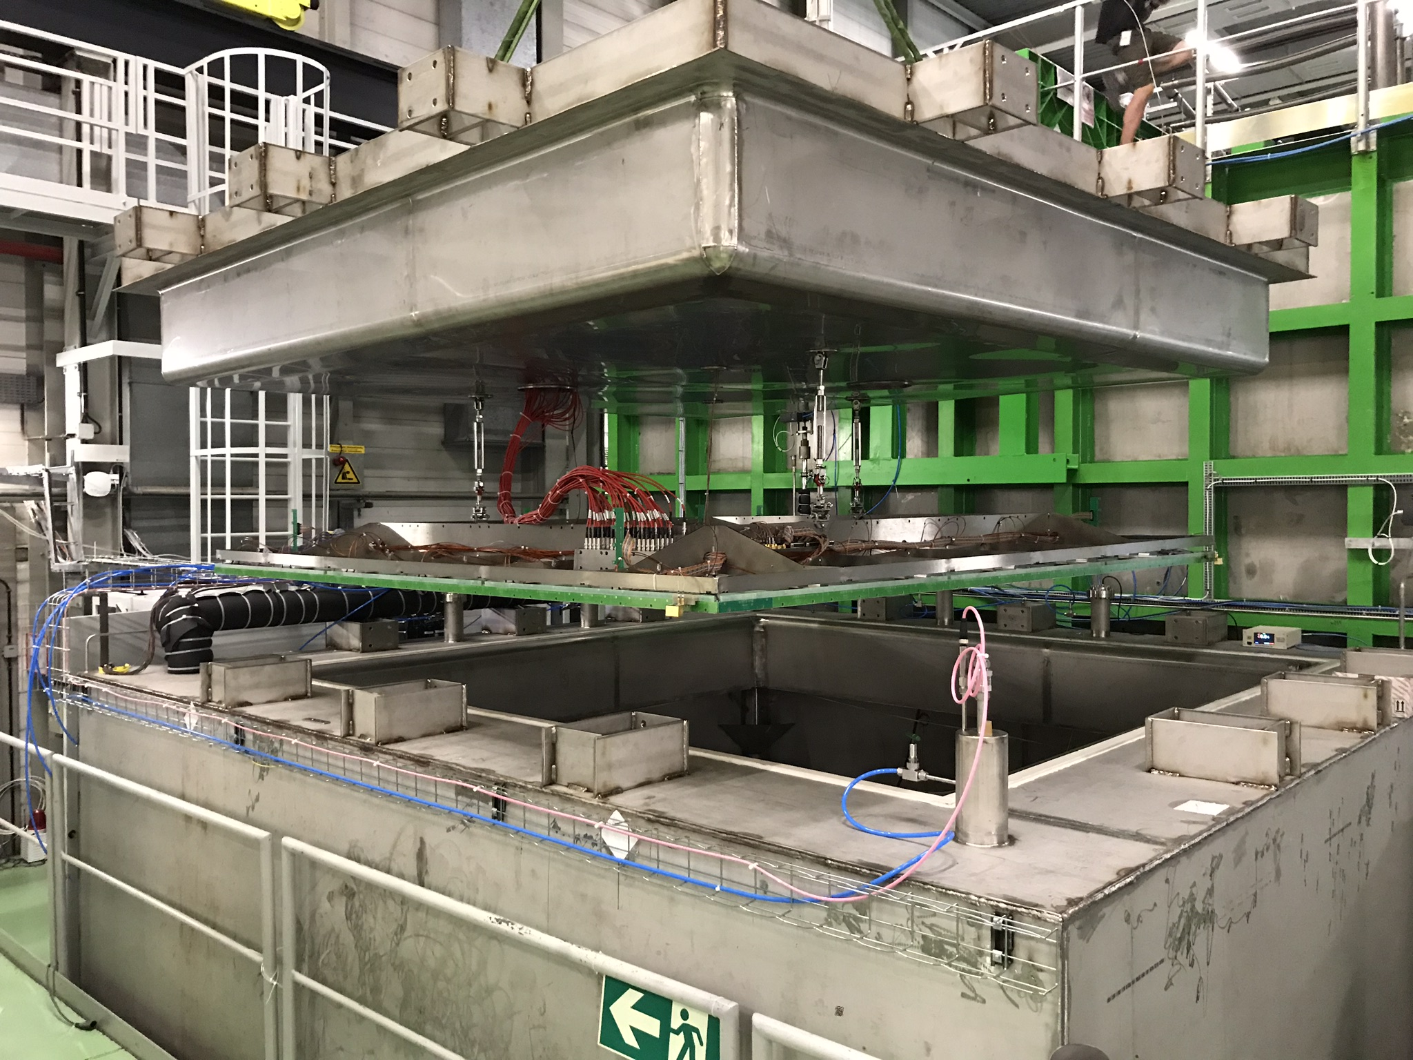
CRP Tests in Cold Box
Perform electrical and mechanical tests of CRPs in nominal thermodynamic dual phase conditions:
  - HV tests of LEMs and Extraction Grid
  - CRP planarity
  - Tensioning of the extraction grid wires
- Ar purity < 100 ppm O₂^{eq} ; GAr @ P_{atm}
- LAr evaporation less than 1 mm/h (< 700 W heat input)
- No boiling, no bubbles, LAr level very quiet
- LAr level controlled @ +/- 0.125 mm with constant refilling
LAr level ∼ 5mm above Grid
Insertion of a CRP in
the Cold Box
All four CRPs tested (07/2018 - 01/2019)

Slide 11
CRP1 and CRP2 LEM HV Test Results (Oct. – Nov./2018)
Liquid level in CB stable to within ∼250µm; T_{LEM} ∼ 91°K; ΔV_{LEM-GRID} = 3kV
CRP1
V_{TOP} (kV) | V_{BOT} (kV) | E_{LEM} (kV/cm) | Time (h) | Spark Rate (h⁻¹) | P_{atm} (mbar) | Estimated G_{eff} (no ch. up)
0.25 | 3.35 | 31.0 | 12 | 1.3 | 968 - 972 | 20
0.50 | 3.55-3.60 | 30.5-31.0 | 13 | 1.3 | 962 - 966 | 24 - 31
0.75 | 3.70 | 29.5 | 42 | 0.6 | 943 - 953 | 20
1.00 | 3.80 | 28.0 | 18 | 2 trips* | 970 - 976 | 9
1.00 | 3.85 | 28.5 | 12 | 3 trips | 936 - 947 | 15
* PS TRIP time set too short
CRP2
V_{TOP} (kV) | V_{BOT} (kV) | E_{LEM} (kV/cm) | Time (h) | Spark Rate (h⁻¹) | P_{atm} (mbar) | Estimated G_{eff} (no ch. up)
0.10 | 3.15 – 3.20 | 30.5 – 31.0 | 17 | 0.8 | 969 - 973 | 9 - 11
0.25 | 3.34 | 30.9 | 16 | 1.3 | 968 – 970 | 19
0.50 | 3.55 | 30.5 | 11 | 0.9 | 957 – 965 | 24
0.50 | 3.555 | 30.55 | 42 | 0.5 | 962 – 964 | 25
Effective gain > 20 before charging up achieved. Best HV configuration with V_{TOP} ∼ 0.5kV. For larger V_{TOP} values, need to decrease E_{LEM} to reach stable operation.

Slide 12
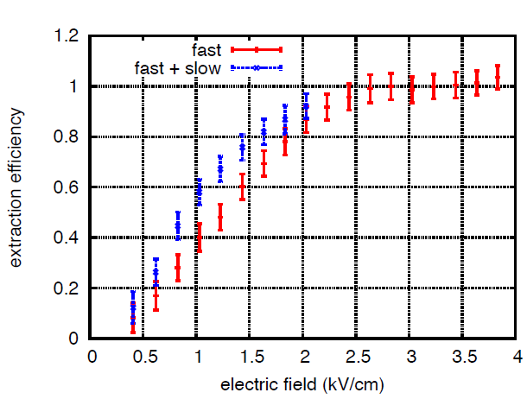
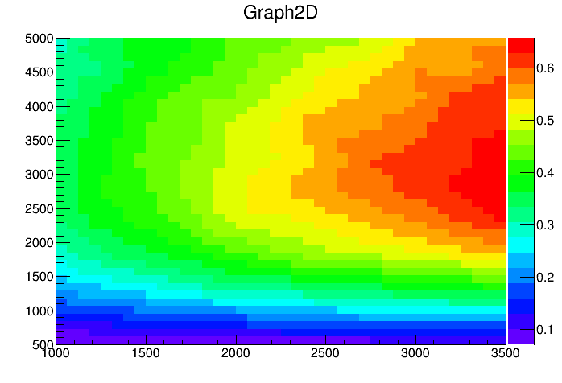
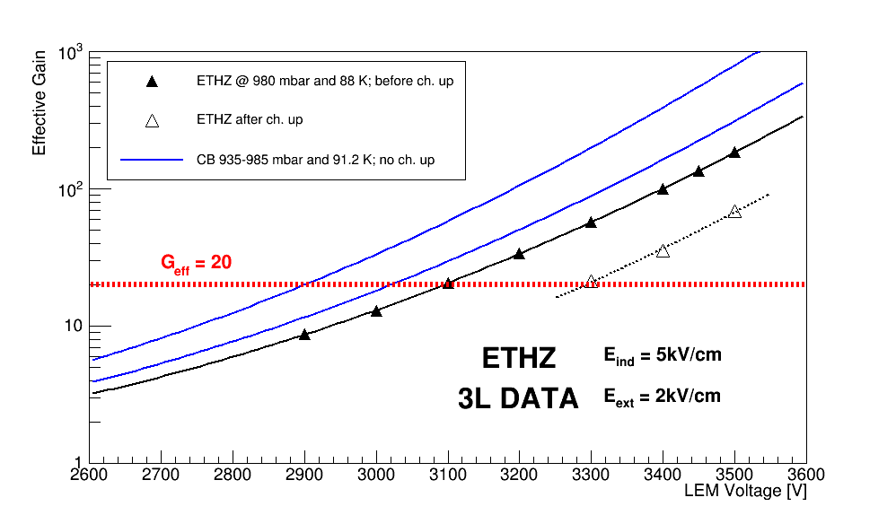
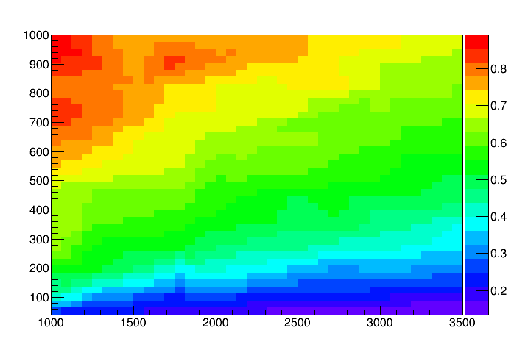
Effective gain
Gushchin et al., Sov. Phys.
JETP 55 (1982) 860-862.
G_{eff} = ε_{extr} × G_{LEM} × ε_{ind}
Extraction efficiency
ΔV_{GRID-LEM} (V)
Includes probability
for electrons to enter
LEM holes
Collection efficiency
V_{LEM_TOP} (V)
C. Cantini et al., JINST 10 (2015) 03, P03017
ΔV_{LEM} (V)

Slide 13
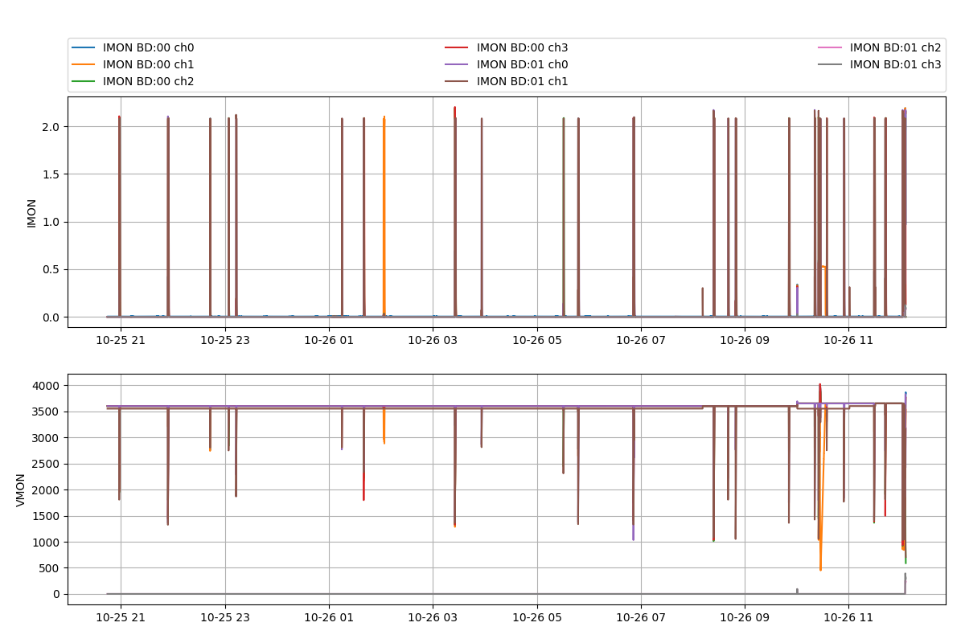
CRP1 : V_{TOP} = 0.50kV and V_{BOT} = 3.55-3.60kV
I_{MON}
E_{LEM} = 31kV/cm
V_{MON}
0 trip, 17sparks @ 0.50kV/3.60kV in 13 hrs

Slide 14
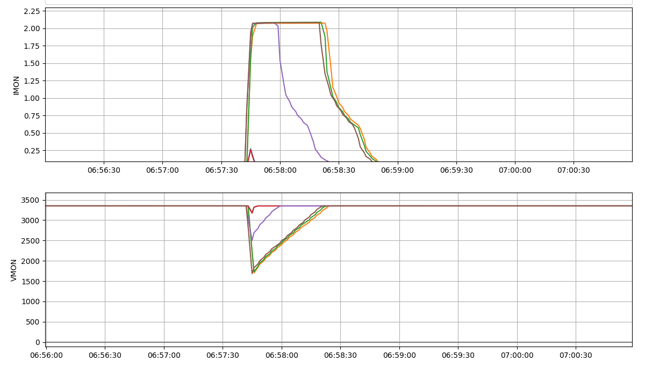
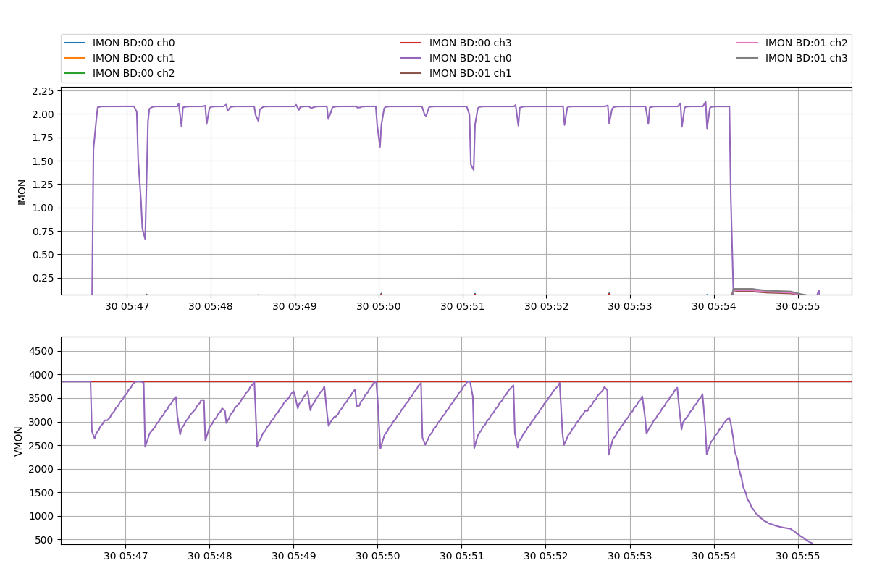
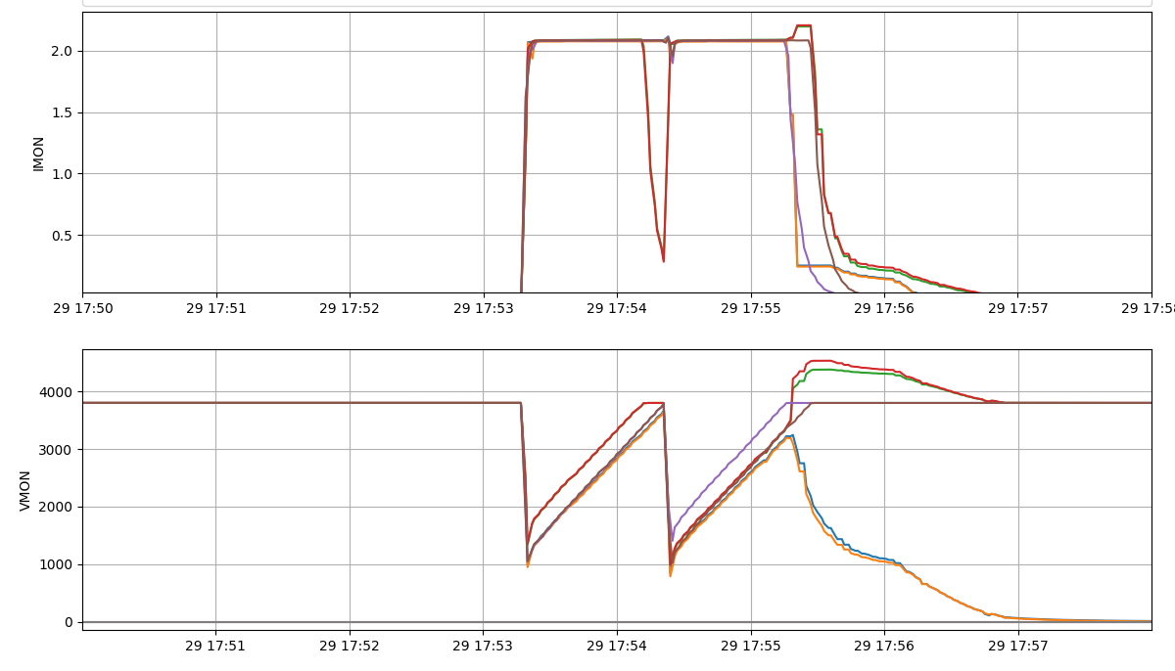
Sparks, trips and … continuous discharges
1 spark
Continuously discharging
Can be detected
and stopped
with appropriate
SC monitoring
program
No Trip
Recovery time < PS TRIP time
2 sparks
Recovery time > TRIP time
PS Trip
2 Channels
tripped
Recovery time > PS TRIP time (120s)
∼8 minutes

Slide 15
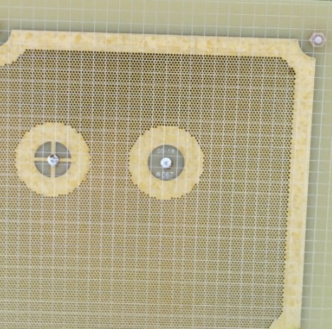
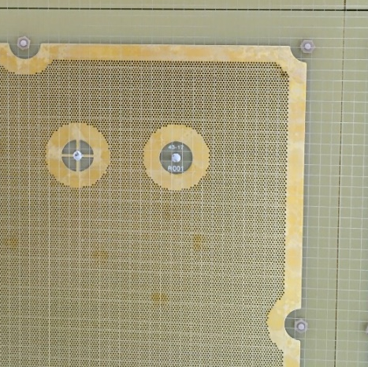
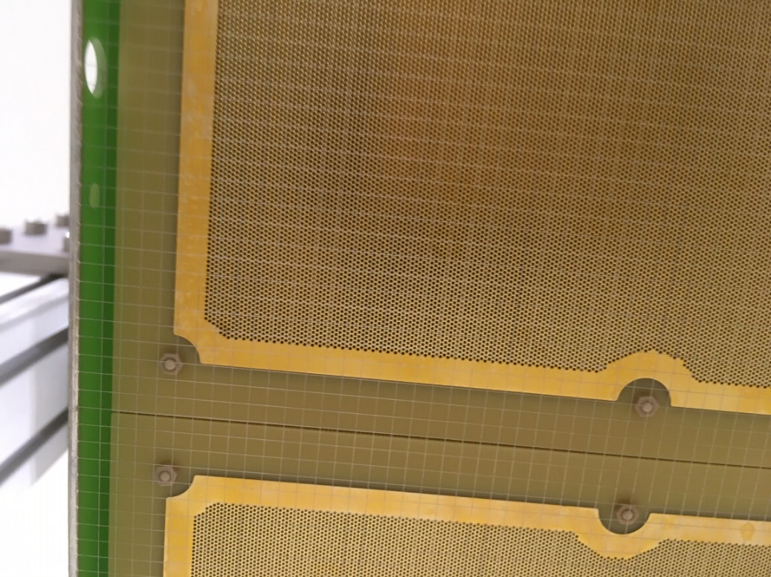
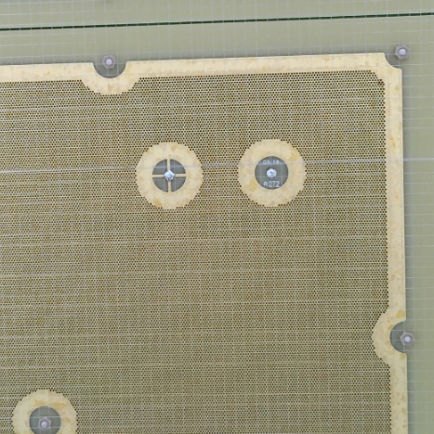
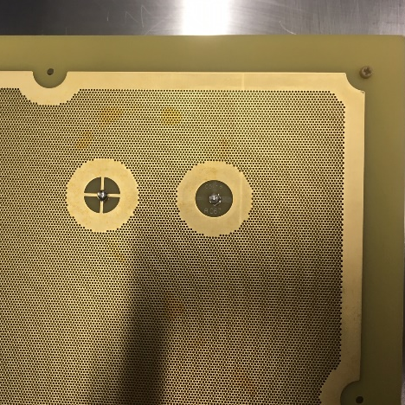
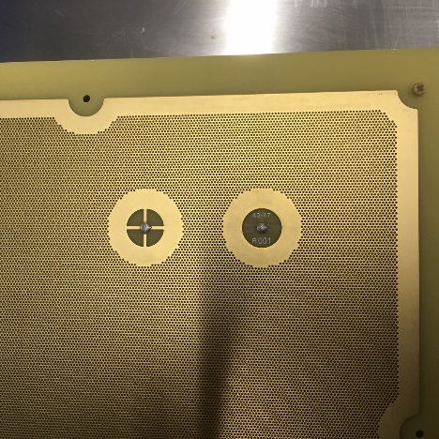
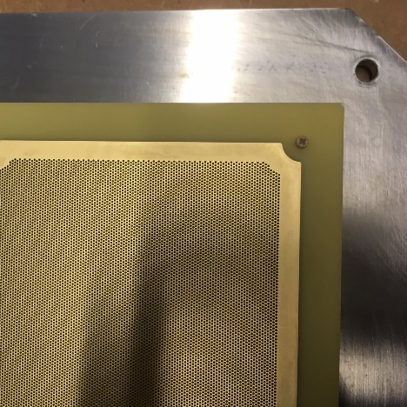
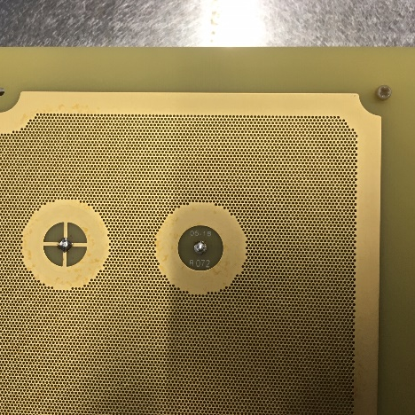
Inspection of discharging LEMs after tests in Cold Box revealed dark spots in the corners
Issues with a few LEMs (5/72)
Points to a weaker regions of the LEM
Treated with potassium
permanganate @ CERN to
remove carbonized FR4
inside holes.
Copper surface unaffected.
LEMs operational again
LEM 16
LEM 28
LEM 30
LEM 14
Risks can be mitigated with
appropriate SC monitoring
Work in progress with CERN
EP-DT-DI
After treatment

Slide 16
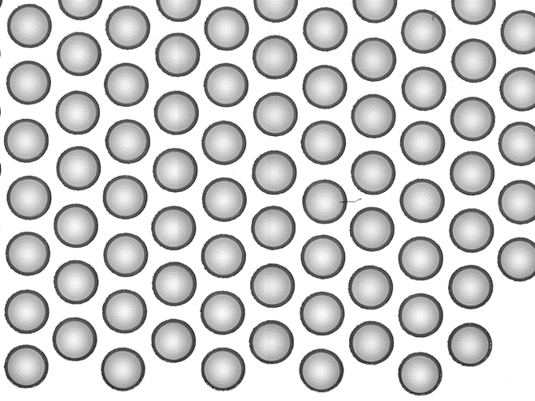
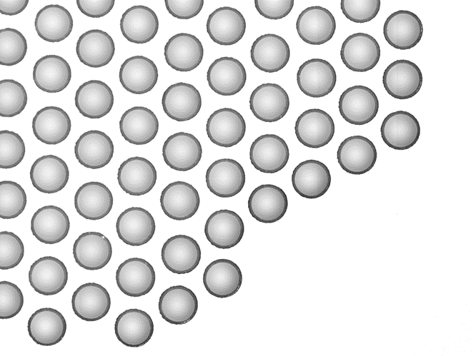
LEM rim defects?
Rims around holes near the LEM edges/corners appear to be
decentered and containing copper residues
Problem known by Rui de Oliveira (CERN EP-DT-EF)
Due to method used by ELTOS for the micro-etching process
Decentered rims with
copper residues
Decentered rims with
copper residues
Bad rims?
Problem being investigated in collaboration with EP-DT-EF

Slide 17
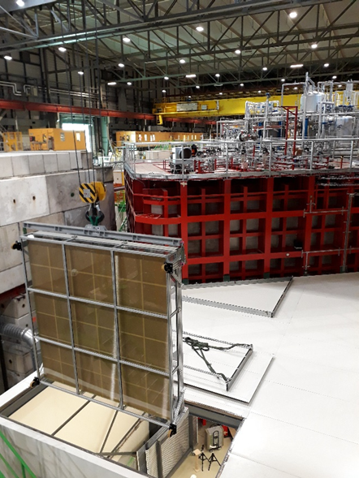
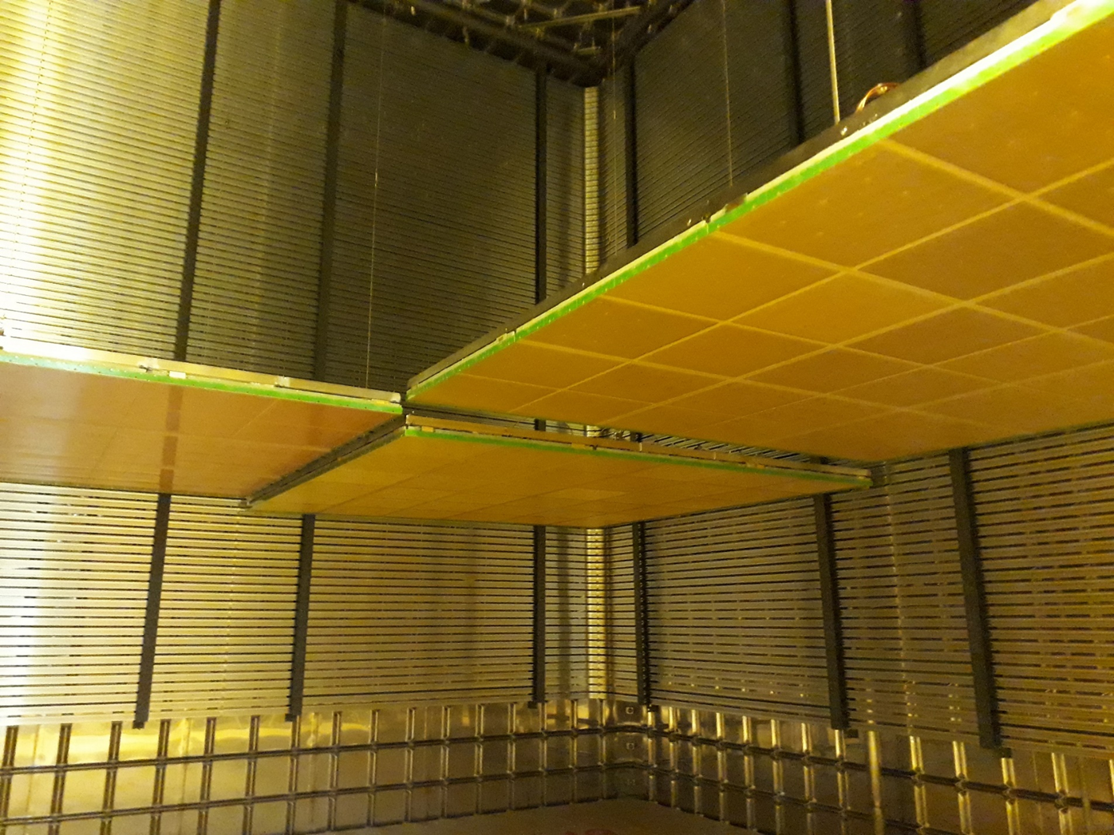
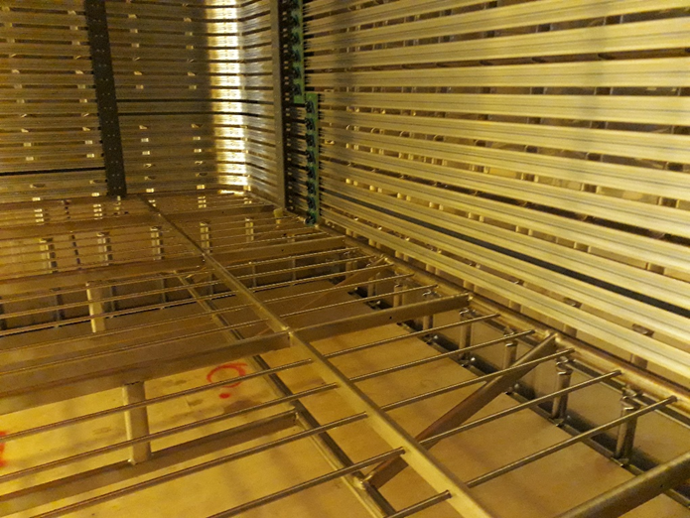
ProtoDUNE-DP Schedule
End on detector installation inside cryostat : 11/03
Cryostat closed : 06/05
Purge and cooldown completed : 27/05
Cryostat filled with LAr : 05/07
⇒ Start LAr purification and commissioning next July
LEMs (2019-2020) : improve design for
larger active area and better HV stability
Possibility to run after the LS2 (2021) with a charged particle beam and a complete detector with the final design for DUNE

Slide 18
Backup Slides

Slide 19
LEM QA/QC by ELTOS
RIM
LEM Specifications
HOLE
FR4
PCB

Slide 20
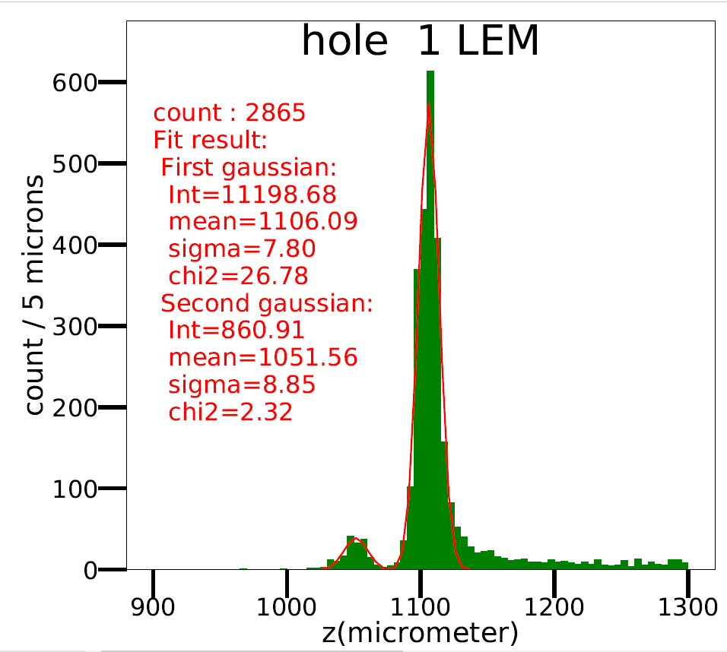
LEM Survey @CEA/Irfu
t₂
t₁
Cu
t₁
t₂
Cu
FR4

Slide 21
LEM HV training in Ar @ ∼3.3 bar
Fully automated HV training up to 3.5kV
LEM A143
3 hours @ 3.5 kV
V
I
LEM A143
All LEMs in CRP1 and CRP2 tested up to 3.4 – 3.5 kV with < 1 spark / 20 minutes

Slide 22
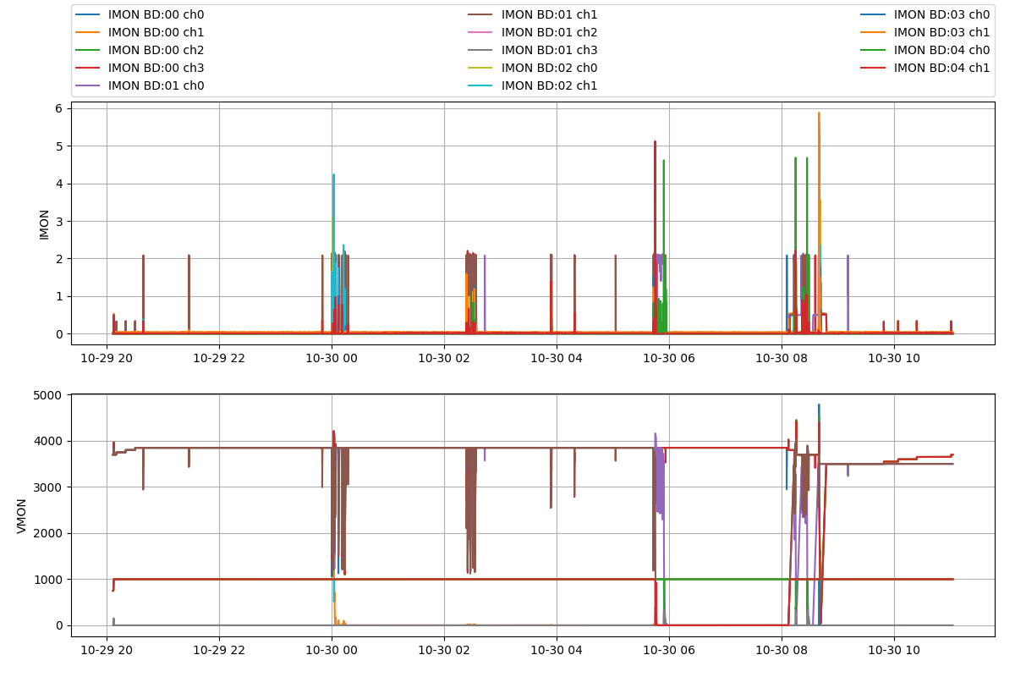
CRP1 : V_{TOP} = 1.00kV and V_{BOT} = 3.85kV
Discharges
Very unstable conditions.
Coincides with LAr delivery
that caused 2mm rapid
increase of level in CB
3 trips @ 1.0kV/3.85kV

Slide 23
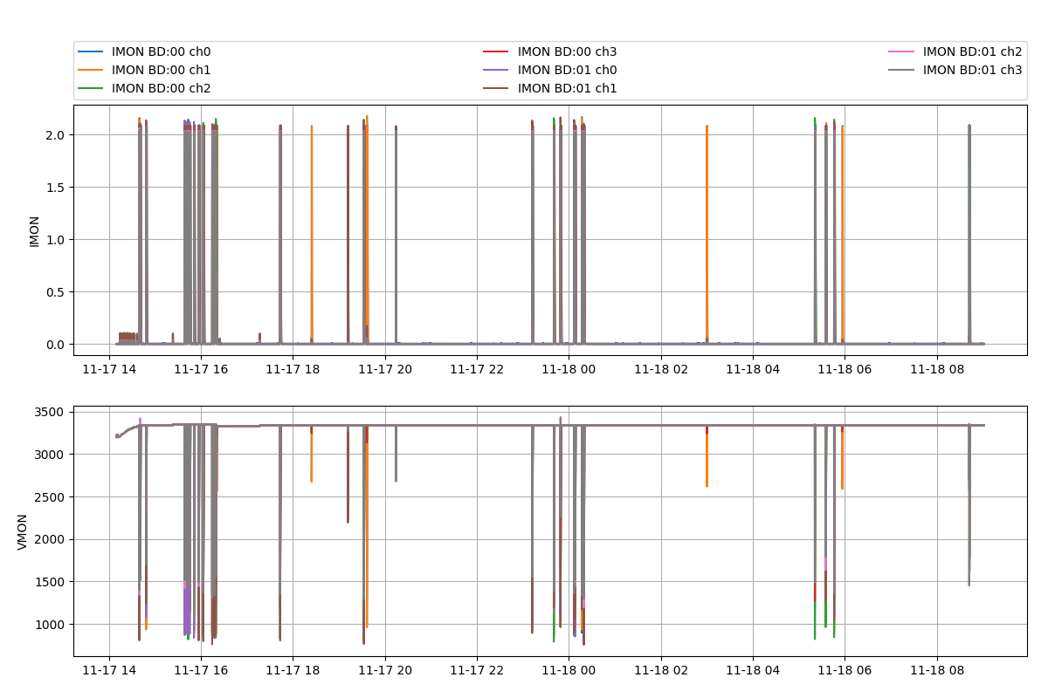
CRP2 : V_{TOP} = 0.25kV and V_{BOT} = 3.34kV
0 trip, 20 sparks @ 0.25kV/3.34kV in 16 hrs

