Slide 1
LABORATORI NAZIONALI DI FRASCATI
www.lnf.infn.it
μ-RWELL layouts
for high particle rate applications:
updated results
G. Bencivenni¹
R. De Oliveira², G. Felici¹, M. Gatta¹, M. Giovanetti¹, G. Morello¹,
A. Ochi³, M. Poli Lener¹
Laboratori Nazionali di Frascati – INFN, Frascati - Italy
CERN, Meyrin - CH
Kobe University, Kobe - Japan

Slide 2
Why this update?
In the December 2018 RD51 meeting we reported about the results of the high rate test beam performed at PSI in October 2018.
In this TB we compared the performance of the different HR μ-RWELL layouts developed in the last year: the Double Resistive Layer (DRL) layout with the various Silver Grid (SG1, SG2, Sg2++) layouts.
The Single Resistive layer (SRL) has been taken as reference.
In the analysis of the data there was an “error” in the calculation of the particle flux of a factor of ~ 2.56 (r = i/(exNxG), for N, total ionization, we used 128 instead of 50 !!!).
In the following, after a brief recall of the detectors geometry, we show the updated plots of the rate capability, together with the gain and efficiency achieved with the various detector prototypes.

Slide 3
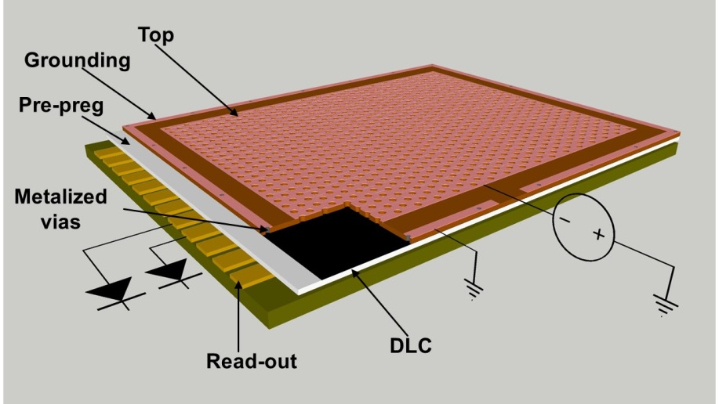
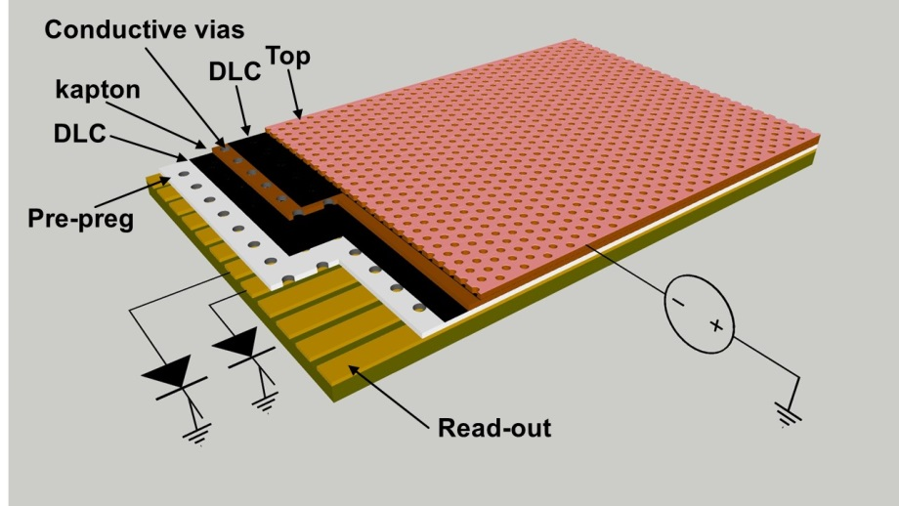
Detector parameters (I)
SRL: 2-D current evacuation scheme based on a single resistive layer with a conductive grounding all around the perimeter of the active area.
DRL: 3-D current evacuation scheme based on two stacked resistive layers connected through a matrix of conductive vias and grounded through a second matrix of vias to the underlying readout electrodes (Rui).

Slide 4
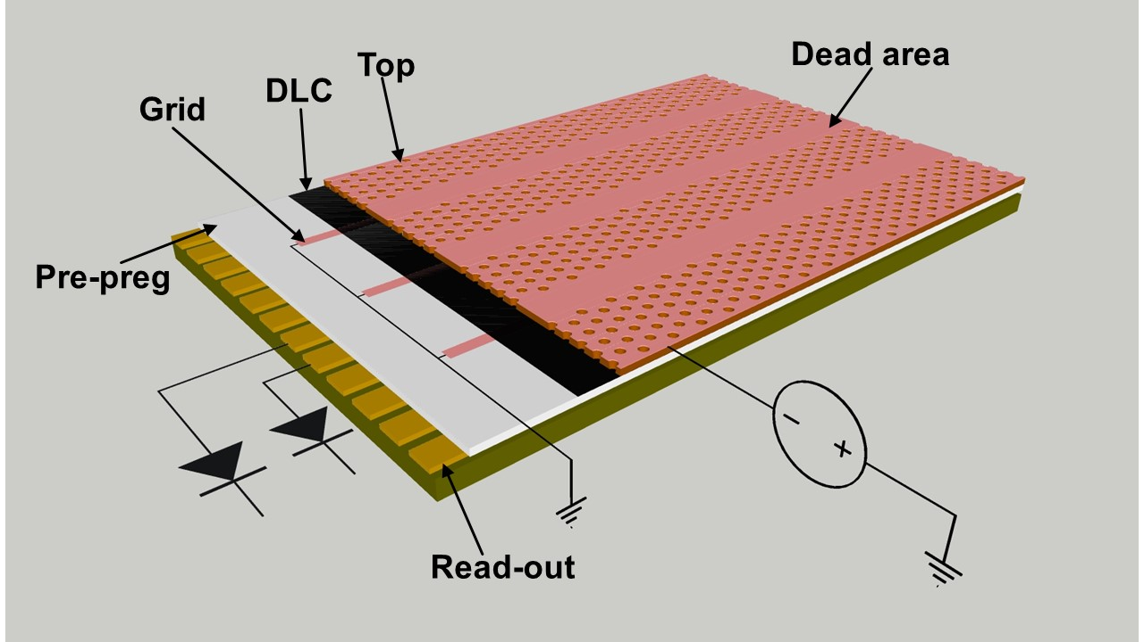
Detector parameters (II)
SG: 2-D current evacuation scheme based on a single resistive layer with a suitable conductive grounding grid realized on the DLC layer.
Since the presence of the conductive grid on the DLC can induce instabilities to the detector due to the discharge occurring over the DLC surface, a small dead zone in the amplification stage (a no-hole area) must be introduced.
This current evacuation scheme, besides the surface resistivity of the DLC, is then characterized by the pitch of the conductive grid and the DOCA, correlated with the dead_zone (dead_zone = 2×DOCA + line_width).
The SG is a very simple HR layout allowing an easy TT to industry.

Slide 5
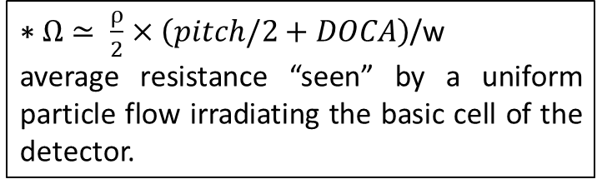
Detector parameters (III)
 | SG1 | SG2 | SG2++ | DLR | SLR
Grid-pitch (mm) | 6 | 12 | 12 | 6 | 100
Dead zone (mm) | 2 | 1.2 | 0.6 | 0 | 0
Conductive line width (mm) | 0.3 | 0.3 | 0.1 | - | -
DOCA (distance of closest approch) between the edge active area & conductive line | 0.85 | 0.45 | 0.25 | 7 | 5.5
Effective average resistance to ground (MΩ) | 134 | 209 | 200 | 270 | 1947
DLC resistivity (MΩ/□) | 70 | 65 | 64 | 54 | 70
$\text{∗} Ω≃ \frac{ρ}{2}×\left(pitch/2+DOCA\right)$/w
average resistance “seen” by a uniform particle flow irradiating the basic cell of the detector.
Ω summarizes the electrical and geometrical features of each current evacuation scheme.

Slide 6
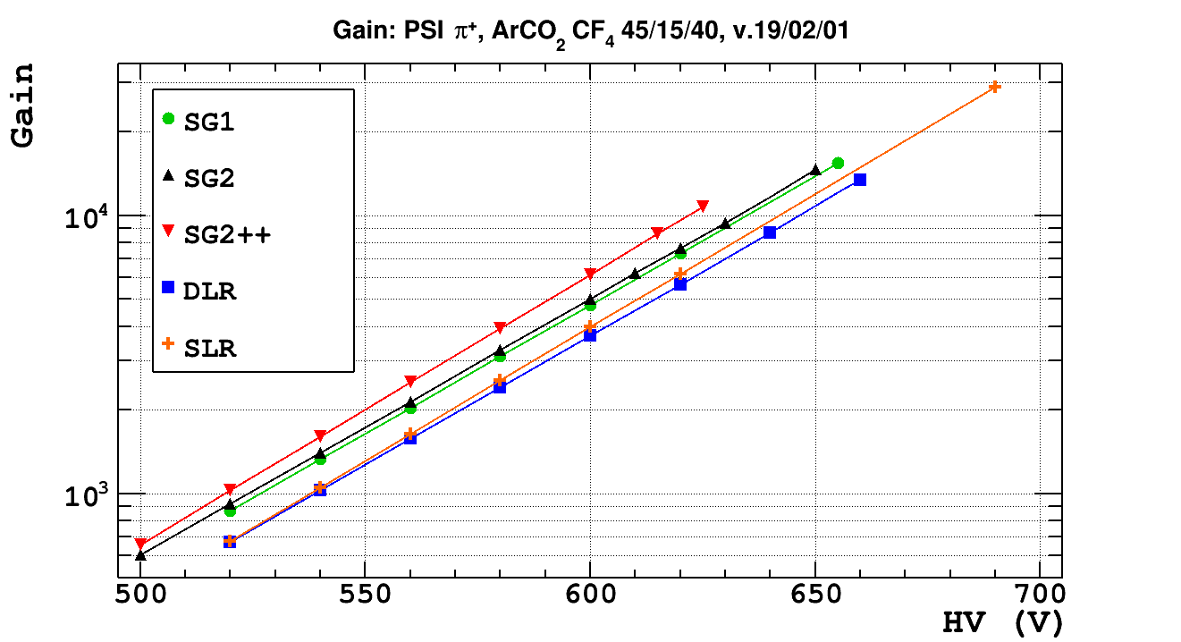
HR layouts performance: gain
Taking into account possible small manufacturing differences in the amplification stage of the various layouts (well diameter/shape), all quantities are reported as a function of the gain. The gain of all prototypes (including the SRL) have been measured with a 270 MeV/c π+ beam at the πM1 of the PSI. The particle flux was ranging from 320 kHz/cm² to 1.2 MHz/cm².

Slide 7
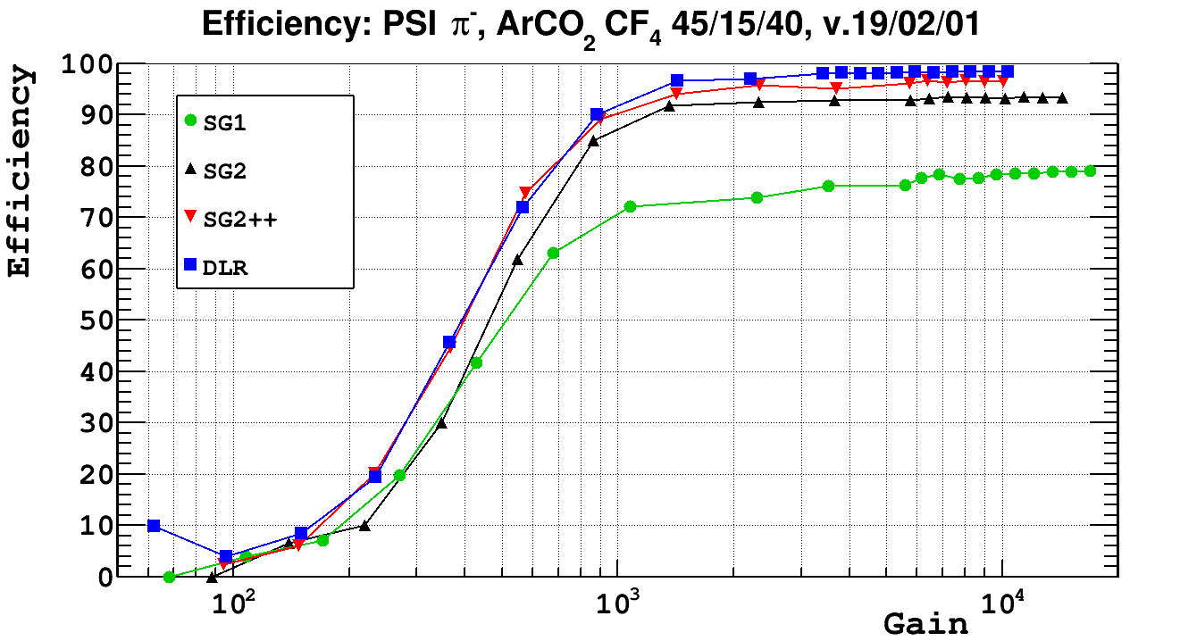
HR layouts performance: efficiency
G = 5000 ± 10%
The DRL prototype reaches a full tracking efficiency > 98% (NO DEAD ZONE).
The SG1, SG2 and SG2++ show lower efficiency (76% -94% - 9(%) BUT higher than their geometrical acceptance (66% - 90% - 95% respectively), thanks to the efficient electron collection mechanism that reduces the effective dead zone.

Slide 8
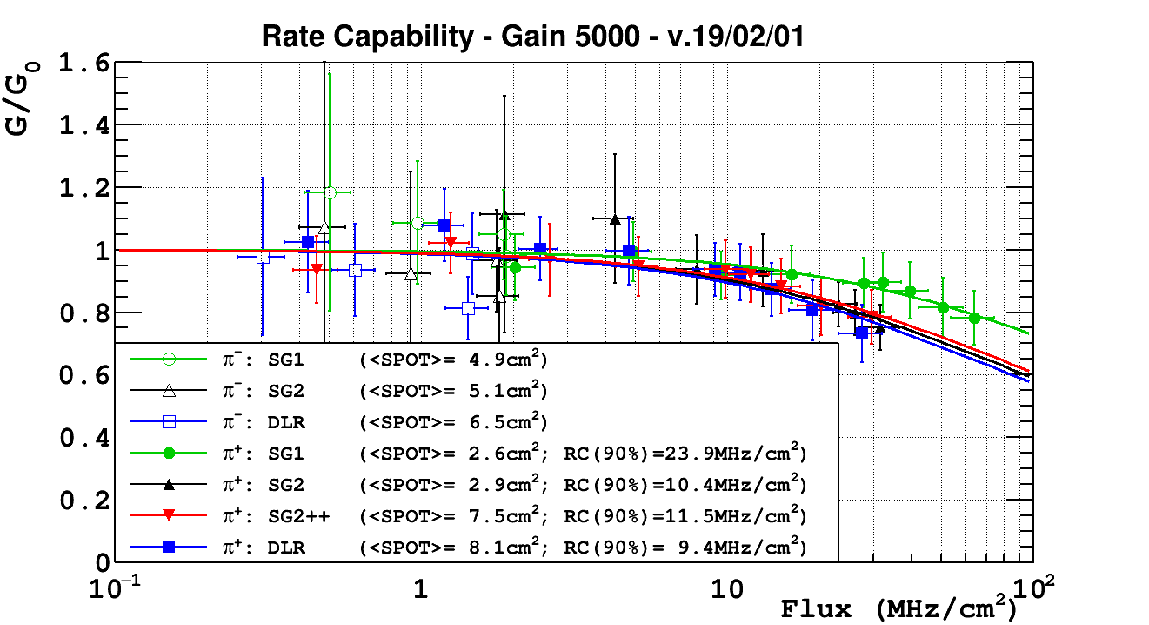
HR layouts performance: rate capability
G/G₀ = 90%
A gain drop of 10 % is largely acceptable since does not affect the detection efficiency (see previous slide).

Slide 9
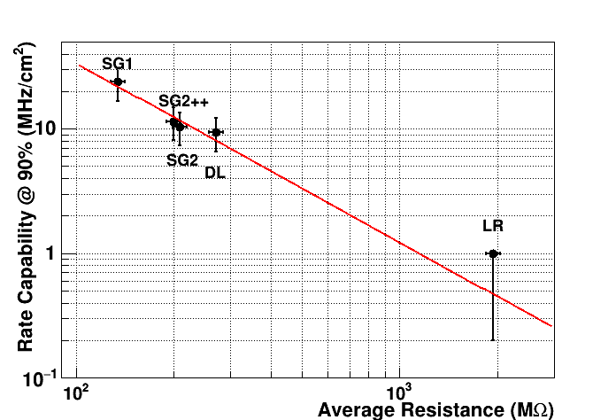
Rate capability @ 90% vs <Ω_{eff}>
Rate capability at G/G0 = 90% vs Ω: the lower is the effective average resistance Ω, the higher is the rate capability.
For the SRL, since the irradiation was not uniform, the measurement reported in this plot must be considered as an upper limit of the actual RC.

Slide 10
Conclusions
Different HR layouts of μ-RWELL have been developed & tested at the πM1 beam facility of the PSI up to particle fluxes exceeding 20 MHz/cm2.
Among the various proposed layouts the SG2++, based on the DLC+Cu sputtering technology developed at USTC-Hefei (Y.Zhou), combines an easy architecture with excellent performance:
  Efficiency ~ 98 %
  Rate capability ~ 10 MHz/cm²
  Gain under irradiation ~ 10⁴

Slide 11
Spare slides

Slide 12
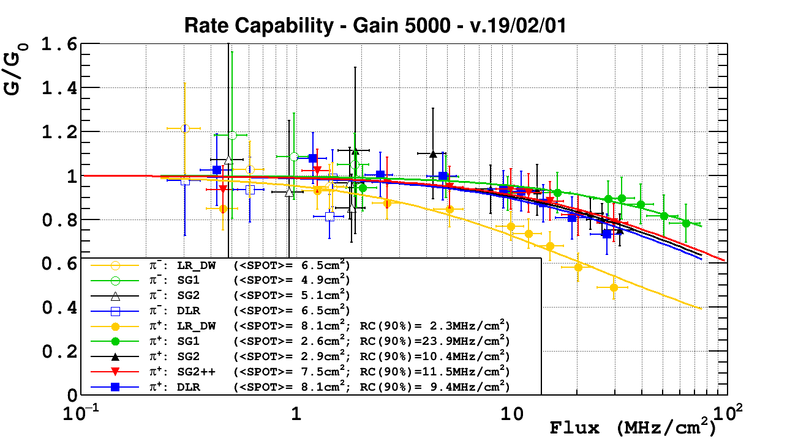

Slide 13
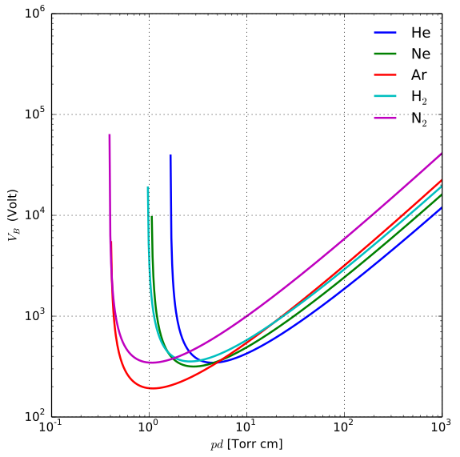
Paschen
760*0,015 ∼11,4
760*0,02 ∼15,2
760*0,005 ∼3,8
600 V
800 V
300 V

Slide 14
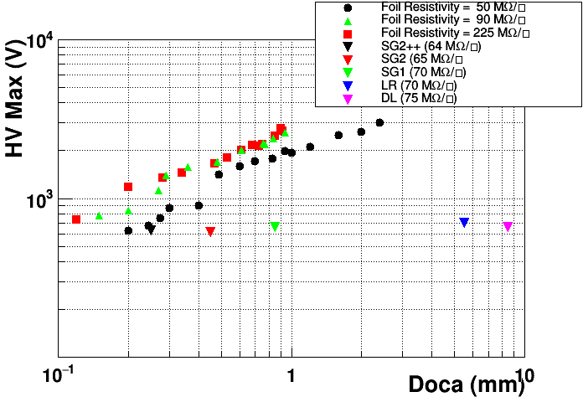
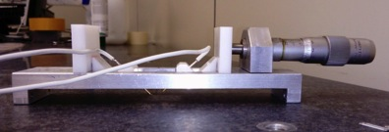
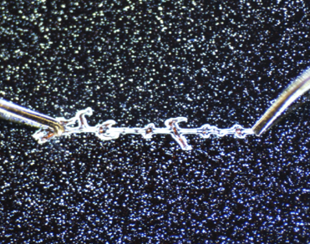
Limiting factor: Doca vs HV max
DOCA
At higher resistivity and small DOCA other effect can dominate such as arc/corona discharge in air.
A solution is under study with Rui: a detector with different DOCA (single hole + conductive line at different distance)

Slide 15
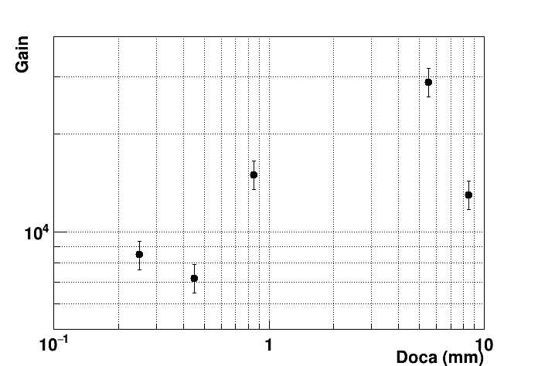
Detector stability vs DOCA
Under irradiation
Max
LR
DL
SG1
SG2++
SG2
Does the max gain depend on DOCA?
More investigation/statistics is required

Slide 16
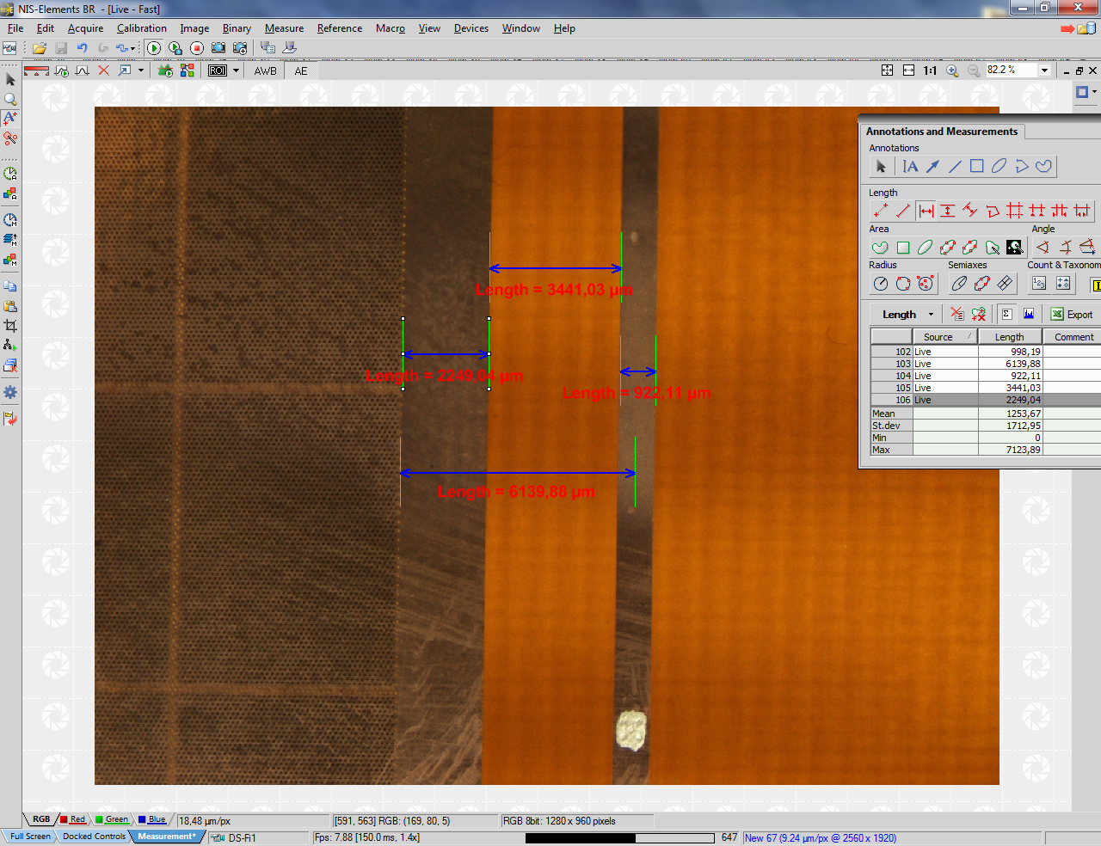
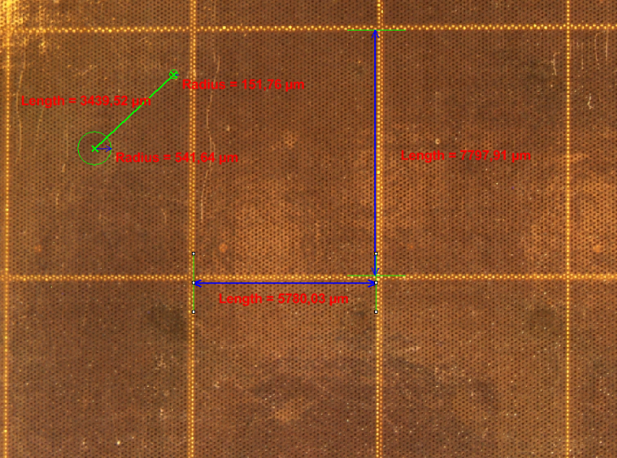
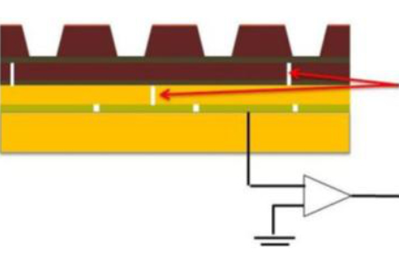
Detector geometrical parameters (I)
Baseline Geometry
Single DLC layer (LR)
Double DLC Layer (DL)
7000. μm
6140.88 μm
75 MΩ/□
70 MΩ/□
Double DLC layer
Conductive vias

Slide 17
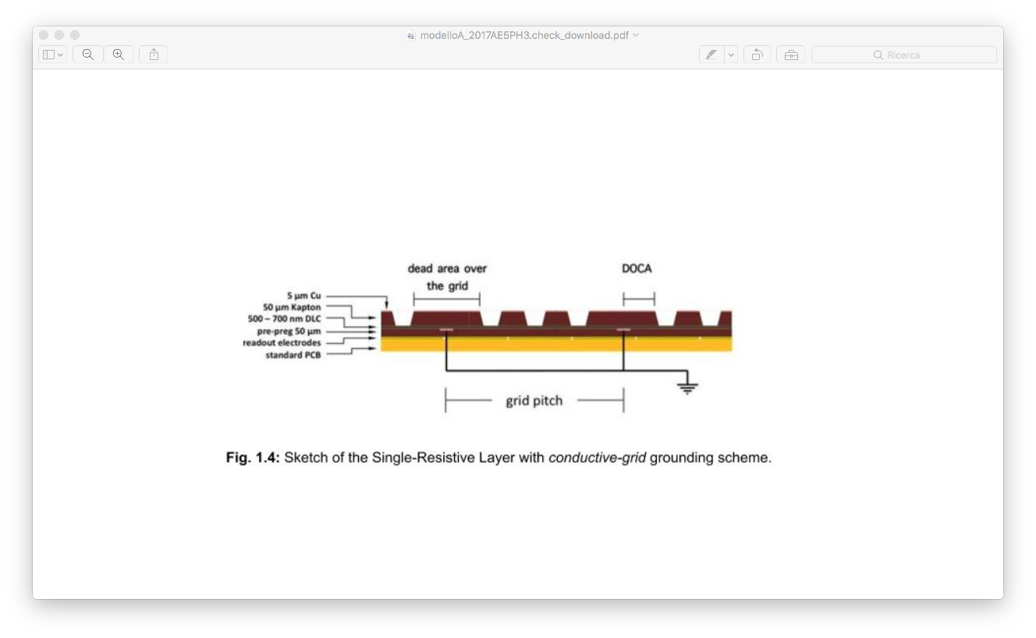
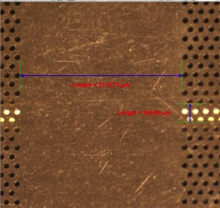
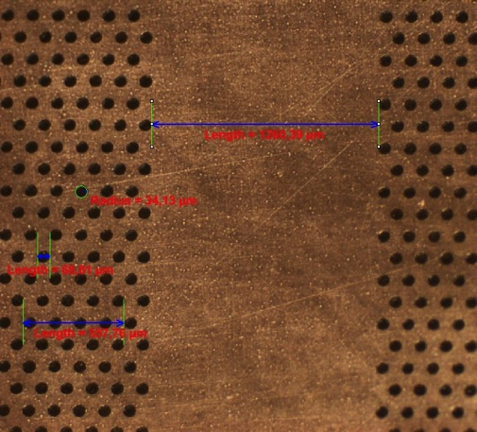
Detector geometrical parameters (II)
Dead area
DOCA
The aim is to maintain a very short path for current moving on the DLC layer to ground and simplifying the construction process
grid pitch
Single DLC layer
Silver Grid v1 (SG1)
Silver Grid v2 (SG2)
Silver Grid v2++ (SG2++)
2178.73 μm
1260.39 μm
600. μm
70MΩ/□
65MΩ/□
64MΩ/□
grid-pitch 6 mm
dead area 2 mm
conductive line 300 um (screen printing)
→ Geometrical acceptance: 66%
grid-pitch 12 mm
dead area 1 mm
conductive line 300 um (screen printing)
→ Geometrical acceptance: 90%
grid-pitch 12 mm
dead area 0.6 mm
conductive line 100 um
(DLC+Cu polyimide foil has been produced by Zhou Yi – USTC, Hefei (PRC))
Geometrical acc.: 95%

