Slide 1
NORTH AREA CONSOLIDATION STUDY
Presented to the ATS Management Board on 19th November
Y. Kadi, F. Gautheron, A. Papageorgiou Koufidou, E. Solodko,
M. Wilhelmsson (EN-EA-PE)
3rd EABI-WG meeting, 11 January 2019

Slide 2
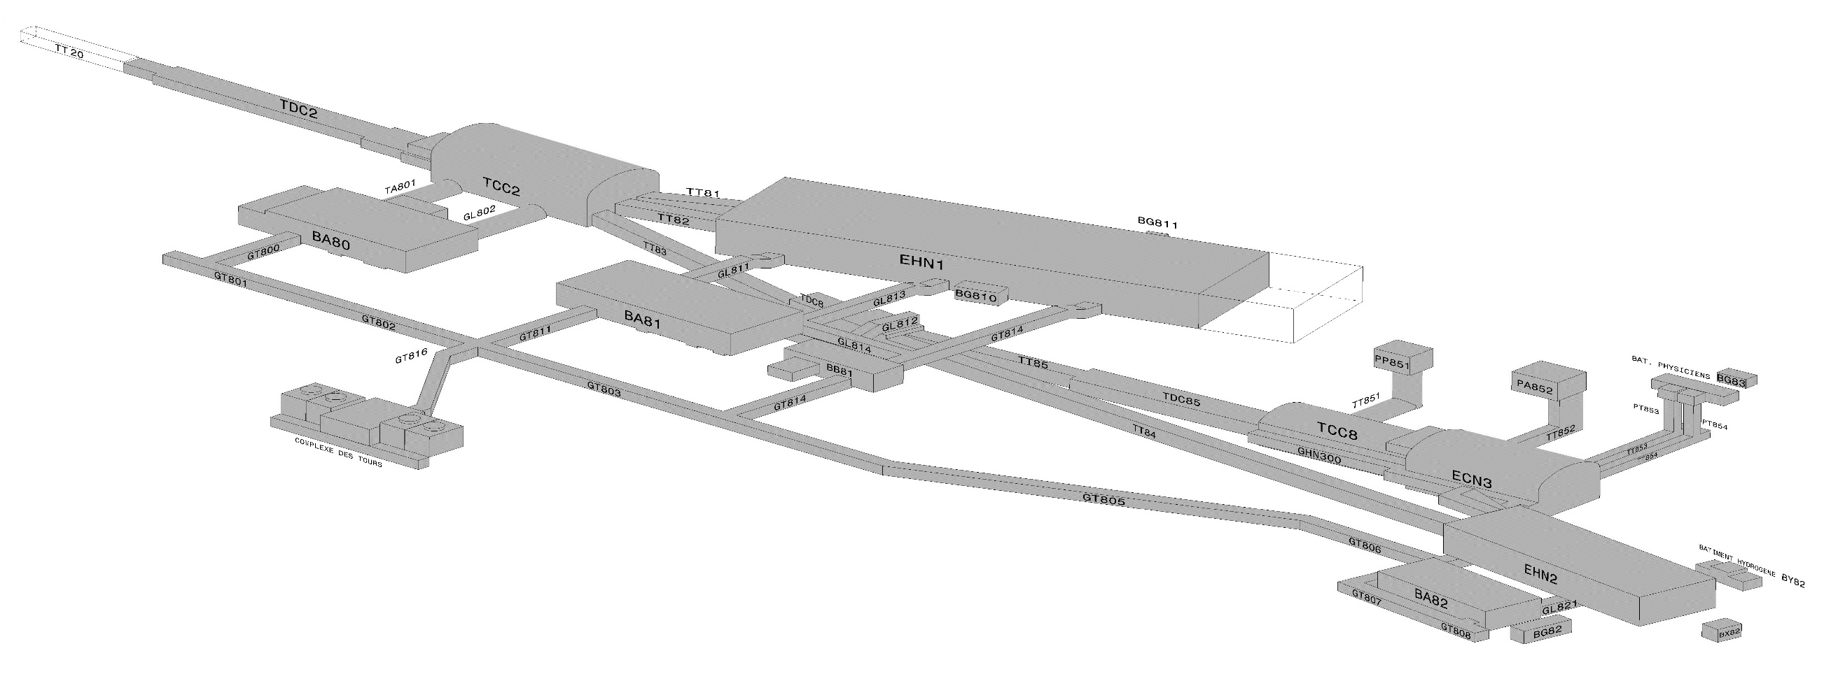
North Experimental Area Consolidation
Undertake the necessary consolidation actions required prior and during LS2 in order to guarantee a stable and reliable beam operation until LS3.
Prepare cost estimates for a more profound consolidation of the existing facilities, to be executed in (or after) LS3, including all possible staging options.
Prepare for alternative scenarios covering increased performance linked to the “Physics Beyond Colliders” future requirements and energy optimizations.
TT20
R&D ATLAS, CMS
R&D ALICE, LHCb
R&D “PBC”
Together with future BDF installation
NA64
NA61
GIF ++
Neutrino
Platform
NA62
NA58
Built in the 70’s
60000 m², surface and underground
~ 7 km of beam lines

Slide 3
The Content of the Study
A detailed review of the NA complex covering the infrastructure, beam lines and safety has been performed.
      Consolidation requests from technical groups
      Failure statistics (2014-2018)
      User feedback
      Non-conformity reports
      Risk assessments, safety audits, accident reports
An accurate picture of the current state has been obtained.
  Full report (EDMS 2042932)
  Executive Summary (EDMS 2042945)

Slide 4
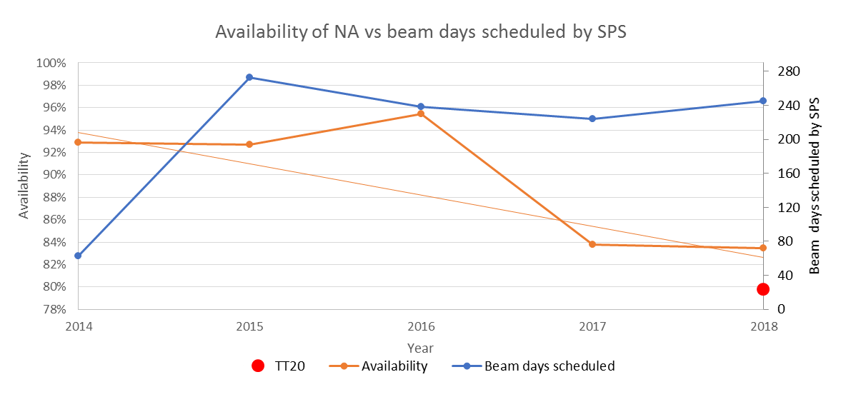
NA-CONS: Reliability-Driven
 | 2014 | 2015 | 2016 | 2017 | 2018
# events NA HW only | 115 (3m) | 349 | 243 | 201 | 240 Up to Oct 6th
Av. downtime [h] / event | 0.87 | 1.46 | 1.35 | 3.88 | 2.87
Combined with SPS avail. : 66% !
Incl. TT20

Slide 5
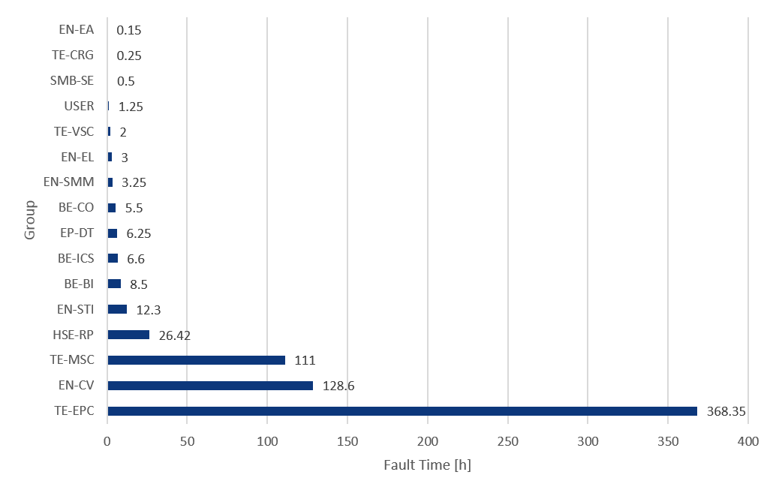
2018 North Area Availability
Availability
83%
Blocking Faults by Group
Blocking Faults
240
Fault Duration (overlap excluded)
684 h
Average Downtime per Fault
2.87 h

Slide 6
Users survey statistics (covering 2014- 2017)
  Try to determine the level of satisfaction wrt beam performance, reliability of facilities, severity of hardware failures since 2014
  Help to investigate the needs of consolidation
Users seem well satisfied by the reliability of the installation and the helpfulness of the support team
Urgent issues highlighted :
Accelerator
Magnets / power converters

Slide 7
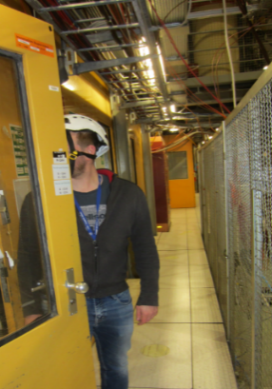
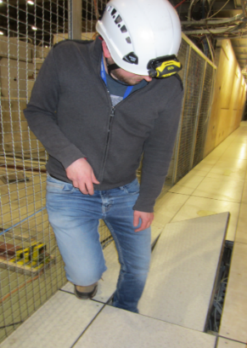
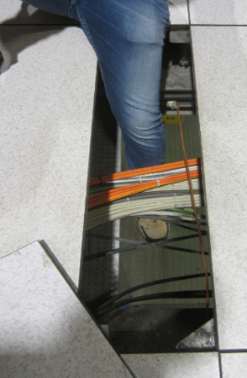
NA-CONS: Safety-Driven
Accidents and injuries in NA: 2010 -2017: 36 accidents - 273 days of sick leave
CO2 leak undetected event in EHN1 underground– near accident
Fire brigade interventions: 103 [2014- mid 2017]
Electrical non-conformities: 713 (306 in EHN1) pointed out in 2017-2018 audits
Obsolete flammable gas and ODH detection
Absence of ventilation in underground galleries (ODH & CO2 risks)
Absence of fire detection system and alarm or non-compliance with safety standards. Need of compartmentalization, smoke extraction and integrated safety system.
Fire intervention and suppression means to be adapted: dry raisers, automatic sprinklers, etc.
Absence of audible Beam Imminent Warning (only flashing lights in Exp. Areas).
Accident / incident
reports
Risk assessments,
safety audits

Slide 8
Main Outcome
In order to guarantee the reliability of the NA, it is recommended to carry out the Hardware Consolidation in two phases:
  Phase I, starting after LS2 and lasting up to LS3 incl.
    Electrical network, Handling, C.E., CV, Cryo, Magnets, Power Converters, Beam intercepting devices, Beam Instrumentation and Control
    Will exclude the consolidation related to building BA80,
    Will address 88.5% of the total downtime from faults.
  Phase II, starting after LS3 and lasting up to LS4 incl.
    will concentrate on the consolidation needs for BA80 in synergy with BDF/SHIP (EPC and EL) + C.E.,
    will address the remaining 11.5% of downtime.
Safety being the top priority, it is recommended to start bringing NA to conformity without further delay.
* Upgrade and Energy Optimization actions were identified to adapt the North Area to the new requirements related to PBC and to the CERN energy saving policy.
but not in the scope of the consolidation.

Slide 9
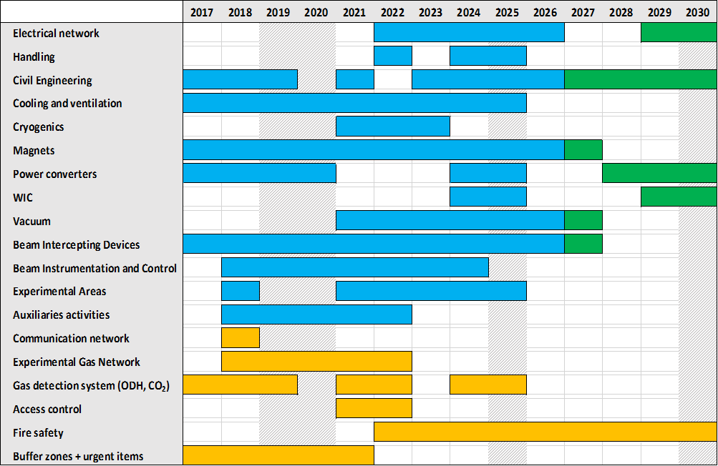
Very preliminary Master Planning
LS2
LS3
LS4
Phase II
Phase I
Safety

Slide 10
Cost Estimate by Department
 | BE | TE | EN | SMB | TOTAL (MCHF)
HW Consolidation Phase 1 | - | 21.2 | 23.8 | 6.3 | 51.3
HW Consolidation Phase 2 | - | 12.0 | 3.8 | 9.5 | 25.3
SAFETY * | 16.3 | - | 1.4 | - | 17.7
NA-CONS TOTAL (MCHF) | 16.3 | 33.2 | 29.0 | 15.8 | 94.3
Upgrade & Energy Opt. | - | 24.2 | 3.7 | - | 27.9
Grand TOTAL (MCHF) | 16.3 | 57.4 | 32.7 | 15.8 | 122.2
*HSE contribution of 1.5 MCHF (radioprotection and electrical non-conformities)

Slide 11
Evolution of the Cost-to-Completion
Phase1
Phase2
25.3 MCHF
8.0 MCHF
12.9 MCHF
48.1 MCHF

Slide 12
Beam Instrumentation consolidation
LS2 (urgent) | Post- LS2
10 Cherenkov counters “XCET” (H2, H4, H6, H8) (control, design, cabling, various parts) Additional urgent items ?? | XSCI intensity counters with new voltage dividers + signal splitter (users) CEDAR: already renovated for NA58. New gas control and faster readout for other (H2, H6, K12 lines). Profile monitors: does not match always with beam rates 10⁵/spill. Some of them could be replaced by scintillating fibre monitors (XBPF) with in/out movement. Some scintillating fiber scanner “FISC” could be replaced by XBPF XEMC: read out to be replaced by ADC

Slide 13
Some other actions to be taken
For LS2 (2019 – 2020)
    The consolidation of the obsolete flammable gas & ODH detection system
    Bringing the gas network to conformity
    New radioprotection monitoring system
    Target consolidation TCC2/8, Beam intercepting devices renovation, …
    VERTEX & ATLAS Morpurgo PC consolidation
    Consolidation of water cooling for beam lines magnets.
    Chilled water pipework
    Cooling towers: replacement of the control system
    …
Extend study to TT20 (w/o BDF/SHIP)
Prepare Safety Review of NA
Prepare Cost & Schedule Review of NA-CONS

Slide 14
Conclusion
Current state of the North Experimental Area has been analyzed.
Consolidation needs have been identified.
  Hardware consolidation : reliability
  Safety : top priority
A strategy is proposed for the consolidation in 2 phases.
  Phase I & Safety [ 2017 – 2026]
    Hardware consolidation (excl. BA80):
    C.E. works.
    Safety (Gas detection, Access control, Fire protection)
  Phase II & Safety [2027 – 2030]
    consolidation needs for BA80 (synergy with PBC and BDF)
    remaining safety items (Fire detection, Alarm, Evacuation) and C.E. works.
The present consolidation strategy will allow keeping the North Experimental Area safe, reliable and attractive for future high-energy physics programmes.

Slide 16
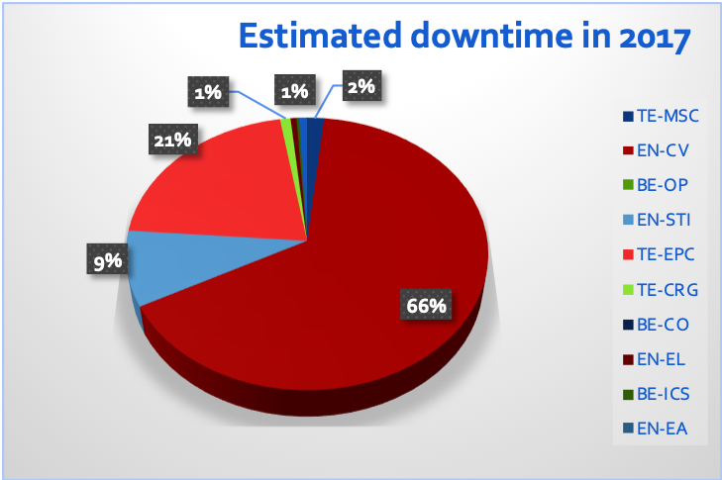
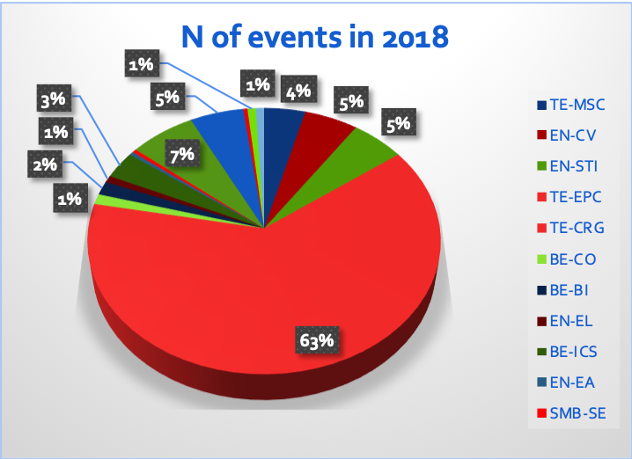
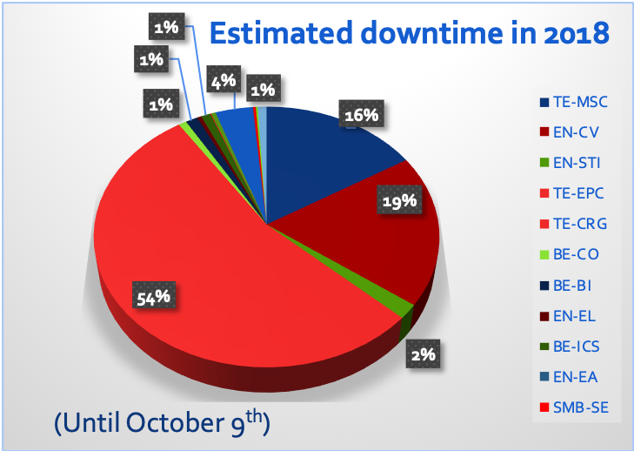
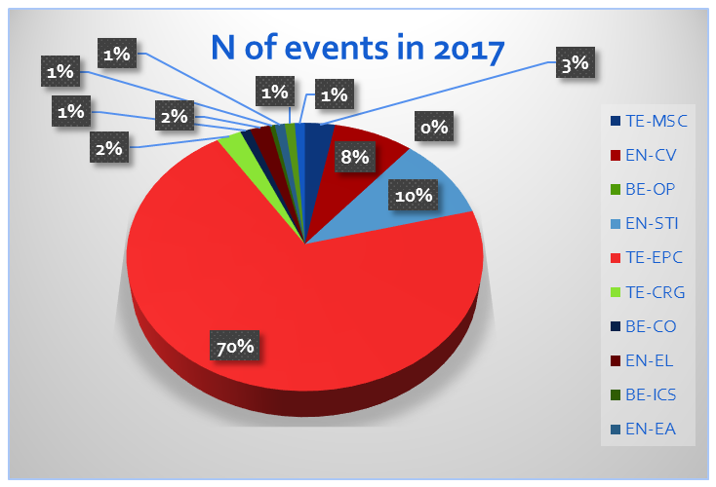
Fault Analysis
EN-STI 20
EPC 165 h
STI 70 h
TE-EPC 141
EN-CV 511 h
MSC 111 h
EN-CV 128 h
TE-EPC 374 h
TE-EPC 152
(Until October 9th)

Slide 17
Safety & Civil Engineering
Fire detection, alarm & evac.
Fire protection
Light Consolidation
BA82, 893, 895
907, 908, 909
911, 912, 918
920, 902

