Slide 1
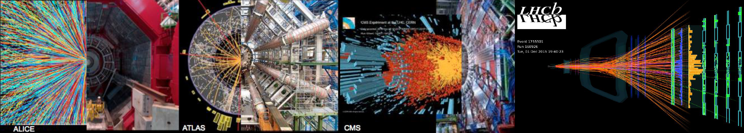
Quark-Gluon Plasma Studies
in Run 3 and 4
Yen-Jie Lee (MIT)
On behalf of WG5
HL/HE-LHC Physics Workshop
CERN, March 1, 2019
Conveners: Zvi Citron (ATLAS), Jan Fiete Grosse-Oetringhaus (ALICE), John Jowett (LHC)
Yen-Jie Lee (CMS), Urs Wiedemann (Theory), Michael Winn (LHCb)
Notes:
25’+5’

Slide 2
Outline of WG5 Yellow Report
Future physics opportunities for high-density QCD with ions and proton beams at LHC
185 contributors to 13 chapters
Final version submitted to arXiv:1812.06772
 | Chapter | Coordinator
1 | Introduction | WG5 Conveners
2 | Heavy-Ion Performance of LHC, HL-LHC and HE-LHC | John Jowett (LHC)
3 | (anti-)(hyper-)nuclei and fluctuations of conserved charges | Francesca Bellini (ALICE)
4 | Flow/Correlations | Soumya Mohapatra (ATLAS)
5 | Open Heavy Flavor | Elena Bruna (ALICE)
 |  | Gian Michele Innocenti (CMS)
6 | Jets and parton energy loss | Marta Verweij (CMS)
7 | Quarkonia | Anton Andronic (ALICE)
 |  | Emilien Chapon (CMS)
8 | Electromagnetic radiation | Michael Weber (ALICE)
9 | Emergence of Hot and Dense QCD in Small Systems | Jan Fiete Grosse-Oetringhaus (ALICE)
 |  | Constantin Loizides (ALICE)
10 | High energy QCD with proton-nucleus collisions and UPC | Michael Winn (LHCb)
11 | Other opportunities with ion and proton beams at the LHC | Zvi Citron (ATLAS)
 |  | Iwona Grabowska-Bold (ATLAS)
 |  | Hans Dembinski (LHCb)
12 | Luminosity requirement and proposed run schedule | WG5 Conveners
13 | High Energy LHC (HE-LHC) | Andrea Dainese (ALICE)
 |  | David d’Enterria (CMS)
 |  | Carlos A. Salgado (Theory)

Slide 3
Label
13 nb⁻¹ of PbPb sample + up to 2 pb⁻¹ of pPb data to be
collected in Run 3 + 4
Analyzed Run 1 + 2015 data (up to 0.5 nb⁻¹ of PbPb data)
HL-LHC
Present Data
Performance studies with data in Run 5 and beyond will be covered in
Guilherme Milhano’s talk

Slide 4
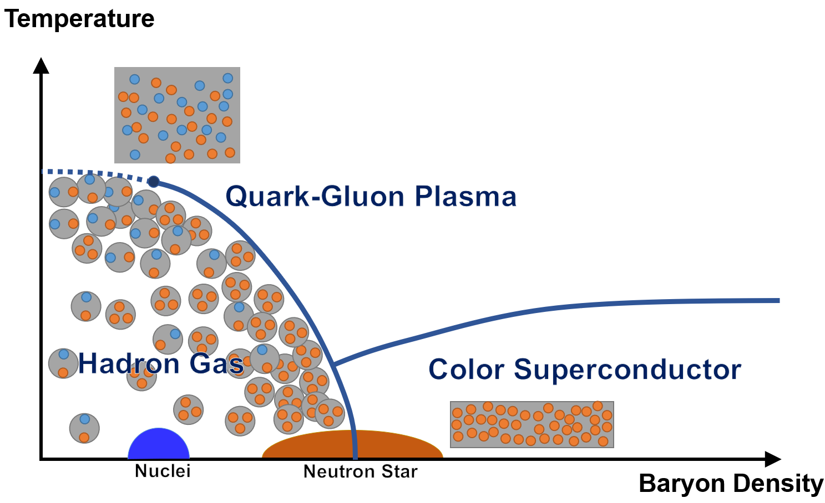
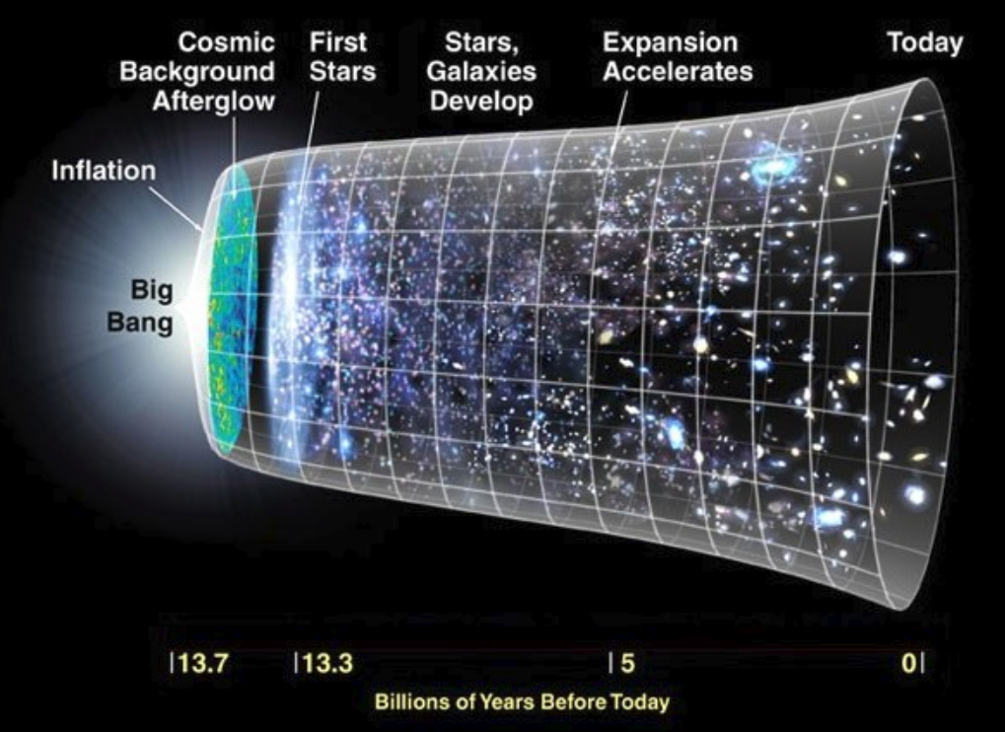
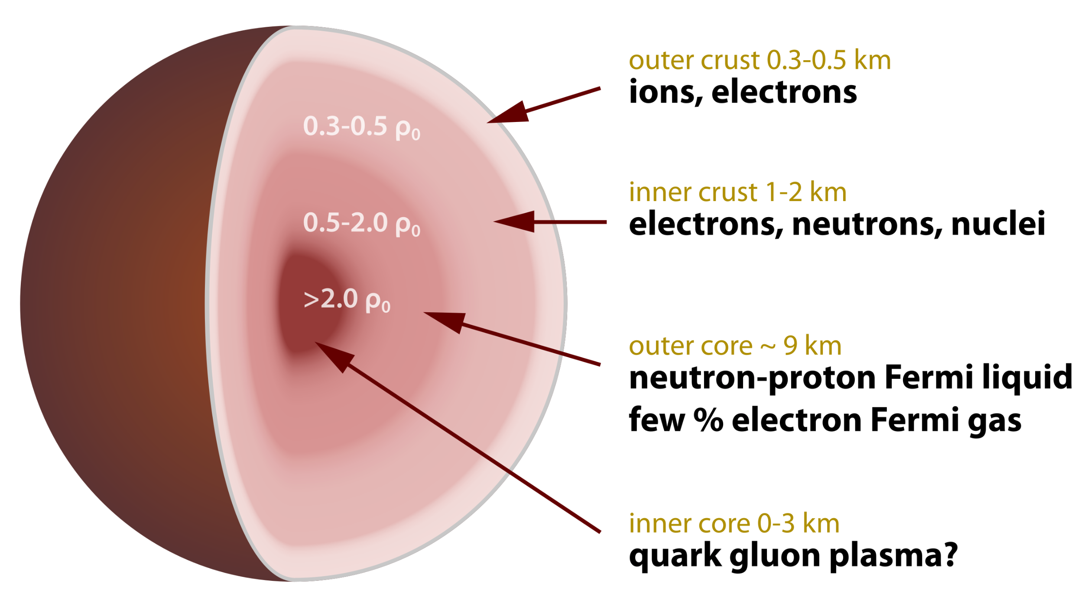
QCD Phase Diagram
Expansion of Early Universe
Neutron Star Formation
Notes:
It is worth mentioning that the early universe once pass through the cross-over between Quark-Gluon Plasma and Hadron Gas, which happened around 1 microsecond after the Big Bang. On the other hand, neutron star formation is moving from Nuclei to a dense but not super high temperature material, probably through a first order phase transition

Slide 5
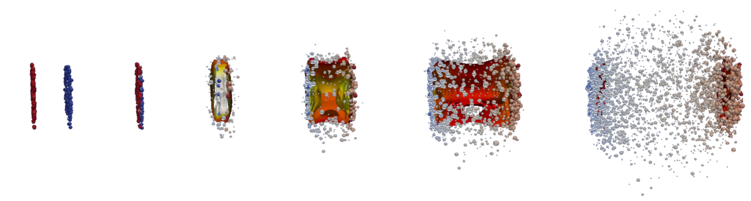
QCD Phase Diagram
QGP Medium in the Midrapidity
Heavy Ion Collision
Compressed Heavy Ion Beam
Notes:
It is worth mentioning that the early universe once pass through the cross-over between Quark-Gluon Plasma and Hadron Gas, which happened around 1 microsecond after the Big Bang. On the other hand, neutron star formation is moving from Nuclei to a dense but not super high temperature material, probably through a first order phase transition

Slide 6
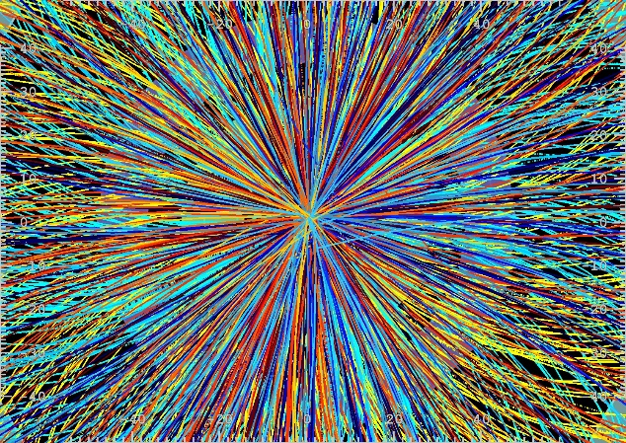

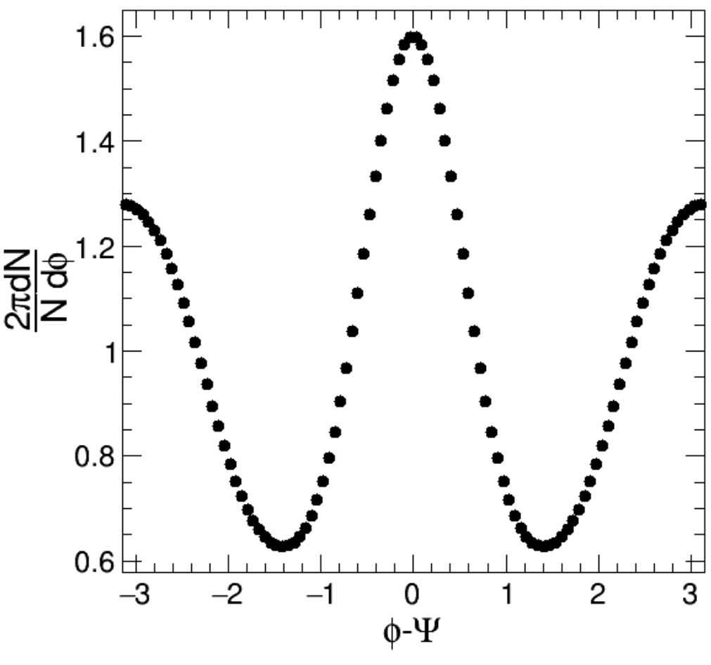
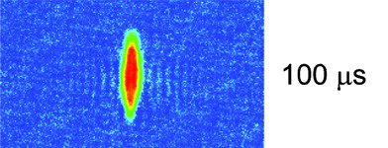
Collectivity from Hydro Evolution
Lead
Charged particles
z
small pressure gradient
ϕ
y
x
Large pressure gradient
Lead
Expansion of Ultra-cold atoms (Li-6) released from trap
‘Data’
Science, 298, pp. 2179-2182 (2002)
Collective motion is observed
→ Early hydrodynamization!
ϕ
Particle Azimuth Angle Distribution
QGP Studies in Run 3 and 4
6
Notes:
This is the measurement from the LHC detector, you can see that the angular distribution of the electromagnetic and hadronic energy are not isotropic! Anisotropic azimuthal distribution could be seen by eye! This means that there much be early thermalization and the time for thermalization is estimated to be smaller than 1fm/c

Slide 7
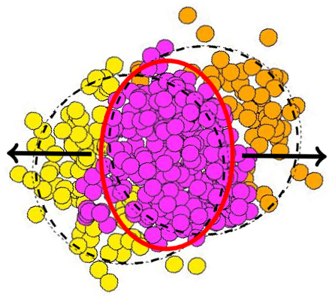
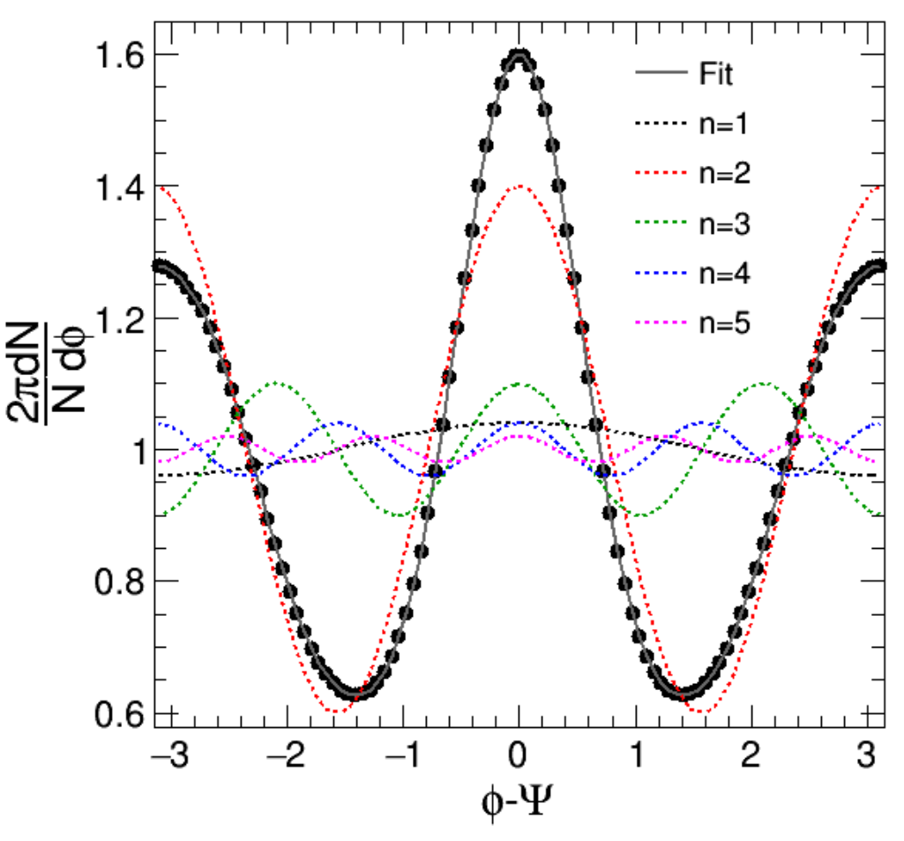
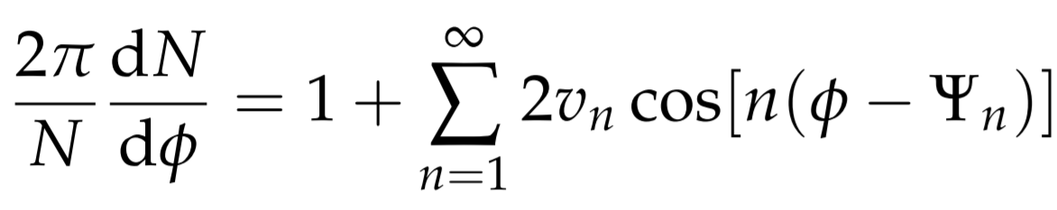
Final State Particle Azimuthal Anisotropy
Magnitude
v₂
‘Data’
ψ₂
+
ψ₃
v₃
+
ψ₄
v₄
ϕ
Fourier Decomposition:
…
+
v_{n}
Alver and Roland (MITHIG)
“Collision geometry fluctuation”
PRC82 (2010) 039903
…
Notes:
It was realized by our group members that this can be explained by the fluctuating initial conditions, one could do a fourier decomposition to get the corresponding Fourier coefficients. Each order corresponds to pressure driven expansion of elliptic (v2), triangular (v3) and quadrupolar (v4) flow

Slide 8
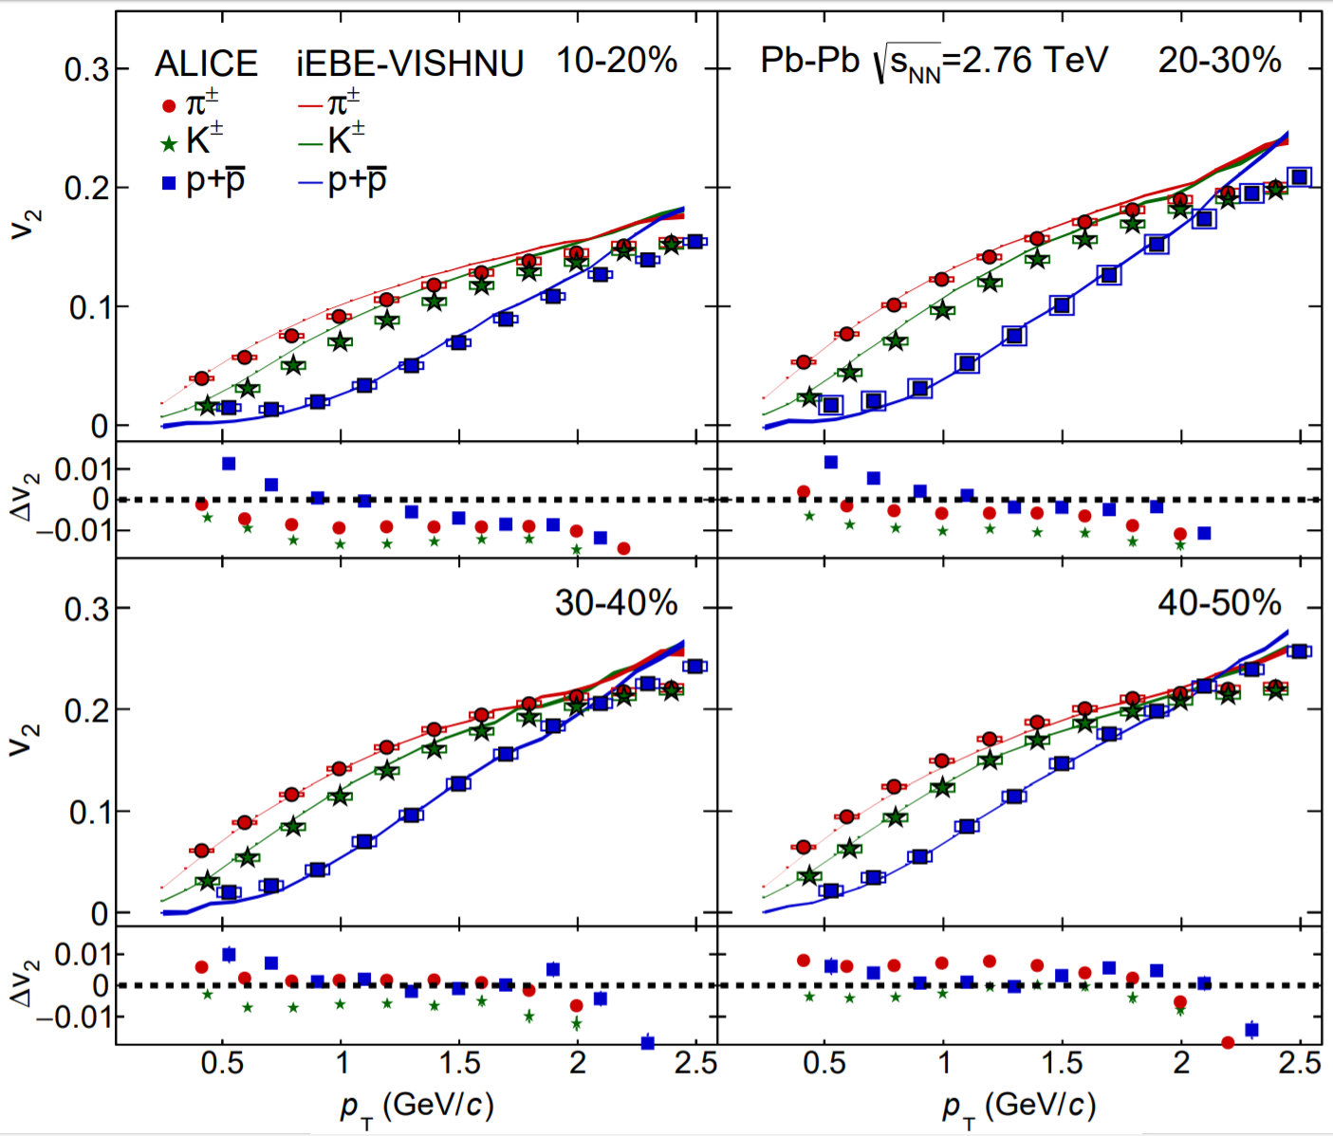
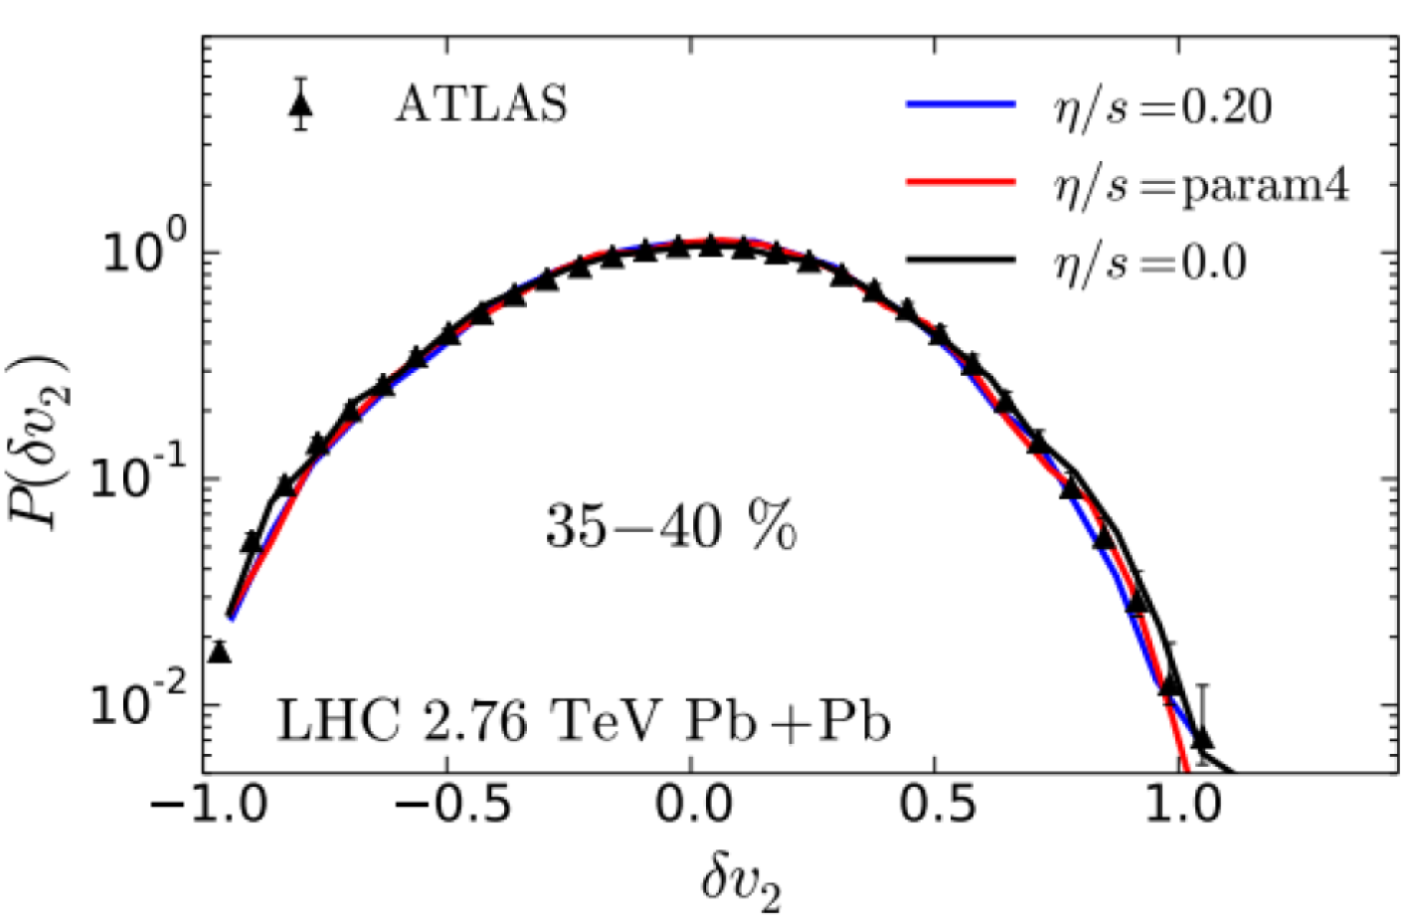
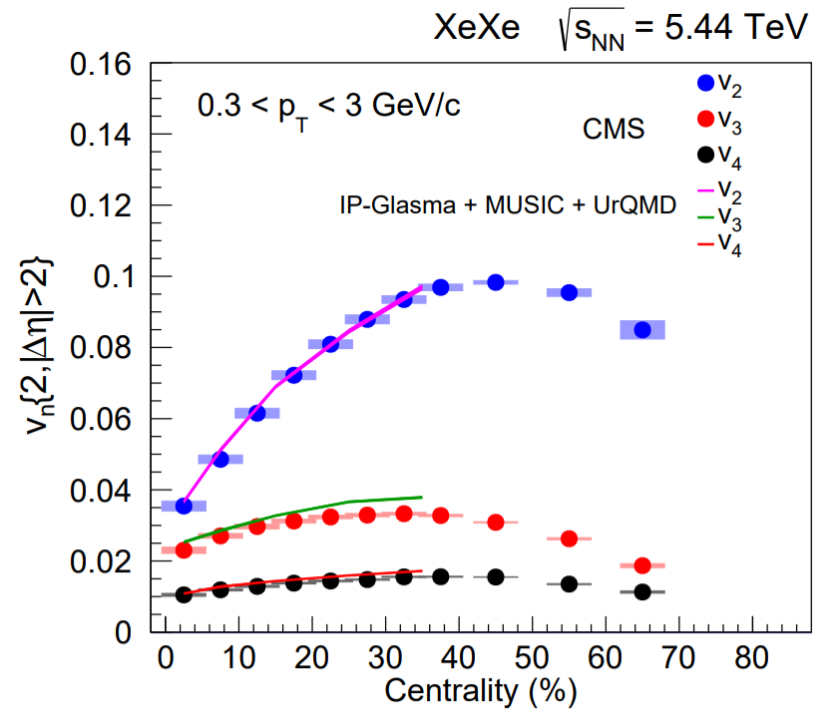

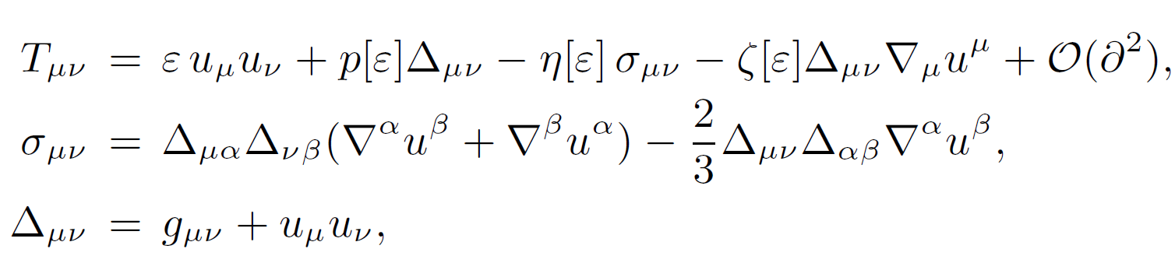
Relativistic Hydrodynamics Calculations
Describes flow of identified particles
Describes the elliptic flow (v₂) fluctuation
Present Data
Present Data
Pb
Pb
Describes large systems of different sizes
Input
Output (from Global fit)
Medium Properties
Present Data
Lattice QCD Equation of State
v₂
v₃
Xe
v₄
arXiv:1901.07997
Notes:
You may say, you could perform Fourier decomposition on any functions and the coefficients could mean nothing! It turns out that the measurements of many different orders are performed in bins of particle transverse momentum, all the data including PbPb collisions with different impact parameters and XeXe collisions could be described by a Relativistic Hydrodynamics calculation. The input is the equation of state from Lattice QCD and one could extract medium properties such as the shear viscosity through a global Bayesian analysis.

Slide 9
Big Questions
What is the longitudinal structure of the QGP?
What is the equation of state of QGP?
What are the initial conditions
of the collision?
Visualization taken from Jonah E. Bernhard
arXiv:1804.06469

Slide 10
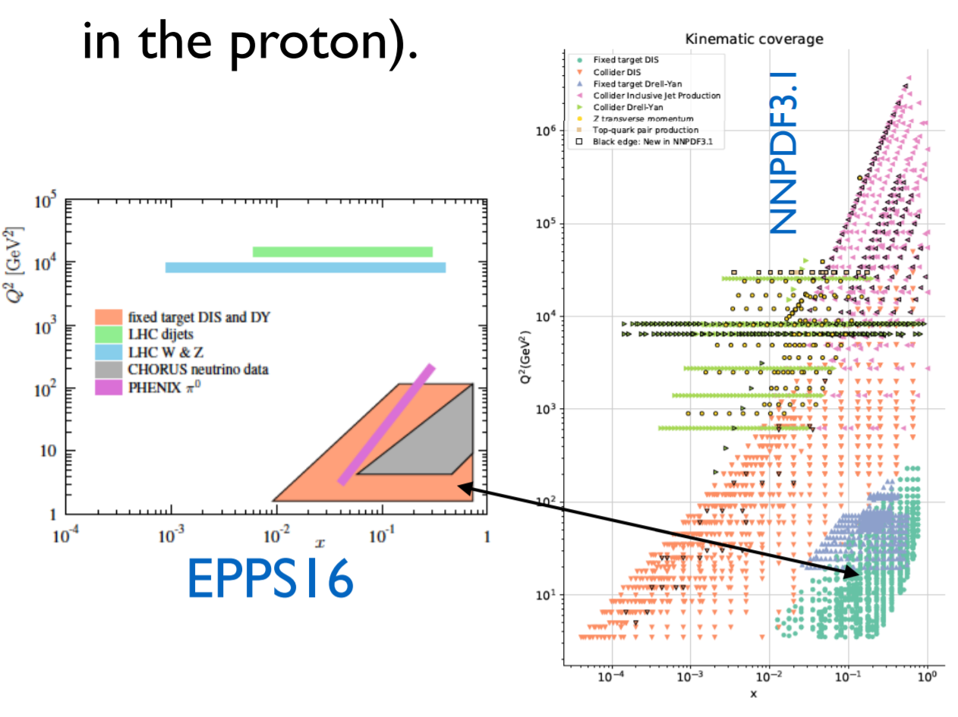
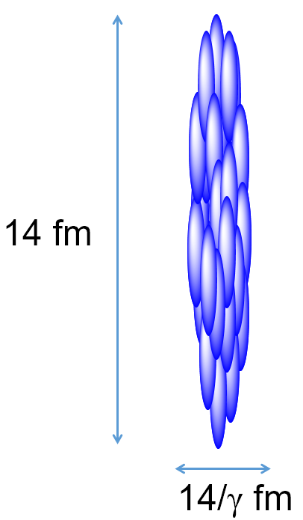
Parton Distribution Function (PDF)
Lead Ion ≠ Superposition of Neutrons and Protons
Input Data for Nucleon PDF
Input Data for Ion PDF
45 Pb collider data vs.1200 proton collider data
Q²(GeV²)
Q²(GeV²)
x
Poor understanding of PDF due to the limited amount of ion data
x

Slide 11
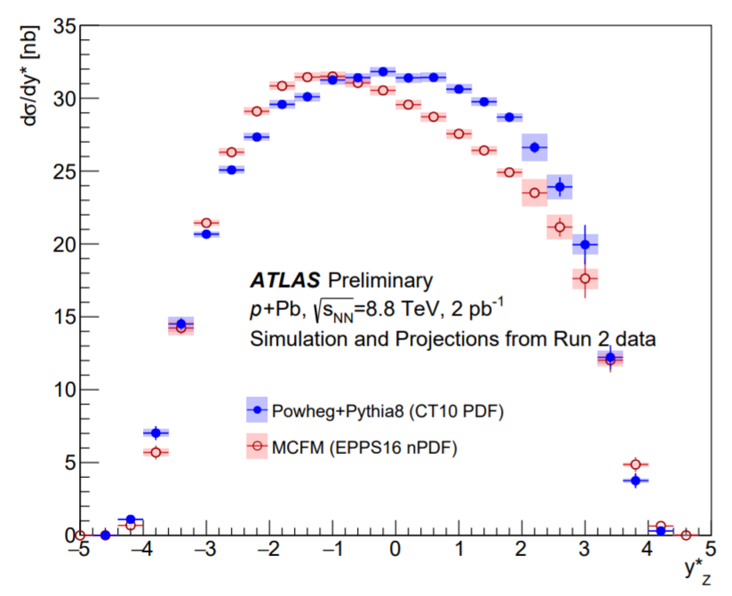
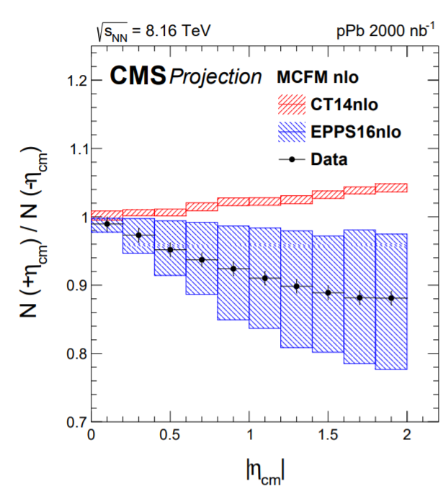
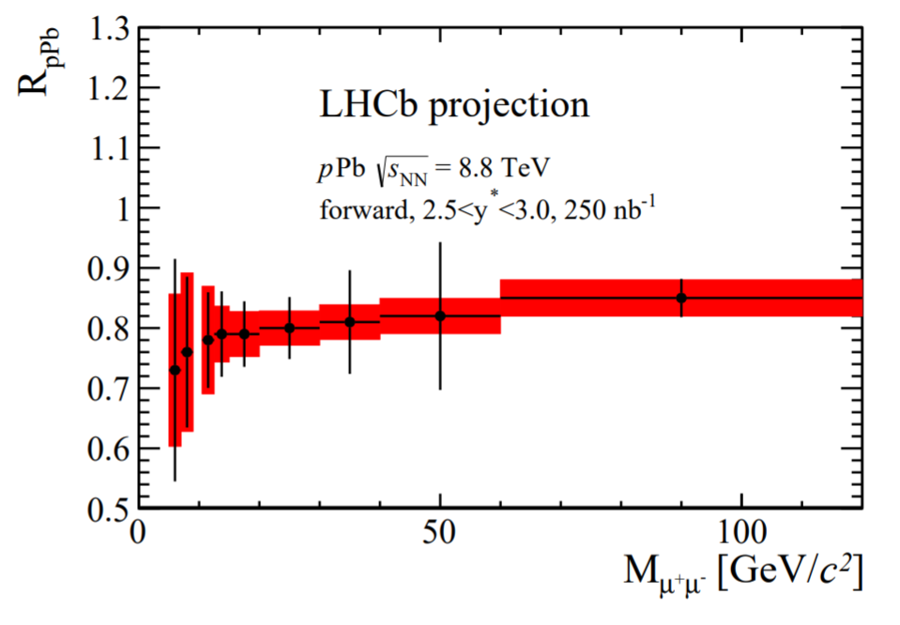

nPDF Constraint from pPb Collisions
HL-LHC
PDF
Z
nPDF
HL-LHC
PDF
nPDF
W±
Strong constraints on (quark) nPDF from electroweak boson, Drell-Yan and dijet cross-section measurements in pPb collisions
HL-LHC
Drell-Yan

Slide 12
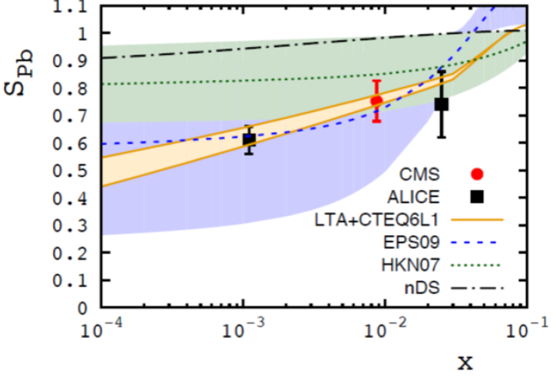
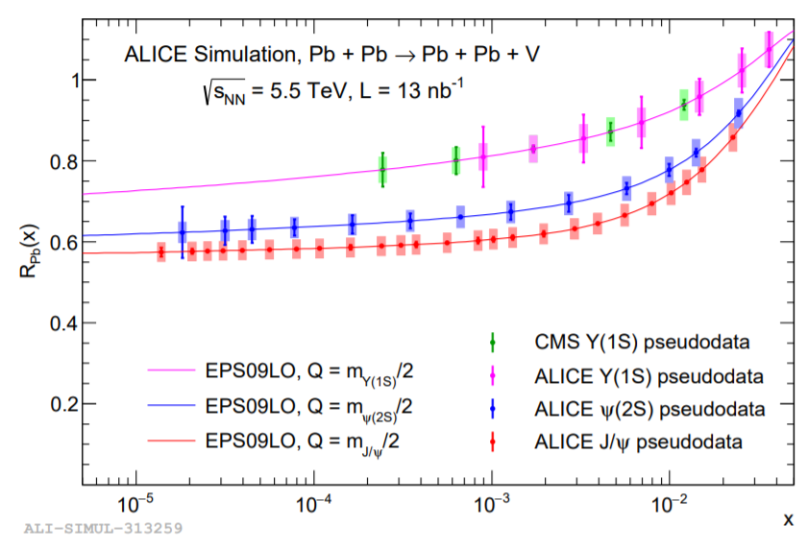
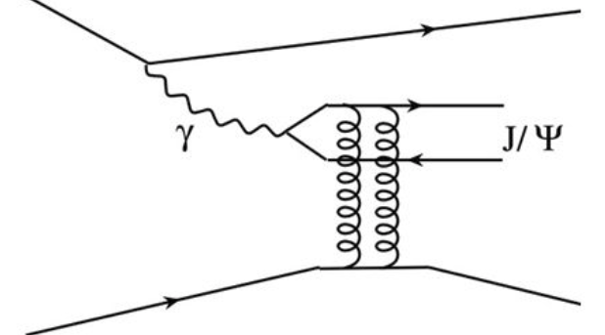
nPDF from Ultra-Peripheral PbPb Collisions
UPC J/ψ in Run 1 + 2015 Data
Present Data
Performance of UPC Quarkonia
HL-LHC
Y(1S)
Ψ(2S)
J/ψ
Pb
Pb
Ultra-Peripheral PbPb Collisions(UPC): γ+Pb collisions!
HL-LHC data: Precise measurements of Y(1S), J/ψ and ψ(2S) over a very wide x range, test Q dependence of nuclear modifications
Together with (di-)jet data in UPC PbPb and pPb collisions:
strong constraint on the gluon nuclear PDF

Slide 13
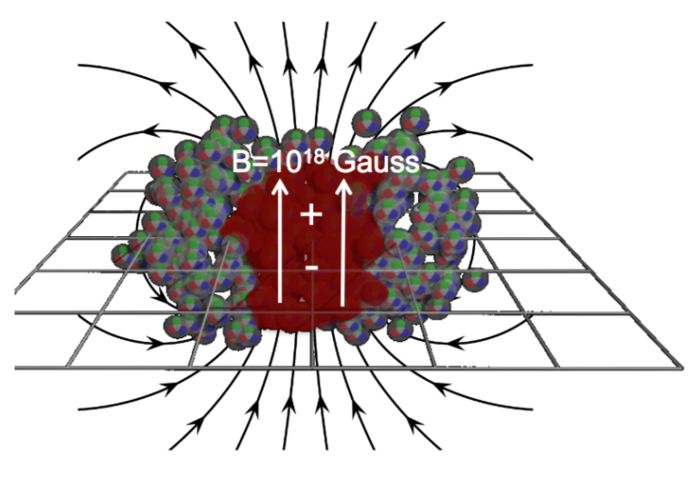
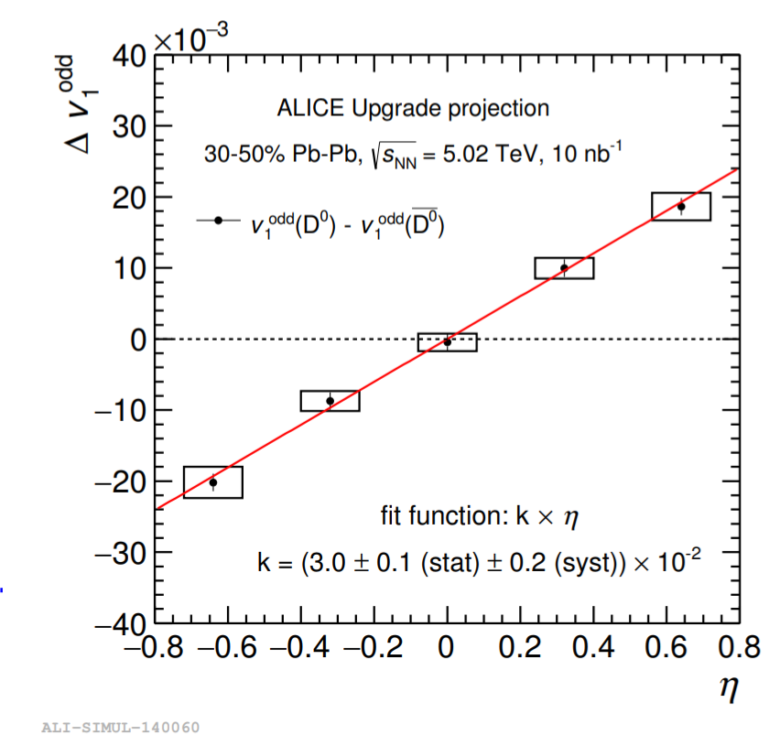
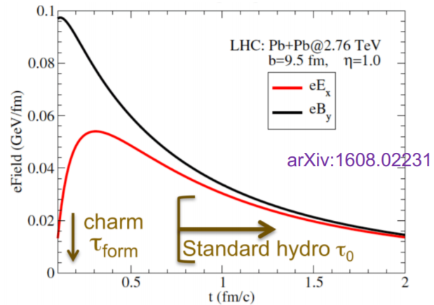
Magnetic Field with Charm Meson
HL-LHC
Greco et al.
Charm Quarks:
  More sensitive (than light flavor) to early magnetic fields and vorticity
High precision measurement could be performed for the first time with HL-LHC data

Slide 14
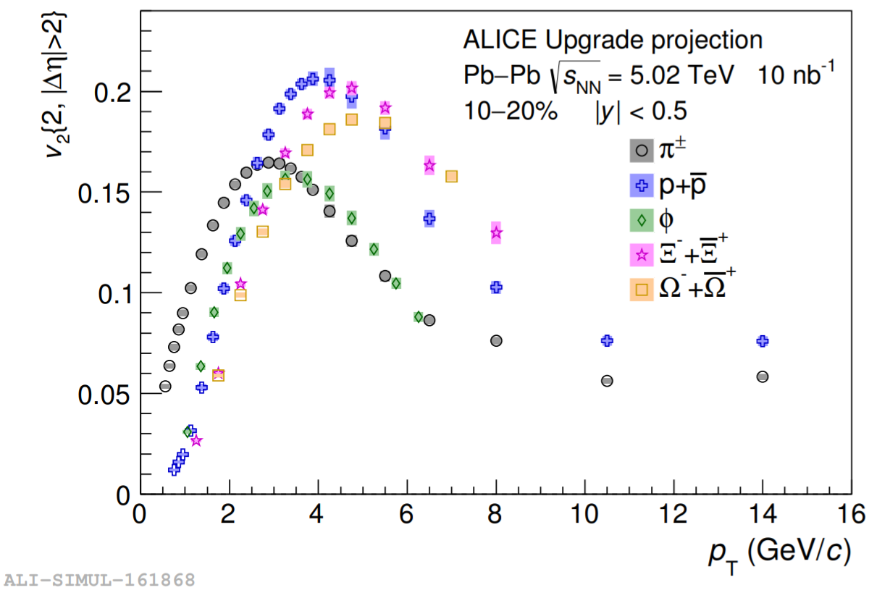
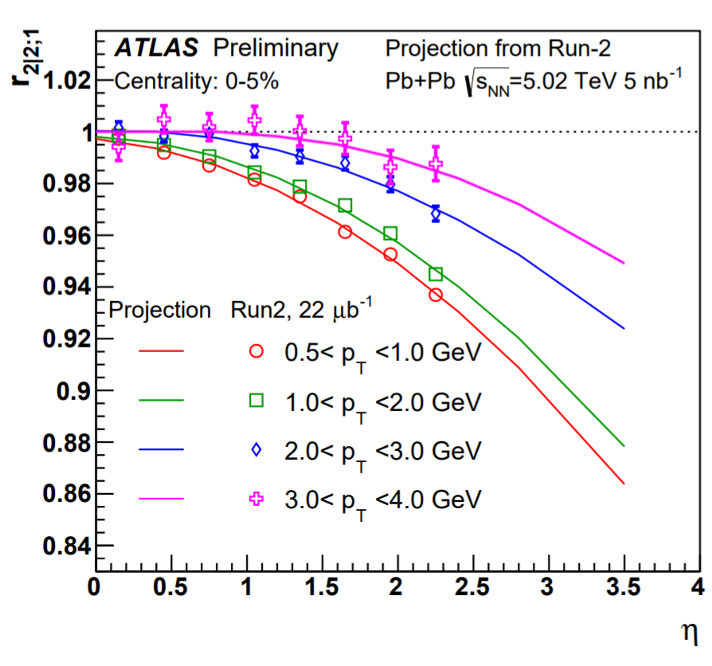
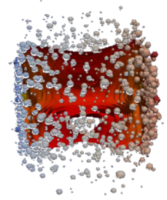
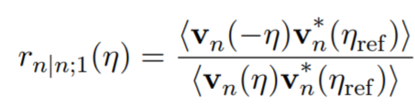
Prospects for Flow Measurements
Unprecedented high precision and differential measurements of flow harmonics and their event-by-event fluctuations
New constraints on the QGP initial density profile,
formation time, properties and hadronization
HL-LHC
HL-LHC
Pseudorapidity dependence of the flow measurements over a wide η window enabled by ATLAS and CMS tracker upgrade
New insights into the longitudinal structure of QGP
(event-plane decorrelation)
η₁
η₂

Slide 15
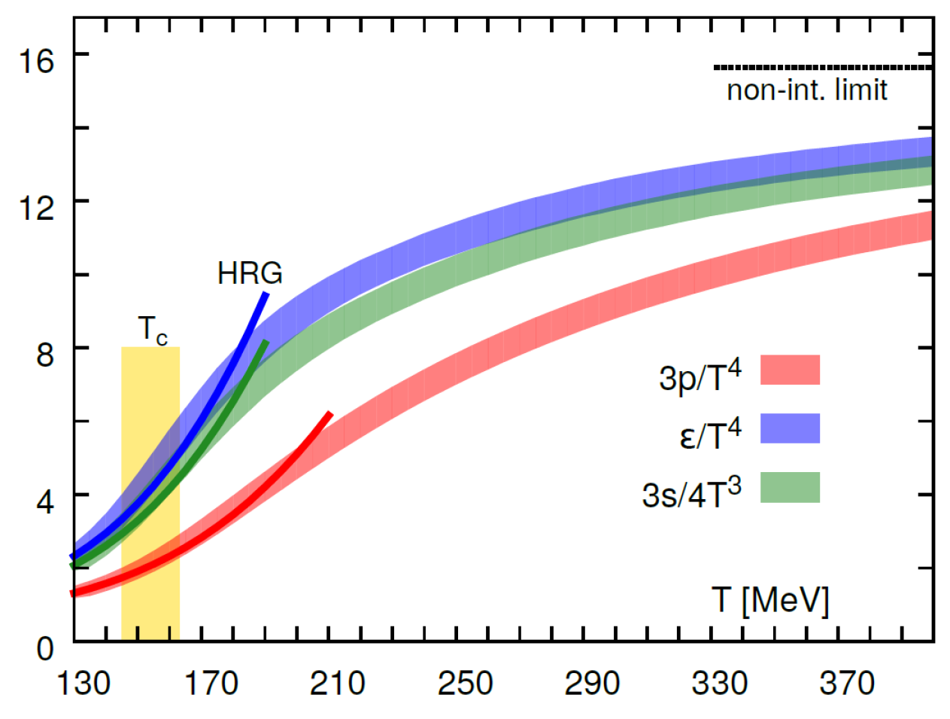
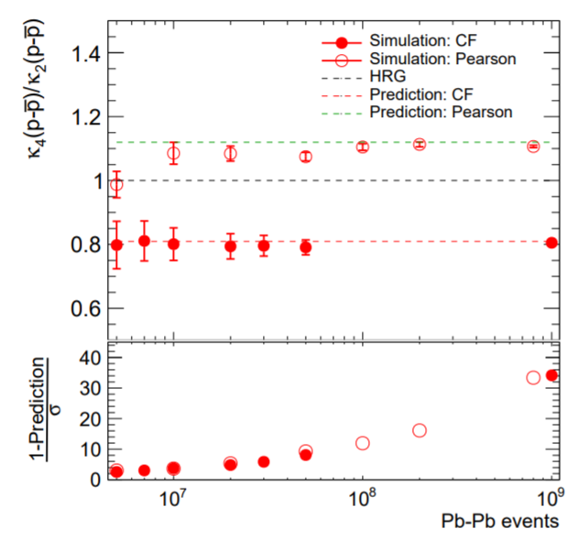
QCD Equation of State at μ_{B}=0
Can we “measure” the QCD Equation of State?
High precision flow
measurement enabled
by HL-LHC data
Dark Lines:
Hadron Resonance Gas
Net-baryons fluctuation
Light bands: Quark Gluon Plasma
HL-LHC
… and many more observables enabled
by HL-LHC data
Notes:
Indeed, based on the lattice QCD calculations, there is a continuous cross-over between hadron gas and the quark gluon plasma.
At the highest temperature range plotted here, the pressure, and energy density is around 20% smaller than the non-interacting limit

Slide 16
Big Questions
What is the longitudinal structure of the QGP?
What is the equation of state of QGP?
What are the initial conditions
of the collision?
How does the system move toward hydrodynamization?
Visualization taken from Jonah E. Bernhard
arXiv:1804.06469

Slide 17
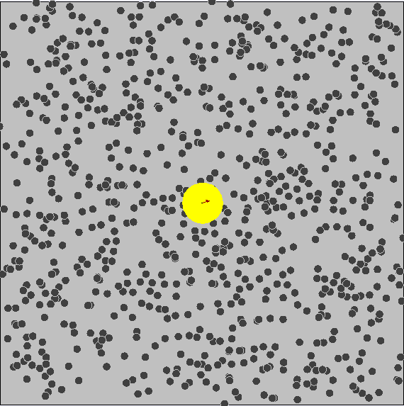
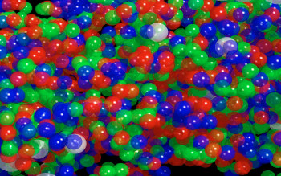
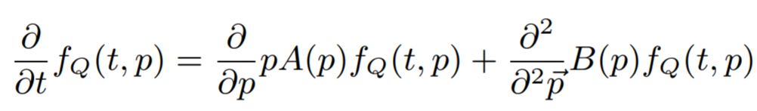
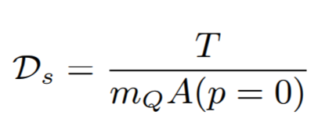
Open Heavy Flavor
Produced before the QGP formation
Low momentum heavy quarks (HQ) are then “kicked around” by
quasi-particles (Brownian Motion)
Heavy quark diffusion coefficient (D_{s}) provides a direct window on the
in-medium QCD force
c,b
Brownian Motion
D, B
v₂
Charged hadrons
Fokker-Planck equation:
Heavy Quark Diffusion Coefficient:
0
Charm quark “at birth”
Transverse Momentum p_{T}
Long-wavelength limit of HQ transport
Notes:
the time evolution of the probability density function of the velocity of a particle under the influence of drag forces and random forces

Slide 18
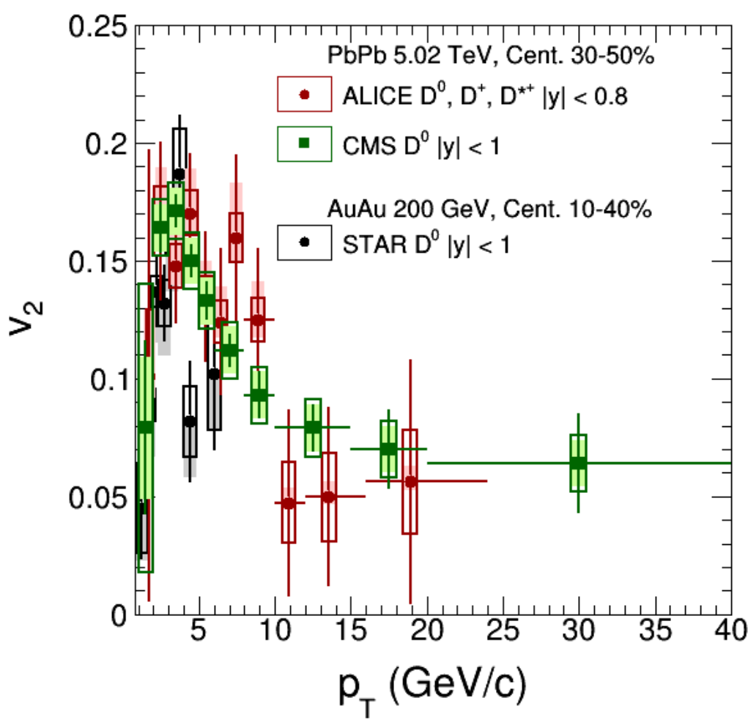
Open Heavy Flavor
Produced before the QGP formation
Low momentum heavy quarks (HQ) are then “kicked around” by
quasi-particles (Brownian Motion)
Heavy quark diffusion coefficient (D_{s}) provides a direct window on the
in-medium QCD force
Since the QGP expands radially, QCD force (like ‘wind’) will increase the v₂ of the heavy quarks
in the QGP bath
Hadronization of heavy quarks (through coalescence) also pick up
v₂ from light flavors
D⁰
v₂
Present Data
Charged hadrons
D⁰ meson
Charm quark
after passing QGP
u
D⁰
c
c
u
0
Charm quark “at birth”
Transverse Momentum p_{T}

Slide 19
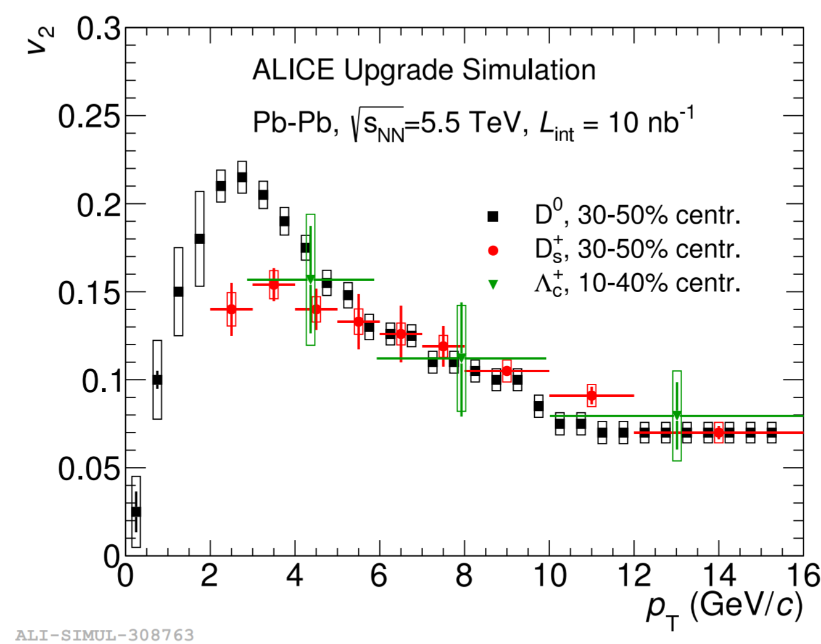
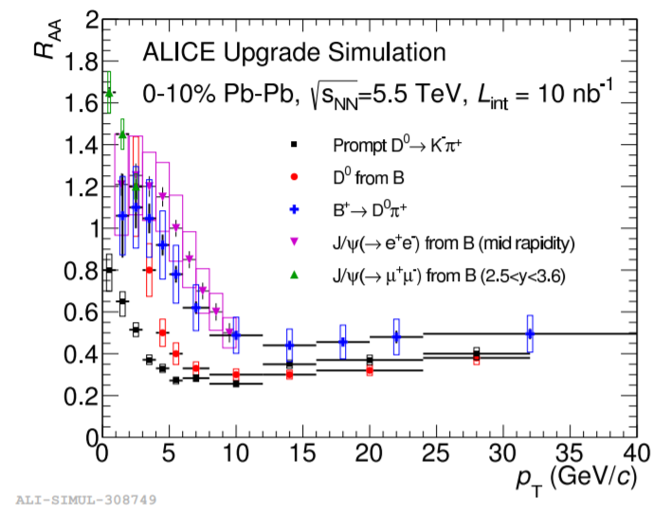
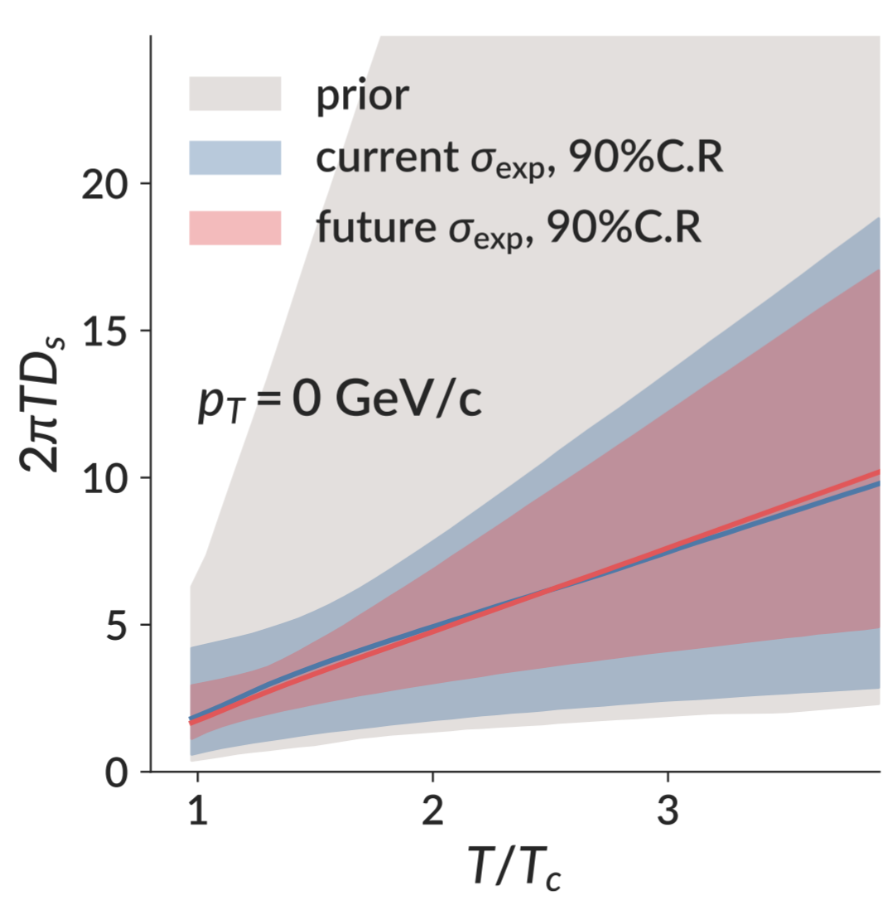

Heavy Flavor Hadron in PbPb at 5.02 TeV
D⁰
V₂
R_{AA}
B⁺
D_{s}⁺
Λ_{c}
HL-LHC
D⁰
HL-LHC
High precision measurement of heavy flavor hadron v₂ and spectra (from high p_{T} to p_{T}~0): Total charm cross-section which provide strong constrains on the models of charmonium recombination
Strong constraints on the
heavy quark diffusion coefficient D_{s}
$$R_{AA}→\frac{PbPb}{pp}$$
HL-LHC
S. Bass et al.
Constrains using a Bayesian analysis

Slide 20
Big Questions
What is the longitudinal structure of the QGP?
What is the equation of state of QGP?
What are the initial conditions
of the collision?
How does the QGP hadronize?
How does the system move toward hydrodynamization?
Visualization taken from Jonah E. Bernhard
arXiv:1804.06469

Slide 21
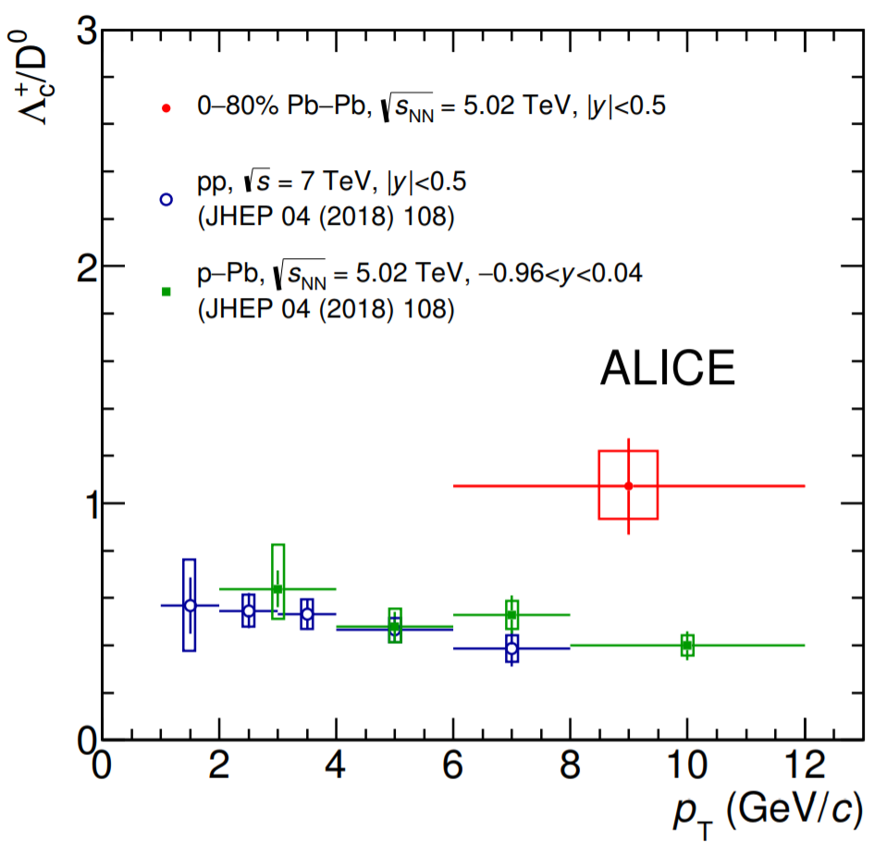
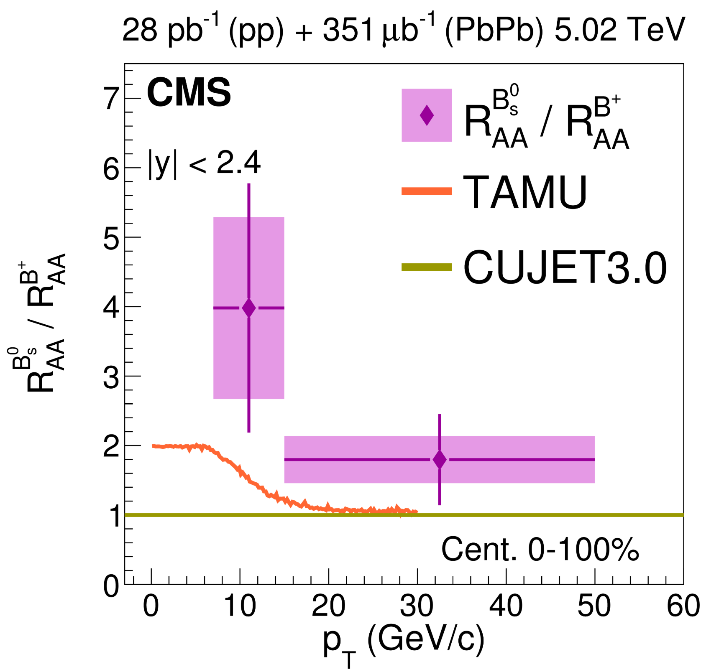
Hadronization of Heavy Quarks in QGP
Strange quark content is enhanced in QGP (Due to the high temperature)
Present Data
Λ_{c}/D
d
u
s
u
PbPb
d
u
arXiv:1809.10922
pPb
u
d
s
u
d
s
d
u
s
pp
Idea: Probe the partonic QGP by heavy quarks!
Ex: D_{s} , B_{s} and Λ_{c} could be enhanced via coalescence
PbPb
s
b
b
s
Present Data
B_{s}⁰
B_{s}/B⁺
B_{s}⁰ arXiv:1810.03022
B± PRL 119 (2017) 152301
Notes:
(6’40”) 1’
With the 2015 PbPb data, CMS was able to report the evidence of Bs production in PbPb collision for the first time through Bs to J/psi phi decay chain which provide new information about the hadronization of Beauty Quarks in the QGP. The nuclear modification factor of Bs is found to be higher than that of B+ meson, which is an indication of Bs enhancement in PbPb collisions. This is consistent with the expectation from beauty + strange coalescence model where this effect is expected to present up to around pT ~ 15. The firmer conclusion could be extracted from the high statistics data to be taken in 2018 and Run III.

Slide 22
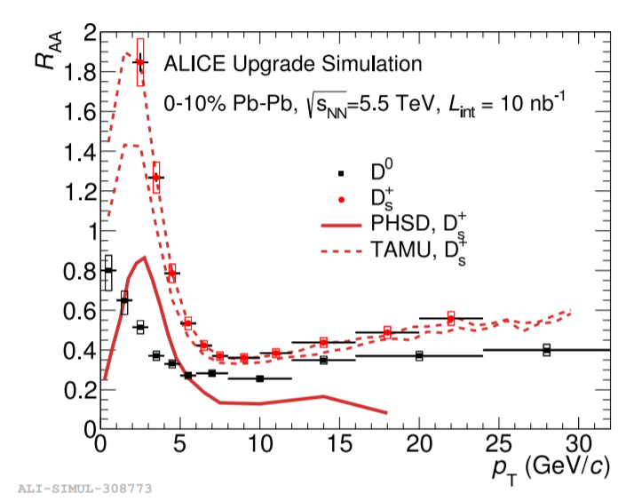
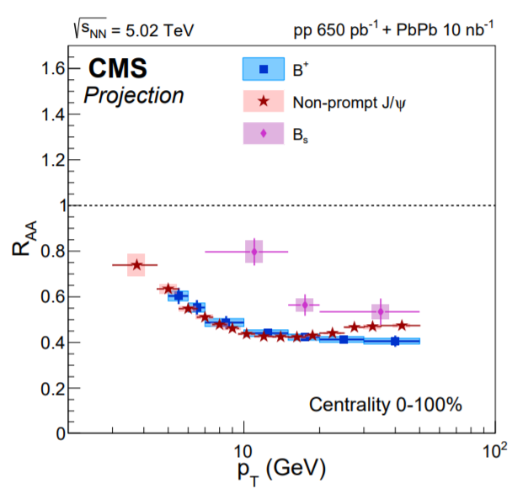
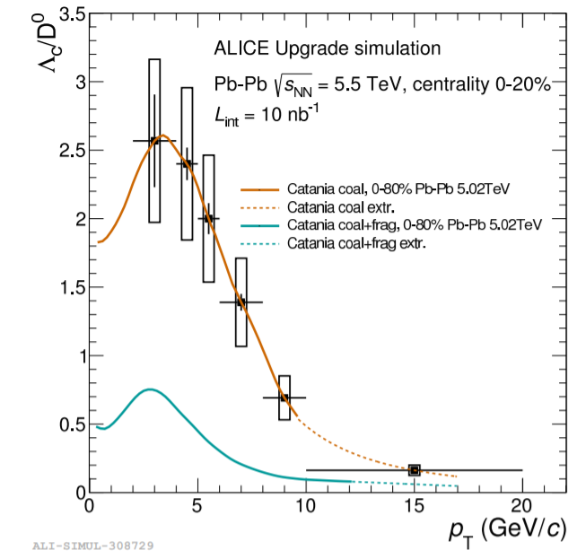
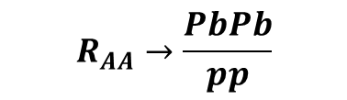
Heavy Quark Hadronization
D_{s} R_{AA}
Λ_{c}/D
B⁺ and B_{s} R_{AA}
HL-LHC
B_{s}
D_{s}⁺
D⁰
HL-LHC
B⁺
HL-LHC
$$R_{AA}→\frac{PbPb}{pp}$$
Charm quark number is conserved in strong interaction
  Hadronization chemistry: crucial for the interpretation of the heavy flavor hadron spectra (“keep track of all the c quarks”)
Run 3+4 data will allow the first comprehensive survey of this effect
  D_{s}, B_{s} and Λ_{c} spectra from low to high p_{T} in pp and PbPb
  Provide the necessary statistical accuracy to see the emergence of the effect at low p_{T}

Slide 23
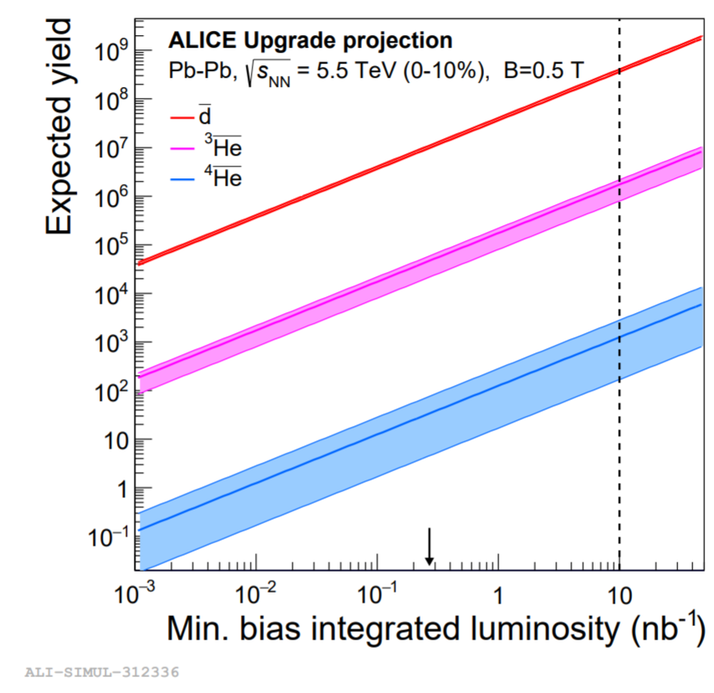
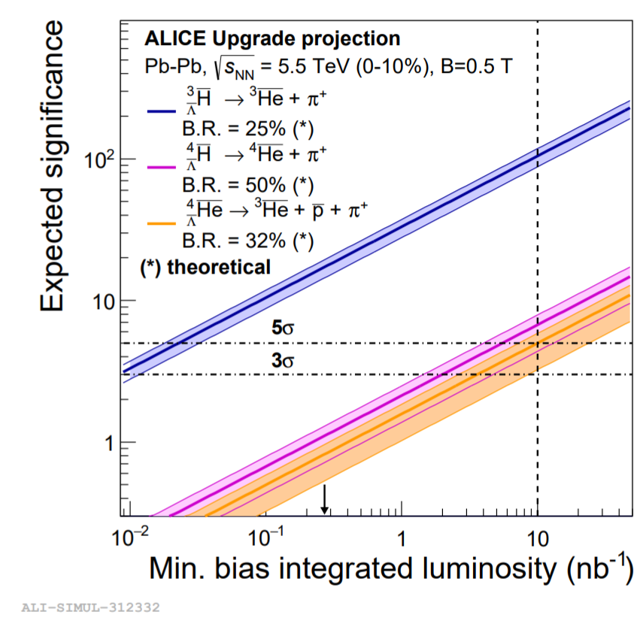
(Anti-)(hyper-)nuclei Production
Precision test of coalescence / thermal production models
Sensitive to size ratio of the object and the source
Search for rarely produced anti- and hyper-matter: Insights on the strength of the hyperon-nucleon interaction, relevant for nuclear physics and neutron stars. HL-LHC: first observation for anti-hyper-nuclei with A = 4
Constrain models with pp measurements:
Estimates of astrophysical background for dark matter searches
5σ
HL-LHC
HL-LHC

Slide 24
Big Questions
What are the initial conditions
of the collision?
What is the longitudinal structure of the QGP?
How does the QGP hadronize?
How does the system move toward hydrodynamization?
What is the temperature of the QGP?
Visualization taken from Jonah E. Bernhard
arXiv:1804.06469

Slide 25
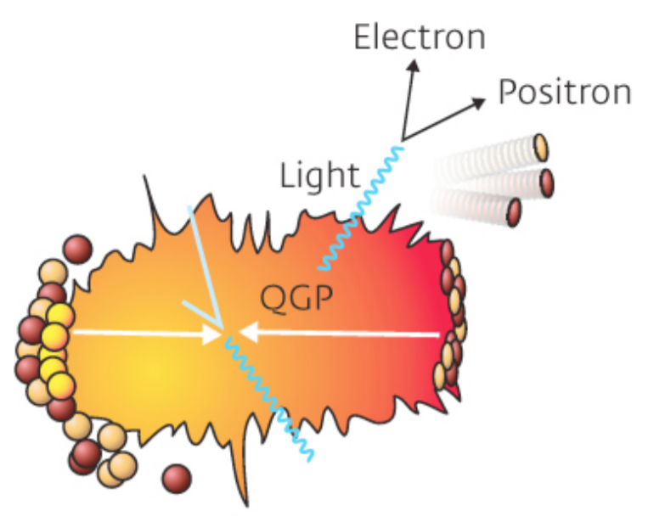
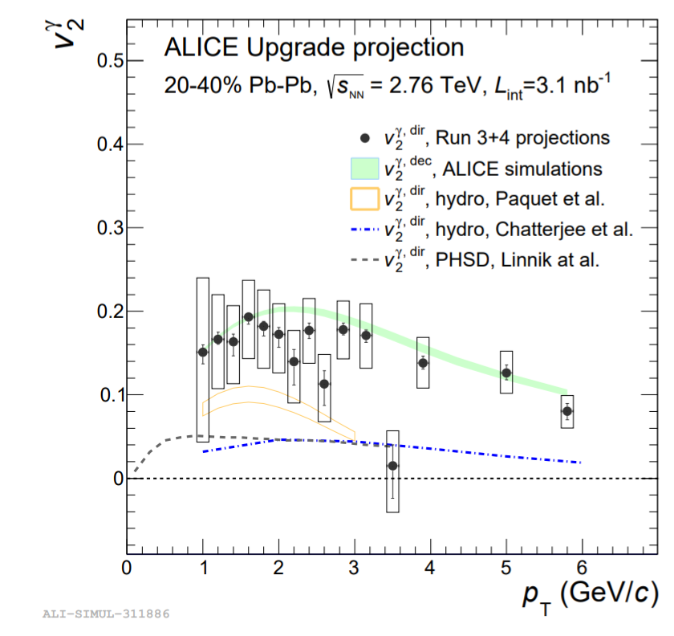

Temperature of QGP: Thermal Photons / Dilepton
HL-LHC
Photon
Azimuthal Anisotropy
Photons:
Thermal radiation
Dileptons:
Thermal radiation
Effective T with uncertainty of ~20%
Vector meson spectral shape
Beyond SM particles with J^{PC}=1⁻⁻ (e.g. dark photons)
3 nb⁻¹ PbPb collisions with B=0.2 T (instead of B=0.5T)
at ALICE
Dielectron
invariant mass
HL-LHC

Slide 26




In QGP (lower Energy AA collisions)
N
Successive suppression of individual states provides a window for the in-medium color force vs. temperature
1/<r₀>
ϒ(1S)
χ_{bJ}(2P)
ϒ(2S)
χ_{bJ}(2P)
ϒ(3S)
Mass
$$Υ(1S)$$
$$Υ(2S)$$
$$Υ(3S)$$
Tightly bound
Small in radius
Loosely bound
Small in radius
Initial T
Debye Screening Length
V(r)
Q
Q
b
b
r
b
b
b
b
Notes:
- s24-s27: in the quarkonium chapter (and also in the introduction), Ralf Rapp and Anton Andronic went a bit away from the concept of quarkonium thermometer, which they consider a bit outdated. And this is actually supported by the fact that the model curves that we have in slide 27 on the Y RAA do not carry any evident indication of a temperature. Ralf now strongly advocates the concept of probing the direct the QCD in-medium potential with quarkonia (see beginning of the quarkonium chapter). Maybe you could rephrase a bit to go in that direction, for internal consistency. Although I agree that the thermometer is much nicer to present the topic to the HEP community (and I myself still use it)

Slide 27
In QGP (AA collisions)
N
Successive suppression of individual states provides a window for the in-medium color force vs. temperature
1/<r₀>
Suppression due melting excited states (reduced the feed down)
ϒ(1S)
χ_{bJ}(2P)
ϒ(2S)
χ_{bJ}(2P)
ϒ(3S)
Mass
$$Υ(1S)$$
$$Υ(2S)$$
$$Υ(3S)$$
Tightly bound
Small in radius
Loosely bound
Small in radius
Initial T
Debye Screening Length
V(r)
Q
Q
b
q
q
b
r
b
b
b
b

Slide 28

In QGP (AA collisions at LHC)
N
Successive suppression of individual states provides a window for the in-medium color force vs. temperature
1/<r₀>
“Melting” of $Υ(1S)$ and $Υ(2S)$
ϒ(1S)
χ_{bJ}(2P)
ϒ(2S)
χ_{bJ}(2P)
ϒ(3S)
Mass
$$Υ(1S)$$
$$Υ(2S)$$
$$Υ(3S)$$
Tightly bound
Small in radius
Loosely bound
Small in radius
Initial T
Debye Screening Length
V(r)
Q
Q
b
q
q
b
q
b
b
q
r
b
b

Slide 29






Quarkonia Production in HL-LHC
HL-LHC
HL-LHC
R_{AA}
Υ(1S)
Υ(1S)
Y(2S)
Y(2S)
Y(3S)
Precise measurement of Y(nS), J/ψ and ψ(2S) R_{AA} as a function of centrality, p_{T} and rapidity
  Observation of Y(3S) production in PbPb
  Precise measurement at large rapidity
  Sensitive to QCD in-medium potential
High precision measurement of J/ψ elliptic flow:
Probe the QCD interaction of deconfined $c$ and $\overline{c}$
J/ψ
V₂
HL-LHC
$$c$$
$$\overline{c}$$

Slide 30
Big Questions
What are the initial conditions
of the collision?
What is the longitudinal structure of the QGP?
How does the QGP hadronize?
How does the system move toward hydrodynamization?
What are the transport properties of the QGP?
How does QGP respond to hard probes?
What are the inner workings of QGP at various length scales?
What is the temperature of the QGP?
Visualization taken from Jonah E. Bernhard
arXiv:1804.06469

Slide 31


Quark Gluon Plasma Substructure
Quarks and Gluons
Thermal Mass Gluons?
QGP Fluid
?
AdS/CFT low viscosity goo
Short Wavelength
What is the structure
of QGP at intermediate
length scale ?
Long Wavelength
Use hard probes which reveal
QGP structure at various length scales
Notes:
Figure 1.7 (right panel) shows that if the length scale probed is very small then one expects scattering directly from point-like bare color charges, most likely without any influence from quasiparticles or deconfinement. As one probes longer length scales, the scattering may be from thermal mass gluons and eventually from possible quasiparticles with size of order the Debye screening length. Rajagopal states that “at some length scale, a quasiparticulate picture of the QGP must be valid, even though on its natural length scale it is a strongly coupled fluid. It will be a challenge to see and understand how the liquid QGP emerges from short-distance quark and gluon quasiparticles. [34]

Slide 32



Jet Quenching up to 1 TeV
(Heavy Flavor)Hadron R_{AA}
Jet R_{AA}
HL-LHC
HL-LHC
D⁰
B⁺
h±
High p_{T} reach of charged hadrons and jet R_{AA} up to ~ 1 TeV
The excitement is that the quenched energy will be significant compared to underlying event energy density!
$$R_{AA}→\frac{PbPb}{pp}$$
Precise measurement of light and heavy flavor hadron R_{AA} up to 0.4 to 1 TeV

Slide 33



Photon-Jet and Hadron-Jet Correlations
Photon-Jet p_{T} Ratio
Hadron-Jet Correlation
HL-LHC
HL-LHC
Δϕ
Transverse momentum conservation
hadron
Z,γ
Jet
Jet
Quenching reduces boson-jets p_{T} ratio
High precision “absolute energy loss” measurement at HL-LHC
Hadron-Jet Angular Correlation: search for large angle scattering, study of QGP substructure

Slide 34


Photon-Tagged Jet Structure
Modification of Jet Fragmentation Function
Modification of Jet Shape
HL-LHC
HL-LHC
High precision measurement of photon-tagged jet substructure
Study of medium response and “jet thermalization”

Slide 35


Subjet Momentum Sharing
p_{T,1}
p_{T,2}
QGP
Time
HL-LHC
Parton energy loss in QGP: space-time evolution of the parton shower matters since QGP is cooling down vs. time
New era of jet substructure fluctuation studies: constraints on the QGP scattering power with a completely orthogonal observable (vs. jet or hadron spectra)
Grooming techniques enable us to classify jets and to study
“Parton Shower Shape Dependence of Jet Quenching”

Slide 36
Summary
Significant progress on all the WG5 chapters, exploit the high statistics pp, pPb and PbPb data in Run 3+4
  New constraints on the nPDF
  Understand initial energy density profile and the underlying dynamics of hydrodynamization
  Search for critical behavior with conserved charge fluctuation and improved sensitivity to QCD EoS
  Precise determination of medium properties such as temperature, viscosity and transport coefficients
  Probe the relevant the degrees of freedom / microscopic structure of QGP at different length scales
Provide stress tests to the heavy ion standard model as a firm foundation to the new discovery in smaller systems
Many thanks to all the contributors to the WG5 chapters!

Slide 37
Backup slides

Slide 38


Global Event Properties
Charged Particle Pseudorapidity Distribution
Transverse Energy Density
Transverse energy
per unit pseudorapidity
~ 2 TeV
Head-on
collision
η
Present Data
Present Data
Particle density in Lead+Lead
~ 400x of that in proton+proton
At t~ 1fm/c: energy density of the medium ~ 13 GeV/fm³
>20x denser than the proton

Slide 39

D⁰ v₂ and R_{AA} in PbPb at 5.02 TeV
Present Data
Present Data

