Slide 1
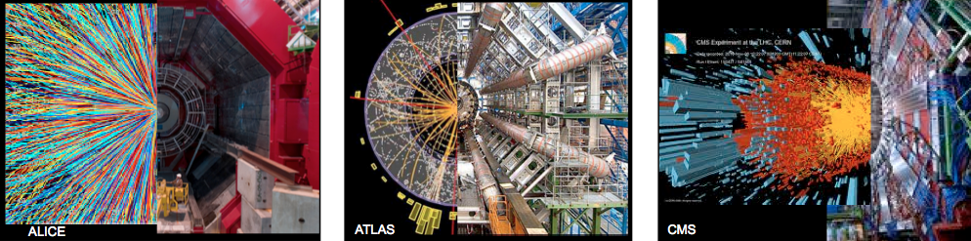
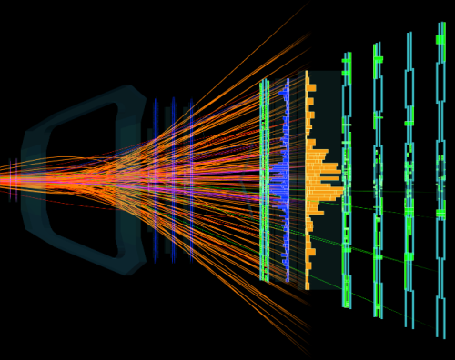
Particle production and collectivity across system size
WG5 Yellow Report: arXiv:1812.06772
LHCb
Jan Fiete Grosse-Oetringhaus, CERN
on behalf of WG5
HL/HE-LHC Physics Workshop: Final Jamboree, CERN
01.03.19
WG5 Conveners: Zvi Citron (ATLAS), John Jowett (LHC), JFGO (ALICE), Yen-Jie Lee (CMS), Urs Wiedemann (TH), Michael Winn (LHCb)

Slide 2
Preamble
None of the content of this talk was known
  when LHC was proposed, and
  when LHC started

Slide 3
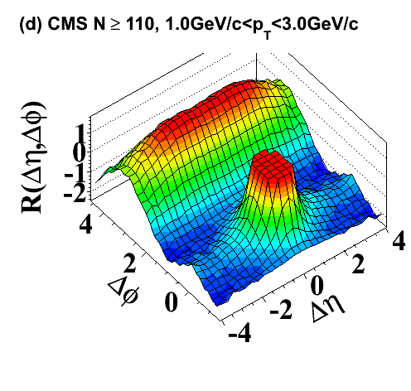
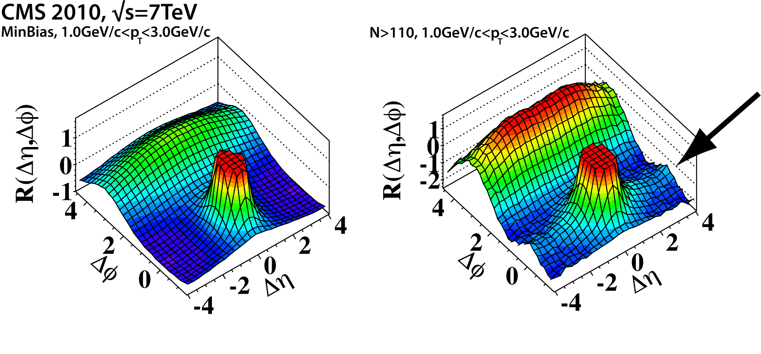
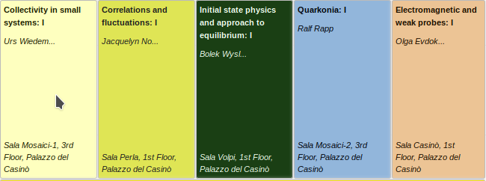
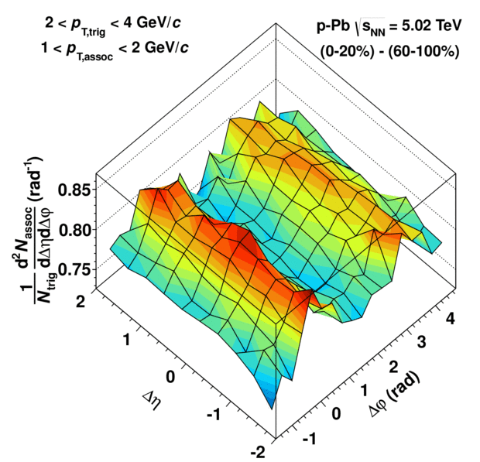
First Discovery: The Ridge
Run 1+2
739
pp
600
ALICE
p-Pb
Quark Matter 2018
ALICE, PLB719 (2013) 29
and also ATLAS, PRL110(2013)18,182302
CMS. JHEP09(2010)091

Slide 4
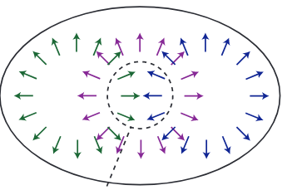
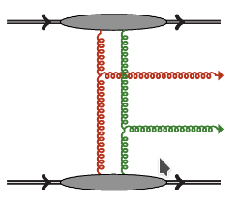
Explanations
Hydrodynamic evolution
Escape mechanism
Initial-momentum correlations
PLB783(2018) 274
PRD87(2013) 9,094034
Many scatterings
Few scatterings
Initial conditions
(Perfect) fluid dynamics ↔ free streaming limit
Theory spans still today a wide field

Slide 5
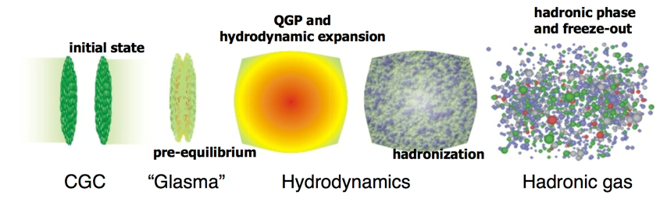
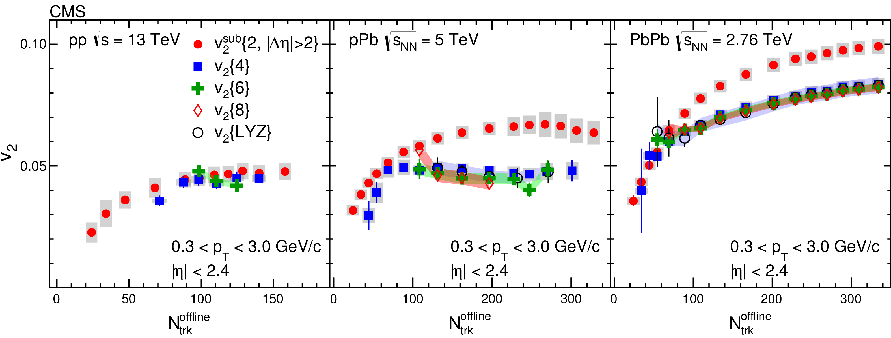
System Comparison
Run 1+2
v₂ vs. N_{ch}
Ridge component characterized with multi-particle correlations: pp ~ p-Pb < Pb-Pb
→ True collective effect above N_{ch} ≈ 100
PLB 765 (2017) 193

Slide 6
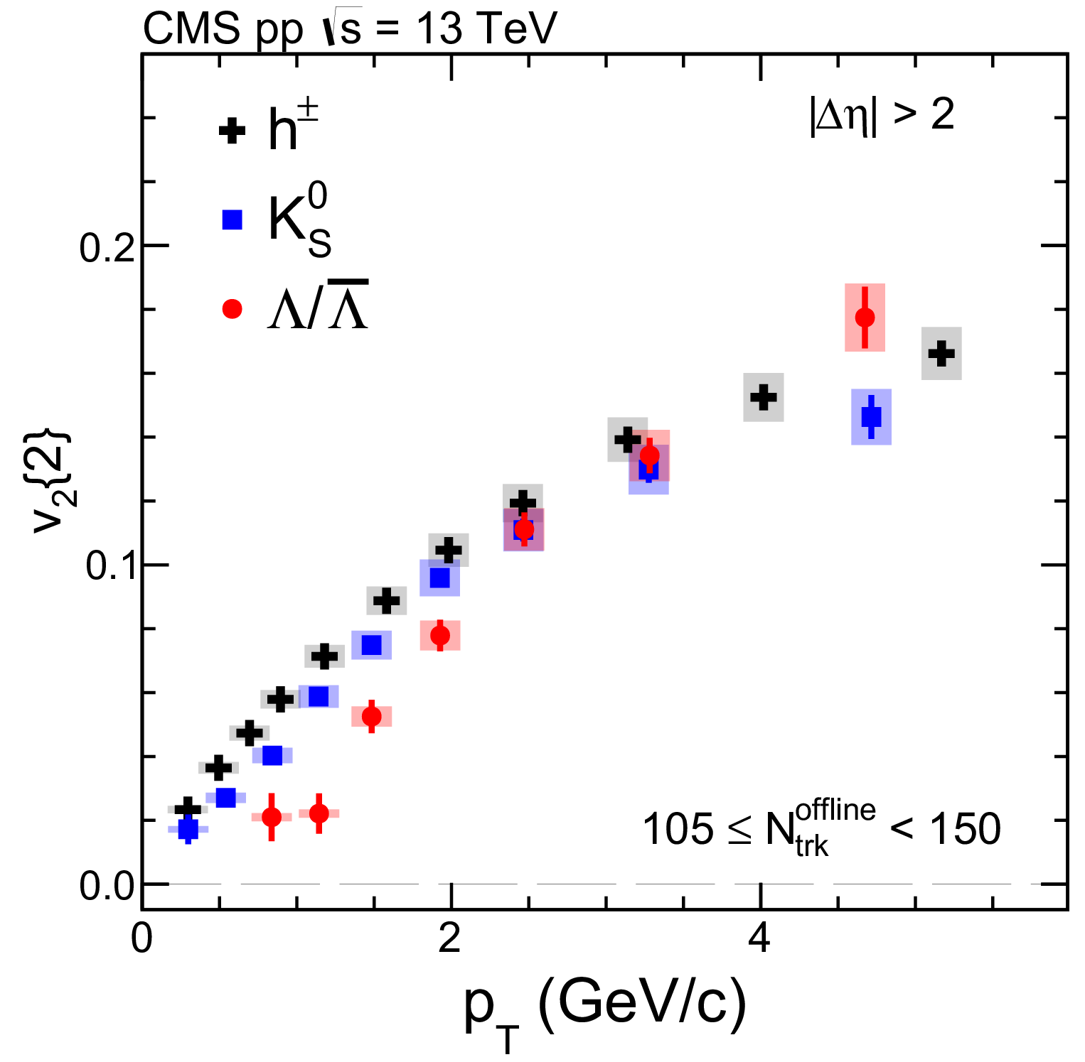
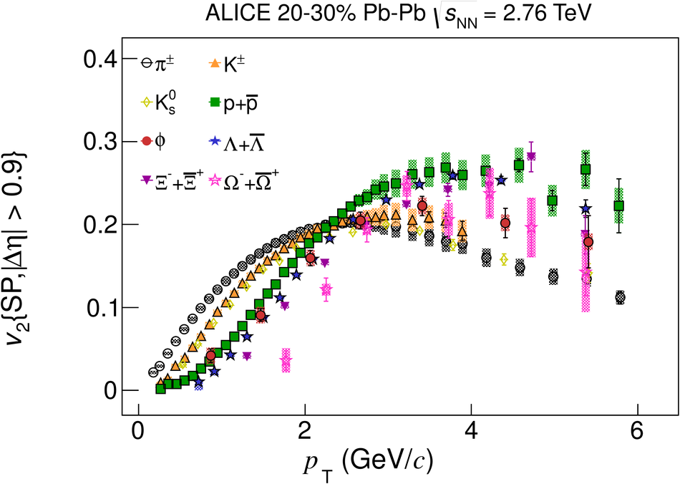
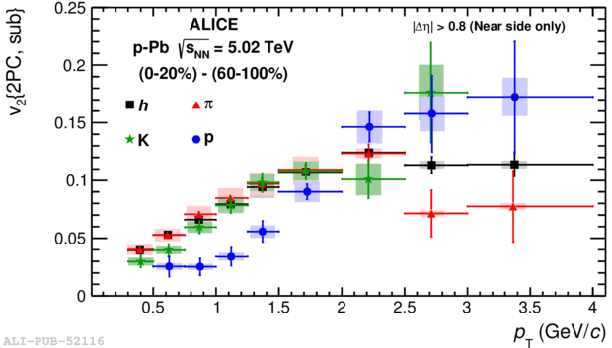
System Comparison – Identified Particles
v₂ vs. N_{ch}
v₂ vs. N_{ch}
v₂ vs. N_{ch}
Mass splitting and crossing observed in small and large systems
PLB765 (2017) 193
PLB726 (2013) 164
JHEP06 (2015) 190

Slide 7
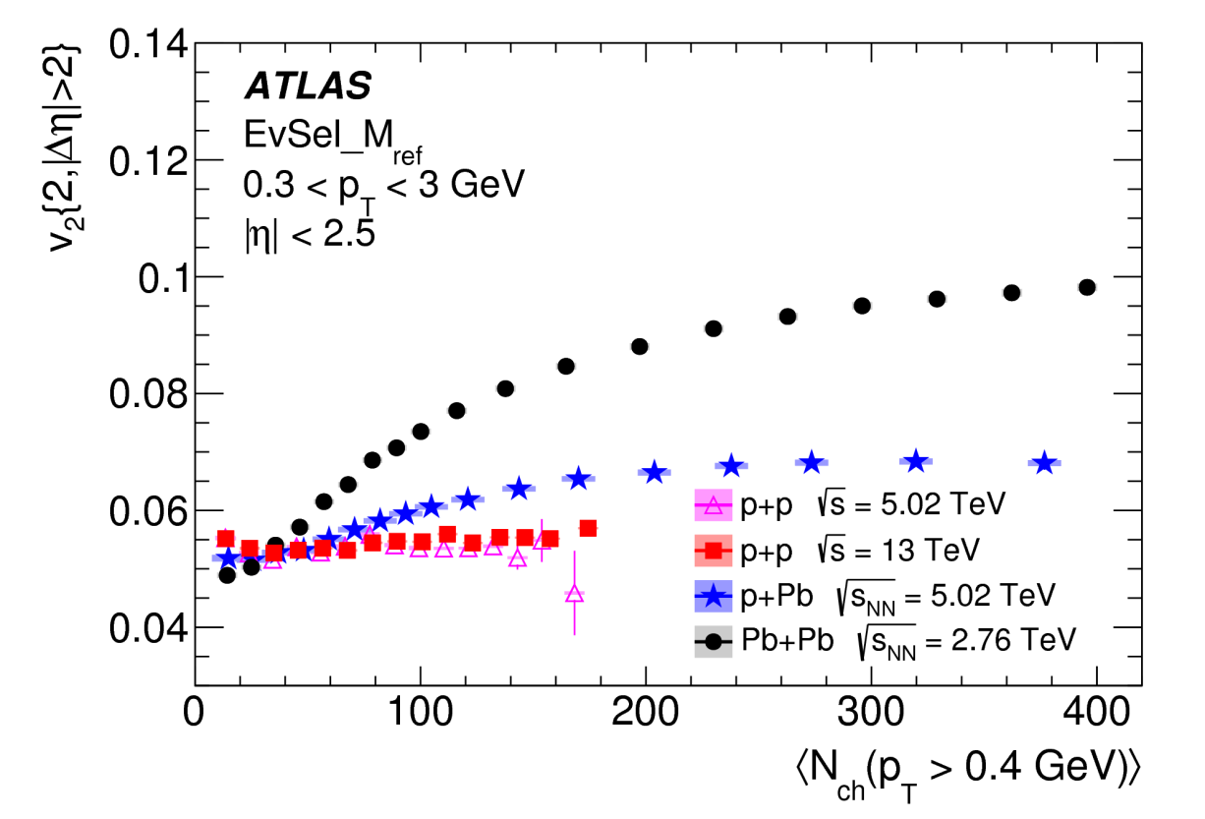
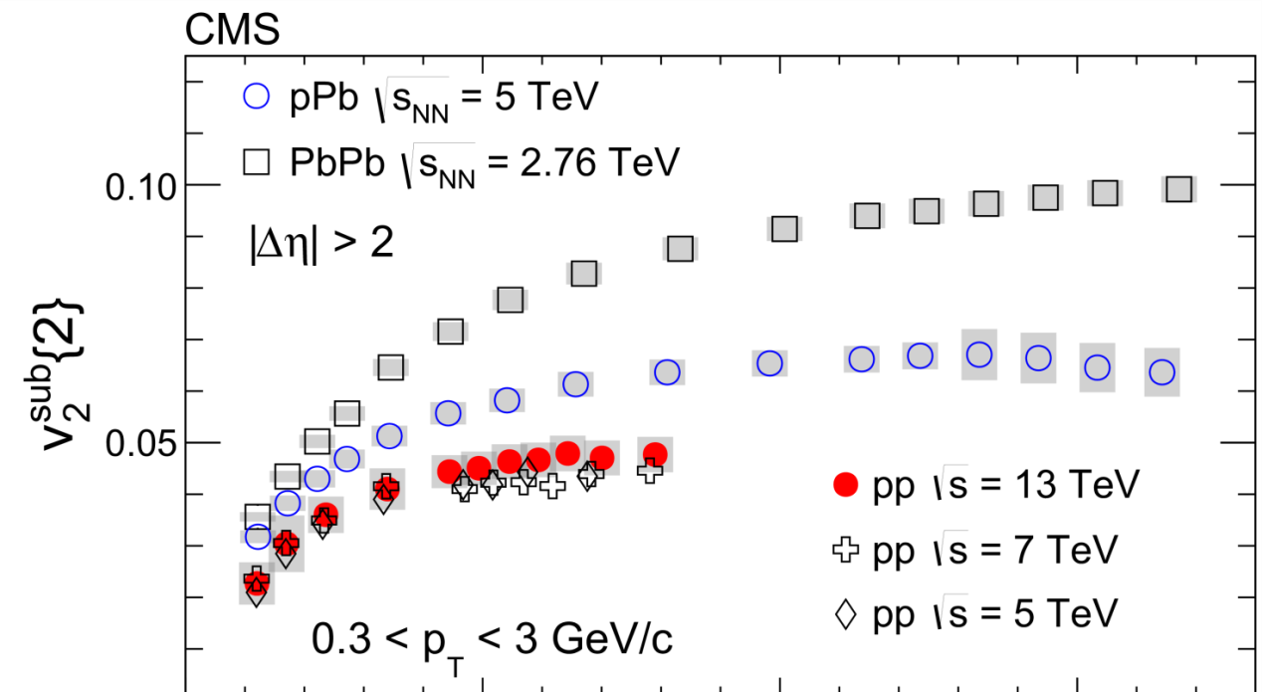


v₂ Coefficients in pp
Run 1+2
v₂ vs. N_{ch}
v₂ vs. N_{ch}
Few particle correlations dominated by jets, resonance decays
Experimental result : procedure dependent
Collective nature of dilute systems not understood, yet
EPJC 77 (2017) 428
PLB 765 (2017) 193

Slide 8
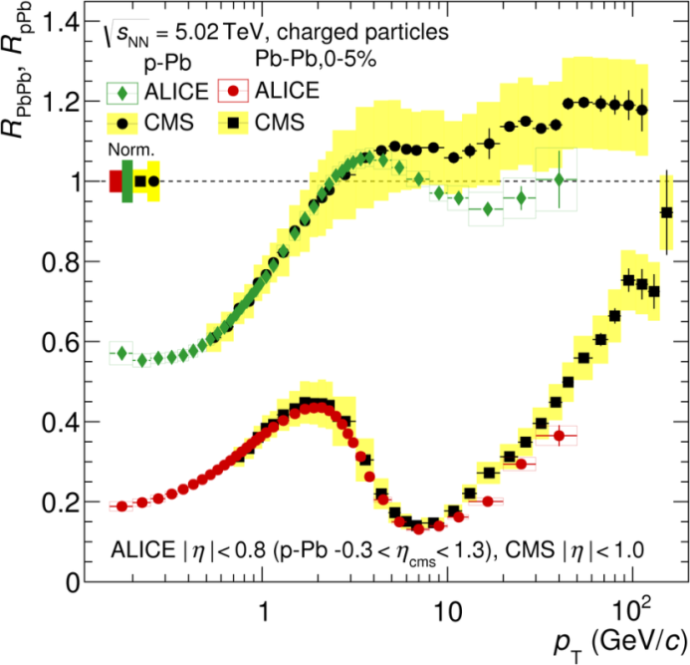
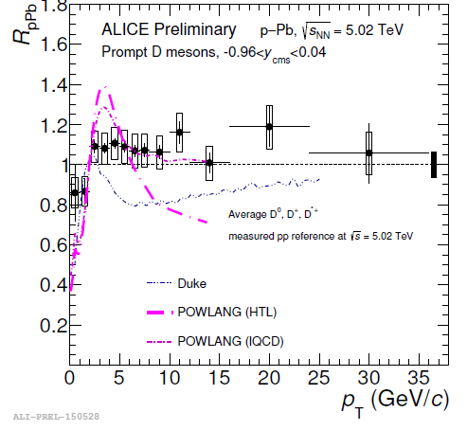
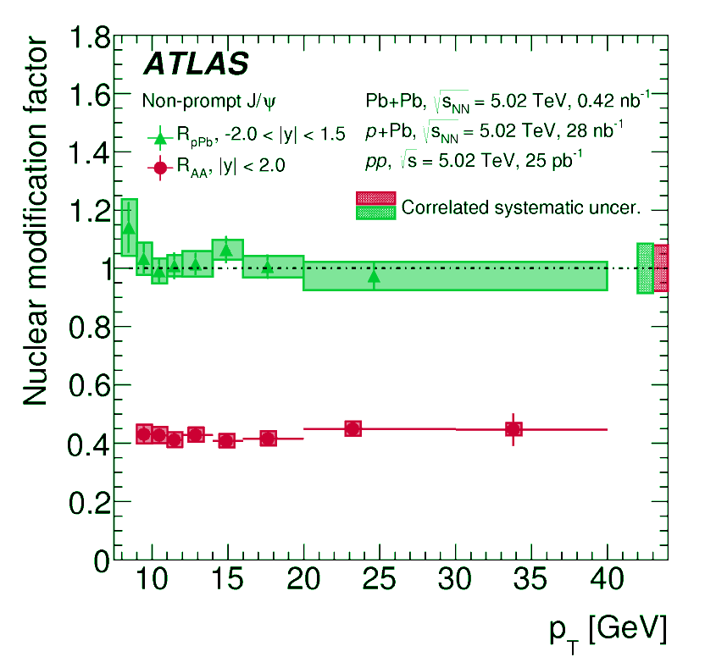
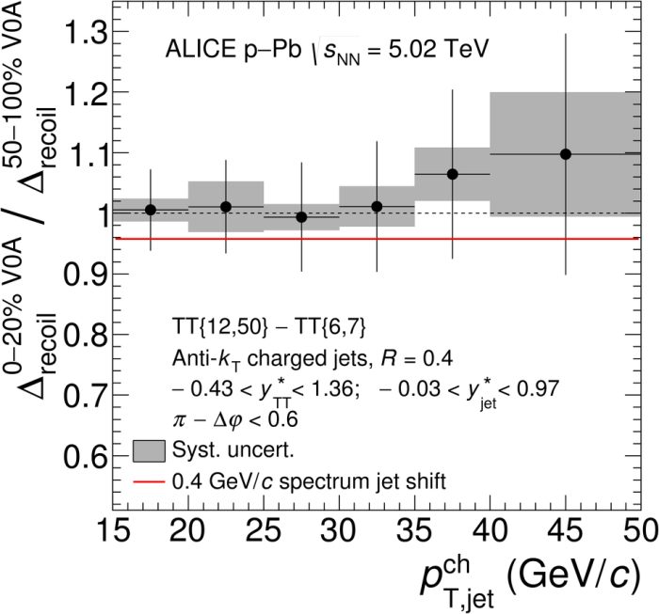
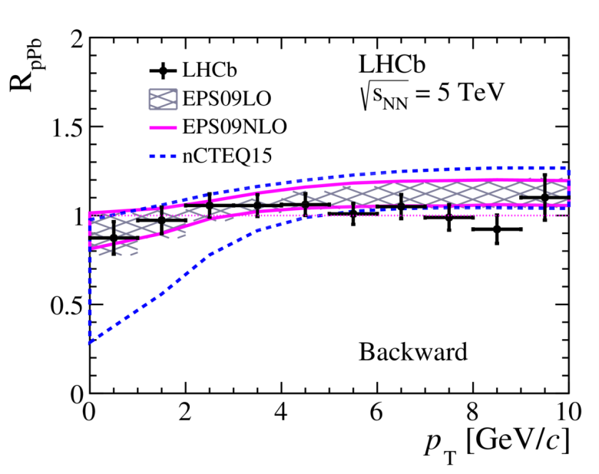
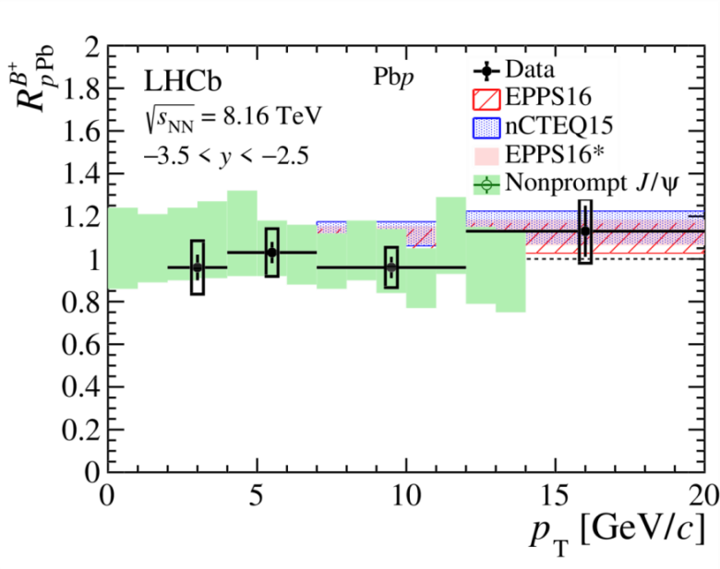
Energy Loss
Run 1+2
If v_{n} are caused by final-state interactions, partons should lose energy
h-jet coincidence
R_{pA} vs. p_{T} - midrapidity
R_{pA} vs. p_{T} - forward
hadrons
J/ψ from B
D mesons
D mesons
B and J/ψ from B
PLB783(2018)95
PRL110 (2013) 082302
EPJC78(2018)762
JHEP1710(2017)090
arXiv:1902.05599
No significant signal observed for hadrons, D and B

Slide 9
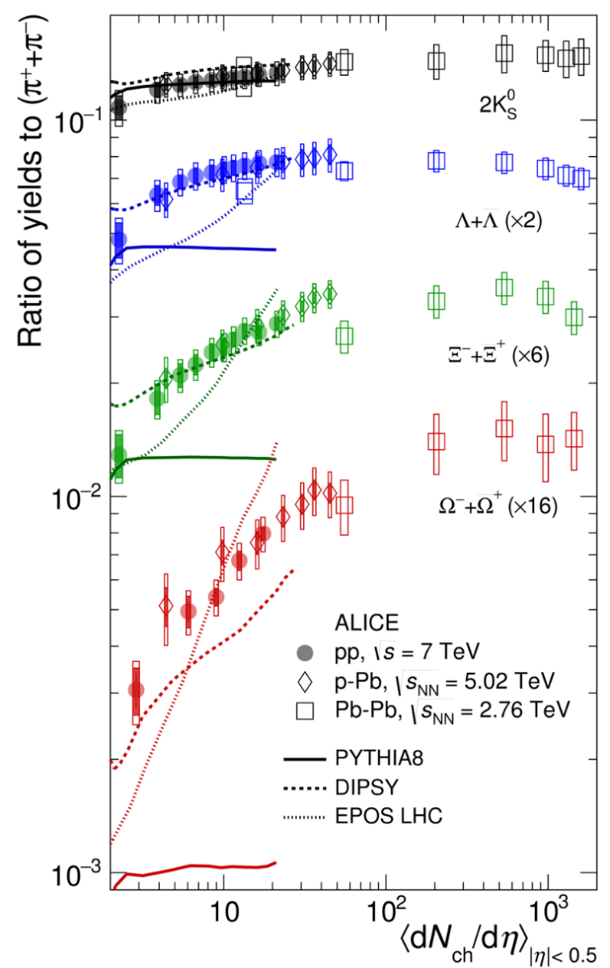
Second Discovery: Strangeness
K⁰/π
Run 1+2
Λ/π
Strange baryon production increases
with increasing multiplicity
  Λ, Ξ, Ω
  Smooth across system (pp, p-Pb, Pb-Pb)
  Multiplicity only relevant variable here?
    Need more overlap for final answer
Traditional MC codes fail to reproduce trend
  Torbjorn Sjostrand [1808.03117]
  “we lack some fundamental insight
  on baryon production”
Ξ/π
Pb-Pb
p-Pb
Ω/π
pp
Nature Phys.13(2017)535

Slide 10
Résumé
Observations challenge two paradigms at once
  What is smallest system for which heavy ion “standard model” remains valid?
  Can the standard tools for pp physics remain standard?
Run 1 + 2
Discovery of heavy-ion like phenomena in small systems
Characterization of multi-particle correlations and strangeness enhancement
Run
3 + 4
Non-flow-free correlation measurements
→ nature of higher-order correlations
Thermal radiation
→ isotropization and equilibration
Energy-loss signals
→ role of final-state interactions
Strangeness enhancement
→ insight into baryon production (incl. HF)

Slide 11
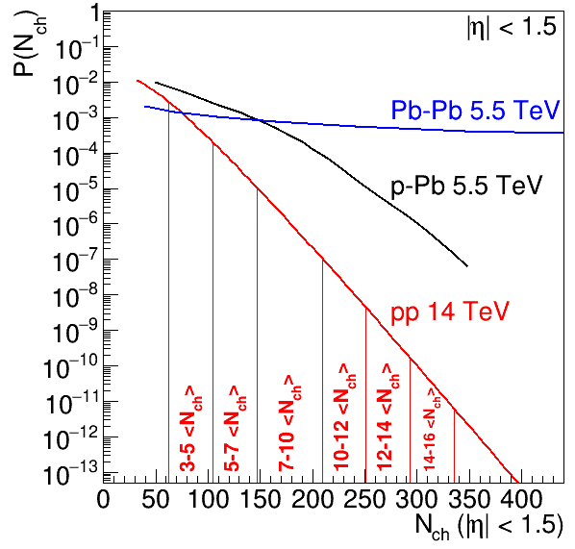
Multiplicity Distribution
Run 3+4
Run 3: 200 pb⁻¹ 14 TeV high-multiplicity pp program → extremely rare events
P(N_{ch}) vs. N_{ch}
65% central in Pb-Pb
>25k events @ 14-16 <N_{ch}>
~ 300 particles in |η| < 1.5
What is smallest droplet of matter showing collective behavior?
Origin of collectivity in few particle system?
Significant overlap between
pp and PbPb
If pp behaves as PbPb, we can look for “standard” PbPb physics
arXiv:1812.06772
Notes:
Intrinsically connected to length scales: size of dissipative properties of QCD matter (e.g. eta/s) quantitatively related to presence/absence of intrinsic length scale
Today we are at about 200 (CMS v2 translated into our phase space)
(color reconnection, gluon interference, escape, … vs. impressively successful hydrodynamic description)

Slide 12
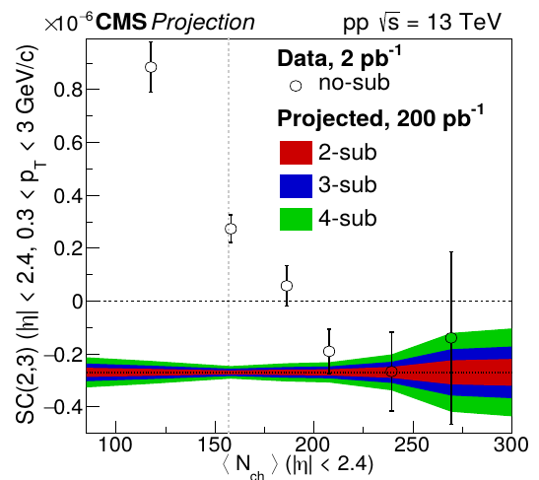
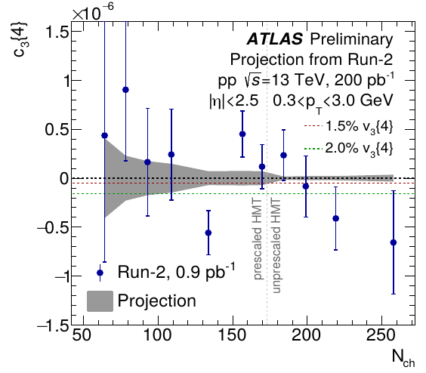
Higher-Order Correlations in pp
Run 3+4
Symmetric cumulants:
Correlation of n^{th} and m^{th} order flow
True collectivity (all particles involved?)
  Need to suppress jet contribution
Triangular flow: 3rd harmonic
measured with 4 particle correlations
Sensitivity to n-m correlations
Sensitivity to 1.5% v₃{4}
Projection
Current data
Constrain models describing collective effects
Nature of collectivity of few-particle systems
arXiv:1812.06772

Slide 13
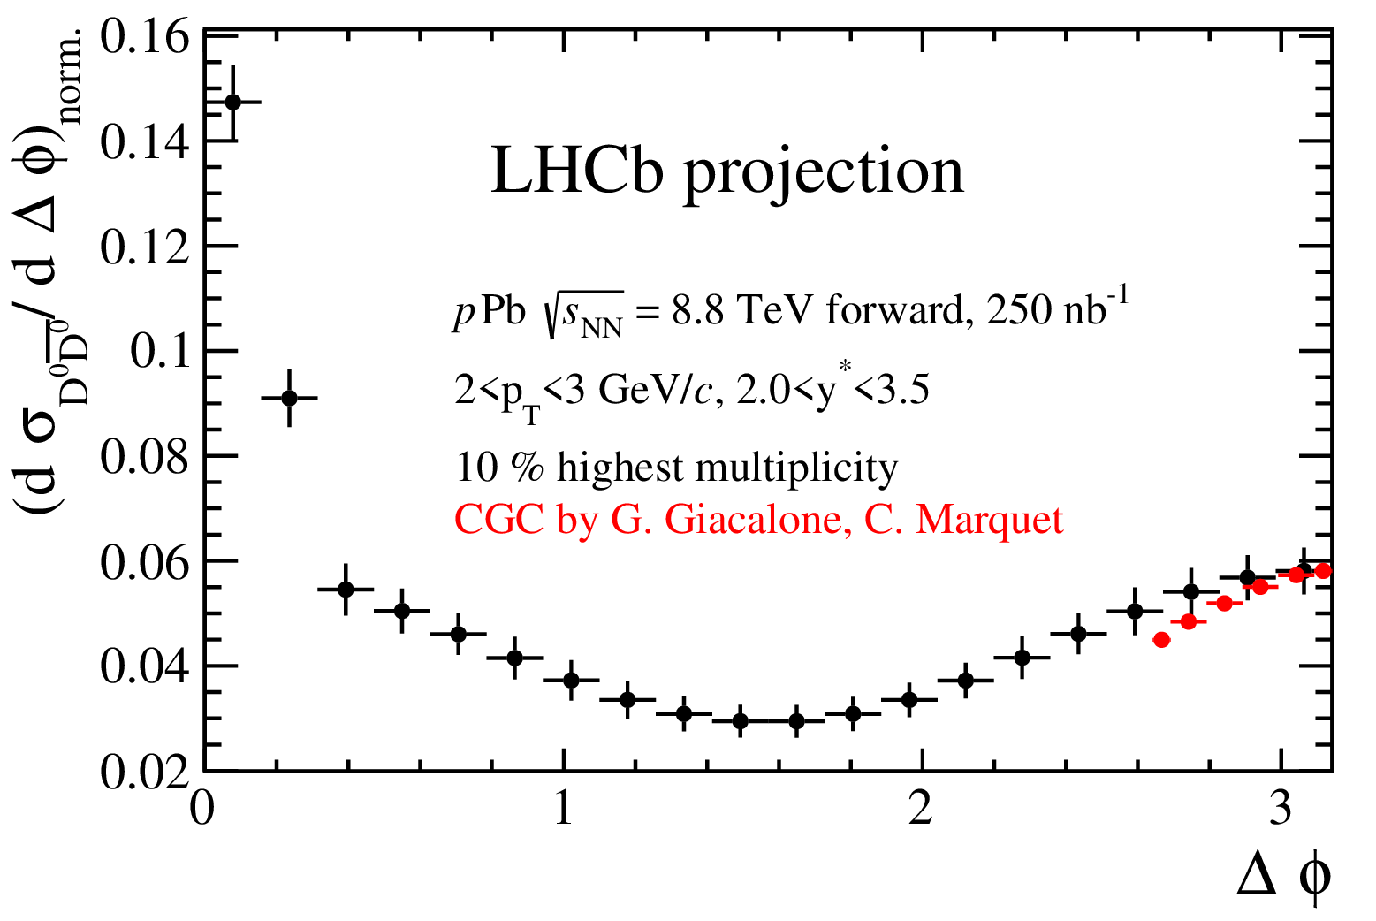
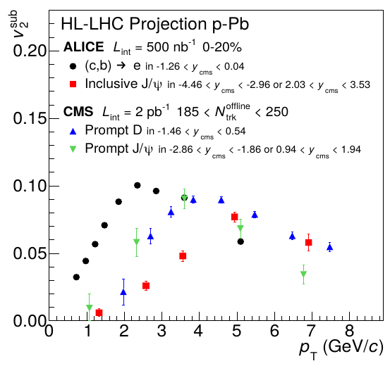
Charm & Beauty
Run 3+4
σ_{DDbar} vs. Δϕ
c & b produced in initial hard scattering
→ clean probe of medium evolution
v_{2,sub} vs. p_{T}
CGC
D-Dbar correlations → a window to the CGC
Participation of heavy quarks in small-system evolution
→ role of final-state interactions
Constrain models by additional “handle” quark mass
arXiv:1812.06772

Slide 14
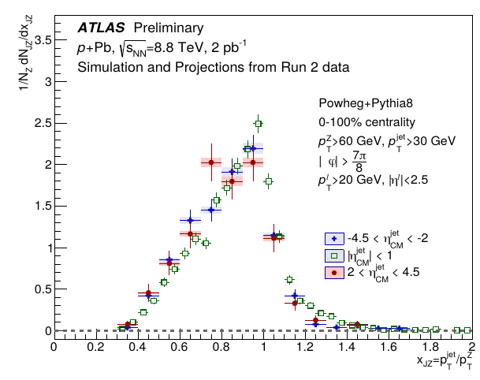
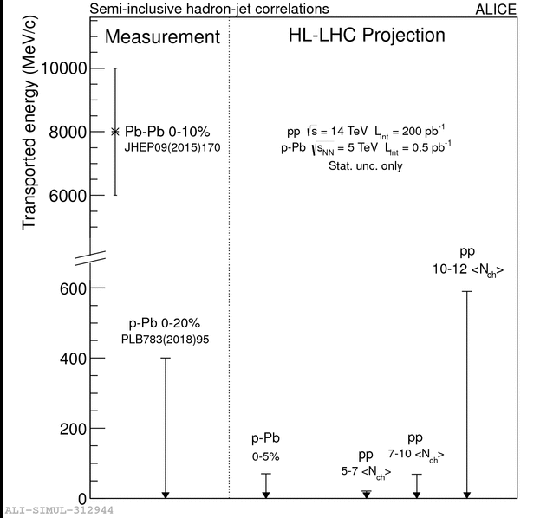
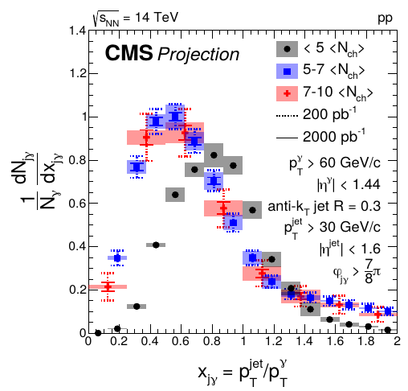
Energy Loss
Run 3+4
If v_{n} caused by final-state interactions, partons should lose energy
Single-particle observables (“R_{pA}”) not sensitive
Coincidence measurements → h-jet, jet-γ, jet-Z correlations
jet-Z
jet-γ
h-jet
current limit (p-Pb)
Measure energy loss signal, or put stringent limit
Understand role of final-state interactions
p-Pb
pp
arXiv:1812.06772
h-jet sensitivity ~ 20 MeV/c in pp
Current limit in p-Pb: ~ 400 MeV/c
Measured in Pb-Pb: ~ 8000 MeV/c

Slide 15
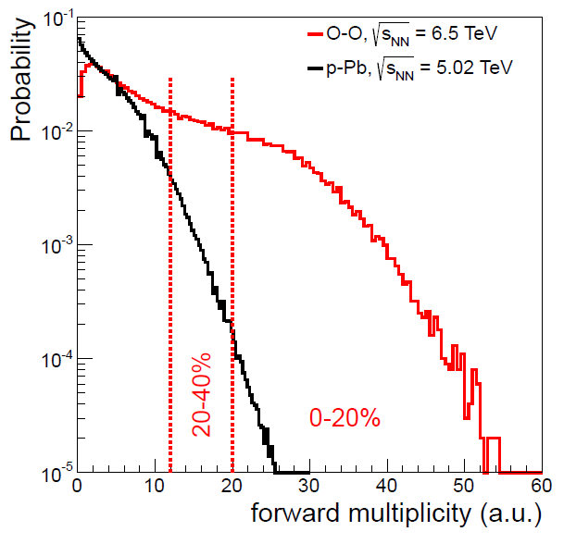
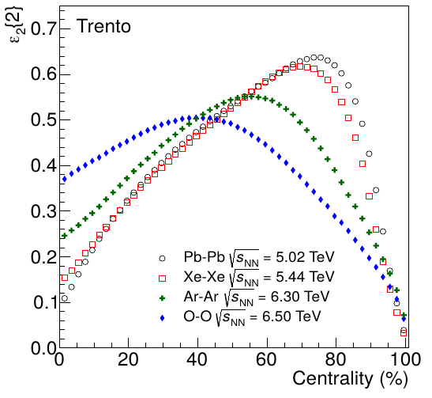
Oxygen-Oxygen Collisions
P(#signal) vs. #signal
Run 3+4
Glauber
AA geometry but N_{ch}, N_{part}, N_{coll} as p-Pb
  Centrality shoulder allows geometry selection (N_{coll}, ε₂)
System large enough to exhibit jet quenching
  Critical test of understanding of energy loss for short path lengths
  If no quenching in O-O
  → also p-Pb has insufficient energy density for quenching
Connection of initial-state geometry and flow
  Different eccentricity profiles of Pb-Pb/Xe-Xe and O-O
Oxygen in LHC
  Relatively easy setup and commissioning (for low L_{inst})
  Few 100 μb⁻¹ sufficient for key measurements like R_{AA}, v_{n}, … (demonstrated by Xe-Xe)
O-O
p-Pb
ε₂ vs. centrality
arXiv:1812.06772

Slide 16
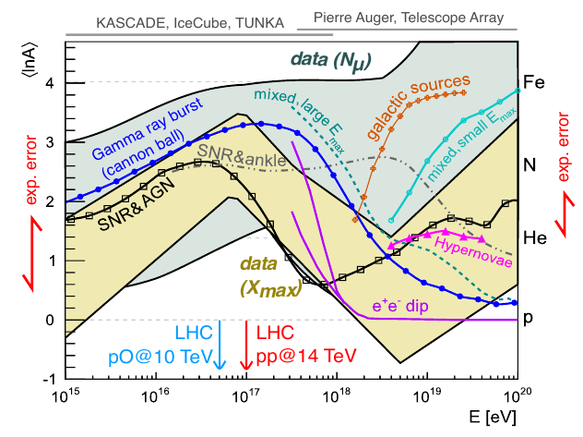
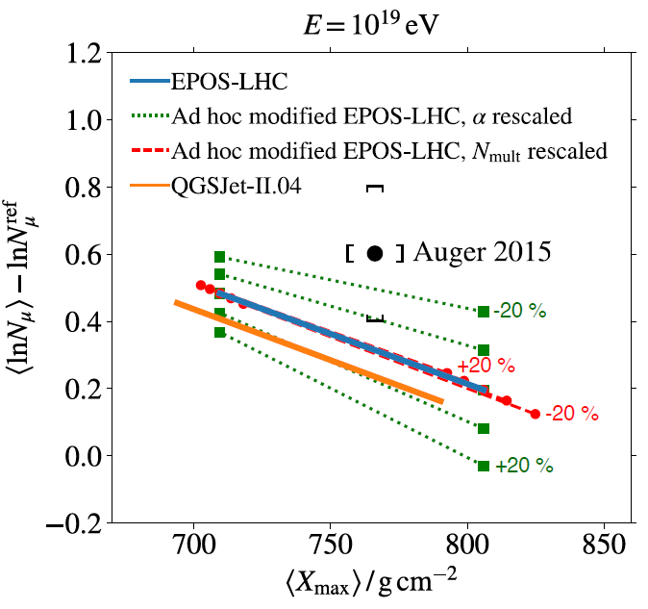
Proton-Oxygen Collisions
<ln A> vs. E
Run 3+4
Cosmic-ray community has expressed strong interest in short p-O run to constrain models describing cosmic-ray showers
  Could be easily appended to a O-O run
Muon deficit in models may be related to an excess of neutral pions (see e.g. arXiv:1902.08124)
  Models mitigate this by adding collective effects or additional strangeness
Measurement wish list
  Production of π, K, p (ALICE, LHCb)
  Production of π⁰ and n (LHCf)
  Energy flow for hadrons and γ (CMS+CASTOR, ATLAS)
#Muons vs. X_{max}
arXiv:1812.06772
Notes:
collective effects -> EPOS ; strangeness (https://arxiv.org/pdf/1612.07328.pdf)

Slide 17
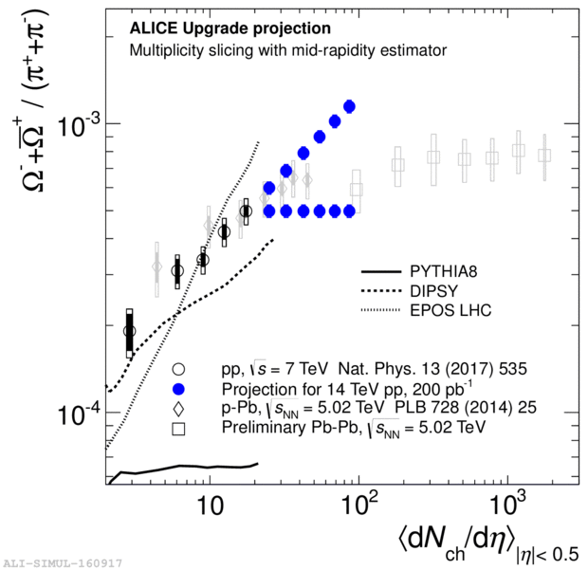
Strangeness Enhancement in pp
Run 3+4
Ω/π ratio vs. N_{ch}
14 TeV Projection
Thermal limit in
grand canonical ensemble
(= many body system in equilibrium)
Pb-Pb
pp
Does strangeness enhancement continue with same trend?
Is there a smooth connection to Pb-Pb?
Thermal limit reached or exceeded in pp?
arXiv:1812.06772

Slide 18
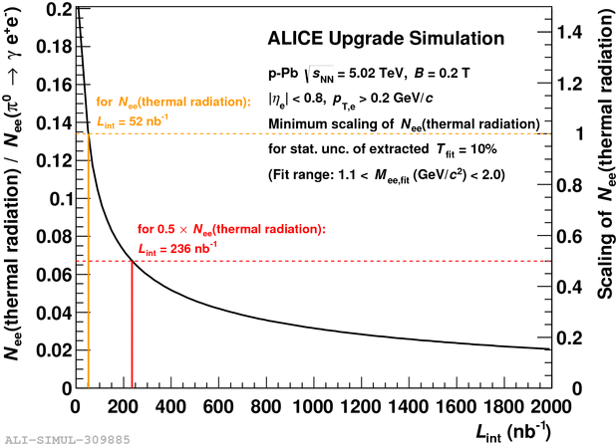
Thermal Radiation in p-Pb
Run 3+4
Direct access to temperature of a potential emitting medium
Strength of signal unclear
  Run 3 and 4 sensitive to 25% of signal predicted by R. Rapp
  [Acta Phys. Polon. B42 (2011) 2823]
Detectable signal vs. L_{int}
arXiv:1812.06772

Slide 19
Proposed Run Schedule for Run 3 and 4

Slide 20
Schedule Considerations
Run 3 and 4
Pb-Pb 5.5 TeV (confirmed): 13/nb ALICE/ATLAS/CMS, 2/nb LHCb
pp 5.5 TeV (confirmed): 600/pb ATLAS/CMS, 50/pb LHCb, 6/pb ALICE
pp 14 TeV (updated): 200/pb in Run-3 at low(er) m [w/o perturbation to HL]
p-Pb 8.8 TeV (updated): 1.2/pb ATLAS/CMS, 0.6/pb ALICE/LHCb
pp 8.8 TeV (new): 200/pb ATLAS/CMS/LHCb, 3/pb ALICE
O-O 7 TeV (new): 500/μb – pilot-like 3-4 days
p-O 9.9 TeV (new): 200/μb – pilot-like 1-2 days
Small systems program

Slide 21
Proposed Run Schedule for Run 3 and 4
 | Year | Systems, time, L_{int} | Total per Run (3 and 4)
RUN3 | 2021 (4 weeks) | Pb-Pb 5.5 TeV, 3 weeks pp 5.5 TeV, 1 week | Pb-Pb: 6.2/nb ALICE/ATLAS/CMS, 1/nb LHCb p-Pb: 0.6/pb ATLAS/CMS, 0.3/pb ALICE/LHCb pp 5.5: 300/pb ATLAS/CMS, 25/pb LHCb, 3/pb ALICE pp 8.8: 100/pb ATLAS/CMS/LHCb, 1.5/pb ALICE O-O: 500/μb p-O: 200/μb
 | 2022 (6 weeks) | p-O + O-O 7 TeV, 1 week (after EYETS?) Pb-Pb 5.5 TeV, 5 weeks
 | 2023 (4 weeks) | pp 8.8 TeV, few days p-Pb 8.8 TeV, 3.x weeks
 | LS3 | ATLAS/CMS upgrades, ALICE: ITS3? FoCal?
RUN4 | 2027 (4 weeks) | Pb-Pb 5.5 TeV, 3 weeks pp 5.5 TeV, 1 week | Pb-Pb: 6.8/nb, ALICE/ATLAS/CMS, 1/nb LHCb p-Pb: 0.6/pb ATLAS/CMS, 0.3/pb ALICE/LHCb pp 5.5: 300/pb ATLAS/CMS, 25/pb LHCb, 3/pb ALICE pp 8.8: 100/pb ATLAS/CMS/LHCb, 1.5/pb ALICE
 | 2028 (6 weeks) | Pb-Pb 5.5 TeV, 2 weeks p-Pb 8.8 TeV, 3.x weeks pp 8.8 TeV, few days
 | 2029 (4 weeks) | Pb-Pb 5.5 TeV, 4 weeks
Run 5 will be discussed in the next talk
This is a proposal agreed in WG5 and reflects the physics discussed in the YR. The final run schedule is decided by the LHCC upon discussion with the experiments.

Slide 22
Summary
Small-systems discoveries opened a field not known to exist when LHC started
Observations challenge two paradigms at once
  What is smallest system for which heavy ion “standard model” remains valid?
  Can the standard tools for pp physics remain standard?
Rich physics program in Run 3 and 4
  Chapter 9 in WG5 Yellow Report – arXiv:1812.06772
Aim: Demonstrate that unified description from pp to Pb-Pb collisions is feasible
or show that different mechanisms are justified

Slide 23
Backup

Slide 24
Collision Systems
pp
Smallest system where collective effects have been observed
“Closest” to e⁺e⁻
Saturation-dominated regime
Well known geometry
Pb-going and p-going direction in the same event
True collective reference
p-Pb
Pb-Pb

Slide 25
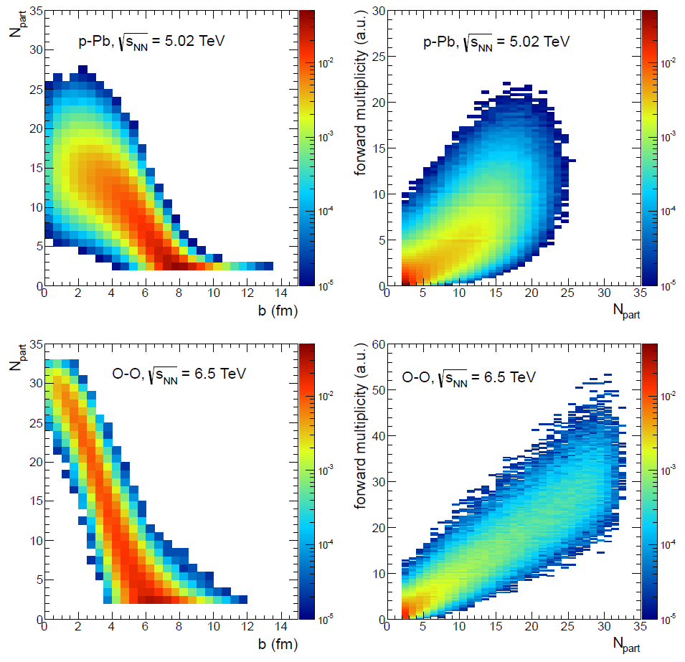

Slide 26
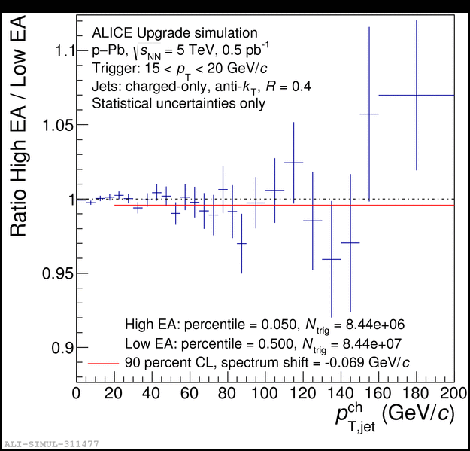

Energy Loss in p-Pb
Hadron-jet correlations assess energy loss w/o need of reference
  Currently set limit of 400 MeV in p-Pb (>10x smaller than in Pb-Pb)
500 nb⁻¹ sample can improve this to 70 MeV
PLB783(2018)95

Slide 27
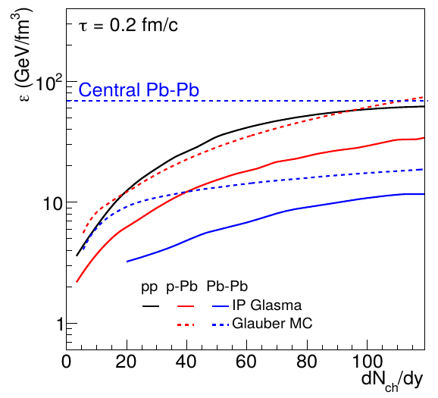
Energy Densities

Slide 28
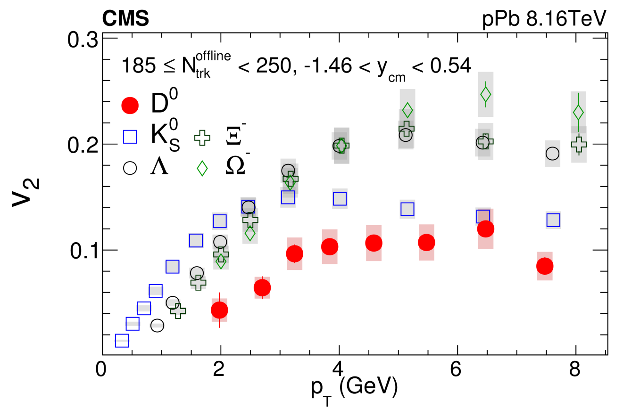
v₂ in p-Pb
Phys. Rev. Lett. 121 (2018) 082301

Slide 29
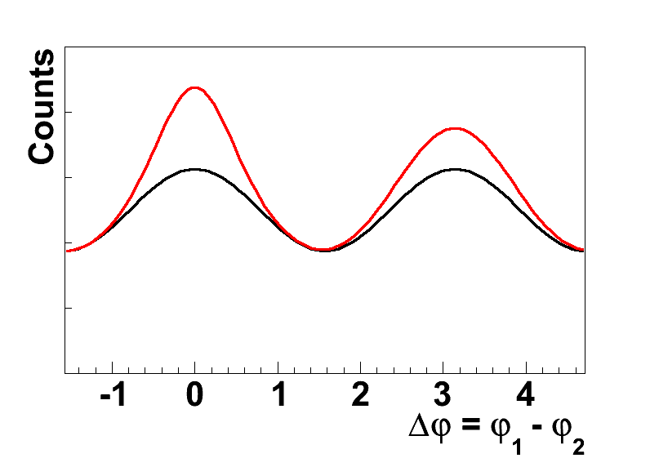
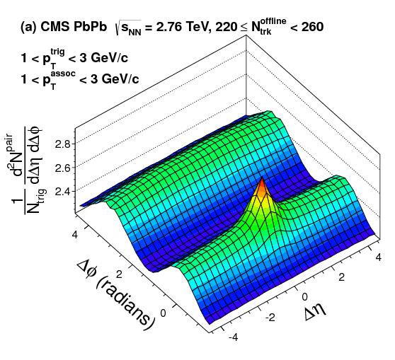
2D Two-Particle Correlations
Flow component overlaid by (mini)jet contribution
This can also be looked at in two dimensions
  Azimuth Δϕ and pseudorapidity Δη
Away-side jet + flow
(Δϕ ~ π, elongated in Δη)
Yield vs. Δϕ vs. Δη
Near-side jet
+ resonances, ...
(Δϕ ~ 0, Δη ~ 0)
include Δη axis
flow modulation
+ (mini)jet
Near-side flow ridge
(Δϕ ~ 0, elongated in Δη)

Slide 30
And in pp?
Pb-Pb
pp
Near-side ridge (flow) only in Pb-Pb
at least everyone thought so for a long time…

Slide 31
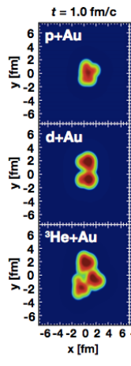
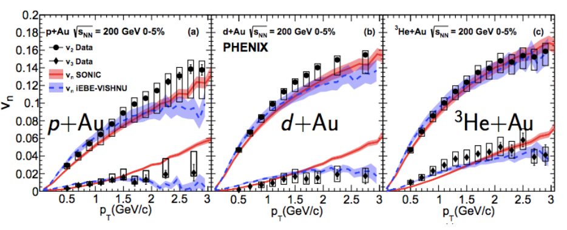
Initial or final state effect?
What is the relation to the shape of the initial state?
RHIC geometry scan
Prediction by hydrodynamic models
p-Au
v_{n} vs. p_{T}
p-Au
d-Au
³He-Au
v₂
d-Au
³He-Au
v₃
Triangular initial state → large v₃
arXiv:1805.02973

Slide 32
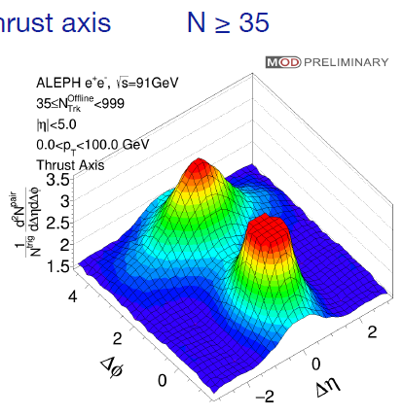
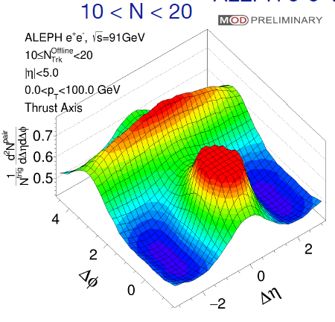
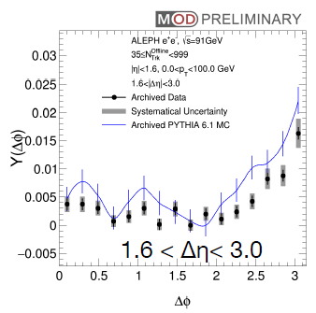
e⁺e⁻ (archived ALEPH data)
Can we observe the same structures in e⁺e⁻ collisions?
Y(Δφ) vs. Δφ
No collective effects found in ee collisions!
Yen-Jie Lee, Quark Matter 2018

Slide 33
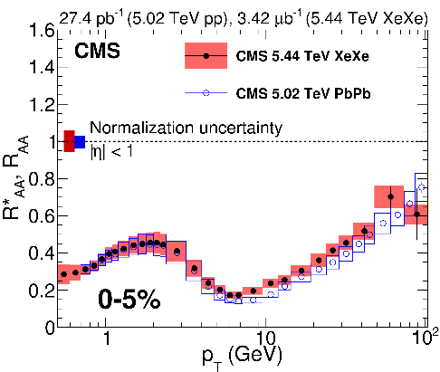
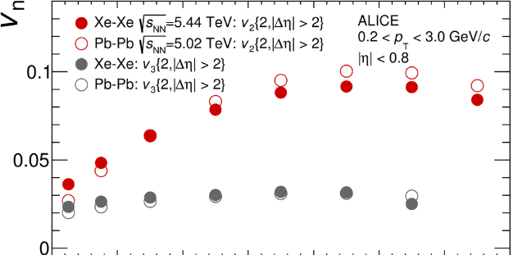

Xe-Xe Measurements
R_{AA} in Xe-Xe
v_{n} in Xe-Xe
PLB784(2018)82
JHEP1810(2018)138

Slide 34
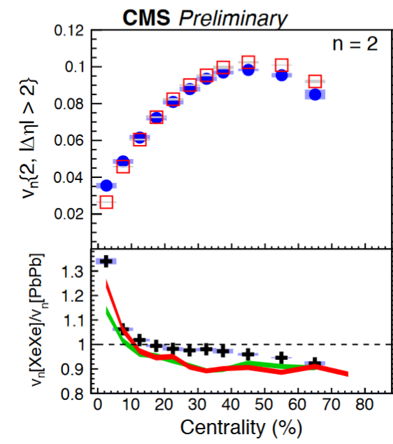






Changing A vs. changing centrality
R_{AA} vs. dN_{ch}/dη
PLB788 (2019) 166
Centrality
Centrality

Slide 35
Proposed Run Schedule
 | Year | Systems, time, L_{int} | Total per Run (3 and 4)
RUN3 | 2021 (4 weeks) | Pb-Pb 5.5 TeV, 3 weeks pp 5.5 TeV, 1 week | Pb-Pb: 6.2/nb ALICE/ATLAS/CMS, 1/nb LHCb p-Pb: 0.6/pb ATLAS/CMS, 0.3/pb ALICE/LHCb pp 5.5: 300/pb ATLAS/CMS, 25/pb LHCb, 3/pb ALICE pp 8.8: 100/pb ATLAS/CMS/LHCb, 1.5/pb ALICE O-O: 500/μb p-O: 200/μb
 | 2022 (6 weeks) | p-O + O-O 7 TeV, 1 week (after EYETS?) Pb-Pb 5.5 TeV, 5 weeks
 | 2023 (4 weeks) | pp 8.8 TeV, few days p-Pb 8.8 TeV, 3.x weeks
 | LS3 | ATLAS/CMS upgrades, ALICE: ITS3? FoCal?
RUN4 | 2027 (4 weeks) | Pb-Pb 5.5 TeV, 3 weeks pp 5.5 TeV, 1 week | Pb-Pb: 6.8/nb, ALICE/ATLAS/CMS, 1/nb LHCb p-Pb: 0.6/pb ATLAS/CMS, 0.3/pb ALICE/LHCb pp 5.5: 300/pb ATLAS/CMS, 25/pb LHCb, 3/pb ALICE pp 8.8: 100/pb ATLAS/CMS/LHCb, 1.5/pb ALICE
 | 2028 (6 weeks) | Pb-Pb 5.5 TeV, 2 weeks p-Pb 8.8 TeV, 3.x weeks pp 8.8 TeV, few days
 | 2029 (4 weeks) | Pb-Pb 5.5 TeV, 4 weeks
 | LS4
R U N 5 |  | Intermediate AA, 11 weeks pp reference, 1 week | E.g. Ar-Ar 3-9/pb (optimal species to be defined)
This is a proposal agreed in WG5 and reflects the physics discussed in the YR. The final run schedule is decided by the LHCC upon discussion with the experiments.

Slide 36
“I am more sure of the conclusions than of any
single argument which suggested them to me.”
Richard P. Feynman
Phys. Rev. Lett. 23 (1969) 1415

