Slide 1
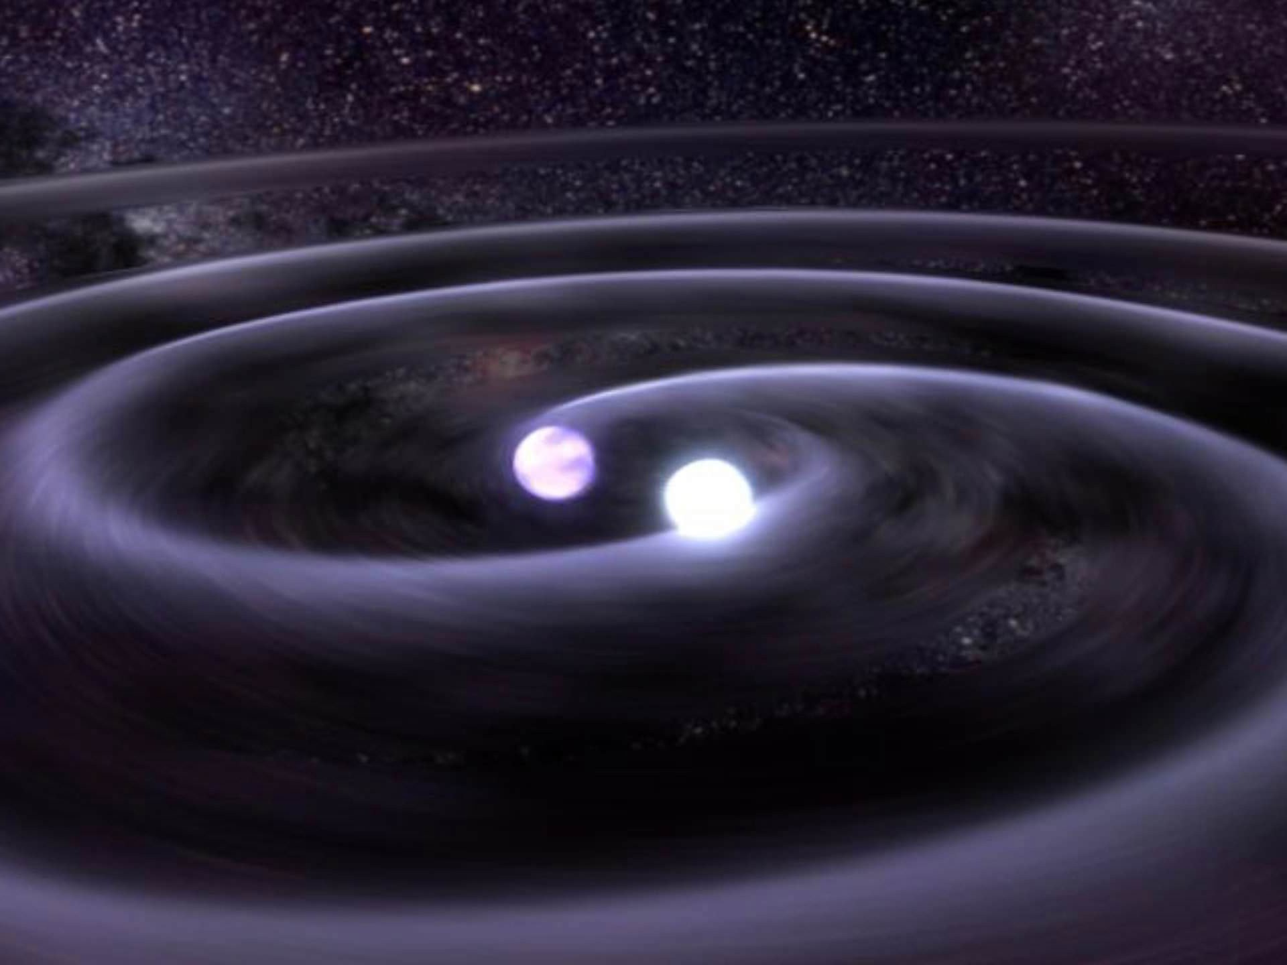
Gravitational Wave Astronomy with LIGO-Virgo
IGFAE Retreat – Jan 10 2019
Thomas Dent
with G. Davies, J. Alvarez-Muñiz, E. Zas,
PhD candidate TBD
Image Credit: NASA/GSFC

Slide 2
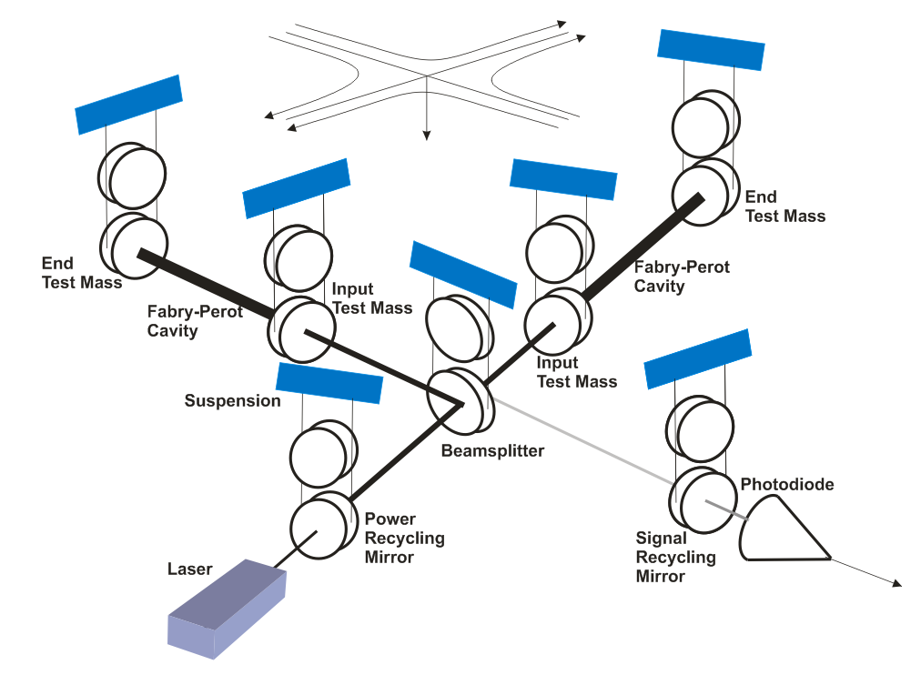
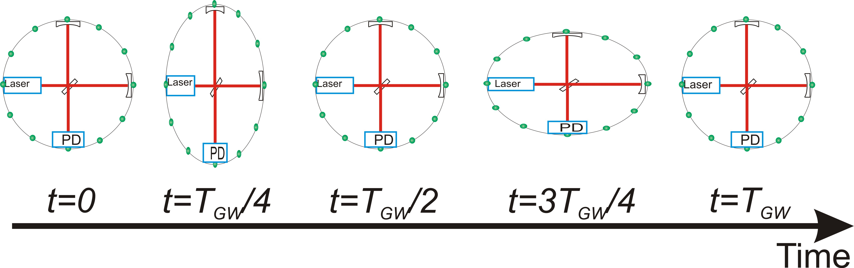
Laser interferometric detection
‘Michelson interferometer’ :
end mirrors free to move
along arms
Differential length change
δ(L_{x} − L_{y}) = h(t)·L
⇒ time of flight difference
⇒ relative phase difference
@ beam splitter
⇒ transmitted intensity
variation @ PD

Slide 3
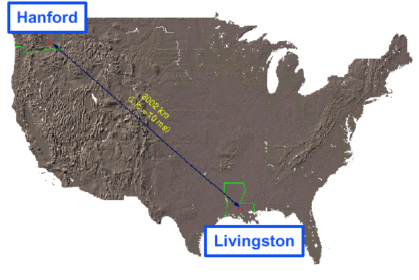
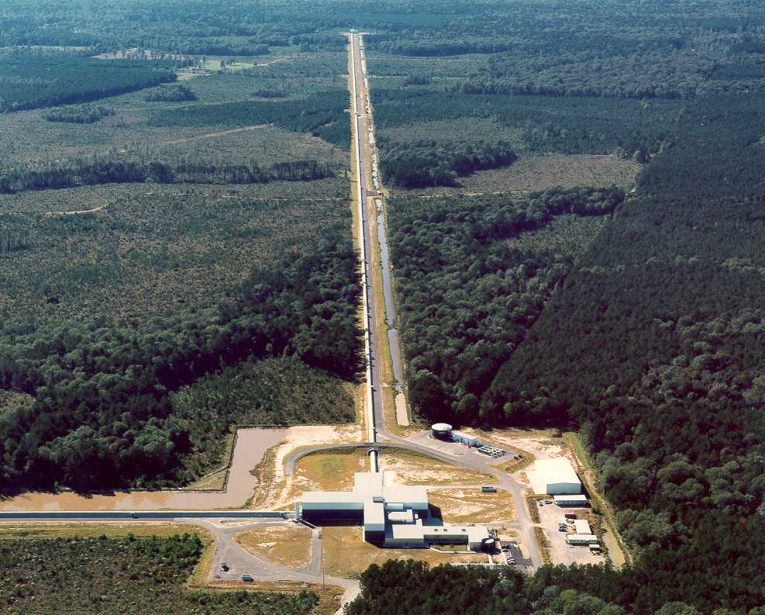
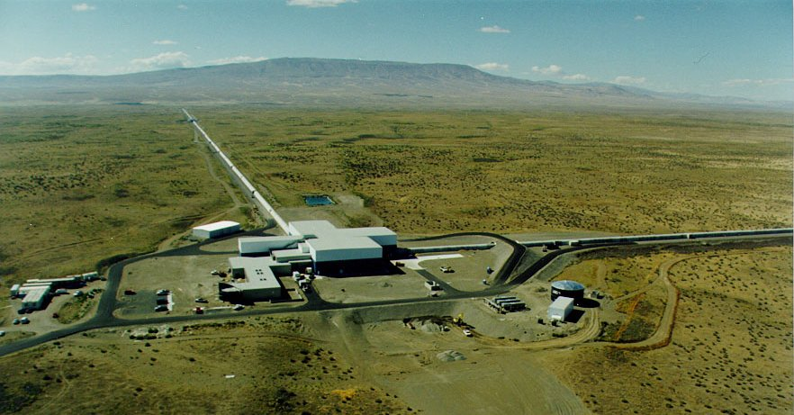
LIGO
Funding
1984: LIGO founded as a Caltech/MIT project
1990: LIGO Construction Project approved by NSF
1992: LIGO Construction Project funded by NSF
1992 – 1995: Site selection, vacuum prototyping
1995 – 1999: LIGO facilities construction at
Hanford and Livingston
1998 – 2002: Installation/integration of initial LIGO
interferometers
2002 – 2005: Interferometer commissioning
interleaved with science runs (S1-S4)
Nov 4, 2005 – Sep 31, 2007: S5 science run
  Design sensitivity reached
  15 Mpc range; > 1 year of triple coincidence data
2007 – 2009: Enhanced LIGO instrument upgrade
  Tests key Advanced LIGO technologies
Jul 7, 2009 – Oct 20, 2010: S6 science run
  18 Mpc range to merging binary neutron stars
Apr 2008: Advanced LIGO Construction begins
Dec 2011: Advanced LIGO detector installation
begins
Mar 2015: Advanced LIGO Construction complete
Sep 2015: First Advanced LIGO Observing
Run ‘O1’
Sep 14, 2015: First binary black hole detection
Nov 30, 2016: Advanced LIGO O2 run starts
Hanford, WA
LIGO Livingston
Construction
LIGO Hanford
Initial LIGO
LIGO Hanford Observatory
Livingston, LA
LIGO Laboratory:
180 staff located at Caltech, MIT, Hanford, Livingston
LIGO Scientific Collaboration:
~ 1200 scientists, ~100 institutions, 16 countries
Advanced LIGO
Notes:
The real history; four epochs, today

Slide 4
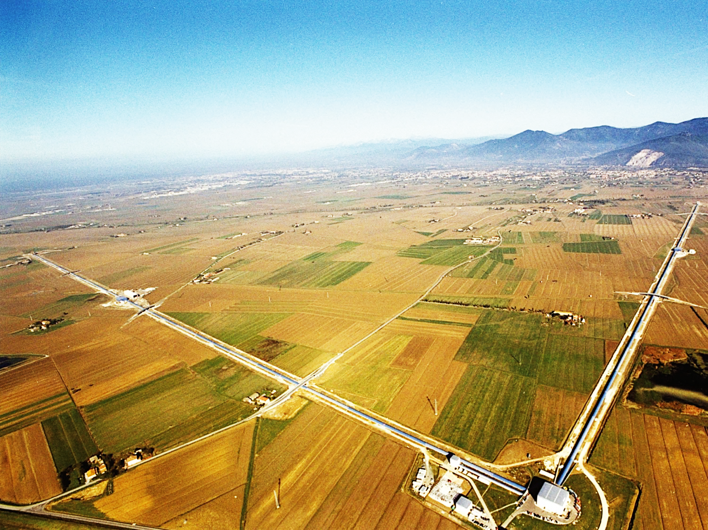







ADVANCED VIRGO
6 EU countries: France, Hungary, Italy, Poland, Spain, and The Netherlands
20 labs, ~280 authors
APC Paris
ARTEMIS Nice
EGO Cascina
INFN Firenze-Urbino
INFN Genova
INFN Napoli
INFN Perugia
INFN Pisa
INFN Roma La Sapienza
INFN Roma Tor Vergata
INFN Trento-Padova
LAL Orsay – ESPCI Paris
LAPP Annecy
LKB Paris
LMA Lyon
NIKHEF Amsterdam
POLGRAW(Poland)
RADBOUD Uni. Nijmegen
RMKI Budapest
University of Valencia

Slide 5
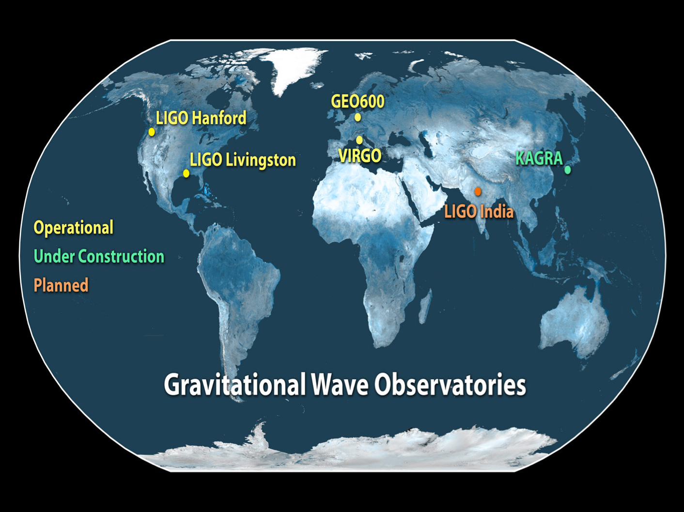
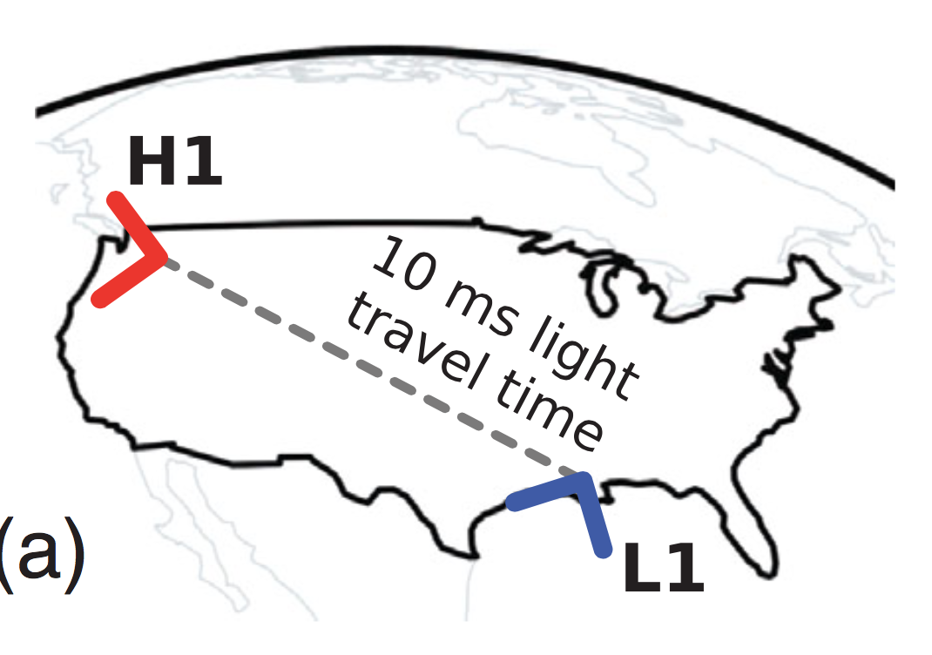
A global network
Higher detection rate
Greater accuracy on source parameters
  distance, sky direction, GW polarization ...

Slide 6
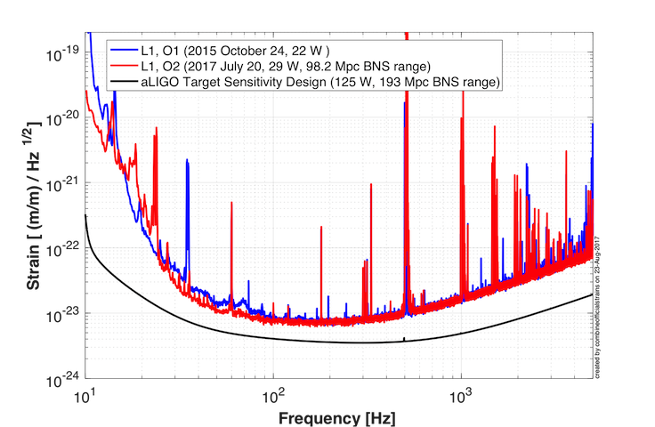
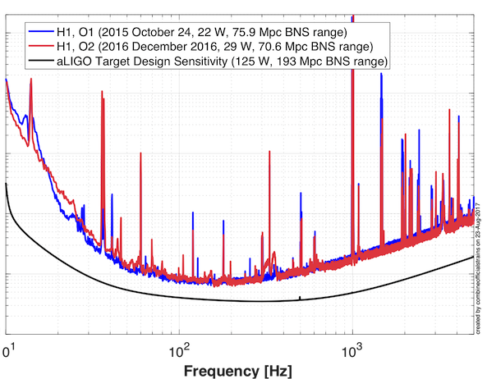
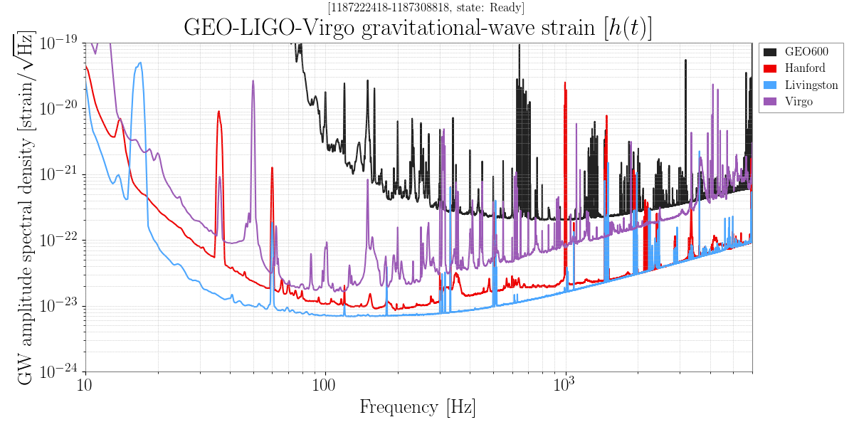
LIGO-Virgo performance in 2016-17

Slide 7
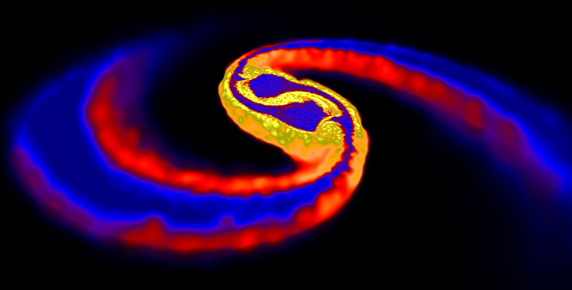

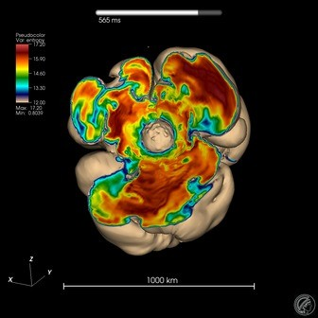
GW sources : Transients
Image credit: D. Price (Exeter) & S. Rosswog (Int. U/Bremen)
Cataclysmic events of compact
astrophysical objects
  Mergers of NeutronStars, BlackHoles “Compact Binary Coalescence”
  CoreCollapseSuperNovae
  Pulsar glitches / oscillation modes ?
  Exotics : cosmic string kinks ? ...
Simulation: F. Hanke et al. (MPIA Garching)

Slide 8

GW sources : Continuous / Persistent
Less intense GW over long times (days → years)
Continuous Wave : sinusoids from rotating NS
  many potential sources in Galaxy
Stochastic : random ‘background’
from superposition of
unresolved sources
  astrophysical
  transients at high redshift
  primordial
  quantum fluctuations / critical
  phenomena in very early Universe
Movie: Chandra X-ray images of Crab pulsar

Slide 9
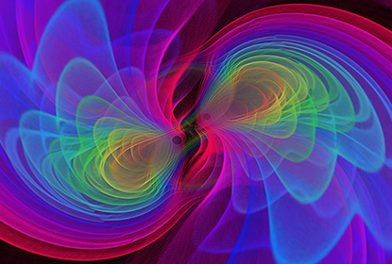
BINARY BLACK HOLE
MERGERS

Slide 10
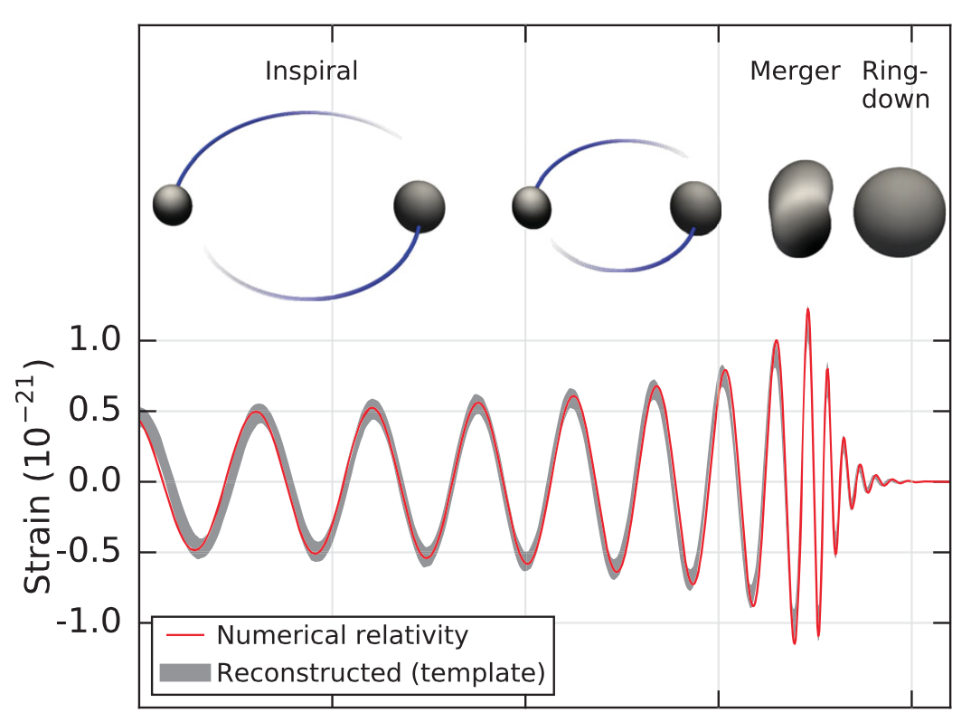



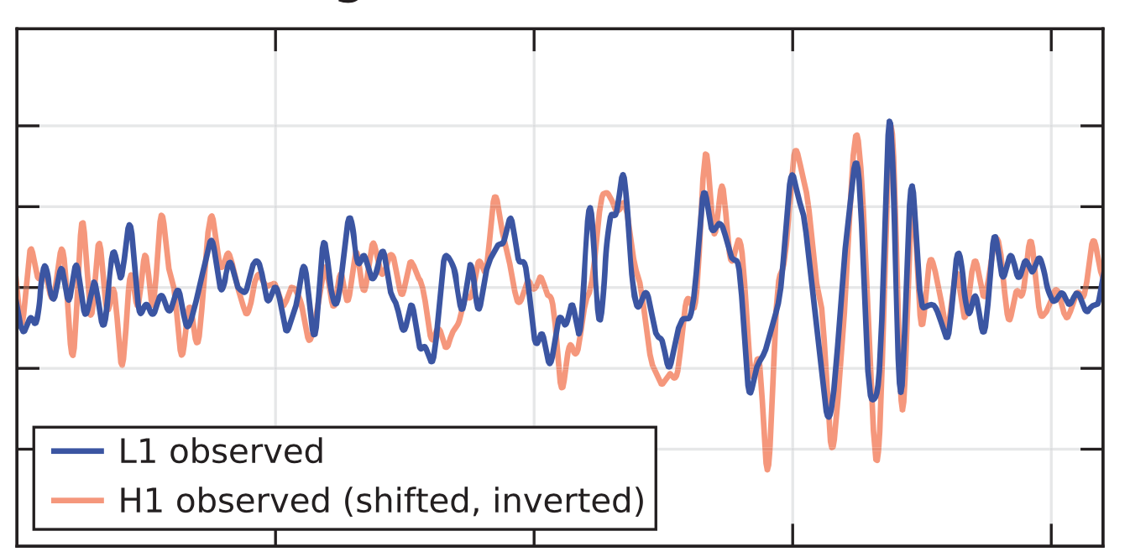
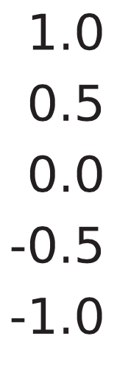
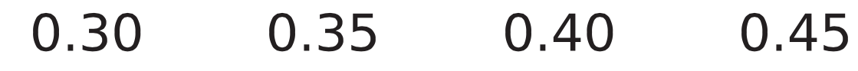
14 September 2015
Strain (𝟣𝟢^{−𝟤𝟣})
Time (s)

Slide 11
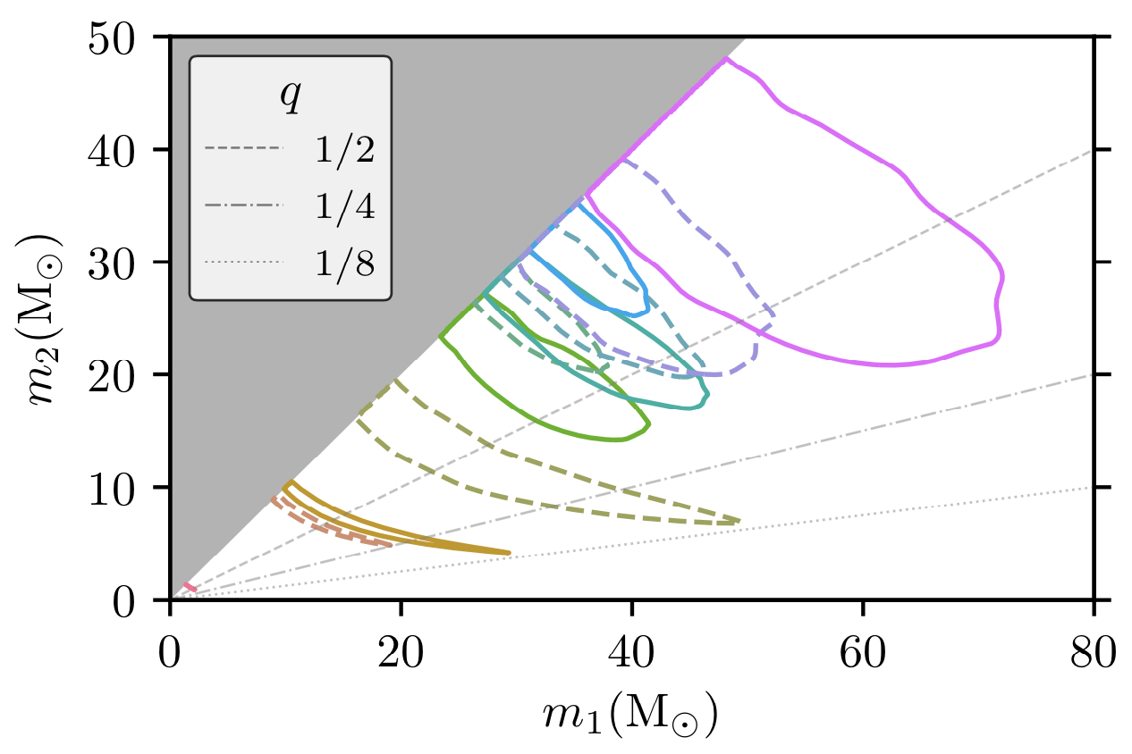
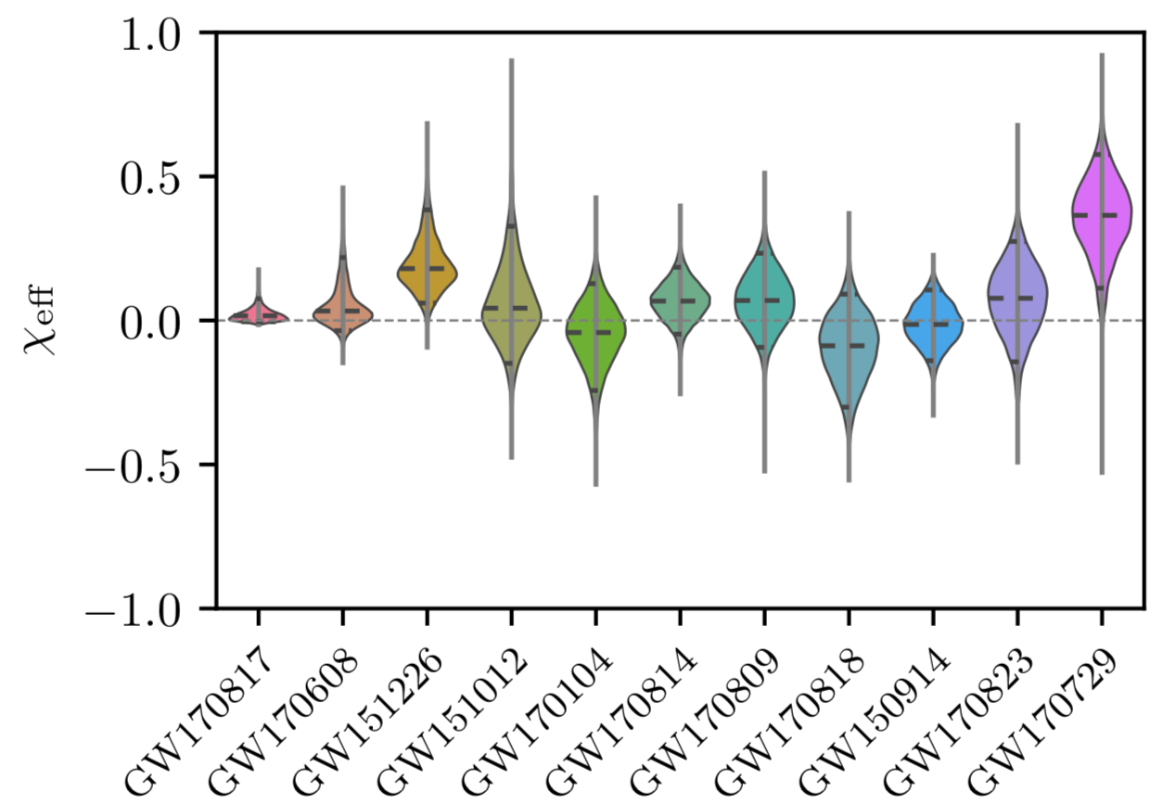
Merging black hole masses & spins
LVC, arXiv:1811.12907
High masses relative to
known X-ray BH
Spin magnitudes appear
smaller than maximum
allowed by GR

Slide 12

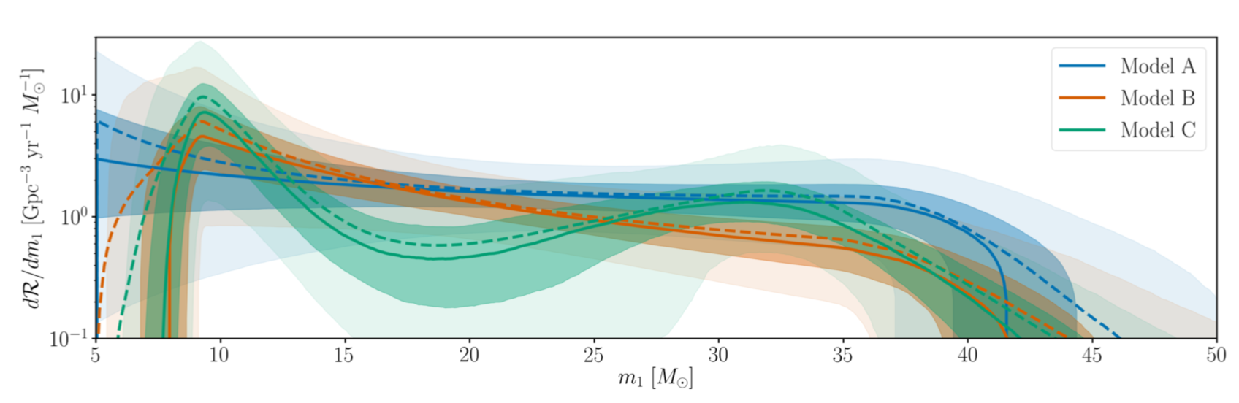
BH merger rate and mass distribution
Prediction from 2010 : 0.1, 5, 300 /Gpc³ /y
(low, realistic, high)
Mass distribution of merging BH : nearly flat up to 40-45 M☉
LVC, arXiv:1811.12940

Slide 13
BINARY NEUTRON STAR MERGER

Slide 14

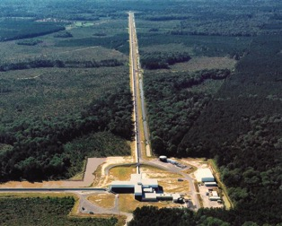
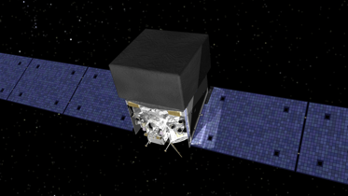
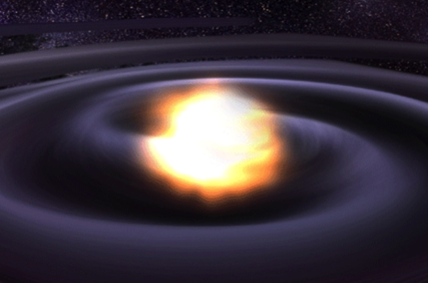
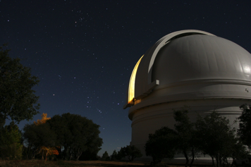
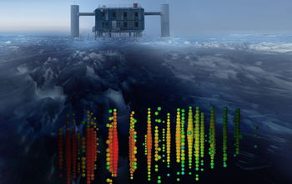
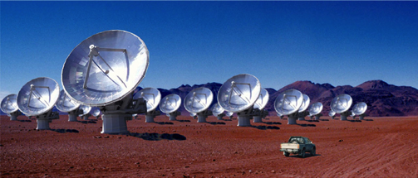
Multi-messenger Astronomy with Gravitational Waves
Binary Neutron Star /
Neutron Star – Black Hole
Merger
X-rays / Gamma-rays
Gravitational Waves
UV / Visible / Infrared Light
HE Neutrinos
Radio

Slide 15
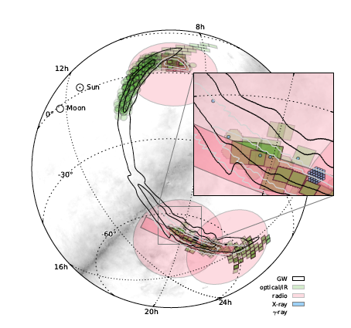
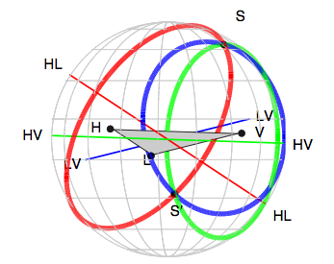
Search for EM counterparts
Source of GW can be localized
  time difference
  GW amplitudes
  oscillation phase
Localization and broadband follow-up of the
gravitational-wave transient GW150914
(LSC-Virgo + many authors)

Slide 16
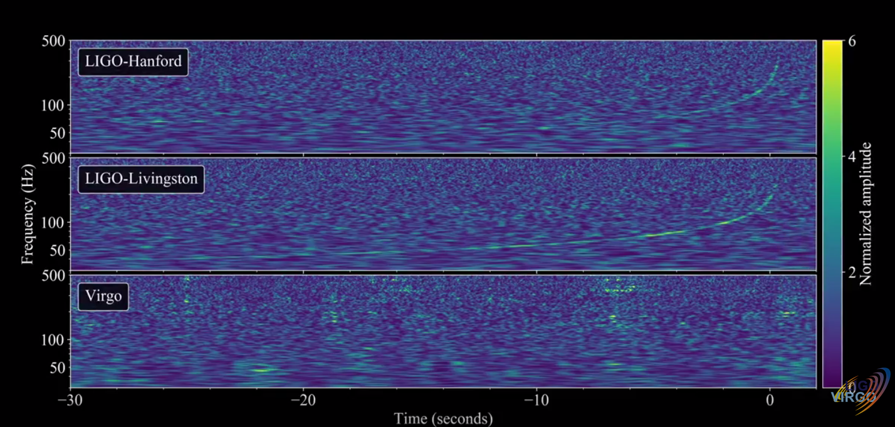
17th August 2017
https://www.youtube.com/watch?v=aWX-BY-A9CY

Slide 17
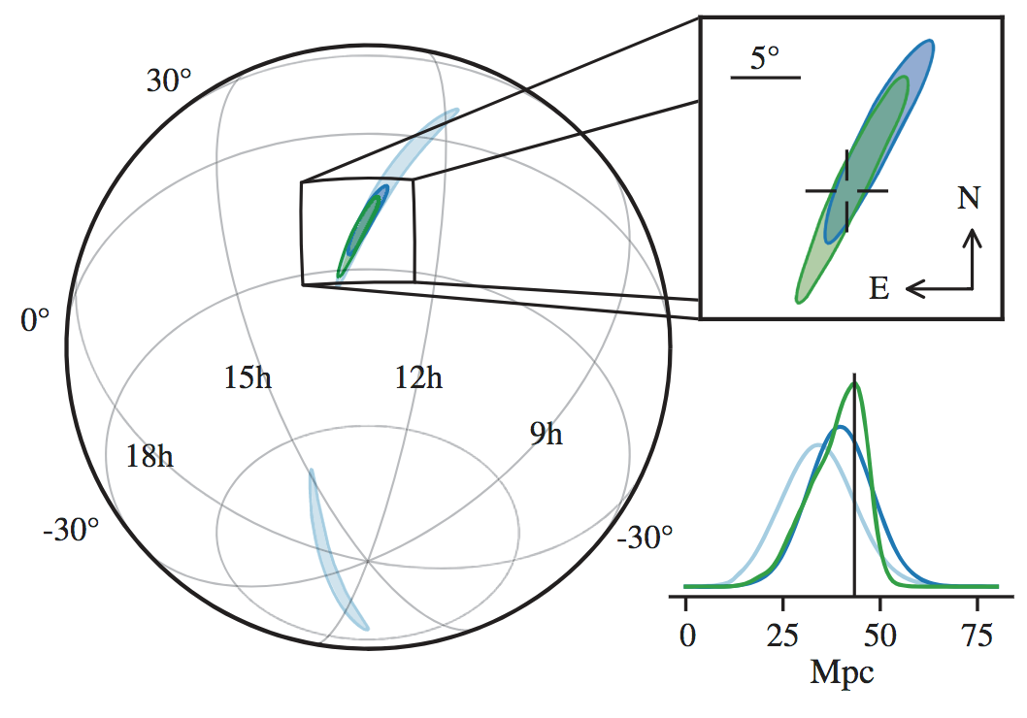
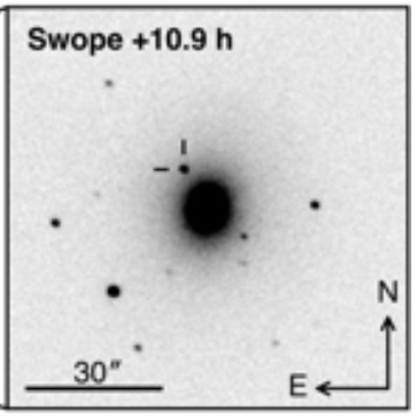
GW170817 on the sky
3-detector sky
area ~30 deg²

Slide 18
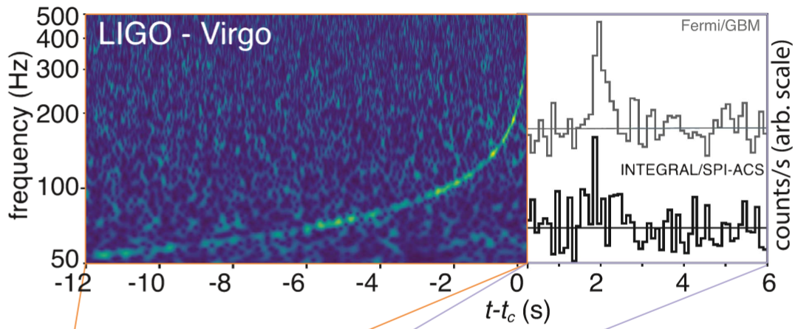
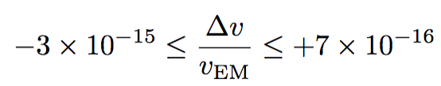
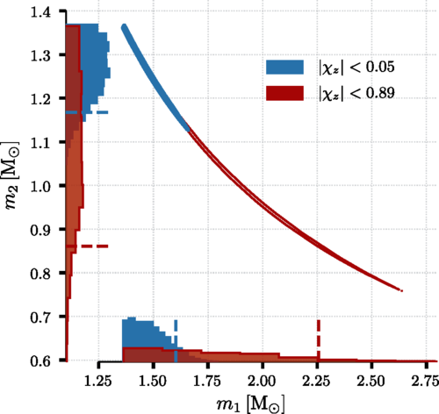
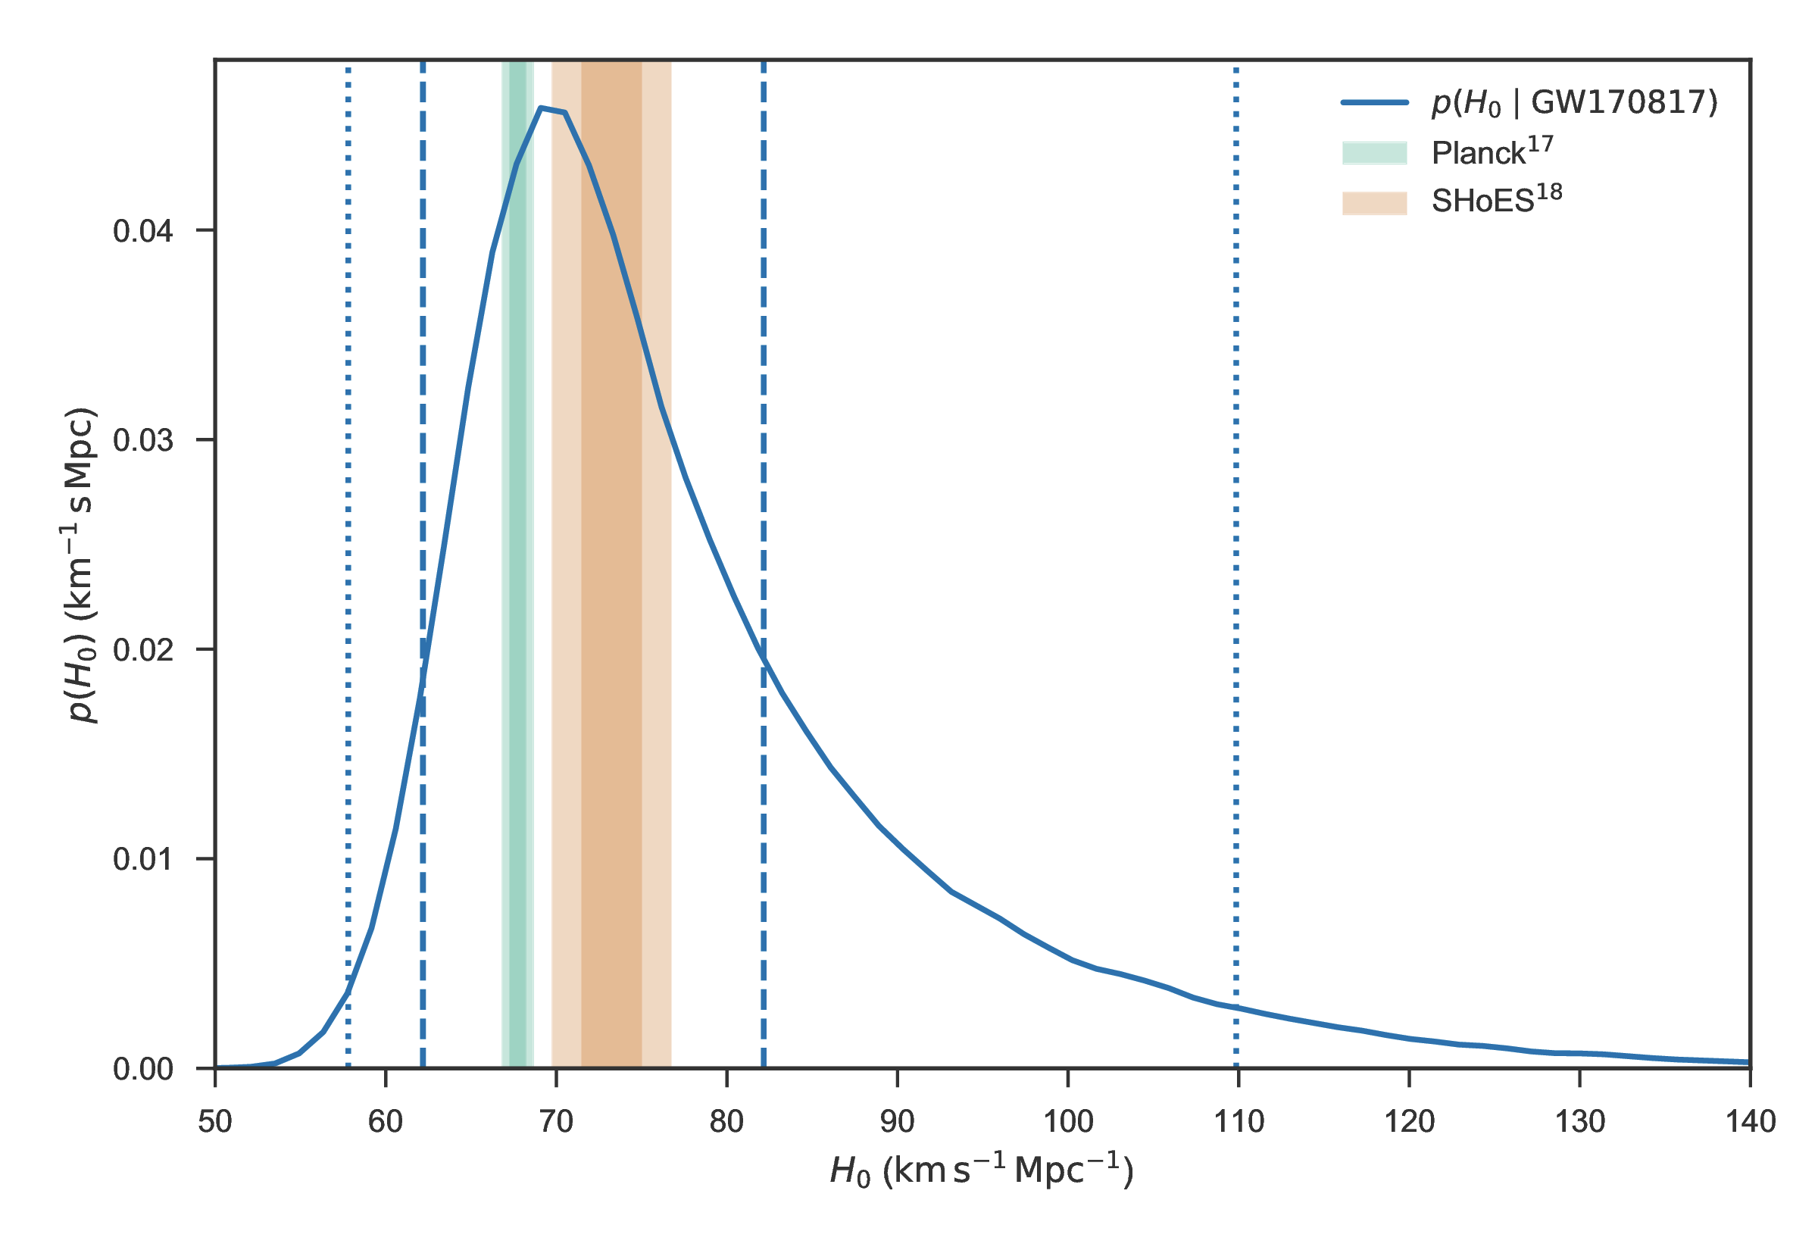

A few science results
Speed of gravity = speed of light
BinaryNeutronStar mergers create many
heavy elements (‘kilonova’)
BNS masses consistent with
Galactic binaries
Amplitude of GW ⇒ distance estimate
Host galaxy ID ⇒ redshift
Independent estimate of Hubble constant

Slide 19
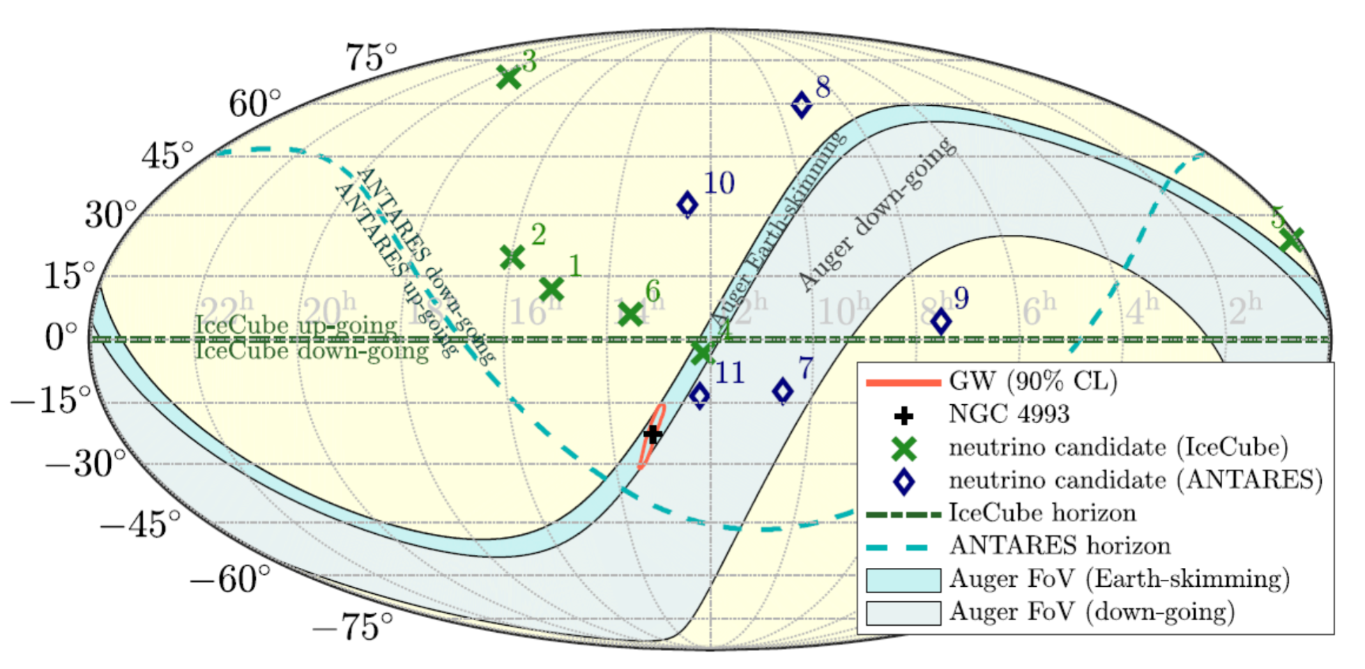
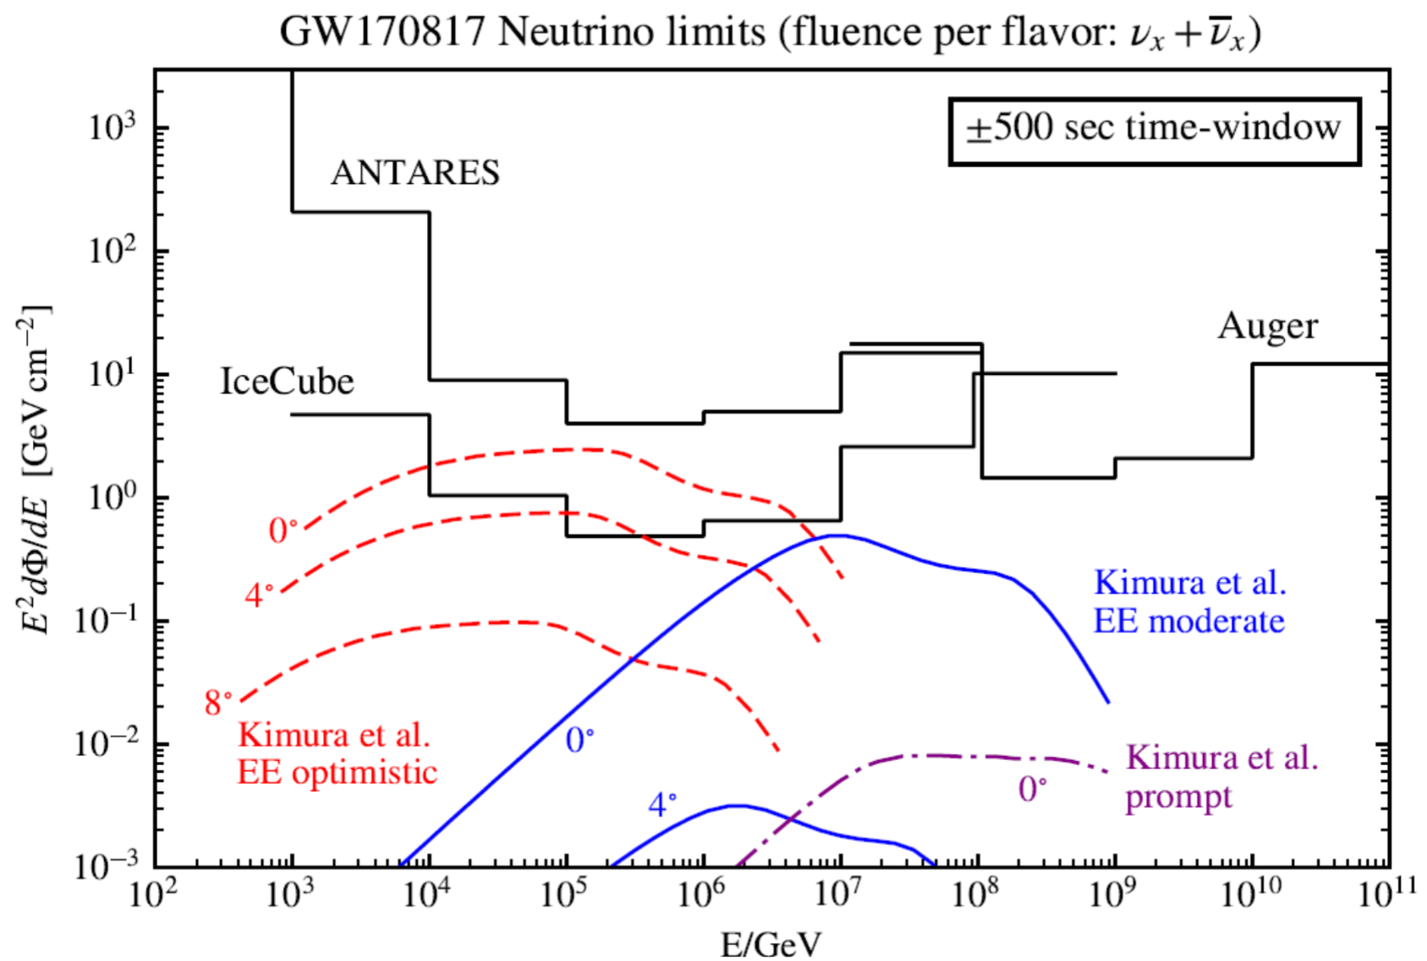
GW170817 HE neutrino search
Host galaxy ideally situated relative to Pierre Auger observatory
No significant HE neutrino events
Upper limits on emission from BNS merger
LVC+IceCube+ANTARES+Pierre Auger
Astrophys. J. Lett. 850, L35 (2017)

Slide 20
IGFAE activities within LSC
Major current/planned contributions
Offline search : correlate 10⁵–10⁶ binary waveform models with data from global network, reproducible results for publication, optimize sensitivity
Rates/Populations : interpret search results by comparing to models of binary merger population in Universe
Multi-messenger search : associate GW events with EM/𝜈/CR events
Minor contributions
  Low latency search : preliminary identification of events (minutes to hours) for EM followup
  DetChar & DQ : diagnose state of detectors, select data for analysis
  Tests of GR : search for non-GR effects, bounds on deviations

Slide 21
IGFAE-related upcoming events
Galician Gravitational Wave Week – GGWW
Jan 14-18 : 15 lectures on GW & related topics
https://indico.cern.ch/event/779256/
9th Iberian GW meeting : June 3-5, SdC
Announcement within next few weeks
GR/Amaldi meeting : July 7-12, Valencia
IGFAE/USC represented on SOC

Slide 22
The future ...

Slide 23
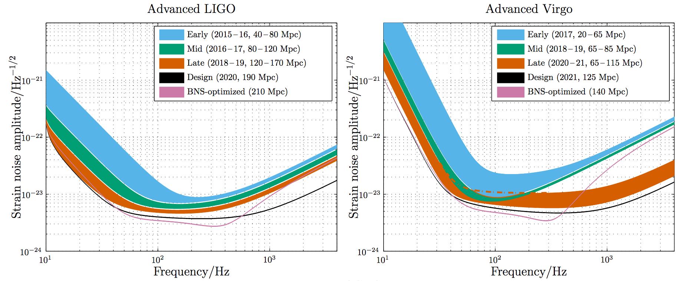
Upcoming science runs
Projections from Living Rev. Relativity vol.19 (2016) 1
O3 run to start ~early 2019, duration ~1 year
Advanced LIGO design sensitivity by 2021-22

Slide 24
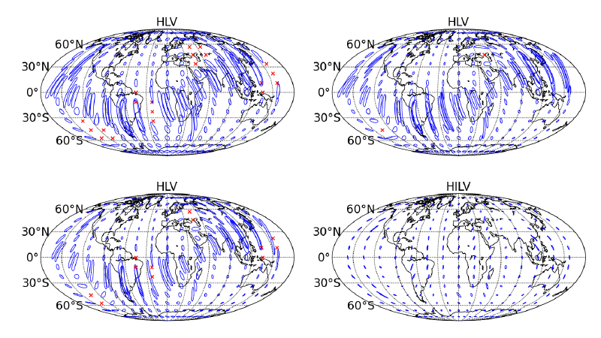
Extending the network
~ 2017+
2022+
with LIGO-India

Slide 25
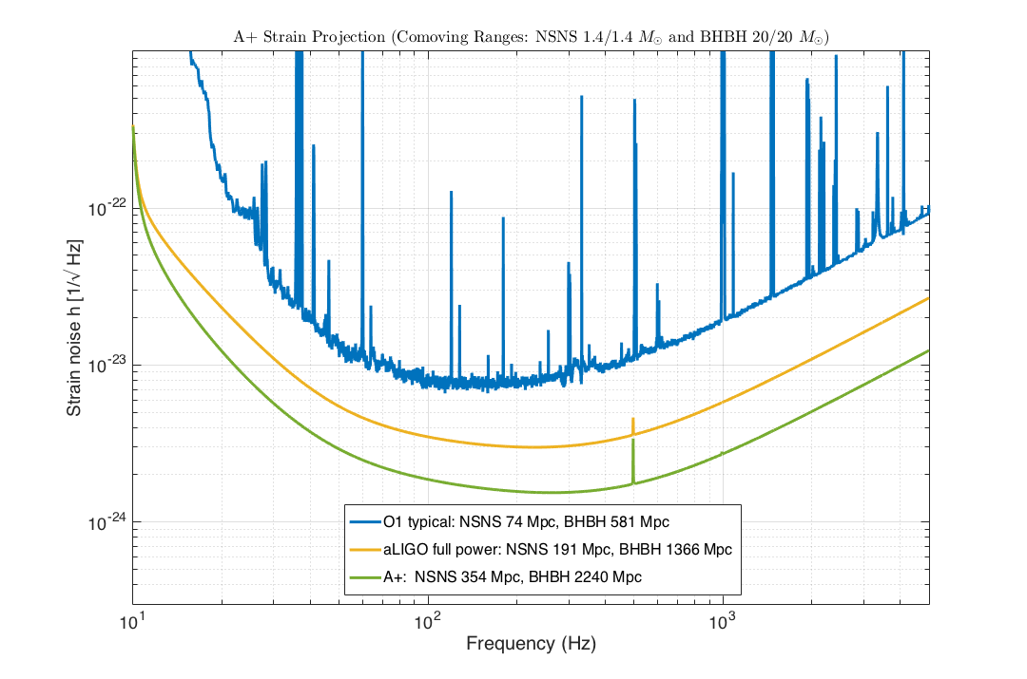
‘A+’ Advanced LIGO
Mid-scale Upgrade
Upgrade to aLIGO that leverages existing technology and infrastructure, with minimal new investment and moderate risk
Target: average 1.7x increase in range over aLIGO
~ 5x greater event rate than Advanced LIGO
~ 40 times greater than current Advanced LIGO sensitivity
Stepping stone to future detector technologies
Two year down time; back online by 2023
A+ key parameters
12 dB injected squeezing
15% readout loss
100 m filter cavity (FC)
20 ppm round trip FC loss
Coating Thermal Noise half of aLIGO

Slide 26
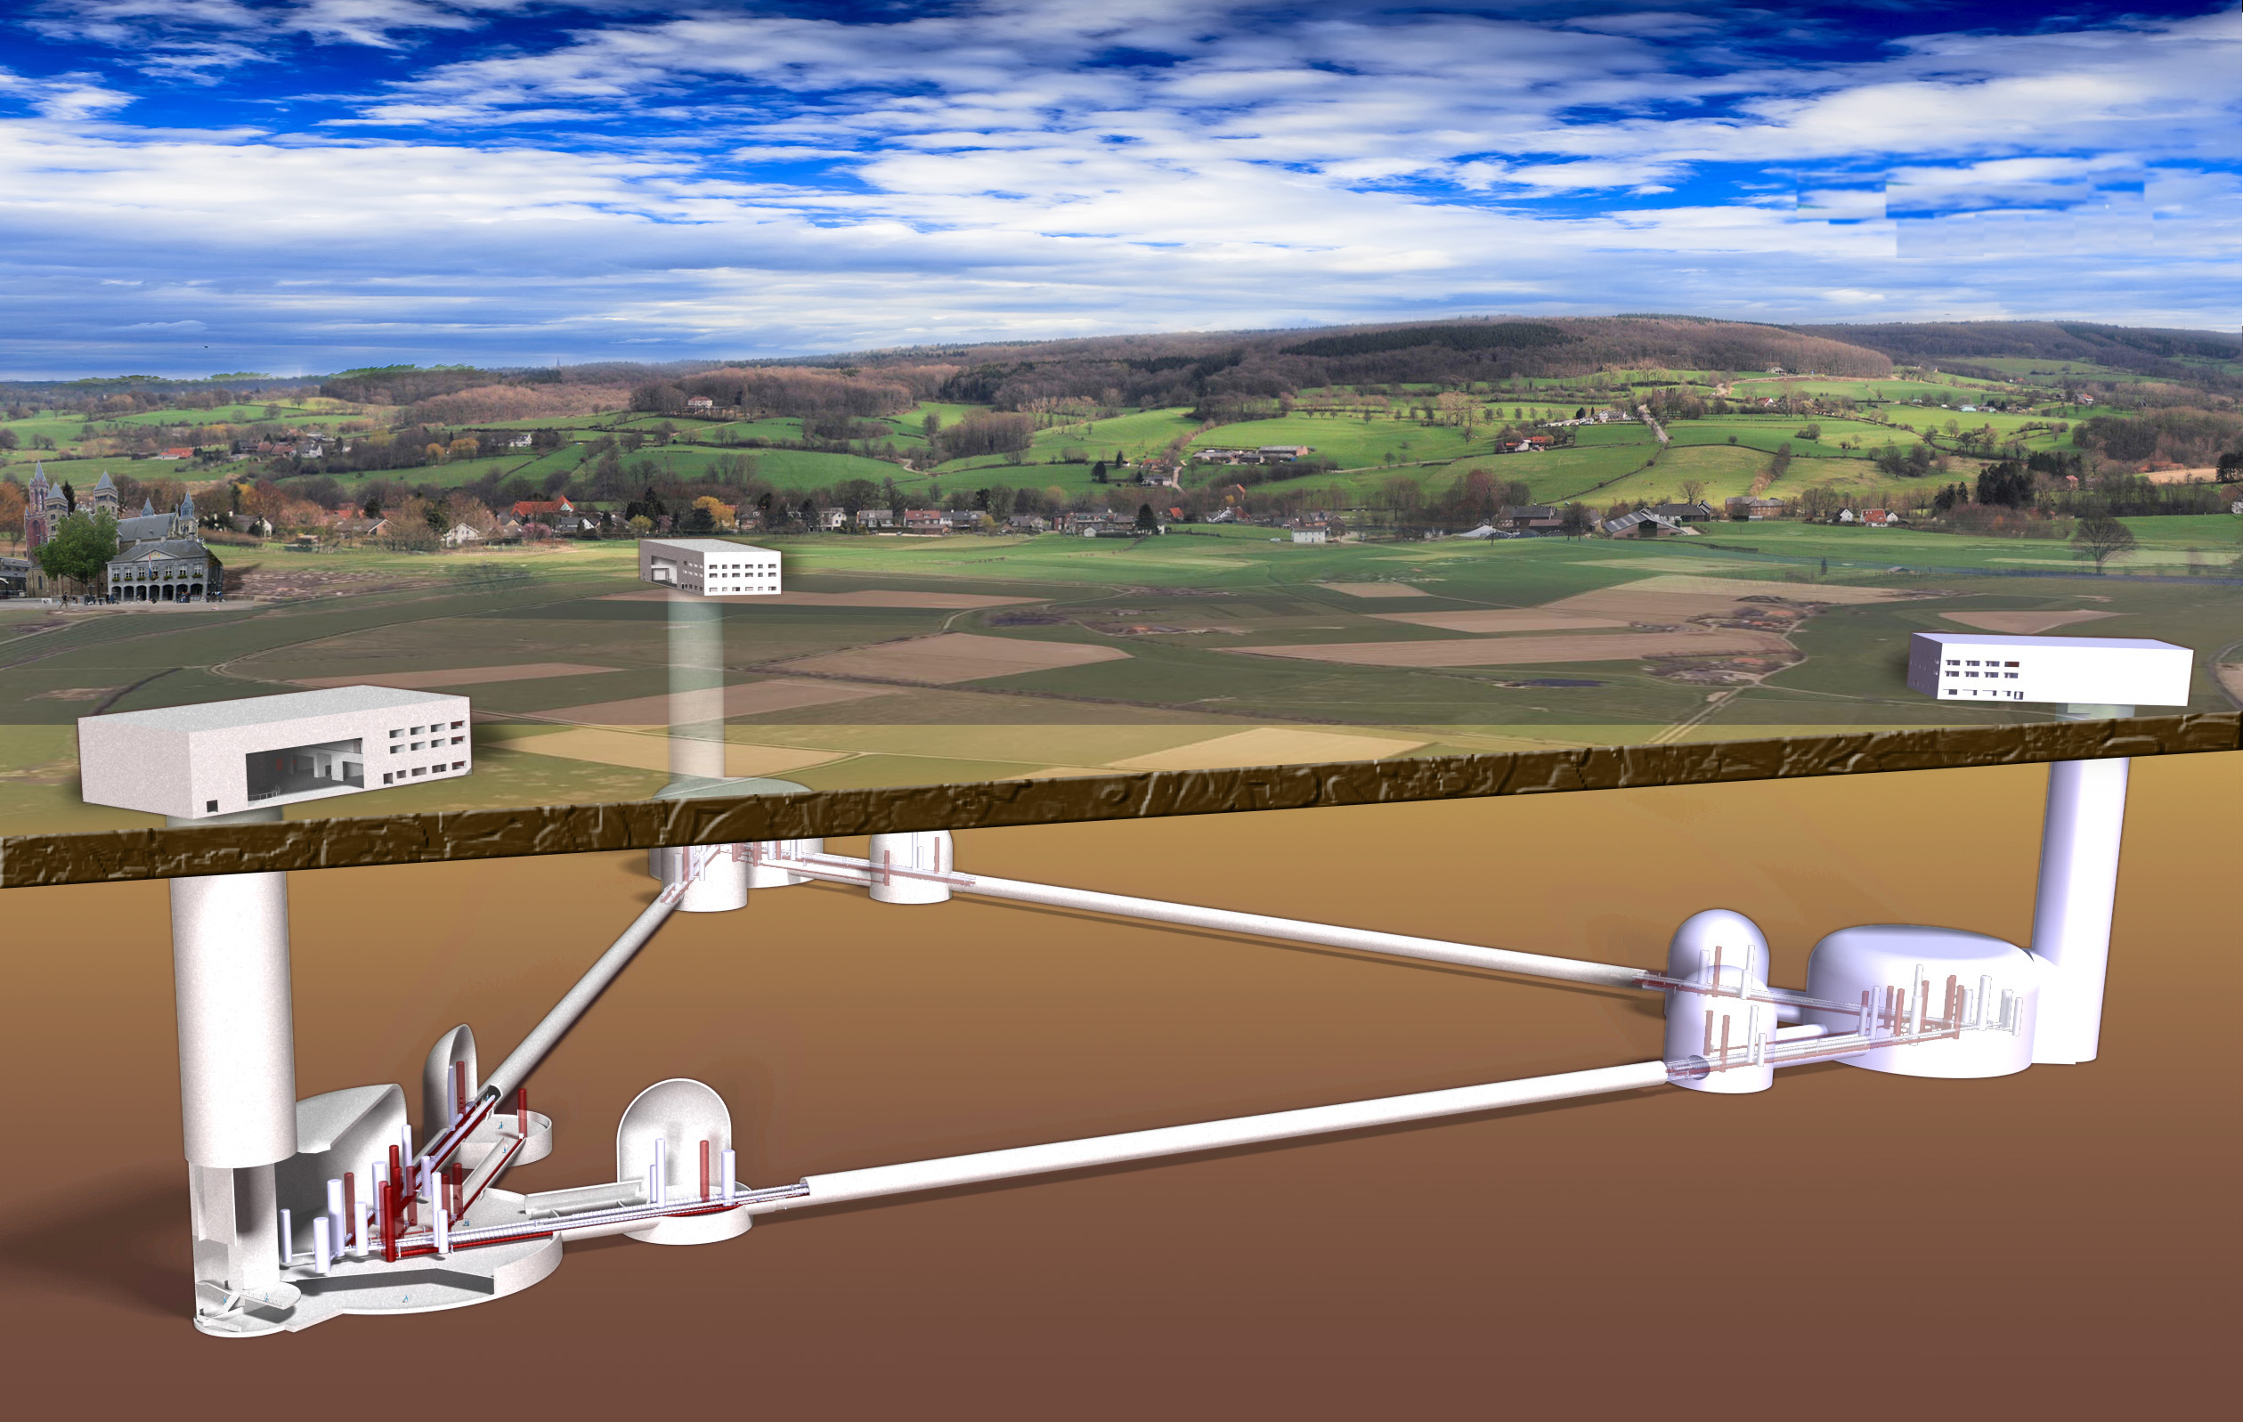
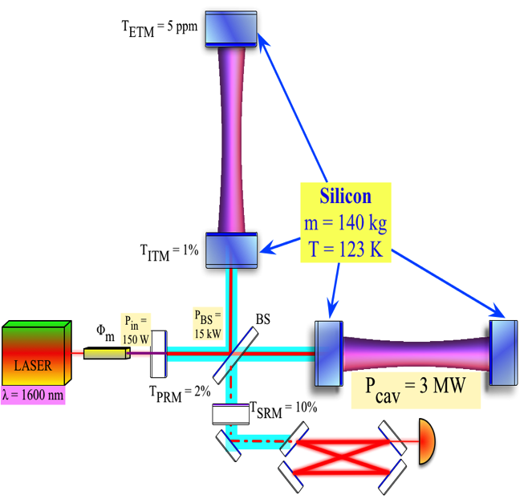
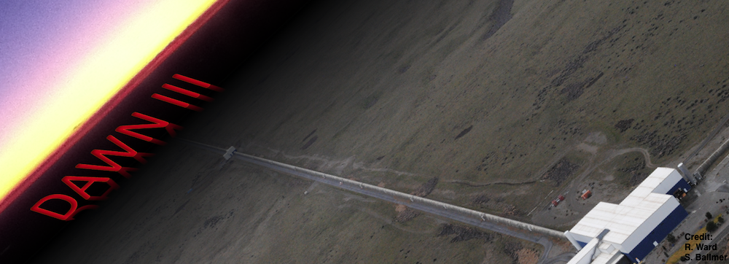
Further on: Voyager,
Einstein Telescope, Cosmic Explorer
LIGO Voyager – exploiting
the LIGO Observatory facility
limits
Longer Arm Length Interferometers
Einstein Telescope
A future GW observatory in the EU
λ = 2 μm
Cosmic Explorer – A future
GW observatory in the US

